Slide 1
The California Experience
NHPA Section 106 Statewide Programmatic Agreements (PAs) for the CWSRF and DWSRF Programs

Slide 2
What This Talk Will Cover
What the conditions were when we decided to push for a PA
What is a PA good for?
Why we decided a Statewide Program PA would benefit us
What challenges we encountered along the way
How we overcame and are still working to overcome our challenges
How we worked around one challenge outside of the PA process

Slide 3
Existing National Historic Preservation Act (NHPA) Section 106 Authorities
Clean Water SRF Nationwide Programmatic Agreement (NPA)
Gives the authority to states administering the CWSRF to consult with the SHPO under Section 106 of the NHPA on behalf of the EPA, to make findings, and resolve adverse effects through the MOA process, but not the PA process. Attached the 1986 version of 36 CFR Part 800.
The NPA does not contain any alternative processes 106 process
The NPA does not have an expiration date.
Drinking Water SRF EPA Region 9 Letter to SHPO (2015)
The EPA sent a letter to our SHPO giving us the authority to consult under NHPA Section 106 on behalf of the EPA for the DWSRF program on the identification of historic properties, but it does not give us the authority to resolve adverse effects.
Adverse effect requires EPA involvement.
Notes:
Both these vehicles do the same thing. They transfer the Section 106 workload from the EPA to the states. The NPA used one document to delegate the authority to all 50 states. The letters had to be written and sent to each state. Neither of these give us any ability to streamline our processes.

Slide 4
State Water Board SRF Conditions in 2017
Our state uses the California Environmental Quality Act (aka CEQA) as our NEPA-like process, and we have a SERP for each of our SRF Programs.
The NHPA is one of our cross-cutters. Our applicants submit historic property identification reports to support our NHPA Section 106 consultations for DWSRF and CWSRF projects.
We consulted with the State Historic Preservation Officer (SHPO) on all projects that might get federal money, about 50-60 projects a year.
Our program has three dedicated archaeological staff, one senior and two specialists. At least one is Secretary of the Interior Qualified.
Notes:
The applicants do CEQA if they are a public agency, which most are. They submit their CEQA documents and other technical studies to support our findings on the cross-cutters. In 2017 we were doing cross-cutters on all CW DWSRF projects. Now we only use federal money for Tier 1 DWSRF project which has helped reduce our workload significantly. Our disadvantaged communities were the hardest clients to get through the federal process.

Slide 5
What is a Programmatic Agreement?
36 CFR Part 800 is the implementing regulations for Section 106 of the NHPA.
§ 800.14 Federal agency program alternatives.
Alternatives to the Section 106 process = Streamlining
§ 800.14(b) Programmatic agreements. The Council and the agency official may negotiate a programmatic agreement to govern the implementation of a particular program or the resolution of adverse effects from certain complex project situations or multiple undertakings.
PAs must be initiated by the federal agency. States first need the support of their EPA Region.
Notes:
The PA can contain alternatives to the Subpart B process that streamline the Section process and tailor it to the specifics of our programs. Instead of the identification of historic properties, making findings, and consulting with the SHPO on every project we can all agree to alternative procedures and streamlining.
Council = the Advisory Council on Historic Preservation (ACHP). We were lucky-our EPA region was very supportive from the beginning.

Slide 6
California’s PA Objectives
Improve the efficiency of reviews for CWSRF and DWSRF projects requiring compliance with Section 106.
Ensure consistency between the CWSRF and the DWSRF Program Section 106 review processes.
Establish professional qualification standards for Section 106 reviewers and consultants who prepare historic property identification reports.
Allow State Water Board’s professionally qualified staff to make findings of “no historic properties affected” when no cultural resources are located within the area of potential effects (APE) without consultation with the SHPO (about 70% of projects).
Allow State Water Board’s professionally qualified staff to make findings of “no adverse effect” for projects that will completely avoid effects to historic properties located in the APE, without consultation with the SHPO.
Improve consultations with Native American tribes and other consulting parties by outlining the proper protocol and establishing a threshold for a “reasonable and good faith effort.”
Notes:
From our PA website

Slide 7
California’s Wish List – Our Original Objectives
Be able to resolve adverse effects without EPA involvement for the DWSRF.
Streamline the SHPO review process by
Make categories of projects exempt from review (e.g. lead service line replacements)
Have a list of property types exempt from evaluation (e.g. treatment plant settling ponds).
Eliminating SHPO consultation on projects with findings of “no historic properties affected” and “no adverse effects with standard conditions”
Allow MOAs with minor phased identification (usually done under a PA)
Notes:
Types of activities that would almost certainly not affect historic properties. Types of properties commonly encountered that will never be historically significant.

Slide 8
Projected Time and Cost Savings
We estimated the PAs could eliminate about 70% of the projects from SHPO consultation. That’s about two months time per project that meet the conditions.
We had hoped to reduce the types of properties that needed evaluation which would have saved applicants time and money.
And if we could prepare agreement documents for DWSRF projects with adverse effects instead of going through the EPA which would also save time.
This Photo by Unknown Author is licensed under CC BY-NC
Notes:
These measures would save both time and money

Slide 9
Challenges
SLOW Progress-EPA Headquarters took almost two years to approve the PA proposal for both programs.
ACHP asked questions regarding how PA would work with existing NPA (took 7 months to agree we could do 2 PAs).
SHPO didn’t allow us to have categories of exempt project types, or a list of property types exempt from evaluation. Our SHPO also stonewalled us.
ACHP said we needed consent in writing from all the tribes in our state. We have 109 federally recognized tribes and well over 60 non-recognized.
Volume of consulting parties: tribes and tribal parties(208), historical societies (72), certified local governments (65), and water agencies (over 1,000) and water advocacy groups
Notes:
We were the first state, as far as I know, to bring the PA idea to EPA HQ. The good news is, we laid the groundwork for the other states.
It was also the first time the EPA ACHP reviewers grappled with the question of the NPA and how we could do a statewide PA that wouldn’t undo or counter the NPA.
The SHPO took the two biggest streamlining methods off the table and then she began her stall-a-thon.

Slide 10
How We Met the Challenges
Epic persistence. SEVEN YEARS.
Appealed to higher authorities as needed.
Two programs, two PAs.
Collaboration with SHPO staff.
The ACHP ended up compromising with the EPA.
Notes:
1. We continued to contact the EPA and SHPO (for years) until we finally got them to engage and/or re-engage. 2 we decided to have two almost identical PAs. The CWSRF PA relies on the authority of the NPA and the DWSRF PA replaces the 2015 letter. That way if the EPA decides to do a new nationwide PA for either program, it will only affect one program’s PA, not both. We are consulting on both simultaneously. 3. who supported no adverse effects with standard conditions and a limited exemption for potholing to test for lead service lines. (possibly the reason for our current SHPO standstill). 4. The EPA sent another round of letters to all the tribes stating they have given us the authority to consult but that they retain the Government-to-Government consultation obligation.

Slide 11
PA Development Timeline-Accomplished
12/19/2019- EPA Region 9 sent the initial consultation request to the ACHP and the CA SHPO.
We began meeting regularly with the SHPO, EPA, and ACHP.
Set up a public website for PA related news, documents, and links.
12/5/2022- Sent the initial outreach letter and factsheet for the PAs to consulting parties.
June 22, 2023- We held two virtual public outreach meetings, one just for tribes and one for everybody.
Put the two detailed outlines on our website.
We consulted with the one tribe who asked to consult on the development of the PAs. No one else chose to consult.
We drafted the two PAs and have received comments from the ACHP. The SHPO staff finished their review, but we’re still waiting on the SHPO to sign off.
Notes:
Out of all those consulting parties no one participated except one tribe. I anticipate many more comments once we have the full draft in a public space.

Slide 12
PA Development Timeline-To Do
Address ACHP and SHPO comments on our drafts
Release the revised drafts to the consulting parties for review
Have another public meeting
Consider comments
Produce final drafts
Execute PAs

Slide 13
For More Information
Our public website for the PAs is https://waterboards.ca.gov/water_issues/programs/grants_loans/section106.html
We also have a dedicated email address DFA-106PA@waterboards.ca.gov

Slide 14
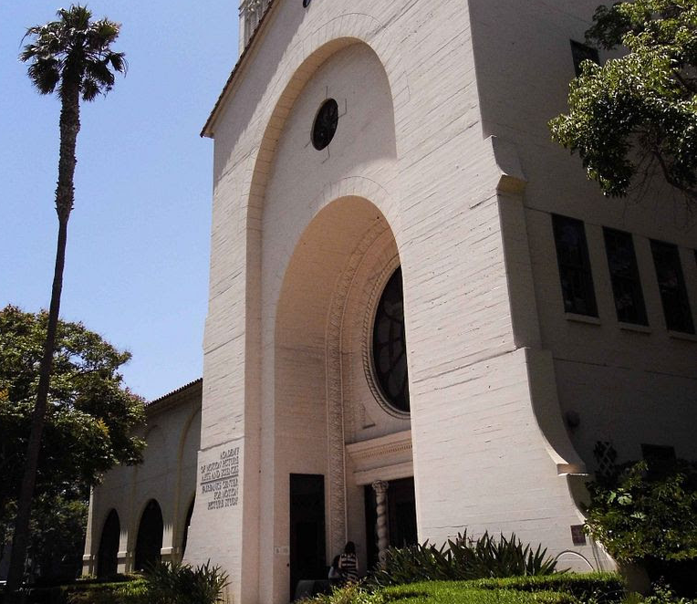
The California Experience Part 2
The Historic Context Report
Notes:
Pictured – the Beverly Hills Waterworks building built in 1927, now the Academy of Motion Picture Arts and Science

Slide 15
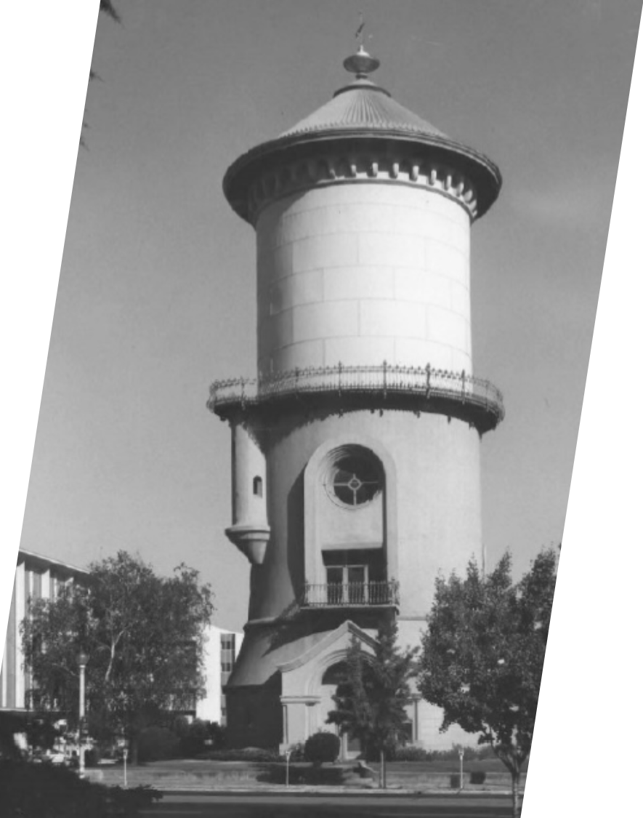
The Evaluation Problem
Anything built in 1974 or earlier is a potential historic property (50 years).
Most Cultural Resources Technical Reports will identify these properties in the project’s area of potential effects, but didn’t record and evaluate them for the NRHP or they did, it isn’t up to Section 106 standards.
We had a historic context report prepared for Water Treatment Systems in CA.
Notes:
Most of the people who write the reports in CA are archaeologists and they often miss buildings and structures. We also have a lot CEQA partitioners that do the cultural reports early in the planning process for CEQA then submit those to us for the Section 106 consultation. When we get a report, the first thing we do is an adequacy review, and we let the applicant know what else we need to support our consultation with the SHPO.
The picture is a water tower in Fresno, CA.

Slide 16
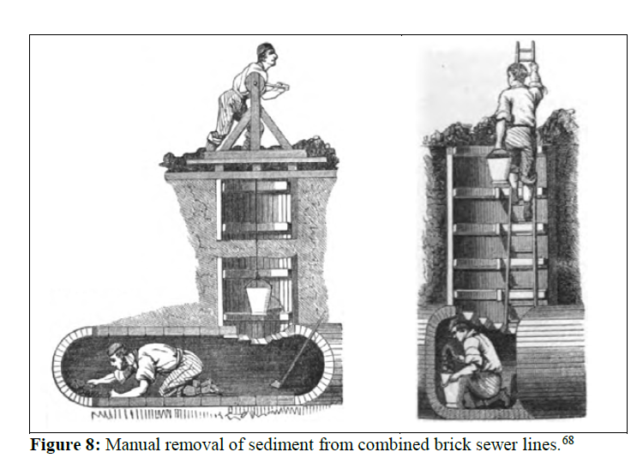
DRINKING WATER AND WASTEWATER TREATMENT FACILITIES IN CALIFORNIA Historic Context and Research Design for National Register Evaluation
Cost estimate was $150K, but the actual cost was $270K.
The report laid out the historical context of water treatment in the state.
They established a theme (sanitation), three periods of significance, and identified individuals who had a significant impact on sanitation in California.
The report makes it much easier for our applicants and ourselves to evaluate water infrastructure, as we can cite the studies to support our conclusions.
Notes:
They addressed all the things that are needed to evaluate a property for the National Register of Historic Places.
There are four criteria for NRHP eligibility, and the report lays out what is needed for a property to be eligible under one or more of these criteria.

Slide 17
Benefits of the Context
Anyone can use the report.
We don’t need a Secretary of the Interior qualified historian to make the evaluation anymore for most property types.
The authors of the report are qualified, and we cite them for our determinations.
Notes:
The photo on the left is from one of our projects. The city was putting in new sewer lines and trenched through these old historic wood water pipes from the 1870s. Milled wood pipe (left) used by the Fresno Water Works Company in 1876, and diagram of wood stave pipe. Wood stave and hoop water tanks are still made.
One may still need an architectural historian to evaluate buildings that may be eligible under criterion c.

Slide 18
Program Webpages with Environmental Review Requirements Including Section 106
CWSRF Environmental Review Requirements
https://waterboards.ca.gov/water_issues/programs/grants_loans/cwsrf_requirements.html
DWSRF Environmental Review Requirements
https://waterboards.ca.gov/drinking_water/services/funding/dwsrf_requirements.html
Historic Context Report https://waterboards.ca.gov/water_issues/programs/grants_loans/docs/2024/historic-context-report.pdf
Notes:
Links and URLs

