Slide 1
Montana Co-funding Process
Anna Miller
November 2024

Slide 2
1. Plan – Preliminary Engineering Report (PER). 2. Process – Who are the funders? 3. Implementation – Who does what? 4. Conclusion – Construction to project finish. 5. Final paperwork.
November 2024

Slide 3
Plan - Preliminary Engineering Report - Alternatives - Cost - Solving the problem
November 2024

Slide 4
Process:
Who does what?
Who are the funding partners?
What do they need?
Are there efficiencies?
Communication – checking progress
Timeline
November 2024

Slide 5
Environmental Documents
Implementation
Rates and Charges
Procurement Documentation
Lead times
Track expenses for all funders
Report
November 2024

Slide 6
Drinking Water Systems SRF FY 2024
PROJECT SPONSOR | WATER PROJECT DESCRIPTION | TOTAL PROJECT COST | RRGL STATE GRANT | MCEP STATE GRANT | TREASURE STATE REGIONAL WATER | CDBG | DWSRF LOAN A FORGIVEN | DWSRF LOAN B REGULAR | WIIN GRANT | DWSRF LOAN BAN | DWSRF EC LOAN | RURAL DEV GRANT | RURAL DEV LOAN | US BOR | FEDERAL ARMY CORP WRDA | ARPA MAG COMP | COMMUNITY FUNDS LOCAL
Basin WSD A&B | Line Replacement and Meters | 1,231,000 | - | - |  |  | 724,500 | 241,500 |  |  |  | - | - |  |  | 263,825 | 1,175
Broadview A&B | Tank | 3,523,000 |  |  |  |  | 750,000 | 773,000 | 2,000,000
Central MT RWA PH 2B BAN | Installation from Harlowton to Roundup | 14,823,465 |  |  |  |  |  |  |  | 500,000 |  |  |  | 14,323,465 |  |  | -
Central MT RWA PH 2C BAN | Installation from Harlowton to Roundup | 75,052,865 |  |  | 1,000,000 |  |  |  |  | 6,710,000 |  |  |  | 67,322,865 |  |  | 20,000
Choteau, City of A&B | New Well & Pump Station | 6,128,775 | 125,000 | 625,000 |  |  | 660,000 | 220,000 |  |  |  | 642,000 | 2,000,000 |  |  | 1,121,757 | 735,018
Coram W&SD A&B | Tank and Main Extension | 2,154,675 | - | 500,000 |  |  | 750,000 | 795,000 |  | - |  |  |  |  |  | 72,450 | 37,225
Cut Bank, City of A&B | Water Storage Tank | 4,876,907 |  |  |  |  | 540,000 | 750,000 |  |  |  |  |  |  |  | 3,586,907
Dawson County Forest Park | Water Storage Tank | 3,209,444 |  |  |  |  |  | 1,210,000 |  |  |  |  |  |  |  | 1,999,444
Elder Grove School District | Water Cistern | 577,000 |  |  |  |  |  |  |  |  | 577,000
Fairview, Town of A&B | Water Line Replacement | 2,933,287 |  |  |  |  | 750,000 | 675,000 |  |  |  |  |  |  |  | 1,182,256 | 326,031
Fort Benton, City of A&B | Tank and Distribution Main | 4,172,748 | 125,000 | 625,000 |  |  | 750,000 | 1,918,000 |  |  |  |  |  |  |  | 559,748 | 195,000
Glendive, City of A&B | Boring under River, RR | 3,537,280 |  |  |  |  | 750,000 | 745,000 |  |  |  |  |  |  |  | 1,252,750 | 789,530
Glendive, City of A&B | Line Replacements | 4,168,899 |  |  |  |  | 750,000 | 1,112,000 |  |  |  |  |  |  |  | 1,358,763 | 948,136
Grass Range, Town of A&B | Water Storage Tank | 301,000 |  |  |  |  | 226,000 | 75,000
Harlowton, City of A&B | Distribution Lines | 2,774,000 | 125,000 | 625,000 |  | 600,000 | 337,000 | 337,000 |  |  |  |  |  |  | 750,000
Kalispell, City of A&B&C | Upper Zone Well & Tank | 21,895,333 |  |  |  |  | 1,000,000 | 18,854,000 | - |  |  |  |  |  |  |  | 2,041,333
Missoula A, City LR | East Beckwith Line Replacement | 1,190,000 |  |  |  |  |  | 1,190,000
Missoula B, City LR | West Pine Line Replacement | 993,000 |  |  |  |  |  | 993,000
Missoula C, City LR | Monroe-Jackson Line Replacement | 1,173,000 |  |  |  |  |  | 1,173,000
Missoula D, City LR | Edith St Line Replacement | 1,148,000 |  |  |  |  |  | 1,148,000
Missoula E, City LR | 4th St Line Replacement Phase 1 | 1,280,000 |  |  |  |  |  | 1,280,000
Ponderilla Hills WSD C | Transmission Line Replacement | 83,000 |  |  |  |  | 83,000 | - |  |  |  |  |  |  |  | -
Sidney, City of | Line Replacements | 3,798,057 |  |  |  |  |  | 2,180,000 |  |  |  |  |  |  |  | 1,462,300 | 155,757
 |  | -
 |  | $ 161,024,735 | $ 375,000 | $ 2,375,000 | $ 1,000,000 | $ 600,000 | $ 8,070,500 | $ 35,669,500 | $ 2,000,000 | $ 7,210,000 | $ 577,000 | $ 642,000 | $ 2,000,000 | $ 81,646,330 | $ 750,000 | $ 12,860,200 | $ 5,249,205
 |  |  |  |  |  |  | $ 53,527,000 | SRF TOTAL
November 2024

Slide 7
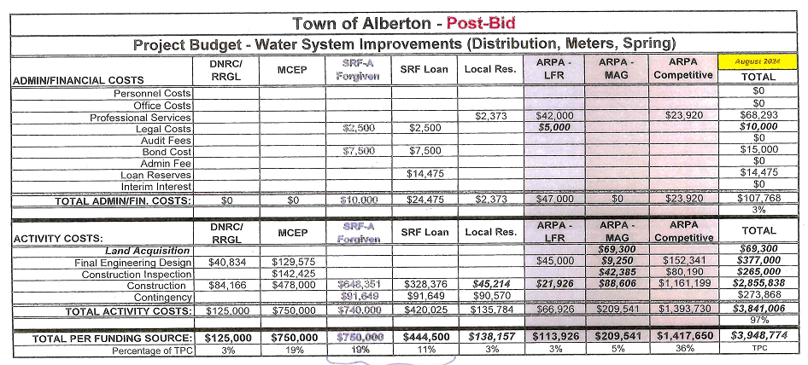
Alberton Water System improvements
November 2024

Slide 8
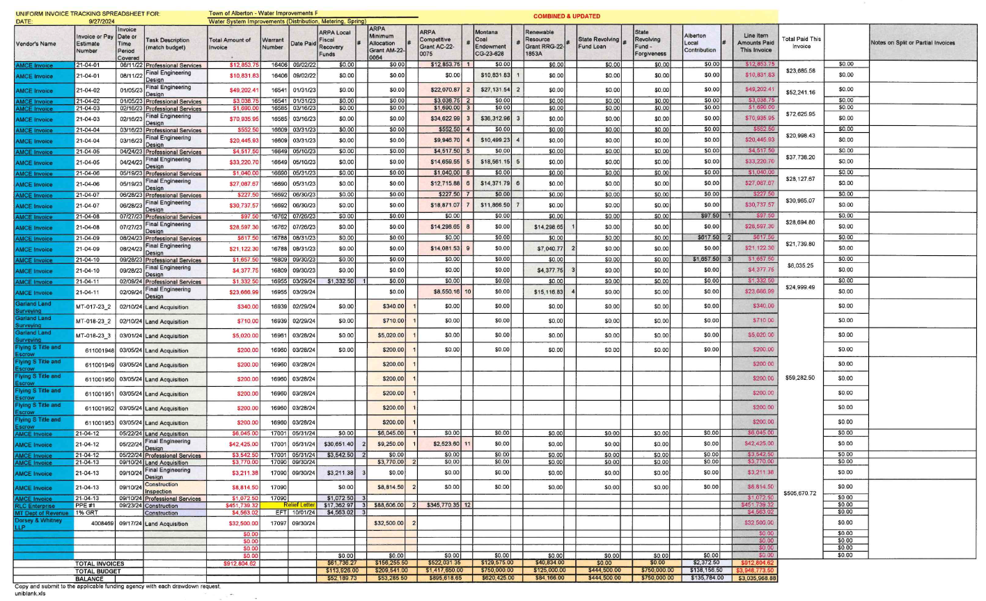
Alberton Water System improvements
November 2024

Slide 9
Any Questions?
November 2024

