Slide 1
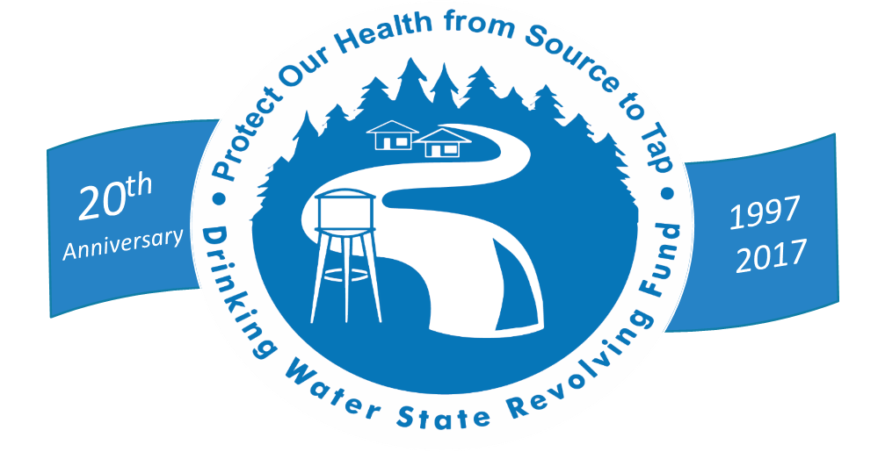
Protecting Public Health for 20 Years
The Drinking Water State Revolving Fund

Slide 2
DWSRF Through 20 Years
$35.4 Billion
in Projects Funded
$3.0 Billion
for Capacity Building, Operator Certification DWSRF & PWSS Support
13,800
Loans Signed
$30.8 Billion
in Project Disbursements

Slide 3
Lenoir, NC
System Improvements
“The low interest rates… save our community money. A few of the projects would have been put off a lot longer, or may not have happened at all without the ability to borrow through the SRF program.”
-Mr. Bradford Thomas
Public Utilities Director
City of Lenoir

Slide 4
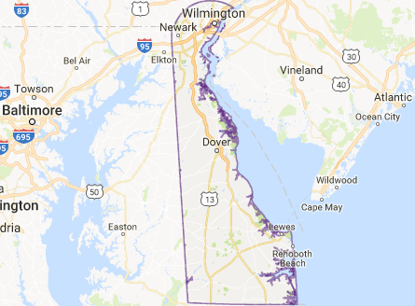
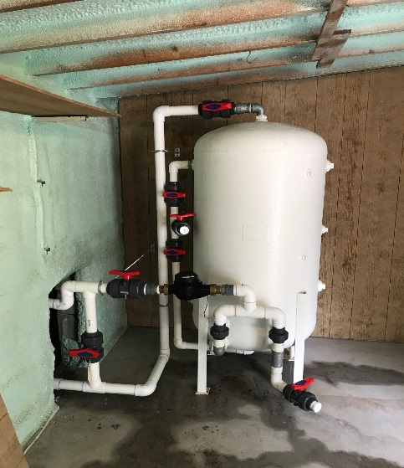
Building System Capacity
Forest Park MHP Millsboro, DE

Slide 5
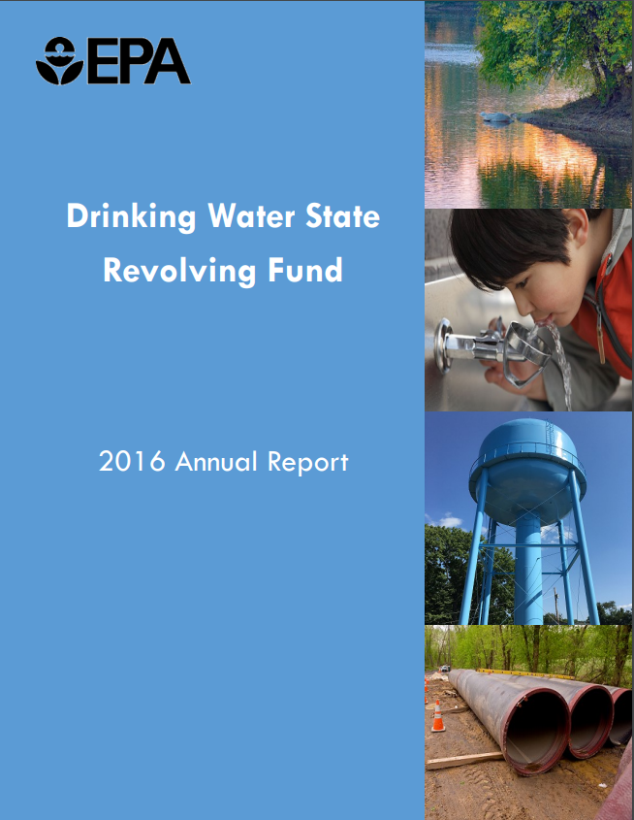

Slide 6
Going forward

Slide 7
Evolving Public Health Protection Challenges of the 21st Century
Infrastructure
Emerging Contaminants & the CCL
Extreme Weather

Slide 8
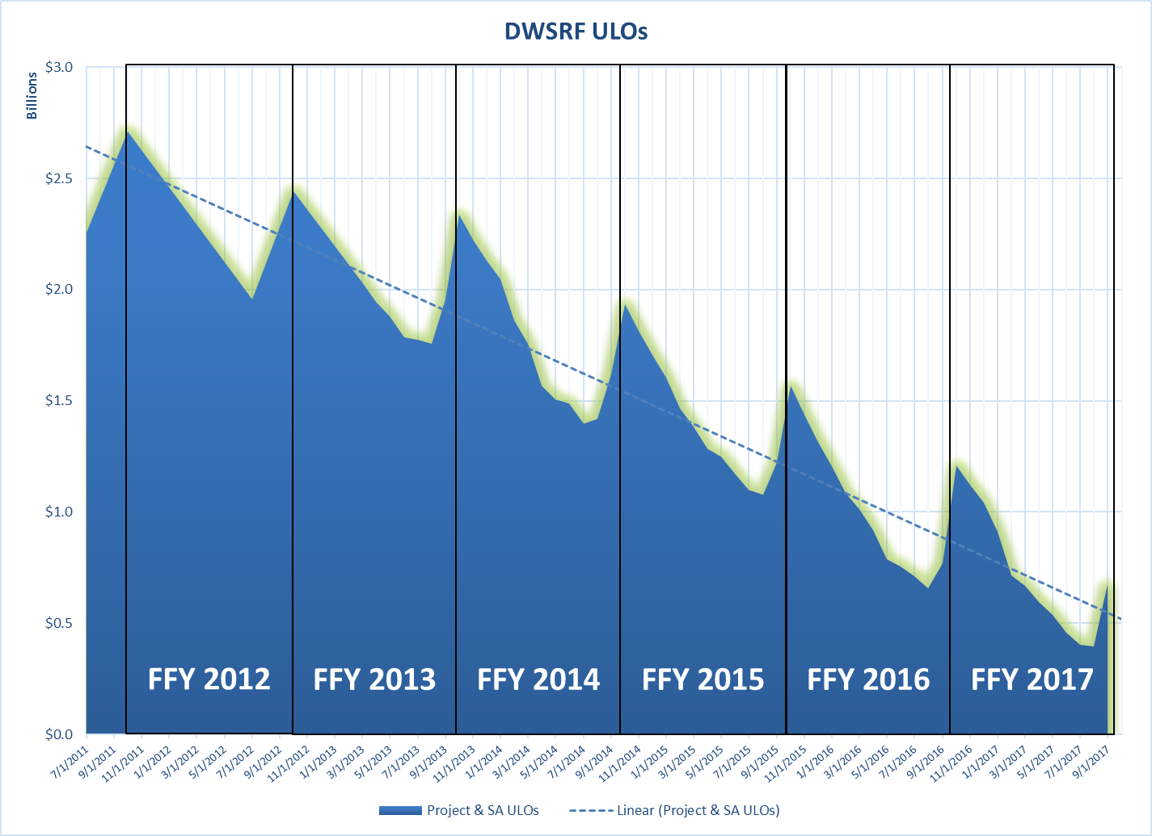

Slide 9
ULO Strategy Stimulates Infrastructure Investment

Slide 10
ULO Strategy Also Moved Non-Federal Funds Into Communities
*Non-Federal = state match, principal repayments, interest earnings, leveraged funds

Slide 11
Strong Demand Encourages Leveraging in 2017

Slide 12
DW Needs Survey
Thank you to states and water systems
  99.7% response rate from surveyed systems
    2,592 of 2,600 surveys received
Nearly 90,000 projects were submitted (many projects per system)
  93% acceptance rate; 97% after adjustments

Slide 13
Keeping the Revolving Funds Revolving
Inflows
Federal Cap Grants State Match Repayments Interest Earnings Leveraging
Outflows
Project Disbursements

Slide 14
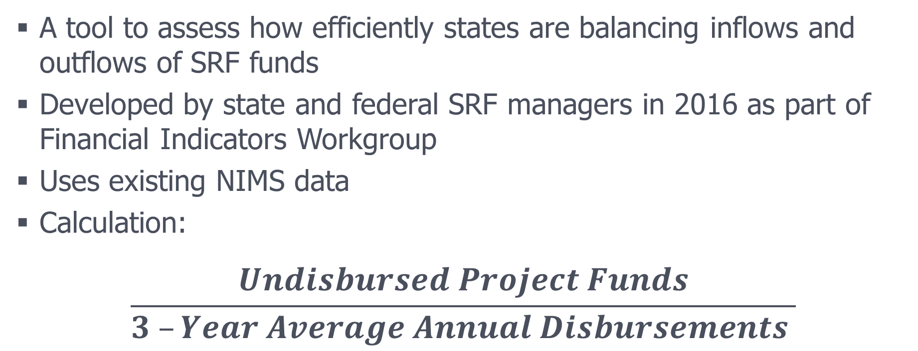
Disbursements Ratio
A tool to assess how efficiently states are balancing inflows and outflows of SRF funds
Developed by state and federal SRF managers in 2016 as part of Financial Indicators Workgroup
Uses existing NIMS data
Calculation:
$$\frac{Undisbursed Project Funds}{3 –Year Average Annual Disbursements }$$
Notes:
Calculate the undisbursed project funds by subtracting total disbursements from total funds available. Then, compare this to average annual disbursements over the past 3 years. This 3-year period is used to smooth any large disbursement peaks or valleys occurring in that time period (including seasonal discrepancies).
Important note: we receive these data once per year from the states (as of June 30 each year)
Thus, must be careful, since we may not see the true highs and lows over the year.

Slide 15
15

Slide 16
Water system partnerships

Slide 17
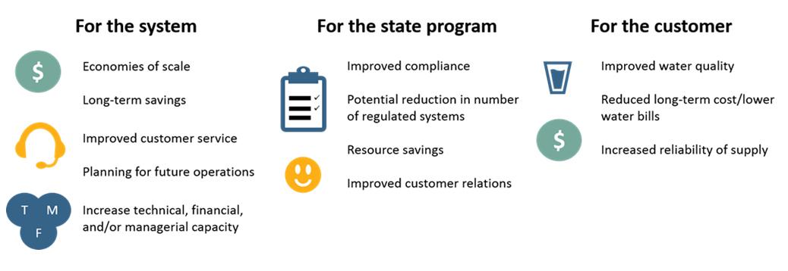
Partnership Benefits
Notes:
The potential benefits of partnerships are numerous and significant:
COST SAVINGS: Partnerships can help reduce capital and operating costs and prices through increased economies of scale.
-This can be seen in formal and informal partnerships. Informal example is the system in Texas that serves as the contract manager for bulk chemical purchasing. A formal example is the economic development that it can bring to a community- Champion Pet Foods built a large facility in Auburn, KY, due in part to the presence of a 12-inch water line on the property that was installed as part of a consolidation project.
INFRASTRUCTURE INVESTMENT: Partnerships can enable communities to raise the capital needed to replace and improve aging water-delivery infrastructure.
PUBLIC HEALTH: Partnerships can improve operational performance through wider use of trained operators and tailored treatment technologies.
Birmingham Water realized a lack of level 4 certified operators in the state. They initiated a training program to increase that number, and the operational ability of neighboring systems. They also use their expertise to help local systems assess leaks.
PREPAREDNESS: Partnerships can enhance environmental protection, resource conservation, and contingency planning for natural or other supply emergencies, through increased coordination and integrated planning.
States can also realize important benefits from system partnership activities. For example, partnerships can be an effective means for helping water systems achieve and maintain technical, managerial, and financial (TMF) capacity, thereby reducing the oversight and resources that the state will need to devote to these systems. If more systems are connected through partnerships or the overall number of systems in a state is lower due to regionalization and consolidation, this can also result in more in depth assistance from state experts.
These examples will not be in the text for Leigh. These are ones to talk through that highlight the benefits of partnerships.

Slide 18
EPA Actions
EPA has collaborated with states and stakeholders to promote and raise awareness about partnership opportunities
Three key priority areas:
  Incentives for partnerships
  Funding and financing
  Outreach and communication
Notes:
Water system partnerships can increase system capacity by providing opportunities for systems to work together to solve compliance challenges, share costs of operations and maintenance activities and leverage other resources. This enables struggling systems to provide safe, reliable and affordable water to their communities.
Water system partnerships include a variety of arrangements that can range from informal equipment sharing to more formal agreements for sharing operators to physical consolidation of two or more systems.
For years, EPA and states have been collaborating to promote and raise awareness about partnership opportunities.
Working together, we’ve develop case studies, incentives and funding and financing tools to support water system partnerships.
Currently, there are 153,000 Public Water systems (PWSs) in the United States
Examples
California and Texas – 7,000 PWSs. California now has new legislation spurring consolidation.
Alabama and Kentucky have made significant efforts to promote water system partnerships. They’ve managed to bring their inventories down to the low 400’s
One of the best examples of a town where all of these things have come together in the right way is Danville, KY. The DW system serves approximately 11,000 residents in the town and an additional 21,000 in the surrounding districts of Junction City, Parksville, Hustonville, Perryville and Lake Village Water Association.
Danville has entered partnerships to provide high quality drinking water to approximately 75,000 residents in most of the surrounding communities through direct connections and sharing of their expert operators to everyone's benefits.
We have been meeting with stakeholders across the water sector to discuss ways to address these challenges, focusing on three key priority areas:
Incentives for partnerships,
funding and financing, and
outreach and communication.

Slide 19
Water System Partnerships: EPA Actions
Increasing awareness
Creating a space where communities can easily find support for partnerships
Identifying opportunities to address technical, managerial and financial capacity needs
Developing case studies, incentives and funding and financing tools to support water system partnerships
Notes:
In the Office of Water, we have worked for several years to promote and raise awareness about partnership opportunities.
We’ve heard ideas and approaches to address challenges, and using this information, we’re identifying what we can do in the short and long term in cooperation with each part of the water sector.
We’ve begun by focusing on:
Increasing awareness about funding options in establishing partnerships for infrastructure and non-infrastructure activities. Short term steps here include sharing case studies of states that have been successful coordinating multiple funding resources into a single application like KY and KS.
Creating a space where communities can find information, facilitation, and local expertise across the country to help establish partnerships.
Identifying opportunities to increase incentives for communities to begin partnerships as a tool to address their technical, managerial and financial capacity needs.
Updating a compendium of state statutes, programs and studies that support water system partnerships.
Cooperation to move these pieces forward is critical. We know EPA cannot do this work without all the members of the water sector. We want to hear from you what is needed, what is working and where we can do better.

Slide 20
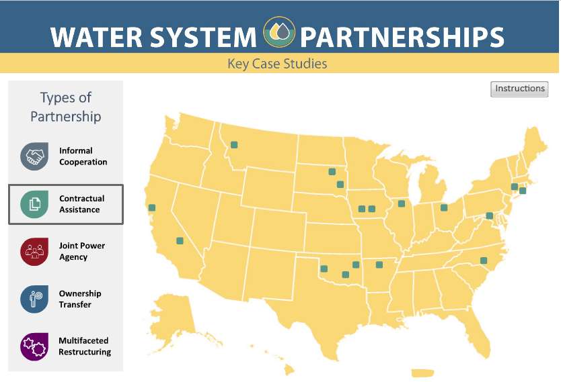
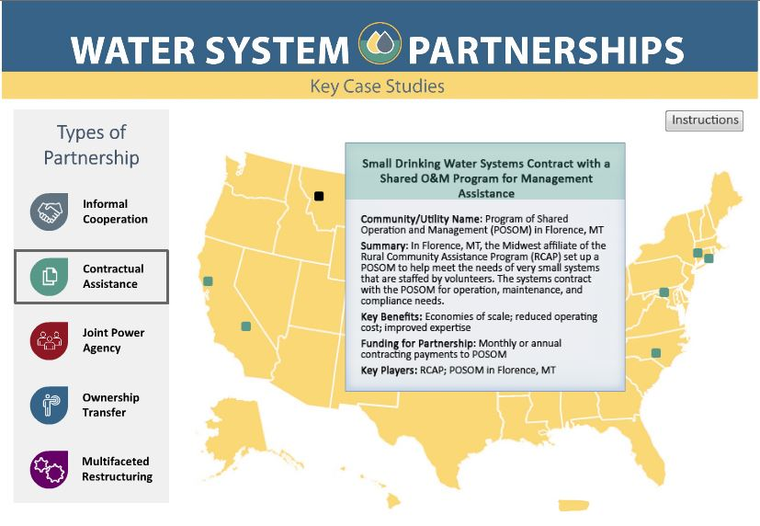
Montana

Slide 21
PROTECTING
AMERICA’s DRINKING water epa.gov/safewater

