Slide 1
How to move beyond climate resilience planning into practical action
CIFA SRF Workshop
Ghina Yamout
November 18, 2024
Notes:
This session will focus on practical considerations for taking climate resilience action, based on results of a science-informed risk assessment which brings insight and action. This helps to build confidence in capital planning, clarity to move through the uncertainty of climate data, and apply consistent processes for decision making. Examples will be included
What is a climate science-informed risk assessment?
Using a risk assessment to make decisions, despite climate uncertainty

Slide 2
The Actionable Climate Science Journey
Analyze climate projections in a way that is useable for the end goal
Climate risk assessment processes, using technology when possible
Climate resilient decisions in plans, designs, and construction
Information
Insight
Action
Notes:
This session will focus on practical considerations for taking climate resilience action, based on results of a science-informed risk assessment which brings insight and action. This helps to build confidence in capital planning, clarity to move through the uncertainty of climate data, and apply consistent processes for decision making. Examples will be included

Slide 3
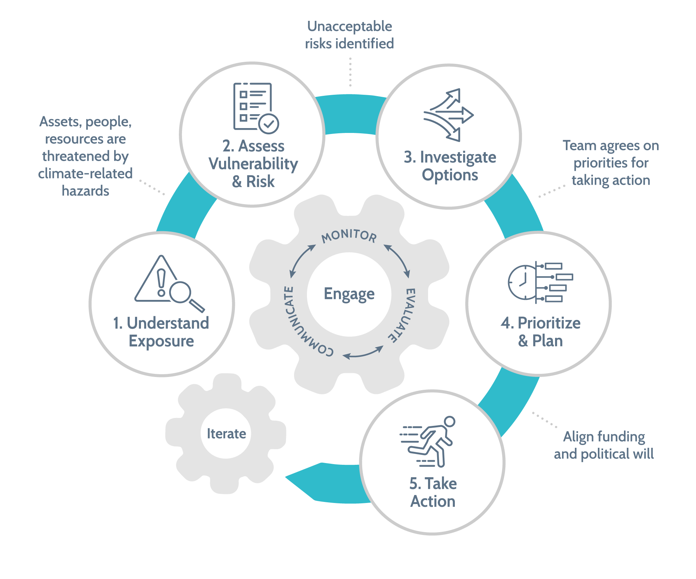
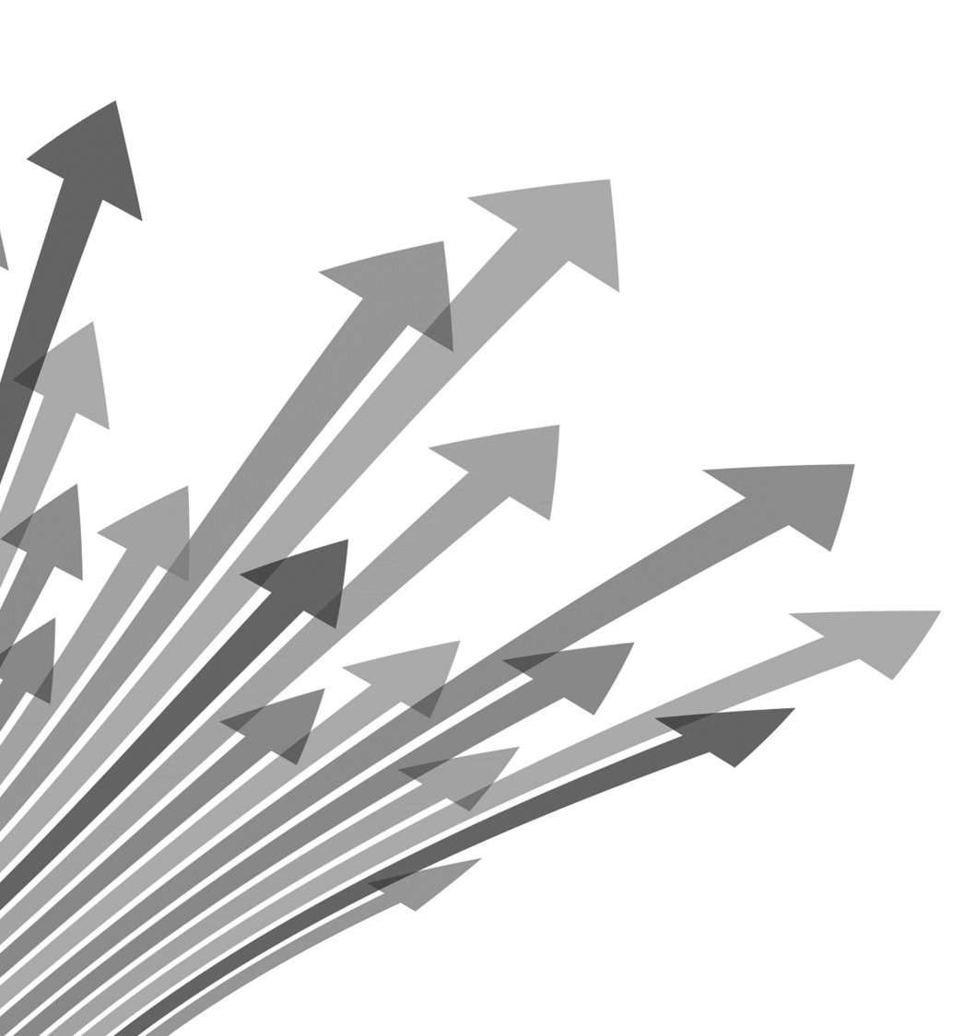
The standard climate risk assessment processes
What’s Next?
Notes:
This is a standard risk and resilience planning framework, but there's many other kinds of planning our team is familiar to everyone. [water supply, transportation, remediation…] THIS IS AN ITERATIVE PROCESS.
Our team excels at executing and communicating the steps of the climate risk assessment process to our clients in a way that is useable, and then applying that information to the risk assessment process in a way that brings insight and action.
- confidence in capital plans
- clarity to move through the uncertainty of climate data
- consistent processes that enable comparison across facilities and assets
Basically:
1) What’s the problem? 2) What are the consequences? 3) How bad are those consequences? 4) What are you gonna do about it? 5) Do it.
Planning means a lot of different things to each of you, BUT it is important to understand the concepts/meaning behind steps in the climate risk assessment process to effectively communicate with clients, colleagues, peers, etc.
They come in many different shapes and sizes
They can be qualitative or quantitative. And this depends on budget, data availability, and end user needs.

Slide 4
Beginning the Journey

Slide 5
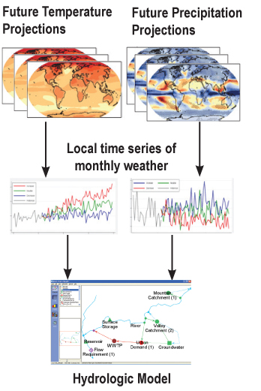
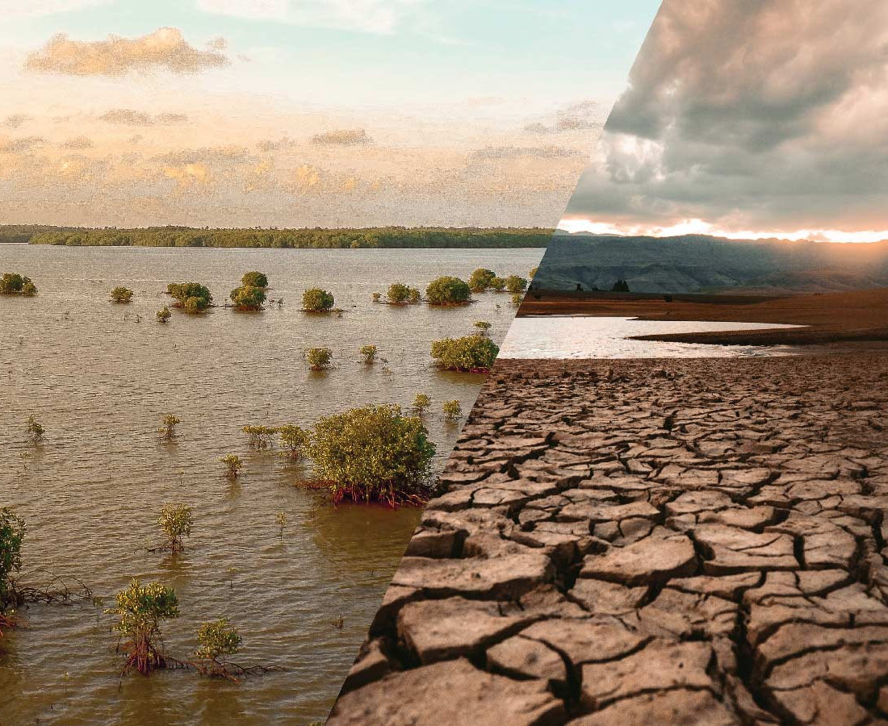
Step 1 - Understand Exposure
Exposure to Climate Hazards
Emissions
Climate Models
Notes:
One of the main inputs of what goes into these models are emission scenarios. There two types of those
a) Are actual emission observed , measures which are used to train these models to reproduce historical climate as best as possible
b) Future emissions… the problem is we don’t really now how future emissions look like. We can’t predict the future either… … right? Will we get our act together and reduce them as a society… near term unlikely.
so what climate scientists use to explore plausible and possible futures, the assumptions they depend upon, and the courses of action that could bring them about are emission scenarios or also called socio-economic scenarios. which essentially are based on different factors like population growht, lifestyles, energy supply etc. essentially factors which result in certain amount of emissions…
GCMs translate this into quantifiable values of change in rain, snow, temperature, wind etc.
Future emissions scenarios and climate models are a super fascinating, complicated and powerful tool for understanding climate change, what can happen if continue as we do as a society, or pathways of how to reach certain reduction targets through climate policies.

Slide 6
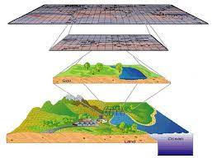
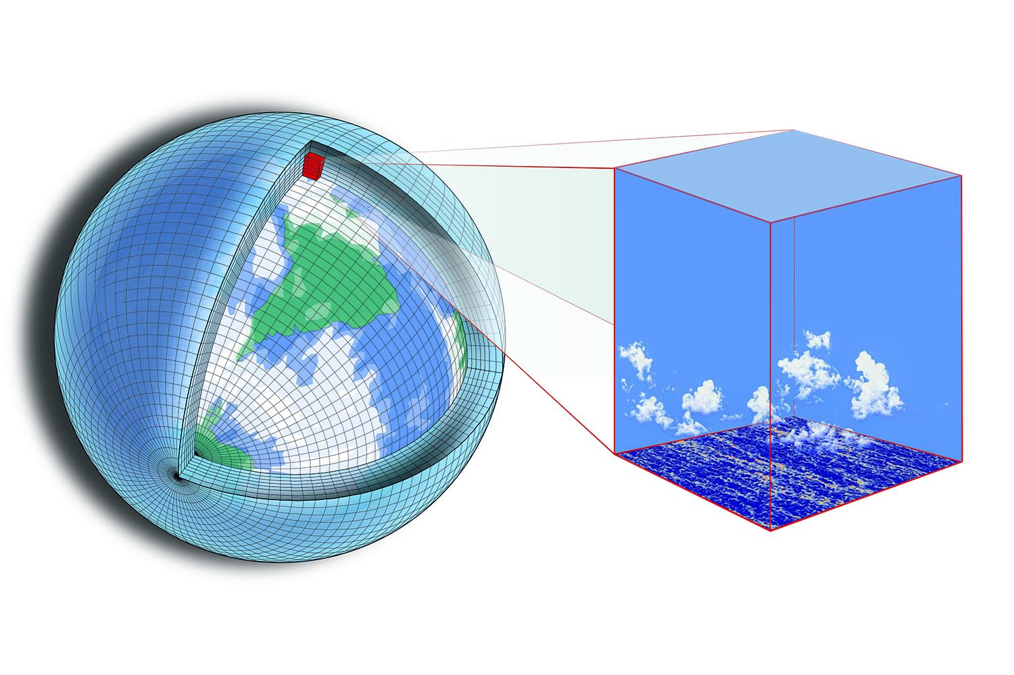
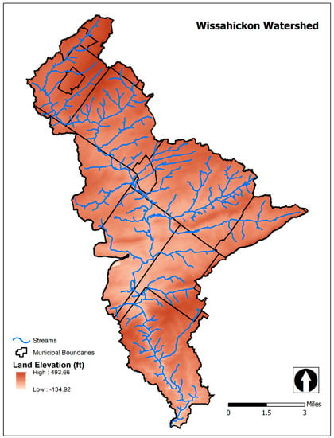
Step 1 - Understand Exposure
“Data Processing”
National Climate Assessment
Climate Mapping for Resilience and Adaptation (Federal)
Bureau of Reclamation (6 subsets)
NASA NEX GDDP 5
NASA DCP30
NOAA or NASA
SLR
NOAA Atlas 15
MACA (Sierra Nevada Research Institute)
NARCCAP
Regional Climate Change Viewer
NOAA RISA programs (e.g., Marisa)
State platforms (e.g., NJDEP)
USGS (national climate change viewer)
World bank climate knowledge center
Climate Central
CORDEX
Center for Climatic Research
Department of Defense
NASA NEX GDDP 6
USDA Climate Map Explorer
Data Source
Data Provision
Spatial Scale
Temporal Scale
Hazard Types
Boundaries
Statistics
Climate Modeling Centers /
IPCC
30+ Data Sources and Portals
(just for the US!)
Notes:
I think it should be added somewhere as it really puts all this data out there into context and helps folks to understand that these data portals all use the same source essentially, it's just how they provide it is what differs.
Spatial Scale
Temporal Scale
Hazard Types
Boundaries
Statistics
Climate Modeling Centers /
IPCC
Spatial Scale
Temporal Scale
Hazard Types
Boundaries
Statistics

Slide 7
Information

Slide 8
Step 2 - Assess Vulnerability and Risk
If climate hazard occurs, what would it cost us?
How often will climate hazard occur at given magnitude?
Monetized value for climate risk
PREDISPOSITION x IMPACT x ADAPTIVE CAPACTY = VULNERABILITY
Notes:
These are DIFFERENT
Vulnerability – predisposition of assets to be adversely affected by hazards: exposure, sensitivity, potential impacts, and adaptative capacity
Do this for communities, for assets, for everything
Risk – potential for adverse consequences where something of value is at stake and occurrence and degree of outcome is uncertain: likelihood of hazard and magnitude of the consequences
Could be value in dollars
Ecosystem or natural habitat loss
Cultural losses
Health impacts
People use these interchangeably
The point: Why / how do climate hazards matter
The naming convention can be a rabbit hole – it is important to know the difference, but understand they are terms used to identify the problem and the magnitude/extents.
Vulnerability and Risk – what is the problem?
This step allows the client to focus resources on what is most important.
For example, may use the Climate and Economic Justice Screening Tool (CEJST) - Explore the map - Climate & Economic Justice Screening Tool (geoplatform.gov) which covers extents nationally, with exceptions to territories and Tribal nations, The tool uses datasets as indicators of burdens. The burdens are organized into categories. A community is highlighted as disadvantaged on the CEJST map if it is in a census tract that is (1) at or above the threshold for one or more environmental, climate, or other burdens, and (2) at or above the threshold for an associated socioeconomic burden.
Diagram – Association of Climate Change Professionals

Slide 9
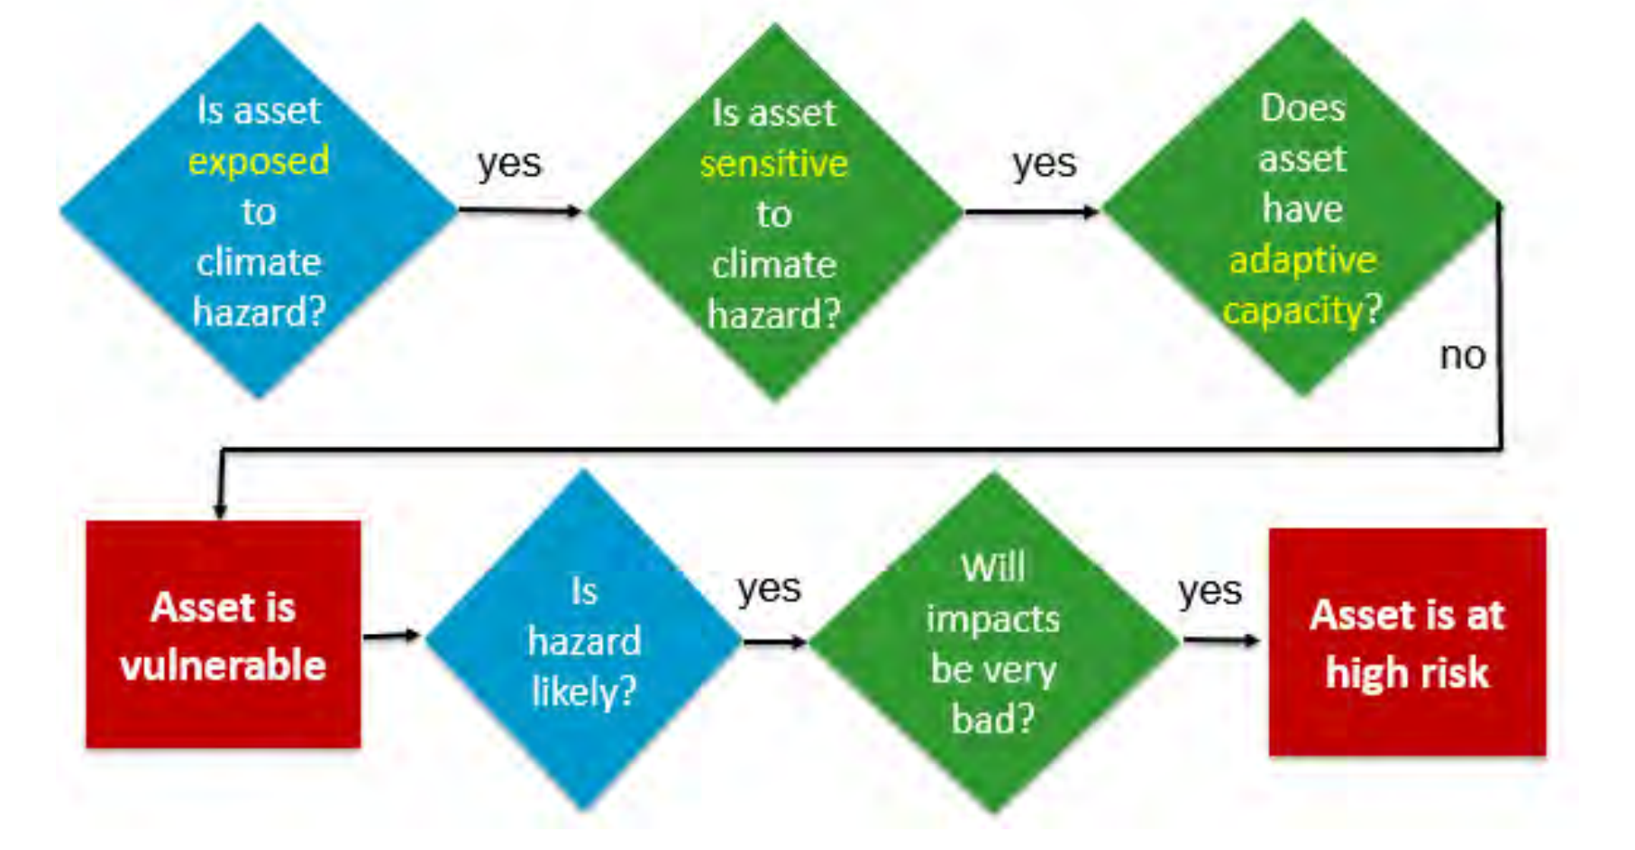
Step 2 - Assess Vulnerability and Risk
– In other Words:
Notes:
These are DIFFERENT
Vulnerability – predisposition of assets to be adversely affected by hazards: exposure, sensitivity, potential impacts, and adaptative capacity
Do this for communities, for assets, for everything
Risk – potential for adverse consequences where something of value is at stake and occurrence and degree of outcome is uncertain: likelihood of hazard and magnitude of the consequences
Could be value in dollars
Ecosystem or natural habitat loss
Cultural losses
Health impacts
People use these interchangeably
The point: Why / how do climate hazards matter
The naming convention can be a rabbit hole – it is important to know the difference, but understand they are terms used to identify the problem and the magnitude/extents.
Vulnerability and Risk – what is the problem?
This step allows the client to focus resources on what is most important.
For example, may use the Climate and Economic Justice Screening Tool (CEJST) - Explore the map - Climate & Economic Justice Screening Tool (geoplatform.gov) which covers extents nationally, with exceptions to territories and Tribal nations, The tool uses datasets as indicators of burdens. The burdens are organized into categories. A community is highlighted as disadvantaged on the CEJST map if it is in a census tract that is (1) at or above the threshold for one or more environmental, climate, or other burdens, and (2) at or above the threshold for an associated socioeconomic burden.
Diagram – Association of Climate Change Professionals

Slide 10
Case Study
Objectives
How (e.g., floodwalls) and when to protect facilities?
Develop a capital improvement program (CIP) designed to protect a Southeast Virginia wastewater utility’s infrastructure (e.g., treatment plants, pumping stations) against climate change induced flooding.
Approach
Implement a consistent method to quantify risk for planning purposes
Optimize a project planning schedule based on estimates of risk

Slide 11
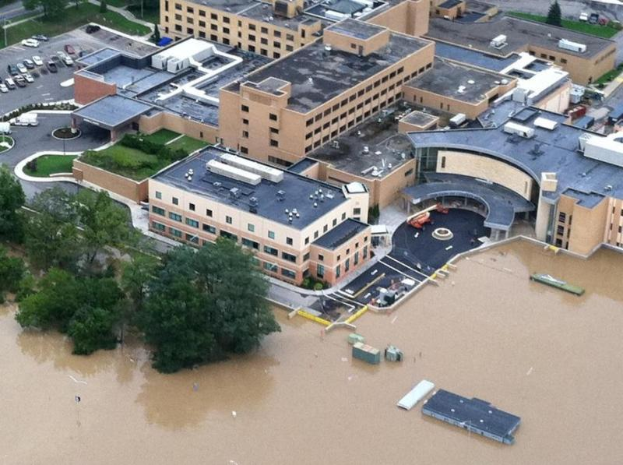
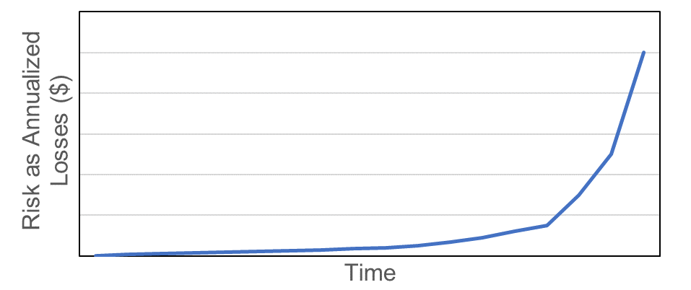
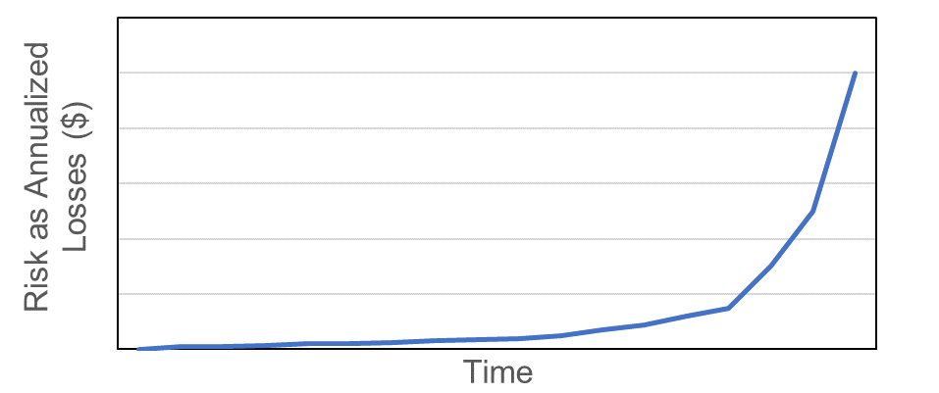
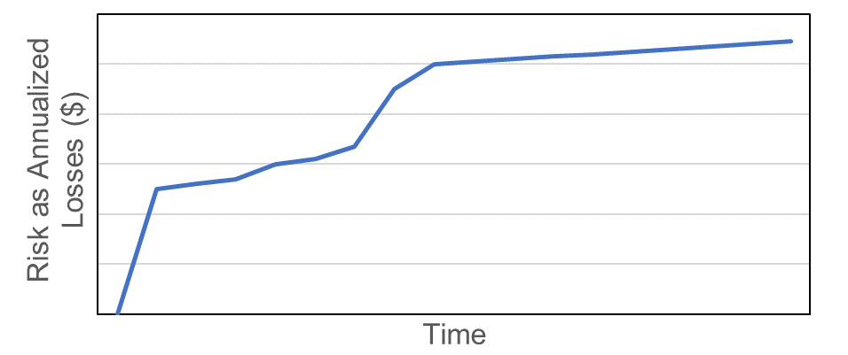
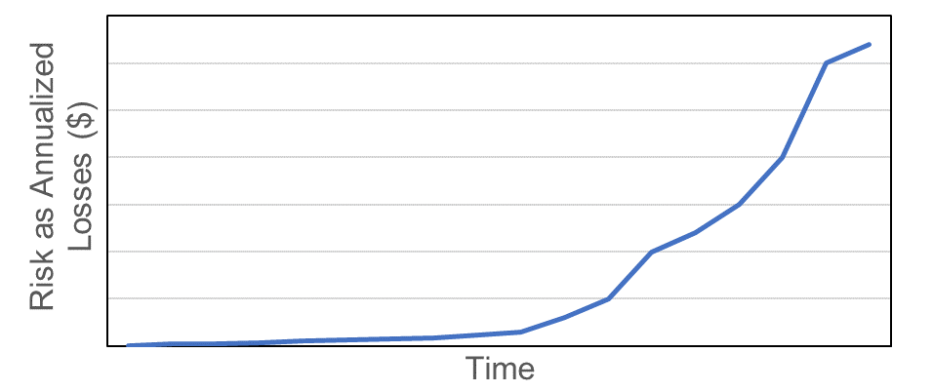
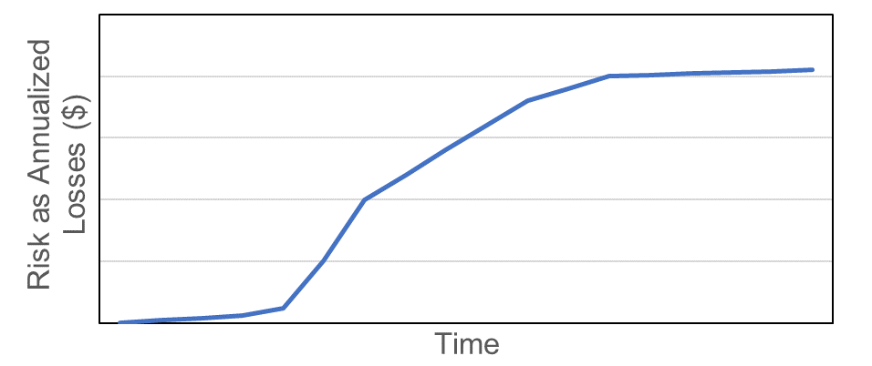
CDM Smith Flood Vulnerability Tool
Calculates flood risk based on estimates of consequences and likelihood
Simplifies planning for individual facilities
Build flood proofing measures by this time
How do we plan flood proofing for an entire system (60+ facilities) ?
Facility #1
Facility #3
Facility #2
Facility #4

Slide 12
Different Options for Decision Making
Decision-Making Framework Approaches
Lowest Cost First
Multi-Criteria Decision
Scenario Analysis
Best possible outcomes for different combinations of goals, targets, criteria, parameters, constraints, risk attitudes, etc.
Risk-Based Multi-Objective Optimization
Notes:
This is not theoretical; we have implemented it (Personally for City of Mesa and SJRWMD and colleagues on CDM Smith Hampton, we can show you if interested)
Portfolio picked out of hat – Cheapest option first
Criteria-Based selection based on average
Criteria-Based selection using scenarios for risk of shortage
Risk-Based Optimization (Stochastic)

Slide 13
Step 4 – Prioritize and Plan
Objectives (Goals)
Variables (“Dials”)
Project start years for multiple resilient projects
Maximize Benefits
Spread Out Costs
Minimize Projects/Year
Optimization Formulation
Solution
Project schedule (CIP) that includes project start years for all facilities

Slide 14
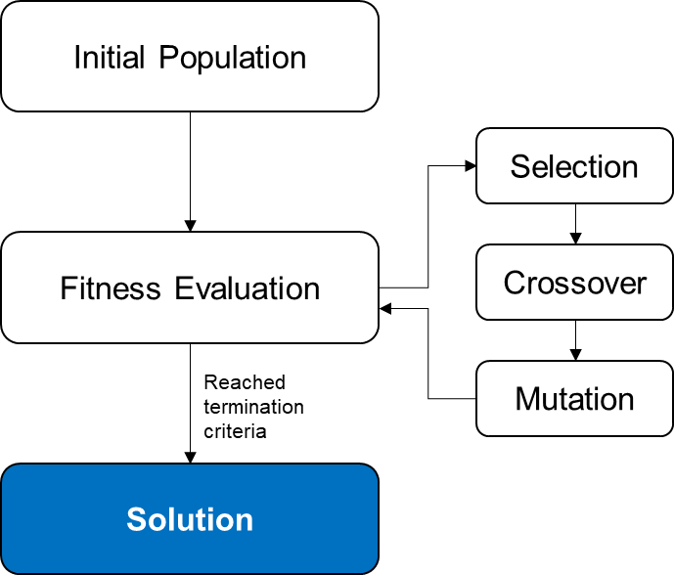
Algorithm Flowchart
Randomly generate 100 CIP schedules
Initial Population
Rank schedules by objective values and extract a subset of schedules (e.g., top 20)
Selection
Calculate objectives for each of the 100 schedules
Fitness Evaluation
Mix project start years between top performing schedules and generate a new set of 100
Crossover & Mutation
Reached termination criteria*
Iterate
Solution
Termination criteria*: maximum number of iterations (e.g., 100,000)

Slide 15
Insight

Slide 16
Step 4 – Prioritize and Plan
Minimize risk
Minimize total age of infrastructure
Minimize costs
Maximize EJ initiatives
Notes:
Considerations:
community capacity (staff availability, community interest)
Available tools and resources to take action
A few examples are:
1) Think about whether the adaptation strategy you are proposing is correctly designed to match the magnitude and timeframe of the expected hazard.
2) You have to think about how to pay for these projects – are you going to be using grants, other funding sources, or are you rolling this into a yearly budget/capital improvement planning. For example, PROTECT (resilience of infrastructure), BRIC, or Federal Mitigation Assistance (FMA) funding.
3) Climate resilience projects don’t have to be separate from what the client is doing - it can be an ASPECT of an existing effort
There’s lots of different ways to become more resilient and we can be creative.

Slide 17
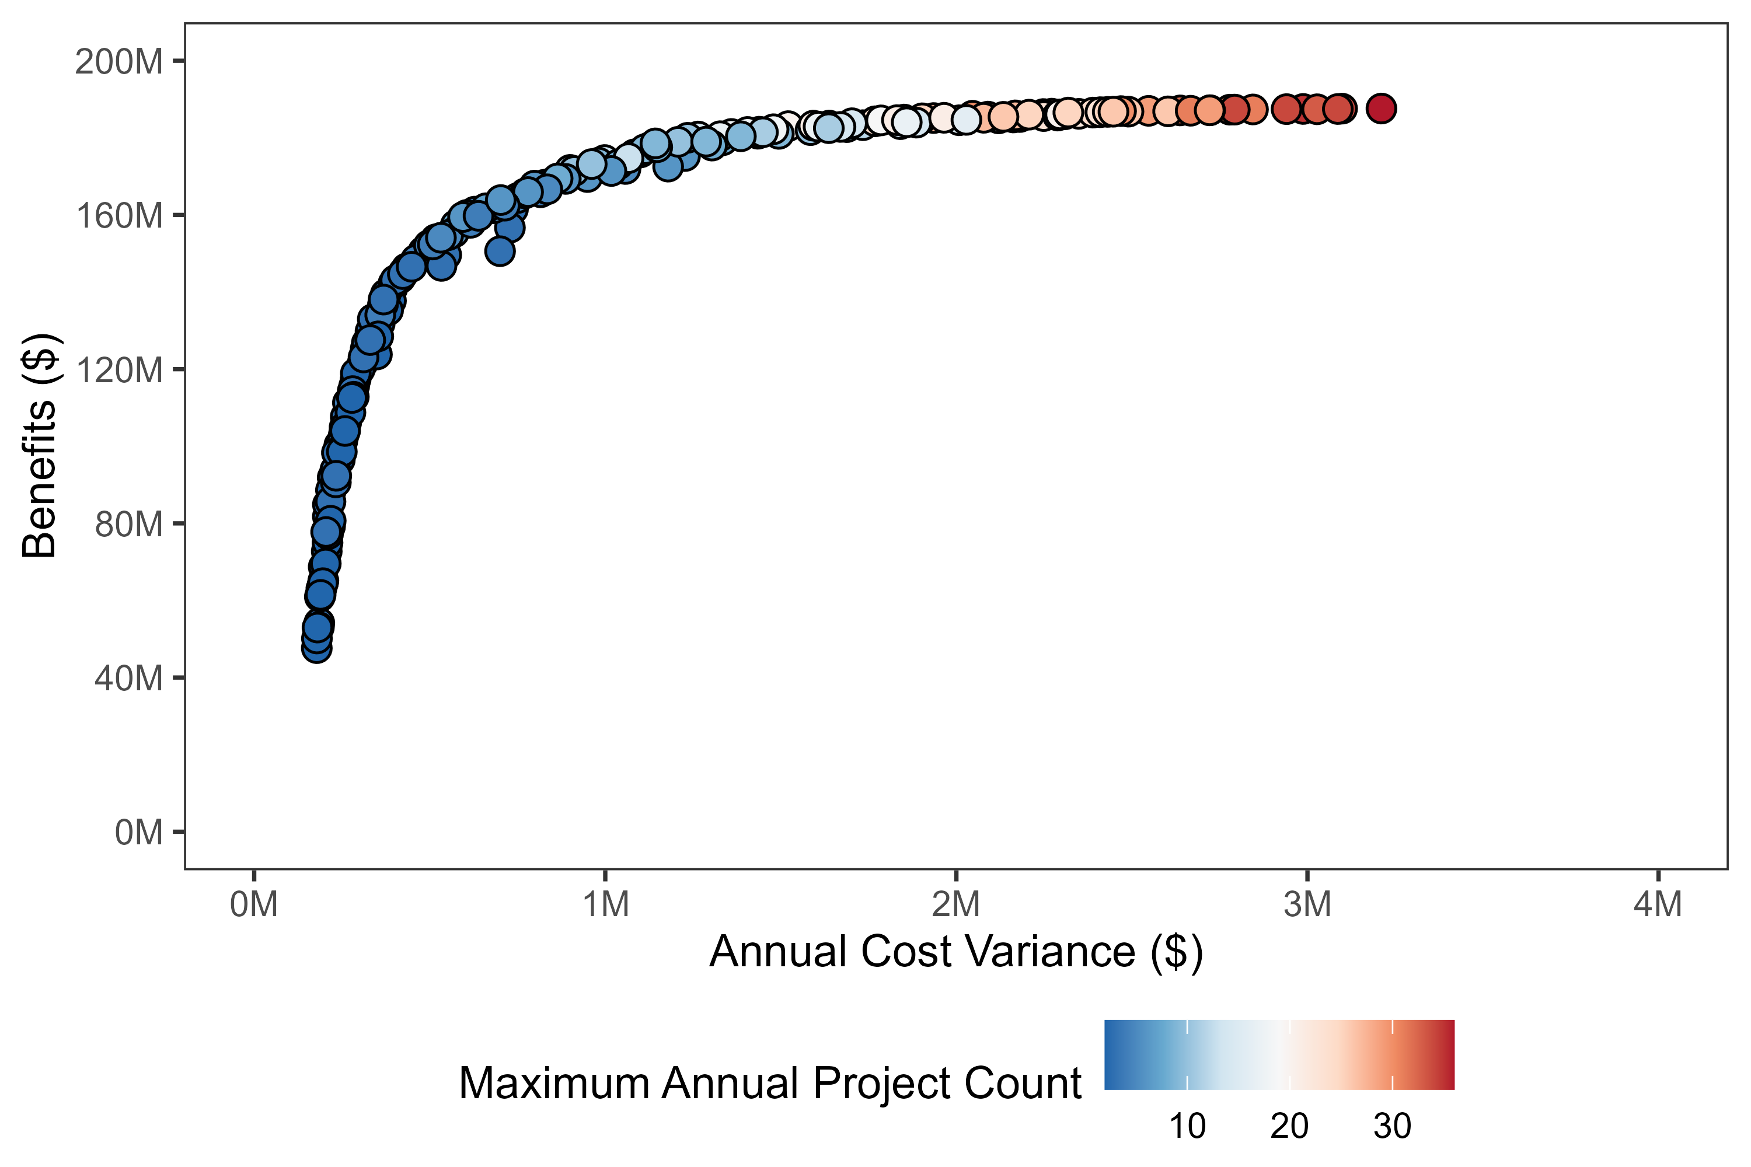
Optimization Results
Results may be displayed as an “efficiency frontier”
Individual points represent different CIP schedules
Visualize tradeoffs between objectives
More risk reduction
High risk reduction
Costly up front
Low risk reduction
Costs allocated throughout century
Less risk reduction
Greater spread of project costs over time
Less spread of project costs over time
Obj. 1
Obj. 2
Obj. 3

Slide 18
Optimization Results
Results may be displayed as an “efficiency frontier”
Individual points represent different CIP schedules
Visualize tradeoffs between objectives
Diminishing returns in total benefits after “knee of curve.”
More risk reduction
High risk reduction
Costly up front
“Knee of curve”
Low risk reduction
Costs allocated throughout century
Less risk reduction
Greater spread of project costs over time
Less spread of project costs over time

Slide 19
Optimization Results
New CIP schedules can always be manually generated or adjusted from original results
Objectives of new schedules can be calculated and compared to existing efficiency frontier.
More risk reduction
Manually generated CIP schedule
Less risk reduction
Greater spread of project costs over time
Less spread of project costs over time

Slide 20
Step 5 – Take Action
Notes:
Hopefully by doing the planning process and risk assessment for the client, we are pre-positioning our teams for the future work of systematically implementing adaptation strategies.
This is where we hope our planning/engineering teams can come in to actually reduce risk and help our clients become more resilient.
So, yes, the climate resilience planning process is about helping the client and doing the right thing BUT it is also good for the firm and for getting future work.
And that leads us to some specific project examples that Kate is going to walk us through.

Slide 21
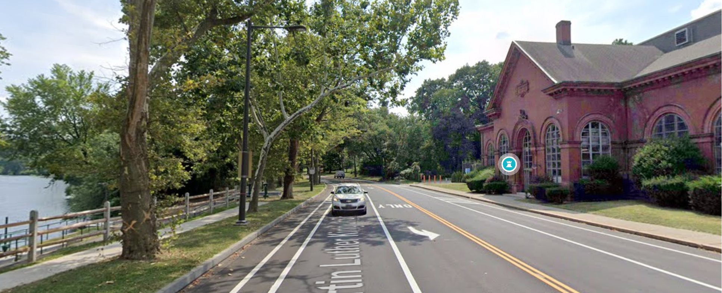
Actionable Climate Science Story: Philadelphia Water Department Story
From Actionable Climate Science to Design Guidance to Resilient Infrastructure
Climate Change Adaptation Program (tools to inform planning and design): Climate Resilience Design Guidance and Changing Flood Elevation Analysis Tool (C-FEAT)
… was flooded and pumping stopped for 11 days. Water production was severely affected; the distribution of treated water to west Philadelphia was at risk. The station is about 250 feet from the Schuylkill River …
Notes:
"I want to give you really great example which shows the value of actionable science in real world applications and the impact it can have to our clients. In 2014, Mark Maimone has planted the seed of actionable climate science at the Philadelphia Water Department. He was instrumental in establishing a Climate change adaptation program, which set up an institutional mechanisms and resources to enable PWD to dive deep into climate projections, explore what they mean, and how they can be used. 0 Now 10 years later PWD is actively using rainfall projections and tools we’ve developed in many applications to inform planning and design.
For example, a couple years ago, Hurricane Ida flood large parts of the city including one of the city's major raw water pump stations (in picture, built in the late 1800s. This station flooded and pumping stopped for 11 days. Water production was severely affected; the distribution of treated water to west Philadelphia was at risk. The station is about 250 feet from the Schuylkill River and is in more danger of flooding as more severe storms affect the area more frequently due to climate change).
To make this pump station more resilient, PWD is now using the Climate resilience design guidance CDM Smith supported developing and CDM Smith's Changing Flood Elevation analysis tool (C-FEAT) to develop future flood elevations and associated probabilities to make raw water access more resilient. (study is going on to find a spot where the pump station should be relocated to)

Slide 22
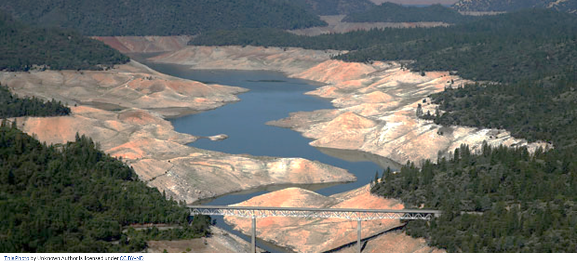
Actionable Climate Science Story: A Community Vulnerable to Drought
Evaluating drought risk justified capital investment for advanced water treatment, ASR, conservation, and increased water imports AND policy decisions

Slide 23
Risk-Based Analysis
Scenario Worst-Case
You are paying too much for the same level of risk
Efficiency Frontier
Map of the trade-offs landscape showing best possible outcomes for different combination of parameters
INEFFICIENT SPACE
$40B
Scenario Average
COST / BENEFIT
Scenario Best-Case
$20B
UNDER-INVESTMENT SPACE
You are paying too little for the confidence level you are aiming for
CONFIDENCE LEVEL (Lower Risk of Shortage)
Hypothetical – For Illustration Only
Notes:
Imagine you’re designing a car engine. You want to maximize fuel efficiency while minimizing emissions. But there’s a trade-off: tweaking one parameter might improve efficiency but worsen emissions, or vice versa. The efficiency frontier is like a map of this trade-off landscape. It shows you the best possible outcomes for different combinations of parameters. Each point on the frontier represents an optimal balance—where you’ve squeezed out as much efficiency as possible without compromising other goals.
Pareto efficiency captures the idea that we’ve reached an optimal state when we can’t make anyone better off without making someone else worse off. Formally, an allocation (distribution of resources or goods) is Pareto efficient if there’s no way to rearrange things so that at least one person is better off without hurting anyone else. It’s like a delicate balancing act: we’re at the sweet spot where no further improvements are possible without causing harm.
Pareto efficiency: We’re at the summit—can’t make anyone happier without upsetting someone else.
Pareto frontier: The cliff’s edge where all these optimal allocations reside.
Efficiency frontier: Navigating trade-offs—finding the Goldilocks zone where everything’s just right.
The solution on the right, using the RB Model is less expensive, for the same level of risk and meeting the same goals
Comments:
The efficiency frontier is the optimization part of the analysis

Slide 24
How to move beyond climate resilience planning into practical action

Slide 25
Session purpose:
This session will focus on practical considerations for taking climate resilience action, based on results of a science-informed risk assessment which brings insight and action. This helps to build confidence in capital planning, clarity to move through the uncertainty of climate data, and apply consistent processes for decision making. Examples will be included
What is a climate science-informed risk assessment?
Using a risk assessment to make decisions, despite climate uncertainty

Slide 26
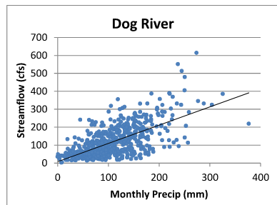
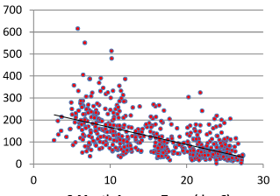
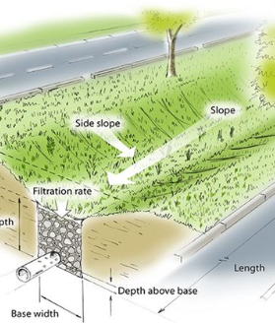
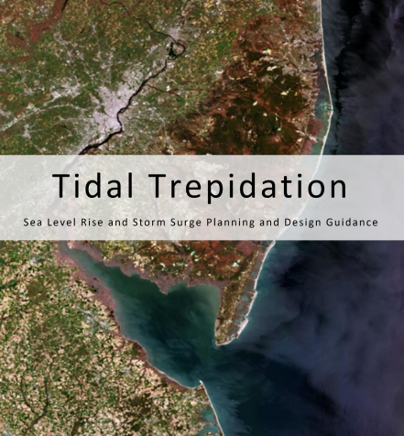
Develop and Provide Actionable Science
End User
Statistical Correlation
Design Parameters
Master and Capital Planning

Slide 27
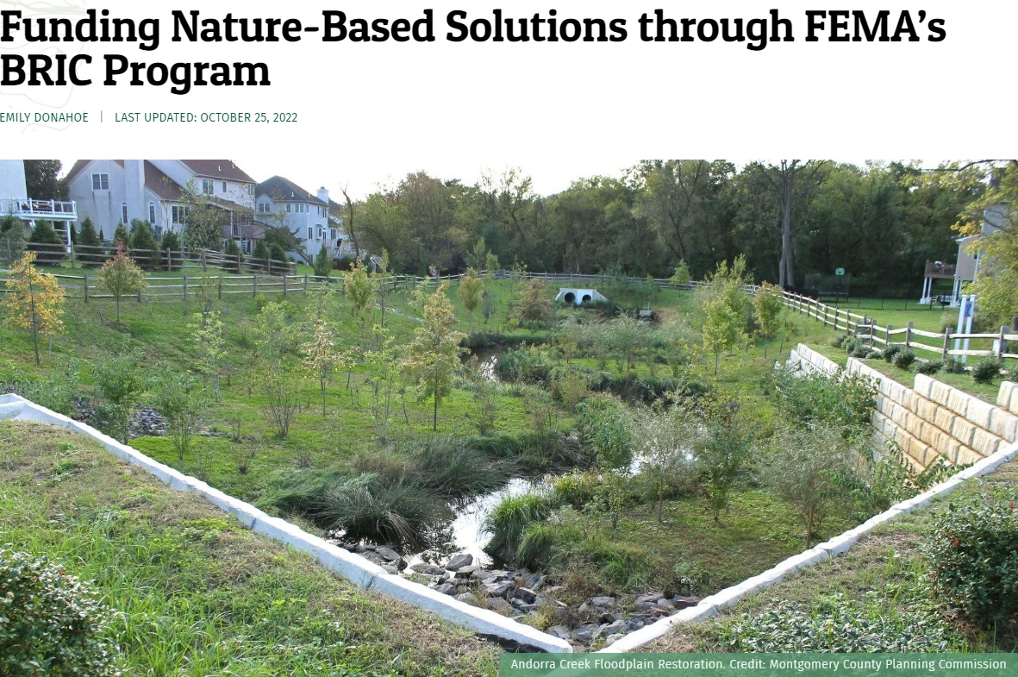
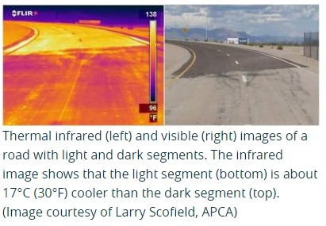
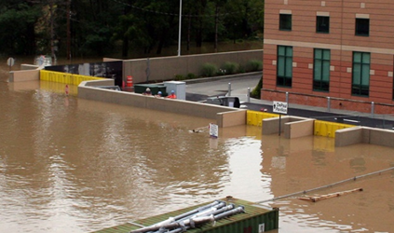
Step 3 – Investigate Options
Bimington New York, 2011, Tropical Storm Lee.
Notes:
At this stage, you want to think about what strategies can actually help reduce the risks you’ve identified in your assessment.
Adaptation and resilient strategies – solve problems
What strategies can be implemented to reduce vulnerability and risk.
There may be multiple strategies to solve the same problem. Also pause to think “what does the community want?” Does the strategy align with community goals, regional plans, public interest, etc.
For example, I recently supported a proposal effort for climate change adaptation and disaster risk reduction for road design and maintenance. Adaptation strategies included soft and hard strategies like using recycled materials for pavement, incorporating carless travel ways for CO2 reduction, and vegetation buffers alongside roadways, as well as, standards for construction equipment, material sourcing.
You hear "adaptation" or "resilience", it's solving the problem. The investigate options piece is not just "hard/engineering solutions".

Slide 28
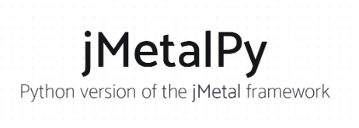
Use multi-objective optimization to develop a project planning schedule

Slide 29
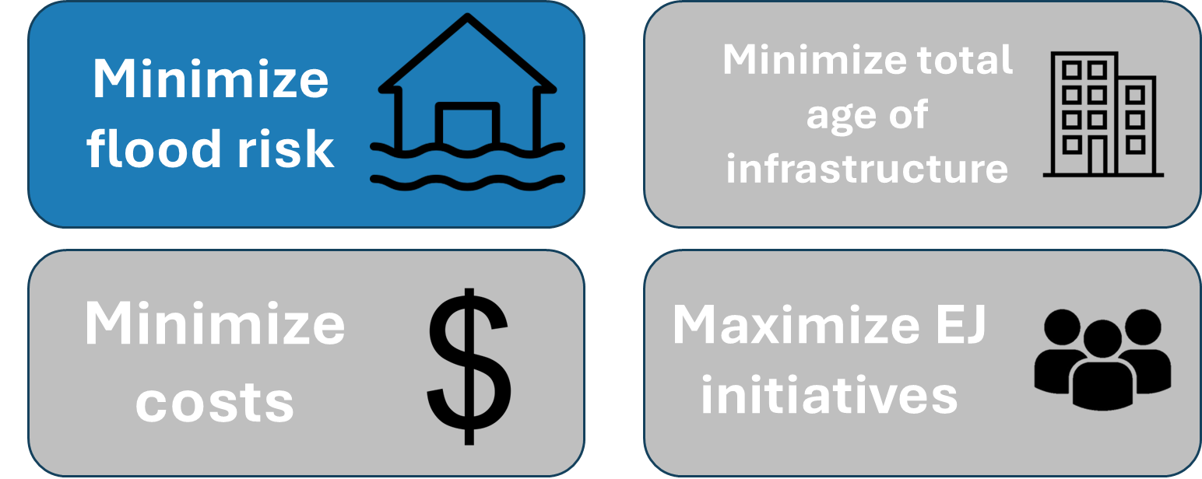
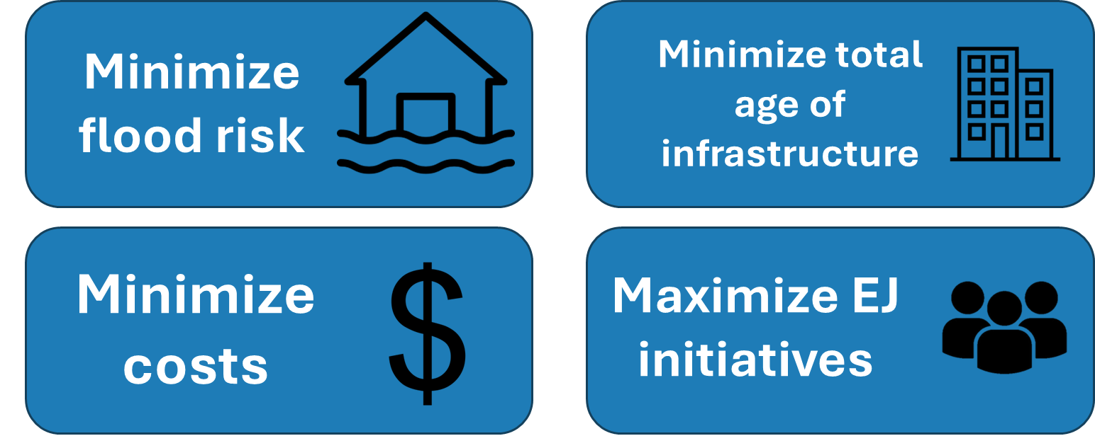
Types of prioritization
Single objective
Multi-objective

