Slide 1
Oklahoma CWSRF Marketing Survey
Presented by Kathy Koon
CIFA-November 1, 2016

Slide 2
Why OK Chose to participate
SFY 2016 was one of our slowest years for the CWSRF
Received some negative feedback about the program we wanted to quantify
Have had positive experiences working with Northbridge on other projects
Wanted to know what our customers really want and where to focus our marketing and incentives
Notes:
Get a check on our program vitals.

Slide 3
Timeline
May 23, 2016
Initial discussion with Northbridge to discuss State’s priorities
June 8, 2016
Received G&O with target audiences and topics to address from Northbridge
July 6, 2016
Received first draft of the survey questions
September 21, 2016
Received final copy of surveys
October 3, 2016
Survey was sent out
October 24, 2016
Received results of survey
Notes:
Had to make the time to invest into this to make it work. To review docs, get contacts, proof survey, run up and down chain.
An initial and two reminder emails went out.
Highlight the delay from July to September
Close out date 21st. State how fast Northbridge got us the results and the info they provided to us.

Slide 4
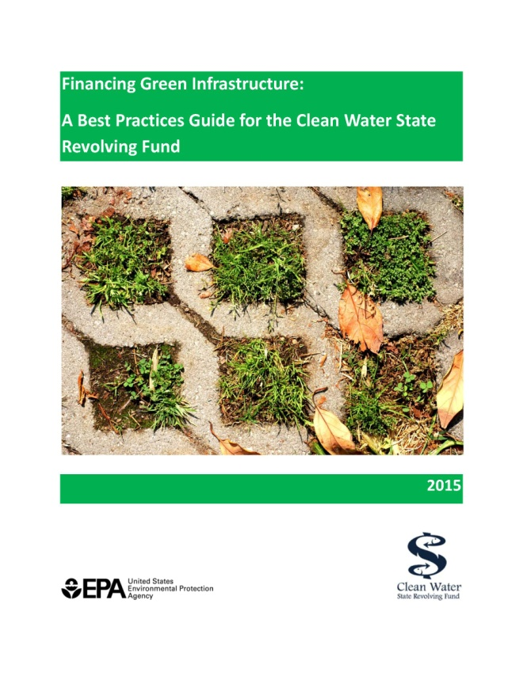
Initial Discussion Topics
State’s priorities
State’s belief in why business is slow
Who to target in survey and what to ask them
What contacts we have
What are our current marketing efforts & what’s working/what’s not
Notes:
States Water for 2060, Stormwater gauge the interest in finance – EPA financing non-traditional.
ARRA amount of financing during this time frame, interest rates so low and can go to local banks for a 15 or less term and costs are comparable if not better b/c of federal requirements.

Slide 5
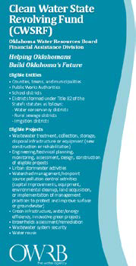
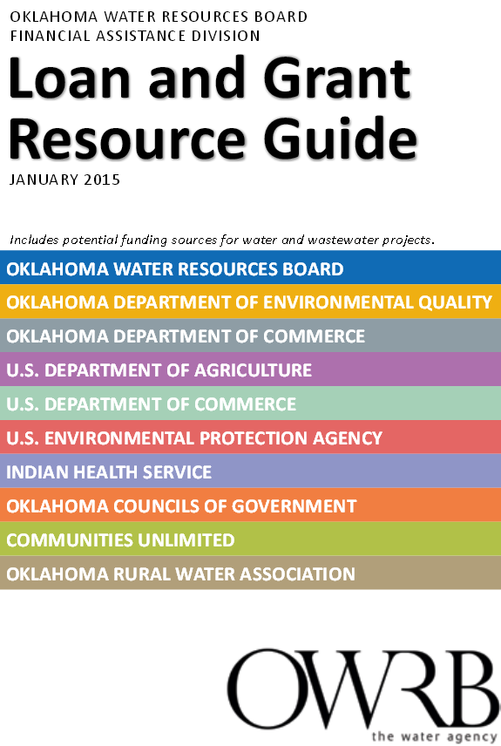
Current Marketing Efforts
Strong presence at conferences with booth/presentations
Twitter/website updates
Email blasts
Printed handouts
FACT meetings
Press Releases
Technical Assistance
Regularly visiting our customers
Trainings on Tools
Publications
Notes:
*Sustainability
Get stats from Charles on Regular visits

Slide 6
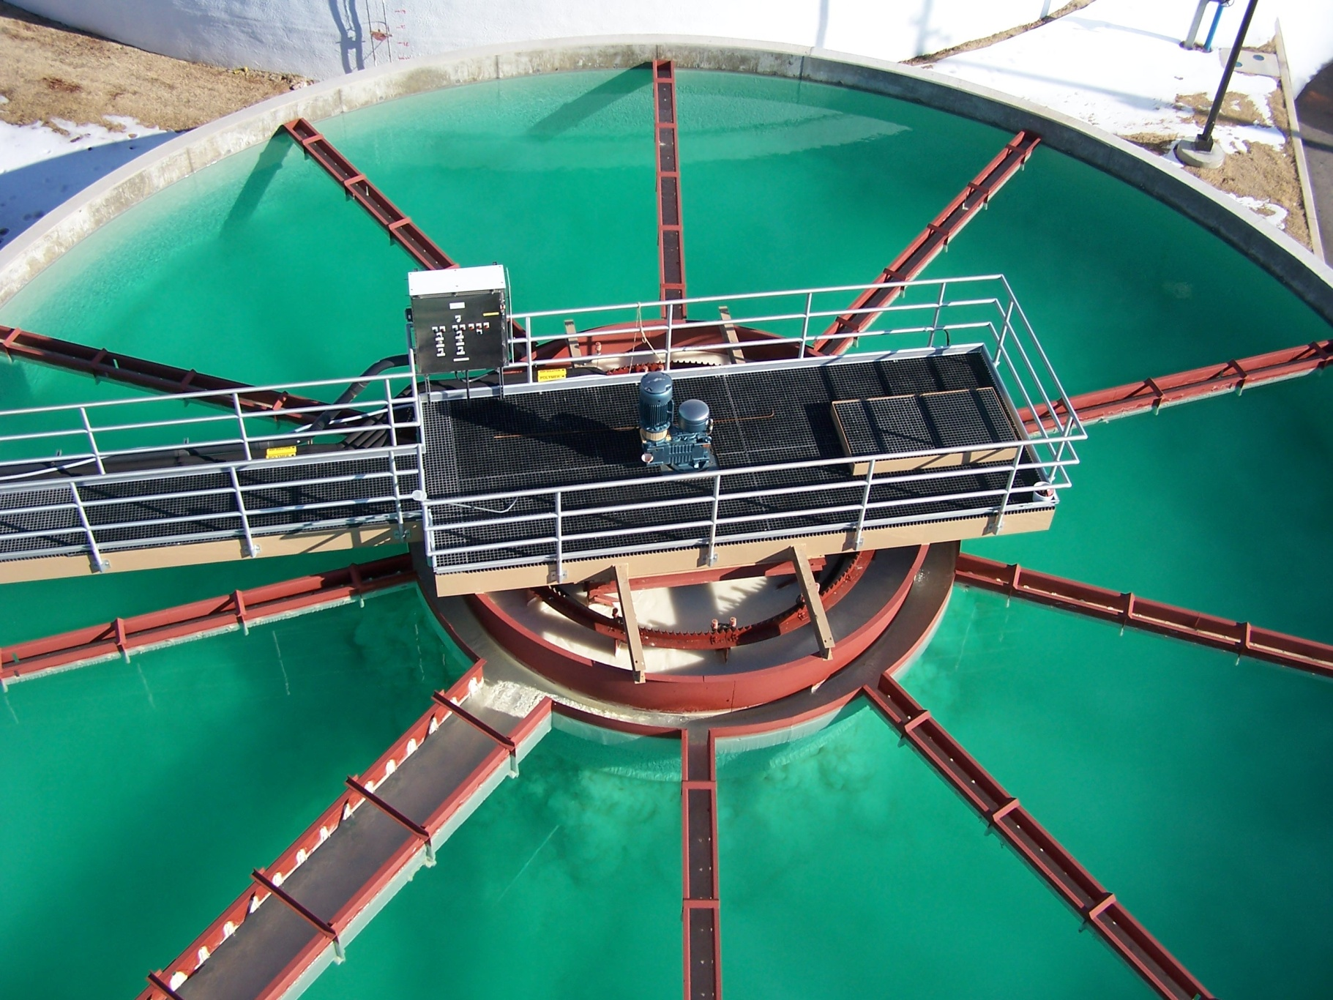
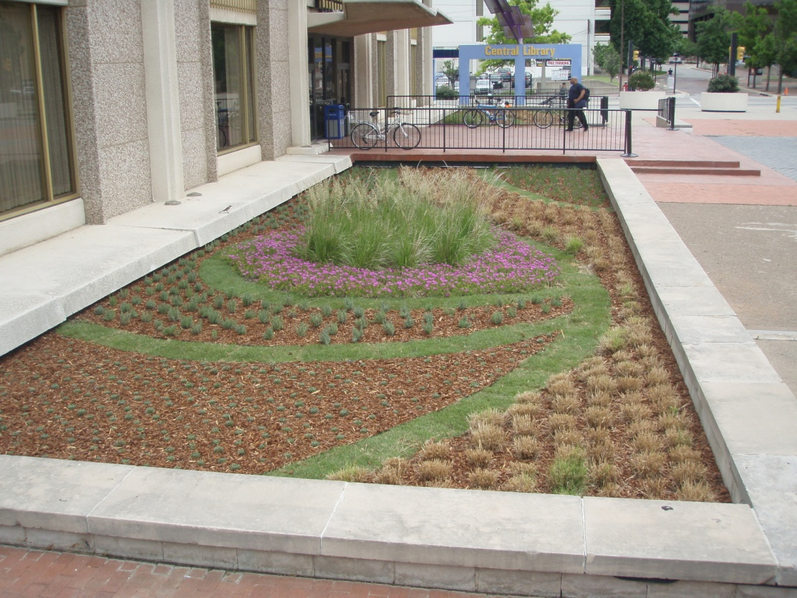
Target Audience
Current and past borrowers
Non-traditional borrowers
Potential borrowers that have not used the program before
Service Providers
Consulting engineers
Financial Advisors
Bond Counsel

Slide 7
Topics Covered
Overall experience with OK CWSRF
Where subsidy should be targeted
Primary reason for selecting/suggesting a funding source
Requirements of the program and how they affect your decision to use the program
Process of the program
Reasons for/against using the CWSRF
Awareness of CWSRF eligibility for non-traditional projects
How they prefer to receive information about the program

Slide 8
Problems Encountered
Other groups unable to share their contacts with us
Solution-Send them survey for them to send out to their contacts
Link was not compatible to all users
Solution-Northbridge sent the word format for them to fill out and NB entered the data for them
This only worked for those that brought the problem to our attention
Change in NB staff and our schedules
Timing of Survey
Notes:
Add in conf. schedules

Slide 9
Experience with Northbridge
NB was a partner, we had to be willing to put in the time to get out of this what we wanted
Prompt and reliable
Asked the right questions
Most delays were due to our staff schedules in order to review information sent to us
Notes:
Had one conference call and they were able to put together the draft survey’s from this initial call. Very impressed with their ability to capture what information we would looking to gather by conducting this survey.

Slide 10
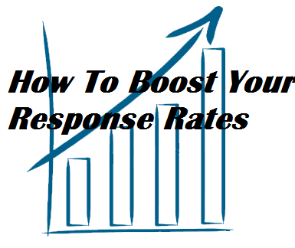
Response Rate
- Lower than we had hoped
Received personal feedback that
individuals were thankful for asking
them to participate
Mentioned in presentations
Constituent | Survey Recipients | Response Rate
Current Borrowers | 500 | 9%
Non-borrowers | 319 | 9%
Nontraditional Entities | 1271 | 11%
Consultants | 130 | 20%
Notes:
Typical range sent out to audience was 10-15% so response rates were a little low. Timing was bad w/ a EPA region 6 stormwater conference the week of October 3rd, and the OK’s Gov Conference Oct 11-12th, and The WateReuse summit October 17-18th. However, it also gave us a chance to ask individuals in person if they wouldn’t mind completing the survey.
Nontradional high. Hit all Conservation districts, NRCS District Conservationists, Stormwater Communities, Certified Floodplain Managers, Other State and Federal Agencies to educate them on opportunities for collaboration.
Focus more on Quality not Quantity.

Slide 11
Results-Current Borrowers:
What funding source(s) did you use for your most recent watershed, stormwater or wastewater project?
Notes:
We have a goal to provide 60% of all water and wastewater financing in the state of Oklahoma. We received comments regarding “made the best sense financially” low interest rate and PF, Speed at which funding was obtained, flexible terms

Slide 12
Results-Current Borrowers:
Rate your experience working with staff during components of the loan process.
Notes:
We wanted to get feed back on how people view us.
“My experience with the staff at OWRB were very good. A lot of good people willing to take the extra step to help in any way.”

Slide 13
Results-Current Borrowers:
Application Forms?
Notes:
Legal Review and Loan closing was viewed as an easy process.

Slide 14
Results-Current Borrowers:
What is your overall impression of the CWSRF program?
Notes:
47% of those that responded said the CWSRF program rates better than other funding sources while another 21% said much better. I think this data helps to also support why when asked if they would use the CWSRF again 74% answered with yes.

Slide 15
Results-Non-Borrowers:
Are you familiar with the Oklahoma Clean Water State Revolving Fund (CWSRF)?
Notes:
Smaller systems or maybe individuals who aren’t working with Financial Service providers. Most in the Non-Borrowers survey were small systems.

Slide 16
Results-Non-Borrowers:
What funding source(s) did you use for your community's most recent watershed, stormwater or wastewater project?
Notes:
Where they go Smaller system like grants or want to try and finance project with what they have on hand and piece meal projects to fix the problems at hand. OWRB has worked to present on Sustainability and Planning guides by partnering with OK Rural Water Association.
49% less than 3,300 and 13% 3,300-10,00

Slide 17
Results-Non-Borrowers:
Which of the following factors would increase your likelihood of applying for CWSRF financing in the future?
4. Lower interest rates
Notes:
2. Combine app with other fed and state funding
Application
Environmental
Engineering
9. Information and Training/Guidance (Hold an annual Grants workshop, started it a couple of year ago)

Slide 18
Results-Non-Borrowers:
Please indicate whether you anticipate funding any of the following project types in the next 1-5 years:
Notes:
8% WQ education and NPS pollution education, Streambank Stabilization & Riparian Zone Protection, SWSupply Protection
Good to know even smaller system are looking at Stormwater and Floodplain project. 49% less than 3,300 and 13% 3,300-10,000

Slide 19
Results-Non-traditional Borrowers:
Are you familiar with the Oklahoma Clean Water State Revolving Fund (CWSRF)?
Notes:
4% A little stumped by this b/c we haven’t really turned anyone down.
We knew going into this survey we needed to expand our outreach for non-traditional type projects. We have presented to Parks and Rec, Forestery and Agricultural groups and to Floodplain and Stormwater Managers at OFMA, Region 6 Stormwater Conference, and educating service providers by sharing Eligibilities paper.

Slide 20
Results-Non-traditional Borrowers: Please indicate whether you anticipate funding any of the following project types in the next 1-5 years:

Slide 21
Results-Consultants:
In the past, why have you chosen not to recommend the CWSRF program to clients?
Project not eligible
Notes:
Feedback from other consultants and service providers
Other- Comment was primarily work on grants. Bond Counsel- Don’t make recommendations that’s the FA’s role.
Time to receive

Slide 22
Results-Consultants:
Please tell us how we can make our program better. Which of the following, if implemented by the CWSRF, would make you more likely to recommend it in the future?
Financial Assistance for P&D
Notes:
14% Assistance in completing key requirements
12% Incentive to offset costs of key requirements
7% Guidance/Training on the application process
14% Financial Assistance for Planning and Design

Slide 23
What we do well
Customer satisfaction levels are high among existing borrowers and consultants we work with
“Good” Experience
“Easy to work with”
Oklahoma’s CWSRF compares favorably to other federal and state funding sources
Notes:
77% of borrowers would come back
85% of consultants have an overall positive perception of the program
If it’s not broke don’t’ fix it. Repeat business sometimes the best business, and based on comment Service provides provide input can weigh heavily on where communities go for financing.

Slide 24
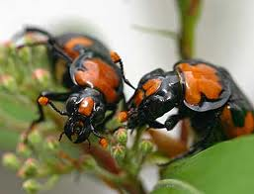
Things that are out our control
Consultants found AIS, Environmental Review and DBE process to be most challenging
Highlight DBE process during pre-bid conference
Conduct Environmental review in house or with outside agency
Notes:
Comment received “With bank interest rates as low as 2%, the Davis Bacon rule and environmental requirements tend to make it more difficult to justify the use of federal funds. “
Eliminate in-house redtape
Take pictures for borrowers and document SHPO requirements

Slide 25
Where we can improve/change
Application process “moderately challenging”
L1 Pre-Application
PPL Questionnaire
Legal Covenants
Ad Valorem
Building Permits
Notes:
We have considered dropping L1- Pre Application requirement and role in letters of incorporation into PPL process
Legal Covenants of restrictions for sales tax and utility revenue obligations: Only require for revenues being pledged
Ad Valorem on 10 highest assessed value. Reduce from four years to one or two
Banks may not require building permits. And permits don’t always provide the best indications of where an applicant is financially.

Slide 26
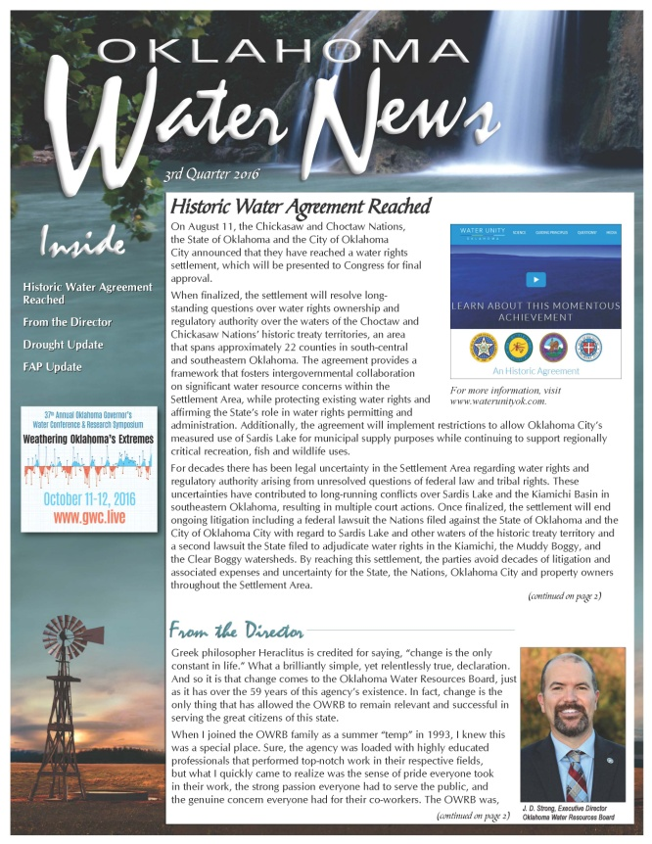
Where we can improve/change
Application process “moderately challenging”
Direct portion of subsidy toward entities of 3,300 or less
Environmental Review
Give presentations at City Council meetings
Oklahoma Water News Quarterly Reports
Notes:
Coordinate in-house with Information Services staff to contact entities about being added to Oklahoma Water News Quarterly Reports
34% City Council and 25% said City manager makes decision on funding sources

Slide 27
Where we go from here…
Application process “moderately challenging”
Find another word for “principal forgiveness” & “additional subsidy” without using the “G” word
Identify a focus group to get deeper into the specific issues raised
One-on-one follow up
Develop marketing plan
Streamlining Efforts
Planning and Design Loans
Notes:
Only ask for necessary information, don’t ask for things multiple times,
24% want email newsletter and 20% said workshop or conferences to learn or obtain more info about our Program
Talk about Email notifications that we send out.
“Keep doing what is being done. Well run program.”

Slide 28
Kathy Koon
Questions?
Project Officer, Financial Assistance Division
Kathy.koon@owrb.ok.gov
Oklahoma Water Resources Board
3800 North Classen Boulevard
Oklahoma City, OK 73118
Phone: 405.530.8800
Fax: 405.530.8898

