Slide 1
Oregon Clean Water State Revolving Fund
State SRF Streamlining
October 30, 2017
Council of Infrastructure Finance Authorities
Indianapolis IN
Anita Yap | Oregon Department of Environmental Quality

Slide 2
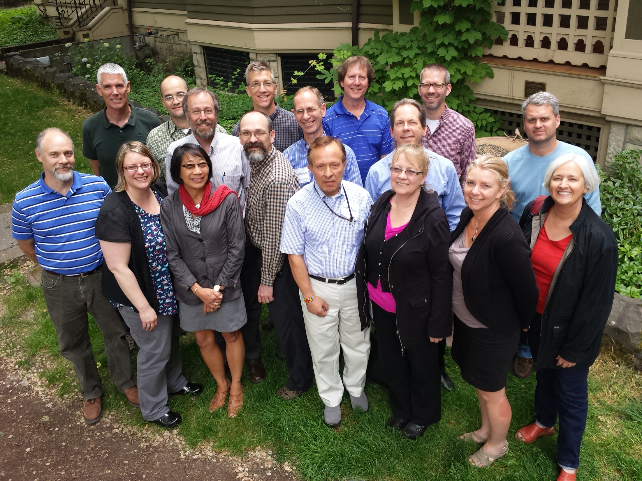
Anita Yap | Oregon Department of Environmental Quality
Notes:
I want to give you a brief background about our program and our state:
Oregon’s CWSRF program is administered through Oregon DEQ. We have approximately 15 full time staff
Five HQ program
Four project officers in three regions
Two circuit riders in regions
2 wastewater engineers
3 PT managers in each region.
Oregon’s population is approximately 4.1 million. Portland 644,000
Portland metro region 2.2 million 26 cities 3 counties
CWSRF program since 1990 loaned $1.4 billion to 145 communities

Slide 3
Anita Yap | Oregon Department of Environmental Quality

Slide 4
Anita Yap | Oregon Department of Environmental Quality

Slide 5
Anita Yap | Oregon Department of Environmental Quality

Slide 6
Anita Yap | Oregon Department of Environmental Quality

Slide 7
Anita Yap | Oregon Department of Environmental Quality

Slide 8
Anita Yap | Oregon Department of Environmental Quality

Slide 9
Anita Yap | Oregon Department of Environmental Quality
Notes:
Within our agency, we’ve had quite a few significant changes, including:
3 directors in 3 years
5 out of 8 new leadership changes
EQC five new members
New Governor
In addition to many statewide environmental crisis, including wildfires

Slide 10
Anita Yap | Oregon Department of Environmental Quality
Notes:
So after my first six months on the job, this is how I felt!

Slide 11
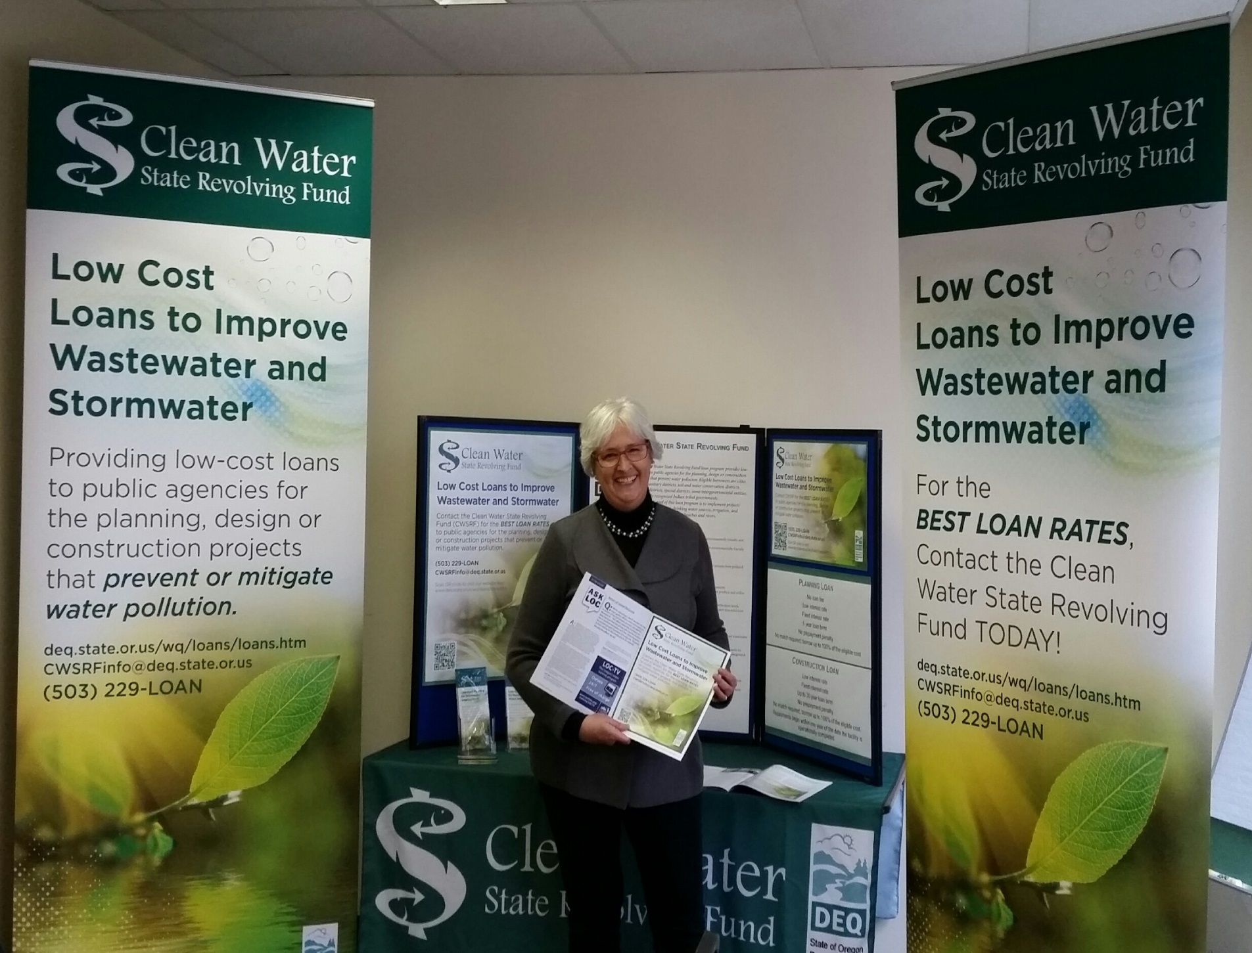
Anita Yap | Oregon Department of Environmental Quality
Notes:
First thing, start marketing,

Slide 12
Program Planning & Implementation
Internal Program Review 2015
Marketing Plan 2016
Strategic Plan 2016
Management Study 2017
Loan Software Procurement 2017
Implementation Actions 2015 +
Anita Yap | Oregon Department of Environmental Quality
Notes:
Then start planning
Internal program review. Conducted by a senior staff
Marketing plan developed by program staff
Strategic plan, three years to bring issues to table and build trust
Northbridge Management study to strategically focus and resource
Loan software procurement, state agency procurement rules: stage gate
Current implementation actions and future state.

Slide 13
Program Planning & Implementation
Internal Program Review 2015
Develop program wide goals
Maximize staff resources
Encourage innovative & non-traditional projects
Be responsive to small communities
Improve application process
Increase funding pace
Anita Yap | Oregon Department of Environmental Quality
Notes:
Then start planning
Internal program review. Conducted by a senior staff
Marketing plan developed by program staff
Strategic plan, three years to bring issues to table and build trust
Northbridge Management study to strategically focus and resource
Loan software procurement, state agency procurement rules: stage gate
Current implementation actions and future state.

Slide 14
Program Planning & Implementation
Marketing Plan 2016
Marketing strategy
Existing markets
Developing markets
Emerging markets
Speculative markets
Tasks, Tactics and Tools
Priorities by markets
EPA Work Group: Surveys & Focus Group 2017
Anita Yap | Oregon Department of Environmental Quality
Notes:
Then start planning
Internal program review. Conducted by a senior staff
Marketing plan developed by program staff
Strategic plan, three years to bring issues to table and build trust
Northbridge Management study to strategically focus and resource
Loan software procurement, state agency procurement rules: stage gate
Current implementation actions and future state.

Slide 15
Program Planning & Implementation
Strategic Plan 2016
Goals, Objectives & Action items
Projects
Program
Technical Assistance
Coordination
Anita Yap | Oregon Department of Environmental Quality
Notes:
Then start planning
Internal program review. Conducted by a senior staff
Marketing plan developed by program staff
Strategic plan, three years to bring issues to table and build trust
Northbridge Management study to strategically focus and resource
Loan software procurement, state agency procurement rules: stage gate
Current implementation actions and future state.

Slide 16
Program Planning & Implementation
Management Study 2017
25 Recommendations
Strategic Program Management Options
Organizational and Staffing Options
Streamlining Internal Processes
Strategic Infrastructure Financing Options
Marketing & Outreach
Anita Yap | Oregon Department of Environmental Quality
Notes:
Then start planning
Internal program review. Conducted by a senior staff
Marketing plan developed by program staff
Strategic plan, three years to bring issues to table and build trust
Northbridge Management study to strategically focus and resource
Loan software procurement, state agency procurement rules: stage gate
Current implementation actions and future state.

Slide 17
Program Planning & Implementation
Implementation Actions
Loan Software Procurement
Procedures
Disbursement
Useful life
Environmental Review
Project Status Reports
Website redesign
Internal Controls Checklist
Guides
Applicant Guide to the SERP
Construction Manual
Design Bid Build
Stormwater Manual
Playbooks. Irrigation Districts/Sponsorship options
Succession Planning
Anita Yap | Oregon Department of Environmental Quality
Notes:
Then start planning
Internal program review. Conducted by a senior staff
Marketing plan developed by program staff
Strategic plan, three years to bring issues to table and build trust
Northbridge Management study to strategically focus and resource
Loan software procurement, state agency procurement rules: stage gate
Current implementation actions and future state.

Slide 18
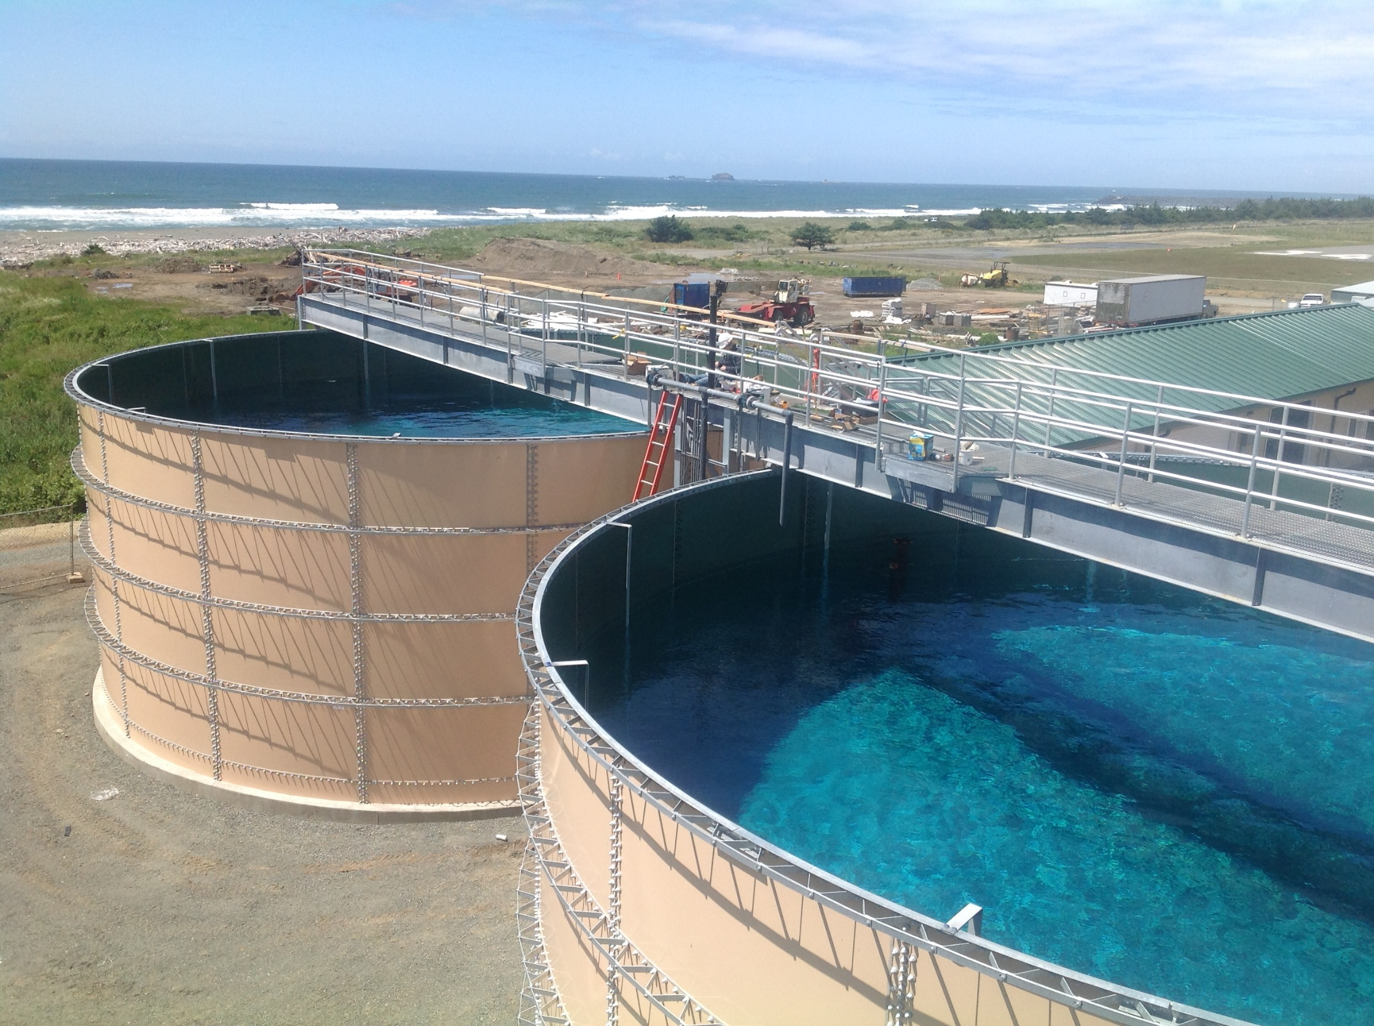
Anita Yap | Oregon Department of Environmental Quality

Slide 19
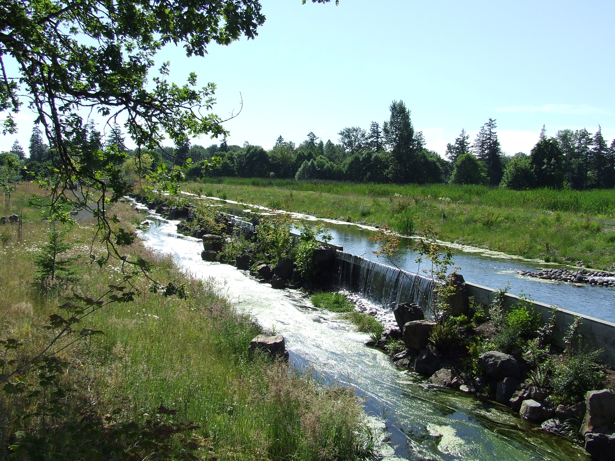
Questions?
Anita Yap
Oregon DEQ
yap.anita@deq.state.or.us
503-229-6896
Anita Yap | Oregon Department of Environmental Quality

Slide 20
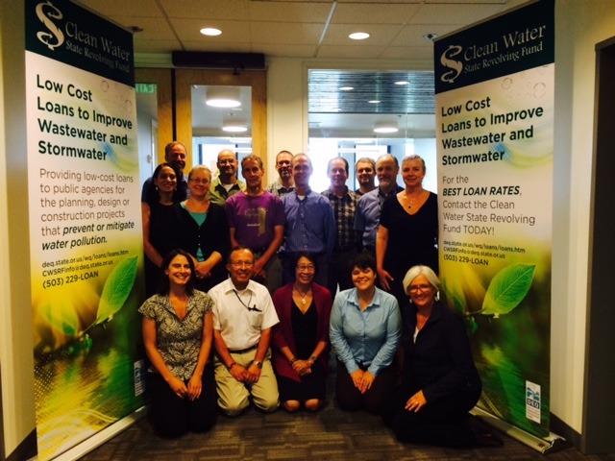
Questions?
Anita Yap
Oregon DEQ
yap.anita@deq.state.or.us
503-229-6896
Anita Yap | Oregon Department of Environmental Quality

Slide 21
Questions?
Anita Yap
Oregon DEQ
yap.anita@deq.state.or.us
503-229-6896
Anita Yap | Oregon Department of Environmental Quality

