Slide 1
Programmatic Financing 2017 CIFA Conference Indianapolis, IN Mark Kellett, Northbridge

Slide 2
Background
Many SRF programs have experienced borrower project delays, rescheduling and cancelations
SRF funding pace and ULO issues can develop:
Where projects are a large part of the year’s funding
When it happens repeatedly
States have taken steps to avoid this problem
Not adding projects to a fundable list until all planning and design is complete
Adding projects to a fundable list after construction has begun
Not signing loan agreements until bids are in
Entering into multi-project funding agreements/commitments

Slide 3
Programmatic Financing
Similar to the way large utilities fund programs through bond issues
Bonds are issued for CIP implementation and not tied to specific projects
With a ProFi loan, funding can go to any eligible project cost from the CIP or a bundle of projects
SRF funds a “program”, not projects
Funding commitment can be for every year or on a schedule (e.g., every other year)
Repayment on each year’s loan begins 1-3 years after the loan (negotiated)
The approach works well for large repeat borrowers
Set an annual loan amount through financial planning and coordination
Large borrowers are more likely to have the resources to prepare a set of projects as SRF programs to include in loan agreement
Approach blends well with muni bond financing used by larger borrowers

Slide 4
ProFi Illustration

Slide 5
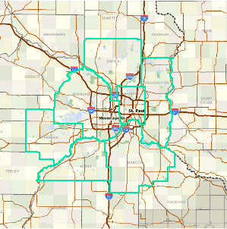
Metropolitan Council of Minnesota (MET Council)
2013 SRF Loan $60,984,748
2014 SRF Loan $60,000,000
2015 SRF Loan $70,000,000
Terms: 20-years at 1.16%
2011 SRF Loan $70,975,000
Notes:
Serving 7 counties and 182 communities within the Minneapolis-St. Paul metro area
Have been using an “Authorized Capital Approach” to financing, which is the same as ProFi. ACP provides multi-year authorization to spend on project costs where funding has been secured and the Council has given final approval to proceed.
MET Council has been using funds provided by the MN SRF program as part of the ACP portfolio successfully for 25 years. Like ProFi, this approach is extremely complimentary when paired with GO bond financing which is the preferred mechanism employed by MET Council.
Interest rate shown is the average interest rate charged over 5 years per CBR data

Slide 6
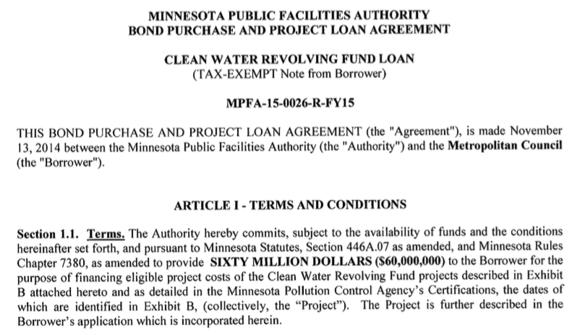
Projects listed in Exhibit B are collectively considered the SRF “Project”

Slide 7
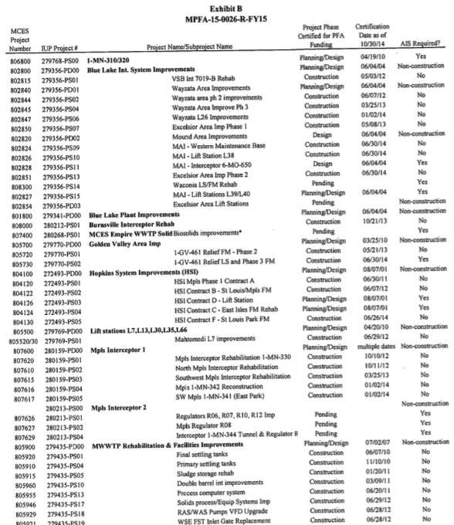
Exhibit B Includes 66 projects from the Met Council CIP

Slide 8
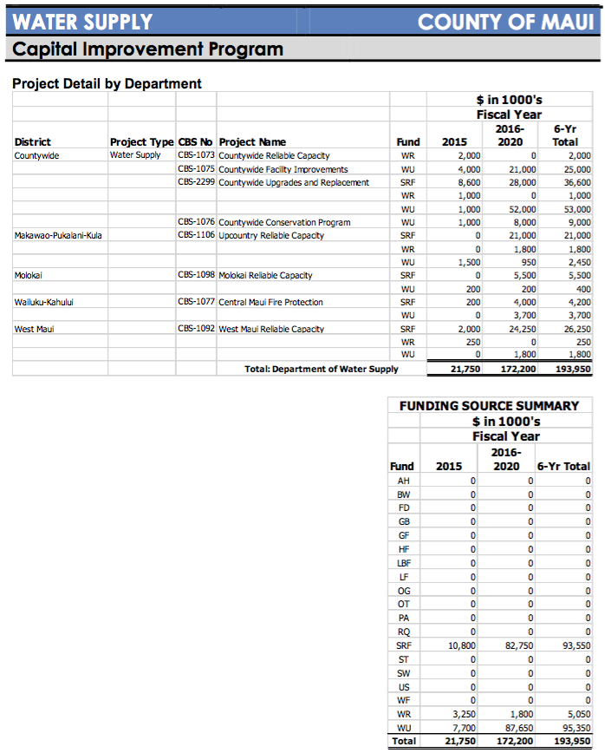
Programmatic Financing requires flexibility in the budget process, to allow any CIP project to receive SRF funds

Slide 9
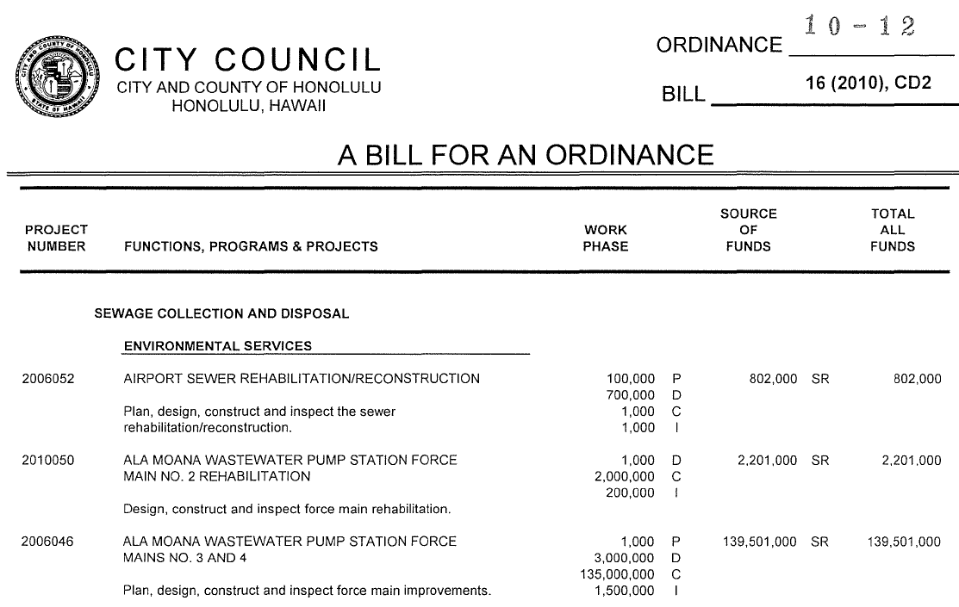
The source of funds is listed as the “SR” Fund Source (Sewer Revenue Improvement Bond Fund, ie., “borrowed money”).
The CWSRF has loaned $40M for the Ala Moana project, but is not identified separately as a fund source in Honolulu’s budget.
Notes:
Here is an example from City/County of Honolulu’s budget. All “borrowed money” is captured by the SR category (Sewer Revenue Improvement Bond Fund). $100M was encumbered from the Sewer Revenue Improvement Bond Fund, and $40M was ultimately funded by the SRF. The SRF was not called out separately as a fund source in Honolulu’s budget.

Slide 10
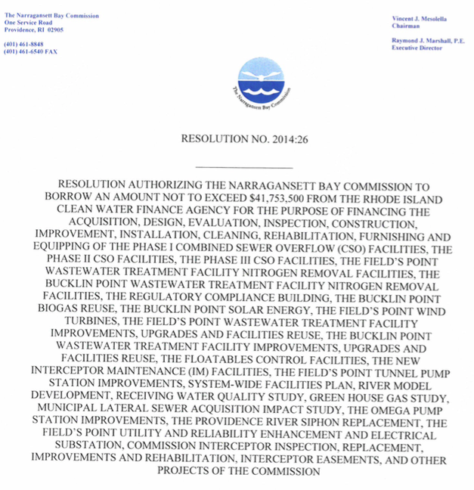
Notes:
This resolution from NBC lists 20-30 projects that may receive SRF funding, and adds in “an other projects of the commission” at the end to allow for maximum flexibility.

Slide 11
Strategic Management of SRF Programs
Use techniques like those being employed by Hawaii, Rhode Island and Minnesota help ensure that funds are going to be used more effectively
But how do states know what they can forward commit?
Financial modeling is required for full strategic cash flow management of SRF programs.
Hawaii is using it’s FOCUS cash flow forecast model to determine how much to commit to ProFi loans with borrowers over the long-term

Slide 13
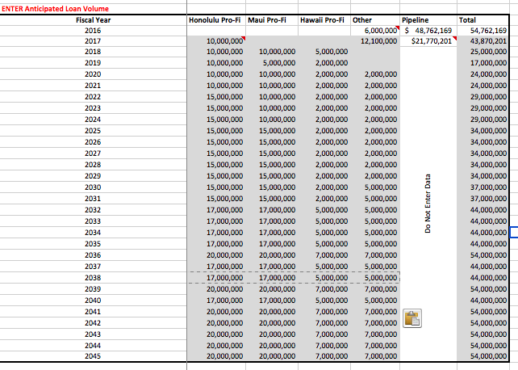
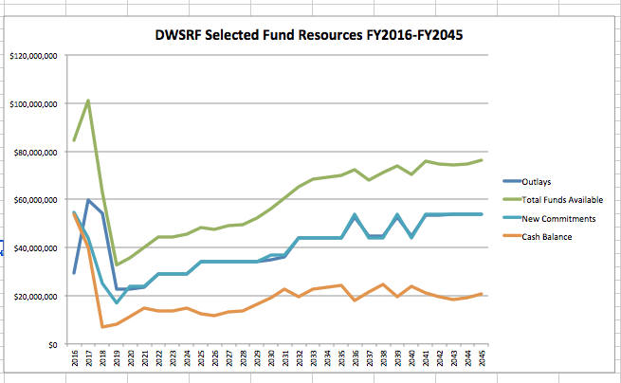
High capacity in early years because state is working through high ULOs

Slide 14
Key Considerations
Best for large, reliable borrower that has continuous CIP construction, a flexible budget process, and is responsive to the CWSRF process (i.e, submits disbursement requests and invoices in a timely manner)
Strong financial modeling capabilities
Ability to allow a more flexible application process (i.e., bundling certain requirements, reports, and certifications)
Ability to execute a loan agreement on a set schedule

Slide 15
Coming out soon…

