Slide 1
Small Communities: Co-funding in Conjunction with Regionalization
in California
James Maughan
CA-State Water Resources Control Board
November 1, 2016
2016 National SRF Workshop
Austin, Texas

Slide 2
Recent Changes to State Program
Clean Water/Drinking Water, primacy, financing, capacity development, are in one department
Streamlining of Drinking Water Application Process
Creation of Office of Sustainable Solutions
Consolidation Bill – SB 88

Slide 3
CA Regulatory Environment
Population | ~ 38.8 million
Population served by Large Water Systems (>1,000 connections) | ~ 38.4 million
Community Water Systems (CWS) | 3,000
Small CWS (>15 connections, <1,000 connections) | 2,300
Non-CWS | 4,500
Total | 7,500 systems

Slide 4
How We are Developing Capacity
Created LEFA
Created OSWS
Partnered with USDA-RD
Contracted with 12 technical assistance providers
Engaged environmental justice groups and non-governmental organizations

Slide 5
Legal Entity Formation Assistance
Pilot program ~$3.3 million (Set-aside funds from 2 CAP yrs)
Program ends in 2017
21 applications received
15 funding agreements executed
As of today; 4 successful entity formations
3 communities choose not to form
3 communities (indiv on wells) agreed to become part of existing PWS

Slide 6
Office of Sustainable Water Solutions
Established March 27, 2015 by AB 92 to serve the drinking water and wastewater needs of disadvantaged communities
3 key functions
PROJECT FUNDING - $1 billion in pending and active drinking water and wastewater projects
FOSTERING PARTNERSHIPS – Co-funding, newsletters and outreach
TECHNICAL ASSISTANCE – unprecedented multidisciplinary scope
Notes:
The Office of Sustainable Water Solutions was created by Assembly Bill 92 on March 27, 2015. OSWS is focused on addressing drinking water and wastewater financial and technical assistance for underserved and vulnerable communities. We now have 23 staff in OSWS.
Staff in OSWS wear many hats, but the activities fall into 3 categories: Project Funding, Fostering Partnerships and Technical Assistance

Slide 7
REACHING OUT TO SMALL COMMUNITIES
Newsletters in Spanish / English
Funding Fairs / Workshops
Non-government organization outreach
Streamline funding – initiated Jan 2015

Slide 8
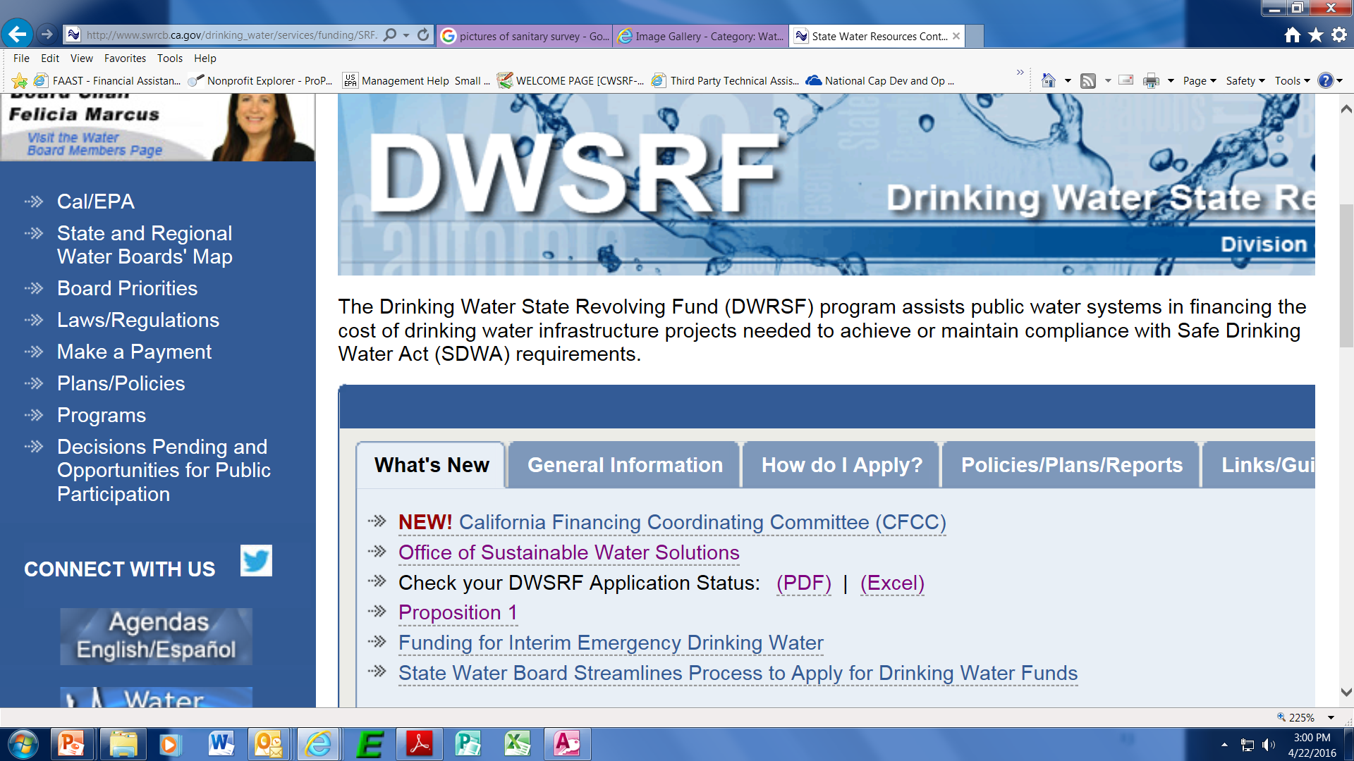
Tools Available Online
Application Status Report
http://www.swrcb.ca.gov/drinking_water/services/funding/SRF.shtml#
Proposition 1 Funded Projects Report

Slide 9
Partnering with USDA-RD
Close working relationship with US Department of Agriculture – Rural Development (USDA-RD)
California Financing Coordinating Committee
6 statewide funding fairs
Exchange project lists and strategize funding

Slide 10
Technical Assistance Providers
California Rural Legal Assistance, Inc.
California Rural Water Association
Community Water Center
Environmental Justice Coalition for Water
Pueblo Unido Community Development Corporation
Rural Community Assistance Corporation
Self-Help Enterprises
Tides Center (for Leadership Counsel for Justice and Accountability)
University of California at Davis
University Enterprises Corporation (at California State University, San Bernardino)
University Enterprises Inc. (at California State University, Sacramento)
Recently received 150 TA request
Website: http://www.waterboards.ca.gov/water_issues/programs/grants_loans/proposition1/tech_asst_funding.shtml

Slide 11
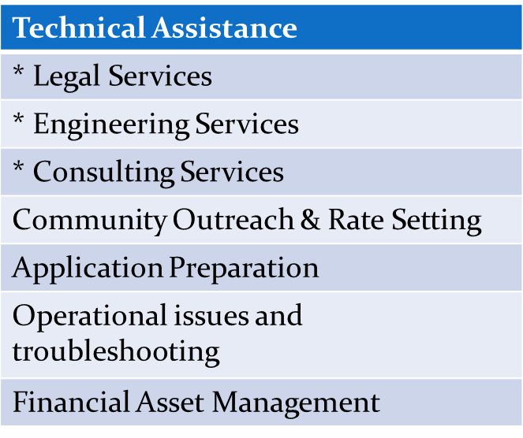
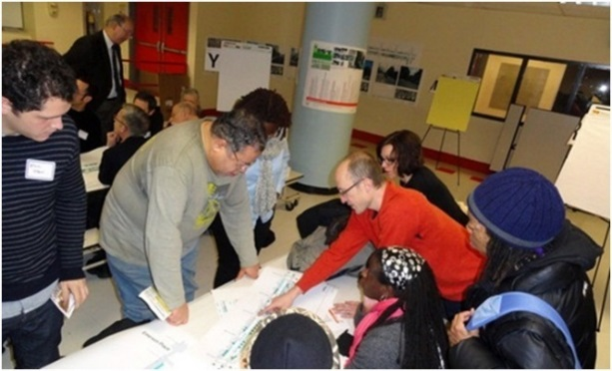
Types of Technical Assistance Available
Notes:
Many communities lack the technical, managerial and financial capacity to apply for funding, construct and operate their systems. So what’s the solution to fill those gaps?
The types of services available vary, but here are the basic categories of help available.

Slide 12
Engaging Non-Governmental Organizations (NGO)
Many NGO focused on water, community development, and environmental justice
Meet periodically to listen to their concerns and provide education/update on programs
Symbiotic relationship to assist communities

Slide 13
Consolidation Bill – SB 88
Gives us the authority to order water system to consolidate:
when PWS consistently fails to provide adequate supply of safe drinking water.
Consolidation can be physical or managerial
Letters are issued to water systems to consolidate with failing system.
Have up to six months from the date of the letter to:
Voluntarily consolidate or supply extension of service
As letters to public water systems are issued, they are made publicly available on our webpage

Slide 14
Consolidation Bill – SB 88 FAQs on website
Why are water systems encouraged to consolidate?
Why is mandatory consolidation being implemented now?
How does the State Water Board approach consolidations?
What liability relief is provided by Senate Bill 88?
What happens if systems do not consolidate after six months?
What is the process for mandatory consolidation?
How will mandatory consolidations be paid for?
How does the State Water Board enforce an order for mandatory consolidation?

Slide 15
Example of Voluntary Consolidation & Non-Voluntary

Slide 16
Semitropic School Consolidation Project
Drinking Water State Revolving Fund, : $631,939
Well exceeds Arsenic, Iron and Antimony Maximum Contaminant Level
Constructed 5,000 feet of pipeline to connect school to Lost Hills Utility District
Installation of backflow preventer and fire hydrants
Cost savings due to reduced operation and maintenance

Slide 17
Semitropic School Consolidation Project

Slide 18
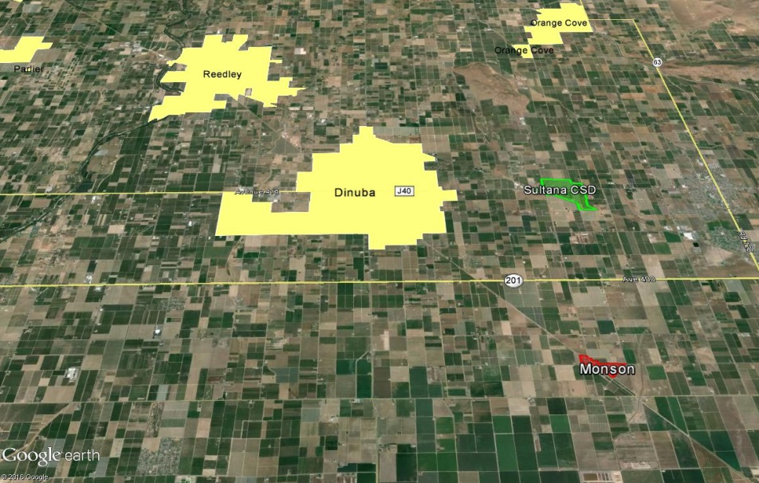
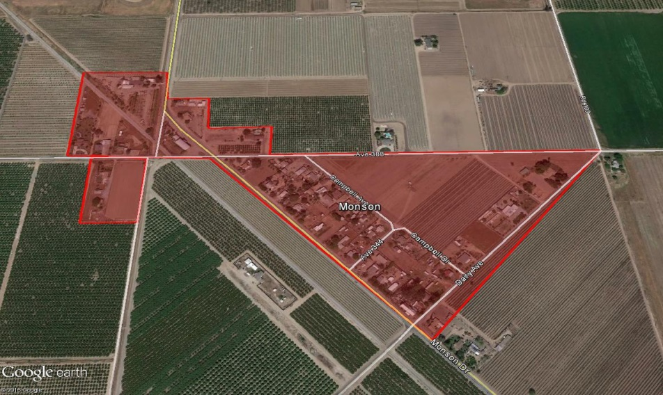
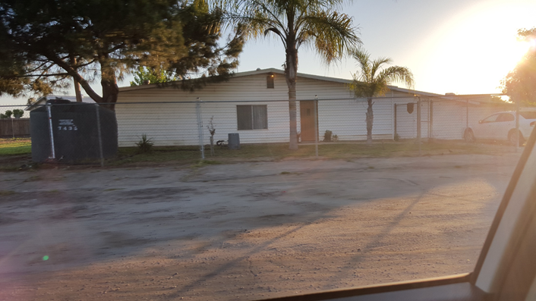
Monson - Ongoing
Unincorporated area ~4 miles south of Sultana CSD
MHI = $15,000
41 homes, 164 people
Private wells with nitrate concentrations above the MCL
Dry wells
Notes:
Monson is an unincorporated community located approximately four miles south of the Sultana Community Services District (Sultana CSD). The community is severely disadvantaged with a MHI of $15,000 and is comprised of approximately 41 homes and 164 people. Domestic water is supplied from private wells, many of which have nitrate concentrations (46-130 ppm) above the maximum contaminant level (MCL) (45 ppm). Additionally, many wells have gone dry due to the drought.
To address the immediate and long term domestic water needs, various sources of funding has been provided. In October of 2013, a DWSRF planning funding agreement in the amount of $180,000 grant with Tulare County. The planning funding was for evaluating possible alternatives for water service and potential governing entities for the Monson community as there is not currently a public water system. A pre-design engineering report containing a summary of alternatives evaluated, proposed layout of a distribution system and projected water rates was prepared. The planning project was completed in April of 2015.

Slide 19
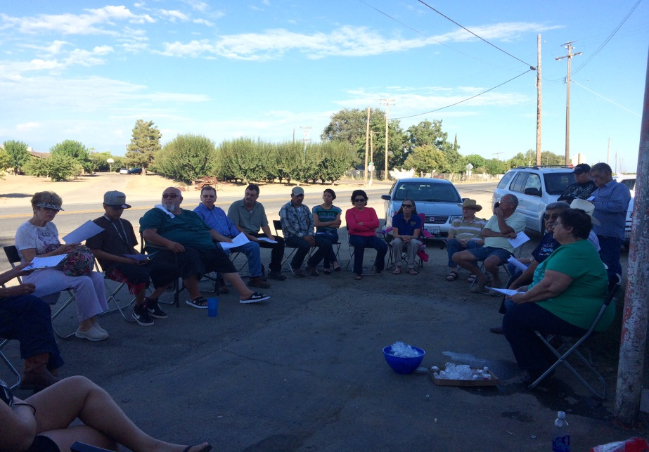
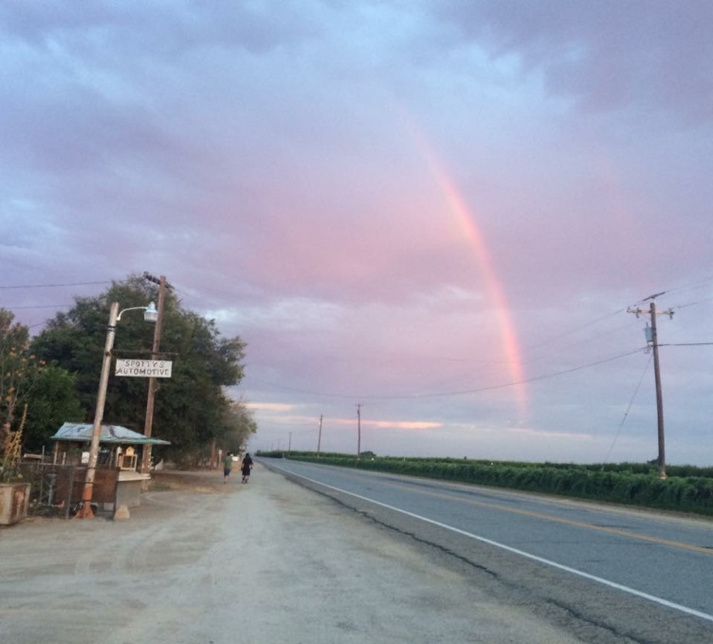
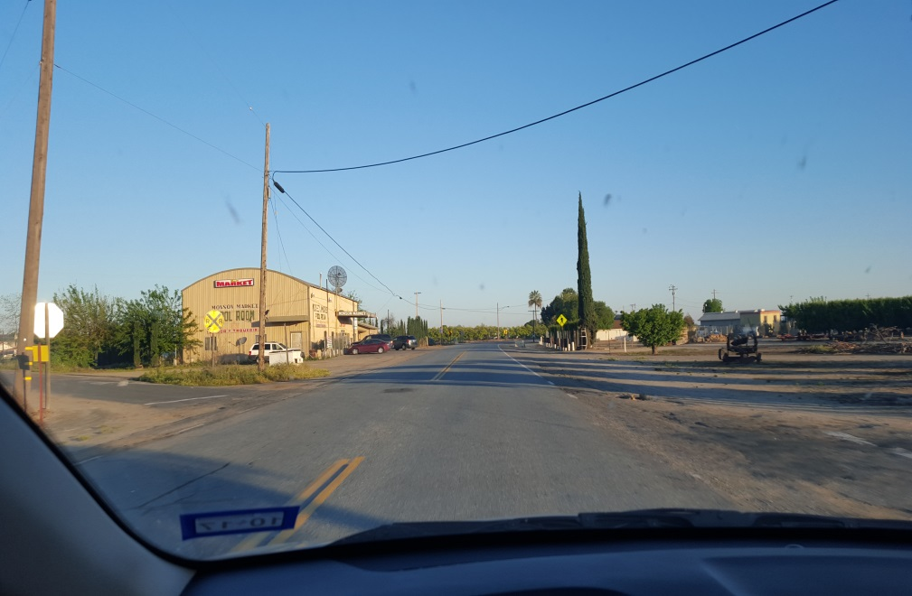
Funding provided:
DWSRF Planning ($180,000)
LEFA ($132,027)
CAA – emergency ($500,000)
Technical Assistance
Long-term solution is extension of service from Sultana CSD and annexation
Notes:
In November of 2015, another grant agreement was given with Tulare County for $132,027 to assist the community in obtaining domestic water service from Sultana approximately 4 miles north of Monson. Public outreach and meetings are currently on-going. The community decided they want to have an Extraterritorial Service Agreement (ESA) with Sultana CSD for water service and move towards full annexation into Sultana CSD’s service area. Tulare County under the LEFA project, is responsible for facilitating the ESA and annexation. Self-Help Enterprises is assisting the County and both are working with Sultana CSD to facilitate the ESA and annexation. Once Sultana CSD has the appropriate legal authorities to provide water service to the Monson community, Sultana CSD is eligible for funding to extend service to the Monson area. The LEFA project is expected to be completed by December 2016.
Under our Technical Assistance set-aside program, we are providing technical assistance via Self-Help, to Sultana CSD for the preparation of a construction funding application for the project to extend service to the community of Monson and for necessary improvements to Sultana’s system to enable provision of water service.
To address the dry wells, DWR, USDA and SWRCB have co-funded an emergency project for the community with Tulare County as the party responsible for the emergency project

Slide 20
Tooleville Mutual Nonprofit Water Association
Community located about 1 mile east of City of Exeter
275 people, 78 service connections
MHI =$34,560
Two nitrate contaminated wells and repeated bacteriological violations in distribution system
Tooleville
Notes:
The Tooleville Mutual Nonprofit Water Association operates a community water system which serves a severely disadvantaged community located approximately one mile east of the City of Exeter. The system’s water supply comes from wells which produce water which exceeds the level for Nitrate. The wells have also experienced repeated bacteriological violations.

Slide 21
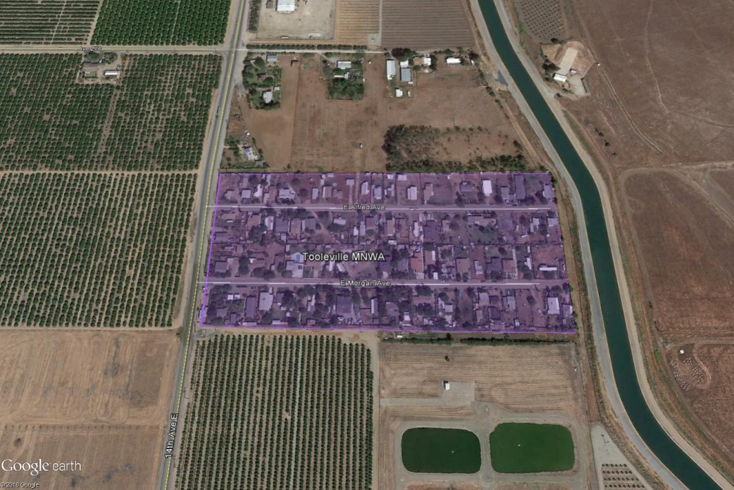
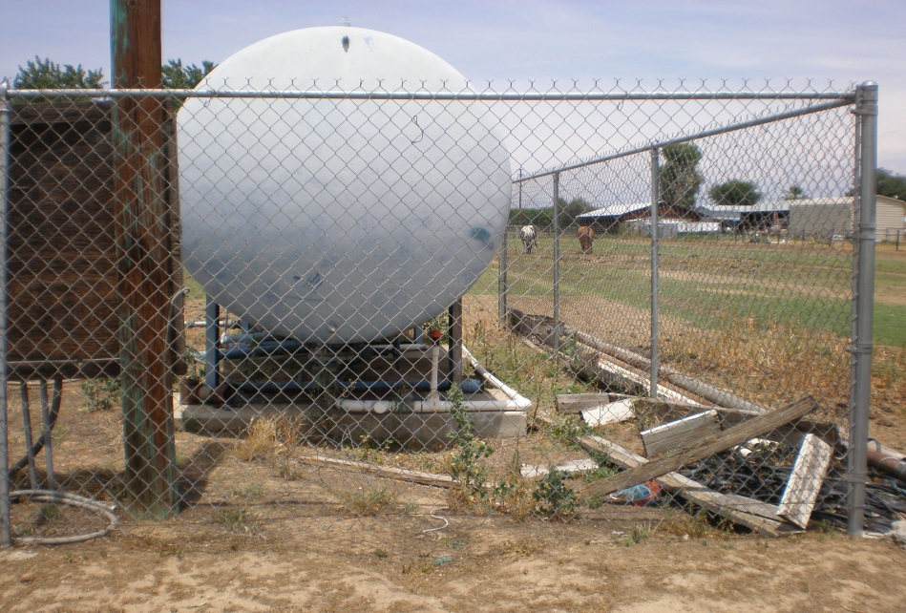
Funding provided:
DWSRF Planning funding ($454,280)
CAA emergency funds ($133,538)for bottled water
Long term solution - new well, storage tank, distribution system and interconnection/ consolidation with City of Exeter
Land/easement acquisition issue
Alfred well
Notes:
In June of 2013, a DWSRF Planning funding agreement for $454,280 in principal forgiveness was executed. The projects includes among other things, a test well, plans and specifications, and environmental for the proposed long-term project to construct a new well, storage tank, distribution system and either consolidation or interconnection with the City of Exeter, with consolidation the preferred option. The planning project also included Point of Use as an interim solution while the long-term solution was developed and constructed; however, POU didn’t turn out to be feasible for the community as it was going to be too difficult for the water system to carry out. Currently residential customers of the water system are receiving bottled water in one gallon containers utilizing CAA funding provided starting in March of 2014.
The planning project has been delayed many times due to the difficulty in obtaining a well site for the test well and subsequent production well. Current negotiations with a property owner have been unsuccessful due to the selling price exceeding the appraised amount. DWSRF and Prop. 1 can only reimburse up to the appraised amount. Anything amount over the appraised amount would have to be covered by Tooleville, funding that they don’t have. Currently the project is delayed until the property issue is resolved. Tooleville is pursuing another property.

Slide 22
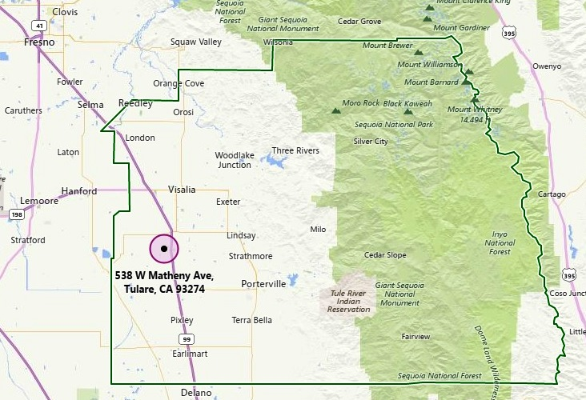
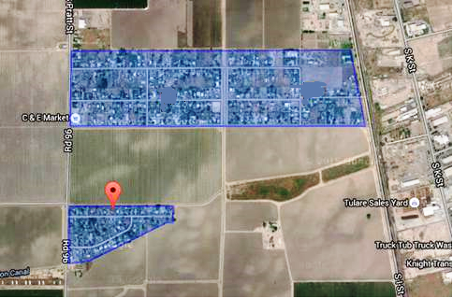
Pratt Mutual Water Company Matheny Tract Safe Drinking Water Project
System Information
Connections: 280
Population: 1,500
Problem
Arsenic contaminated wells
Funding
$486,500 planning
$4.9M construction
Tulare County
Pratt MWC and Matheny Tract
Notes:
Pratt MWC and Matheny Tract exceed the arsenic MCL, many residents purchase bottled water for drinking and cooking. In August 2013 Prop 84 awarded $4.9 million to consolidate to City of Tulare. Project includes installation of approximately 2 miles of pipeline from City of Tulare to Pratt MWC, install water meters and replace Pratt MWC distribution system. Before installation of pipeline City of Tulare agreed to deliver clean water from City Wells and add Matheny Tract residents as metered customers. Then the City of Tulare reneged on their water service agreement over concerns of unexpected system capacity issues and jurisdictional concerns over service connections outside City limits.
City of Tulare entered into Litigation with Pratt MWC and Tulare County - City suggested to change terms of water service agreement recommending to supply water via wholesale having Pratt MWC handle the billing and maintenance, also asked to require the County to form a joint powers agreement so City employees can gain access to the water system in areas of County jurisdiction. County disagreed with City of Tulare’s claims since on Nov. 2010 Tulare County Local Agency Formation Commission approved an Extra Territorial Service Agreement for the City of Tulare to serve Matheny Tract. Matheny Tract is a disadvantage community within Pratt MWC and they opposed wholesaling because of the caveat that the City of Tulare can withhold water service from Matheny Tract particularly in the summer when demand for City water is high. Pratt MWC also preferred for the City to operate and maintain its facilities as originally agreed.

Slide 23
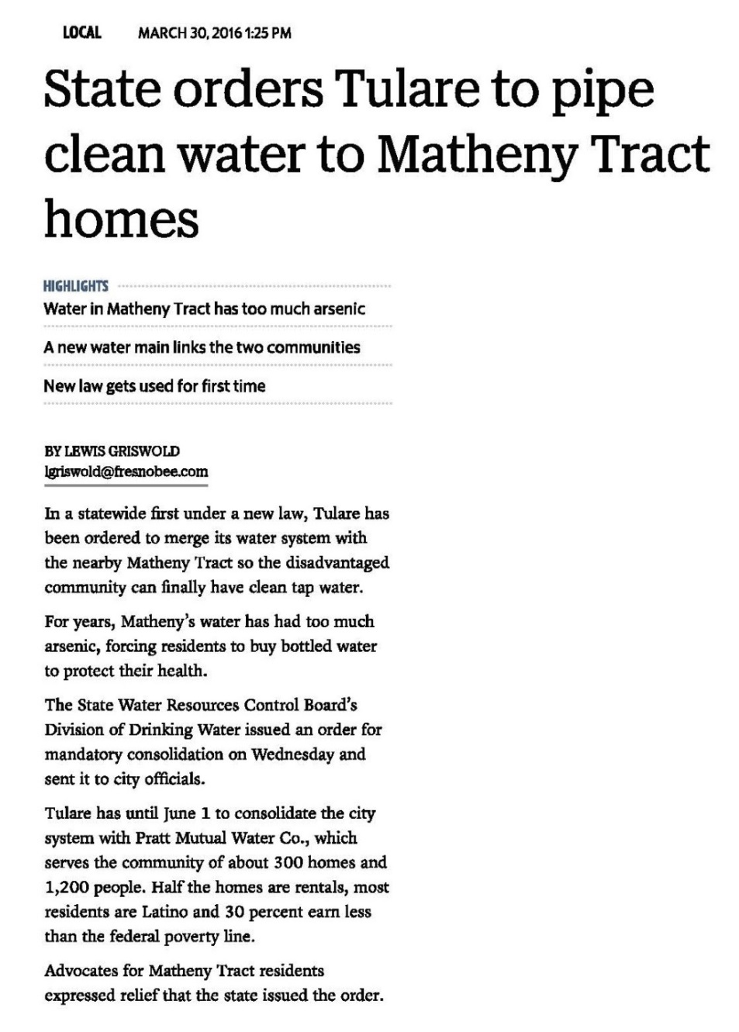
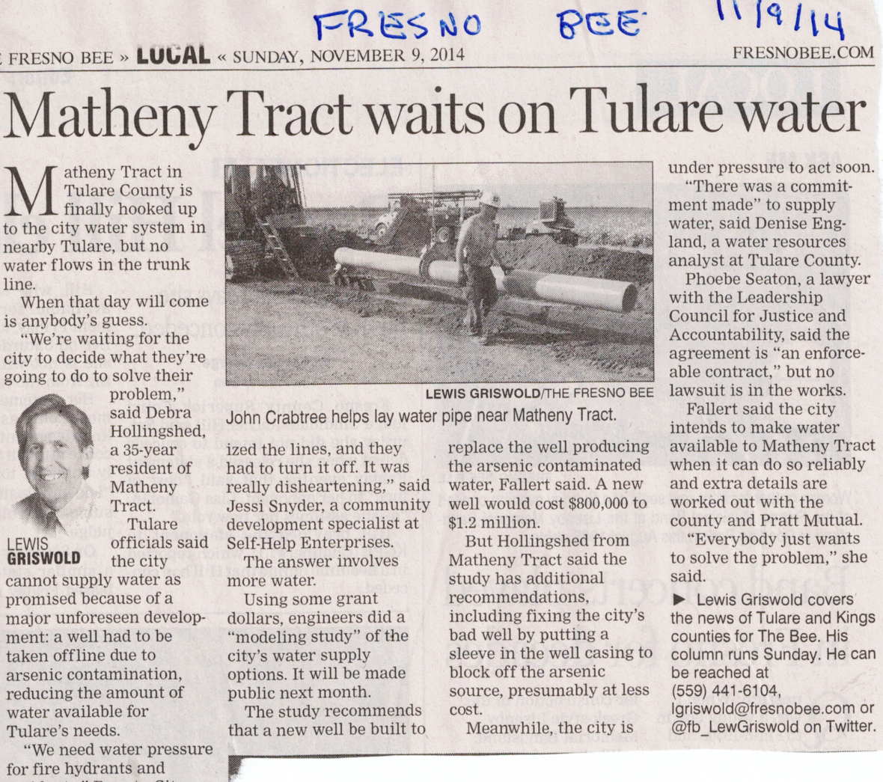
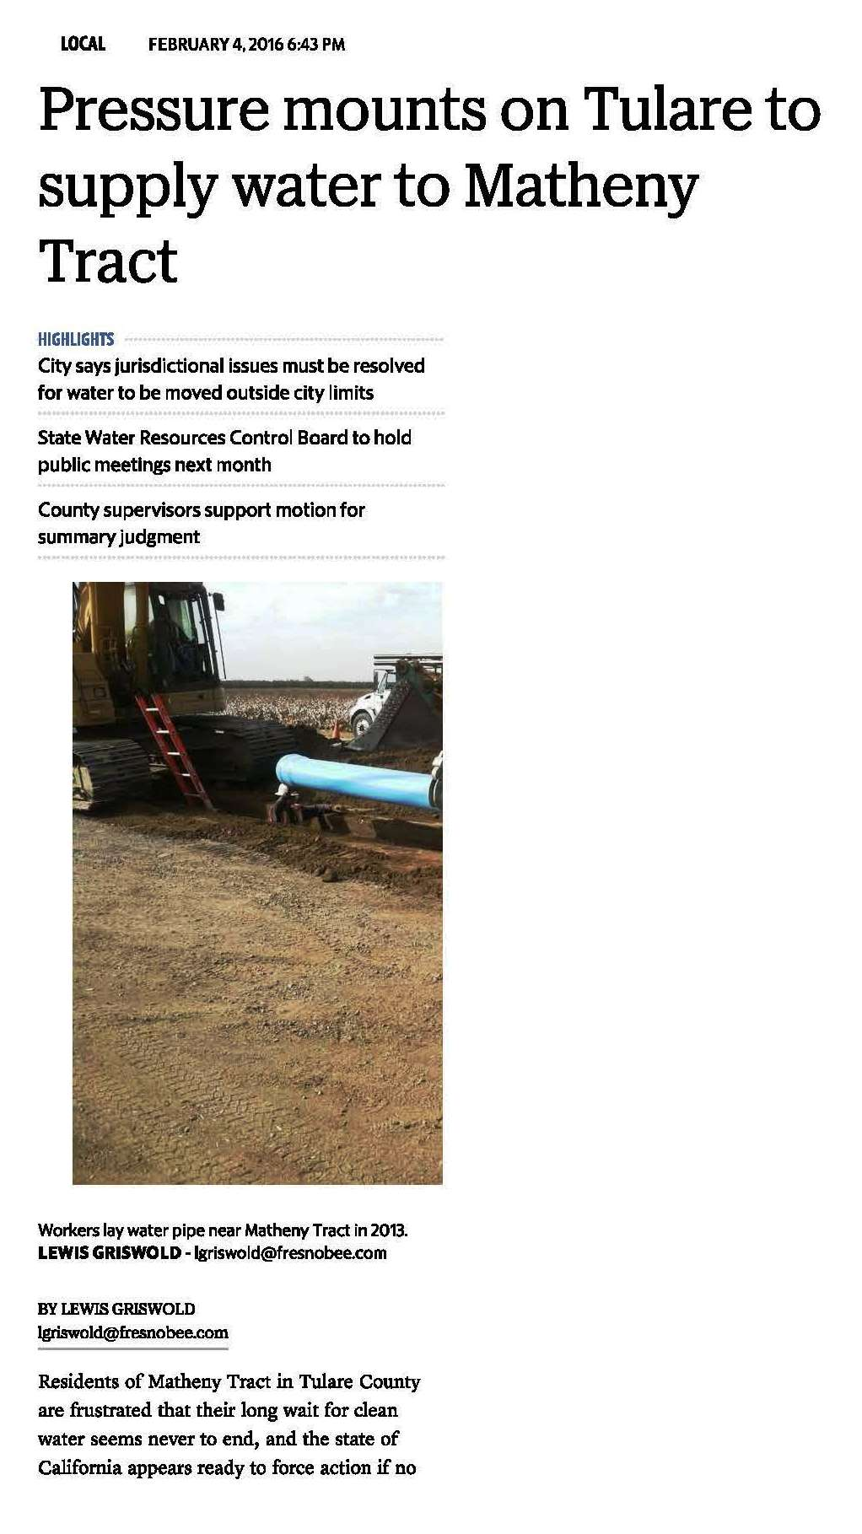
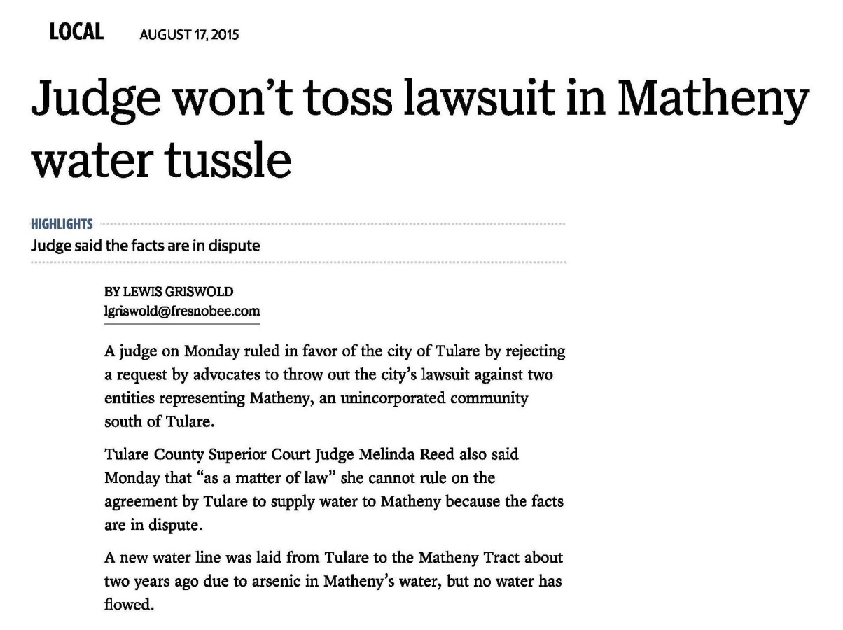
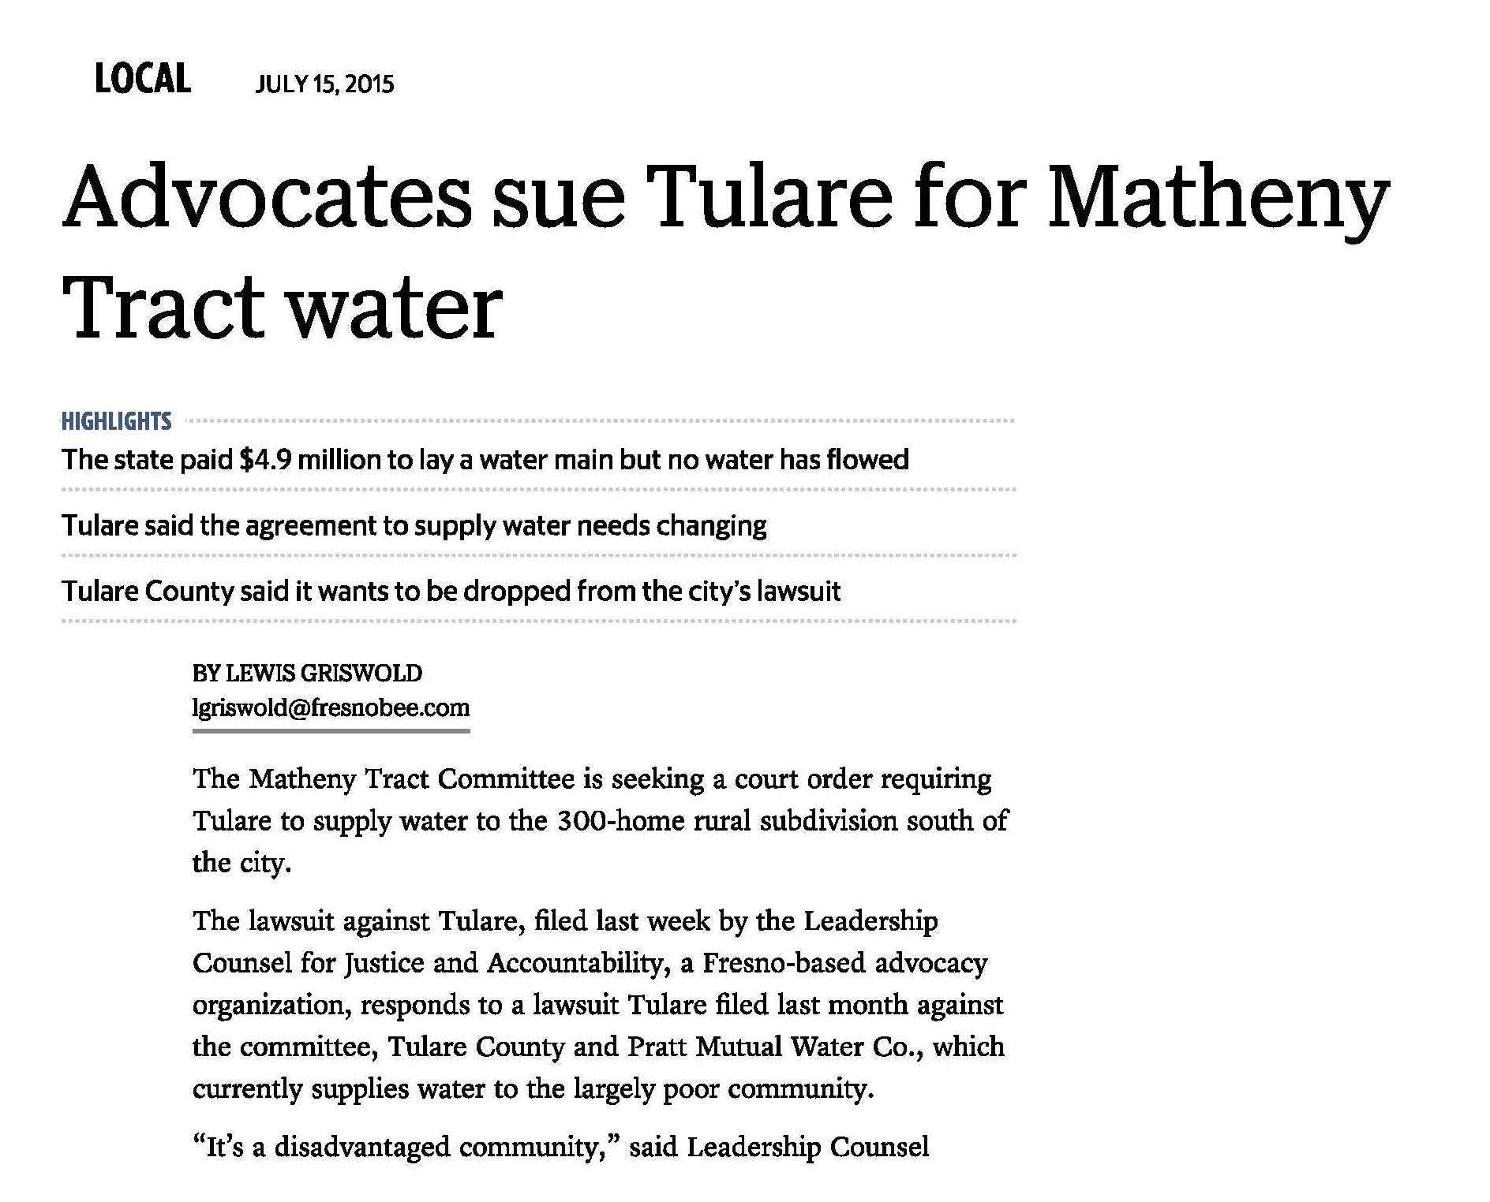
Pratt Mutual Water Company Matheny Tract Safe Drinking Water Project
Notes:
A no voluntary agreement was reached between City of Tulare and Pratt MWC so the SWRCB issued an order for mandatory consolidation under new SB88 law. As part of SB88 two Public Meetings were held for Pratt MWC residents. City of Tulare is now directed to respond by April 15 indicating agreement to comply with the directives of the Order and submit a consolidation plan.
Difficulties
This project has been a local controversy for about 2 years. Since SB88 passed on June 24, 2015 and since both parties (City of Tulare and Pratt MWC) received the mandatory consolidation letters, not only are residents of Pratt MWC relieved that they are closer to receiving clean drinking water but environmental justice groups and surrounding communities, in particular severely disadvantage communities facing similar challenges are watching the progress of this unprecedented action unfold.
Successes
Project construction is mostly complete
Project Status
Installation of pipeline is complete, pending final water meter installations, with estimated project completion in August 2016. SWRCB issued an order for mandatory consolidation under new SB88 law (deadline was April 15, 2016)

Slide 24
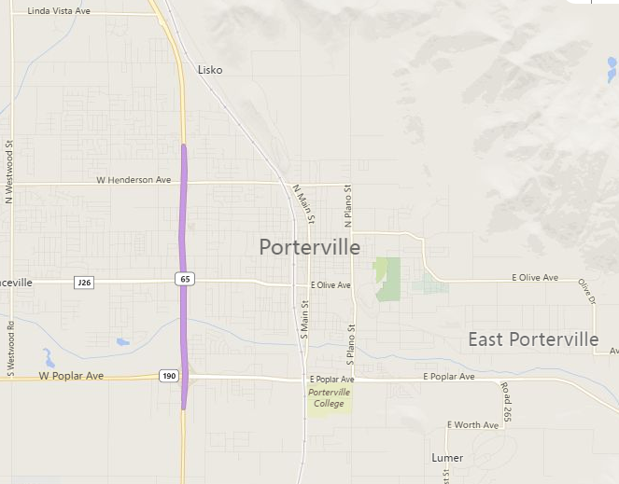
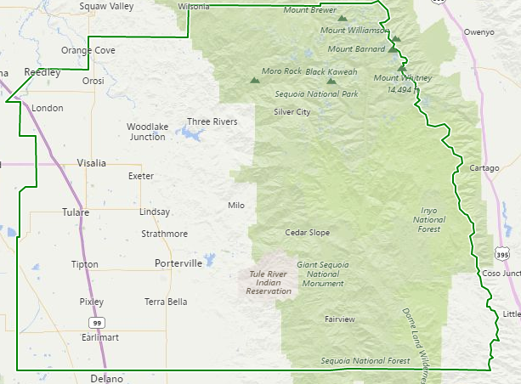
CONSOLIDATIONS WITH THE CITY OF PORTERVILLE
Planning Projects:
Beverly-Grand MWC
Akin Water Company
Funds Committed:
$1,033,527
Notes:
Beverly-Grand Mutual Water Company and Akin Water Company are two water systems in the County of Tulare that are planning to consolidate to the City of Porterville. The groundwater wells for both water systems produce water with nitrate in excess of the nitrate maximum contaminant level (MCL). Since 2011, over $1 million in grant funding has been awarded to both systems to assist them in conducting feasibility studies to meet safe drinking water standards.

Slide 25
CONSOLIDATION OF BEVERLY-GRAND MWC WITH THE CITY OF PORTERVILLE
Planning Project Design Components:
Consolidating pipeline
Distribution system pipe improvements (~2,800 ft)
Production well
Total $ Committed:
$499,050
Beverly-Grand MWC
Beverly-Grand MWC
City of Porterville
Notes:
In January 2012, grant funding in the amount of $113,000 was awarded to Beverly-Grand MWC to conduct a feasibility study to evaluate the consolidation with the City of Porterville. The water system is located next to the north-western side of the City of Porterville’s service area. The water system consists of one active groundwater well, storage tanks, and a distribution system that serves approximately 108 persons through 28 service connections. The feasibility study included developing a preliminary engineering report, consolidation agreement, construction plans and specifications, and environmental documentation. Unfortunately, due to project delays, the funding agreement term expired in July 2013 prior to the completion of the scope of work. The main project delay was attributed to the longer than expected process of Beverly-Grand MWC being annexed to the City of Porterville through the Local Agency Formation Commission (LAFCo). Other delays were also related to the Drinking Water Program being in transition to the SWRCB. The total grant fund was reduced to the actual total expended amount of $25,539.
In April 2016, a second grant in the amount of $473,511 was awarded to Beverly-Grand MWC to conduct a second feasibility study to complete the unfinished scope of work. In addition to the original scope of work, drilling of a test well was included with the intention of finding a site for a new production well to augment the City of Porterville’s ability to serve Beverly-Grand MWC (the location of the test well site is currently unknown). This project is now underway and is expected to complete by October 2017.

Slide 26
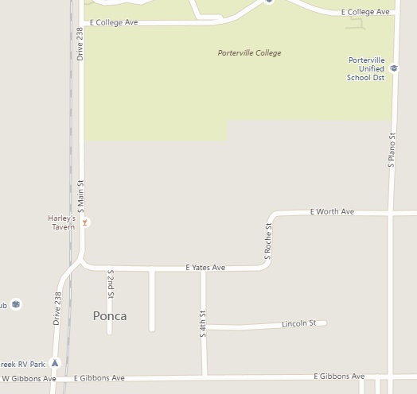
CONSOLIDATION OF AKIN WATER COMPANY WITH THE CITY OF PORTERVILLE
Planning Project Design Components:
Consolidation pipeline (~500 ft)
Distribution system pipe improvements (~1,000 ft)
Production well
Total $ Committed:
$534,477
City of Porterville
- - - Existing
___
Proposed
Akin Water Company
Akin Water Company
Notes:
In June 2011, grant funding in the amount of $91,000 was awarded to Akin Water Company to conduct a feasibility study to evaluate the consolidation with the City of Porterville. The water system is located approximately 1,000-feet south of the City of Porterville’s service area. The water system consists of two active groundwater wells, pressure tanks, and a distribution system that serves approximately 50 persons through 22 service connections. The feasibility study included developing a preliminary engineering report, consolidation agreement, construction plans and specifications, and environmental documentation. Unfortunately, due to project delays, the funding agreement term expired in December 2012 prior to the completion of the scope of work. The main project delay was attributed to the longer than expected process of Akin Water Company being annexed to the City of Porterville through LAFCO. The funding agreement was amended to reflect the actual costs incurred of $19,365.
In January 2014, a second grant in the amount of $470,000 was awarded to Akin Water Company to conduct a second feasibility study to complete the unfinished scope of work. In addition to the original scope of work, drilling of a test well was included with the intention of finding a site for a new production well to augment the City of Porterville’s ability to serve Akin Water Company (the location of the proposed well is within the City’s north-western service area near W Henderson Ave and N Westwood St). This project is near completion and is expected to complete by June 2016.
In August 2015, an emergency oral agreement was approved, awarding Akin Water Company $10,000 in grant funding to address bacteriological contamination problems in their wells. The work was completed by the end of August 2015; unfortunately, the water system continued to experience bacteriological contamination problems. In February 2016, emergency grant funding in the amount of $30,000 was awarded to the City of Porterville to construct an emergency interconnection to the Akin Water Company’s water distribution system. This project is near completion and is expected to complete by June 2016. In March of 2016, grant funding in the amount of $5,112 was awarded to Akin Water Company to cover costs incurred beyond the statutory $10,000 limit in the previous oral agreement.

Slide 27
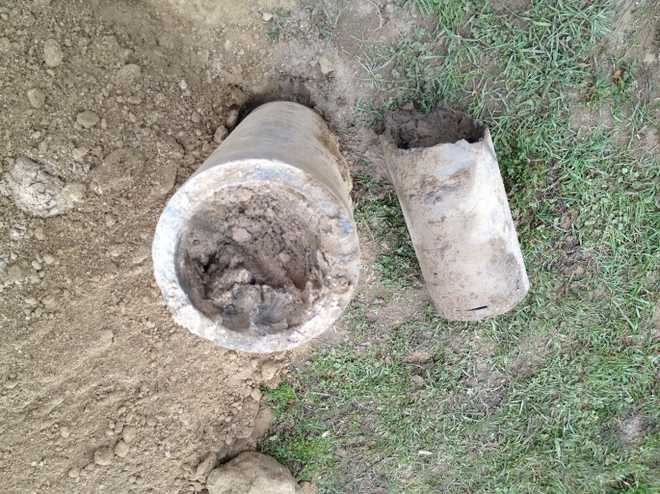
West Goshen Mutual Water Company
Well had Nitrate over the MCL
Wells collapsed and caused severe sand intrusion
Well pumps were destroyed
Several water outages
Longest outage lasted 48 hours
Notes:
West Goshen Mutual Water Company is a small severely disadvantaged community water system that serves approximately 350 residents via 86 service connections. The water system consists of one primary well and one backup well, a 5,000 hydropneumatic tank, and distribution system. Primary well had nitrate over the maximum contaminant level. Both wells, aged over 40 years, collapsed and caused severe sand intrusion which had destroyed the primary well pump and two secondary well pumps. The water system experienced several water outages and the longest one lasted for 48 hours.

Slide 28
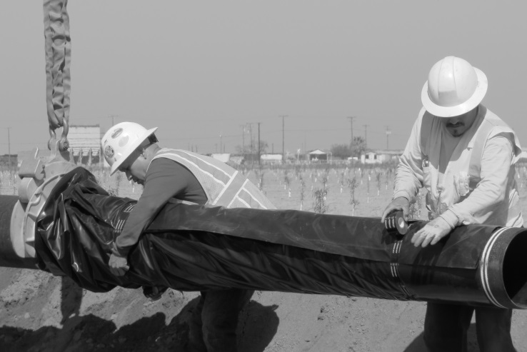
West Goshen Mutual Water Company
$250,000 Grant from Proposition 84
Emergency Intertie with California Water Service Company – Visalia (Cal Water)
$3,000,000 Grant from DWSRF
Consolidate with Cal Water
Notes:
Grant funding from Proposition 84 in the amount of $250,000 to intertie with California Water Service Company – Visalia (Cal Water) for an immediate solution. Approximately 1 mile of pipe running from Road 64 to Road 52 on Avenue 308 and a master meter were installed.
Grant funding from Drinking Water State Revolving Fund in the amount of $3,000,000 to construct new distribution system that meets Cal Water’s standards, then consolidate with Cal Water.
It is anticipated that all customers will be switched to the new distribution by the end of Summer 2016.

Slide 29
Drought and East Porterville
Worst drought on record in the history of State of California
5,000 dry wells throughout California
Approx. 500 dry wells in East Porterville area

Slide 30
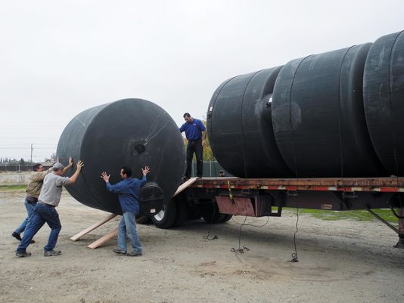
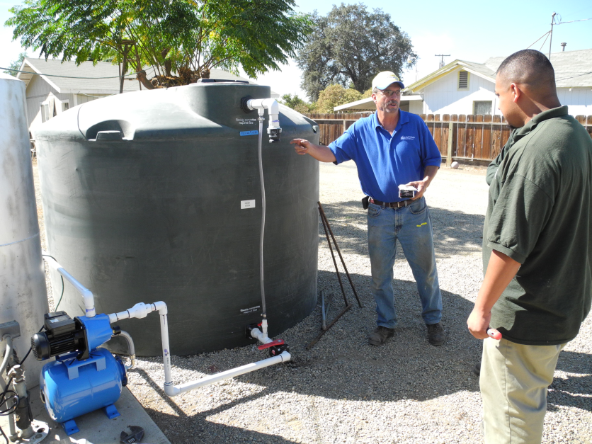
Temporary Assistance Given but Unsustainable
Initial Assistance Given
Household Tank Program
Non-potable Water Tanks
Bottled Water Program

Slide 31
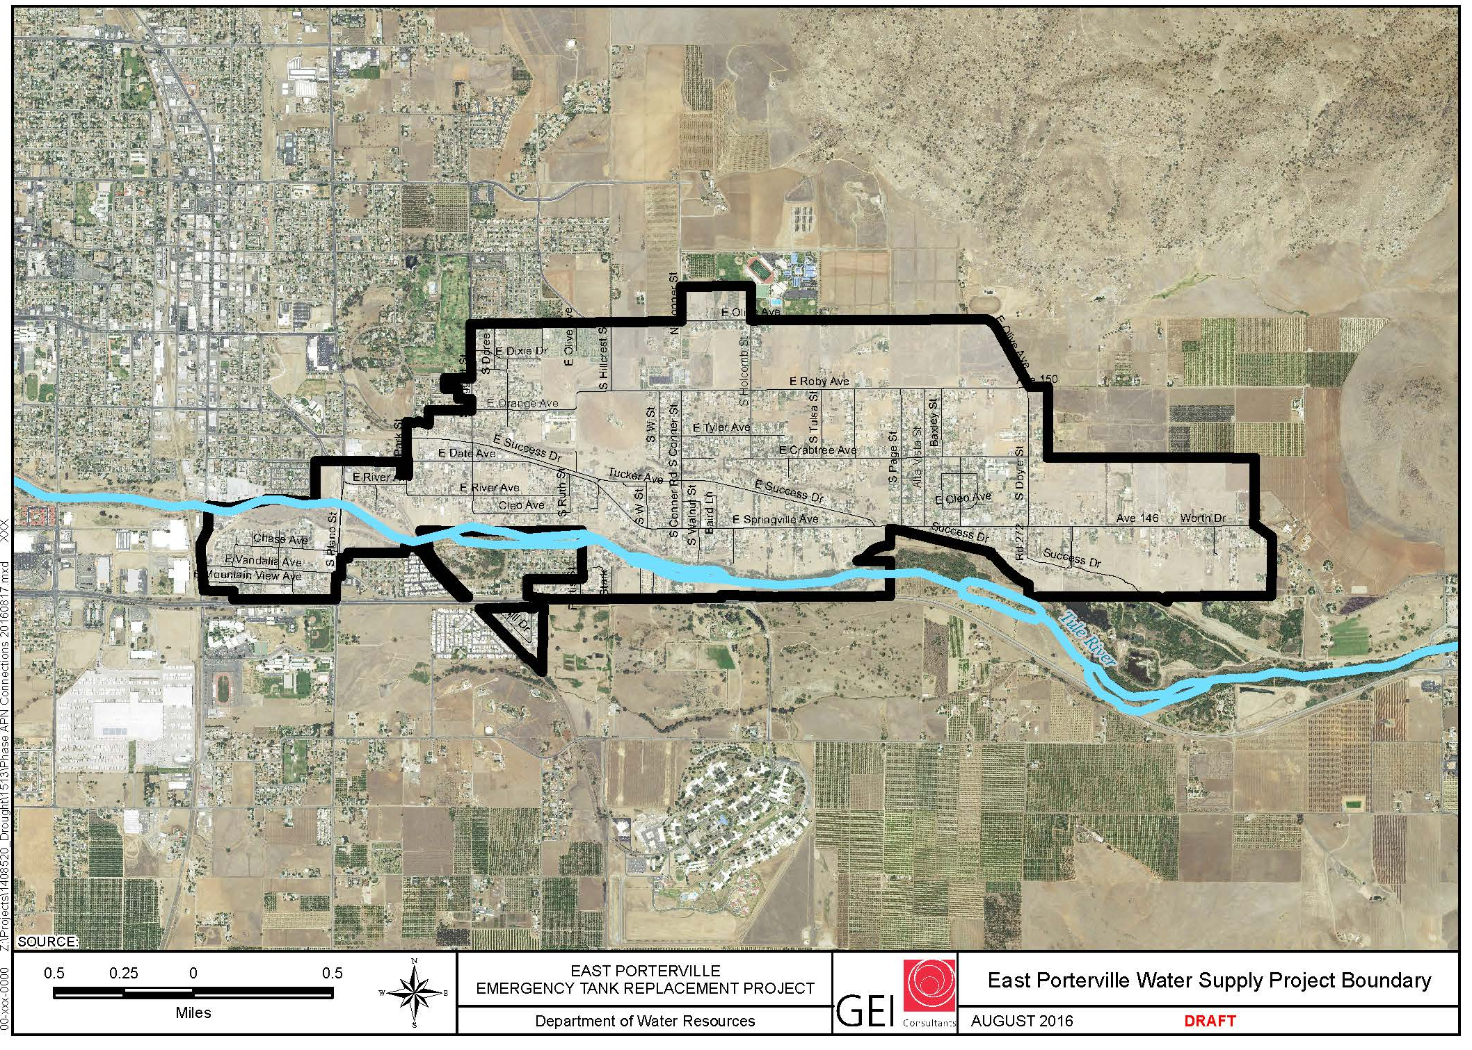
East Porterville Water Supply Project

Slide 32
East Porterville Water Supply Project
Connect residents to City Water System in Two Phases:
Emergency Water Tank Replacement Project (Phase 1)
Converting Well installed 1st as drought fill-station to supply Well of the City
Connect 70 residents to existing City’s supply line they were adjacent to.
Remaining Dry Well residents that consent to connect
Long-term Project (Phase 2)
Remaining residents that consent to connect to the new system

Slide 33
Deal to Drought Stricken Residents
One time only - fully pay for connect to City Water system
Need to disconnect from private well
Need it sign up for service
If don’t take deal have to pay for full connection cost
About 50% acceptance rate
Do not want to give up well
Distrust the City or government

Slide 34
Helpful Links
Technical Assistance and Capacity Development
http://www.waterboards.ca.gov/drinking_water/certlic/drinkingwater/TMF.shtml
OSWS Homepage
http://www.waterboards.ca.gov/water_issues/programs/grants_loans/sustainable_water_solutions/index.shtml
DWSRF Homepage
http://www.waterboards.ca.gov/drinking_water/services/funding/SRF.shtml
State Water Resources Control Board
http://www.waterboards.ca.gov/

Slide 35
Questions & Contact
State Water Resources Control Board
James Maughan
Assistant Deputy Director
(916) 341-5694
James.Maughan@waterboards.ca.gov

