Slide 1
California SRF Policy Adaptations
The Proof of Plan is in the Pipeline
Michael Downey, P.E.
Assistant Deputy Director
Division of Financial Assistance

Slide 2
Content
Funding Demand
Application Process
DWSRF Policy & IUP
Technical Assistance
Marketing & Outreach

Slide 3
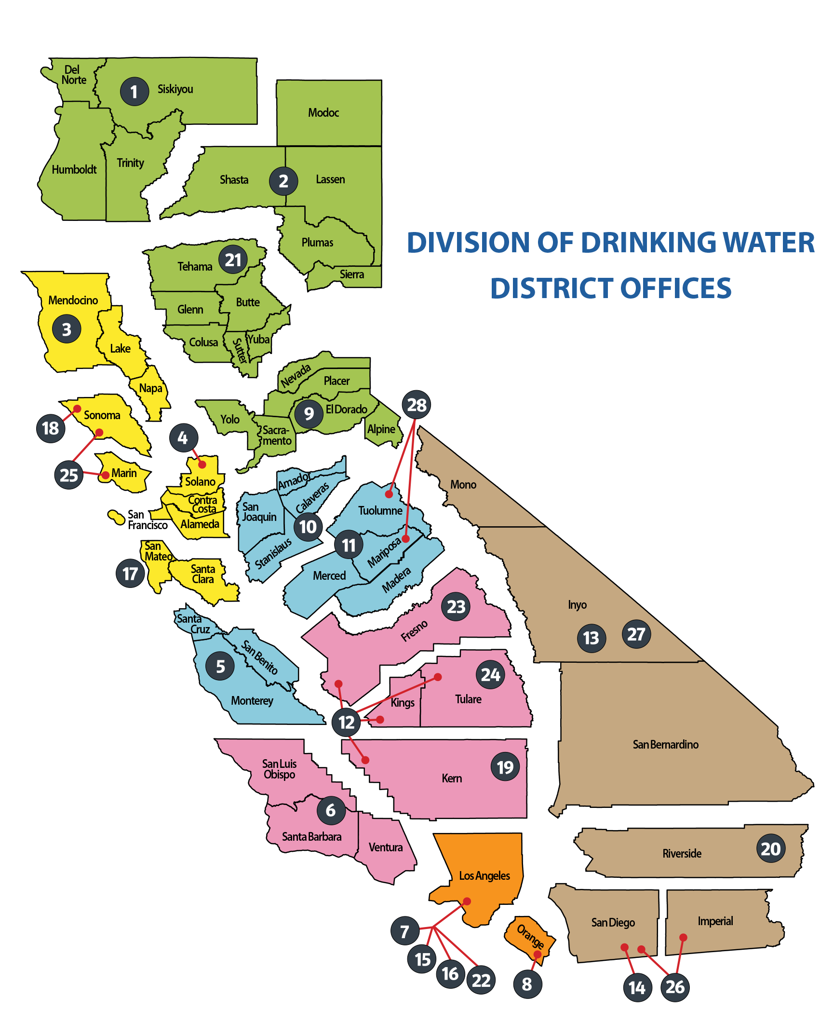
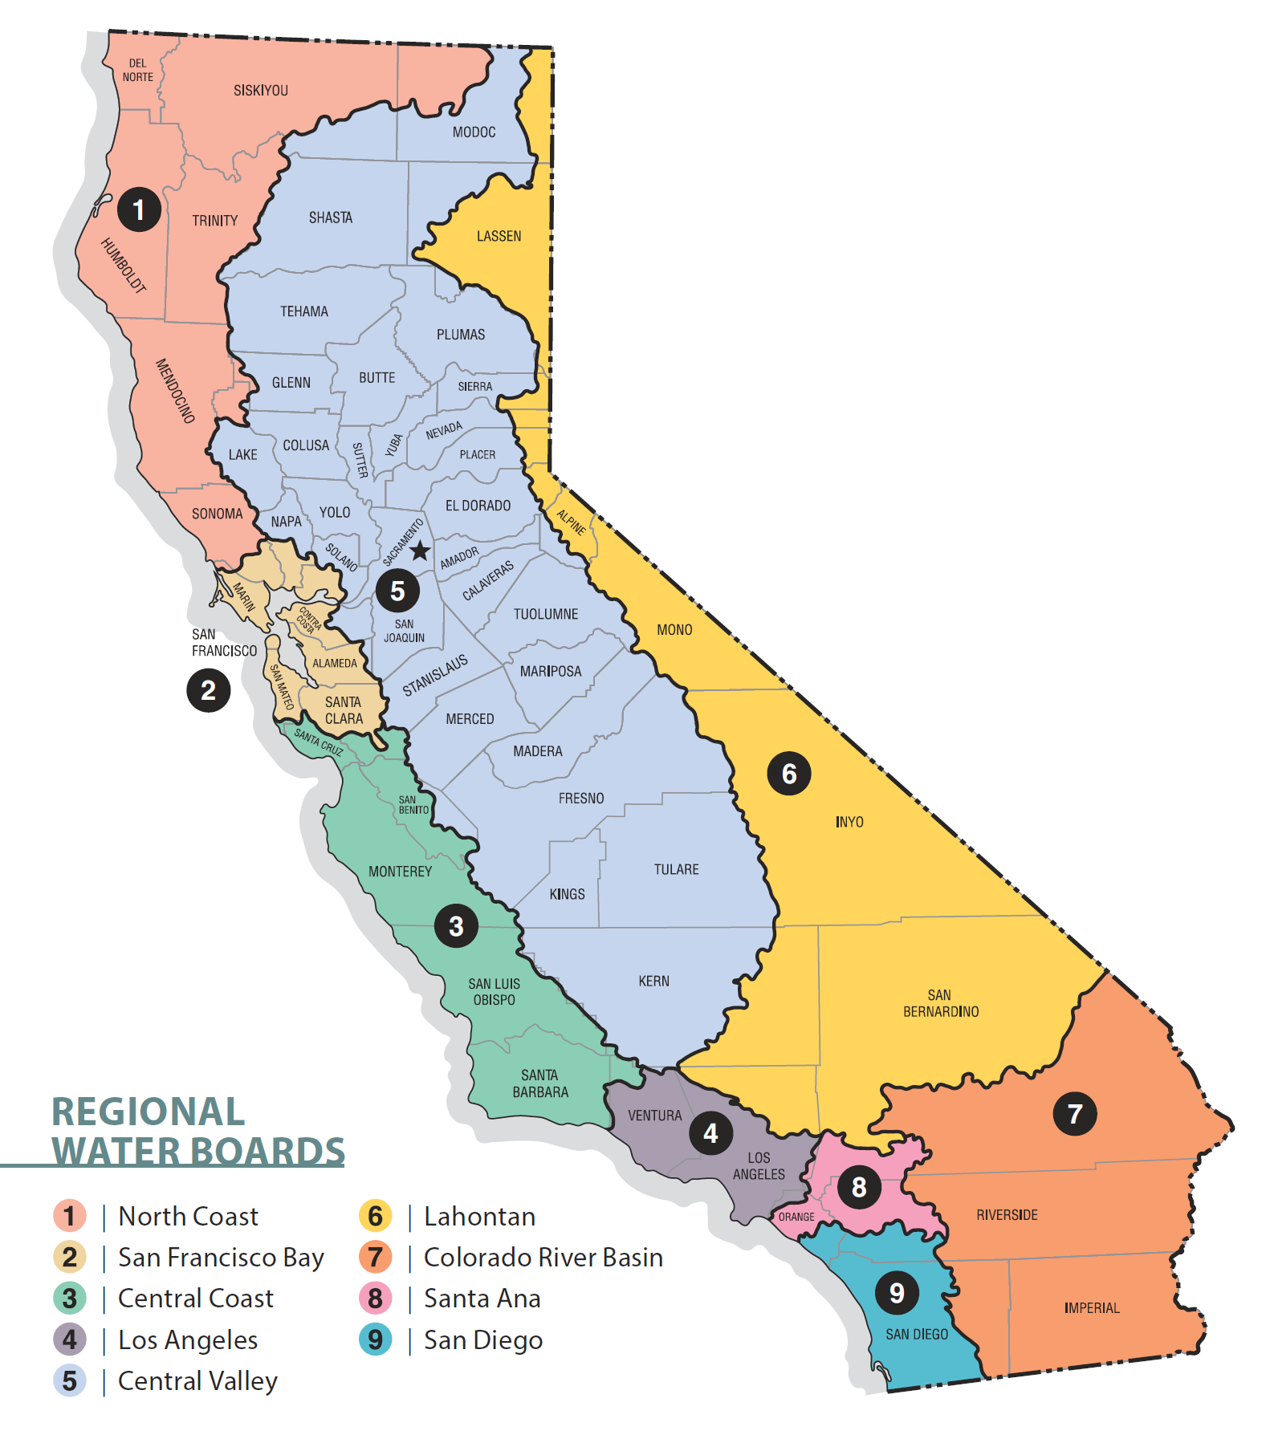
9 Regional Boards, 27 Drinking Water Districts
3

Slide 4
California Water Systems
7,200+ public water systems (2,840 community water systems)
98% of California’s population receives water that meets drinking water standards
385 failing public water systems serving 913,500 Californians
7th DWINSA shows $83.5 billion need over next 20 years for CA
Notes:
1,400 nontransient noncommunity water systems – schools, day cares,
2,900 Transient noncommunity water systems – parks, rest areas, motels, ski resorts

Slide 5
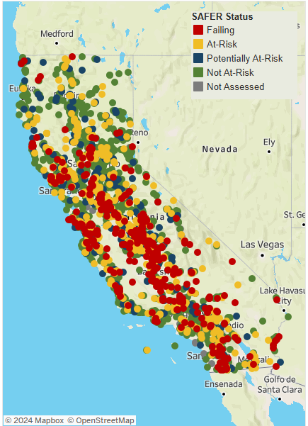
Total No. Of Small Systems: 2,809 Failing Systems: 368 At-Risk Systems: 483
Total No. Of Small Systems: 2,809 Failing Systems: 368 At-Risk Systems: 483

Slide 6
DWSRF Demand
6

Slide 7
Water Funding in CA
CWSRF
Recyled water bonds
Storm water bonds
DWSRF
Drinking Water bonds
Desalination bonds
Integrated Water Management funding
7

Slide 8
DWSRF Policy
Broad Eligibilities
Align acceptable Project and eligible costs with federal guidance
Adjusted criteria for project ranking
Projects are ranked based on water quality categories and readiness
Previously ranked only on water quality
Align with Clean Water SRF Policy
Established a planning/design program
Prioritize planning for small DACs
Also allows prioritization of lower ranked construction projects that are ready to proceed
Notes:
Projects that are needed primarily for fire protection are ineligible under the federal DWSRF regulations
Engage with commentor(s) and CPUC to continue to collaborate on potential improvements

Slide 9
DWSRF Intended Use Plan (IUP)
Projects are evaluated for placement on the Fundable List Projects Are Prioritized To:
Address most serious public health risk problems
Ensure compliance with Safe Drinking Water Act requirements
Assist those most in need on per household affordability basis
Two pathways: loan vs grant/principal forgiveness
Previously every applicant was receiving a combination.
Allows for lower priority (but ready!) loan applicants to utilize funds
Administer state grant funding through IUP
Steady pipeline of small DAC projects avoids individual solicitations
Applicants only apply to one program

Slide 10
Technical Assistance
Third path: Technical Assistance
For small DACs not ready for a planning/design agreement
Utilized state funds (non-SRF) with fewer requirements
Improved document preparation
Environmental documents (Cultural Report, Biological Opinion)
Consolidation evaluation
Other SRF requirements

Slide 11
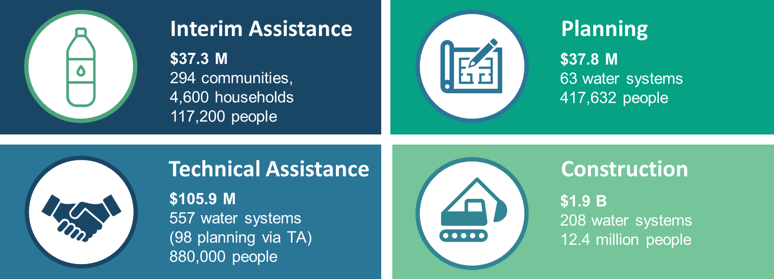
Safe and Affordable Funding for Equity and Resilience (SAFER) Program Performance since 2019
11

Slide 12
DWSRF Application Process
Application Submission – Changed to continuous application process. Previously used a ranked pre-application process that did not consider readiness to proceed.
Project Ranking & Placement on Fundable List – Two pathways: grant/PF and loan.
Application Review and Approval – Each packages is independently reviewed and approved for funding by technical, financial, and environmental unit.
Financing Agreement Execution – After receiving the signed FA, DFA Deputy Director signs the FA to execute the financing agreement
Application Submission
Application Review & Approval
Financing Agreement execution
Project Ranking & IUP Fundable List

Slide 13
DWSRF Application
Application Packages:
Application packages is divided into each specific subject and each package can be submitted individually or as a whole.
General Package – information about the water system.
Technical Package – information about the project.
Financial Package – information about financial situation of the water system.
Environmental Package - information about environmental impact of the project.

Slide 14
DFA Marketing & Outreach
California Financing Coordinating Committee Funding Fair
Project Manager Assignment
DWSRF Stakeholder Advisory Group
Public workshop for SRF Policy and Annual IUP
In-depth interaction on policy, procedures, and process improvements
Provide opportunity for potential funding applicant to interact directly with State Water Board and get information of all the DFA funding program
Present updates on Policy and IUP and get feedback from the water systems and public.
Provide early assistance to every applicant from application submittal to project completion

Slide 15
Online Resources
Financial Assistance Application Submittal Tool (FAAST)
Online application submittal for funding applicants
DWSRF website
Online resources for DWSRF application instructions, policies, intended use plan, and other guidance documents on program requirements.
Draft Financing Agreement Templates
Standard language of DWSRF financing agreement & legal opinions are available online.

Slide 16
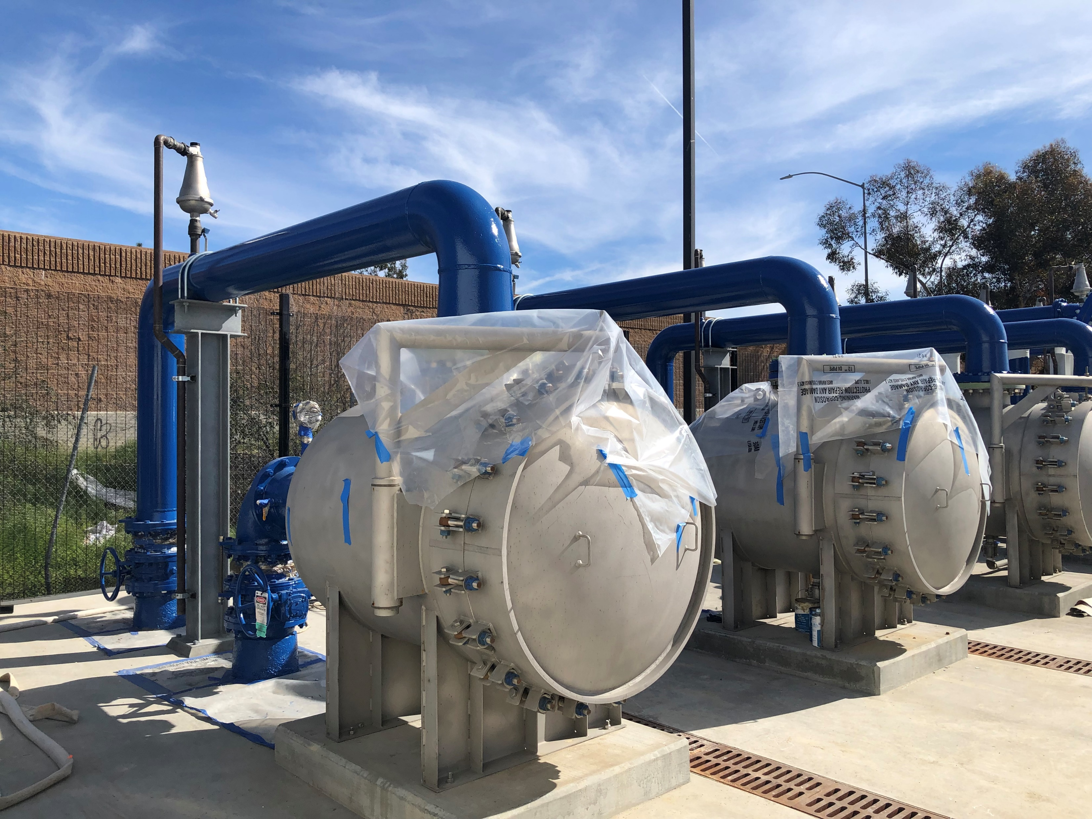
Questions?
16

