Slide 1
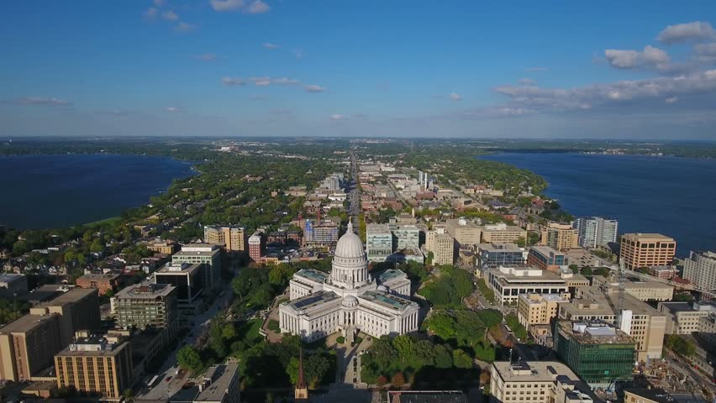
Alternative to a Traditional Water Revenue Pledge for Private Lead Service Line (LSL) Replacements Becky Scott, Wisconsin Department of Natural Resources CIFA SRF Workshop November 18, 2024
Notes:
I don’t know if any of you have ever been to Madison but it’s a beautiful city, situated in the midst of four lakes, the two largest of which you can see in this picture. Lake Monona is on the right and Lake Mendota on the left with the capitol situated on the isthmus in between. This presentation has a somewhat dry topic so I’m going to include a little history of how we got to where we are today, and the Madison lakes are pertinent to that history.

Slide 2
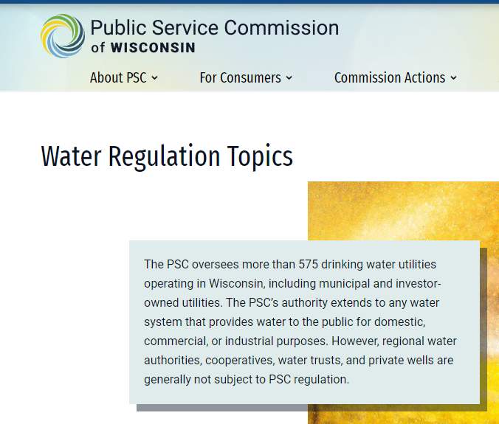
Water utilities in Wisconsin are regulated by the Public Service Commission of Wisconsin (PSC). PSC is responsible for setting user rates as well as authorizing construction of water infrastructure. This regulation by PSC has caused issues with our DWSRF providing loan funding for private LSL replacements. A little history helps explain how we got to where we are today.
Notes:
In Wisconsin, water utilities are regulated by the Public Service Commission, the PSC. PSC sets user rates and authorizes construction for some types of water infrastructure. This regulation by the PSC has caused some issues with providing SRF funding for private LSL replacements.

Slide 3
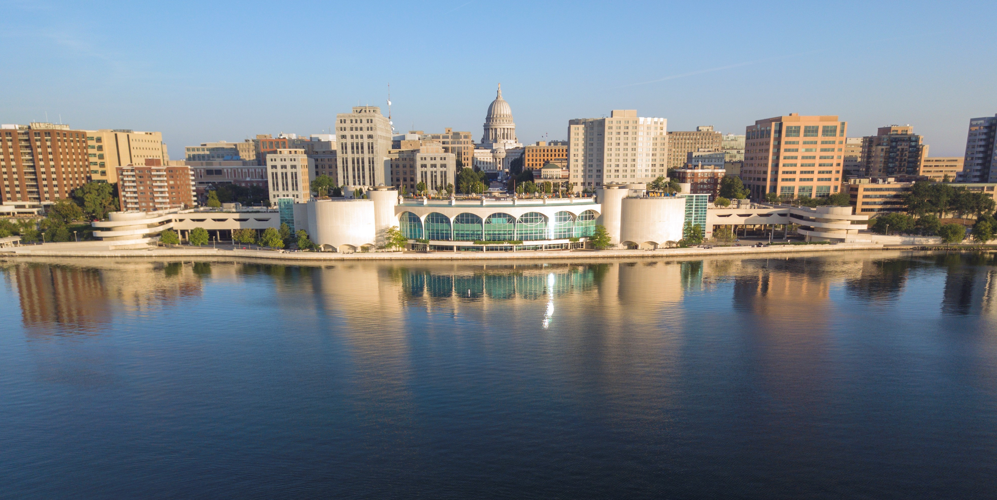
In 1992 Madison had an Action Level Exceedance for lead
Considered two options:
Use orthophosphates for corrosion control
Replace all lead service lines (LSLs)
Did a 4-year study on corrosion control with two conclusions
Would increase phosphorus loading to the Madison lakes too much
Still wouldn’t bring lead levels down sufficiently
Madison City Council approved ordinance in 2000 requiring replacement of all LSLs
Notes:
Madison had an action level exceedance for lead in 1992. They considered two options for dealing with this exceedance – add orthophosphates to the water for corrosion control or replace all LSLs.
They did a 4-year study on corrosion control and arrived at two conclusions – orthophosphates would increase the phosphorus loading to the Madison lakes too much and it still wouldn’t bring the lead levels down sufficiently.
So, in 2000, the Madison City Council passed an ordinance requiring replacement of all LSLs.

Slide 4
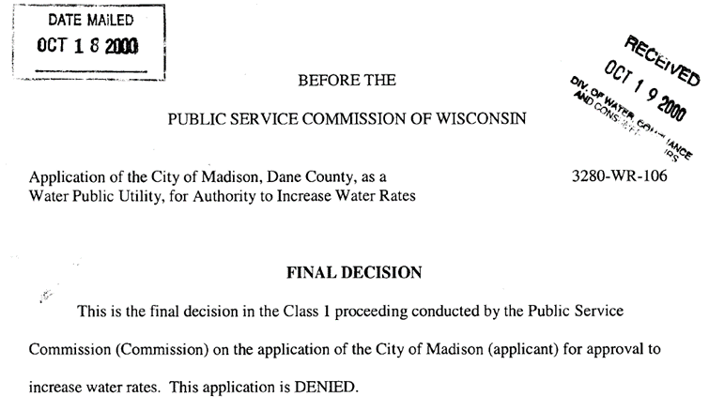
Applied to PSC in April 2000 for rate increase to cover private side rebates for 50% of cost.
Orthophosphates would cost $1,000,000 per year to add to water & remove from wastewater
Orthophosphates would add 7-10 tons of phosphorus into the Madison lakes per year
Reimbursing an average of $750 per LSL would cost $800,000 per year
Asked for 10-year surcharge to raise $800,000 per year
PSC agreed that replacement was the best option but…
“…it would be unreasonable and unjustly discriminatory if public program dollars generated through utility rates were to be authorized as a subsidy to furnish a direct benefit to an exclusive group of private property owners.”
PSC denied the rate increase request on October 17, 2000
Notes:
To make this more palatable to homeowners who would be required to replace their service line, the city decided to cover 50% of the replacement cost. They applied to the PSC in April 2000 for a rate increase to cover rebates for 50% of the private side cost. They pointed out that orthophosphates would cost $1M per year to add to the water & then remove from wastewater, that this would add 7-10 tons of phosphorus to the Madison lakes each year, and that reimbursing an average of $750 per LSL would only cost about $800,000 per year. They requested a 10-year surcharge to raise $800,000 per year.
The PSC agreed that replacing LSLs was the best option but stated “…it would be unreasonable and unjustly discriminatory if public program dollars generated through utility rates were to be authorized as a subsidy to furnish a direct benefit to an exclusive group of private property owners.”
PSC denied the rate increase request on October 17, 2000.

Slide 5
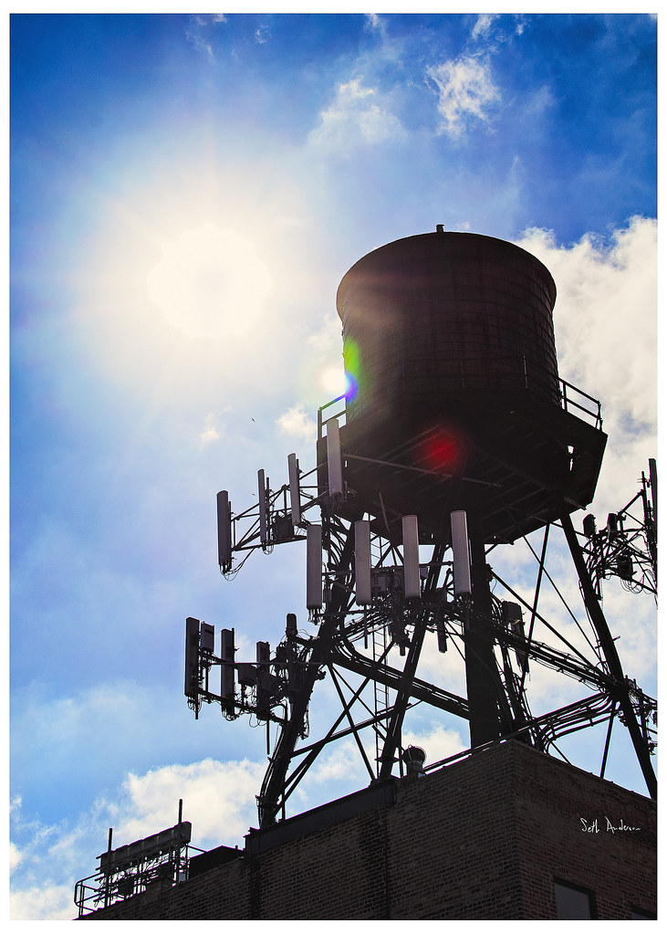
Madison rented space on water towers to cell phone companies for antennas
Revenues paid for public side of replacements and half the cost of private side replacements
Replaced 8,000 LSLs during 2001-2012 for total cost of $15.5M
Average public side cost of $1,997
Average private side cost of $1,340
Rebates for 50% of cost up to $1,000
Still find an occasional LSL & still offer 50% rebate up to $1,500
Notes:
Ultimately Madison paid for the LSL replacements by renting space on their water towers for cell phone antennas. The revenues from this paid for all the public side costs and half the cost of private side replacements. Between 2001 and 2012, 8,000 LSLs were replaced for a cost of $15.5M. The average public side cost was $1,997 and the average private side cost was $1,340 with 50% rebates of the cost up to $1,000. They still find an occasional LSL when doing street work and still offer rebates for 50% of the cost up to $1,500.

Slide 6
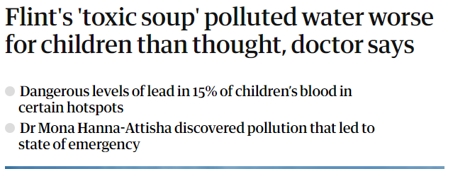
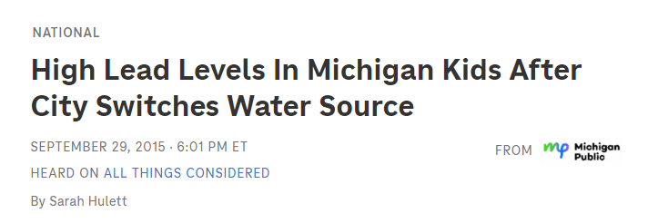
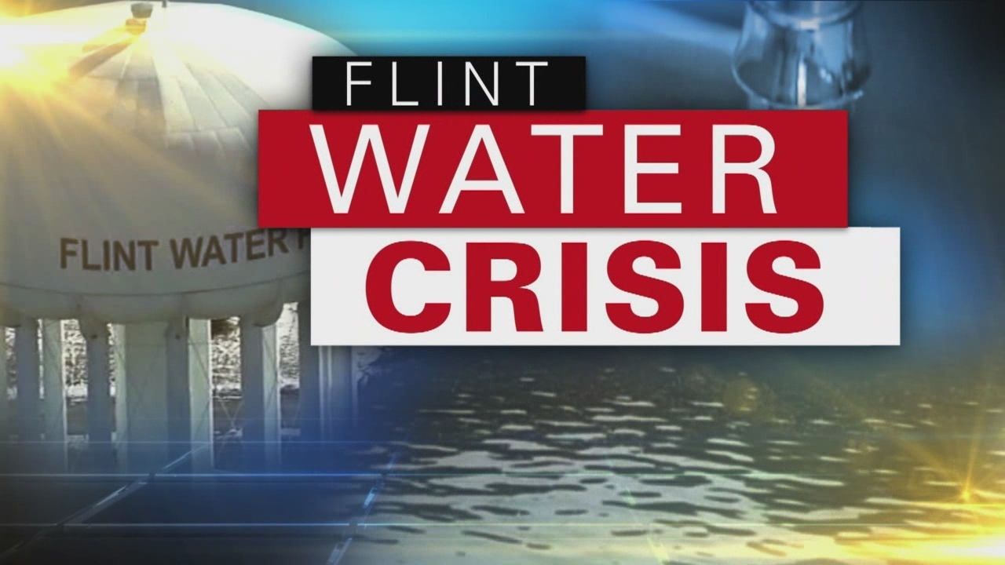
2015 – Flint Michigan happened
Notes:
Then in 2015 Flint Michigan happened, bringing the issue of lead service lines fully into the public focus.

Slide 7
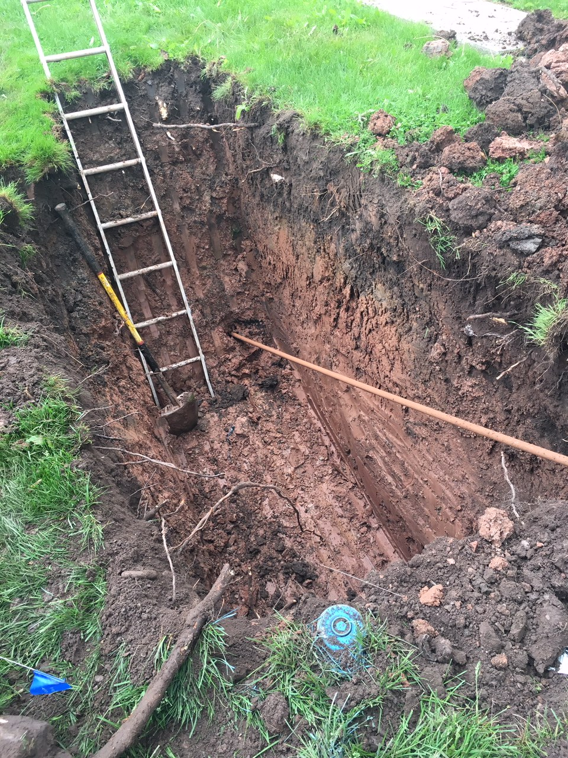
April 2016 – CIFA spring policy conference
EPA announces that private LSLs are eligible for DWSRF funding
EPA announces that old cap grants can be reopened in order to utilize unused authority for additional subsidy (FFY 2010 & 2011 Cap Grants)
Managers from DWSRF & Drinking Water Program decide to offer 100% principal forgiveness for private LSL replacements
April-June 2016 – simple LSL replacement program designed in time for June 2016 application cycle for SFY 2016
Private LSL Replacement Program modified slightly for SFY 2017
$26M in principal forgiveness awarded to 42 municipalities over the two-year program
Almost 7,000 LSLs replaced
Notes:
In April of 2016, my former boss was attending the spring CIFA policy conference where EPA announced that private LSLs are eligible for DWSRF funding and that old cap grants can be reopened in order to utilize any previously unutilized authority for additional subsidy. This was important because the FFY 2010 & 2011 grants allowed up to 100% of the grants to be used as additional subsidy but we had not fully utilized this authority.
My boss and a manager from the Drinking & Groundwater Bureau decided to offer 100% principal forgiveness for private side replacements using that old add sub authority as well as a portion of the current year’s authority. We threw together our first, very basic version of our LSL replacement program in two months, just in time for our SFY 2017 application deadline at the end of June 2016. We modified this program slightly in it’s second year. During this two-year program we awarded $26M in principal forgiveness to 42 municipalities and replaced almost 7,000 LSLs.

Slide 8
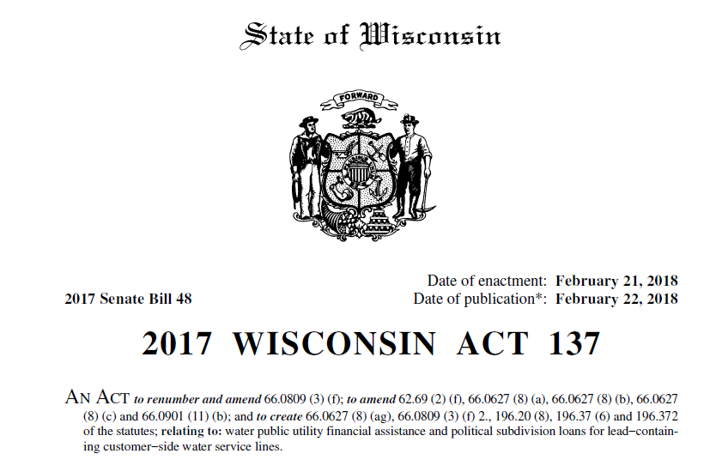
2017 Wisconsin Act 137 passed in February 2018, amending or creating several sections of state statutes
Section 196.372, Wis. Stats.
created the PSC approval process & requirements for using ratepayer funds for private LSL replacements
restricts grant funding to no more than 50%
requires a mandatory replacement ordinance
requires previous or simultaneous replacement of public side of LSL
Requires all customers in a class to be treated equally
Notes:
Our providing this LSL funding brought the issue of funding for private LSL replacements to the attention of some members of our state legislature. This resulted in 2017 Wisconsin Act 137 being passed in February 2018. This Act amended or created several sections of state statutes.
The piece we paid the most attention to at the time was section 196.372 which created a PSC approval process & requirements for using water ratepayer funds for private LSL replacements. The statute restricts grant funding to no more than 50% of the cost, does not allow loans to be forgiven, requires a mandatory replacement ordinance & previous or simultaneous replacement of the public side of an LSL and requires all customers in a class to be treated equally. This last provision means a water utility cannot offer more assistance to a low-income household than they do to a wealthy one. Still, this was a step in the right direction.

Slide 9
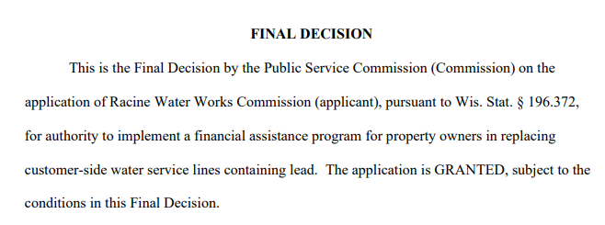
October 2019 – Water Infrastructure Fund Transfer Act (WIFTA) passed allowing transfer of funds from CWSRF to DWSRF as PF to be used for lead abatement
DWSRF awarded $63.8M in 100% PF LSL funding from WIFTA transfer in CYs 2021 & 2022-23 (Over 14,000 LSLs replaced)
During same timeperiod, PSC approved 12 applications under 196.372 authority:
3 applications in 2018 (Kenosha, Manitowoc, Menasha)
4 applications in 2019 (Kaukauna, Fond du Lac, Sun Prairie, Sheboygan)
3 applications in 2022 (Shorewood, Mayville, Edgerton)
2 applications in 2023 (Watertown, Racine)
All these municipalities received PF for LSL replacements from DWSRF
2 more applications are in process, one new, one revised, dealing with specifics of integrating with DWSRF funding
Notes:
Then in October of 2019 the Water Infrastructure Fund Transfer Act, also known as the Booker Bill, was passed, allowing a transfer of funds from the CWSRF to the DWSRF for the purpose of lead abatement. Wisconsin transferred the full $63.8M that we were allowed to transfer under the act and used this to provide 100% principal forgiveness funding for private LSL replacements in CYs 2021 and 2022-23. Over 14,000 LSLs were replaced with this funding.
During the same timeperiod, only a dozen municipalities applied to the PSC for approval of an LSL replacement program utilizing ratepayer funds. 3 in 2018, 4 in 2019, 3 in 2022, and 2 in 2023. All these municipalities also received funding from our program during this time, but that funding was not subject to the restrictions in the statute. Currently there are two more applications in process with the PSC – one new and the other revised – both dealing with the specifics of integrating the PSC approved program with DWSRF funding.

Slide 10
Wisconsin purchases bonds from municipalities to finance projects
June 2023 – Application deadline for first year of BIL LSL funding
37 municipalities applied for total of $74M in LSL funding
IUP pledge options for LSL awards:
General Obligation (GO) Pledge
Water Revenue Pledge
Only 2 new applications submitted to PSC in 2023 – PSC approval needed for Water Revenue Pledge
August 2023 – Bond counsel from Quarles & Brady & an attorney from Municipal Environmental Group (MEG) initiated discussions of Alternative Revenue Pledge after being contacted by numerous municipalities.
This Photo by Unknown Author is licensed under CC BY-SA
Notes:
This brings us to the topic of this presentation. – the Alternative Revenue Pledge. In Wisconsin we purchase bonds from municipalities to finance projects. As you all know, the LSL funding from BIL is not 100% principal forgiveness; there is a loan component.
Our SFY 2024 IUP, which was the first year we were using LSL funding from the BIL, stated that there were only two options for loan pledges – a general obligation (tax) pledge or a water revenue pledge that required PSC approval. Most municipalities are reluctant to pledge GO as they have limited GO capacity and the previous PSC approvals were not necessarily sufficient for a water revenue pledge if they had not included DWSRF funding in their proposal. We had received applications from 37 municipalities for $74M in LSL funding, so the fact that only two of our applicants had new applications submitted to the PSC was concerning.
In August of 2023 we were contacted by an attorney who works for the Municipal Environmental Group, Water Division which is a coalition of municipal water systems formed in 1991 to lobby on municipal water issues. MEG also has a wastewater division. This attorney along with a bond attorney from Quarles & Brady, the bond counsel firm that does the most work with our program, believed there was another option.

Slide 11
Wisconsin 2017 Act 137 also created section 66.0627(8)(ag), Wis. Stats.
Allows a municipality to set up a property owner loan program for LSL replacements
Amounts due can be collected as a special charge & placed on the tax roll
Requires adoption of two municipal ordinances:
Ordinance creating the loan program
Mandatory replacement ordinance
Does not involve PSC approval as program is in essence its own utility run by the municipality
Wisconsin’s DWSRF allows the repayments of the property owner loans to be pledged as security for revenue bond
Can only be used for private side LSL replacements
Provide model ordinances for our applicants to use
Notes:
Wisconsin Act 137 that I mentioned earlier had another section, 66.0627(8)(ag). This section allows a municipality to set up a property owner loan program for LSL replacements and collect the amounts due as a special charge that can be placed on the tax roll. It requires adoption of two ordinances – one creating the loan program and one mandating replacements. It does not require PSC approval as in essence the loan program is its own utility run by the municipality.
A team consisting of myself, Katherine Miller from our Department of Administration, Kate Leja-Brennan who is our LSL specialist, along with the MEG attorney and bond counsel worked over several months in fall of 2023 to develop this alternative and to modify our financial assistance templates to incorporate the new revenue pledge type. The property owner loans can be pledged as security for the SRF loan but can only be used for private side replacements. We have two model ordinances available for our applicants to use.

Slide 12
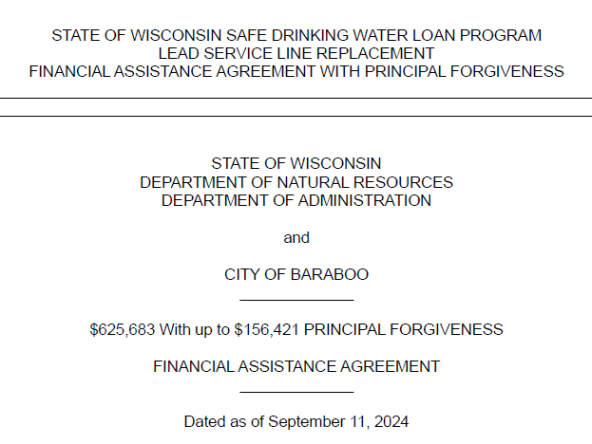
Municipality’s Property Owner Loans can be for up to 10 years with an interest rate of up to 4%.
DWSRF loans from LSL capitalization grant funds are loaned out at 0.25%.
DWSRF Loans secured by an Alternative Revenue Pledge can be for up to 12 years and can be prepaid on normal May 1 & November 1 payment dates.
Municipal Property Owner Loan Program considered a “Utility” under the Bond Resolution.
Eight SFY 2024 applicants chose the Alternative Revenue Pledge option.
Notes:
The municipality’s property owner loans can be for up to 10 years with an interest rate of up to 4%. The SRF loans from LSL cap grant funds are loaned out at 0.25% and can be amortized for up to 12 years with prepayments allowed on our normal payment dates of May 1 & November 1. The Property Owner Loan Program is considered a utility under the bond resolution.
Eight of our SFY 2024 LSL awards were made utilizing the Alternative Revenue Pledge option. Only two utilized a normal water revenue pledge for private side replacements that required PSC approval. The rest were either 100% principal forgiveness, used a water revenue pledge for public side work, or chose a general obligation pledge.

Slide 13
Becky Scott Environmental Loans Section Manager
rebecca.scott@wisconsin.gov

