Slide 1
Regionalization
Not
Privatization
Kumar Menon, Director
Fort Wayne City Utilities
October 31, 2017

Slide 2
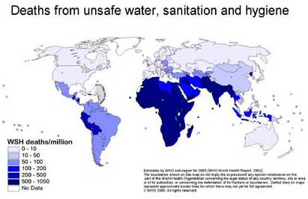
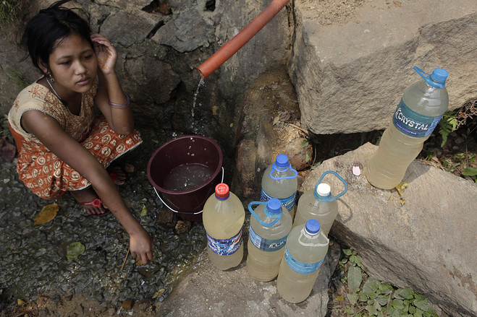
Water for Life
Notes:
More lives have been saved by advances in the water and wastewater fields than by advances in medical science...Could be the leading line...

Slide 3
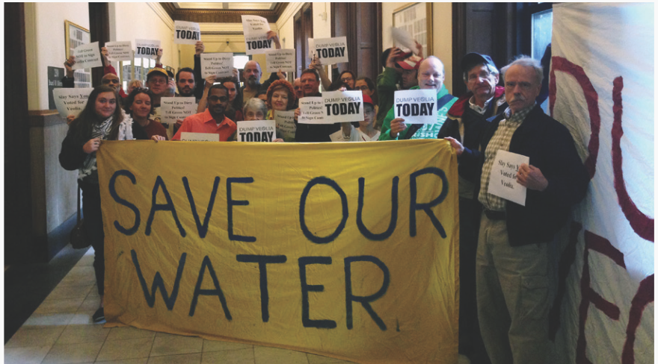
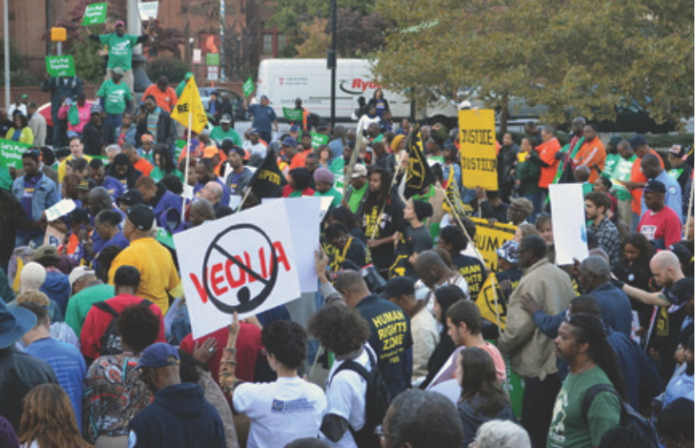
Residents Want Municipal Control
Baltimore
St. Louis
Notes:
Atlanta, New Orleans, Indianapolis backed out of their contract ops.

Slide 4
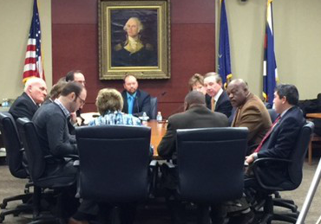
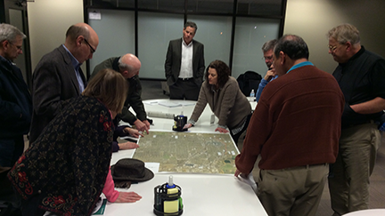
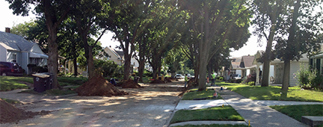
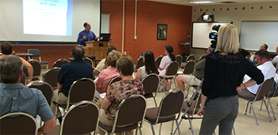
Local Control
City Council
Public Meetings
Neighborhood Coordination
Notes:
Residents want local control
Their elected council members approve the rates
As a city owned utility – between construction meetings, education meetings, events and one on one meetings our staff meets with the public more than 300 times a year.
We have a Utility Advisory Group – that guides us as we move forward with improvements and meeting federal regulations. THIS GROUP HAS BEEN MEETING SINCE THE MID 1990’s and is made up mostly of neighborhood leaders and more recently, business leaders. You won’t get that with a private utility.
We work in neighborhoods and coordinate with public works and parks on projects.

Slide 5
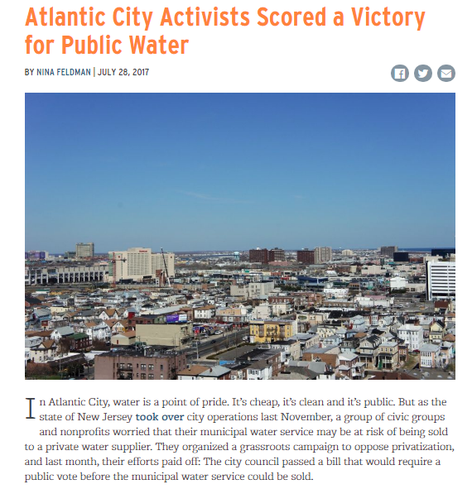
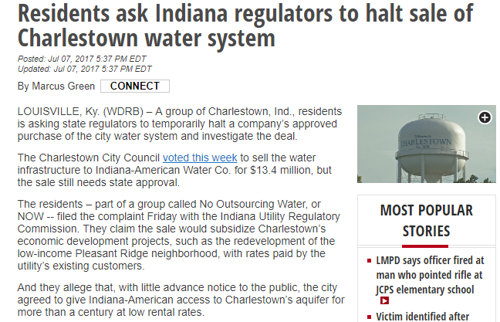
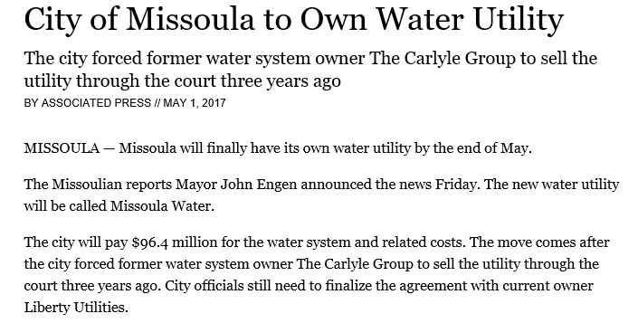
Why Regionalization

Slide 6
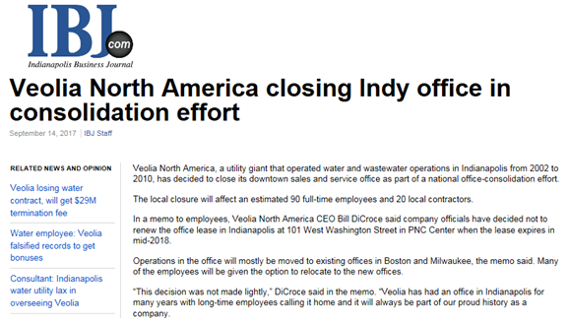
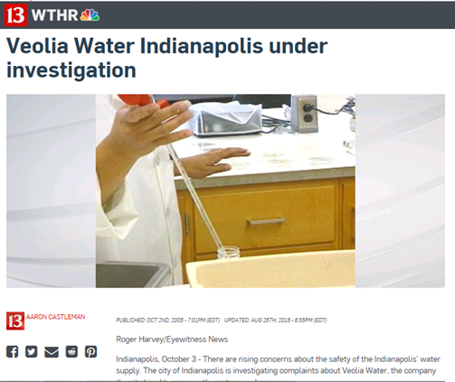
Why Regionalization

Slide 7
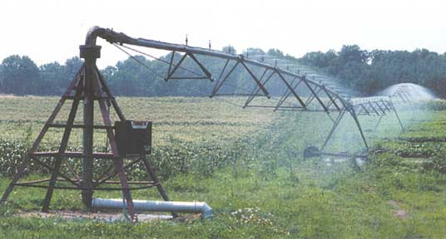
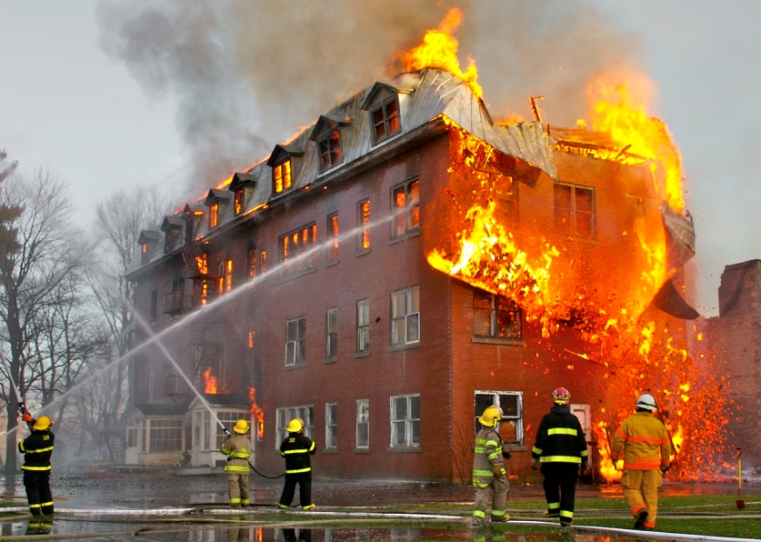
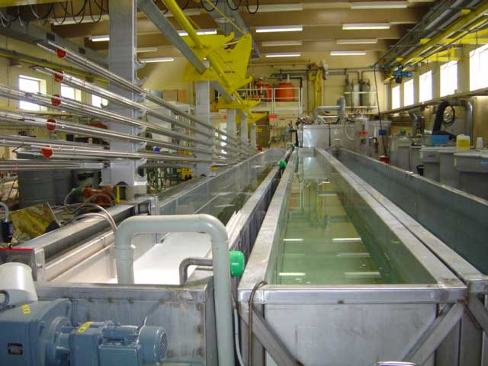
Water, Essential and Great Value
"Everyone knows the price of everything, but the value of nothing." - Oscar Wilde
Notes:
We take water for granted.
Our pipes are out of sight… underground … and out of mind.
We don’t value water and we Complain about the price.
Water keeps our house going and it keeps our lives going.
Medical facilities rely on water for surgery, instrument Sterilization, bathing, cooking, and specialty treatments like dialyses.
Our farming community relies on water to grow our food.
Manufacturers use water to make food, paint vehicles, clean processes and to remove waste.
AND – without an adequate supply of water – with good pressure – we wouldn’t be able to put out fires.
Speaking of fire fighting – the local control we have allows us to immediately offer local information to the fire department and to offer redundancy and an increase in pressure when needed. It is why all of us in Fort Wayne – pay less for homeowners insurance – our strong rating from the Insurance Services Offices – collectively saves our residents $7 Million a year on our homeowners insurance.
Water in Fort Wayne is about 7 cents a gallon. A bargain when you lit to your cell phone or cable bill.
It’s Public Health, Public Safety, Public Infrastructure...these should be managed conscientiously for the public good....and water utilities are on the forefront of all those ideals.

Slide 8
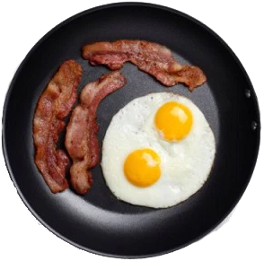
Involved vs. Committed
Public Commitment, Local Accountability
Notes:
Public vs Private ownership is like bacon vs eggs...the pig is committed, while the chicken is just involved...we invest, engage and commit to our local businesses, environment, schools and community as public utilities (I want to have some fun with this line)

Slide 9
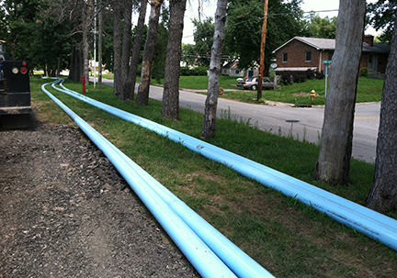
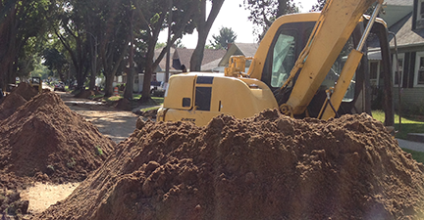
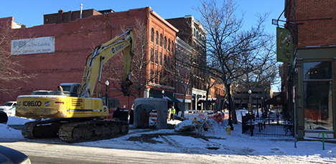
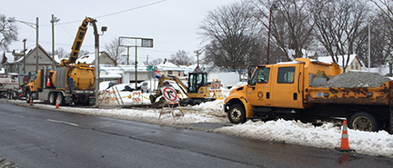
Serving the Public
"Nothing is more expensive than mediocrity“
Irwin Miller, Founder of Cummins Inc.
Notes:
"Nothing is more expensive than mediocrity". Irwin Miller, Founder of Cummins Inc.: This could explain why private systems tend to be more expensive, and it also represents what happens when public systems fail to invest appropriately in their own infrastructure.
The top priority for PRIVATE Utilities is to make a profit and return an investment to shareholders. They are more expensive – and generally only invest when they must.
PUBLIC Utilities take all revenue and invest it in maintenance, operations and capital improvements. Water main replacements are intrusive – but they set our neighborhoods up to thrive for generations to come.

Slide 10
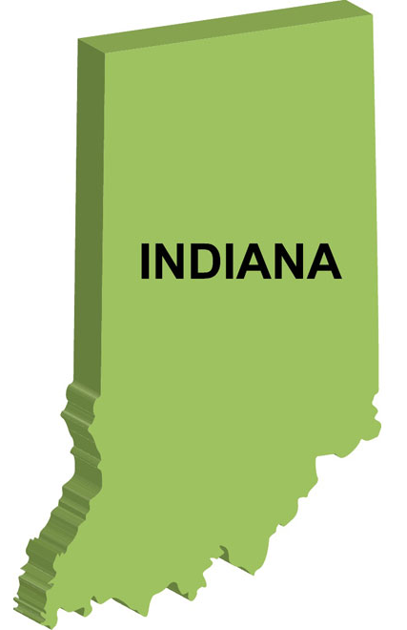
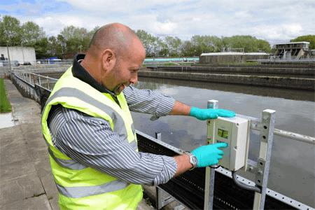
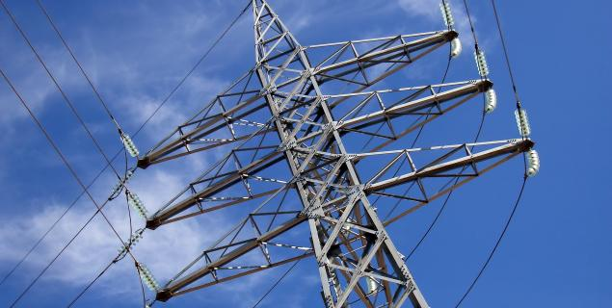
“Resource”–ful Connections
"When you are made a leader, you are not given a crown...you are given the responsibility to bring out the best in others" - Jack Welch
Utility Directors Group
30 largest cities
Collaboration
Joint Efforts
Notes:
"When you are made a leader, you are not given a crown...you are given the responsibility to bring out the best in others" Jack Welsh.
We put together the from the 30 largest cities in Indiana – the Indiana Utility Directors Group … we meet to share ideas, concerns and to educate lawmakers about the issues facing the utility.
We’ve had some success at getting on the radar of lawmakers when it comes to energy costs and how we can generate energy and sale back to the grid.
For my city alone we spend about $3 Million in energy costs every year.
This collaboration has been positive and is helping Indiana Utilities improve and serve the residents of Indiana better than before.
Private sector doesn't do this....they view others as competition.

Slide 11
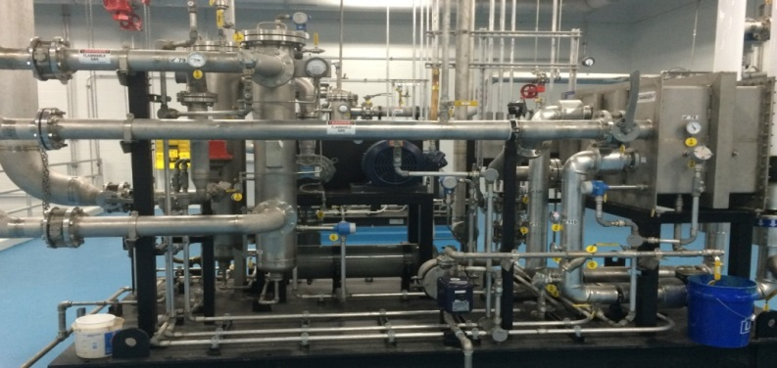
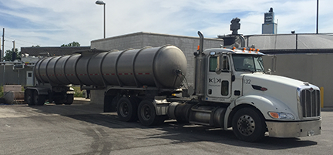
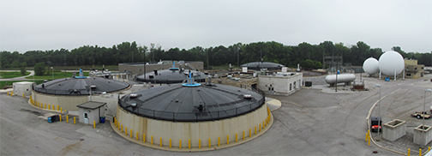
Innovation Offsets Costs
Methane power generation
Reducing electric bill and increasing revenue by $750,000

Slide 12
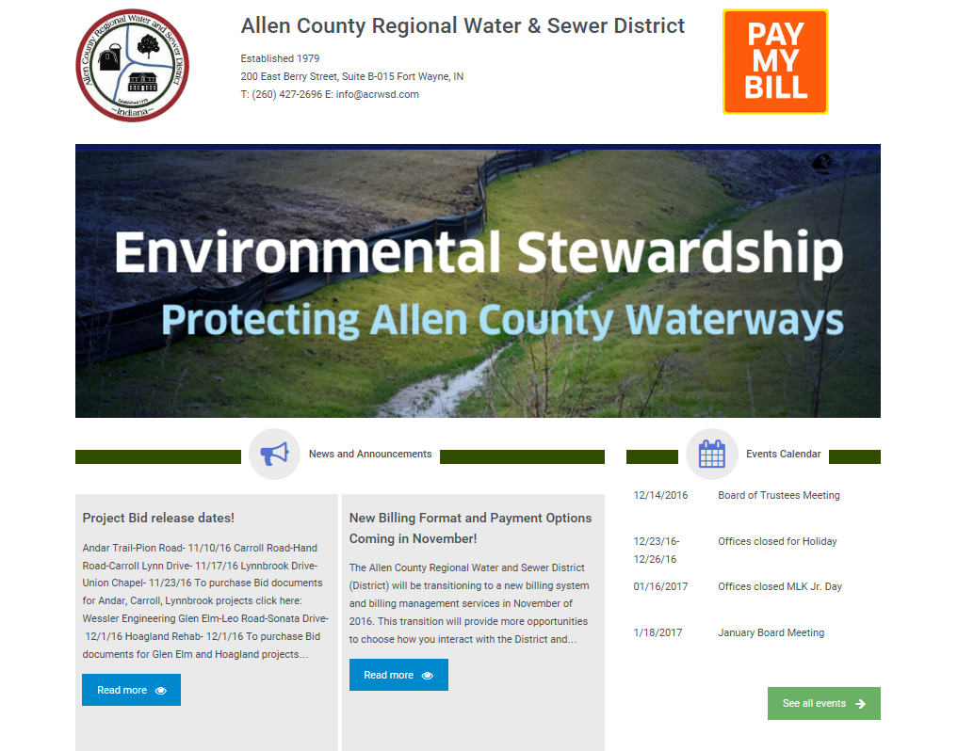
“Resource”–ful Partnerships
Notes:
We serve additional service areas outside of our municipal boundaries of Fort Wayne.
The value of these programs is close to $100 million dollars.
For the communities – it saves them from building $50 million dollar facilities, not including daily maintenance and operation with specialty positions such as mechanics, engineers, chemists, and licensed plant operators – it takes daily headaches off of the smaller communities we serve.
For City Utilities – we are able to bring in additional revenue for operations and capital improvements
It helps us keep rates low

Slide 13
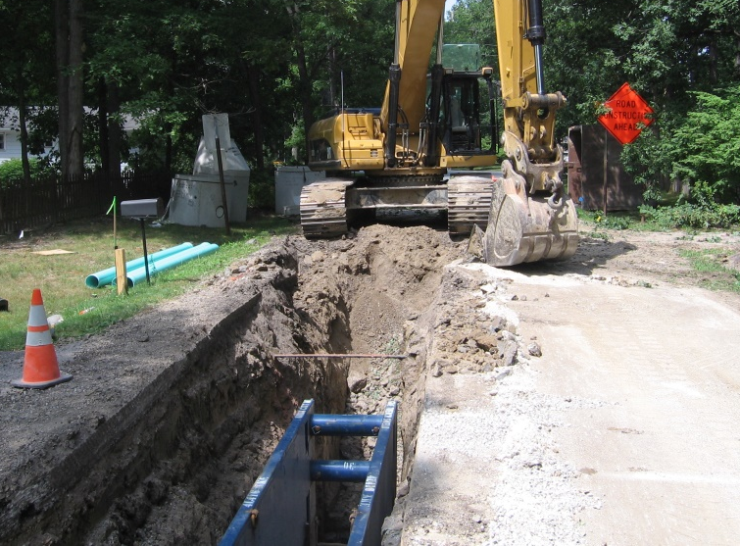
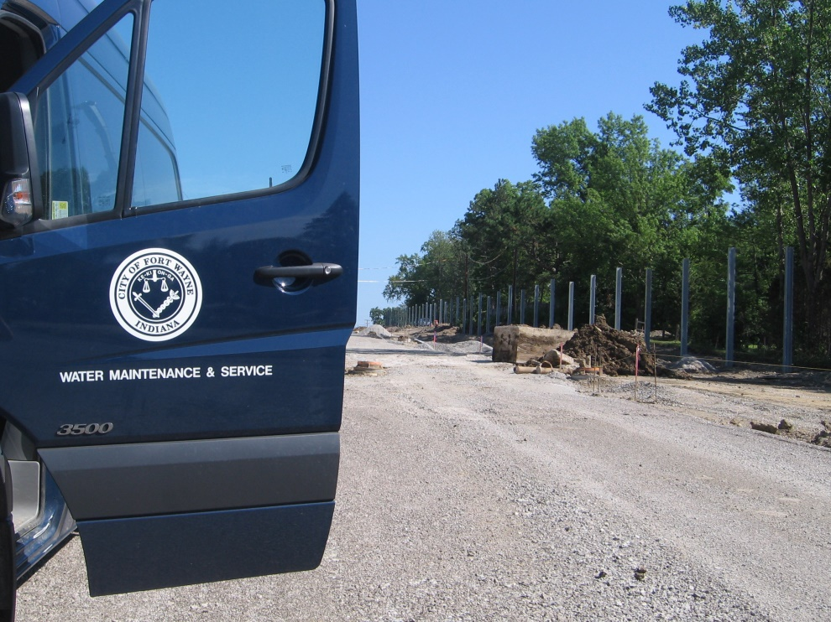
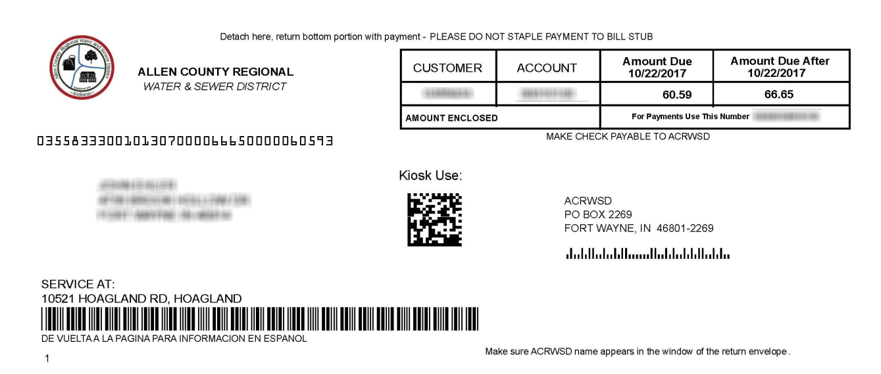
Regional Water & Sewer Partnership
$2M District Savings
$3M City Revenue
Notes:
Let’s take a look at one of those. The Allen County Regional Water & Sewer District
Our sewer district was partnering with a private company to provide engineering, billing and other services.
Costs were rising and it was impacting their customers and the solvency of the important service they provided.
We partnered to take care of billing, engineering and emergency on call services.
For the Sewer and Water District it resulted in a savings of around $2,000,000
For City Utilities – it brought in $3 million over 10 years and allowed us to use existing staff. The economies of scale make the regional partnership valuable to our entire region.

Slide 14
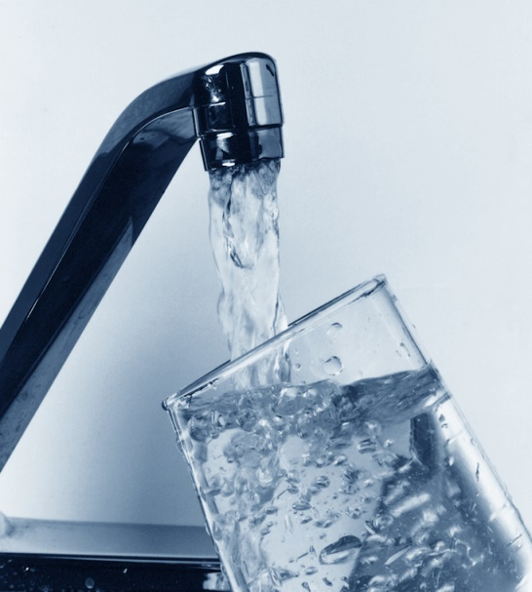
Public Buyout from Private Sector
22,000 new customers get lower rates, better water quality, better service
$10 million customer savings in 10 years
Existing customers benefit from Utility Growth
Notes:
Between the north and south acquisition of Aqua – those customers have saved $10million collectively. Money that stays in their pocket or is invested locally rather than going to shareholders.
It also brought in additional revenue to City Utilities in the way of new customers. Those new Customers were enough to pay for the acquisition and to have a downward impact on customer growth.
We’ve seen a tremendous amount of new development since that acquisition – bringing in even more new customers.

Slide 15
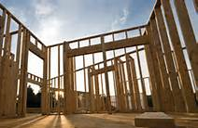
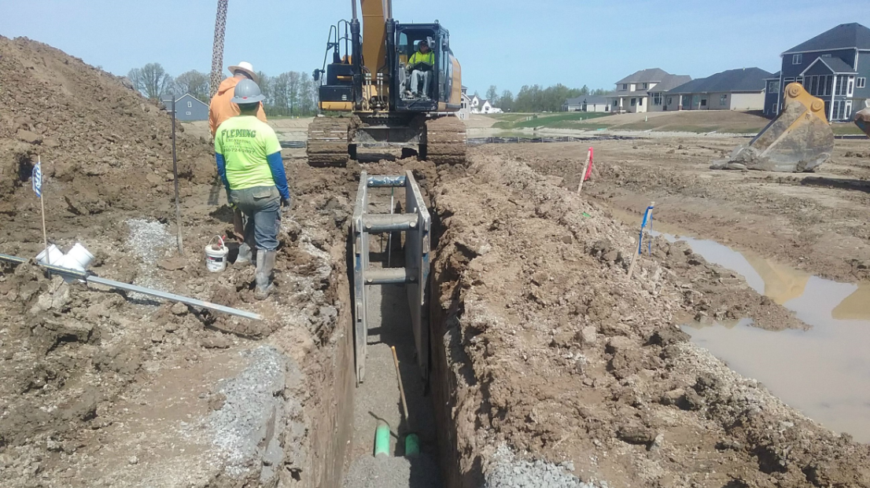
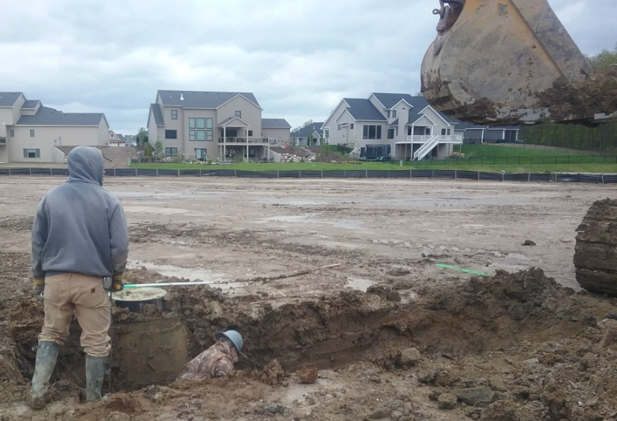
Public Private Partnerships
Millions in Private Regional Investment
Attractive Return on Investment
Adds Larger, Diverse Customer Base
Increases Market Share
Notes:
Increases market share in a competitive environment.
We partner with Developers to allow them to move forward with projects – by paying for the sewer or water line extension as they build their projects outside of our current area and then we reimburse them after customers are connected.
Millions in Private-sector investment in our regional facilities; dependable and attractive returns for investment
Provides larger, more diverse customer base
Increases market share in a competitive environment.

Slide 16
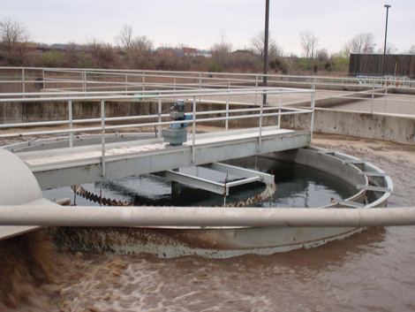
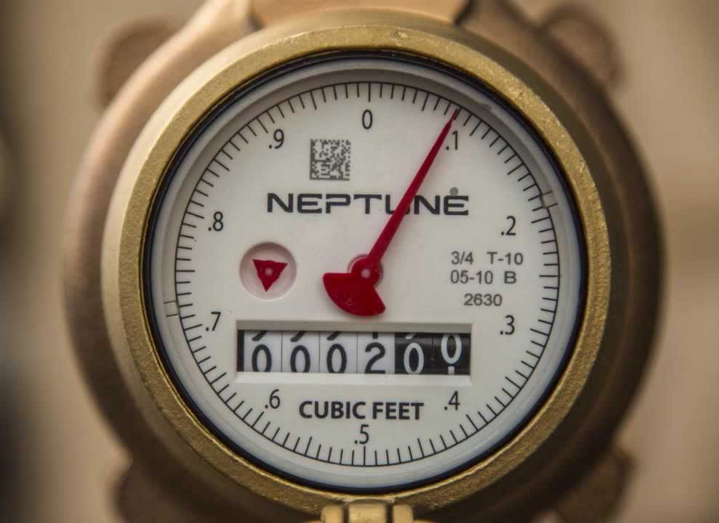
Partnership with Private Utilities
10 year agreement -$20M plus
1.5 Million gallons treated daily
Frees up capital funding for City
Prevents duplication of Facilities and Equipment
Notes:
Besides purchasing the water side of the Aqua north and south customers we are also partnering with Aqua to take sewage flow from our systems far southwest connections
This allowed us to free up funding for capital investments as we move forward with a deep rock tunnel
The move will allow us to complete the tunnel before that flow comes back to our system.
For Aqua – we are now reading their meters and it has prevented them from having a meter reading system of their own and staffing that area.

Slide 17
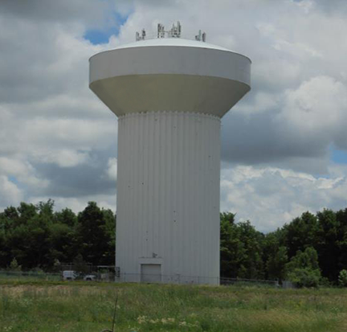
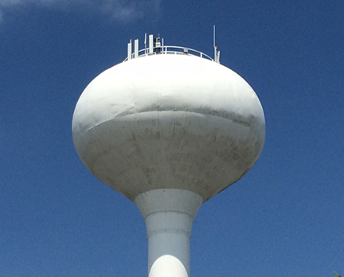
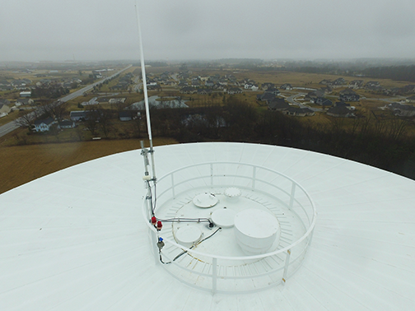
Monetizing Resources
Maximizing return on existing assets
$2.3 Million

Slide 18
Reassessing
Banking, Billing Services
$500,000 Savings 1st year
Reduction in staff time
Earnings Credit
10 Year Savings $6 Million

Slide 19
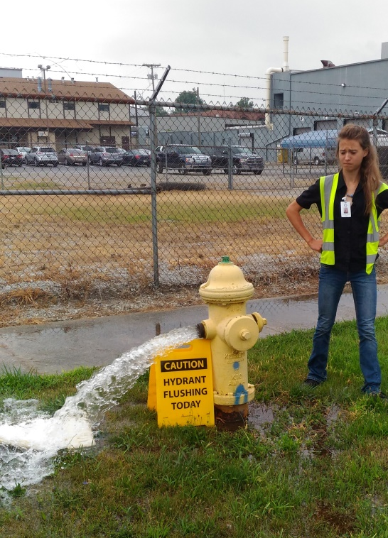
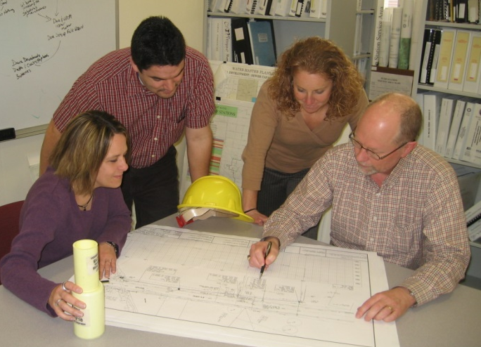
Building the Pipeline of Talent

Slide 20
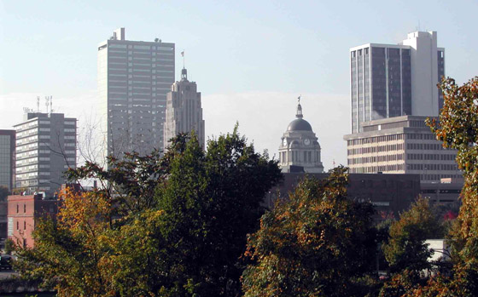
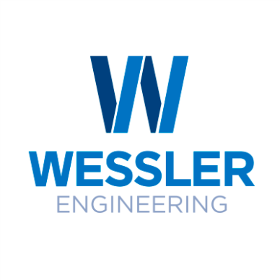
Expanding Firms
Notes:
Many of these are new – others expanded.

Slide 21
Regionalization and Partnerships
“…small systems are both more expensive to operate and less resilient to the changes that are affecting health and safety.”
“Protecting the economy means making sure that utilities manage our water resources together.”
Notes:
A recent study by the Indiana Finance Authority found that operating small systems are more expensive – and ultimately not good for residents.
Plants even for small communities of 3,000 residents can cost more than $20 million for construction and design – and that doesn’t include maintenance and specialty staff.
The study also found that managing water resources together is essential to protecting the driving the economy.

Slide 22
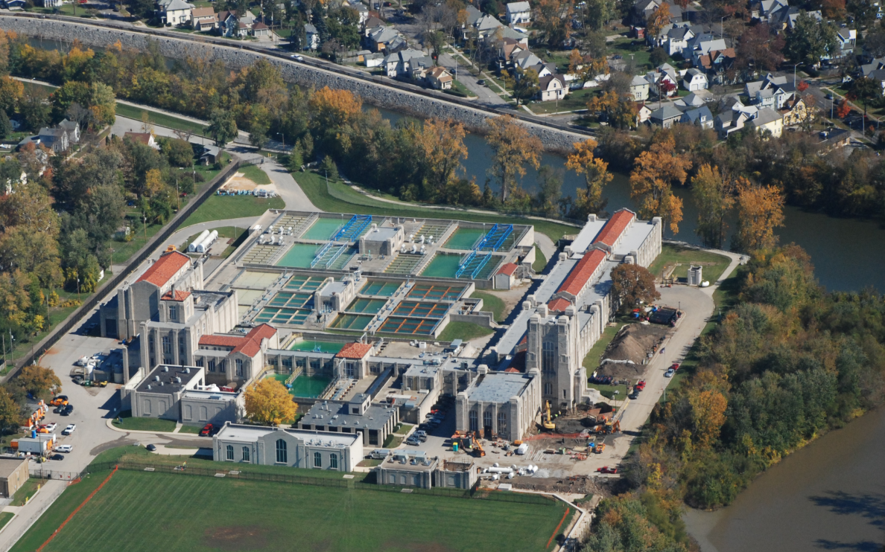
Enhanced Utility Management Establishing Centers of Excellence
Commitment to leadership and training
Maintenance Management
Technology Growth
Environmental Stewardship
Educational Partnerships
Regulatory Support
Local, Regional, National Advocacy
Reliable, resilient, responsible, affordable services for all customers

Slide 23
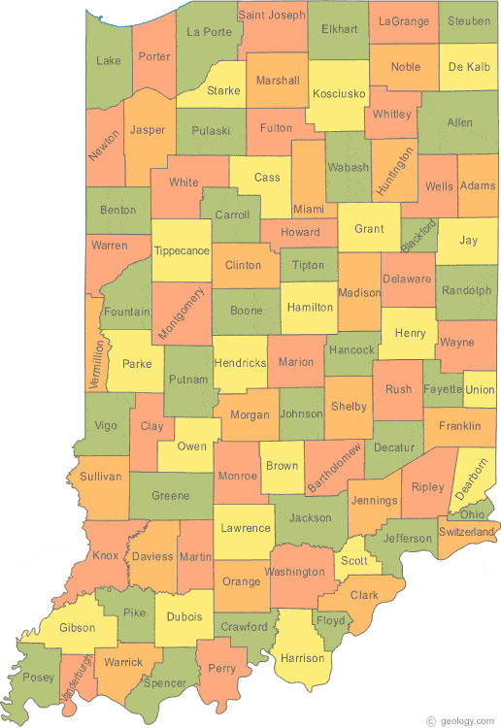
Why Regionalization
Economies of Scale
Downward Effect on Customer Rates
Improved Opportunities to attract and retain high demand positions
Environmental Stewardship
Effective Resource Management
Enhanced Educational and Training
Cyber Security and Technology Investments

Slide 24
Regionalization
Not
Privatization
Kumar Menon, Director
Fort Wayne City Utilities
October 31, 2017

