Slide 1
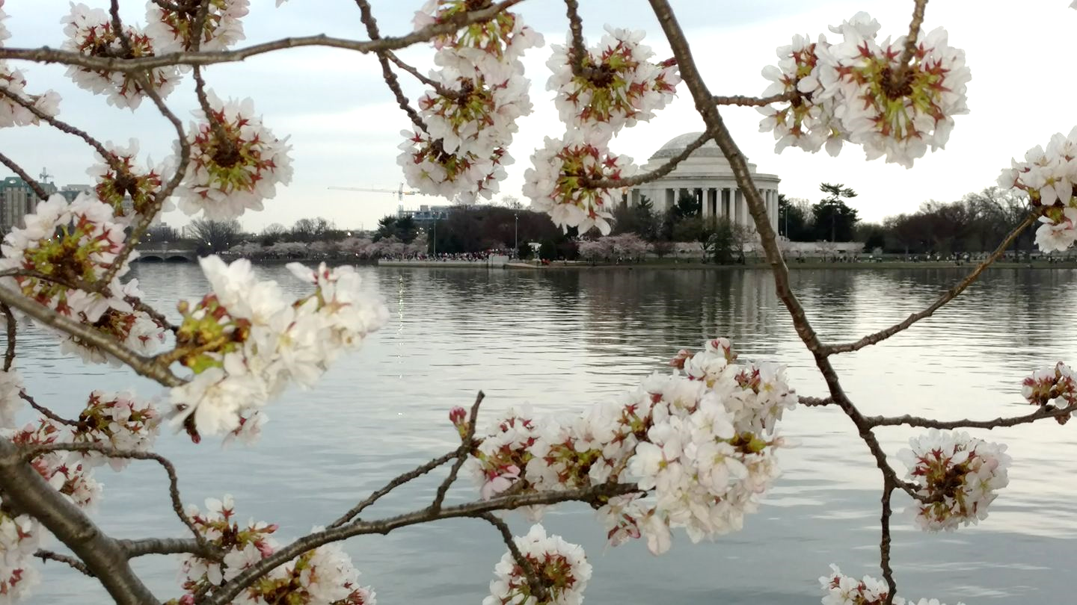


Andrew Sawyers, Ph.D., Director
Office of Wastewater Management
Washington, DC March 2018

Slide 2


CWSRF Update
Assistant Administrator for the Office of Water, David P. Ross
The President’s Infrastructure Plan
FY 2019 President’s Request for the CWSRF
FY 2018 CWSRF Appropriation
30th Anniversary of the CWSRF

Slide 3
30 Years of Success
Annual Funding: 1988 to 2017
CWSRF Funding 1988 to 2017: $126.1 Billion

Slide 4
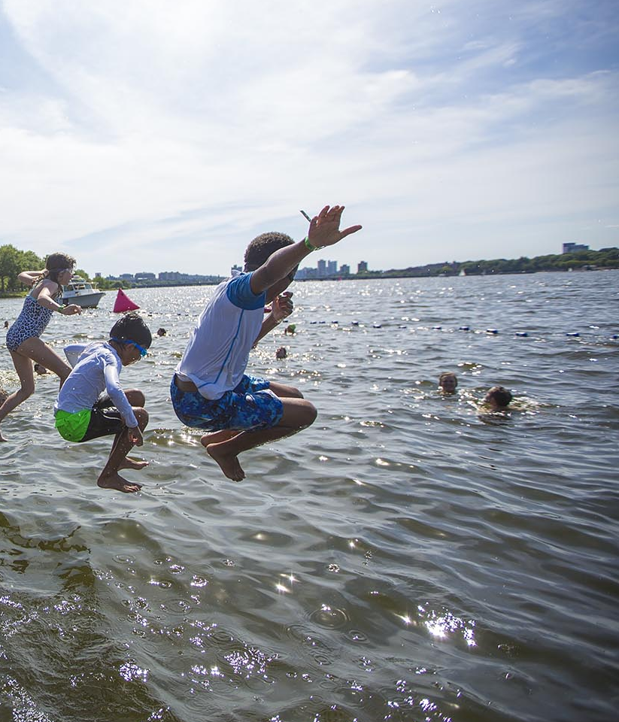
30 Years of Success
CWSRF Environmental Benefits: 2005 to 2017
$53.9 billion to improve water quality
$33.1 billion to achieve compliance
$54.7 billion to protect and restore aquatic life and wildlife
$11.4 billion to protect and restore drinking water sources
$56.9 billion to protect and restore recreational uses

Slide 5
30 Years of Success
Cumulative Rate of Loan Commitments and Disbursements: 1988 to 2017

Slide 6
30 Years of Success
CWSRF Interest Rates: 1988 to 2017

Slide 7
30 Years of Success
SRF Revenues vs. Expenses: 1988 to 2017

Slide 8
30 Years of Success
CWSRF Program Equity: 1988 to 2017

Slide 9

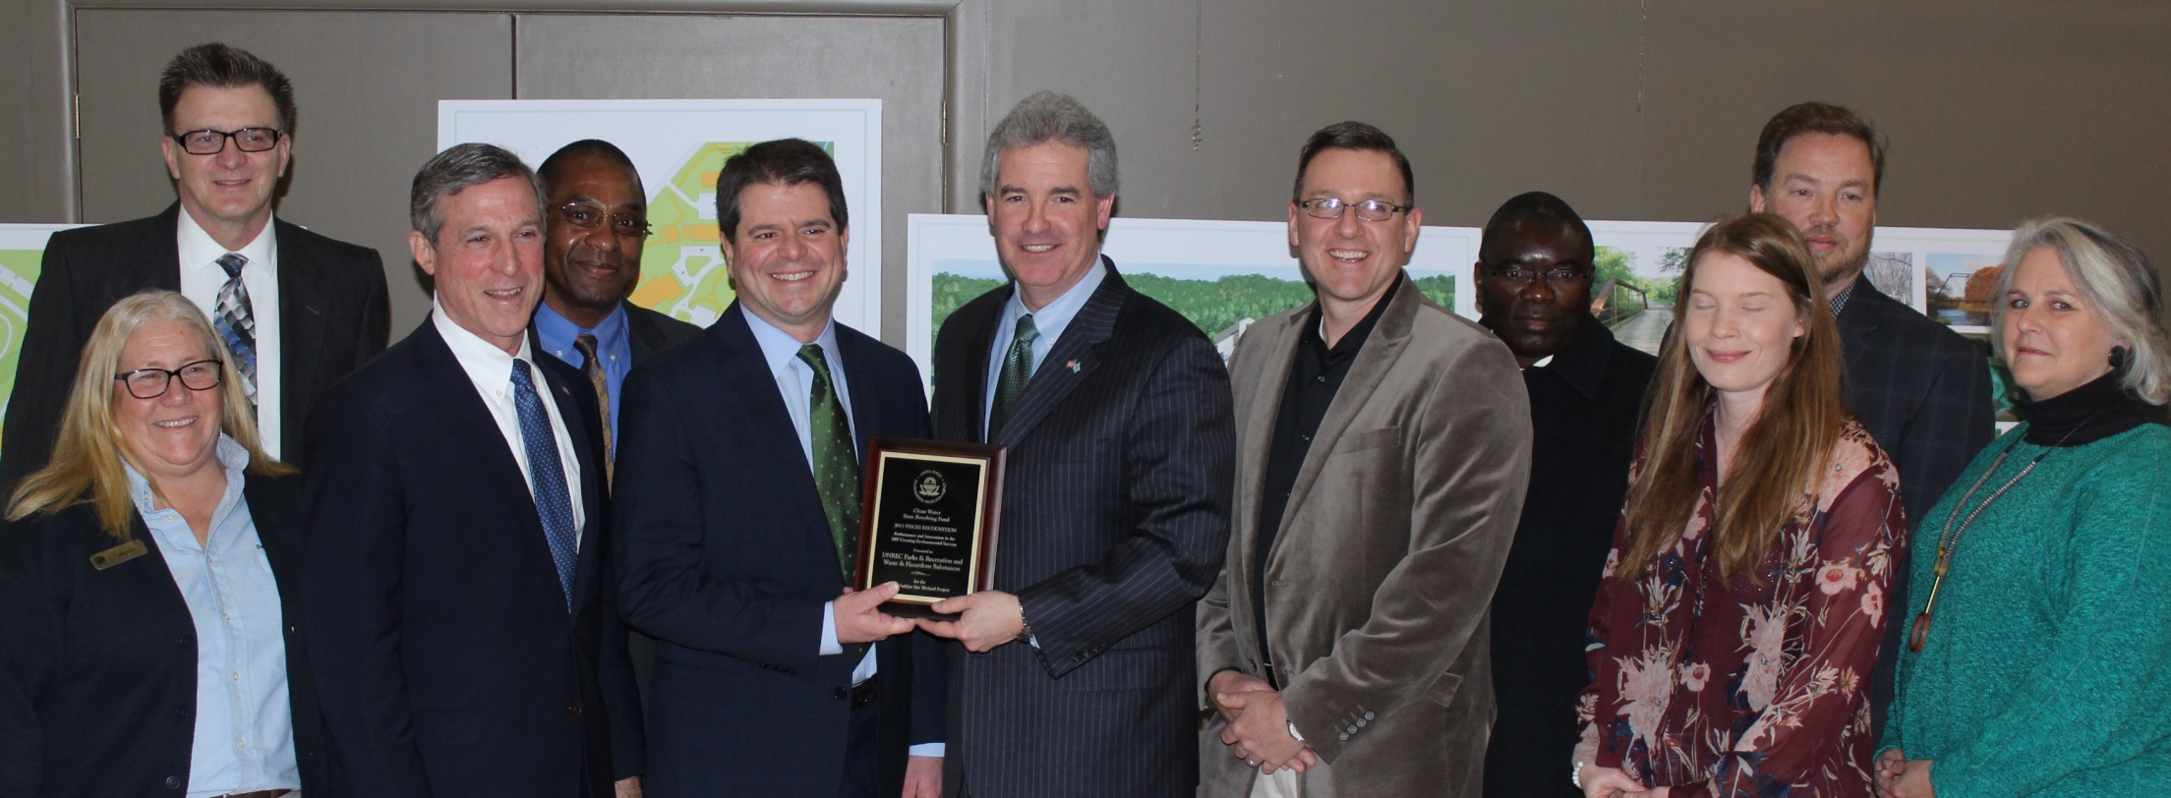
CWSRF PISCES Recognition Program
Now accepting nominations for 2018’s PISCES for innovative CWSRF projects
Recognized projects will be featured at the 2018 Fall CIFA Workshop
Delaware’s Governor receives 2017 PISCES Recognition Plaque

Slide 10

Ongoing Efforts to Streamline the CWSRF
Promoting Financing Innovations (Five Fi’s)
Co-Financing
Extended Term Financing
Sponsorship Financing
Portfolio Financing
Programmatic Financing

Slide 11

Ongoing Efforts to Streamline the CWSRF
SRF Database Redesign and Modernization
The Office of Ground Water and Drinking Water and the Office of Wastewater Management are partnering with stakeholders to modernize SRF data collection.
Create a single database that is mutually beneficial to the states and EPA.

Slide 12
Marketing and Outreach Update
State Customizable Marketing Brochure
State Surveys and Focus Groups
Compilation of Feedback from State Surveys and Focus Groups

Slide 13
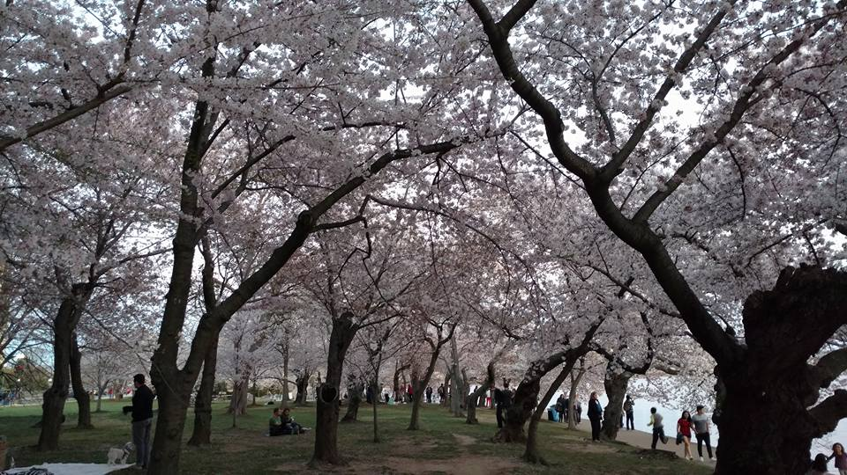
www.epa.gov/cwsrf
14

