Slide 1

2018
The Baton Is Passed
U.S. Economics Team
Ward McCarthy, PhD Managing Director, Jefferies LLC
Chief Financial Economist
212-323-7576
wmccarthy@jefferies.com
Thomas P. Simons, CFA
Senior Vice President, Jefferies LLC
Senior Money Market Economist
212-323-7577
tsimons@jefferies.com
Malachy Mahon
Analyst
212-707-6319
mmahon@jefferies.com
March 2018
Jefferies LLC
Member SIPC

Slide 2
2018: The Baton Is Passed, the Handoff Is Shaky
With the enactment of tax reform, 2018 will be marked by the passing of the baton from monetary policy to fiscal policy as the primary source of economic stimulus, as Jerome Powell assumes the mantle of leadership for monetary policy normalization.
Economy: In a Good Place, Growth Profile Will Continue to Improve
1. Consumer spending will be boosted by continued job growth, increased wealth, rising disposable income and increased confidence.
2. Many, but not all households will benefit from tax cuts and increased disposable income.
3. The cumulative effects of business deregulation and corporate tax relief will foster a more business friendly environment.
4. Rebuilding housing stock in regions devastated by natural disasters will boost construction activity in a market that is already
struggling with a housing shortage and a shortage of construction workers.
5. With 6 million job openings, tightening labor markets and rising voluntary separations wages will accelerate in a more meaningful way.
Inflation: Gradual Acceleration
1. The supply shock in housing caused by the natural disasters will accelerate the upward trend in the shelter component of the CPI.
Rising prices for imported goods will get passed on to a stronger consumer sector that is able to absorb price increases.
Inflation measures will also be boosted by supportive base effects.
Monetary Policy: Four Rate Hikes, More SOMA Normalization, Focus Shifts to Composition
1. New Fed Chairman Jerome Powell will continue a monetary policy of gradual rate and balance sheet normalization.
2. Powell will also guide a tailored financial deregulation that moves away from the one-size-fits-all post-crisis regulatory approach.
3. With the departure of Janet Yellen, Stanley Fischer and Bill Dudley, there will be uncertainty until replacements are on board.
4. The composition of the Fed balance sheet -- the lack of bill holdings and the slow roll-off of MBS-- is likely to become a policy focus.
Fiscal Policy: Tax Reform Benefits and Unfortunate Unintended Consequences
1. The “Tax Cuts & Jobs Act” (TCJA) is far from perfect.
2. The TCJA corporate tax reform will create a more business friendly environment and boost long-term growth in the US.
3. The consequences of the TCJA for the consumer sector are more ambiguous and mixed. The housing sector in high-tax states is at risk.
4. Treasury net borrowing will rise by at least $450 bln, increases in auction sizes and additions to the auction calendar will be required.
Risks: Usual Suspects
1. The transfer of economic stimulus from monetary policy to fiscal policy will be a bumpy process.
2. The perpetually poisonous political environment in Washington will continue to generate uncertainty, frustration, a surplus of
investigations and a shortage of progress on important issues.
3. The evolution of protectionist policies could threaten global trade and adversely affect both growth and inflation.
4. Fiscal profligacy is a threat to long-term prosperity.
1

Slide 3
Table of Contents
Different Inflation Worlds, Hurricanes & Inflation, SOMA Composition
Inflation: Goods Prices Are Primary Cause of Volatility……………………..16
Inflation: Rent, OER & Service Inflation…Lessons from Katrina………......17
Inflation: Wage Growth & Inflation…………………………………………….18
Monetary Policy: Policy Decision Depends On Chosen Inflation Measure...19
Monetary Policy: Fed Funds Dot Plot………………………………………….20
Monetary Policy: SOMA Normalization, Size vs Composition……………….21
Monetary Policy: SOMA Normalization, Treasuries vs MBS..……………….22
Treasury Financing: Bigger Auctions, More Maturities? Bills & Bonds? 23
Appendix: GDP Growth & Seasonality Data Enigma……………………......24
Appendix: Productivity Conundrum & Anomaly………………………………25
Appendix: Detailed CPI Breakdown……………………………………………26
Appendix: U.S. Corporate Taxes in a Globalized Economy………………….27
Appendix: Fed SEP Projections for Growth & Inflation……………………...28
Appendix: JEF Economic & Rate Projections…………………………………29
Disclaimer………………………………………………………………………..30
Pace vs Endurance, Changing Structure, Labor Market Strength
Cyclical Dynamics: Not Robust, Still Going…….....…………….….3
Secular Dynamics: Dominant Service Sector, Growth & Inflation....4
Consumer Sector: Confident, Still Carries the Load…….………….5
Consumer Sector: Solid Fundamentals…………………….………..6
Consumer Sector: Vehicle Sales Hit Ceiling ………………….…....7
Housing Sector: Low Inventories + Demand = Rising Prices .….….8
Housing Sector: Still Has Legs……………………..…………….….9
Manufacturing Sector: Back to Life………………………………...10
Labor Market: Rolling Along………………………………………...11
Labor Market: Low Claims + High Openings = Growth………..…12
.
Labor Market: Approaching Full Employment?....…….……….….13
Labor Market: Anatomy of Wage Growth………………………......14
Labor Market: Underlying Dynamics of Wage Growth………..…..15
2

Slide 4
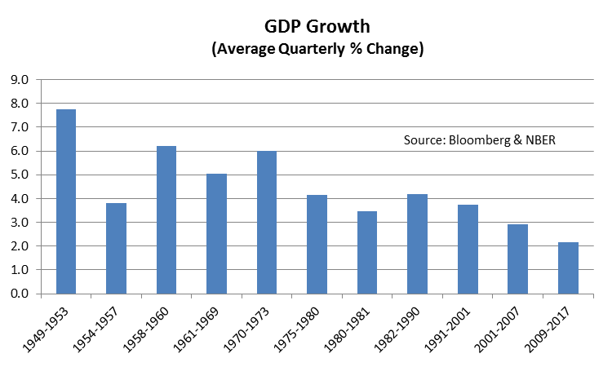
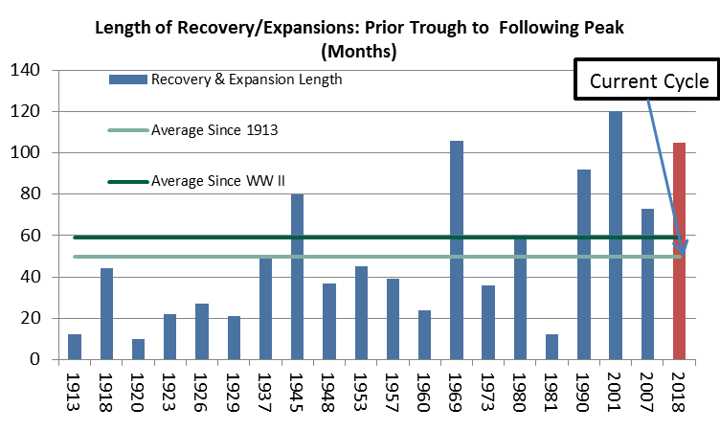
Business Cycle: Not Robust, but Still Going
Since 1913, the recovery and expansion phase of the business cycle has lasted an average of 4 years; since WWII, the average cycle has lasted almost 5 years.
Gradual and prolonged growth has replaced boom/bust conditions in recent cycles.
Growth in the last four cycles has been among the slowest but the length of each cycle has been among the most prolonged.
The change in the composition of the US economy and globalization are contributing factors to the changing nature of the US business cycle and growth.
3

Slide 5
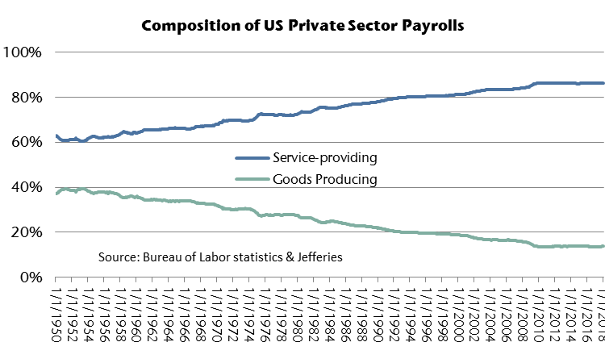
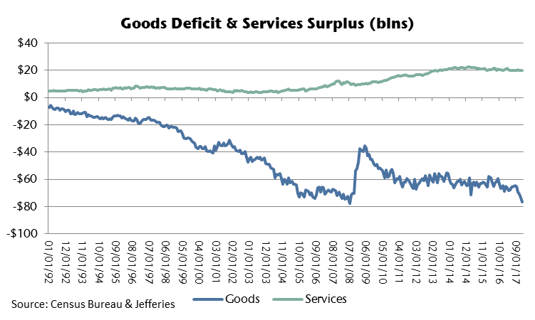
Secular Dynamics: Dominant Service Sector, Growth & Inflation
The US economy has evolved into an economy that is dominated by service activities.
Currently, more than 85% of US private sector workers are employed in the service sector, with less than 15% employed in the goods-producing activities of manufacturing, mining, energy exploration and construction.
The massive service sector tends to generate a very modest monthly trade surplus.
With the decline in manufacturing, the trade deficit for goods tends to be significantly larger than the service sector surplus.
Consequently, the trade imbalance between the service sector and goods-producing sector has been a drag on measured growth.
The contrast between the size of the goods deficit and services surplus is also an indication of how domestically-oriented the US economy and service sector have become.
Global economic conditions have played an increasingly important role in the determination of US inflation due to the greater influence of import prices for goods.
4

Slide 6
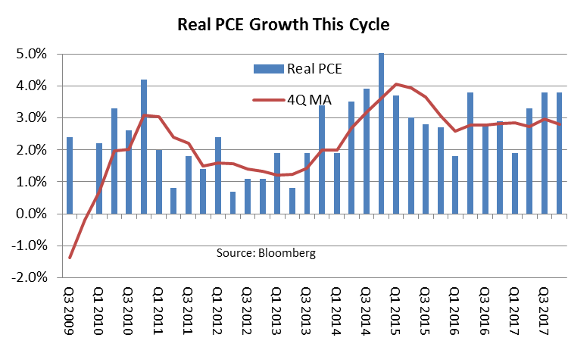
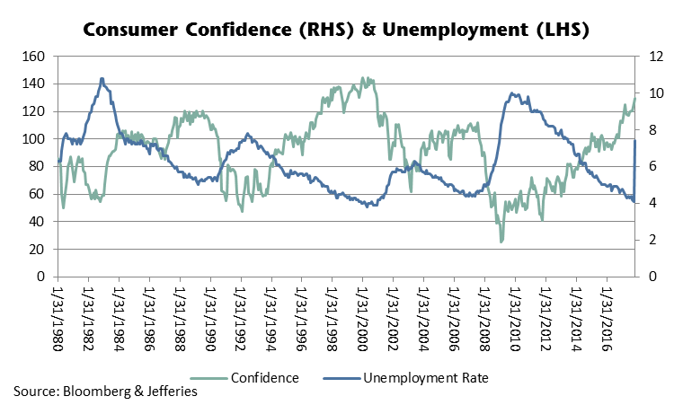
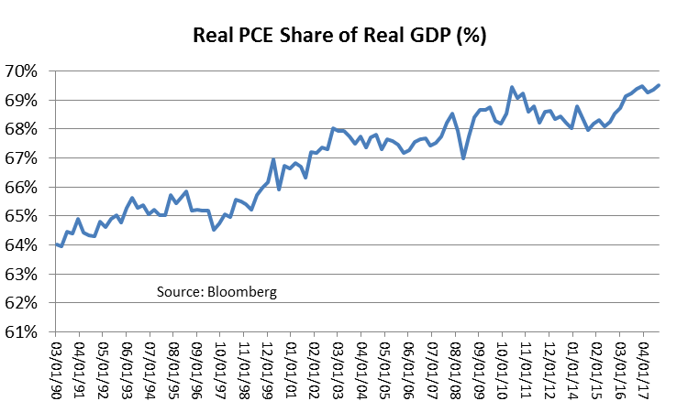
Consumer Sector: Confident, Still Carries the Load
Real PCE growth has grown at an average of 2.4% per quarter to-date this cycle and contributed the lion’s share to GDP growth.
PCE has also maintained a fairly stable share of GDP this cycle.
The outlook for the consumer sector remains favorable.
Consumer confidence has continued to rise as the unemployment rate has fallen and income has risen.
So long as the labor market continues to generate jobs and household net worth continues to increase, consumer confidence will remain high and spending will continue to rise.
Tax cuts will increase disposable income for most, but not all households.
5

Slide 7
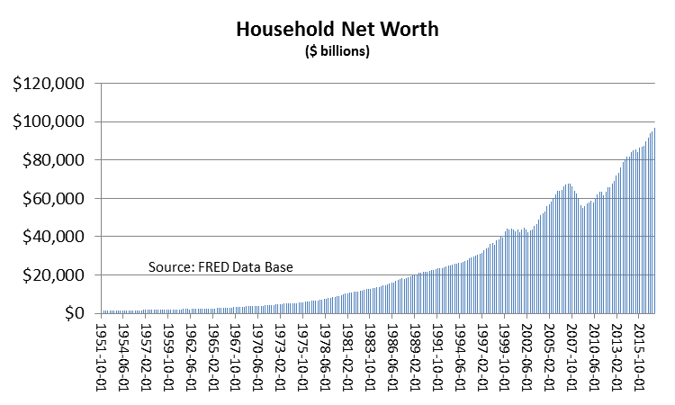
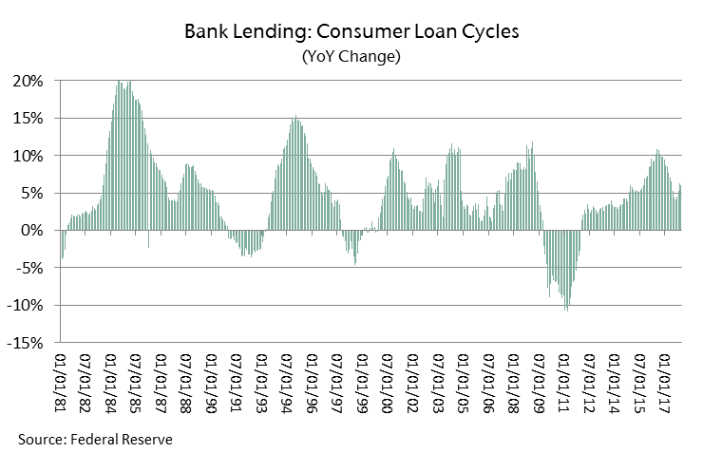
Consumer Sector: Solid Fundamentals
Overall, consumer behavior continues to be rational and cautious by historical standards.
Household disposable income has recovered from the 2013 tax hike that caused disposable income to downshift. Tax cuts will shift disposable income up another notch for most, but not all, households.
Rising home and equity prices have boosted household net worth.
Auto loans, revolving credit and bank lending have perked-up over the past few years, there has been rising credit stress in subprime auto loans.
Student loan growth dominated the increase in consumer credit after the crisis and has delayed, muted and altered the potentially positive effect of the younger generation on the U.S. economy.
6

Slide 8
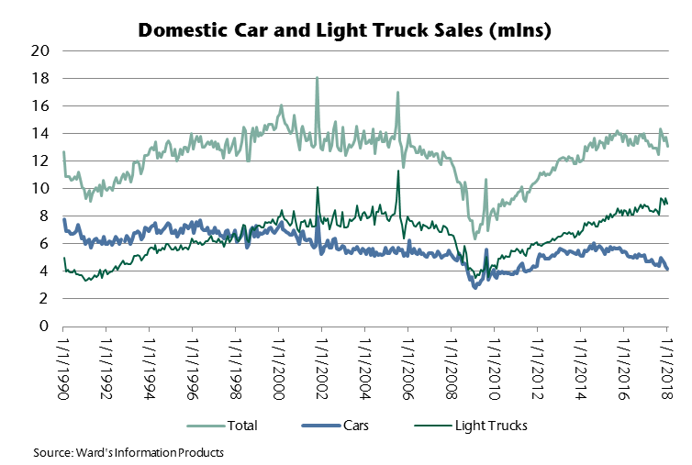
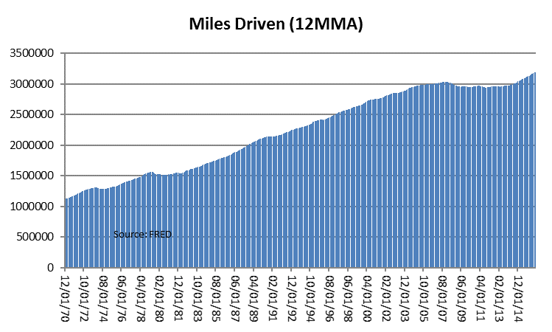
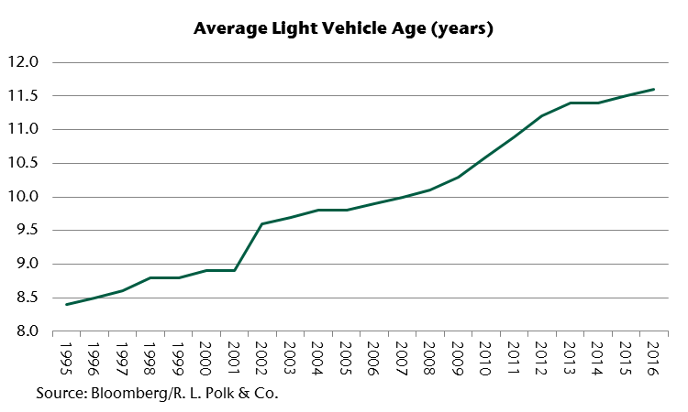
Vehicle Sales Hit Ceiling, Temporary Hurricane Boost Is Over
Light vehicle sales this cycle have been driven at least in part by replacement sales of an aged fleet. The average age of all cars and trucks was 11.6 years in 2016.
Job growth, rising confidence and an increase in miles driven have also supported auto sales.
However, vehicle sales have attained selling rates that have previously proven to be a ceiling and appear to have peaked for this cycle.
Light truck sales have been boosted by lower gasoline prices and risen at the expense of car sales.
Sales received a boost due to the need to replace vehicles damaged or destroyed by the hurricanes. That surge was temporary.
7

Slide 9
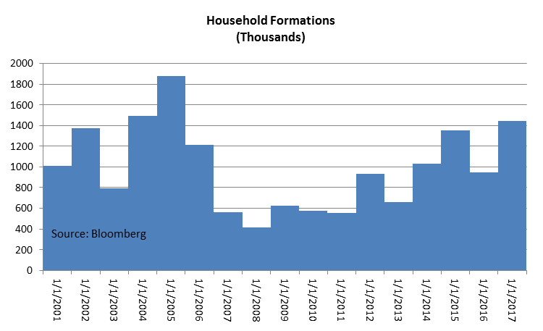
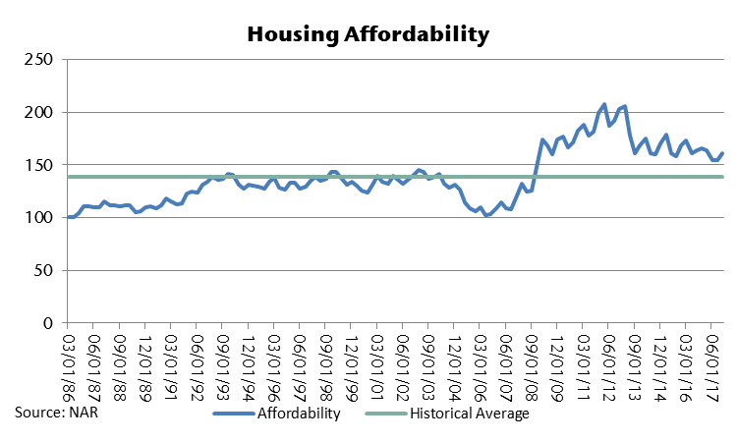
Housing Sector: Shortage + Demand = Rising Prices
Home prices continue to rise. In most regions, home prices have exceeded or are approaching price levels reached prior to the housing collapse.
Housing affordability is less attractive than earlier in the cycle and migrating toward the historical norm.
Household formations are again on the rise as the improved job market and confidence have freed millennials to get on with their lives. First-time homebuyers have accounted for about 30% of existing home sales over the past year.
8

Slide 10
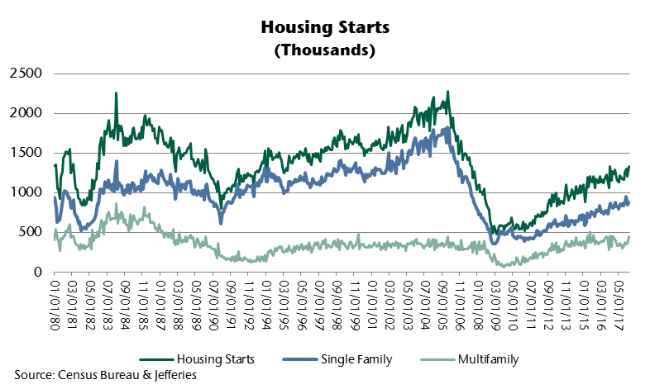
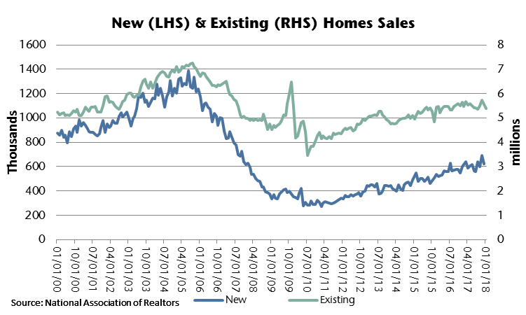
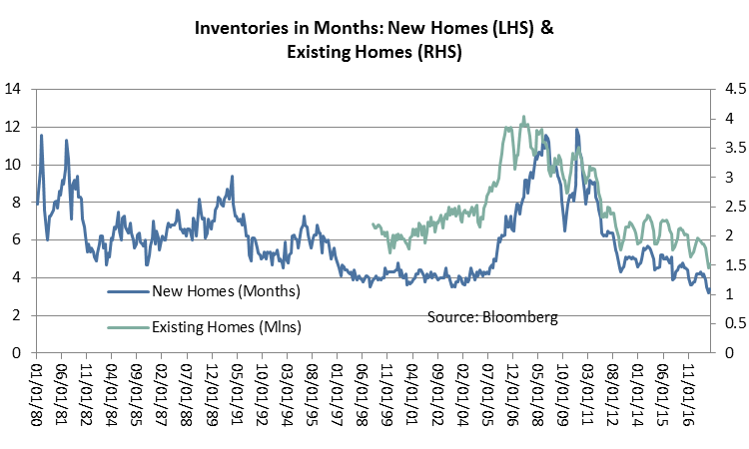
Housing Sector: Still Has Legs
Single family housing activity has taken the lead in the housing sector., but new and existing home markets continue to carry very low inventories that restrain the pace of home sales.
Furthermore, the share of single family homes occupied by renters increased has increased sharply since the housing crisis, exacerbating the housing inventory shortage.
In the face of rising demand, low inventories argue for continued price appreciation and home building.
Due to demographics and deteriorating housing affordability, the mid-price range of the housing market will to continue to outperform the upper end of the market.
Hurricane damage will boost housing-related activity for years to come.
9

Slide 11
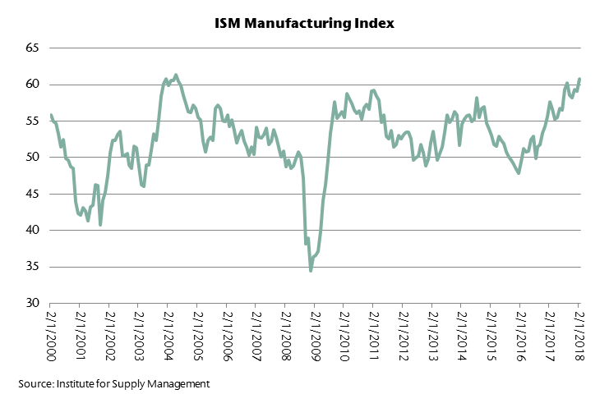
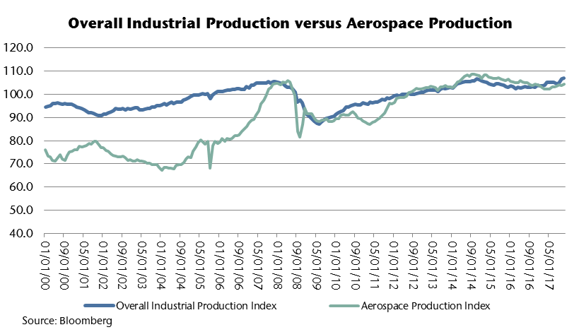
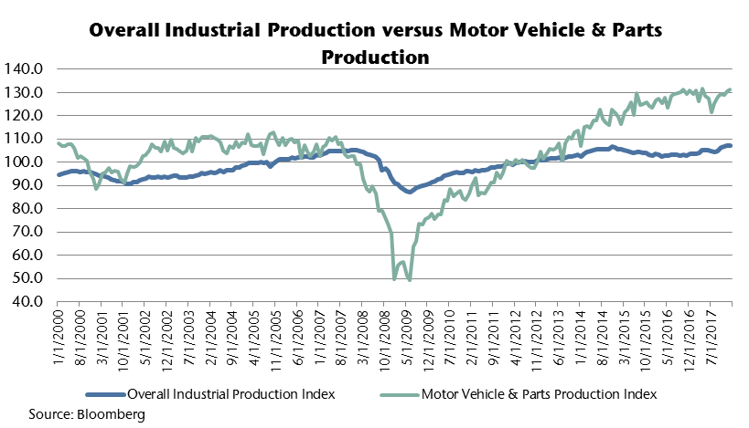
Manufacturing Sector: Back to Life
The pace of manufacturing in the transportation sector has moderated and manufacturing activity outside of transportation has improved since energy prices and energy-related CAPEX spending have recovered.
Aircraft orders and light vehicle sales will continue to support manufacturing in the transportation and related sectors, although light vehicle sales have slipped from the peak of the cycle.
A more competitive US corporate tax rate will slow the migration of manufacturing to destinations outside the US borders.
Manufacturing payrolls rose 224k over the prior 12 months.
10

Slide 12
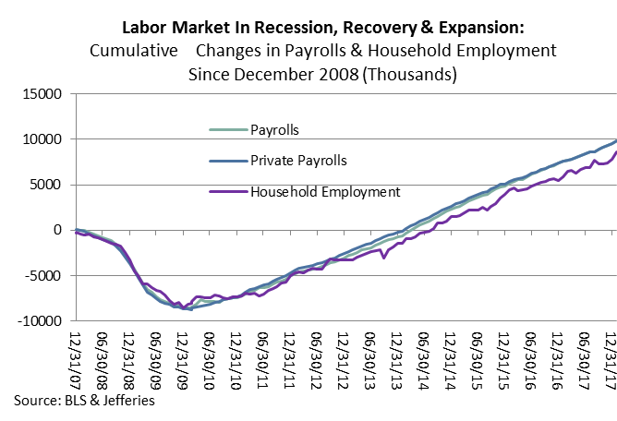
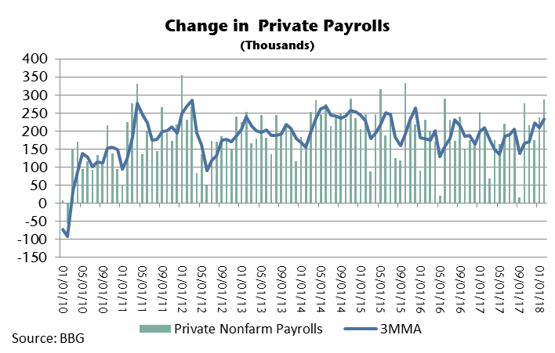
Labor Market: Rolling Along
Private nonfarm payrolls have risen every month since March 2010 and have increased by an average of roughly 190k per month.
Payroll growth has also been gradually decelerating since 2014 as the pool of available labor has dwindled.
Changes in household employment have been significantly more erratic than payroll changes.
Labor market conditions will continue to become more conducive to an acceleration of earnings growth as the labor market expansion continues and pushes toward full employment.
11

Slide 13
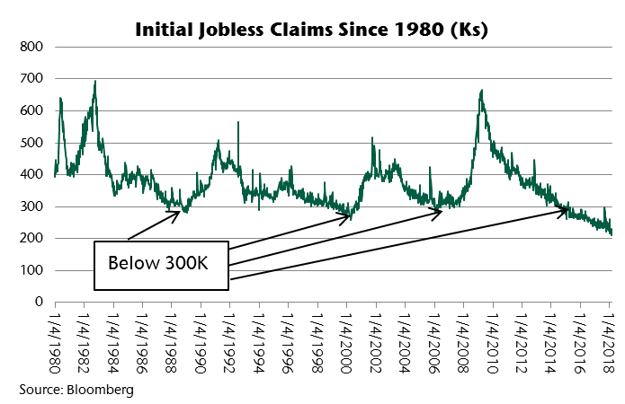
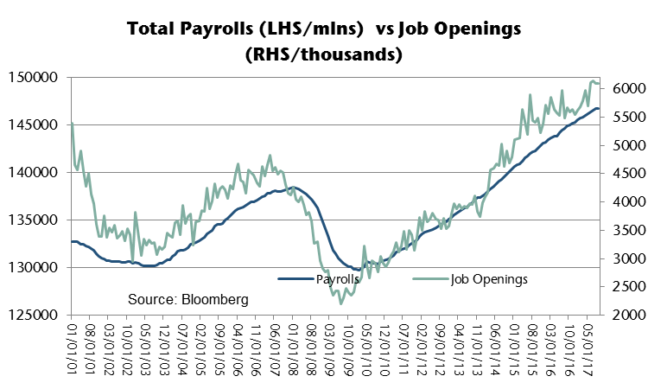
Labor Market: Low Claims + High Openings = Job Growth
Since September 2014, the weekly jobless claims have been holding near or below a frictional level of claims of 300k. Even the surge due to the hurricanes did not penetrate 300k.
Since 1980, there have been three prior periods of a frictional level of claims. These periods of frictional claims levels occurred when the labor market was strong.
Despite the strong payroll growth, the number of job openings set records in excess of 6 mln in 2017.
12

Slide 14
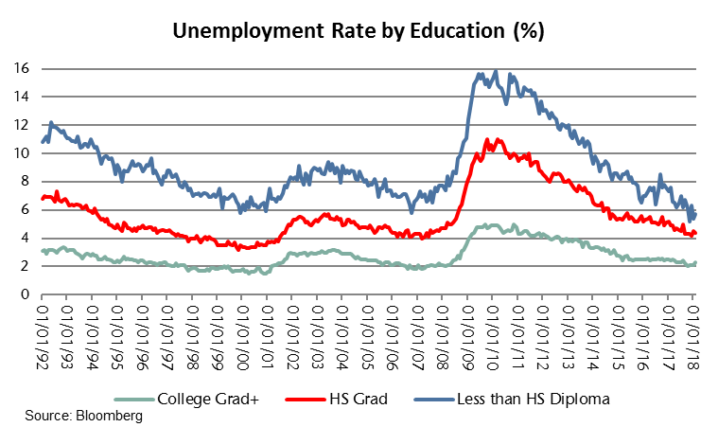
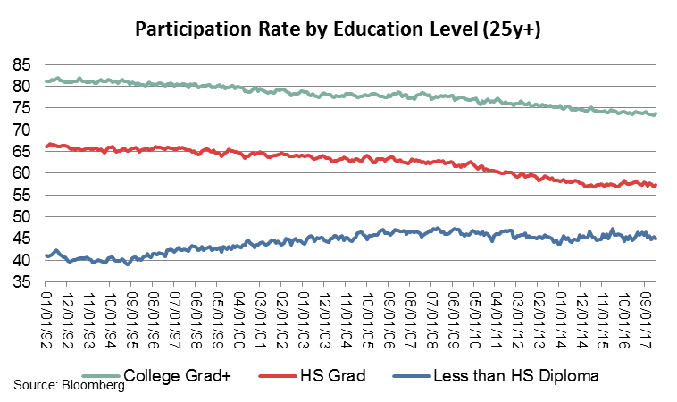
Labor Market: Approaching Full Employment?
The disparity between unemployment rates by education for much of this cycle suggested that the labor market was nearing full employment for skilled workers, but not for less skilled labor.
Less skilled labor has narrowed the gap.
Participation rates across the skill spectrum have stabilized over the past few years, and rose more recently.
If the participation rate continues to rise as it did in February, the rate of growth of the labor market could again accelerate.
13

Slide 15
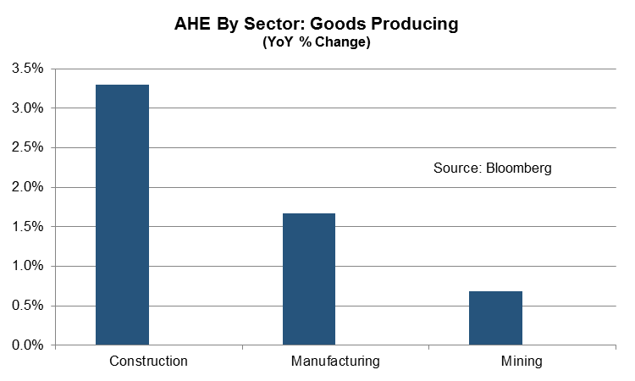
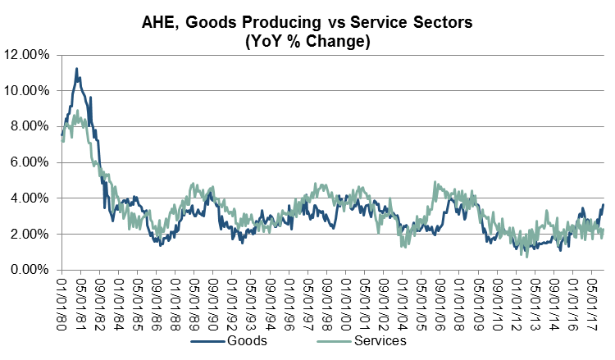
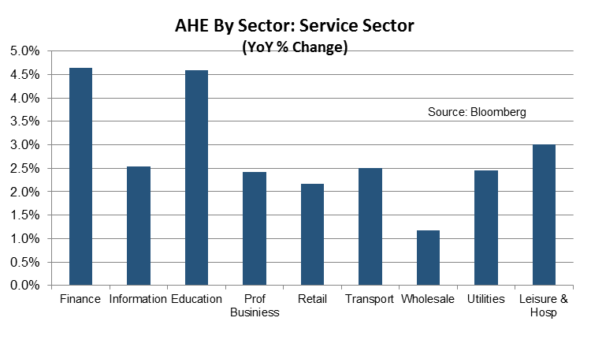
Labor Market: Anatomy of Wage Growth
The acceleration in wage growth this cycle has been slow and fitful.
There are some factors that may have helped to suppress wage growth this cycle, including a slow return of confidence and consequential willingness to change jobs
Wage growth in the goods-producing sector lagged wage growth in the service sector for much of this cycle, but has taken the lead more recently.
Replenishing the housing stock depleted by natural disasters in Gulf regions and California will increase the labor demand and foster faster wage growth in the construction sector.
14

Slide 16
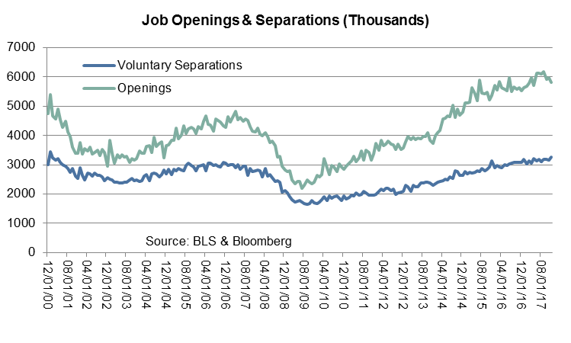
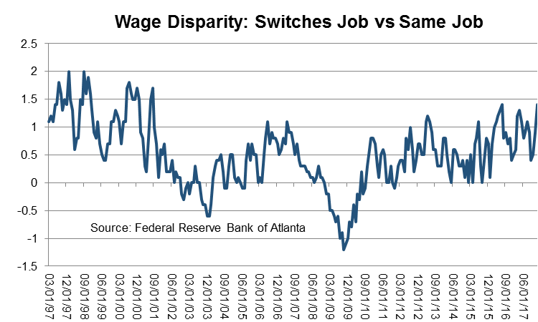
Labor Market: Underlying Dynamics of Wage Growth
While wages have yet to accelerate in a compelling fashion to-date this cycle, the conditions for growing wage pressures are coming together.
The rise in job openings suggests that employers will have to raise wages to attract skilled workers to fill existing job openings.
The rise in voluntary separations (Quits) suggests that employers will have to raise wages to keep existing employees from leaving.
Atlanta Fed research indicates wages tend to rise faster for those who switch jobs than for those who stay at the current job.
So, a rising trend in voluntary separations is an important piece of the wage puzzle.
15

Slide 17
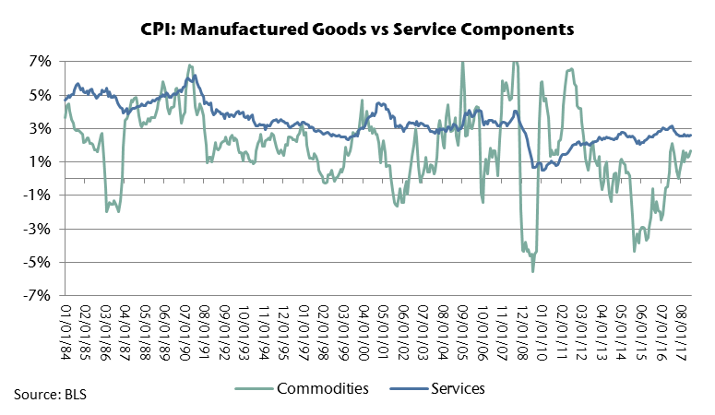
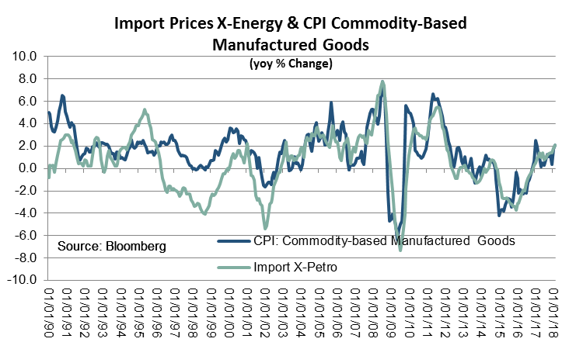
Inflation: Goods Prices Are Primary Cause of Volatility
The prices of manufactured goods prices are the primary source of volatility in US inflation.
Because of the influence of global markets in determining goods prices, the volatility of manufactured goods prices and headline CPI has become more pronounced with globalization.
Service-based prices continue to be pro-cyclical with the U.S. economy and are primarily domestically determined.
The prices of many U.S. goods are determined in global markets and imported. Consequently, the goods prices of the CPI are highly correlated with import prices.
16

Slide 18
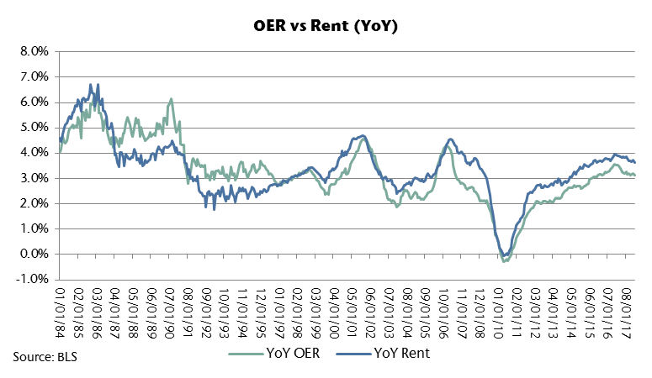
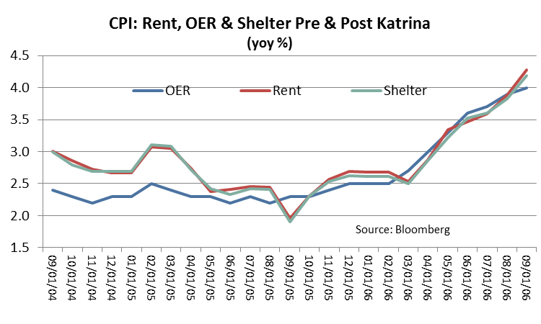
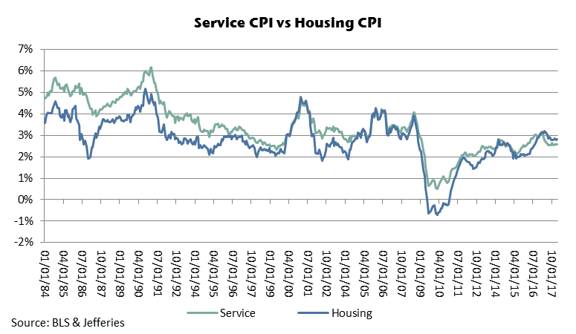
Inflation: Rent, OER & Shelter…Lessons from Katrina
The YoY increases in both rent and the OER to-date this cycle have been moderate by historical standards.
Vacancy rates remain low, but have ticked above the cyclical lows. In isolation, this would argue for a more gradual rise in rents and the OER going forward.
However, there is already a shortage of housing that has been exacerbated by the hurricanes and wild fires. Hundreds of thousands of homes were destroyed and many more were damaged in regions struck by natural disasters.
If the 2005 experience is repeated, displaced homeowners will bid up rents and the OER and shelter component of the CPI will follow suit.
17

Slide 19
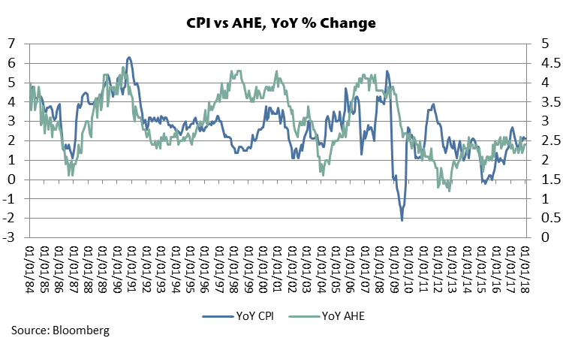
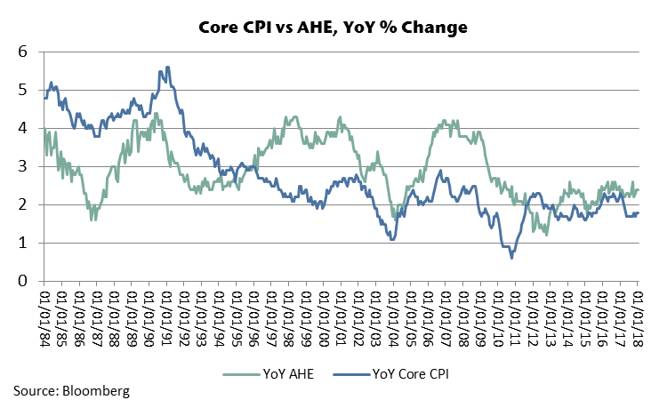
Inflation: Wage Growth & Inflation
The behavior of wage growth has significance that extends beyond the labor market.
Income growth and wage growth are fundamental to consumer spending.
In addition, history suggests that an acceleration in inflation is not likely to be sustained in the absence of an acceleration in AHE and income.
Over the past thirty years, the annual change in the Core CPI has tended to run below the annual change in average hourly earnings. The spread is positive but narrow at the current juncture.
18

Slide 20
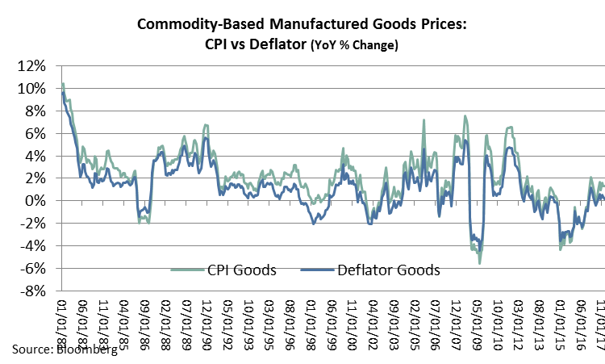
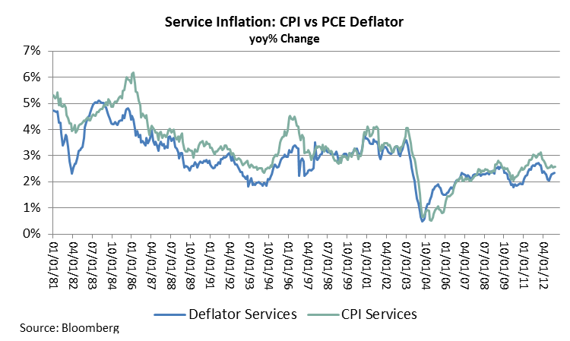
Monetary Policy: Policy Decisions Depend On Choice of Inflation Measure
The inability of the Fed to achieve it’s inflation target is due to the volatile nature of goods prices that are determined in global markets and imported to the US.
If trends in manufactured goods prices are not procyclical with the US economy, US monetary policy is not the appropriate tool for addressing headline inflation that is driven by import prices.
In contrast, service prices tend to be procyclical with domestic U.S. economic conditions, so US monetary policy is a useful tool for addressing service inflation.
Service price inflation has been above 2% for much of this cycle.
Had the FOMC focused on a service inflation target that is more responsive to domestic economic conditions, the Fed would have a very different view of the inflation mandate at this stage of the business cycle.
The rate normalization process would be more advanced than it is today, and short-term rates would be higher.
19

Slide 21
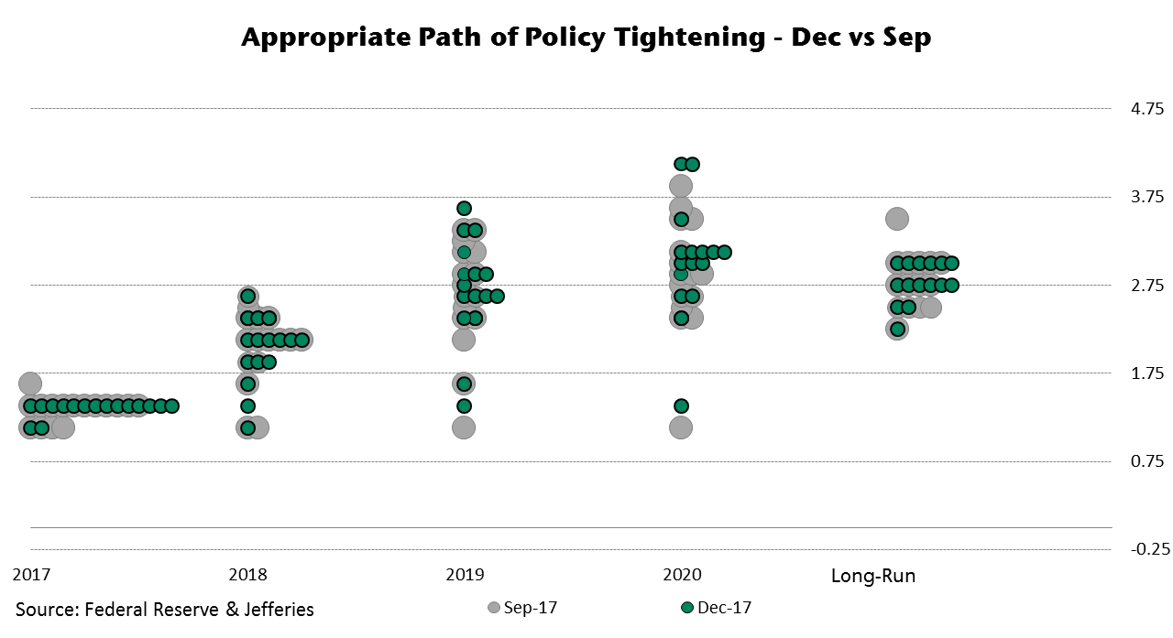
Monetary Policy: Fed Funds Dot Plot
The January 31“Dots” (the appropriate path of policy tightening) reflect
small and mixed changes in the near-term. They continue to reflect an expectation for 3 rate hikes in 2018 despite a modest decline in the average projection for the year.
Looking further ahead to 2020, rose Dots lie above the long-run forecasts, suggesting that the FOMC expects to temporarily overshoot the long term neutral fed funds rate before the end of this cycle.
20

Slide 22
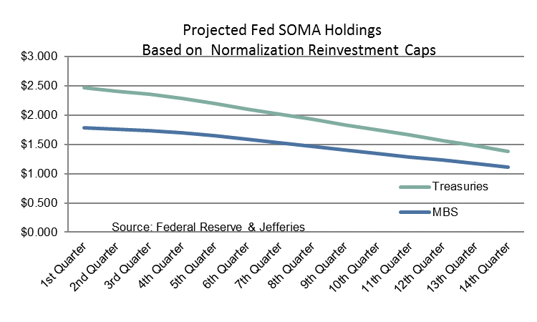
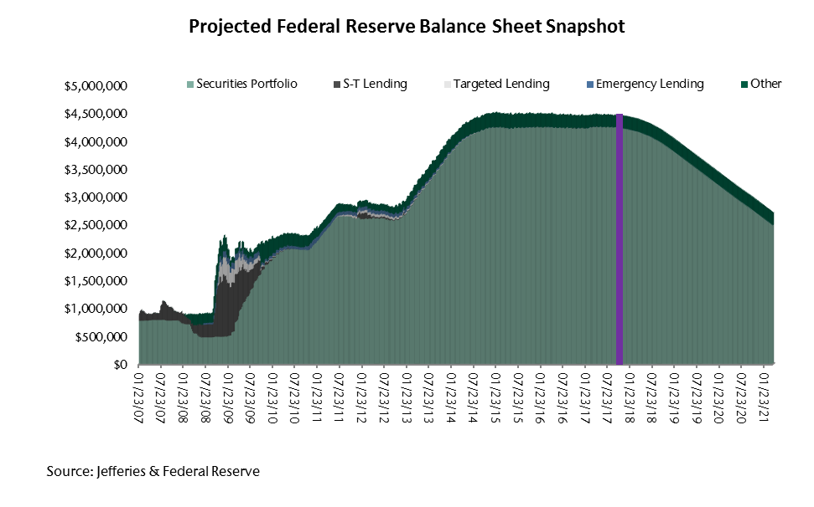
Monetary Policy: SOMA Normalization, Size vs Composition
The FOMC has laid out a well defined trajectory for the normalization of the balance sheet that is projected to reduce the size of the balance sheet to roughly $2.75 trln in 2022. There are still two lingering issues that need to be addressed.
The ongoing normalization program falls far short of eliminating all MBS from SOMA holdings.
The ongoing normalization program falls far short of returning bill holdings to roughly 1/3 of Treasury SOMA holdings.
MBS normalization has been very erratic and fallen short of the Caps.
The Fed could address these issues by rolling some mortgage proceeds into bills. This would both increase SOMA bill holdings and accelerate the process of shedding MBS holdings.
This would also help the Treasury Department to finance SOMAs normalization at a time when rising deficits will put significant upward pressure on Treasury financing needs.
21

Slide 23
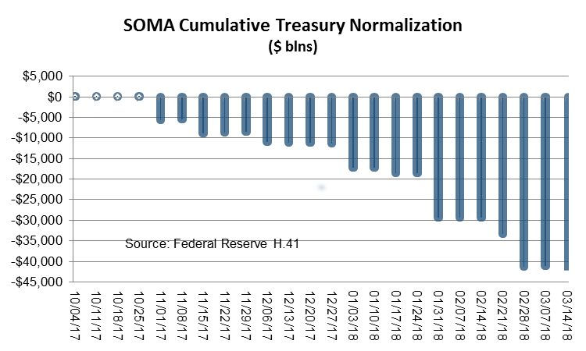
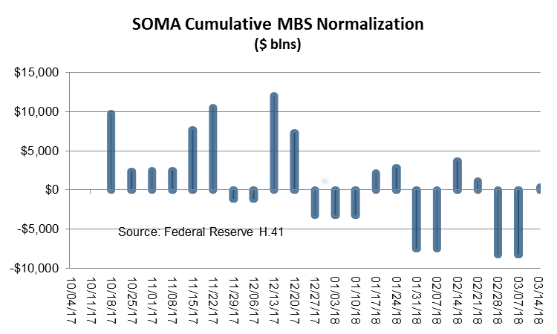
Monetary Policy: SOMA Normalization, Treasuries vs MBS
The normalization of Treasury securities has been proceeding at a pace that has been running close to the Caps laid out by the Fed.
The normalization of MBS securities has been proceeding much more erratically, and at a pace that has been running well below the Caps laid out by the Fed.
22

Slide 24
Treasury Financing: Bigger Auctions, Additional Maturities? Bills & Bonds?
Treasury debt managers face a daunting task
The size of the budget deficits will increase dramatically due to the tax cuts and increased spending in the budget that passed in February.
The volume of maturing issues will also increase.
The wind-down of SOMA Treasury holdings also needs to be financed.
The effect on interest rates and the curve of the increased Treasury borrowing will depend upon the maturity structure of the increase in Treasury borrowing and debt. Treasury will need to add new issues to the auction calendar or the sizes of existing auctions will become unwieldy. A longer-term issue would be logical.
It would require coordination between the Fed and Treasury, but the Fed could adjust the ongoing balance sheet normalization by rolling some of the MBS proceeds into bills. This would increase SOMA bill holdings AND ease Treasury borrowing needs.
23

Slide 25
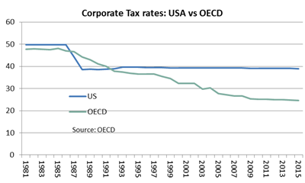
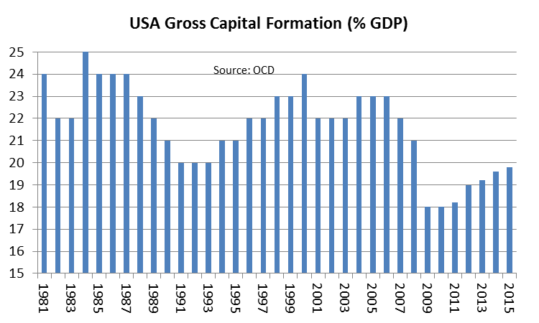
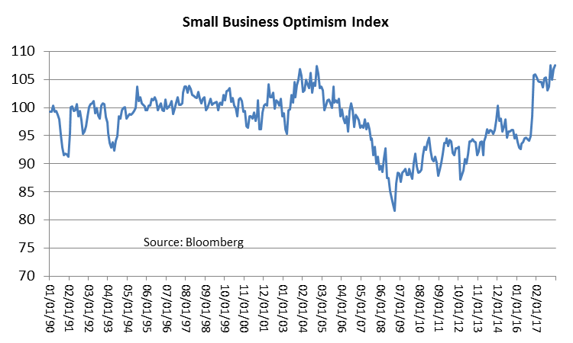
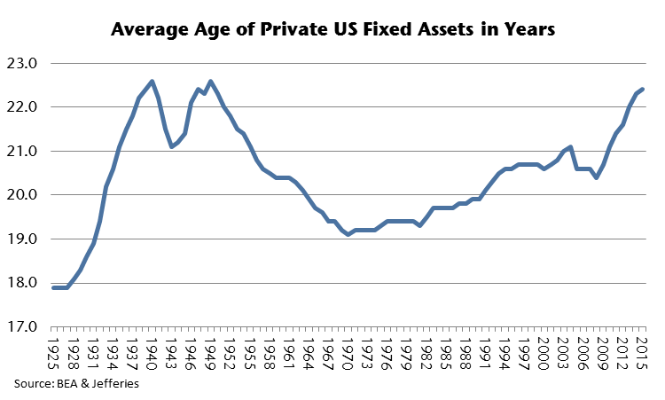
Fiscal Policy: Corporate Tax Reform Matters Most
An uncompetitive tax structure is why US corporations continue to hold an estimated $2.5 trln profits overseas and, in some cases, have implemented so-called “inversions” to low tax countries.
The decline in US corporate tax competitiveness also lies at the heart of the secular decline in US capital formation and the aging of capital assets.
The secular decline in investment has been a contributing factor to the soft productivity.
Corporate tax reform will boost investment spending, growth and productivity.
The promise and delivery of tax reform has boosted small business optimism to the highest reading since 1983!
24

Slide 26
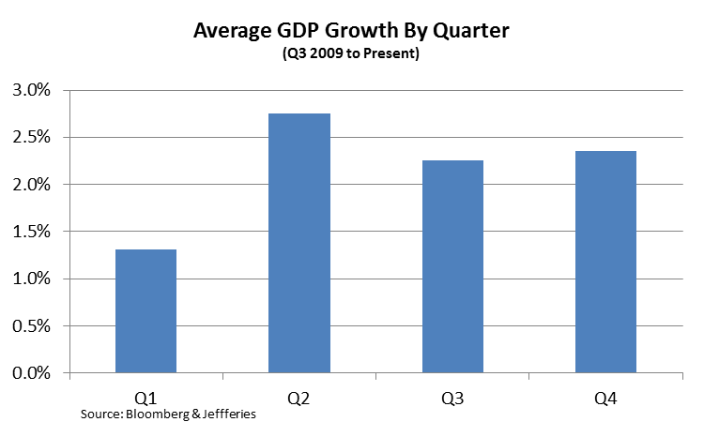

Appendix: GDP Growth & Seasonality Data Enigma
Growth to-date this cycle has been uneven across quarters.
Growth in Q1 has averaged 1.3%. Growth in Q2, Q3 and Q4 has collectively averaged 2.5%.
The issue of slow Q1 growth predates the current cycle, however. Economic research at the Federal Reserve Bank of San Francisco attributes the relatively sluggish Q1 growth to “residual seasonality” that occurs because of the process used by the BEA to aggregate data.
Source: Bloomberg
Source: Federal Reserve Bank of San Francisco
25

Slide 27



Appendix: Productivity Conundrum & Anomaly
The slowdown in productivity growth and the change in the relationship between payroll growth and productivity growth is puzzling.
Payroll growth and productivity growth had a positive and pro-cyclical relationship during the 1960s, 1970s and 1980s.
The relationship has been quite different since 1990.
There is no single compelling explanation for the countercyclical productivity conundrum.
The decline in investment spending as a share of GDP and measurement issues associated with the evolution in the structure of the U.S. economy are probably partial explanations.
26

Slide 28
Appendix: Detailed CPI Breakdown
27

Slide 29
Appendix: U.S. Corporate Taxes in a Globalized Economy
At 39%, roughly the combined federal and average of state and local rates, the U.S had the highest marginal corporate tax rate in the OECD and third highest in the world.
Even when corporate taxes are adjusted for the various tax credits and deductions available in the US and elsewhere, the U.S. corporate tax burden is substantially more onerous than most U.S. competitors.
The average effective tax rate is an all-in measure of tax burden that is measured by dividing the amount of tax a corporation in a country pays divided by its income. This measure takes into account the statutory tax rate, deductions, and any credits that reduce a corporation’s tax liability.
The marginal effective tax rate is the tax corporations pay on a marginal investment, and is mainly a function of the statutory tax rate and deductions corporations can take on new investments, such as depreciation allowances. The lower the marginal tax rate is on new investment, the lower the pre-tax returns on investments need to be to be attractive to investors. Consequently, the lower the marginal effective tax rate, the more likely business are to invest.
85% of US workers are employed in the corporate sector. Making the US economy more competitive globally would foster faster job growth and a healthier labor market.
28

Slide 30
Appendix: Fed SEP Projections for Growth & Inflation
The changes to the economic forecasts released along with the policy statement reflected better growth and lower unemployment projections for 2017 and 2018.
However, there was very little change in the inflation forecasts. The median forecast for 2018 GDP was revised up to 2.5% from 2.1%. Other years were up modestly. Forecasts may be starting to factor in some fiscal stimulus.
29

Slide 31
Appendix: JEF Economic, Fed & Rate Projections:
30

Slide 32
IMPORTANT PLEASE READ: THIS MESSAGE CONTAINS INSUFFICIENT INFORMATION TO MAKE AN INVESTMENT DECISION.
Please contact your Jefferies representative for copies of the most recent research reports on individual companies. This material has been produced by one of the following affiliates of Jefferies Group LLC (“Jefferies”):
United States: Jefferies LLC, an SEC-registered broker dealer, a CFTC-registered futures commission merchant and a member of FINRA and NFA; Jefferies Bache Financial Services, Inc., a CFTC-provisionally registered swap dealer and pending membership with NFA; Jefferies Derivative Products LLC, a CFTC-provisionally registered swap dealer and pending membership with NFA, and Jefferies Financial Products LLC, a CFTC provisionally registered swap dealer, each located at 520 Madison Avenue, New York, NY 10022.
United Kingdom: Jefferies International Limited, authorized and regulated by the Financial Conduct Authority and registered in England and Wales No. 1978621; and Jefferies Bache Limited, authorized and regulated by the Financial Conduct Authority and registered in England and Wales No. 512397, each with their registered offices at Vintners Place, 68 Upper Thames Street, London EC4V 3BJ.
Switzerland: Jefferies (Schweiz) AG, authorized and regulated by the Swiss Financial Market Supervisory Authority and registered in Switzerland No. CH-020.3.005.806-7. Registered office: Uraniastrasse 12, CH-8021 Zürich, Switzerland.
Hong Kong: Jefferies Hong Kong Limited, licensed by the Securities and Futures Commission of Hong Kong, CE number ATS546; located at Suite 2201, 22nd Floor, Cheung Kong Center, 2 Queen's Road Central, Hong Kong.
India: Jefferies India Private Limited (CIN - U74140MH2007PTC200509), licensed by the Securities and Exchange Board of India for: NSE Capital Market Segment INB231491037; BSE Capital Market Segment INB011491033 and Merchant Banker INM000011443, located at 42/43, 2 North Avenue, Maker Maxity, Bandra-Kurla Complex, Bandra (East) ,Mumbai 400 051.
Japan: Jefferies (Japan) Limited, Tokyo Branch, registered by the Financial Services Agency of Japan and member of the Japan Securities Dealers Association; located at Hibiya Marine Bldg, 3F, 1-5-1 Yuraku-cho, Chiyoda-ku, Tokyo 100-0006.
Singapore: Jefferies Singapore Limited, registered in Singapore No. 200605049K and licensed by the Monetary Authority of Singapore; located at 80 Raffles Place #15-20, UOB Plaza 2, Singapore 048624.
This material is a marketing communication and is not and should not be construed as investment research or a research report prepared by a research analyst. Any views portrayed in this material may differ from those of the research department of Jefferies. This material has not been prepared in accordance with legal requirements designed to promote the independence of investment research, and is not subject to any prohibition on dealing ahead of the dissemination of investment research. Jefferies has employed appropriate expertise, and is of the belief that this material is clear, fair and not misleading. The information set forth herein was obtained from sources believed to be reliable, but has not been independently verified by Jefferies. Therefore, except for any obligation under applicable rules we do not guarantee its accuracy.
This material is being furnished for informational purposes only and does not constitute an offer to sell or the solicitation of an offer to purchase [or otherwise trade] any security, future, commodity, option or other financial instrument or product. This material does not constitute a personal recommendation or take into account the particular investment objectives, financial situations, or needs of individual clients. This material is not intended to form the basis of an investment decision and has not been verified. Jefferies makes no recommendation or representation as to, and accepts no responsibility or liability for, the accuracy or completeness of the information contained herein. Jefferies is not an adviser as to legal, tax, accounting or regulatory matters in any jurisdiction, and is not providing any advice as to any such matter to the recipient of this material. You should be aware of the risks of trading equities, fixed income, foreign exchange, futures, commodities or derivative instruments or in non-liquid or emerging market investments. Derivatives generally involve leverage and are therefore more volatile than their underlying cash investments. Trading in futures and options on futures is not appropriate for all persons, as the risk of loss is substantial. Your capital may be at risk. You should make your own independent decision regarding any investment in the securities or instruments described herein and any such decision should be made only after reviewing the related final documentation, conducting such investigations as you deem necessary and consulting your own legal, tax, financial, accounting and regulatory advisors in order to make an independent determination of the suitability, risks and consequences of an investment in such securities or instruments.
The information and any opinions contained here are as of the date of this material and, if applicable, the time indicated, and Jefferies does not undertake any obligation to update the information. All market prices, data and other information are not warranted as to completeness or accuracy and are subject to change without notice. Past performance is not a guide to future performance, future returns are not guaranteed, and a loss of original capital may occur. Fluctuations in exchange rates could have adverse effects on the value or price of, or income derived from, certain investments. The price and value of any investments referred to herein and the income from them may fluctuate. Any simulations, projections, valuations and statistical analyses contained herein have been provided to assist the recipient in the evaluation of the matters described herein; such simulations, projections, valuations and analyses may be based on subjective assessments and assumptions and may utilize one among alternative methodologies that produce differing results; accordingly, such simulations, projections, valuations and statistical analyses (historical or otherwise) are not to be viewed as facts and should not be relied upon as an accurate representation of future events. The information contained herein is based on data obtained from recognized statistical services and other sources believed to be reliable. However, such information has not necessarily been verified by Jefferies, and Jefferies does not make any representations as to its accuracy, timeliness, reliability, effectiveness, or completeness. Jefferies may from time to time issue futures reports based on fundamentals, such as expected trends in supply and demand, as well as reports based on technical factors, such as price and volume movements. Since such reports rely upon different criteria, there may be instances when Jefferies’ conclusions in individual reports are not in concert. Any market views or opinions expressed herein are those of the individual sender, except where such views or opinions are expressly attributed to Jefferies or a named individual. Market views and opinions are current opinions only; Jefferies and the individual sender accept no responsibility to update such views and opinions or to notify the recipient when they have changed.
31

Slide 33
Jefferies and its affiliates, officers, directors and employees may, directly or indirectly, effect or have effected a transaction for Jefferies’ own account in any investment referred to herein, either before or after this material is published, or may give advice to customers which may differ from or be inconsistent with the information and opinions contained herein or may from time to time hold long or short positions in, buy or sell (on a principal basis or otherwise), or act as market maker in, securities, derivatives, futures or other financial instruments or products related to matters discussed herein and may make trading decisions that are different from or contrary to any of those which may be discussed herein.
This material may contain information obtained from third parties, including ratings from credit ratings agencies such as Standard & Poor's. Reproduction and distribution of third party content in any form is prohibited except with the prior written permission of the related third party. Third party content providers do not guarantee the accuracy, completeness, timeliness or availability of any information, including ratings, and are not responsible for any errors or omissions (negligent or otherwise), regardless of the cause, or for the results obtained from the use of such content. Third party content providers give no express or implied warranties, including, but not limited to, any warranties of merchantability or fitness for a particular purpose or use. Third party content providers shall not be liable for any direct, indirect, incidental, exemplary, compensatory, punitive, special or consequential damages, costs, expenses, legal fees, or losses (including lost income or profits and opportunity costs) in connection with any use of their content, including ratings. Credit ratings are statements of opinions and are not statements of fact or recommendations to purchase, hold or sell securities. They do not address the suitability of securities or the suitability of securities for investment purposes, and should not be relied on as investment advice.
U.S. OPTIONS ARE NOT SUITABLE FOR ALL INVESTORS. Please ensure that you have read and understand the current U.S. options risk disclosure document before entering into any U.S. option transaction. The U.S. options disclosure document can be accessed at the following web address: http://optionsclearing.com/about/publications/character-risks.jsp. For additional information on trading U.S. options, please contact Jason Roelke, Head of New York Derivative Sales at +1 212 284-2454.
In the United Kingdom and European Economic Area this material is issued and/or approved for distribution by Jefferies International Limited and Jefferies Bache Limited and is intended for use only by persons who have, or have been assessed as having, suitable professional experience and expertise, or by persons to whom it can be otherwise lawfully distributed. In the member states of the European Economic Area this material is for distribution only to persons who are “qualified investors” within the meaning of article 2(1)(e) of The Prospectus Directive.
For Canadian investors, this material is intended for use only by professional or institutional investors. None of the investments or investment services mentioned or described herein is available to other persons or to anyone in Canada who is not a “Designated Institution” as defined by the Securities Act (Ontario).
In Singapore, this material is distributed by Jefferies Singapore Limited and is intended for use only by accredited, expert or institutional investors (as defined by the Securities and Futures Act (Cap. 289) of Singapore (the “SFA”)). Jefferies Singapore Limited is licensed under the SFA as a capital markets services license holder for the regulated activities of “dealing in securities”, “trading in futures contracts” and "advising on corporate finance", and is also an exempt financial adviser under the Financial Advisers Act for advising on securities (including collective investment schemes), futures contracts and contracts or arrangements for the purposes of foreign exchange trading. Jefferies Singapore Limited is also exempt from licensing as a commodity broker (and therefore trading in commodity contracts) under the Commodity Trading Act (Cap. 48A of Singapore) (“CTA”) insofar as such trading is only with accredited investors as defined under the CTA. Apart from the foregoing, Jefferies Singapore Limited is not licensed to carry out or produce or issue any materials relating to any other regulated activities not otherwise described above.
In Japan this material is issued and/or approved for distribution by Jefferies (Japan) Limited, Tokyo Branch to institutional investors only. Jefferies (Japan) Limited will not issue or approve for distribution any material relating to any product that Jefferies (Japan) Limited is not licensed to deal in or provide services for, including commodities, foreign exchange, futures and options.
In Hong Kong, this material is issued and/or approved for distribution by Jefferies Hong Kong Limited and is intended for use only by professional investors as defined in the Hong Kong Securities and Futures Ordinance and its subsidiary legislation. Jefferies Hong Kong Limited is not licensed by the Securities and Futures Commission to conduct leveraged foreign exchange trading. Accordingly, any communications relating to leveraged foreign exchange contracts (as defined in the Securities and Futures Ordinance) are not issued or approved for distribution by Jefferies Hong Kong Limited or its staff.
In India this material is issued and/or approved for distribution by Jefferies India Private Limited. Jefferies India Private Limited is not permitted to be associated with or carry on any business relating to commodities or foreign exchange and therefore any material or communications relating to commodities or foreign exchange are not issued or approved for distribution by Jefferies India Private Limited or its staff.
In Australia this material is issued and/or approved for distribution by one of Jefferies LLC, Jefferies International Limited, Jefferies Bache Limited, Jefferies Hong Kong Limited or Jefferies Singapore Limited. It is directed solely at wholesale clients within the meaning of the Corporations Act 2001 of Australia (the “Corporations Act”), in connection with their consideration of any investment or investment service that is the subject of this material. Any offer or issue that is the subject of this material does not require, and this material is not, a disclosure document or product disclosure statement within the meaning of the Corporations Act. Jefferies LLC, Jefferies International Limited, Jefferies Bache Limited, Jefferies Hong Kong Limited and Jefferies Singapore Limited are each respectively authorized and regulated as described herein in their home jurisdictions all of which differ from Australian laws and have each obtained relief under Australian Law, which conditionally exempts them from holding an Australian financial services license under the Corporations Act in respect of the provision of certain financial services to wholesale clients.
32

Slide 34
Recipients of this material in any jurisdiction should inform themselves about and observe any applicable legal requirements in relation to the receipt of this material. Products and services mentioned herein may not be eligible for sale or available to residents of certain countries or certain categories of investors. The information contained herein does not constitute an offer or solicitation to buy or sell or otherwise deal in any security, currency, investment or any other product, service or information to anyone in any jurisdiction in which an offer or solicitation is not authorized or cannot legally be made, nor does it constitute an offer or solicitation by a Jefferies entity to any person to whom it is unlawful for the Jefferies entity to make an offer or solicitation.
This document and all information herein is comprised of information, data and other material owned by either Jefferies or its data providers, which is protected under copyright, trademark and other intellectual property laws. Jefferies and its data providers, as applicable, own all rights, title and interest, including without limitation, all copyrights, in and to all content of this document. All trademarks, service marks, and logos used in the document are the trademarks service marks, or logos of Jefferies or its data providers, as applicable. You may not use such names or logos without prior written consent of the relevant owner thereof. Other than the right to access the document and view information contained therein under the terms and conditions set forth herein, you acquire no ownership, title, right of interest, of any kind in or to any of the content of this document.
THIS PUBLICATION AND ALL CONTENT HEREOF ARE PROVIDED SOLELY ON AN AS IS BASIS, WITHOUT ANY REPRESENTATION OR WARRANTY OF ANY KIND, EXPRESS OR IMPLIED, AND JEFFERIES HEREBY DISCLAIMS ALL SUCH REPRESENTATIONS AND WARRANTIES OF FITNESS FOR A PARTICULAR PURPOSE AND NON-INFRINGEMENT. ANY USE OF OR RELIANCE UPON THIS PUBLICATION, IN WHOLE OR IN PART, IS SOLELY AT THE USER’S OWN RISK.
Jefferies makes no representation that (i) the content hereof is appropriate or available for use in any particular location or (ii) that any futures, options-on-futures or other products discussed in this document are appropriate or available for use or sale in any jurisdiction. Each user who accesses this material from any location does so on his or her own initiative and at his or her own risk, and is responsible for compliance with all applicable local laws. Jefferies reserves the right to limit the availability of this document to any person, geographic area, or jurisdiction it desires, at any time and in its sole discretion.
All information contained herein is intended solely for your own personal, informational use, and you are not permitted to reproduce, retransmit, disseminate, sell, license, distribute, republish, broadcast, post, circulate or commercially exploit the information in any manner or media without the express written consent of Jefferies, or to use the information for any unlawful purpose.
© 2015 Jefferies Group LLC
33

