Slide 1
Alternative Delivery for Water Supply and Wastewater Treatment
October 31, 2017
Mary Francoeur
Managing Director
PFM Financial
Advisors LLC.
40 Wall Street, 49th Floor
New York, NY 10005
212-809-4212
www.pfm.com

Slide 2
Project Delivery Models
Public
Private
Traditional Public Operations
Privatized
Contracts
Design-Bid-Build
PM/CM at Risk
Design-Build
Concessions
Design-Build-Finance
Design-Build-Operate-Maintain
Design-Build-Finance-Operate-Maintain
Asset Sales

Slide 3
Project Finance Development Issues
Development Issues
Management
Design
Construction
O&M
Revenue Sources
Finance / Security
Public
Private
Benefits
Risks
Control
Costs
Accountability
Best Value
While often presented as a package (e.g. a concession), the various elements of an infrastructure project can in many cases be segregated and used in various combinations
Careful analysis of attributes and risk by the public sponsor can produce the optimal results on a case-by-case basis

Slide 4
When is a P3 a Viable Alternative?
“Greenfield” projects
Large, discrete and complex capital initiatives
Higher completion risk due to design and construction elements
Accelerated delivery timeline
Redevelopment and economic development
“Brownfield” projects
“State of good repair” where maintenance had been underfunded
Improvements or expansion to existing facilities or projects
Changing demographics and market demand allow for redevelopment and potential repricing
Financial considerations
Debt constraints and “off balance sheet” or “off credit” objectives
Monetization
Value capture (unlocking pricing power, expense reductions or other benefits)

Slide 5
Misconceptions About P3s
Misconception | Reality
P3s provide “free money” to close funding gaps for projects | Private sponsors require a return on investment that will depend on project’s risk profile
Cost of capital is most significant value driver | Cost of capital is one consideration, along with construction engineering solutions, lifecycle optimization, risk-sharing, etc.
P3s give away government oversight and allow private sector free reign to raise rates | Detailed project agreements preserve government oversight or define limitations on rate increases
Profit incentivizes private sector to deliver a more expensive P3 | P3s are implemented after an exhaustive qualification process, having “best in class private sponsors” compete to deliver the most viable option to RT (lowest NPV, highest payment, lowest subsidy, etc.)
P3s “glass half full or glass half empty” | P3s provide public value, but need to be carefully crafted. When they have failed, the issue is often inappropriate transaction design and application

Slide 6
Utility P3 Case Studies

Slide 7
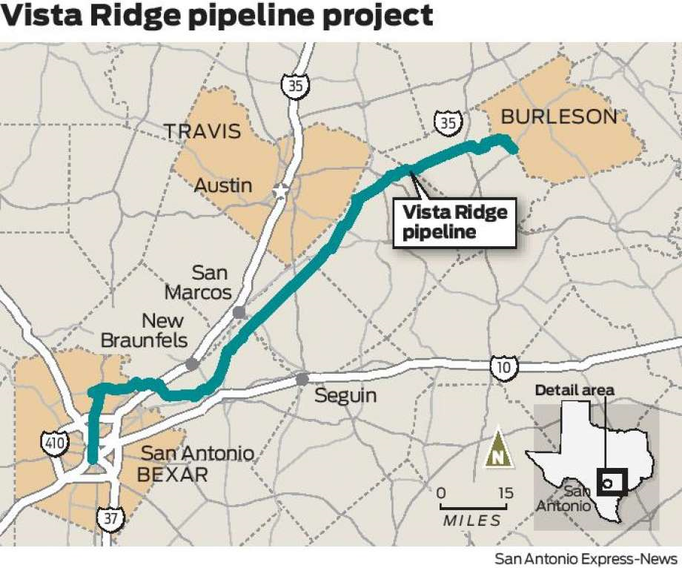
San Antonio Water System Vista Ridge P3
Production, Treatment and Delivery of up to 50,000 AF/year for 30 years
Source: Carrizo-Wilcox aquifer
Construction of 18 wells, three pump stations and a treatment plant at source
Construction of 140 mile pipeline to connect to SAWS
Expected completion in 2020
Achieved Financial Close in November 2016
Total project costs of $923 million
$73 million in equity from Garney P3 LLC (80%) and Abengoa Vista Ridge LLC (20%)
$800 million in loans from a consortium of international banks
SAWS will make fixed and variable payments to the Concessionaire

Slide 8
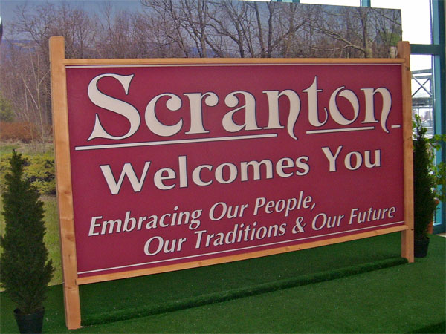
Scranton, PA, Wastewater System Asset Sale
Acquired by Pennsylvania American Water on December 30, 2016
31,000 customers in NE Pennsylvania
PA American already the water service provider
Purchase price of $195 Million
Scranton applying proceeds to address pensions, debt and deferred capital
Required approval of US EPA, PA DEP, US DOJ and PA PUC
System under consent decree
$140 million in upgrades required
PA American has been actively acquiring assets throughout the Commonwealth, including small homeowner association water systems

Slide 9
Biosolids Facility at Stickney Wastewater Treatment Plant
Metropolitan Water Reclamation District of Greater Chicago, operator of the 1.4 bgd Stickney Wastewater Treatment Plant, needed to diversify its biosolids program within the footprint of the facility
The 150 dry-ton per day facility produces organic fertilizer pellets and soil conditioners
Procured under a design-build-finance-operate-maintain contract with Veolia
Construction cost of $43 million funded with tax-exempt debt
Project delayed by permitting
Debt guaranteed by Vivendi Environnement, now Veolia
Project completed in 2008
Environmentally conscious means of recycling waste material
Beneficial use product

Slide 10
Public to Public: Allentown Water System to Lehigh County Authority
50-Year Concession and Lease to Operate Regional Water Supply and Wastewater System
Each regional water supply systems; Allentown provided regional wastewater treatment
LCA has the right to collect revenues from wholesale and retail customers
Up-front and ongoing compensation:
$211.3 million up front
$500,000 annually adjusted for inflation
Required capital improvements of $20 million in first four years
Up front and capital funded from bond proceeds
$307 million issued in 2013
Separately secured from LCA existing debt

