Slide 1
State of Maine’s CWSRF
Silviculture, Climate Resiliency
Stormwater Management,
& Drinking Water Supply Protection
Brandy M. Piers, P.Eng., P.E.
CWSRF Manager
Notes:
BRANDY M. PIERS, P. Eng., P.E.
CWSRF Program Manager
Maine Department of Environmental Protection
Augusta, Maine
Brandy is a licensed Professional Engineer in Maine and New Brunswick, Canada with over 20 years’ experience in construction. She is currently the CWSRF program manager directing the:
Small Community Grant program which provides grant assistance in the replacement of failing septic systems;
Overboard Discharge removal program that aids the removal of small package wastewater treatment systems and installs subsurface wastewater systems resulting in water quality improvements and in some cases opening closed clam flats;
Clean Water State Revolving Fund assisting wastewater communities with low interest loans and principal forgiveness (grant) funding for infrastructure improvements, stormwater upgrades, landfill closures, sand/salt storage facilities and much more;
State Wastewater Infrastructure Grant program to support the aging infrastructure needs;
State Tribal Assistance Grants through the Congressional Delegation and EPA;
Brandy has worked with the Maine Department of Environmental Protection since 2006.

Slide 2
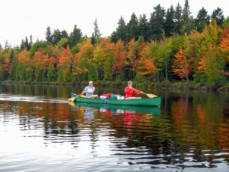
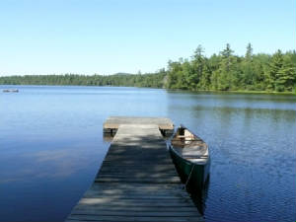
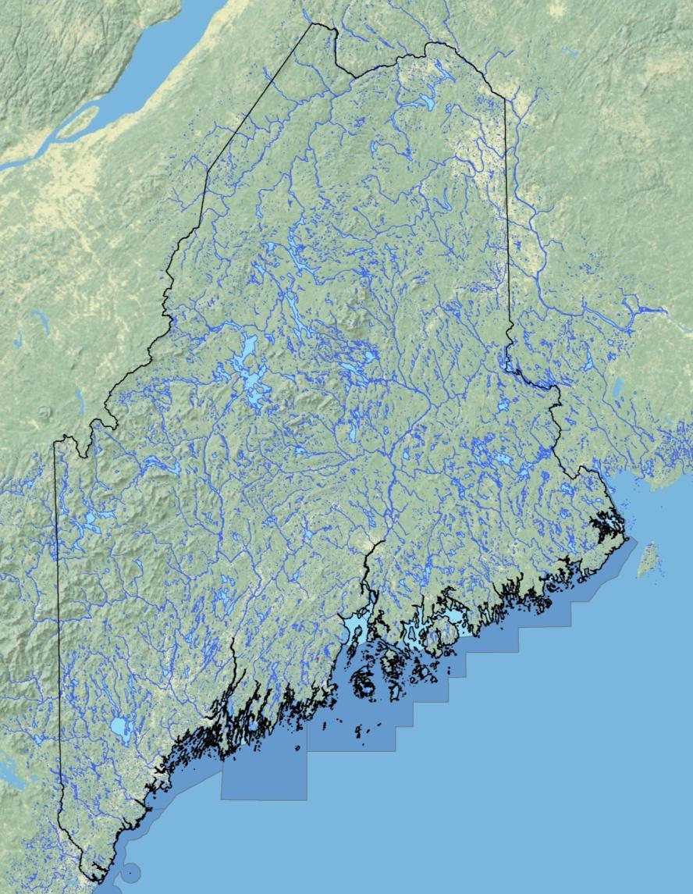
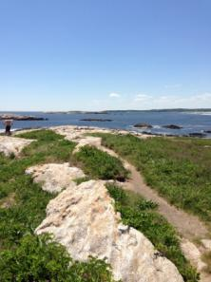
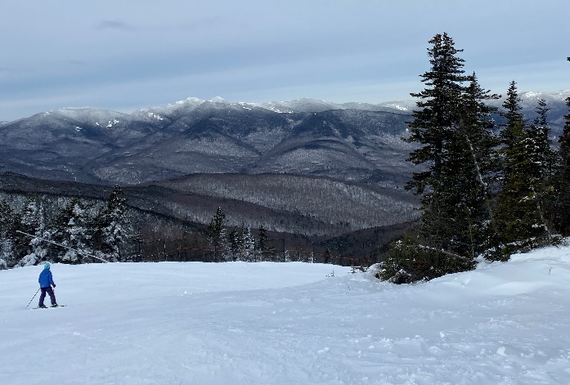
State of Maine
Notes:
Background on State of Maine.
It is on the East Coast,
Population 1.4 M.
Abundant Water Resources.
Rural population.
Cold winters.
Most of the development in Southern Maine, especially along the coast.
Northern and Western Maine forested and agriculture.
I’m going to talk today about our:
Forestry Direct Link Program
City of Saco’s wastewater treatment facility resiliency project
North Windham and Sebago Lake Water Supply / Lake Restoration

Slide 3
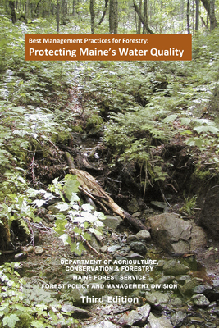
Silviculture
Subsidized loans for environment-friendly logging equipment
Borrowers:
  Must use forestry BMPs
  Loggers certified sustainable
  Requires master logger harvest plan
  Maine Forest Service inspections
Notes:
Started in 2007 in partnership with Maine Forest Service, DACF. Modeled after Ohio program.
Several environmental benefits
Equipment selected that reduces environmental impact during logging activity
- smaller footprint where equipment operates,
- less soil compaction,
- less impact in wet areas and stream crossings,
- also requires BMPs and certifications.

Slide 4
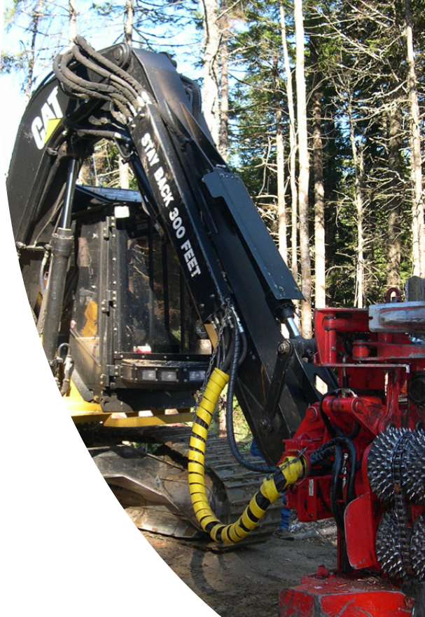
Silviculture -
Maine Forestry Direct Link Loan
MFS and Commercial Banks
2% below market, term < 5 years
To help loggers reduce non-point source pollution risk on timber harvests in Maine
All Financed Equipment must remain in Maine for the length of the loan
Notes:
MFS = Maine Forest Service
Maine Forestry Direct Link Loan
MFS and Commercial Banks – an agreement to help Maine’s harvesters
2% below market, term < 5 years
T help loggers reduce non-point source pollution risk on timber harvests in Maine.
All Financed Equipment must remain in Maine for the length of the loan
Currently, the State has completed more than $55M in loans

Slide 5
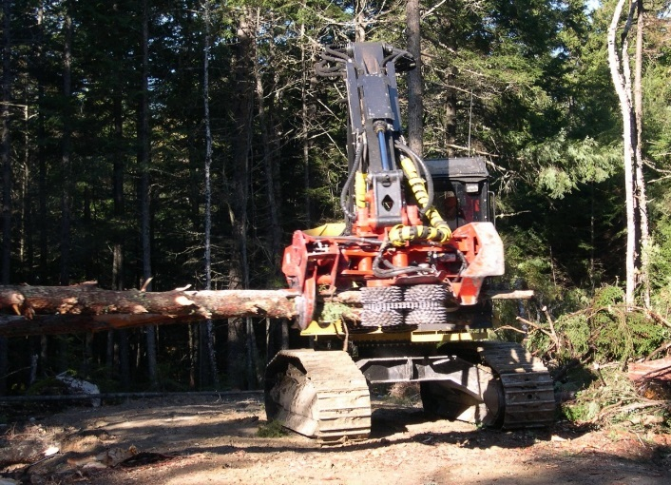
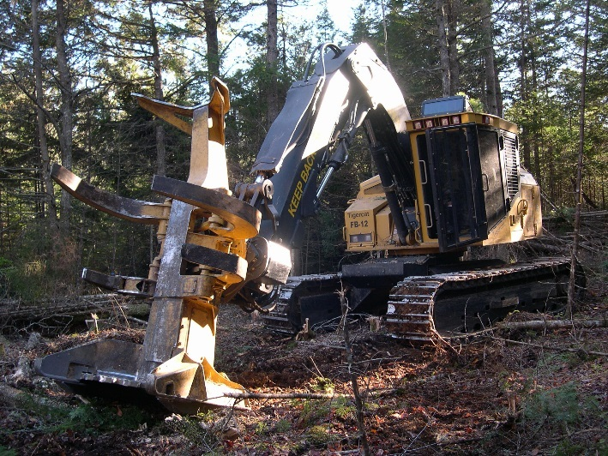
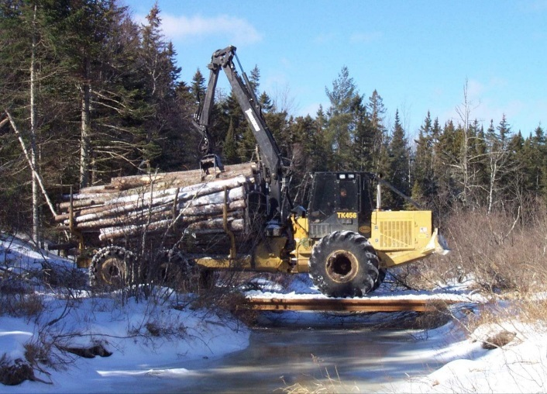
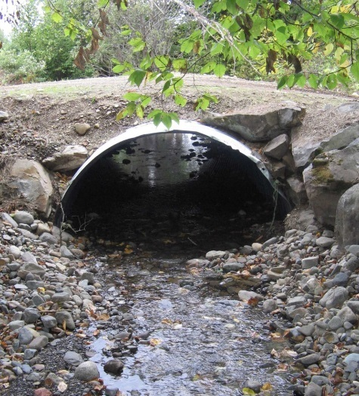
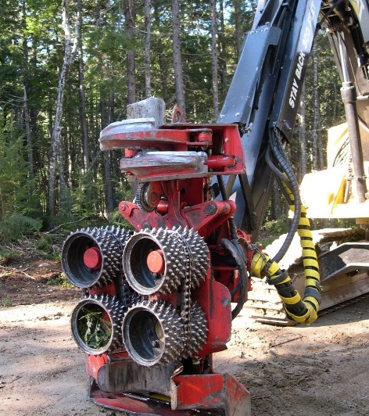
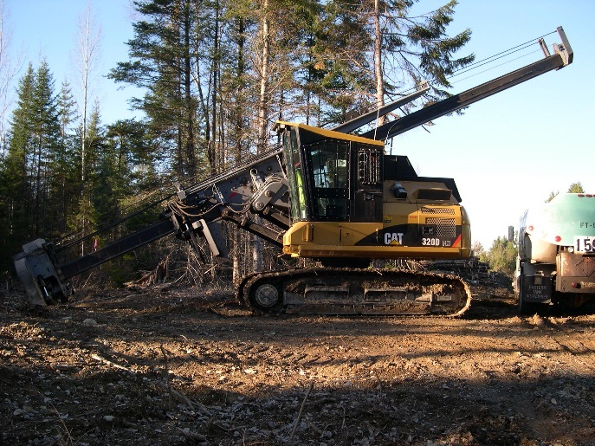
Common Forestry
Equipment
Cut to Length Harvester
Fellerbuncher
Forwarder
Bottomless Culvert
Harvester Head
Delimber
Notes:
To date the State has completed over $55M in loans to this program.
New Equipment
Forwarders, Harvesters, tree planter and assoc. equipment,
mulching machines, cut-to-length harvesters,
feller buncher, swing machines
Retrofit Existing Equipment
Floatation tires, Bogey wheels, GPS equipment tracking systems
Harvester and processor heads
Miscellaneous Purchases
Metal bridges, Wooden bridges, Bottomless trenches,
Sediment and erosion control practices

Slide 6
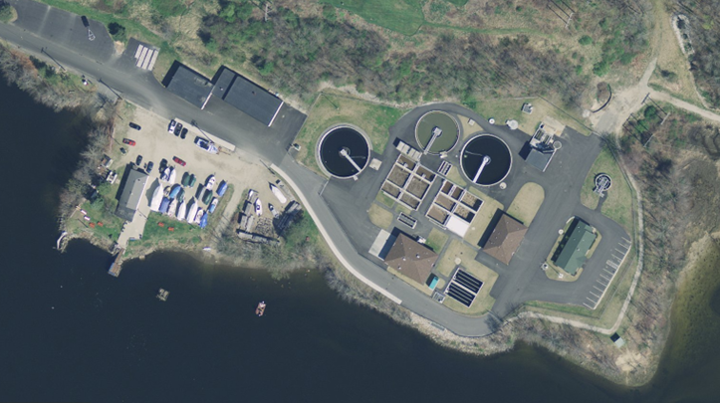
Saco Water Resource Recovery Facility
Notes:
Climate Resiliency & Stormwater Management
4,998 residential units and 406 non-residential sewer connections and growing.
Current average residential sewer user charge is $114.48 per quarter
71.31 inches of rain up from 39.60 inches.
963.50 MGD up from 760.13 Million Gallons of Water Treated
Biosolids produced 1,980 wet tons

Slide 7
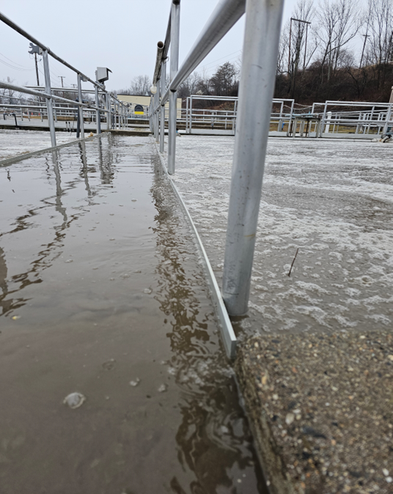
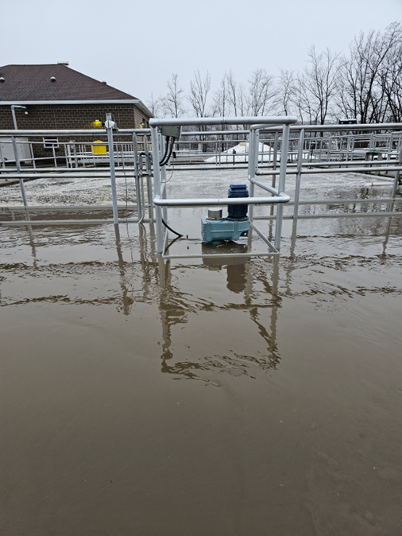
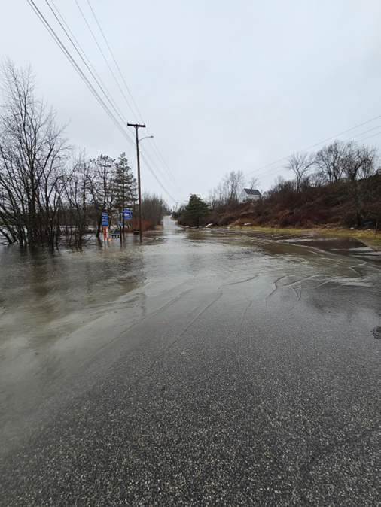
January 13, 2024, Rain Event
Aeration tank catwalk under water.
Aeration tank ~2-3” from overflowing.
Access road to plant flooded.

Slide 8
PROPOSED WRRF UPGRADE SITE RENDERING
Notes:
Highlight new buildings
Aqua Nereda process, along with filters, and UV disinfection.
New Storage garage.
New centrifuges and solids handling building.
New influent pump station to pump to Aqua Nereda treatment system.
Stormwater storage tanks. One on right will take flow from the Storm King and then discharge out outfall. The addition of these will lead to reclassifying last remaining CSO in the City to an Emergency Bypass.
New headworks building, including redundant screens and grit removal
Future greenspace and riverwalk enhancement.
Note Riverwalk is conceptual (not in project)

Slide 9

Site rendering
Aqua Nereda process, along with filters, and UV disinfection.
Notes:
Highlight new buildings
Aqua Nereda process, along with filters, and UV disinfection.
New Storage garage.
New centrifuges and solids handling building.
New influent pump station to pump to Aqua Nereda treatment system.
Stormwater storage tanks. One on right will take flow from the Storm King and then discharge out outfall. The addition of these will lead to reclassifying last remaining CSO in the City to an Emergency Bypass.
New headworks building, including redundant screens and grit removal
Future greenspace and riverwalk enhancement.
Note Riverwalk is conceptual (not in project)

Slide 10

Site rendering
New Storage garage
Notes:
Highlight new buildings
New Storage garage.
Existing Garage is at 16ft elevation
New Garage is at 37ft elevation

Slide 11

Site rendering
New centrifuges and solids handling building.
Notes:
Highlight new buildings
Aqua Nereda process, along with filters, and UV disinfection.
New Storage garage.
New centrifuges and solids handling building.
New influent pump station to pump to Aqua Nereda treatment system.
Stormwater storage tanks. One on right will take flow from the Storm King and then discharge out outfall. The addition of these will lead to reclassifying last remaining CSO in the City to an Emergency Bypass.
New headworks building, including redundant screens and grit removal
Future greenspace and riverwalk enhancement.
Note Riverwalk is conceptual (not in project)

Slide 12

Site rendering
New influent pump station to pump to Aqua Nereda treatment system.
Notes:
Highlight new buildings
Aqua Nereda process, along with filters, and UV disinfection.
New Storage garage.
New centrifuges and solids handling building.
New influent pump station to pump to Aqua Nereda treatment system.
Stormwater storage tanks. One on right will take flow from the Storm King and then discharge out outfall. The addition of these will lead to reclassifying last remaining CSO in the City to an Emergency Bypass.
New headworks building, including redundant screens and grit removal
Future greenspace and riverwalk enhancement.
Note Riverwalk is conceptual (not in project)

Slide 13


Site rendering
Stormwater storage tanks
One on right will take flow from the Storm King and then discharge out outfall. The addition of these will lead to reclassifying last remaining CSO in the City to an Emergency Bypass.
Notes:
Highlight new buildings
Aqua Nereda process, along with filters, and UV disinfection.
New Storage garage.
New centrifuges and solids handling building revamp.
New influent pump station to pump to Aqua Nereda treatment system.
Stormwater storage tanks. One on right will take flow from the Storm King and then discharge outfall. The addition of these will lead to reclassifying last remaining CSO in the City to an Emergency Bypass.
New headworks building, including redundant screens and grit removal
Future greenspace and riverwalk enhancement.
Note Riverwalk is conceptual (not in project)

Slide 14

Site rendering
New headworks building, including redundant screens and grit removal.
Notes:
Highlight new buildings
Aqua Nereda process, along with filters, and UV disinfection.
New Storage garage.
New centrifuges and solids handling building revamp.
New influent pump station to pump to Aqua Nereda treatment system.
Stormwater storage tanks. One on right will take flow from the Storm King and then discharge out outfall 001B. The addition of these and increasing flow capacity to plant, will lead to reclassifying last remaining CSO in the City to an Emergency Bypass.
New headworks building, including redundant screens and grit removal.
Future greenspace and riverwalk enhancement.
Note Riverwalk is conceptual (not in project)

Slide 15

Site rendering
Future greenspace and riverwalk enhancement.
Notes:
Highlight new buildings
Aqua Nereda process, along with filters, and UV disinfection.
New Storage garage.
New centrifuges and solids handling building revamp.
New influent pump station to pump to Aqua Nereda treatment system.
Stormwater storage tanks. One on right will take flow from the Storm King and then discharge out outfall 001B. The addition of these and increasing flow capacity to plant, will lead to reclassifying last remaining CSO in the City to an Emergency Bypass.
New headworks building, including redundant screens and grit removal
Future greenspace and riverwalk enhancement.
Note Riverwalk is conceptual (not in project)

Slide 16
PROPOSED WRRF UPGRADE - SITE RENDERING
Stormwater storage tanks. One on right will take flow from the Storm King and then discharge out outfall 001B. The addition of these and increasing flow capacity to plant, will lead to reclassifying last remaining CSO in the City to an Emergency Bypass.
Aqua Nereda process, along with filters, and UV disinfection.
New headworks building, including redundant screens and grit removal.
New Storage garage.
New influent pump station to pump to Aqua Nereda treatment system.
Future greenspace and riverwalk enhancement.
New centrifuges and solids handling building revamp.
Notes:
Highlight new buildings
Aqua Nereda process, along with filters, and UV disinfection.
New Storage garage.
New centrifuges and solids handling building revamp.
New influent pump station to pump to Aqua Nereda treatment system.
Stormwater storage tanks. One on right will take flow from the Storm King and then discharge out outfall 001B. The addition of these and increasing flow capacity to plant, will lead to reclassifying last remaining CSO in the City to an Emergency Bypass.
New headworks building, including redundant screens and grit removal
Future greenspace and riverwalk enhancement.
Note Riverwalk is conceptual (not in project)

Slide 17
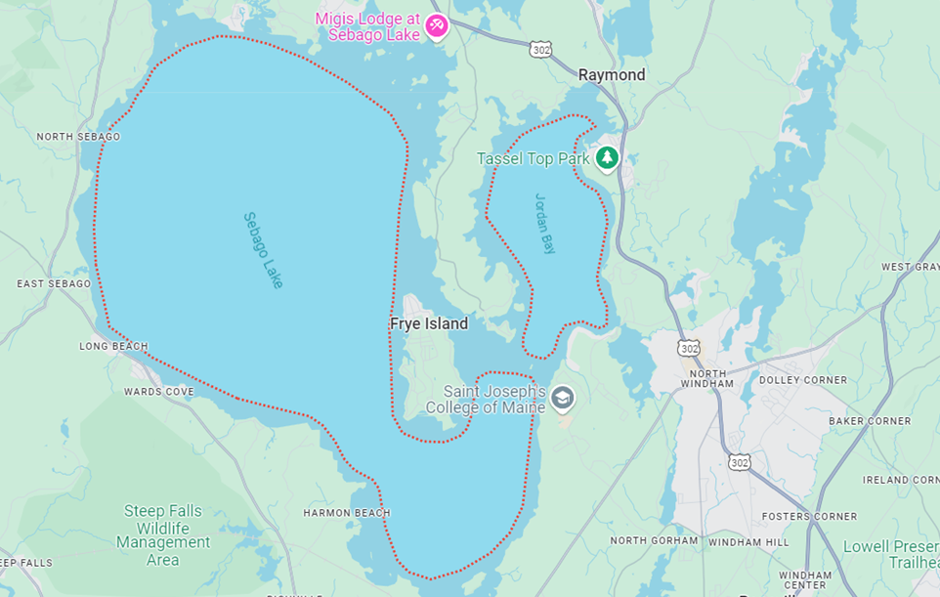
North Windham
Notes:
Drinking Water Supply Protection
The Town of Windham has been seeking a solution to address the water quality degradation of the groundwater aquifer due to ongoing commercial development in North Windham.
The proposed project includes a new collection system and advanced membrane filtration treatment plant serving the North Windham area, along with treated water recharge to a groundwater drip dispersal system located adjacent to the
plant.

Slide 18
North Windham
Drinking Water Supply Protection
Notes:
Drinking Water Supply Protection
The Town of Windham has been seeking a solution to address the water quality degradation of the groundwater aquifer due to ongoing commercial development in North Windham.
The proposed project includes a new collection system and advanced membrane filtration treatment plant serving the North Windham area, along with treated water recharge to a groundwater drip dispersal system located adjacent to the
plant.

Slide 19
North Windham
Water Supply
Notes:
Sebago Lake serves a population over 250,000 and is the sole water source for the Greater Portland area.
Based on a hydrogeologic analysis of the area served, 20% of the existing onsite septic system effluent flows to the Sebago Lake watershed and 80% to the Little Sebago Lake watershed.

Slide 20
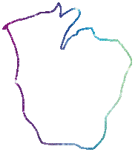
North Windham
Water Supply
North Windham
Notes:
Town of North Windham
This project will utilize membrane filtration and advanced treatment to remove nutrients to advanced levels while also leveraging aerobic treatment in the upper layers of the soil by utilizing drip dispersal. Therefore, the proposed system will provide a significant net benefit protection to water quality in the region including not only the drinking water supply for Greater Portland but also the sand and gravel aquifer, kettle ponds and rivers in the North Windham area.
Failing Septic Systems around Sebago Lake

Slide 21
Notes:
So, what are we doing?
We are building a new collection system and membrane bioreactor treatment system that will discharge into a drip dispersal system under the athletic fields at the local school.
This will provide a solution to the degrading Water Supply, prevent the failing septic systems and provide reliable for commercial properties.
22,000 lbs of Nitrogen per year is currently being added to the aquifer
3,000 lbs of Phosphorous per year is currently being added to the aquifer
Current testing wells indicate ground water issues

Slide 22
North Windham – Drip Dispersal
Depth of line burial is 6” to 24”
Water is beneath the playing fields
Water is near “potable” drinking water
Soils can handle 3 to 4 times the volume being applied
Notes:
So, what are we doing?
We are building a new collection system and membrane bioreactor treatment system that will discharge into a drip dispersal system under the athletic fields at the local school.
This will provide a solution to the degrading Water Supply, prevent the failing septic systems and provide reliable for commercial properties.

Slide 23
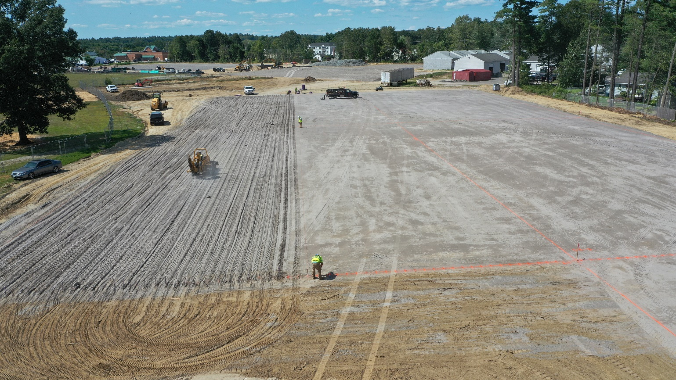
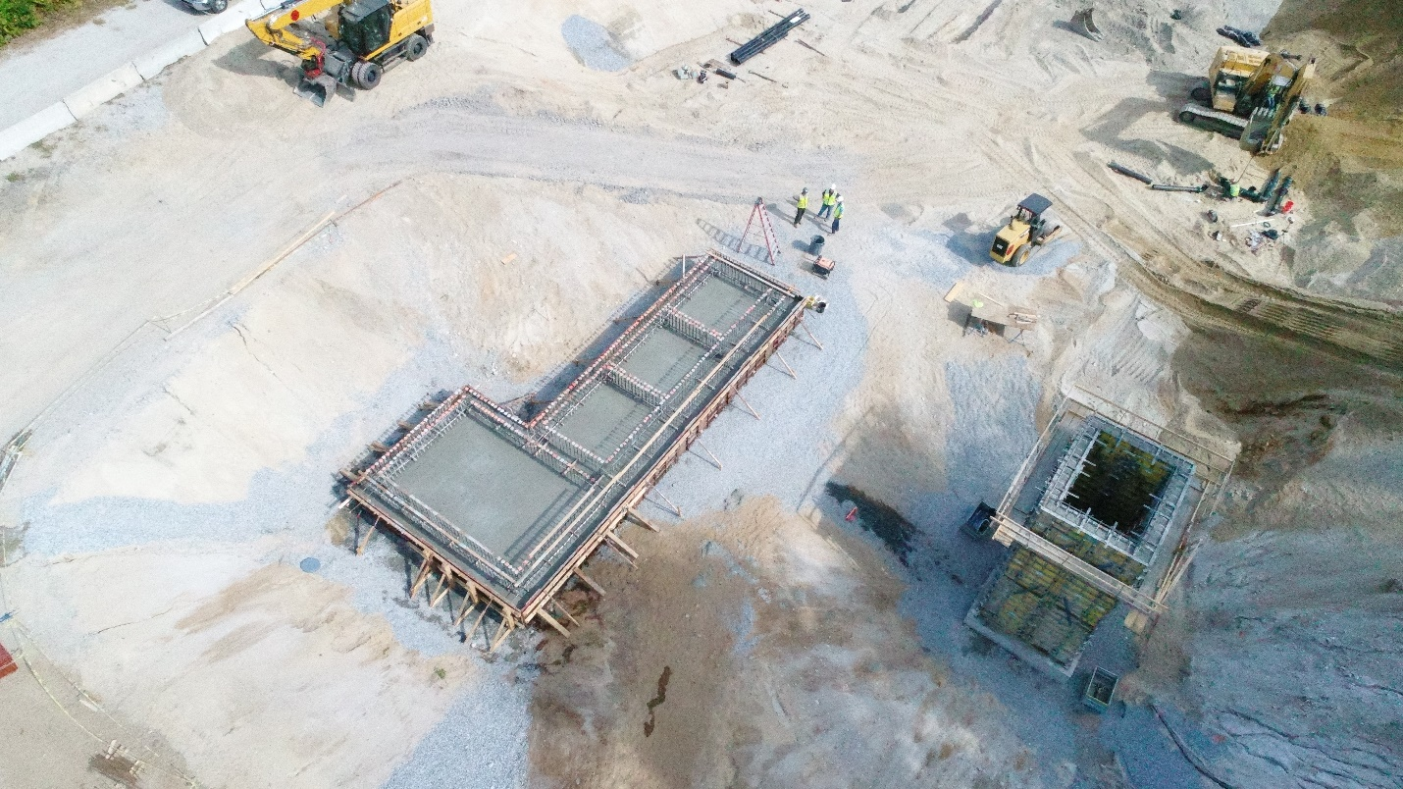
North Windham
Notes:
So, what are we doing?
We are building a new collection system and membrane bioreactor treatment system that will discharge into a drip dispersal system under the athletic fields at the local school.
This will provide a solution to the degrading Water Supply, prevent the failing septic systems and provide reliable for commercial properties.

Slide 24

CONTACT:
Brandy M. Piers, P. Eng., P.E.
(207) 287-6093
Brandy.m.piers@maine.gov
www.maine.gov/dep

