Slide 1
Small Communities: Co-Funding in Conjunction with Regionalization
2016 SRF National Workshop | October 30 - November 1, 2016 | Austin, TX Barry Cress | Colorado Department of Local Affairs

Slide 2
Co-Funding in Colorado
Cooperation Between Funding Agencies Since Late 1970’s
Department of Local Affairs (community development)
Department of Public Health and Environment (primacy)
Department of Natural Resources (water resources)

Slide 3
Co-Funding in Colorado
More Recent Collaborators
Colorado Water Resources and Power Development Authority
USDA Rural Development
Rural Community Assistance Corporation
Colorado Rural Water Association

Slide 4
Co-Funding in Colorado
Currently a two-pronged approach with policy and project development teams
Strong local control state
Co-funding encouraged at project development meetings in community with local officials
Programs and agencies seek to support local efforts

Slide 5
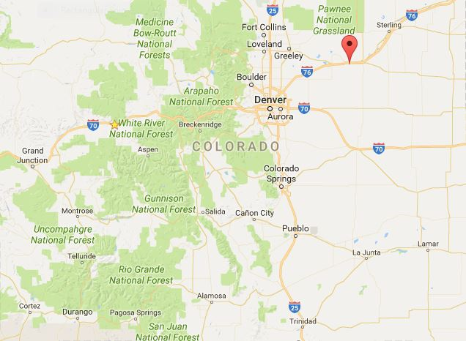
City of Fort Morgan

Slide 6
City of Fort Morgan
• Drinking water not meeting standards
• Southern Water Supply Pipeline Available
• Other communities tapping the new supply
• Effective outreach
• Community support

Slide 7
City of Fort Morgan

Slide 8
City of Fort Morgan
Funding Provided
Drinking Water Revolving Fund: $15,000,000
Colorado Water Conservation Board: $8,000,000
USDA Grant: $3,200,000
USDA Loan: $4,800,000

Slide 9
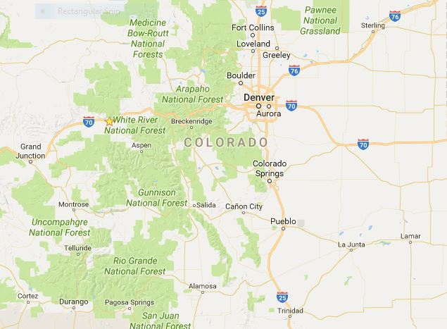
Arkansas Valley Conduit

Slide 10
Arkansas Valley Conduit
Southeast Colorado – many water quality challenges
Among the most saline stream segments in the U.S.
Southeast Colorado Water Conservancy District leading effort
Communities in support of effort
Seeking federal appropriation ($300m. project)

Slide 11
Arkansas Valley Conduit

Slide 12
Arkansas Valley Conduit
Regional Solution Options Have Been Limited
Rural water authority
Centralized treatment proposal

Slide 13
Arkansas Valley Conduit
Public Entities
Towns of Boone, Crowley, Eads, Fowler, Manzanola, Olney Springs, Ordway, Sugar City, Swink, and Wiley
Cities of La Junta, Lamar, Las Animas, and Rocky Ford
St. Charles Mesa Water District

Slide 14
Arkansas Valley Conduit
*Non-Public Systems
96 Pipeline Company
Beehive Water Association
Bents Fort Water Company
Crowley County Water Association
East End Water Association
Eureka Water Company
Fayette Water Association
Hasty Water Company
Hilltop Water Company
Holbrook Center Soft Water
Homestead Improvement Association
May Valley Water Association
McClave Water Association
Newdale-Grand Valley Water Company
North Holbrook Water
• Patterson Valley Water Company
South Side Water Association
South Swink Water Company
Valley Water Company
Vroman Water Company
West Grand Valley Water Inc.
West Holbrook Water

Slide 15
Arkansas Valley Conduit
* Senate Bill 15-121 passed in 2015
* DWRF Program loans made available to private non profit systems
* Many supporters from the Arkansas Valley

Slide 16
Thank You!

