Slide 1
Shared Resources

Slide 2
Small Community Environmental Infrastructure Group (SCEIG)
Federal Agencies
U.S. Department of Agriculture/Rural Development
U.S. Army Corps of Engineers
State Agencies
Ohio Department of Health
Ohio Development Services Agency
Ohio Environmental Protection Agency
Ohio Public Works Commission
Ohio Water Development Authority
Local Development Districts
Buckeye Hills – Hocking Valley Regional Development District
Ohio Valley Regional Development Commission
Ohio Mid-Eastern Governments Association
Toledo Metropolitan Area Council of Governments
Other
American Council of Engineering Companies of Ohio
Coalition of Ohio Regional Districts
County Commissioners Association
Ohio RCAP
Ohio Rural Water Association
Ohio Water Environmental Association

Slide 3
Goal of SCEIG
Encourage share resources to maintain or reduce operation and maintenance costs.
Why is this goal important?
Declining federal grant funding resulting in higher water and sewer rates as the local governments borrow money for their infrastructure needs.

Slide 4
Challenges
Community perception
Negotiation and compensation disparities
Engineering concerns
Lack of knowledge regarding the types of shared resources

Slide 5
Types of Shared Resources
Informal cooperation
Contractual assistance
Ownership transfer

Slide 6
SCEIG’s accomplishments
Sub-committees have been actively working on solutions
Incentives
Education
One-on-One

Slide 7
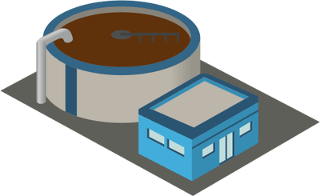
Village C 269 Homes MHI $28,000
Village A 203 Homes MHI $33,500
Village B 173 Homes MHI $29,500
7 miles
4 miles
3 miles
City 2,161 Homes MHI $25,000

Slide 8
Education Materials
Case studies
Power Point Presentation
Webinar(s)
Brochure – benefits of partnering, testimonials/case studies, whom to contact

Slide 9
Case Studies
Regionally diverse examples; water and wastewater
Video testimonials from local officials
Jefferson County Water and Sewer
Benefits of Shared Services / Obstacles overcome

Slide 10
Brochure

Slide 11
Contact
Ken J. Heigel, P.E.
Chief Program Officer
Ohio Water Development Authority
kheigel@owda.org
614-466-5822

