Slide 1
MEASURING AFFORDABILITY
Andrew Sawyers, Director of the Office of Wastewater Management
Kristyn Abhold, Water Finance Center
Sonia Brubaker, Water Finance Center
Spring CIFA, Washington, D.C.
March 27, 2018

Slide 2
01
OUR
AGENDA
1
Financial Capability & Household Affordability
2
National Academy of Public Administrator's Study
3
Potential Next Steps
4
Discussion

Slide 3
02
AFFORDABILITY METHODOLOGIES
Current affordability guidance utilized within the agency can be traced to the 1990s.
Providing guidance for CSO schedule development.
Granting variances for:
Water quality standards.
Compliance technology for small drinking water systems.
All utilize a similar methodology for determining a utility’s “financial capability.”
Step 1: Determine Household Affordability (Residential Indicator)
Step 2: Examine additional utility Financial Capability Indicators
Notes:
Many SRF projects are funded in part due to Consent Decrees – we hear, as I’m sure you do as well, that affordability is a critical concern.
Many of these concerns have been expressed by mayors and others and the agency is listening
Congress also listened and they commissioned NAPA to developed a definition and framework for affordability.
The NAPA report was published last October and had several recommendations for EPA (more on this later).
We have reviewed those recommendations and are hoping to re-assess how we look at affordability to help mitigate some of the challenges communities are facing.
One of the primary recommendation was to review the guidance developed for CSO schedule development – often referred to as the 1997 Financial Capability Assessment guidance.
We are also reviewing other guidance related to determining variances on the CW and DW side.
WQS variance
Compliance technology variances for small drinking water systems.
THE methodology outlined in it’s 1990’s guidance's all follow a similar methodology involving two steps:
Step 1: Determine Household Affordability (Residential Indicator)
Step 2: Examine additional utility Financial Capability Indicators
Important to note – in 2014 EPA released the Financial Capability Assessment Framework for Municipal Clean Water Act Requirements which provided additional guidance and flexibility for EPA’s 1997 FCA guidance.
____________________
In the 90’s EPA developed guidance's on water quality variances, CSO, and technology
CWA
1995 Interim Economic Guidance for Water Quality Standards–Workbook
1997 Combined Sewer Overflows–Guidance for Financial Capability Assessment and Schedule Development
SDWA
1998 Variance Technology Findings for Contaminants Regulated Before 1996
1998 Information for States on Developing Affordability Criteria for Drinking Water

Slide 4
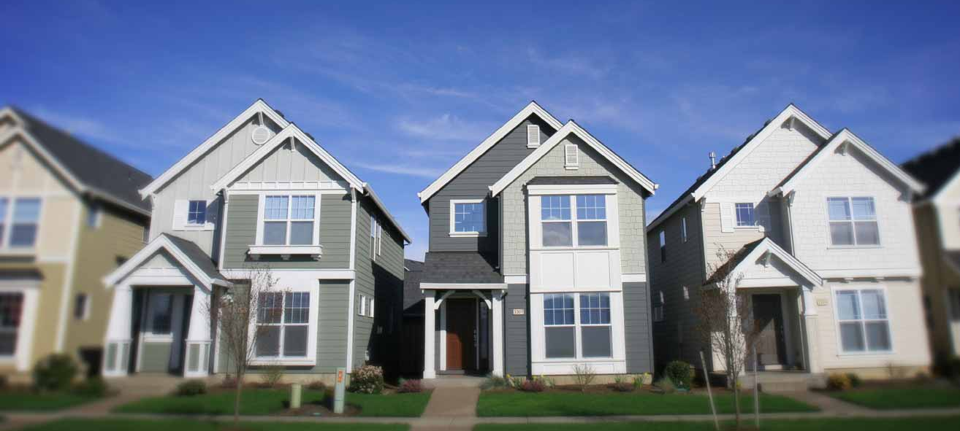
03
90s AFFORDABILITY GUIDANCE
STEP 1
STEP 2
MEASURE FINANCIAL CAPABILITY INDICATORS
MEASURE HOUSEHOLD AFFORDABILITY
(Residential Indicator)
Metrics that indicate the community's ability to obtain financing and describes the socioeconomic health of the community. Financial Indicators include:
$\frac{Average Cost Per Household}{Median Household Income}$ = % MHI
Drinking water uses 2.5% as a threshold.
Clean water uses < 1% (Low); 1%-2% (Mid-Range); and > 2% (High).
Bond Rating
Net Debt as a percent of Full Market Property Value
Unemployment Rate
MHI
Property tax Revenues as a percent of full market property value
Property Tax Collection Rate
Notes:
The 1990’s Guidance developed has a similar measurement process
Step (1) household affordability (sometimes referred to as a “Residential Indicator”) typically looks at a ratio of “costs of compliance per household” to median household income = %MHI
Mention a range of thresholds for %MHI on the CW side. Drinking water uses 2.5% as a threshold.
CW: < 1% (low); 1%-2% (Mid-Range); and > 2% (High)
Step (2) measures Financial Capability Indicators – metrics that describe the utility’s financial health and the overall socioeconomic conditions of the community. Metrics analyzed include:
Bond Rating
Net Debt as a percent of Full Market Property Value
Unemployment Rate
MHI
Property tax Revenues as a percent of full market property value
Property Tax Collection Rate

Slide 5
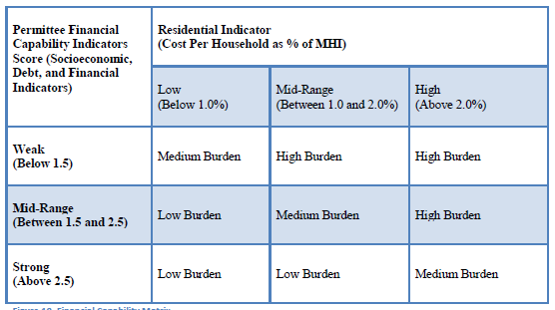
04
FINANCIAL CAPABILITY MATRIX
Final step is to evaluate everything
Notes:
EPA evaluates all the metrics together to determine affordability.

Slide 6
05
2014 Financial Capability Assessment Framework for Municipal Clean Water Act Requirements
EPA’s 2014 Financial Capability Assessment Framework for Municipal Clean Water Act Requirements includes additional factors EPA may consider in negotiating compliance schedules for permits and consent decrees, such as:
Bankruptcies
Natural disasters
Drinking water costs, etc.
Emphasizing flexibility in considering local conditions in the analysis.
Notes:
In response to sector feedback – specifically related to the CSO guidance, EPA released the 2014 Framework – outlining additional factors EPA would consider when negotiating compliance schedules to mitigate affordability concerns.
The framework was developed and is currently used as a supplement to the 1997 guidance

Slide 7
06
2017 NAPA STUDY
Congress directed EPA in the FY16 Appropriations to utilize the National Academy of Public Administrators (NAPA) to conduct an independent study to create a definition and framework for “community affordability.”
The study was primarily focused on EPA’s 1997 Guidance
NAPA engaged in substantial outreach for more than one year.
The report was submitted to Congress in October 2017.
Primary recommendation – EPA should reassess affordability going forward.
Notes:
The sector sought an update to EPA’s approach to measuring affordability – especially with regards to developing compliance schedules to meet Clean Water Act (CWA) objectives.
Highlight some of the sectors interviewed by NAPA

Slide 8
KEY NAPA CONCLUTIONS
07
NAPA issued its report Developing a New Framework for Community Affordability of Clean Water Services in October of 2017.
NAPA Conclusions:
New Household Affordability (Pg. 6 of Study)
Median Household Income (MHI) was an inadequate metric for identifying affordability issues for the most vulnerable low-income rate payers, and
All water costs should be included in assessing rate payer burdens.
Financial Capability Indicators should focus on: (Pg. 6 of Study)
The financial strength of the utility providing clean water services; and
The economic and social conditions affecting the utility’s market area.

Slide 9
08
NAPA RECOMMENDATIONS
Revise the Household Affordability measurement (Residential Indicator) (Page 8 of Study)
New measurement should include all costs: clean water, drinking water and stormwater.
Focus on the income of low-income users – those most vulnerable to rate increases
Identify the size of the vulnerable users relative to the utility’s total rate payers base; and
Avoid arbitrary normative thresholds to determine relative burdens.
Notes:
For the last bullet: The NAPA report and others within the sector believe EPA’s CW Household Affordability threshold of 2% is arbitrary because there is no documented methodology.
When developing new thresholds for household affordability, EPA should clearly document it’s methodology and reasoning.

Slide 10
09
NAPA RECOMMENDATIONS
Revise Financial Capability Indicator Component (Page 8 of Study)
Focus on the operational efficiency, debt burden, and managerial effectiveness of the utility; and
Expand the socioeconomic components affecting the utility’s market conditions to include trends in population, relative wealth, economic growth, and other economic structural problem in the community served by the utility.

Slide 11
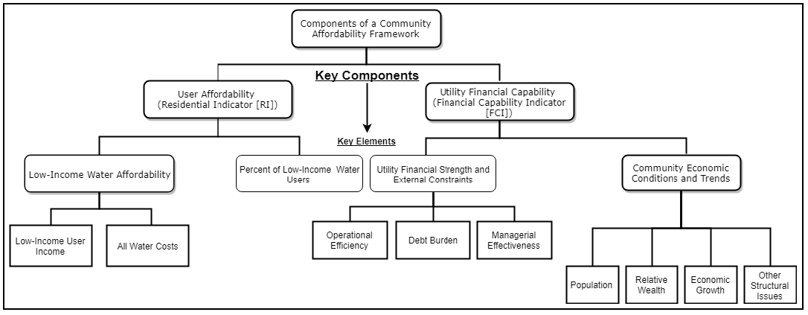
10
NAPA RECOMMENDATIONS
Notes:
EPA evaluates all the metrics together to determine affordability.

Slide 12
10
NAPA RECOMMENDATIONS
Household Affordability Measurement Metrics
Notes:
EPA evaluates all the metrics together to determine affordability.

Slide 13
10
NAPA RECOMMENDATIONS
Financial Capability Indicators
Notes:
EPA evaluates all the metrics together to determine affordability.

Slide 14
11
REIMAGINING HOUSEHOLD AFFORDABILITY
AFFORDABILITY RATIO (AR)
(Teodoro)
HOURS of LABOR at MIN. WAGE (HM)
(Teodoro)
WEIGHTED AVERAGE RESIDENTIAL INDEX (WARi) (MWH Global now Stantec)
AR: Compares the cost of minimum water services per member of the user household to the available disposable household income after other basic needs have been met.
HM: Basic household drinking water and wastewater cost is expressed in terms of hours of labor at minimum wage.
The calculation of the weighted-average financial burdens across all income levels, in Census tracts in a given utility’s service area.
$\frac{\left(\begin{aligned}\% of population \\ in census tract\end{aligned}\right) × \left(\begin{aligned}Average bill \\ in census tract\end{aligned}\right)}{median income in tract}$ = WARi
$\frac{PC (W + S)}{IC − EC}$ = AR_{C}
$\frac{PC (W + S)}{A}$ = HM_{C}
Once completed for all tracts – the average WARi is calculated for the entire service area.
C Given customer
P_{C} # of Persons in Household
S Per Capita Wastewater Costs
W Per Capita Drinking Water Costs
I_{C} Household Income
E_{C} Essential Household Expenses
A Minimum Wage in C’s labor market
Notes:
The NAPA report clearly states that EPA should reconsider how it measures household affordability – moving beyond %MHI
NAPA stresses that EPA should:
Include all costs: clean water, drinking water and stormwater.
Focus on the income of low-income users – those most vulnerable to rate increases
Identify the size of the vulnerable users relative to the utility’s total rate payers base; and
Avoid arbitrary normative thresholds to determine relative burdens.
The NAPA report provides a few alternatives EPA may want to consider – AR; HM; and WARi
Important to note that these methodologies for measuring Household Affordability are not the only options EPA will consider – but they are a starting point for discussion.
Affordability Ration (AR)
Household-level affordability (sometimes called micro-affordability) can be measured as the percentage or ratio of basic water and sewer costs to disposable household income for low-income customers. This measure may be calculated for an individual customer or aggregated statistically for any defined group of customers. We have seen this used for the 20th percentile of low income households – lower boundary of the middle class.
The ease and precision with which the AR can be calculated depend on the availability of household-level customer data.
Calculating the numerator is straightforward, requiring only information about the utility’s rates (or proposed rate).
Ideally, the AR’s denominator would be calculated using a comprehensive household-level consumer survey of the utility’s customer base.
Because such data are unlikely to be readily available, in most cases analysis will depend on estimates of household income and expenditures. Those estimates can draw from a variety of sources; the analysis presented in this article uses regression-based estimates, but a simpler approach could be to use more readily available data on local housing, food, medical, home energy, and tax costs for a given community.
Hours of Labor at Minimum Wage (HM)
A complementary way to measure affordability is to calculate the Hours of Labor at Minimum Wage that would be necessary to pay for basic water and sewer service.
HM can be calculated for an individual customer or aggregated statistically for any defined group of customers.
HM represents the cost of basic water and sewer service for low-income households, many of which work at or near minimum wage. HM is not sensitive to other essential costs as AR is, but it is intuitively appealing because minimum wage is a familiar economic touchstone.
Weighted Average Residential Index (WARi)
The WARi approach uses actual customer billing data calculated for each census tract resulting in a more accurate depiction of the real financial impacts of individual households in neighborhoods over time as rates increase.
It has been specifically designed to use more of the data points available in the census information and in an individual community’s billing records to enhance EPA’s current methodology.
Specifically, WARi more accurately takes into account and is more sensitive to MHI in individual census tracts (i.e. neighborhoods) and actual bill records for those census tracts.
To calculate WARi, the following steps are completed:
Census tract data for the community is gathered to understand MHI and income distribution within each census tract.
Using the City’s actual billing records, an average bill by census tract is calculated.
A Residential Indicator is calculated for each census tract by dividing the average bill for the tract by its own median household income.
The distribution of households and financial impact by income group are multiplied together to get a weighted average of financial impact for each census tract.
All calculations are repeated for each income group and for each census tract to determine the WARi for the City’s service area. The Residential Index for the service area is calculated by weighting the Residential Indicator from each tract by the number of households; summing the total weighted Residential Indicator results in a weighted average residential index for the service area.
Important to note that any new measurement will require the formulation of new thresholds.
AUDIENCE QUESTIONS
Do you have any concerns, limitations, anything we might be missing based on your day to day experiences that we should be considering when exploring alternative household affordability measurements?
Do you anticipate our efforts impacting your work?

Slide 15
POTENTIAL NEXT STEPS
12
1
Form a Stakeholder Workgroup
2
Develop New Household Affordability Measurement/s
3
Develop Criteria for Evaluating New Measures
4
Revise or Replace EPA Guidance
5
Develop Tools and Resources for Implementation
Notes:
CIFA (you all) are out primary funding partners – you are the first group we are engaging with on our initial thoughts on our process moving forward.
The following is still in development – but we would appreciate your thoughts and feedback on our path forward
Form a Stakeholder Workgroup
We have already initiated internal discussion to move this effort forward. The Water Finance Center will be working with folks in OW, OWM, OGWDW, OST, and OECA.
We don’t want to move forward without engaging with key external partners. EPA will be reaching out to engage with the public, providing forums for soliciting feedback and suggestions.
Develop New Household Affordability Measurement/s
NAPA clearly recommends that EPA re-think how it measures Household Affordability. EPA will explore alternative methodologies.
In addon to ensuring that EPA’s new measurement approach is effective, EPA must also take into consideration the ease of use in gathering the data required to utilize this new measurement approach.
Develop Criteria for Evaluating New Measure (new thresholds)
If EPA develops a new measurement for Household Affordability, the agency will need to develop thresholds or criteria for evaluating the new measures - what constitutes “affordable” and “non-affordable.”
EPA will need to clearly document it’s methodology and reasoning for these new thresholds.
Revise of Replace EPA Guidance
If a new household affordability measurement and corresponding thresholds are set, EPA will need to consider revising or replacing its guidance documents for relevant programs.
The NAPA study recommends a new methodology that takes more metrics into account. EPA will need to determine which metrics to incorporate and, more importantly, determine if the assessment process should be modified to place less emphasis on the %MHI or the new household affordability metric.
Develop Tools and Resources for Implementation
EPA should develop tools and resources to help with the application of the new methodologies developed above. (Don’t need to discuss the following unless audience askes for examples)
Conduct CAP Study: It is important to demonstrate that a utility or state can take steps to manage the impact of rates on low-income customers. EPA should conduct a study of existing CAPs to explore how they can affect the new household affordability measurement – demonstrating how well-designed CAPs can help make full-cost pricing affordable for low-income rate-payers.
Quick Analysis Tool: plug and chug web-based tool that pulls available national data and incorporates utility/community level data to apply the methodology developed to help communities determine household affordability and/or community affordability.
Guide for Developing a CAP: Develop a guide for municipalities on how to develop a CAP that meet's their community's unique needs.
CAP Marketing Materials: Develop marketing materials and strategies on how to develop, maintain, and support CAPs.
Affordability Map: Develop an ESRI mapping tool utilizing publicly available data that helps a municipality identify where their must financially burdened residents reside.
Examining the data and incorporating specific recommendations
We will ultimately develop new threshold (s) and guidance
Public will have an opportunity to provide input

Slide 16
DISCUSSION QUESTIONS
13
1. Would you say that affordability is a concern for your borrowers?
2. Are you moderately concerned that a portion of your borrowers can’t afford the loan they need for their infrastructure projects?
3. Do you think that this represents at least half of your potential borrowers?
Notes:
As Kristyn mentioned, while this was initially looking at the CSO guidance, much of the feedback included the need for a holistic approach to looking at water affordability – including drinking water
drinking water + wastewater + stormwater
These recommendations also noted the need to address the household component of the affordability ratio
Two-phase approach
We need to address this together – all stakeholders with EPA – in addressing this issue. In getting it right.
We want to work internally on it
But even more importantly we need to hear from all parts of the sector
And we’re starting with you
Choose someone who had their hand up – Why do you think so many borrowers have affordability concerns? Any others?
(Planted question) Jeff I’m going to pick on you – only because I know you have worked in this area for a long time. Median household income is common metric to use in assessing affordability. What are some positives to using it and what are some challenges?
(Planted question) Andrew, you worked on the household issue a number of years ago. What are some differences that you see with small community affordability vs larger community affordability?
Andrew then chooses a state to talk about the differences in challenges for service area size

Slide 17
14
REIMAGINING HOUSEHOLD AFFORDABILITY
AFFORDABILITY RATIO (AR)
(Teodoro)
HOURS of LABOR at MIN. WAGE (HM)
(Teodoro)
WEIGHTED AVERAGE RESIDENTIAL INDEX (WARi) (MWH Global now Stantec)
AR: Compares the cost of minimum water services per member of the user household to the available disposable household income after other basic needs have been met.
HM: Basic household drinking water and wastewater cost is expressed in terms of hours of labor at minimum wage.
The calculation of the weighted-average financial burdens across all income levels, in Census tracts in a given utility’s service area.
$\frac{\left(\begin{aligned}\% of population \\ in census tract\end{aligned}\right) × \left(\begin{aligned}Average bill \\ in census tract\end{aligned}\right)}{median income in tract}$ = WARi
$\frac{PC (W + S)}{IC − EC}$ = AR_{C}
$\frac{PC (W + S)}{A}$ = HM_{C}
Once completed for all tracts – the average WARi is calculated for the entire service area.
C Given customer
P_{C} # of Persons in Household
S Per Capita Wastewater Costs
W Per Capita Drinking Water Costs
I_{C} Household Income
E_{C} Essential Household Expenses
A Minimum Wage in C’s labor market
Notes:
The NAPA report clearly states that EPA should reconsider how it measures household affordability – moving beyond %MHI
NAPA stresses that EPA should:
Include all costs: clean water, drinking water and stormwater.
Focus on the income of low-income users – those most vulnerable to rate increases
Identify the size of the vulnerable users relative to the utility’s total rate payers base; and
Avoid arbitrary normative thresholds to determine relative burdens.
The NAPA report provides a few alternatives EPA may want to consider – AR; HM; and WARi
Important to note that these methodologies for measuring Household Affordability are not the only options EPA will consider – but they are a starting point for discussion.
Affordability Ration (AR)
Household-level affordability (sometimes called micro-affordability) can be measured as the percentage or ratio of basic water and sewer costs to disposable household income for low-income customers. This measure may be calculated for an individual customer or aggregated statistically for any defined group of customers. We have seen this used for the 20th percentile of low income households – lower boundary of the middle class.
The ease and precision with which the AR can be calculated depend on the availability of household-level customer data.
Calculating the numerator is straightforward, requiring only information about the utility’s rates (or proposed rate).
Ideally, the AR’s denominator would be calculated using a comprehensive household-level consumer survey of the utility’s customer base.
Because such data are unlikely to be readily available, in most cases analysis will depend on estimates of household income and expenditures. Those estimates can draw from a variety of sources; the analysis presented in this article uses regression-based estimates, but a simpler approach could be to use more readily available data on local housing, food, medical, home energy, and tax costs for a given community.
Hours of Labor at Minimum Wage (HM)
A complementary way to measure affordability is to calculate the Hours of Labor at Minimum Wage that would be necessary to pay for basic water and sewer service.
HM can be calculated for an individual customer or aggregated statistically for any defined group of customers.
HM represents the cost of basic water and sewer service for low-income households, many of which work at or near minimum wage. HM is not sensitive to other essential costs as AR is, but it is intuitively appealing because minimum wage is a familiar economic touchstone.
Weighted Average Residential Index (WARi)
The WARi approach uses actual customer billing data calculated for each census tract resulting in a more accurate depiction of the real financial impacts of individual households in neighborhoods over time as rates increase.
It has been specifically designed to use more of the data points available in the census information and in an individual community’s billing records to enhance EPA’s current methodology.
Specifically, WARi more accurately takes into account and is more sensitive to MHI in individual census tracts (i.e. neighborhoods) and actual bill records for those census tracts.
To calculate WARi, the following steps are completed:
Census tract data for the community is gathered to understand MHI and income distribution within each census tract.
Using the City’s actual billing records, an average bill by census tract is calculated.
A Residential Indicator is calculated for each census tract by dividing the average bill for the tract by its own median household income.
The distribution of households and financial impact by income group are multiplied together to get a weighted average of financial impact for each census tract.
All calculations are repeated for each income group and for each census tract to determine the WARi for the City’s service area. The Residential Index for the service area is calculated by weighting the Residential Indicator from each tract by the number of households; summing the total weighted Residential Indicator results in a weighted average residential index for the service area.
Important to note that any new measurement will require the formulation of new thresholds.
AUDIENCE QUESTIONS
Do you have any concerns, limitations, anything we might be missing based on your day to day experiences that we should be considering when exploring alternative household affordability measurements?
Do you anticipate our efforts impacting your work?

Slide 18
DISCUSSION QUESTIONS
15
4. Would you all think that information geared toward board member/local decision makers would be helpful?
5. What about information for the general public?
6. From the limited information on what you’ve heard so far, what additional factors should EPA consider when we start thinking about possible changes to defining affordability?
Notes:
(Planted question) Kristyn, you mentioned that some of NAPA’s recommendations included the need for EPA to develop tools to make information readily available to states and communities. Can you expand on some ideas that NAPA said they heard?

Slide 19
ENGAGE WITH US
Kristyn Abhold U.S. EPA Water Finance Center
202.566.2730 | abhold.kristyn@epa.gov
Sonia Brubaker U.S. EPA Water Finance Center
202.564.0120 | brubaker.sonia@epa.gov
Notes:
This won’t be your last chance to engage with us on this issue!
You’ll definitely hear from us in the near future but feel free to reach out to any one of us on the panel in the meantime if you have additional ideas

