Slide 1
Proposed Section 106
Exclusion Programmatic Agreement (PA)

Slide 2
Background
SRF recipients are required to comply with a variety of state and federal regulations including environmental cross-cutters
Complicated
Time Consuming
Expensive

Slide 3
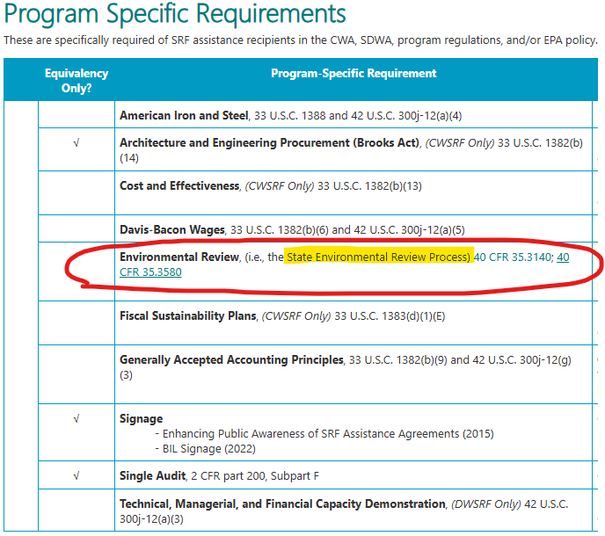
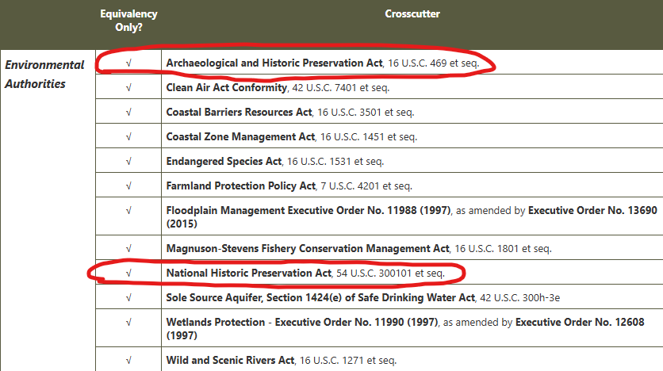
Crosscutters for Equivalency Projects Crosscutting federal authorities are the requirements established by federal laws and executive orders that apply in federal financial assistance programs. Certain projects and activities receiving assistance under the SRFs may be required to comply with the federal crosscutters. These requirements are not cited in the SRF programs’ authorizing statutes or regulations but apply broadly by their own terms in federal statutes, regulations, or executive orders to a wide range of federal financial assistance programs.

Slide 4
Background
Today, the Iowa SRF Program staff at the DNR conduct environmental reviews (ER) on behalf of our borrowers
Iowa uses a single NEPA-like State Environmental Review Process (SERP) and does not have an alternative SERP so SRF follows the same ER process for all projects:
Coordinate with Federal, Tribal, and State organizations
Determine potential environmental and historical impacts
Contract and cover expenses for archaeological and architectural studies and sampling for compliance with Section 106 of the National Historic Preservation Act (NHPA)
The current Section 106 process requires project-by-project consultation with the Iowa State Historic Preservation Office (SHPO)

Slide 5
Section 106 –Key Concepts
Section 106 of NHPA requires federal agencies to take into account the effect of their undertakings on historic properties and to afford the Advisory Council on Historic Places (ACHP) an opportunity to comment on such undertakings.
Historic properties: Objects, sites, buildings, structures, and prehistoric or historic districts that are listed on or potentially eligible for the National Register of Historic Places
ACHP: Is invited to consult on SRF Section 106 process but typically delegates this lead responsibility to the State Historical Preservation Office (SHPO)
Notes:
Kelly’s slide

Slide 6
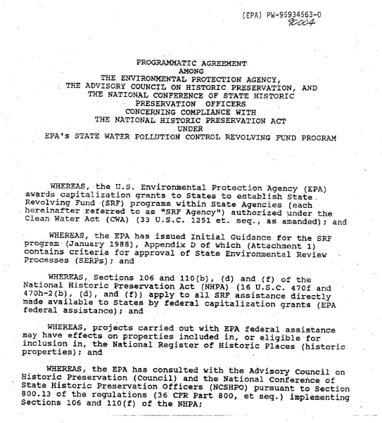
Section 106 –Delegation of Authority
CWSRF
A 1990 Nationwide Programmatic Agreement
Among the EPA, the ACHP, and the National Conference of State Historic Preservation Officers (NCSHPO)
Authorizes State SRF agencies to carry out Section 106 consultation (36 CFR Part 800) without direct EPA involvement provided no disputes exist
Notes:
Kelly’s slide

Slide 7
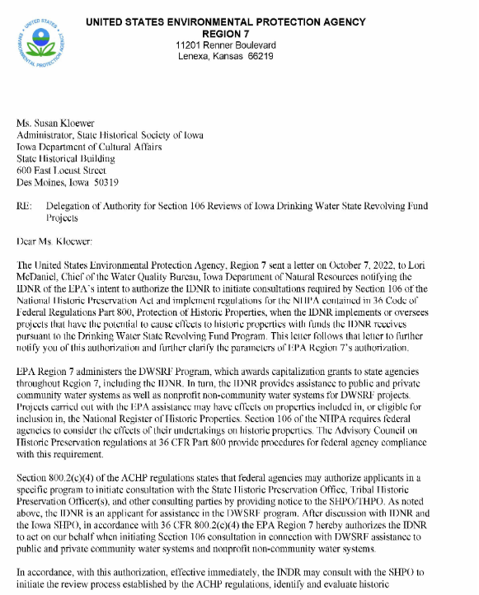
Section 106 –Delegation of Authority
DWSRF
No Nationwide PA exists for DWSRF
Authority granted to state SRF’s from each Regional EPA Office
EPA Region 7 expressly authorized Iowa DNR, in a letter dated November 17, 2022, to begin the Section 106 consultation process with the Iowa SHPO on projects funded through the Iowa DWSRF
Notes:
Kelly’s slide

Slide 8
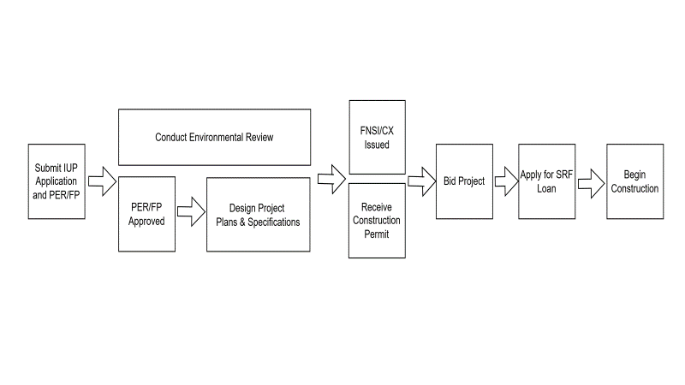
Environmental Review Process
With this delegation…Section 106 consultation is completed with the SHPO by Iowa SRF staff at the DNR in conjunction with the NEPA-like SERP reviews
Notes:
Kelly’s slide

Slide 9
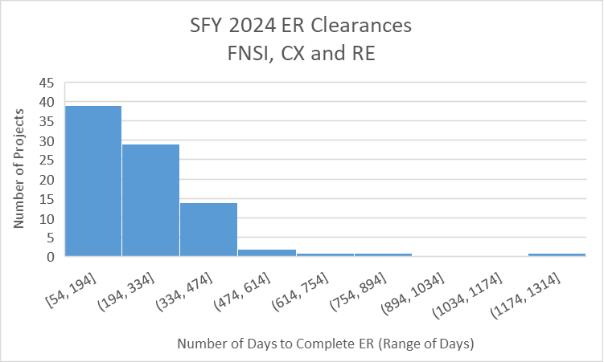
Challenge
Historical and archaeological impacts are typically the longest part of the environmental review process
Delays were very project-specific if over 365 days!

Slide 10
Impact
Lengthy process impacts construction schedule and delays initiation of public health projects

Slide 11
Proposed Solution
Issue
Iowa wants to streamline the normal Section 106 process, which requires project-by-project consultation with the IA SHPO
Exclusions Programmatic Agreement (PA)
between
State Revolving Fund Program (Iowa DNR)
State Historical Preservation Office (SHPO)

Slide 12
Purpose
The PA would exclude certain activities from a full SHPO review when the facts show those projects will not have the potential to adversely affect historic properties
Some activities will require oversight by a Secretary of Interior (SOI) qualified provider for archaeology and/or architecture
The PA would also allow Iowa DNR to send consultation invitations to Tribes on projects on behalf of EPA
If a Tribe accepts the consultation invitation, EPA would take over any further consultation unless otherwise agreed to by the Tribe(s)

Slide 13
36 CFR Part 800.14 states that changes to the Section 106 process require a Programmatic Agreement with the lead federal agency (EPA) as the Lead Signatory
Obstacle

Slide 14
Required Federal Participants
EPA Region 7 – Lead Agency
Awards SRF Capitalization Grants
Provides Annual Oversight
Tribal Consultation
Advisory Council on Historic Preservation (ACHP)
Promotes preservation of historic resources
Consults on SRF Section 106 of National Historic Preservation Act (NHPA)

Slide 15
Required State Participants
DNR & IFA – State SRF Agencies
Manage the SRF program and individual projects
State Historic Preservation Office (SHPO)
Promotes preservation of historic resources through Section 106 Process
Notes:
Kelly’s slide

Slide 16
Potential Consulting Parties & Signatories
U.S. Army Corps of Engineers (USACE)
Regulates dredging and filling activities in waters of the US, including wetlands, under Section 404 of the CWA
Prior to the issuance of any permit, USACE must consider the effect the permit may have on Historic Properties
Tribal and Local Parties
Tribal Historic Preservation Offices (THPOs)
Local Historical Societies/Commissions
Notes:
Kelly’s slide

Slide 17
Proposed PA - Overview
Clarifies the boundaries of the SRF’s authority to implement the Section 106 process for CWSRF and DWSRF funding (incorporating the National CW PA and the Regional Letter for DW)
Exclusions list identifies (9) Tier 1 and (21) Tier 2 undertakings that will allow SRF to internally review projects for Section 106 (essentially skipping the need for SHPO review)
Establishes Tribal communication process as well as other consulting party notifications
Expires after 5 years with opportunity to extend through an amendment process

Slide 18
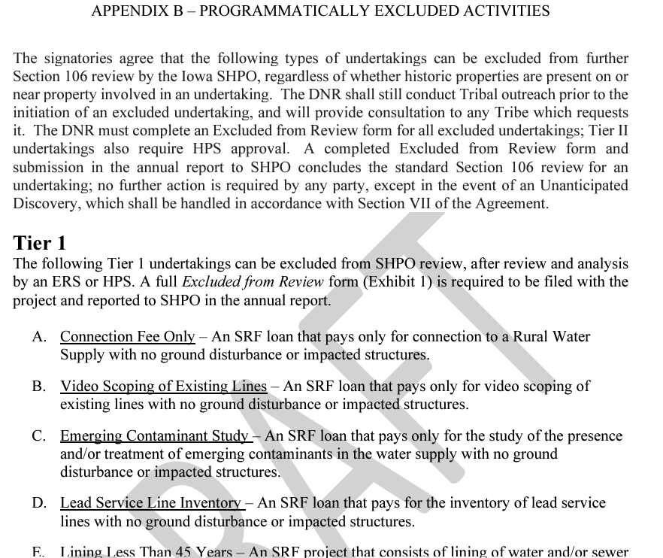
Copies available after session
or online
https://www.iowasrf.com/section-106/

Slide 19
Use of Exclusions
SRF staff will complete an Excluded from Review Form for all exclusions
Tier 1 exclusions are reviewed by ERS (environmental review staff)
Tier 2 exclusions must be reviewed by SOI qualified staff (but are not submitted to SHPO for review)
Iowa SRF initiated contracts on Nov. 1st with (2) SOI-qualified services
SRF will provide Iowa SHPO, EPA, and ACHP an annual report of all undertakings for which the exclusions were applied
SHPO may review/audit any project file related to the use of the exclusions

Slide 20
What will this Accomplish for SRF?
The PA will allow SRF to streamline the Section 106 process for certain types of SRF funded projects
When the potential for adverse effects to historic properties is limited, SRF will have greater control of project timeline in regards to Section 106 clearance
For certain projects which are not likely to impact historic properties, SRF will be able to provide an annual report to the SHPO

Slide 21
Why is the SOI Contract Important?
The PA identifies the ways that SOI-qualified staff can assist with exclusions, reducing the number of projects submitted to SHPO
Beyond assistance with exclusions:
SOI staff will assist SRF with preparing documentation for SRF projects prior to SHPO submittal (streamlining SHPO review)
Having SOI staff assist SRF with reviewing archaeological or architectural reports prior to SHPO submittal will reduce likelihood of SHPO requests for more information and need for ER rework

Slide 22
PA Development Timeline
8/24/2022 - Kick-off meeting SRF & SHPO with moderator
12/7/2022 - First PA Draft distributed for review
10/25/2023 - Public meeting to present Draft PA topic
1/8/2024 - Draft PA publicly posted for comments and sent to Tribes
5/8/2024 - Tribe meeting to discuss Draft PA
January 2023 through October 2024, SRF led 33 meetings with PA partners to discuss comments and improve the draft
11/4/2024 - PA partners met with USACE to update PA

Slide 23
Our Path to Completion
Potentially, another Tribe meeting will be held to present final draft
Final 30 Day public comment period on final draft (anticipated for December/January)
Review and incorporate public comments (January/February)
Execute PA (March 2025)

Slide 24
Questions & Resources
The DRAFT Programmatic Agreement (PA) and supporting materials can be viewed at www.iowasrf.com/section-106/
Questions regarding the PA can be directed to: Karrie.Darnell@dnr.iowa.gov
Lead SRF Environmental Review Specialist
Questions regarding the SOI contract can be directed to: Jerah.Sheets@dnr.iowa.gov
Water Quality Improvement Supervisor

Slide 25
Tribal Consultation – Proposed PA
IA SRF currently contacts Tribes and other consulting parties early in project planning and the PA proposes SRF continue that work with Tribes
Iowa SRF has consulted with nearly 30 different Tribes for the last 20 years
Tribes have the opportunity to either make their concerns about places and properties of religious and cultural significance known and decide how they want to move forward, if a Tribe believes a project may have an effect on a property of importance to the Tribe
PA formalizes the 11-17-22 EPA Authorization for DNR to conduct consultation with Tribes on SRF projects covered by the proposed PA
If Tribes do not want to interact or consult with DNR on specific projects, EPA will manage the 106 process for those projects
Per law and guidance, the proposed PA includes the option for Tribes to request at any time to consult directly with the EPA
The Osage Nation has requested and received direct consultation with EPA Headquarters during this PA process

