Slide 1

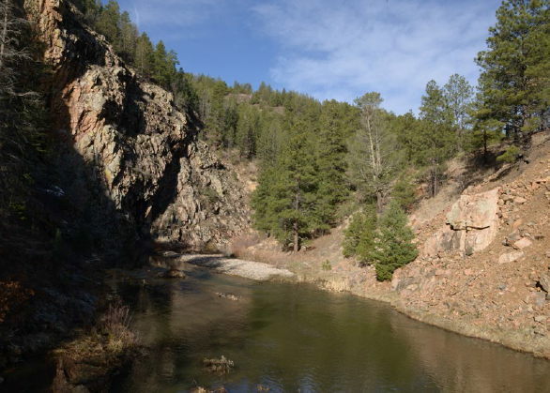
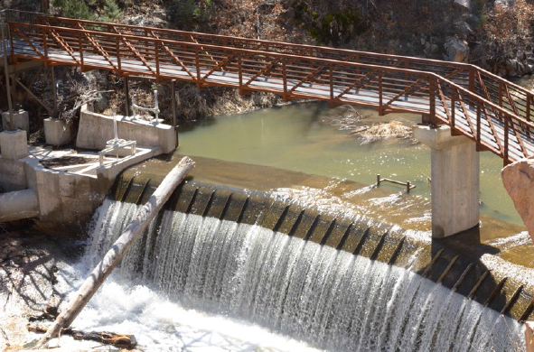
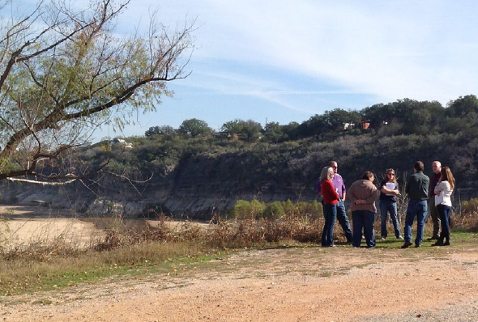
Drought Response and Recovery
A Basic Guide for Water Utilities
Dawn Ison
U.S. EPA Office of Ground Water and Drinking Water Water Security Division
CIFA SRF – October 30, 2017 – Indianapolis, IN
Notes:
Extreme and prolonged droughts can and have impacted water utilities across the U.S. and in the State of Georgia
Regardless of previous drought experience, utilities want to learn how other communities similar to them have responded to severe drought conditions
EPA's Drought Response and Recovery Guide for Water Utilities is based on lessons learned from seven drought-impacted case study utilities, and features an interactive format with worksheets, best practices, videos and key resources that outline emergency response actions that also build long term resilience to drought.

Slide 2
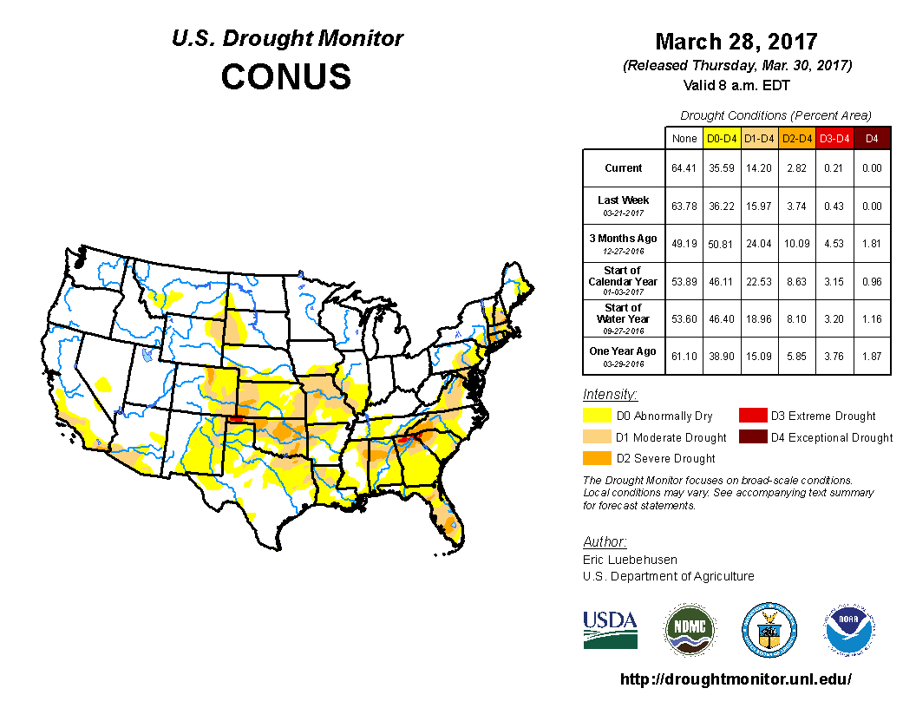
Drought – A National Issue
Drought is a slow moving natural hazard that affects water utilities in all areas of the United States
Drought can deplete water sources, presenting major challenges to utilities
EPA has developed a user-friendly tool for utilities that outlines short-term actions to respond to drought
The U.S. Drought Monitor is jointly produced by the National Drought Mitigation Center at the University of Nebraska-Lincoln, the United States Department of Agriculture, and the National Oceanic and Atmospheric Administration. Map courtesy of NDMC-UNL.
Notes:
Drought is often only considered a major issue for western and southwestern states. However, the effects of moderate to extreme drought can and have impacted communities all across the United States.
Drought-related impacts are often underestimated because it is a slow moving hazard. Long term and extreme drought can result in losses as substantial as those from hurricanes, tornadoes, and other faster-moving disasters.
Prolonged drought can deplete water reserves and a community’s ability to produce potable water.

Slide 3
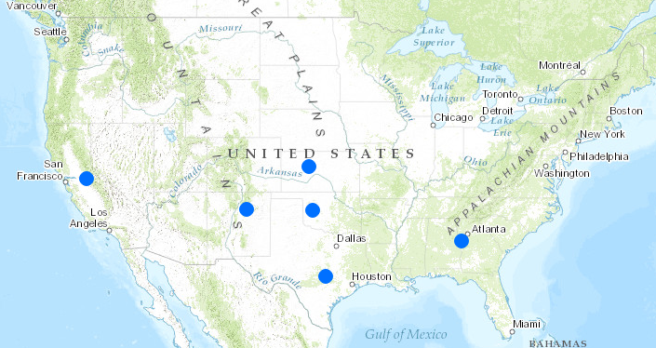
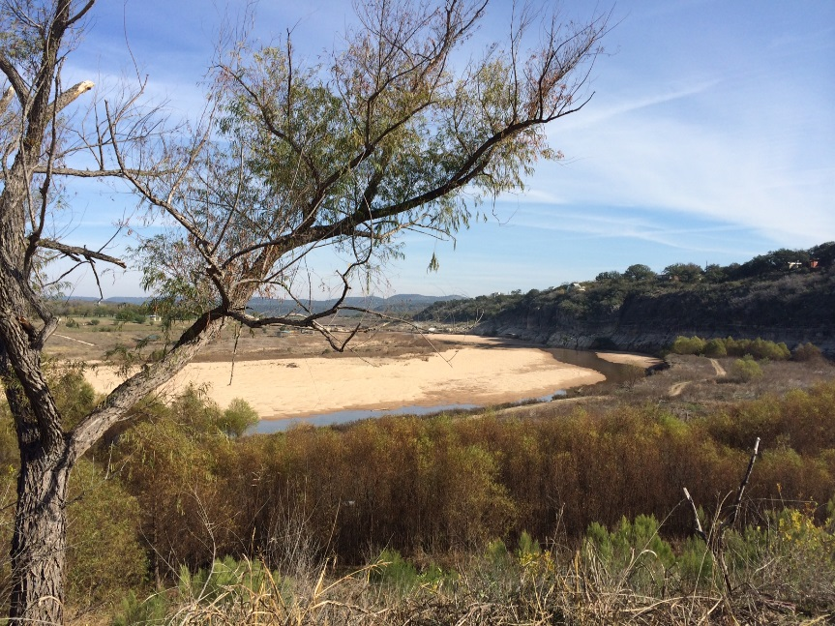
Drought Response and Recovery Project Approach
Captured lessons learned from six diverse case studies (varying location, system type, etc.) which helped to drive Guide content
Worked with Water Sector Focus Group throughout Guide development
Case Study Visits:
Tuolumne Utilities District, CA
Spicewood Beach Water System, TX
City of Las Vegas, NM
City of Hogansville, GA
Cities of Hays and Russell, KS
City of Clinton, OK
Notes:
Approach:
Visit pilot and case study utilities that have already responded to drought to gather lessons learned and approaches to water utility drought resilience. This provided the “raw materials” to construct the guidance.
Document drought mitigation options and solutions and collect videos interviews to tell each utility’s story.
Pilot utilities were visited by EPA, video team and drought engineers/experts, while case study utilities were visited only by EPA and the video team.
Ensure geographical diversity and variation in water systems (i.e. surface water versus groundwater supply) in pilot and case study utilities.
Develop an interactive Drought Response and Recovery Guide based on this information for use by water utilities nationwide.
Focus Group members:
Liz Gardner, Denver Water (retired)
Lain Leoniak, City of Bozeman Water Conservation Specialist
Mike Howe, TXWARN & Executive Director Texas Section American Water Works
Maryann Dickerson & Bill Christianson, Alliance for Water Efficiency
Brian Skeens: CH2M Hill, Co-Chair of AWWA Drought project
Dale Reed, White Bear Township Public Works Director
Melinda Moritz, City of Leon Valley Director of Public Works and alternate David Dimaline, Asst. Director of Public Works

Slide 4
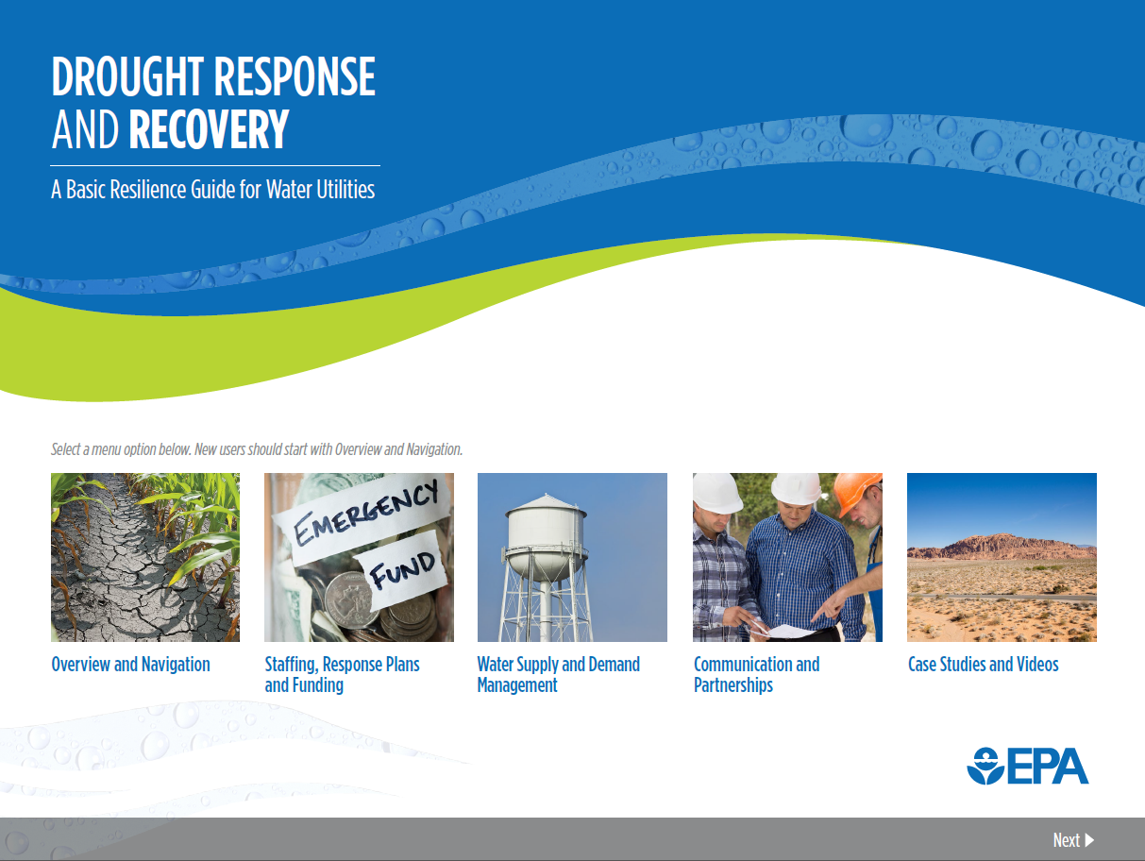
Guide Home Page
Notes:
Front page of Drought Guide:
After the overview and navigation there are 4 main sections.
The first three are different sections that cover a variety of drought response and recovery topics:
Staffing, Response Plans, and Funding
Water Supply and Demand Management
Communication and Partnerships
The last section focuses on the 7 case study utilities that were involved with the project – also links to the external case study map and video site – will explain later.

Slide 5
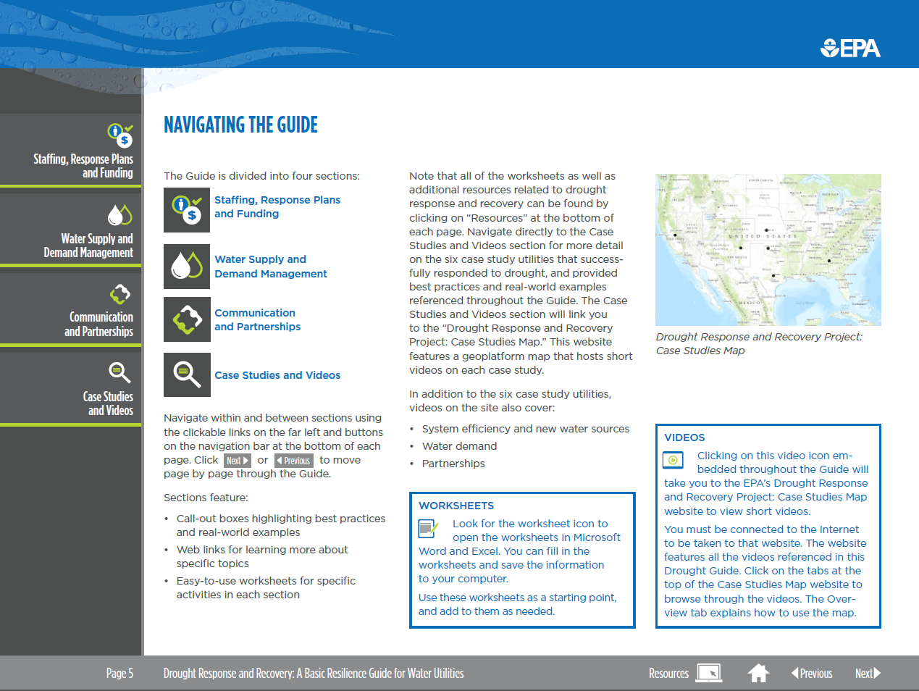
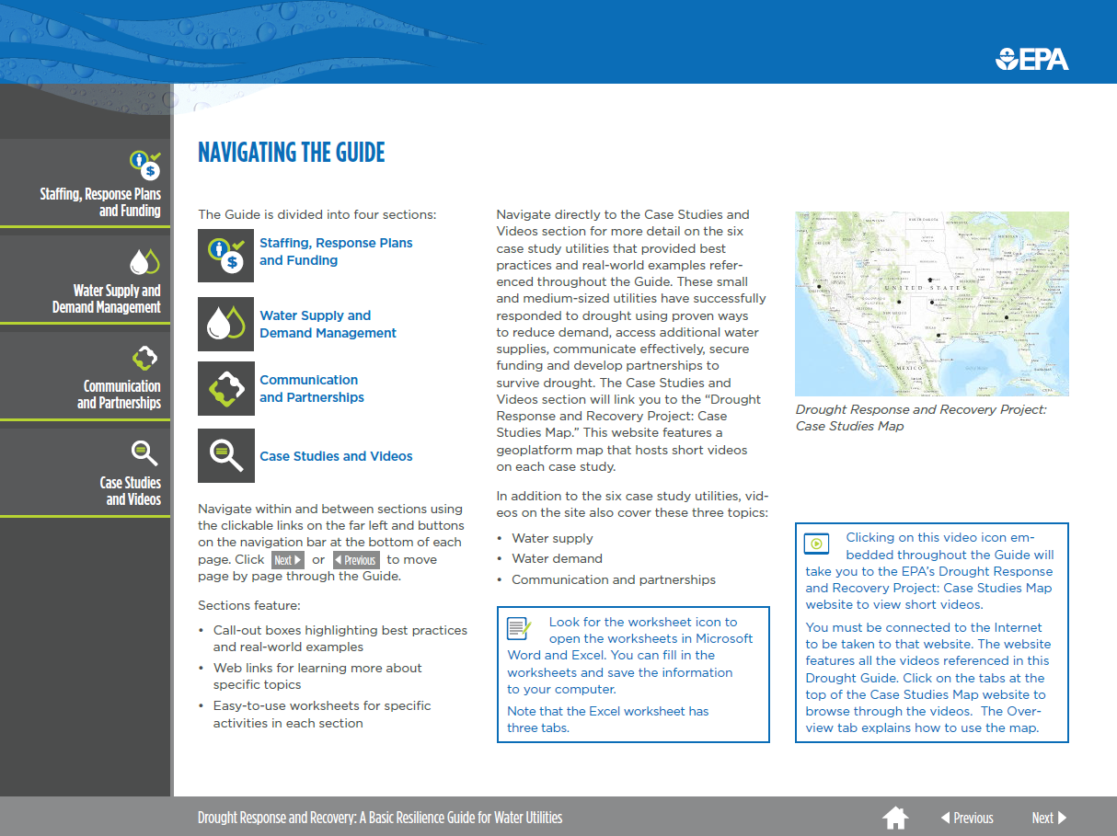
Guide Navigation
Informational and Easy-To-Use
Explore the Drought Guide more easily through:
Simple icons for tabs, worksheets and videos
Separate boxes embedded throughout that represent certain types of info
Sections broken up into key areas with bullets
Quick navigation between sections and pages
Notes:
Interactive PDF means a more user-friendly experience. Quickly navigate to information you want and read through broken up sections. Very different that many typical guidance documents you sometimes see – 30+ pages of text blocks.

Slide 6

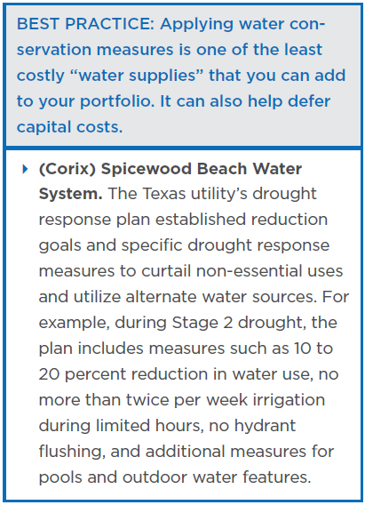
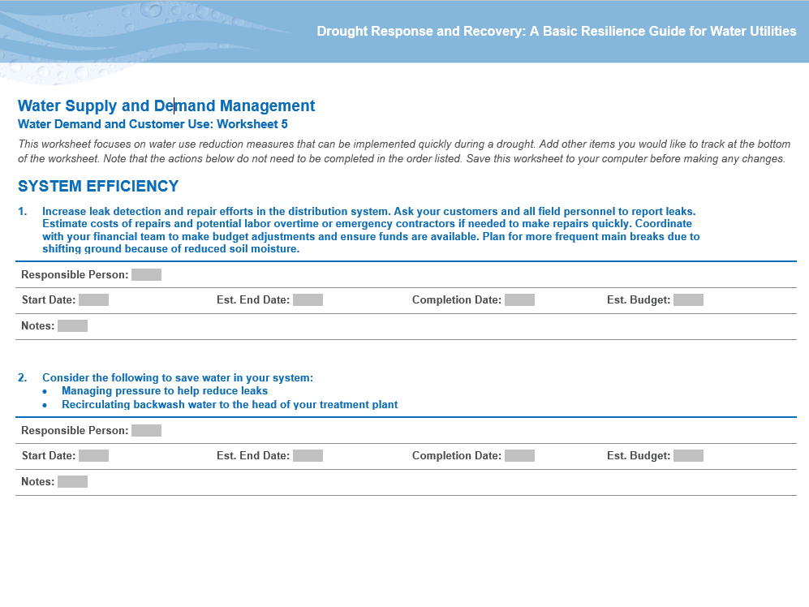
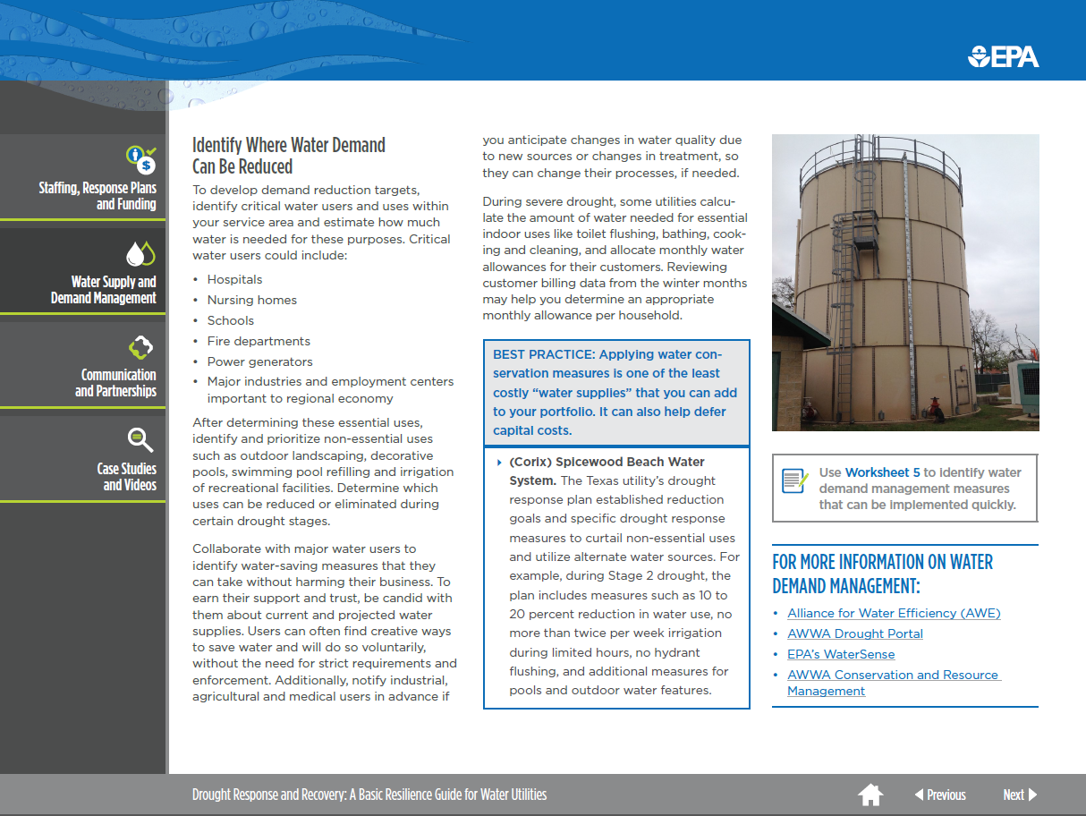
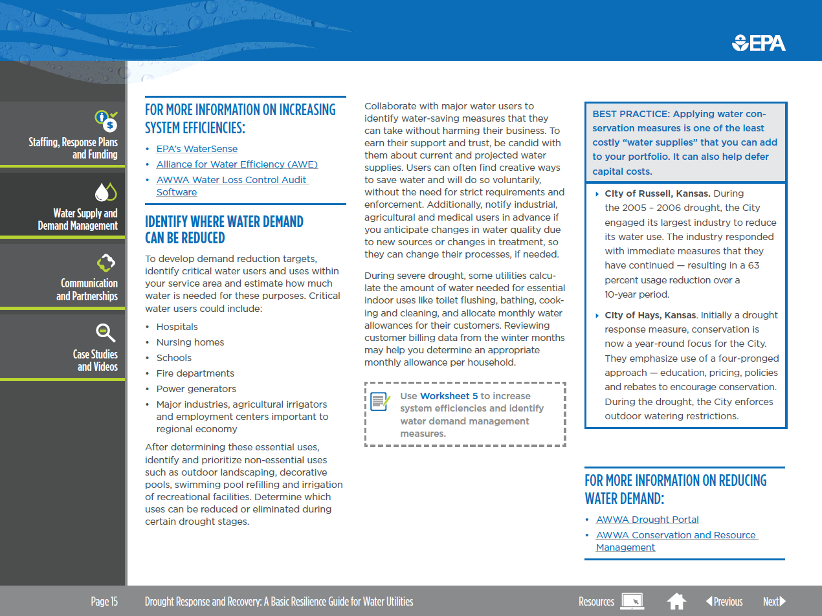
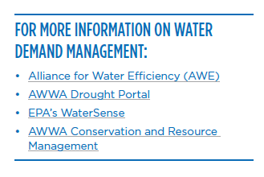
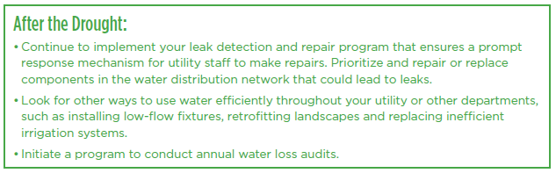
Guide Features
Best Practices, Worksheets, Links and More
Notes:
For each section, text is broken up into key points, bulleted lists, easy to read and process.
Along with simplified text, the Guide includes:
Customizable worksheets and a spreadsheet (orange box shown here)
Best practices coupled with case study examples (red box shown here)
‘After the Drought” (or as conditions improve) - considerations for building long-term resilience (green box shown here)
Links to helpful resources (black box shown here)
FYI: AWWA’s M60 Drought Preparedness and Response Manual (60 pages) concentrates on development of a comprehensive Water Shortage Contingency Plan; our Drought Guide provides a more user-friendly, easy-to-use, interactive format, particularly for use by small and medium utilities.

Slide 7

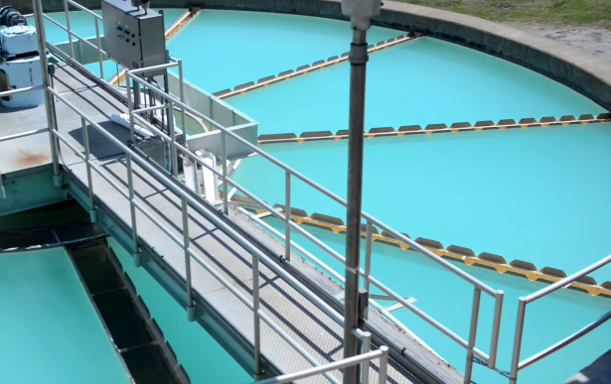

Drought Response and Recovery Guide What’s covered?
1) Staffing, Response Plans and Funding
Developing your drought response team and drought plan
Training on and exercising drought response (tools and tips)
Recovering revenue, finding sources of funding
2) Water Supply and Demand Management
Estimating available groundwater/surface water supplies
Improving system efficiency and reducing customer demand
Identifying options for additional water supplies
3) Communication and Partnerships
Communicating drought issues/solutions to customers and decision-makers
Examples of unique partnerships and outreach efforts
List of suggested partners to consider reaching out to
Notes:
The guide covers a variety of topics and here are a few examples.
*Pick a few bullets and read them off the slide. Mention that the worksheets help utilities work through many of these actions.
One example: Worksheet 4, under section 2, is actually an Excel spreadsheet with built in formulas that gives utilities steps to help them answer a simple question: How much more water supply do I have and how long will it last based on current and forecasted demand, weather conditions, etc.

Slide 8
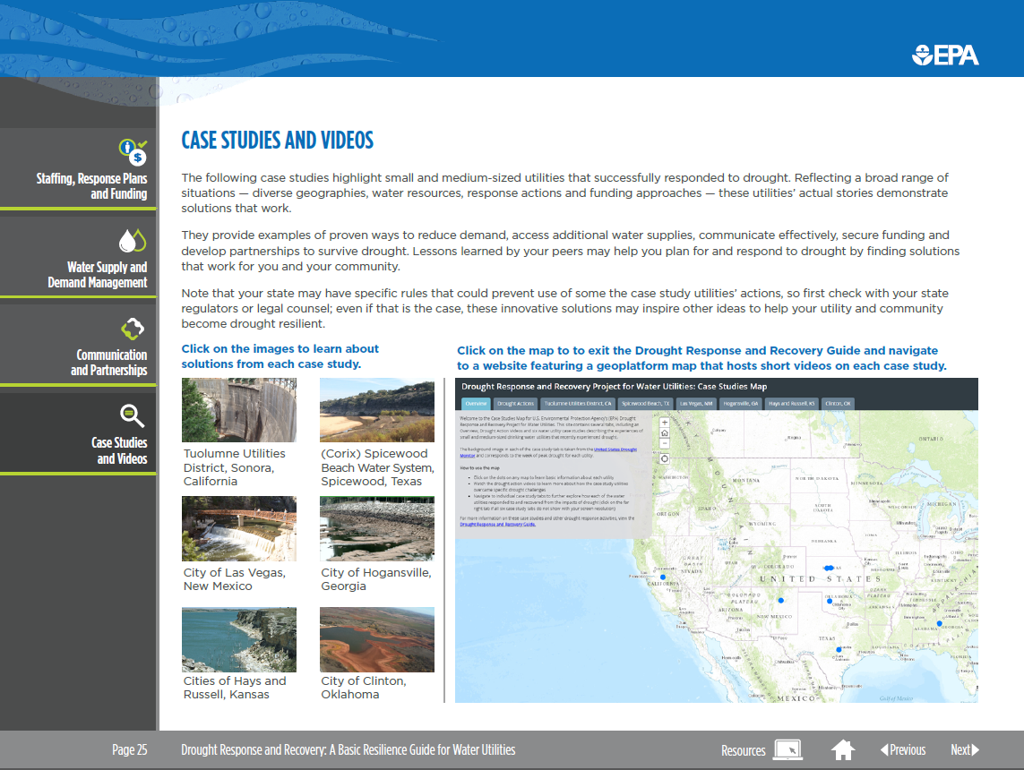
Drought Response and Recovery Guide
Case Studies and Videos
Notes:
Case Studies and Video Home Page – the 4th main section of the guide offers more details about the 6 case studies that EPA engaged for the project.
On left are link to more details about each of the case studies (2 pages each)
On right is link to external Geoplatform site which houses the Case Study Map and Videos
Click on Hogansville (red arrow) for 2 page summary

Slide 9
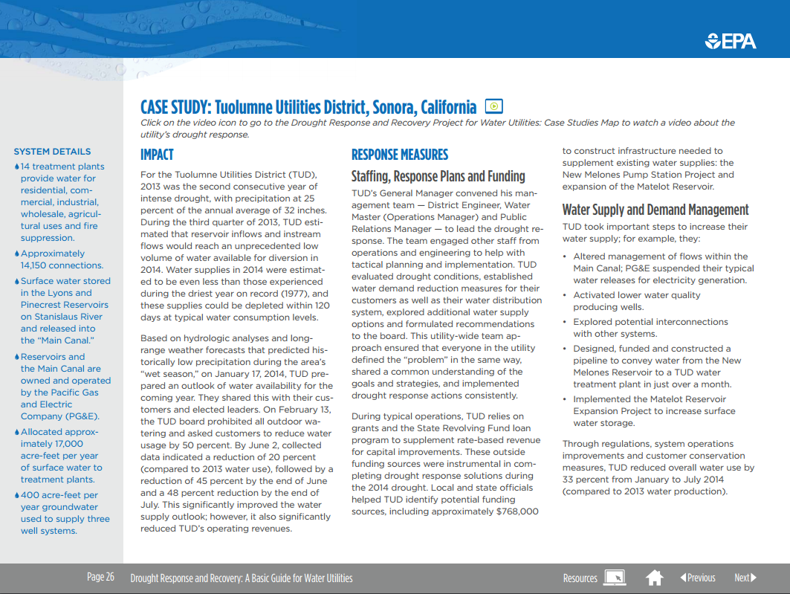
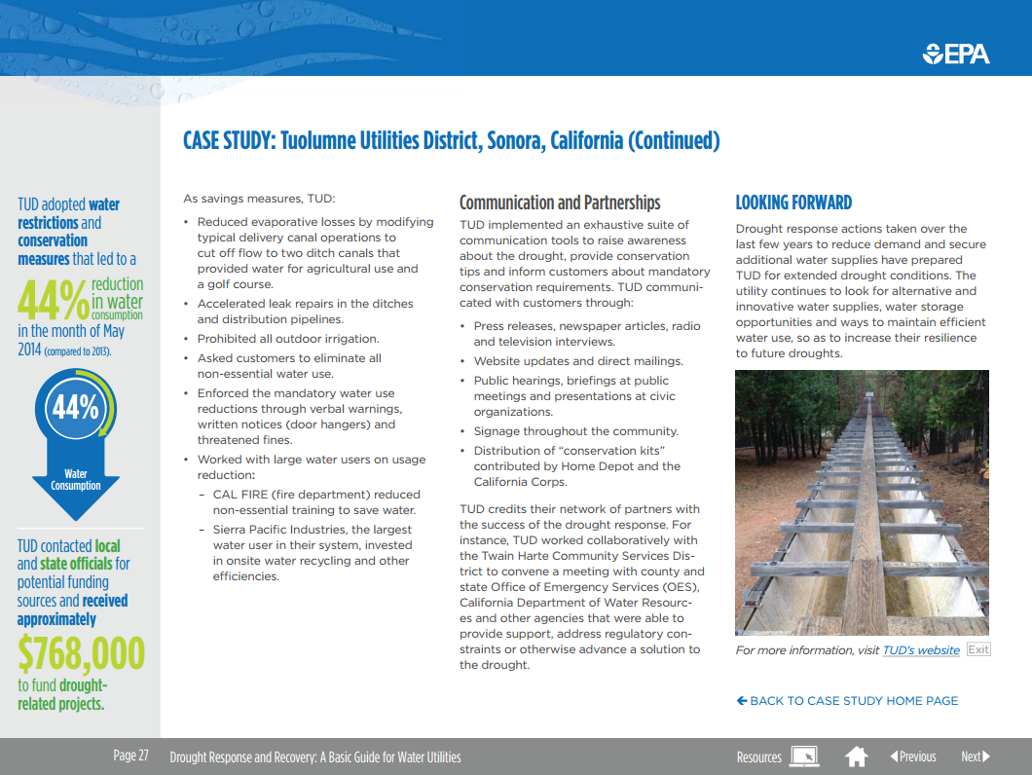

Case Studies and Videos
Two-page summary on water utility that includes:
System details
Drought response measures taken
Links to external Case Studies Map and Videos
Notes:
Each of the six case studies have two-page summaries that include:
System Details (infrastructure and customer make up - # of plants, # of customers, ratio of customer types, main water sources, etc.)
A short description of the drought conditions that impacted the community, which years, how bad it was, etc.
What response and recovery measures were taken throughout the drought. All fall under one of the 3 main categories the guide is broken up into.
On Page 2 of each case study, there are infographics describing innovative or unique drought response measures taken by the utility
A link to the external Geoplatform site which house the case studies map and videos.
A link back to the case study home page of the drought guide
TUD drought response incorporated:
Conservation, with specific triggers tailored to the system and rate structures that incorporate lower customer usage

Slide 10
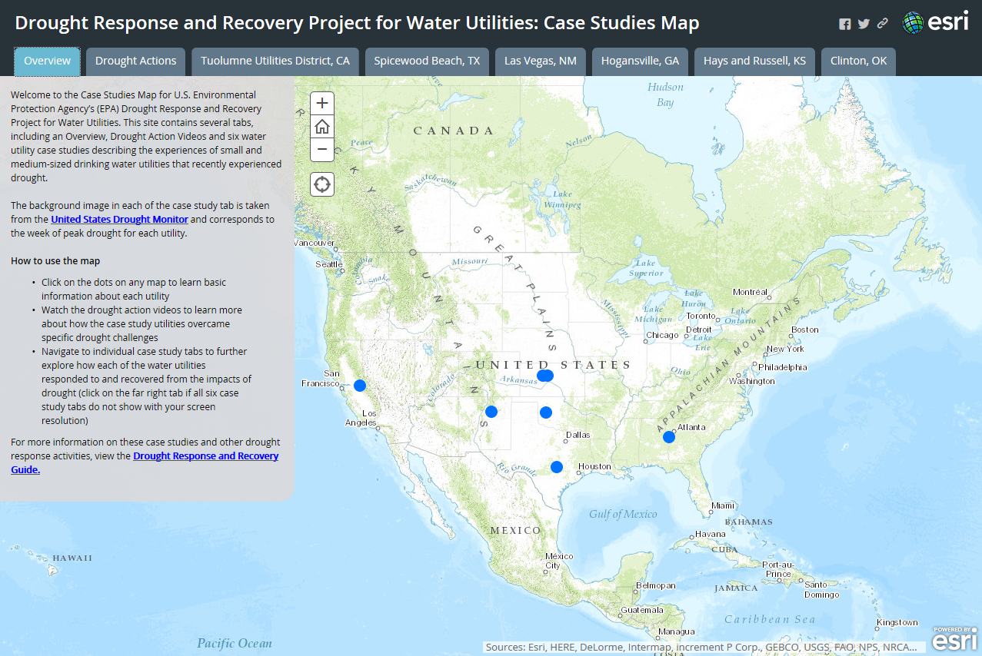

Case Studies Map and Videos Home
Geoplatform
Notes:
Home page of case study map – see all 6 utilities – blue dots – clicking on dot gives some basic info.
Tabs at top are for each case study – as well as a tab for the thematic videos.
Three thematic videos under the “drought actions” tab cover more general drought response topics:
System Efficiency
Reducing Customer Demand
Partnerships

Slide 11
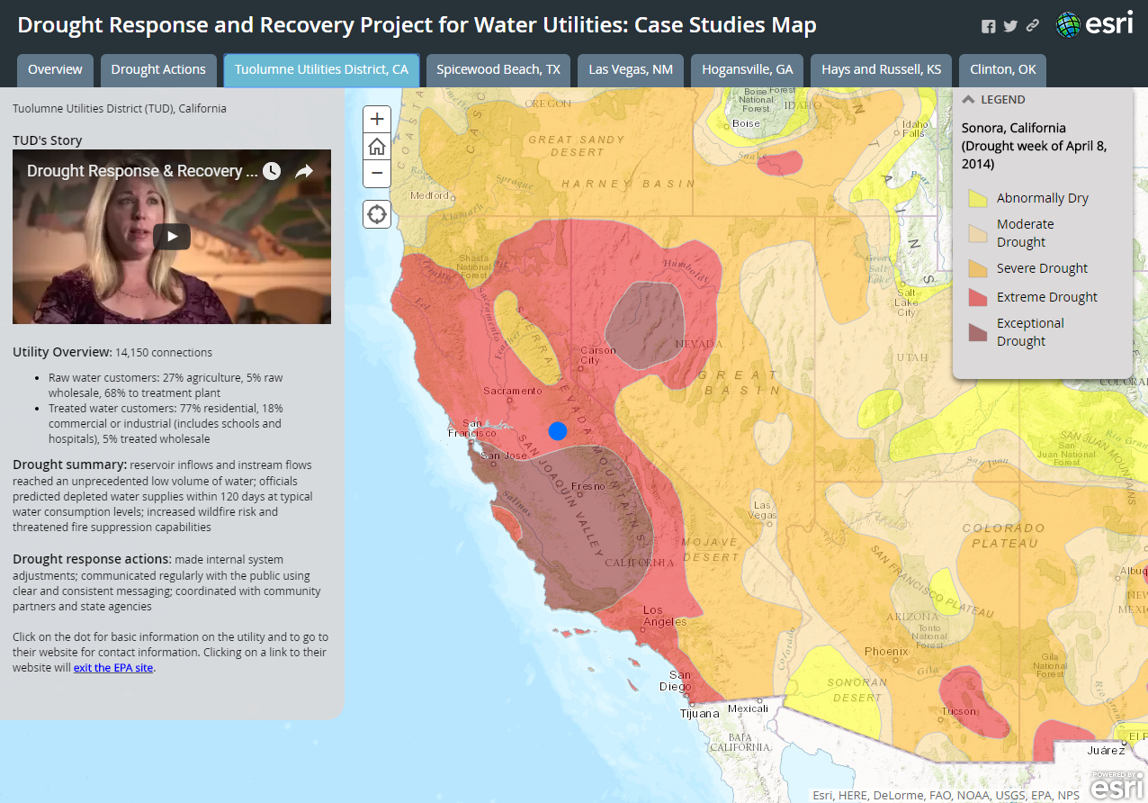
Case Studies Map and Videos
Geoplatform – Tuolumne Utilities District (TUD), CA
https://www.youtube.com/watch?v=FfXgT5je51Y
Notes:
Tab brings you to details about utility – shows drought monitor of time when area drought was at it’s worst (for TUD, the peak week of drought was April 8, 2014) Gives basics about utility overview, impacts, and response actions plus the 5-6 min youtube video of the utility’s story. The map is interactive and allows users to see how communities and states in the region were also being impacted by drought at the time.
Now we’ll watch a short clip of the TUD, CA case study video ** show first 1:05 of video https://www.youtube.com/watch?v=FfXgT5je51Y

Slide 12
Case Study - Tuolumne Utilities District, CA
2013 was the second consecutive year of intense drought, with precipitation at 25% of the annual average
Estimated that 2014 supplies could be depleted in 120 days
Created a drought response team that met weekly
Asked customers to reduce use by 50%
Banned all non-essential water use
Reduced evaporative losses by modifying canal operations
Used grants and the SRF to supplement rate based revenue for capital improvements (reservoir expansion and pipeline project)
Worked extensively with partners to reduce use and communicate to raise awareness
Notes:
Brief summary of Hogansville, GA’s response:
They survived the most recent drought by conserving, fixing leaks and working towards building alternative sources. Hogansville embarked on a regional approach and made interconnections with two neighboring water systems to increase their resilience.

Slide 13
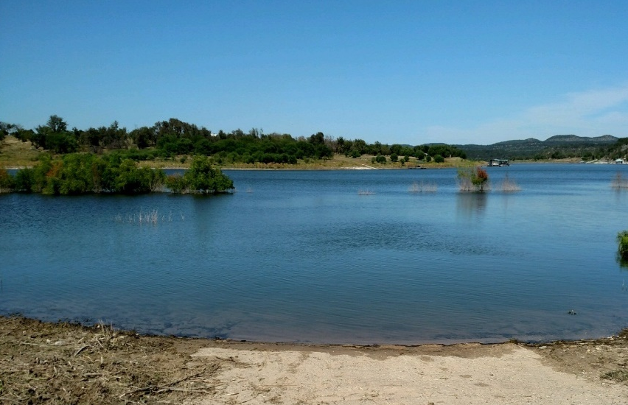
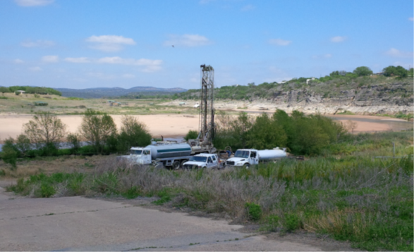
Case Study - (Corix) Spicewood Beach, TX
Spicewood Beach experienced a number of consecutive dry years, including the driest year on record in 2011
The system’s well production began dropping in Dec. 2011 and couldn’t meet demand within 6 weeks.
For 2 years, the system trucked in 5-6 water tankers per day ($35,000/month)
  Talking and doing very different
The system did have a drought plan, but it didn’t account for losing their wells
The solution – 1st bank infiltration well with surface water treatment in TX
Innovative financing – county applied for TX Dept. of Ag disaster relief grant on behalf of system (only county gov. eligible)

Slide 14
Case Study Focus
Hogansville, GA
Severe droughts in 1988, 2003, and 2007
  Had to truck in water in ‘88 and had to put in a portable pump in ‘03
Abandoned their source and built pipelines to interconnect with two neighboring systems as part of a regional solution
Funded project through
  Tiered rates
  Special-Purpose Local-Option Sales Tax (SPLOST)
  Immediate Threat and Danger Grant (state emergency assistance)
  SRF loan
Notes:
Each of the six case studies have two-page summaries that include:
System Details (infrastructure and customer make up - # of plants, # of customers, ratio of customer types, main water sources, etc.)
A short description of the drought conditions that impacted the community, which years, how bad it was, etc.
What response and recovery measures were taken throughout the drought. All fall under one of the 3 main categories the guide is broken up into.
A link to the external Geoplatform site which house the case studies map and videos.
Brief summary of Hogansville, GA’s response:
They survived the most recent drought by conserving, fixing leaks and working towards building alternative sources. Hogansville embarked on a regional approach and made interconnections with two neighboring water systems to increase their resilience.

Slide 15



Drought Guide - 2017 Updates
New resources include:
A customizable Drought Response Plan template for utilities
Two additional video case studies for the Geoplatform
A “share your story” section of the Geoplatform
Notes:
EPA is updating the Guide to include a number of new resources including:
A customizable Drought Response Plan Template for utilities, to be released Fall 2017
Two additional Case studies to highlight the benefits of using recycled water and drought response for communities with island geographies
A re-vamped look to the GeoPlatform, as well as a new section of the Geoplatform, which will allow utilities to share their own drought stories.
Updates to the Geoplatform are scheduled to be completed around the new year.

Slide 16
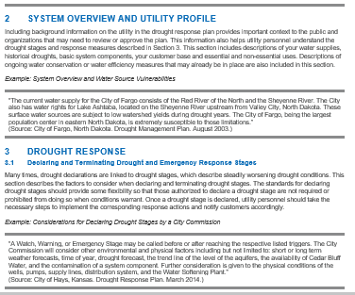
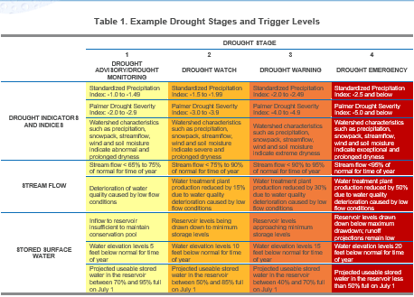
Drought Response Plan Template
Instructions
Assists water and wastewater utilities with developing a drought response plan
Instructions guide users through the process
Diverse examples of drought response plans
Addresses 3 key components
  Policy, purpose and objectives
  System overview and utility profile
  Drought response actions
Notes:
Integrated into the Existing “Staffing, Response Plans, and Funding” PDF section of the Guide, the Drought Response Plan Template assists water utilities with developing a drought response plan.
The template is a customizable Word document separated into an instructions section and a fillable template.
The instructions include general guidance and discussion to help users complete the template step by step, as well as examples from other state or utility drought response plans from across the nation.
Following the instructions helps utilities address 3 key components of a drought response plan:
Policy, Purpose and Objectives
System Overview and Utility Profile
Drought Response Actions

Slide 17
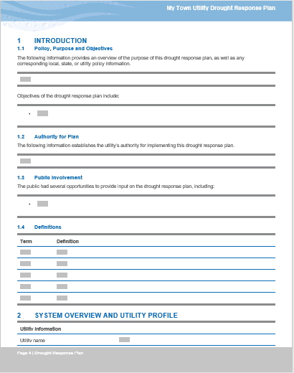
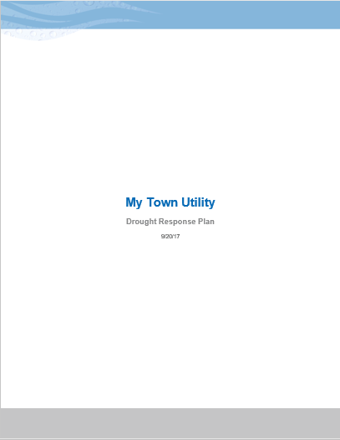
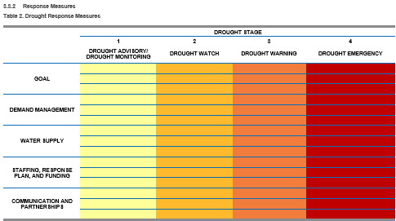
Drought Response Plan Template
Fillable Template
Customizable, fillable document
Flexible and adaptive to unique utility needs
Notes:
After learning about the components of a successful drought response plan template in the Instructions section, Users can move on to creating their own customizable response plan using the fillable template included in the Microsoft Word document.
The template provides a comprehensive overview of everything a utility might need to consider to prepare, respond, and recover from drought impacts. Highlights include space for utilities to document their authority to declare a drought, multi-layered tables where user can define “drought trigger levels” for their community, space to determine enforcement procedures for mandatory conservation measures, and more.
EPA recognizes that all water utilities have unique challenges related to managing their water supplies and operating their systems during drought conditions. The fillable template gives users the flexibility to change information or add new sections based on the needs of their individual service areas.
For utilities that have struggled to develop a Drought Response Plan, or those whose response plans might need a routine update, the Drought Response Plan Template is a highly practical and adaptable resource and a valuable addition to the Drought Response and Recovery Guide.
The updated Guide Featuring the Drought Response Plan template will be available to download in the coming weeks.

Slide 18

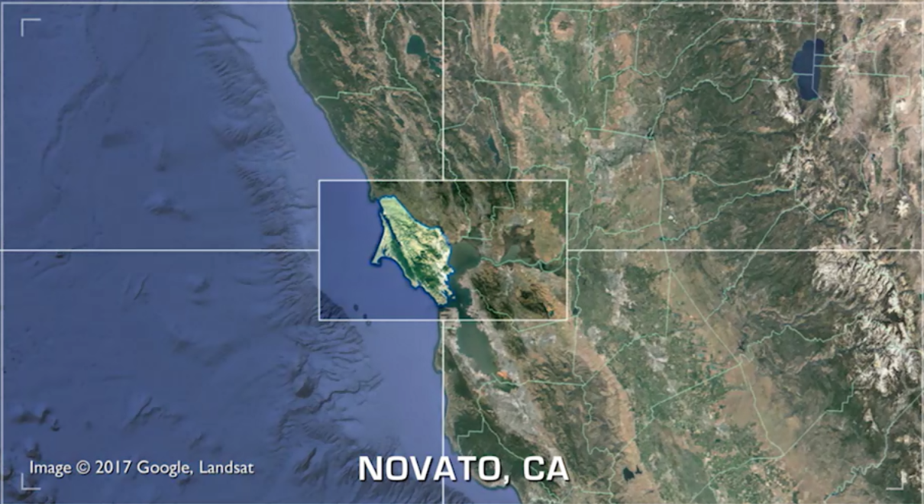
Geoplatform Updates
Case Studies
Castine, ME
Highlights drought response to a water shortage
Illustrates an innovative solution to providing drinking water in an island geography location
Novato, CA
Highlights the importance of partnerships
Illustrates the value of recycled water in drought-plagued communities
Notes:
The Water Security Division is also updating the Drought Response and Recovery Guide’s interactive Geoplatform with two new video case studies.
The first, filmed in Novato, California, documents a drinking water utility’s partnership with two nearby wastewater districts to respond to drought. The partners develop a mutually-beneficial relationship founded on the use of recycled water as a crucial water source during a drought.
The second tells the story of Castine, Maine, a small town isolated on a peninsula with very little fresh water available in the surrounding geography. EPA follows their efforts to implement an innovative solution amid a challenging water shortage situation.
The additional case studies provide coverage of two new strategies that utilities can use to increase their resilience to drought while expanding the range of the map itself into previously unexplored geographical and conceptual areas.
The case study videos will be finalized and posted to the Geoplatform around the new year.

Slide 19
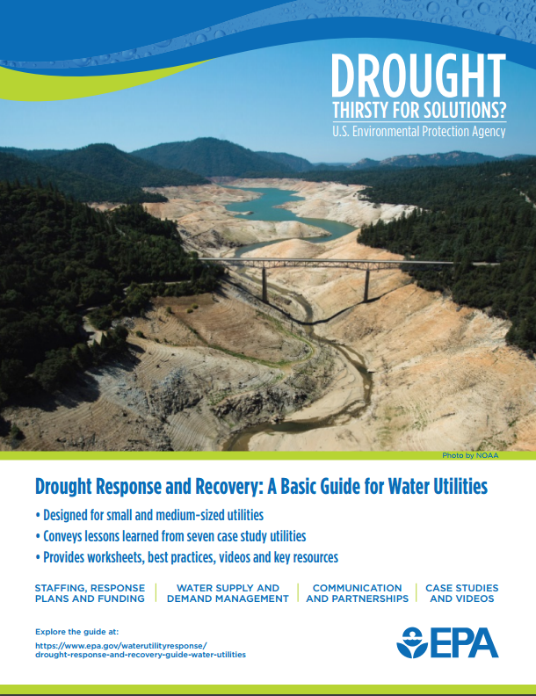
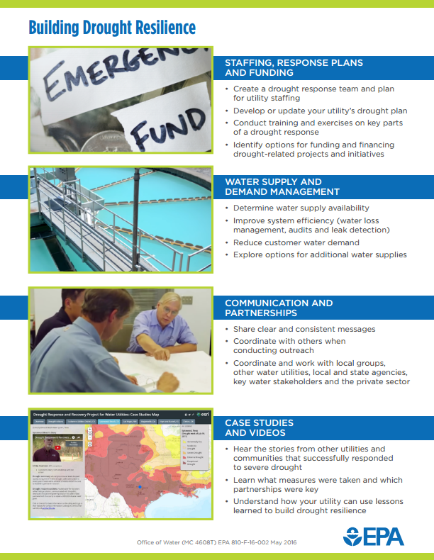
Drought Response and Recovery
Outreach
  *Fact sheet available online or by request
Two workshops conducted in December 2015
  In Merced and Tulare, CA as part of the National Drought Resilience Partnership (NDRP)
  Focused on drought challenges and solutions, as well as funding
Three workshops conducted in May & June 2016
  In Kentucky, Missouri and Utah
  Focused on water loss and leak detection, including walkthrough of AWWA’s Water Audit Tool
Notes:
WSD recently conducted 3 drought response and water loss workshops in Kentucky (5/10), Missouri (5/25), and Utah (6/8). Discussed local drought issue, talked about water loss 101 and went through how to build and implement a water loss control program using resources from EPA, AWWA, etc.
If you have any follow up questions about the guide, case studies or drought response in general, please contact Dawn or myself. Also please let us know if you utility or region might be interested in holding a drought response workshop.

Slide 20
Drought Response and Recovery
Outreach
One workshop in September 2017
  In Lewistown, MT
  Focused on water loss and the importance of having a water shortage plan
Additional workshop scheduled for November in CO and March 2018 in GA (postponed due to hurricane Irma)
  GA will focus on what to do with water audit results
EPA is requesting funding for two additional workshops in 2018
  These workshops can be customized to the needs of the state
  *Fact sheet available online or by request
Notes:
WSD recently conducted 3 drought response and water loss workshops in Kentucky (5/10), Missouri (5/25), and Utah (6/8). Discussed local drought issue, talked about water loss 101 and went through how to build and implement a water loss control program using resources from EPA, AWWA, etc.
If you have any follow up questions about the guide, case studies or drought response in general, please contact Dawn or myself. Also please let us know if you utility or region might be interested in holding a drought response workshop.

Slide 21
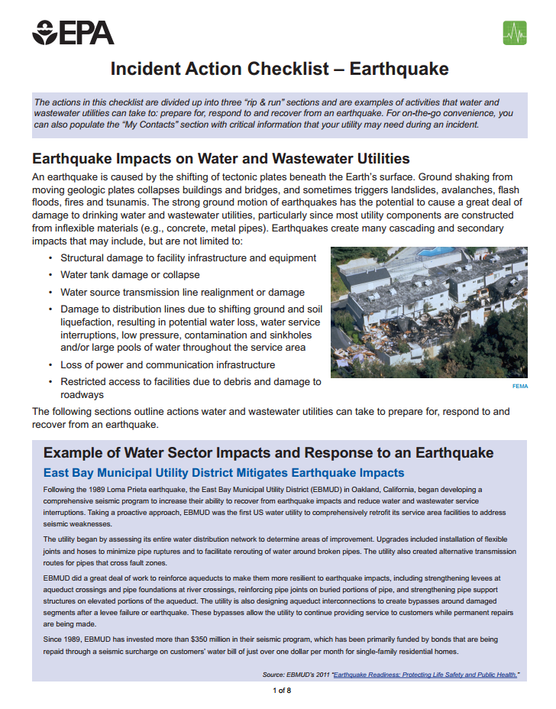
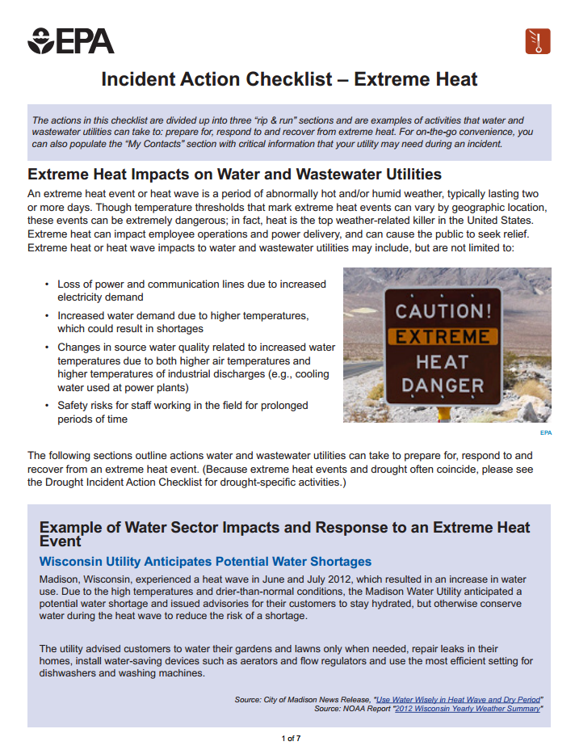
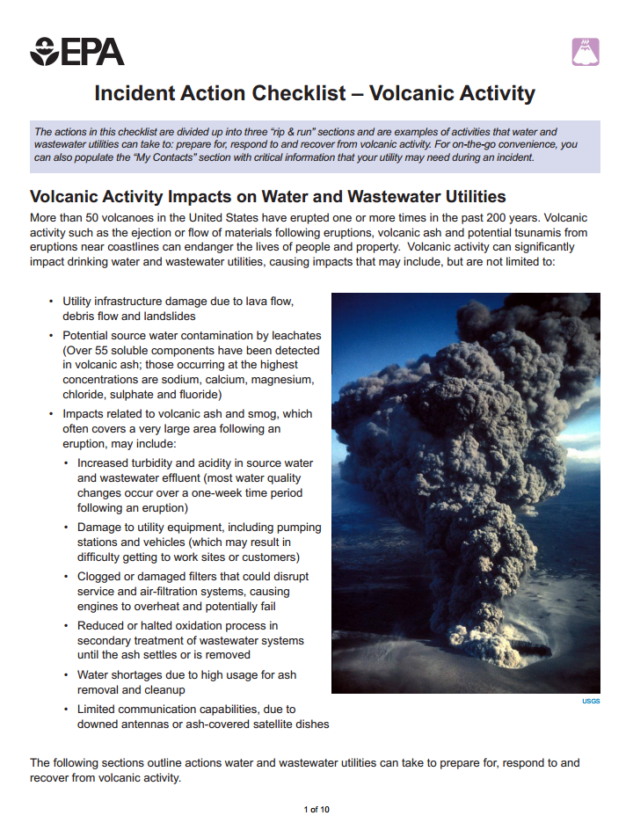
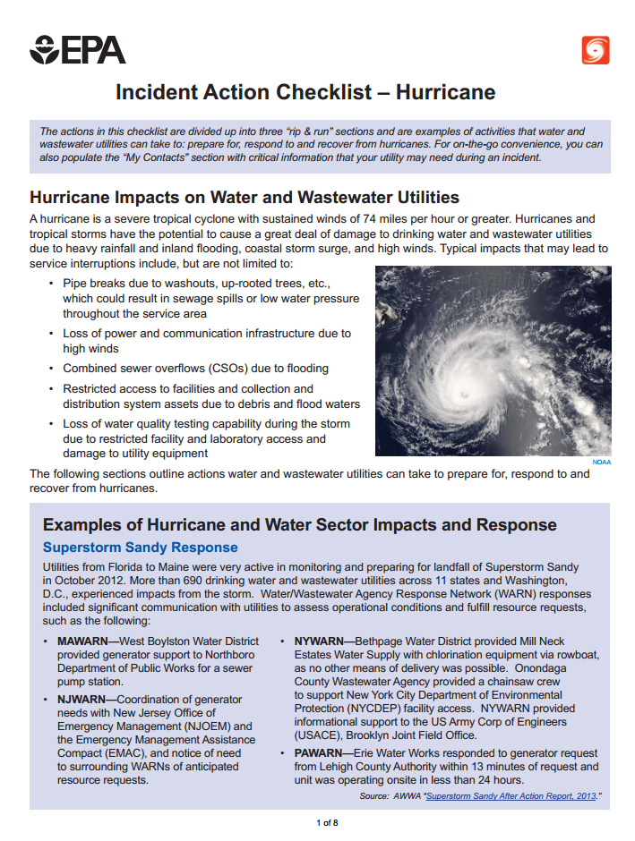
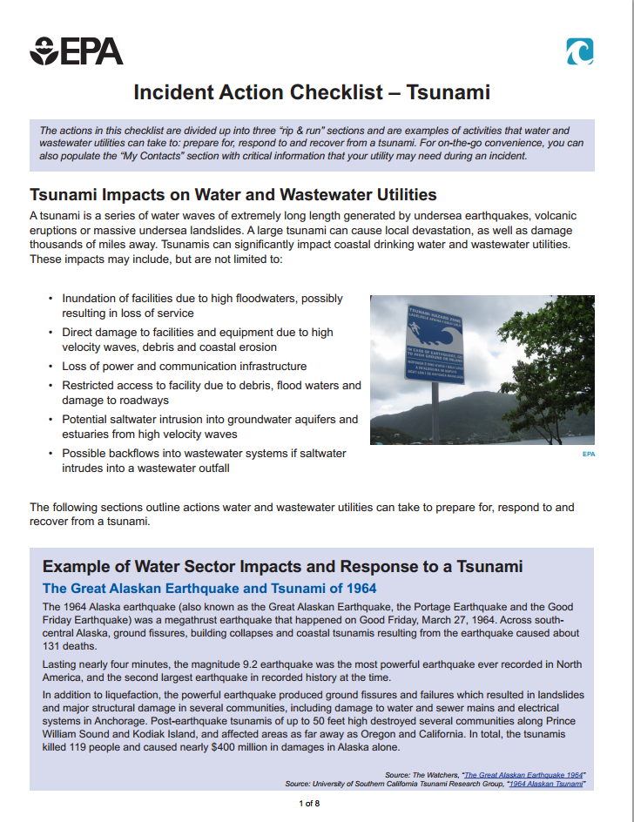
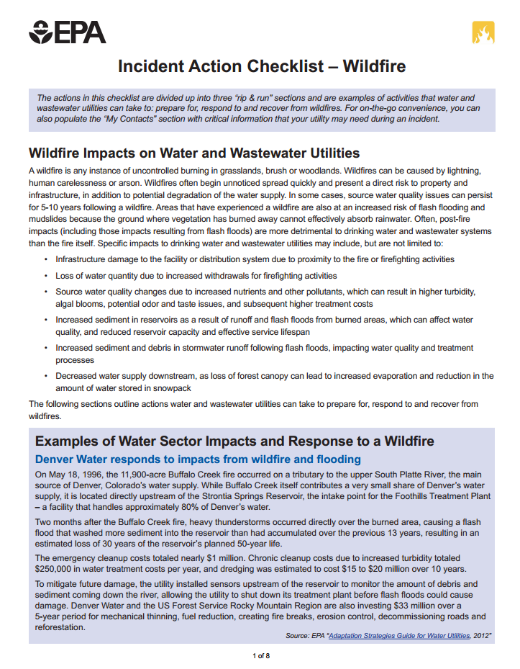
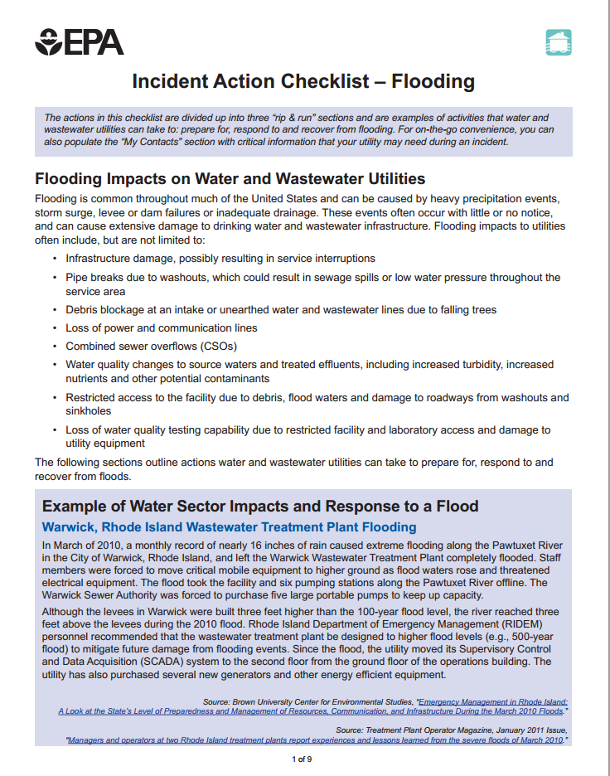
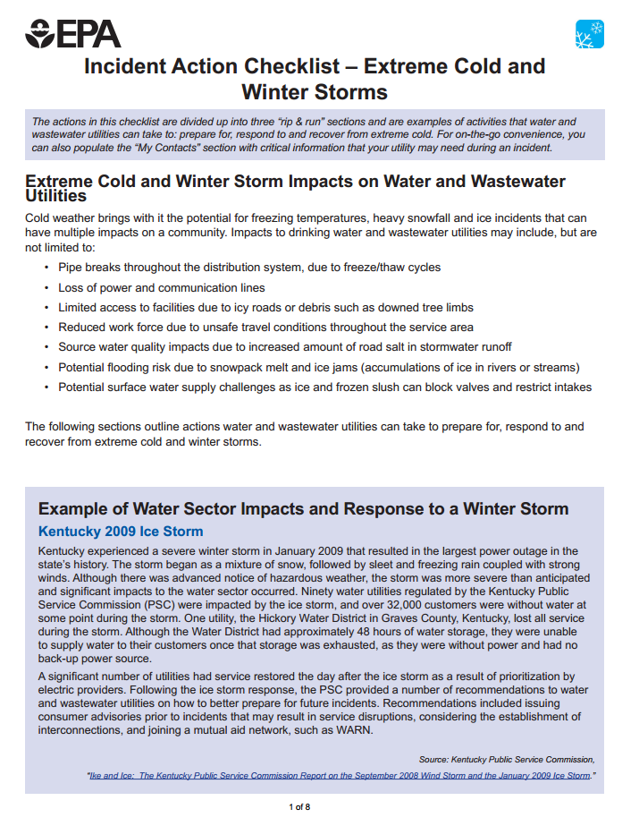
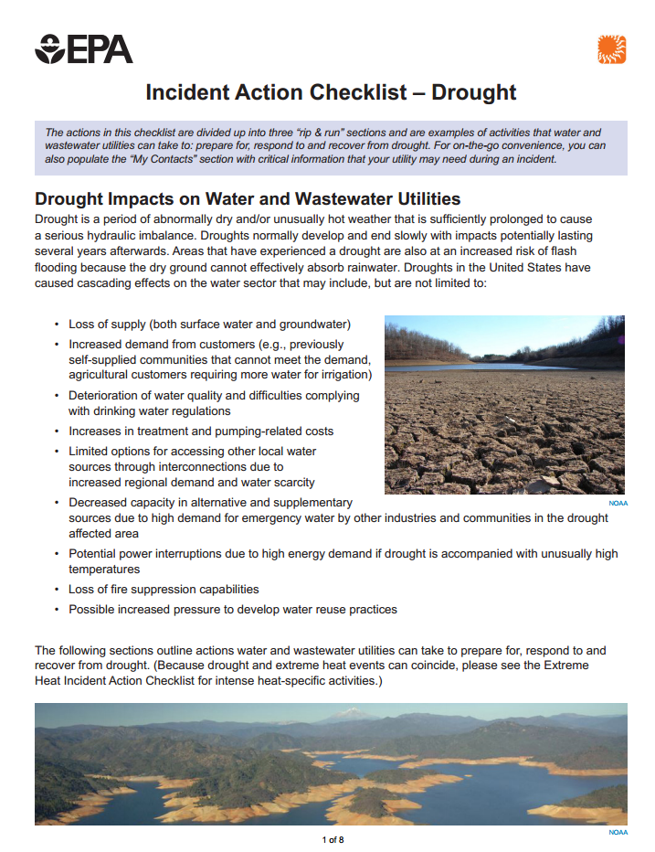
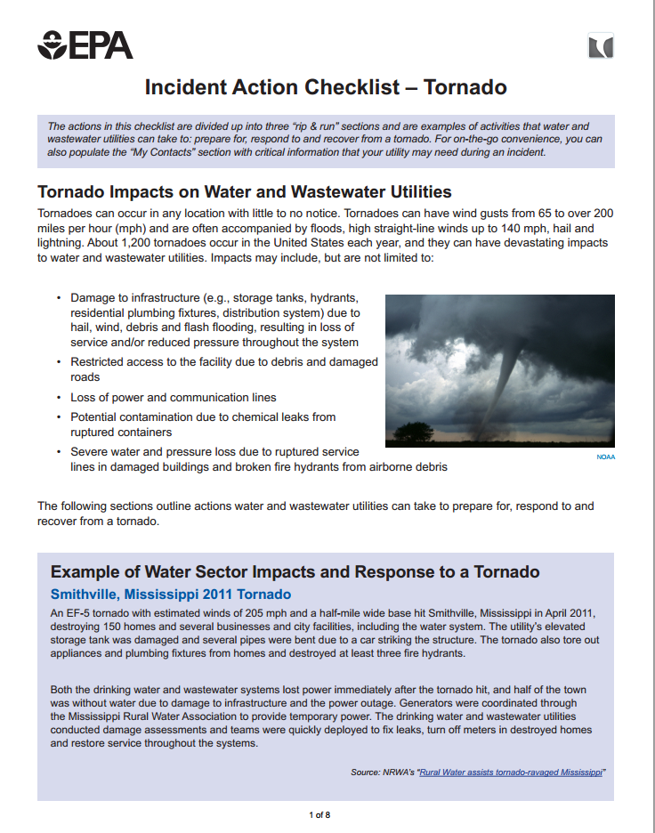
Other WSD Drought Related Products
Drought Incident Action Checklist
  One of ten “Rip and Run” style checklists that utilities can use to help with preparedness, response and recovery
Notes:
EPA developed ten “rip & run” style incident-specific checklists for -
Drought,
Earthquake,
Extreme Cold
and Winter Storms,
Extreme Heat,
Flooding,
Hurricane,
Tornado,
Tsunami,
Volcanic Activity,
and Wildfire.
The goal is for these lists to be printed and taken into the field for easy access before, during and after an incident.

Slide 22
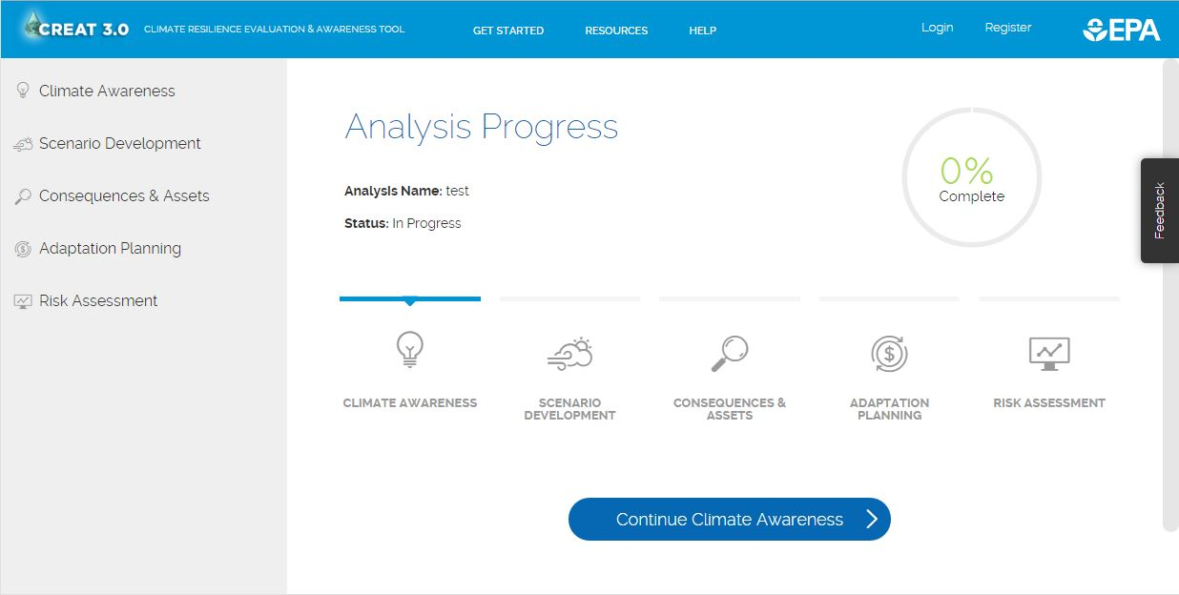
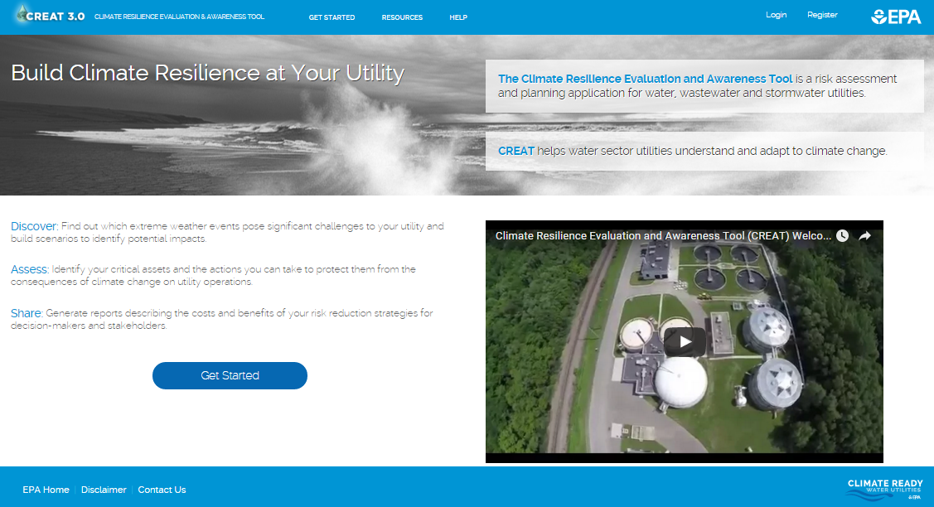
Climate Resilience Evaluation &
Awareness Tool (CREAT)
Other WSD Drought Related Products
Web-based tool that assists utility managers in understanding potential climate change threats, including drought
Assessments will help inform adaptation planning
Results from CREAT help utilities compare monetized risk and adaptation costs
Notes:
CREAT is a web-based tool for water sector utilities to assess risks from climate change impacts and evaluate options for adaptation.
We provide climate data from the US Global Change Research Program, so if for those utilities that don’t know what climate change means for them, this tool will break it down into usable formats- so what are my biggest threats? How do they affect my assets? How can I reduce risk? Which adaptation options will reduce risk the most?

Slide 23
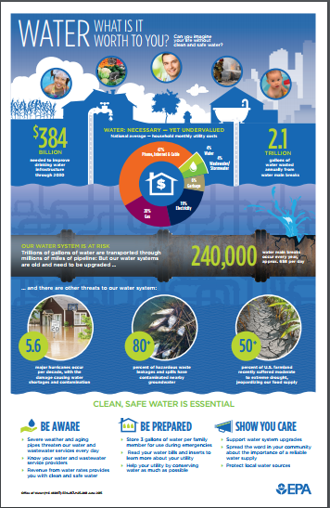
Other WSD Drought Related Products
Water Utility Public Awareness Tool Kit
  By using several effective communications methods—print, web, and TV— this kit will help officials reinforce important messages to the public and drive home the call to action.

Slide 24
A Few Lessons Learned Along the Way
Have a water shortage plan
  Conduct training on the plan, not just lip service. What does it really require to truck in water?
Have a short-term and a long-term plan
  Capital improvements take time and money. Have a 6-month, 5-year and 10-year plan
It usually always comes down to money
  Asset management is key, esp. evaluating rate structures (many systems moving toward higher base rates)
Don’t ever assume you have enough water
  If you think you have enough now, then start planning for the next source. No easy water sources anymore.

Slide 25
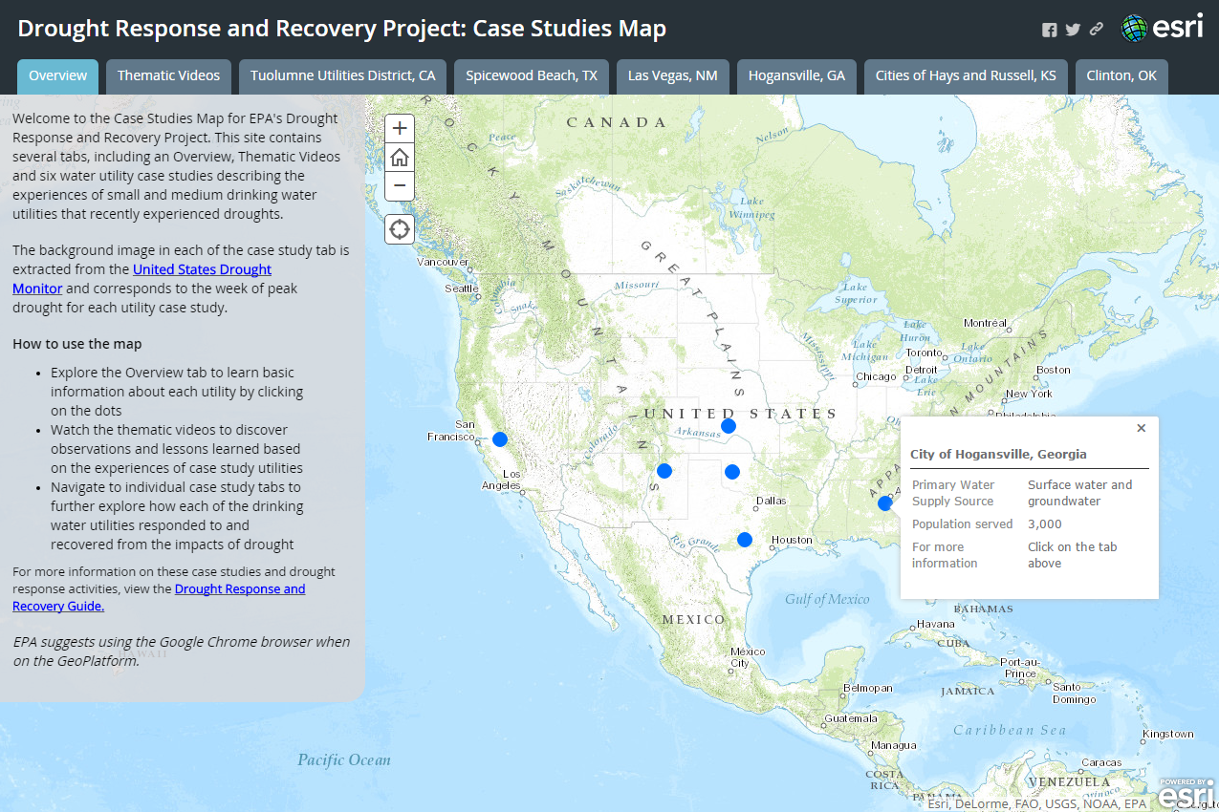
Drought Response and Recovery
Q&A
Questions?
Project Contacts:
Dawn Ison, ison.dawn@epa.gov, 513-569-7686
Brian Pickard, pickard.brian@epa.gov, 202-564-0827
Explore at:
https://www.epa.gov/waterutilityresponse/drought-response-and-recovery-guide-water-utilities
.. or google: “EPA Drought Response”

