Slide 1
South Winds WSD
Case Study
Anna Miller
October, 2017

Slide 2
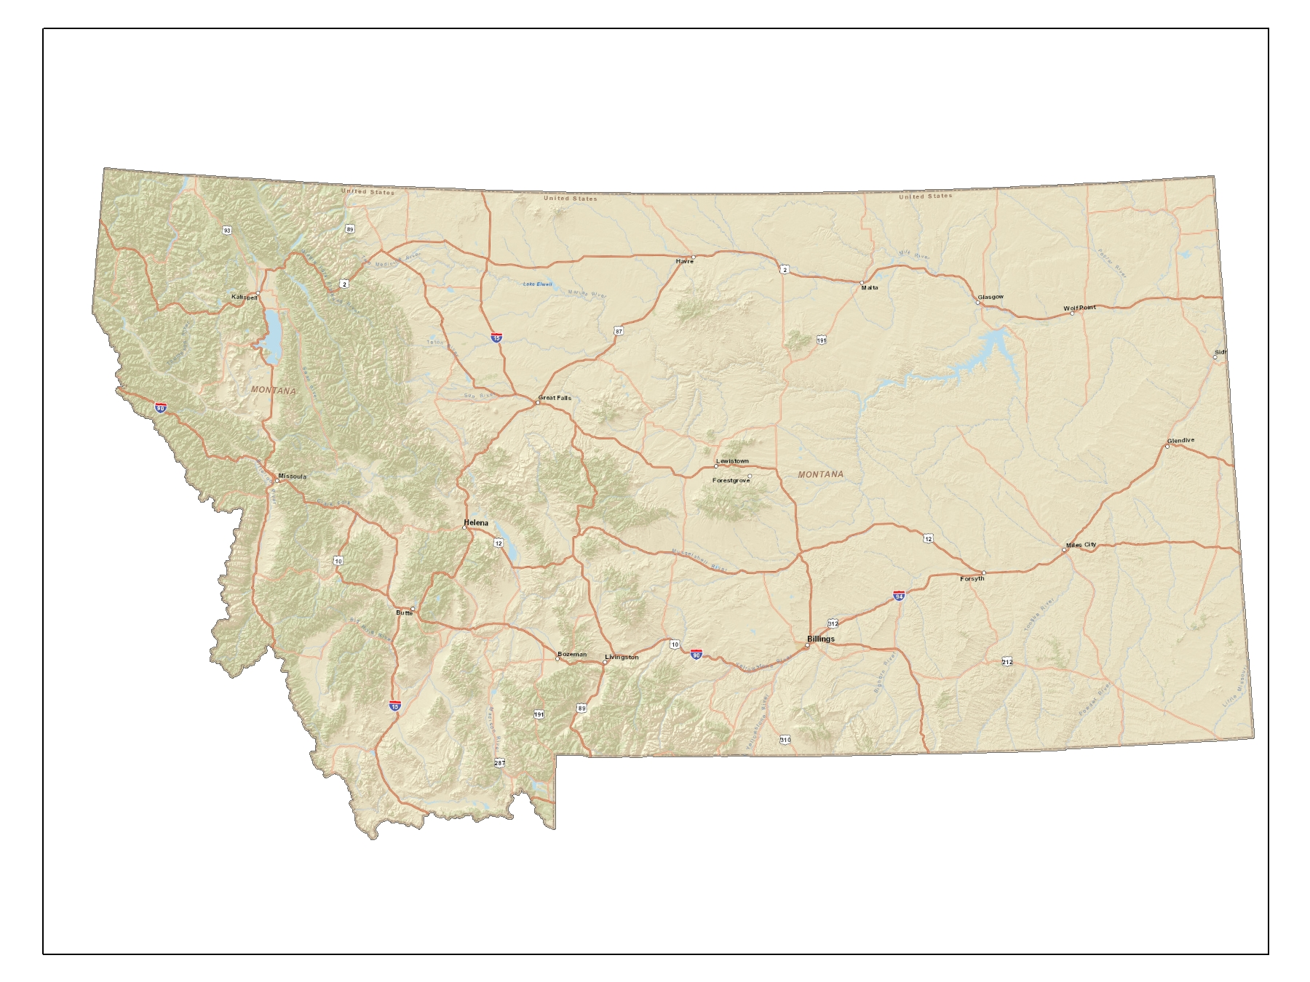
Montana
Great Falls

Slide 3
Historical Information:
Trailer Terrace was constructed between 1958 and 1962 to house temporary construction employees without long range implication in mind. Design plans for the north phase of the collection system indicate 8 inch concrete sewer pipe. No plans have been found for the first or south phase of the collection system. The manager indicates the south system pipe is 8 inch concrete and 4 inch PVC. Further evaluation is required to ascertain collection system condition. There are no manholes on the south side and no scheduled maintenance has ever been completed on this portion of the system. Total treatment system storage operating volume is 45% of the size it should be under current design standards. This lagoon has no formal outlet, no discharge permit, and is designed to leak.
No “as-built” drawings exist for the water system. The water source consists of two wells. One well produces 20 gpm and water of poor quality. The second well delivers 60 gpm and contains arsenic in violation of the federal drinking water standard. The well water is very hard and contains very high concentrations of TDS, iron sulfates and other minerals. Laundry washed in the well water turns orange. Due to inadequate well production to meet peak demand, water storage is provided with an at-grade corroded steel tank and too low in elevation for pressurized storage and too circulate water. The water distribution system consists of 2 inch pipe. Service lines are 5/8 inch diameter polyethylene.

Slide 4
Problems:
Water and sewer system deficiencies include:
Undersized and leaking lagoon system in an urban area.
Odor problems in the neighborhood from lagoon in urban area.
Violation of Montana water quality laws dues to leaking undersized treatment system.
No access to collection system for maintenance.
Undersized and leaking collection system piping.
Probably hydrogen sulfide attack to concrete pipe.
Recent arsenic MCL violation with and Administrative Order sent to the current owner.
Poor water quality with arsenic, high sulfate and iron concentrations and high TDS plugging undersized services, causing fixture staining and creating objectionable taste and odor.
Undersized water services and water mains, resulting in substandard pressure.
Substandard water distribution pipe materials.
Repeated total coliform contamination and other safety issues due to water tank problems.

Slide 5
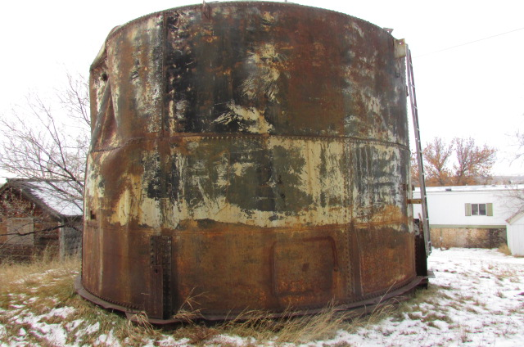
Trailer Terrace Collection Tank

Slide 6
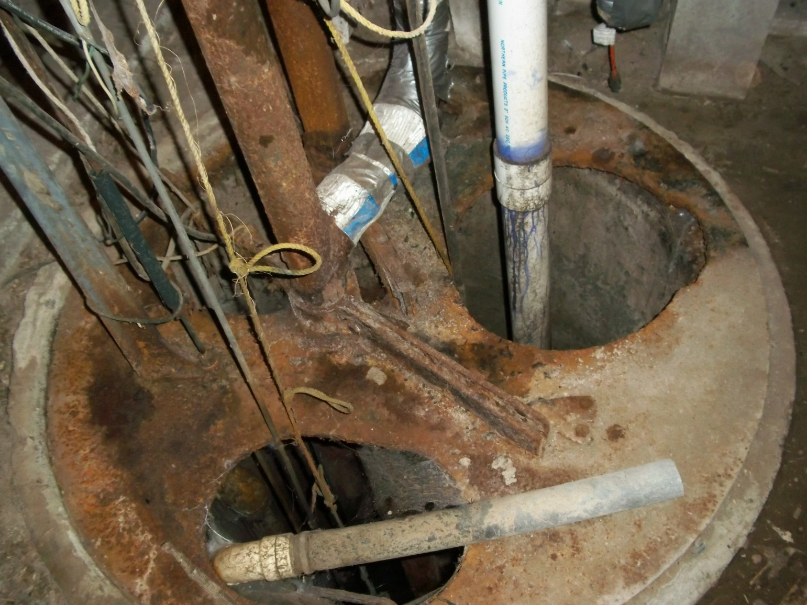
Collection Lines

Slide 7
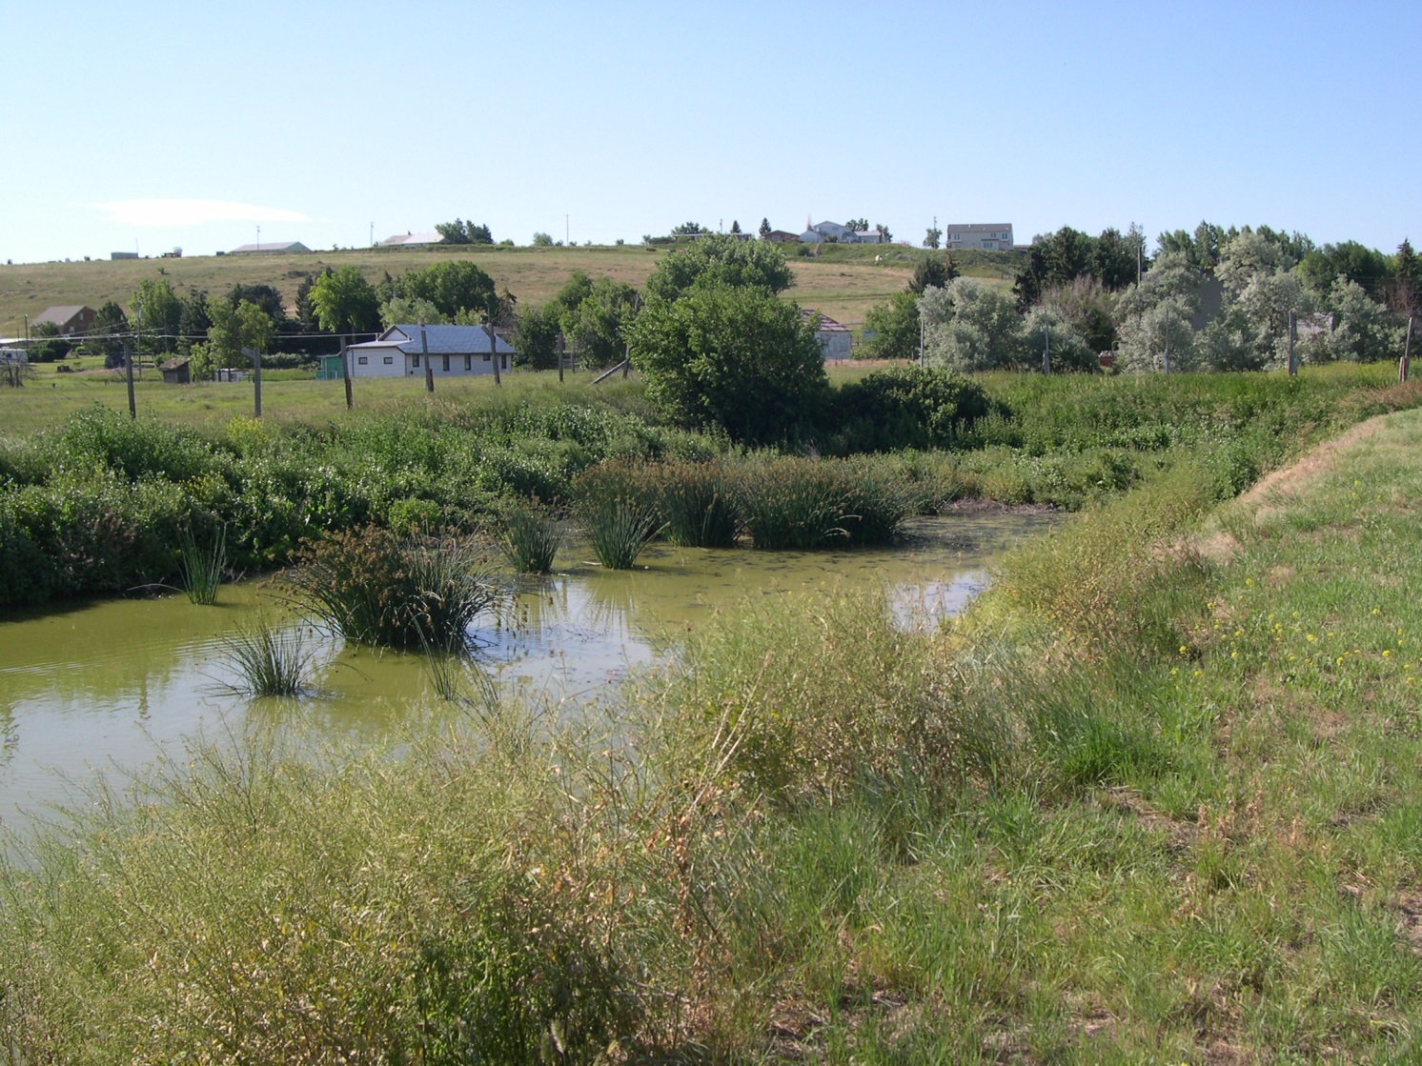
The Lagoon

Slide 8
Time Line
1960 – Trailer Park
Private owners
2000 – Problems began
2009 – Issues continue with system
2011 – Co-op to buy trailer park and form a water & sewer district
2012 – Enforcement notice given
2013 – Water rights issues. No “As Builts”
2014 – Alternatives to repair system. City will not let them connect.
2015 – Phase I: New well needed - storage tank, water lines
Phase II: New WWTP, lagoon work
2016 – Drinking water loan
2017 – Water tank and well complete
2018 – Planned work on the sewer system
2019 – Finish collection and distribution system

Slide 9
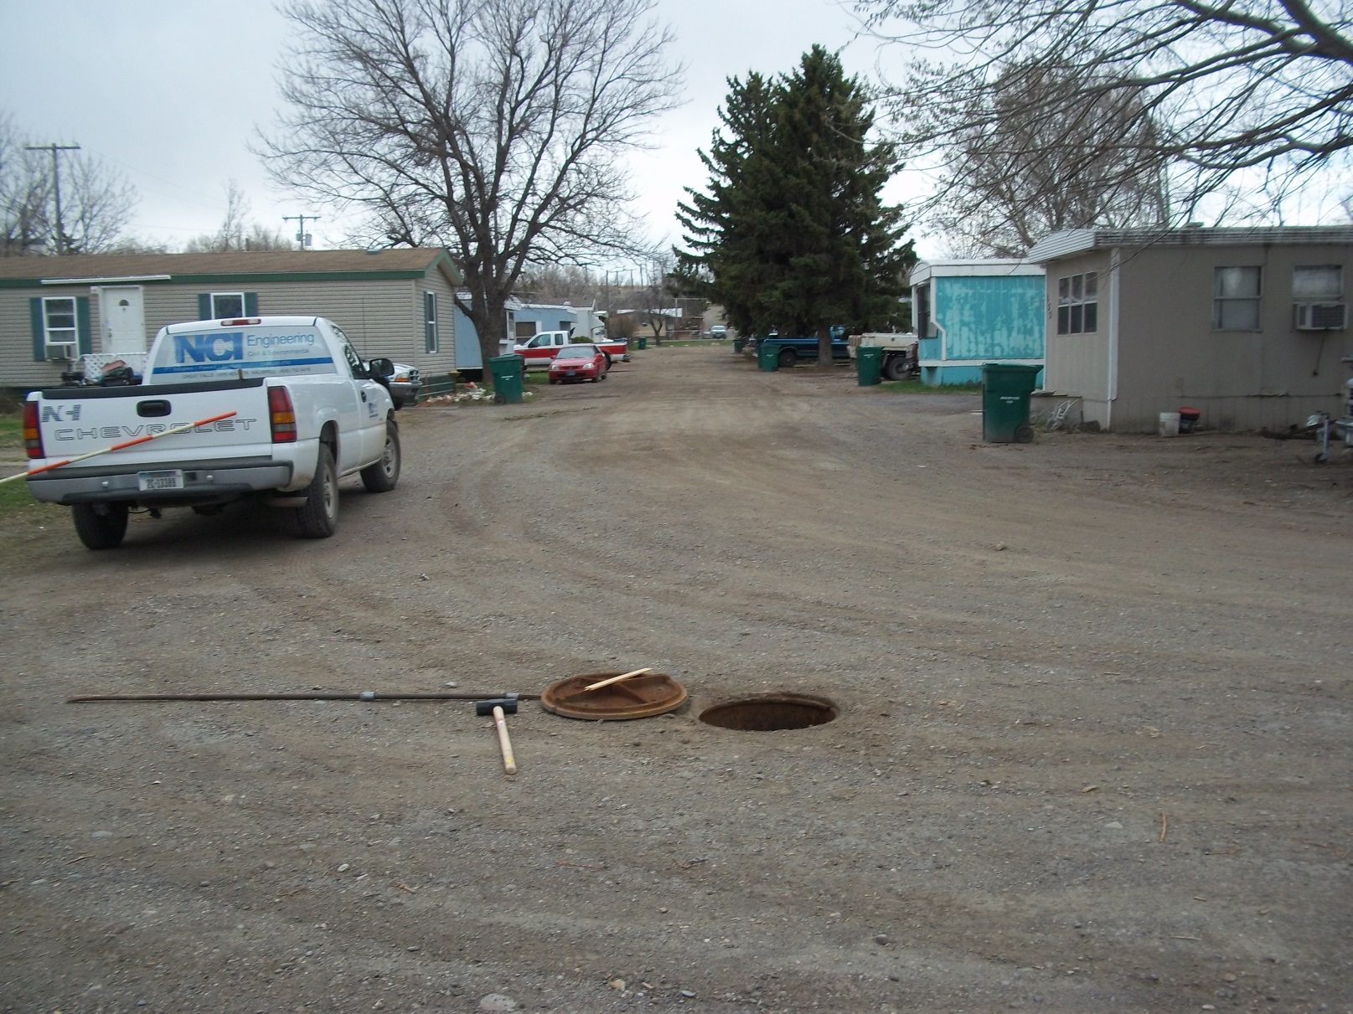
Limited Access for Maintenance

Slide 10
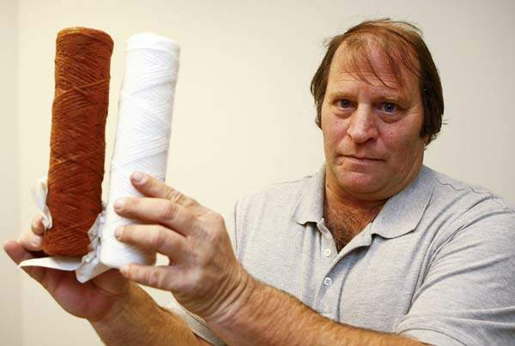
Poor water quality: discoloration and odor
In 2013, Don Feist of Trailer Terrace holds a month-old water filter next to a new one. Work to fix the park’s water system is scheduled to get underway in a week.
-From the Great Falls Tribune

Slide 11
Preliminary Budget Report – Phases 1 & 2
SOUTH WIND WATER & SEWER DISTRICT
WATER AND WASTEWATER SYSTEMS
PRELIMINARY PROJECT BUDGET - COMBINED Phases 1 & 2
3.00% - 20 YEAR SRF LOAN, SRF LOAN FORGIVENESS and DNRC GRANTS
Prepared by: NCI Engineering Co. |  |  |  |  |  |  |  |  |  |  |  |  |  |  |  |  |  |  |  |  |  |  |  |  |  |  | March 17, 2017
ADMINISTRATIVE | SOURCE |  |  | SOURCE |  |  | SOURCE |  |  | SOURCE |  |  | SOURCE |  |  | SOURCE |  |  | SOURCE |  |  | SOURCE
 | RRGL |  |  | WRDA - 1 |  |  | SRF A Loan - Forgiven |  |  | SRF B loan 3% |  |  | WRDA - 2 |  |  | TSEP |  |  | COUNTY CDBG |  |  | WRDA - 3 |  |  | Totals
FINANCIAL COSTS: | Water | Sewer | Total | Water | Sewer | Total | Water | Sewer | Total | Water | Sewer | Total | Water | Sewer | Total | Water | Sewer | Total | Water | Sewer | Total | Water | Sewer | Total | Water | Sewer | Total
Personnel Costs |  |  | 0 |  |  | 0 | 500 |  | 500 | 500 |  | 500 |  |  | 0 |  |  | 0 |  | 500 | 500 |  |  | 0 | 1,000 | 500 | 1,500
Office Costs |  |  | 0 |  |  | 0 |  |  | 0 |  |  | 0 |  |  | 0 |  |  | 0 |  | 1,000 | 1,000 |  |  | 0 | 0 | 1,000 | 1,000
Grant admin /professional services |  | 3,000 | 3,000 | 6,000 | 6,000 | 12,000 | 10,000 |  | 10,000 | 10,000 |  | 10,000 | 6,000 | 6,000 | 12,000 |  | 21,000 | 21,000 |  | 13,000 | 13,000 |  |  | 0 | 32,000 | 49,000 | 81,000
Legal Costs |  |  | 0 |  |  | 0 | 1,500 |  | 1,500 | 1,500 |  | 1,500 |  |  | 0 |  |  | 0 |  | 5,000 | 5,000 |  |  | 0 | 3,000 | 5,000 | 8,000
Audit Fees |  |  | 0 |  |  | 0 |  |  | 0 |  |  | 0 |  |  | 0 |  |  | 0 |  | 0 | 0 |  |  | 0 | 0 | 0 | 0
Travel & Training |  |  | 0 |  |  | 0 |  |  | 0 |  |  | 0 |  |  | 0 |  |  | 0 |  | 500 | 500 |  |  | 0 | 0 | 500 | 500
Loan Reserves |  |  | 0 |  |  | 0 | 25,000 |  | 25,000 |  |  | 0 |  |  | 0 |  |  | 0 |  | 0 | 0 |  |  | 0 | 25,000 | 0 | 25,000
Interim Interest |  |  | 0 |  |  | 0 |  |  | 0 |  |  | 0 |  |  | 0 |  |  | 0 |  | 0 | 0 |  |  | 0 | 0 | 0 | 0
Bond Cost (legal) |  |  | 0 |  |  | 0 |  |  | 0 | 35,000 |  | 35,000 |  |  | 0 |  |  | 0 |  | 0 | 0 |  |  | 0 | 35,000 | 0 | 35,000
 |  |  | 0
TOTAL ADMINISTRATIVE COSTS | 0 | 3,000 | 3,000 | 6,000 | 6,000 | 12,000 | 37,000 | 0 | 37,000 | 47,000 | 0 | 47,000 | 6,000 | 6,000 | 12,000 | 0 | 21,000 | 21,000 | 0 | 20,000 | 20,000 | 0 | 0 | 0 | 96,000 | 56,000 | 152,000
 |  |  |  |  |  |  |  |  |  |  |  |  |  |  |  |  |  |  |  |  |  |  |  |  |  |  | 5.7%
ACTIVITY COSTS:
Preliminary Engineering
Preliminary Engineering (PER) |  |  | 0 | 25,000 | 25,000 | 50,000 |  |  | 0 |  |  | 0 |  |  | 0 |  |  | 0 |  |  | 0 |  |  | 0 | 25,000 | 25,000 | 50,000
MDT, DPPHS, County special use permits |  |  | 0 | 4,000 |  | 4,000 |  |  | 0 |  |  | 0 |  |  | 0 |  |  | 0 |  |  | 0 |  |  | 0 | 4,000 | 0 | 4,000
CDBG investigation / report on annexation |  |  | 0 |  | 5,100 | 5,100 |  |  | 0 |  |  | 0 |  |  | 0 |  |  | 0 |  |  | 0 |  |  | 0 | 0 | 5,100 | 5,100
Land Acquisition
Ph 1 Well Site (Huber) |  |  | 0 |  |  | 0 | 10,750 |  | 10,750 | 10,750 |  | 10,750 |  |  | 0 |  |  | 0 |  |  | 0 |  |  | 0 | 21,500 | 0 | 21,500
Ph 2 WWTP Site (Heppner) |  |  | 0 |  |  | 0 |  |  | 0 |  |  | 0 |  |  | 0 |  | 40,000 | 40,000 |  |  | 0 |  |  | 0 | 0 | 40,000 | 40,000
Ph 1 Water System |  |  | 0 |  |  | 0 | 73,000 |  | 73,000 | 74,000 |  | 74,000 |  |  | 0 |  |  | 0 |  |  | 0 |  |  | 0 | 147,000 | 0 | 147,000
DNRC Capacity/Water Rights
DNRC Capacity/Water Rights |  |  | 0 | 40,000 |  | 40,000 |  |  | 0 |  |  | 0 |  |  | 0 |  |  | 0 |  |  | 0 |  |  | 0 | 40,000 | 0 | 40,000
Preliminary Engineering Design
Field Investigation & Geotech |  |  | 0 | 5,700 | 6,800 | 12,500 |  |  | 0 |  |  | 0 |  |  | 0 |  |  | 0 |  |  | 0 |  |  | 0 | 5,700 | 6,800 | 12,500
Test Well (Boland) |  |  | 0 | 6,500 |  | 6,500 |  |  | 0 |  |  | 0 |  |  | 0 |  |  | 0 |  |  | 0 |  |  | 0 | 6,500 | 0 | 6,500
Ph 1 Water Supply & Distribution |  |  | 0 | 24,000 |  | 24,000 |  |  | 0 |  |  | 0 |  |  | 0 |  |  | 0 |  |  | 0 |  |  | 0 | 24,000 | 0 | 24,000
Ph 1 Wastewater Collection |  |  | 0 |  | 21,000 | 21,000 |  |  | 0 |  |  | 0 |  |  | 0 |  |  | 0 |  |  | 0 |  |  | 0 | 0 | 21,000 | 21,000
Ph 2 WWTP |  |  | 0 |  |  | 0 |  |  | 0 |  |  | 0 |  | 5,000 | 5,000 |  | 40,000 | 40,000 |  |  | 0 |  |  | 0 | 0 | 45,000 | 45,000
Ph 1 Administrative Operations Assistance |  |  | 0 | 1,800 | 1,800 | 3,600 |  |  | 0 |  |  | 0 |  |  | 0 |  |  | 0 |  |  | 0 |  |  | 0 | 1,800 | 1,800 | 3,600
Well Site Acquisition |  |  | 0 | 8,500 |  | 8,500 |  |  | 0 |  |  | 0 |  |  | 0 |  |  | 0 |  |  | 0 |  |  | 0 | 8,500 | 0 | 8,500
Ph 2 WWTP Site Acquisition/Permitting |  |  | 0 |  | 1,100 | 1,100 |  |  | 0 |  |  | 0 |  |  | 0 |  |  | 0 |  |  | 0 |  |  | 0 | 0 | 1,100 | 1,100
Final Engineering Design
Test Well (Boland) |  |  | 0 | 6,000 |  | 6,000 |  |  | 0 |  |  | 0 |  |  | 0 |  |  | 0 |  |  | 0 |  |  | 0 | 6,000 | 0 | 6,000
Ph 1 Water Supply & Distribution |  |  | 0 |  |  | 0 |  |  | 0 |  |  | 0 | 80,000 |  | 80,000 |  |  | 0 |  |  | 0 |  |  | 0 | 80,000 | 0 | 80,000
Ph 1 Wastewater Collection |  |  | 0 |  | 50,000 | 50,000 |  |  | 0 |  |  | 0 |  |  | 0 |  |  | 0 |  |  | 0 |  |  | 0 | 0 | 50,000 | 50,000
Ph 2 WWTP |  |  | 0 |  |  | 0 |  |  | 0 |  |  | 0 |  |  | 0 |  |  | 0 |  |  | 0 |  | 140,000 | 140,000 | 0 | 140,000 | 140,000
Eng Construction Admin/Inspection
Test Well (Boland) |  |  | 0 |  |  | 0 |  |  | 0 |  |  | 0 |  |  | 0 |  |  | 0 |  |  | 0 |  |  | 0 | 0 | 0 | 0
Ph 1 Water Supply & Distribution |  |  | 0 |  |  | 0 |  |  | 0 |  |  | 0 |  |  | 0 |  |  | 0 |  |  | 0 | 60,000 |  | 60,000 | 60,000 | 0 | 60,000
Ph 1 Wastewater Collection |  |  | 0 |  |  | 0 |  |  | 0 |  |  | 0 |  |  | 0 |  |  | 0 |  |  | 0 |  | 60,000 | 60,000 | 0 | 60,000 | 60,000
Ph 2 WWTP |  |  | 0 |  |  | 0 |  |  | 0 |  |  | 0 |  | 35,000 | 35,000 |  | 40,000 | 40,000 |  |  | 0 |  |  | 0 | 0 | 75,000 | 75,000
Construction
field invest. / Test Well (Boland) |  |  | 0 | 38,460 |  | 38,460 | 60,500 |  | 60,500 | 24,000 |  | 24,000 |  |  | 0 |  |  | 0 |  |  | 0 |  |  | 0 | 122,960 | 0 | 122,960
Ph 1 Schedule 2 Water Supply |  |  | 0 |  |  | 0 | 275,250 |  | 275,250 |  |  | 0 | 185,000 |  | 185,000 |  |  | 0 |  |  | 0 |  |  | 0 | 460,250 | 0 | 460,250
Ph 1 Schedule 3 Water Distribution |  |  | 0 |  |  | 0 | 36,000 |  | 36,000 | 307,200 |  | 307,200 | 120,000 |  | 120,000 |  |  | 0 |  |  | 0 |  |  | 0 | 463,200 | 0 | 463,200
Ph 1 Schedule 4 Wastewater Collection |  | 97,000 | 97,000 |  | 292,240 | 292,240 |  |  | 0 |  |  | 0 |  |  | 0 |  |  | 0 |  |  | 0 |  |  | 0 | 0 | 389,240 | 389,240
Ph 2 WWTP |  |  | 0 |  |  | 0 |  |  | 0 |  |  | 0 |  |  | 0 |  | 590,000 | 590,000 |  | 430,000 | 430,000 |  | 125,000 | 125,000 | 0 | 1,145,000 | 1,145,000
Contingency
Ph 1 Contingency |  |  | 0 |  |  | 0 | 7,500 |  | 7,500 | 37,050 |  | 37,050 |  |  | 0 |  |  | 0 |  |  | 0 |  |  | 0 | 44,550 | 0 | 44,550
Ph 2 Contingency |  |  | 0 |  |  | 0 |  |  | 0 |  |  | 0 |  | 38,000 | 38,000 |  | 19,000 | 19,000 |  |  | 0 |  |  | 0 | 0 | 57,000 | 57,000
 |  |  |  |  |  |  |  |  |  |  |  |  |  |  |  |  |  |  |  |  | 0 |  |  |  | 0 | 0 | 0
TOTAL ACTIVITY COSTS | 0 | 97,000 | 97,000 | 159,960 | 403,040 | 563,000 | 463,000 | 0 | 463,000 | 453,000 | 0 | 453,000 | 385,000 | 78,000 | 463,000 | 0 | 729,000 | 729,000 | 0 | 430,000 | 430,000 | 60,000 | 325,000 | 385,000 | 1,520,960 | 2,062,040 | 3,583,000
 |  |  |  |  |  |  |  |  |  |  |  |  |  |  |  |  |  |  |  |  |  |  |  |  |  |  | 94.3%
TOTAL PROJECT COSTS | 0 | 100,000 | 100,000 | 165,960 | 409,040 | 575,000 | 500,000 | 0 | 500,000 | 500,000 |  | 500,000 | 391,000 | 84,000 | 475,000 | - | 750,000 | 750,000 | - | 450,000 | 450,000 | 60,000 | 325,000 | 385,000 | 1,616,960 | 2,118,040 | 3,735,000
% PROJECT PARTICIPATIION
 |  |  |  |  |  | - |  |  |  |  | Total Loan amount | 500,000
 |  |  |  |  |  |  |  |  |  |  |  |  |  |  | O&M and Consumption |  |  |  |  |  |  | Debt
 |  |  |  |  |  |  |  |  |  |  |  |  |  |  | Costs |  |  |  |  |  |  | Service
 |  |  |  |  |  |  |  |  |  |  |  |  |  |  | Total Annual |  |  |  |  |  | $ 40,502 | Loan Amount (est. 50% Loan Forgiveness) |  |  |  |  | $500,000.00
 |  |  |  |  |  |  |  |  |  |  |  |  |  |  | Annual/EDU |  |  |  |  |  | $ 440 | Loan Term |  |  |  |  | 20
 |  |  |  |  |  |  |  |  |  |  |  |  |  |  | Monthly/EDU |  |  |  |  |  | $ 37 | Interest Rate |  |  |  |  | 0.0300
 |  |  |  |  |  |  |  |  |  |  |  |  |  |  |  |  |  |  |  |  |  | Annualization Factor |  |  |  |  | 0.06721571
 |  |  |  |  |  |  |  |  |  |  |  |  |  |  |  |  |  |  |  |  |  | Annual Debt Service |  |  |  |  | $33,607.85
 |  |  |  |  |  |  |  |  |  |  |  |  |  |  |  |  |  |  |  |  |  | EDU Count |  |  |  |  | 92
 |  |  |  |  |  |  |  |  |  |  |  |  |  |  |  |  |  |  |  |  |  | Monthly Debt Service /EDU |  |  |  |  | $30.44
 |  |  |  |  |  |  |  |  |  |  |  |  |  |  |  |  |  |  |  |  |  | Monthly Combined User Rate |  |  |  |  | $30.44

Slide 12
Summary
Projects take time – IUP list in the top 10 for 10 years.
Projects with less resources need your help and patience.
Communicate with enforcement agency.
Protect your agency’s interests – legal assistance.
Team members will change – bring new team members up to speed.
Educate the parties involved as you go along.
Protect the asset – Keep an open line with the project.

