Slide 1
Coming Together for Safe, Reliable, Affordable Water in Kentucky
Sandy Williams, Kentucky Infrastructure Authority

Slide 2
Planning is Legislatively Supported in Kentucky
1986 – Established a planning process for the management and development of Kentucky’s water resources (KRS 151.112 )
2000 - Further articulated how that planning and management process should be carried out
(KRS 224A.300)
Required the Kentucky Infrastructure Authority (KIA) to implement a program of water and wastewater management planning to ensure necessary infrastructure for public water and sewer service for all Kentucky’s households by 2020
2018 - Granted utilities the ability to own assets outside of their originally chartered borders

Slide 3
Kentucky Area Development Districts (ADD) Each ADD has a Water Management Council

Slide 4
Water Management Councils Responsible for Long Range Planning Efforts for Public Water and Wastewater Systems Represented on the Council
Develop regional service strategies
1
Encourage regionalization, consolidation, and partnerships
2
Eliminate or prevent duplication of service
3
Approve and amend water and wastewater projects
4
Create a Water Management Plan
5
Prioritize annual water and wastewater projects
6
Serve as a forum for important information, discussion on common issues, and training
7

Slide 5
Regionalization Case Studies
Where it Worked
Louisville Metropolitan Sewer District (MSD)
Multi-County
Logan Todd Regional Water Commission
Multi-County / Multi-State
City of South Shore
Multi-State

Slide 6
Regionalization Case Study – Louisville MSD
2019 Purchased Systems
City of Crestwood
Purchased from City after operating for 20 years
resulted in lower rates
Oldham County
6,000 residential customers
Lower future rates from operational efficiencies
2021 Ownership Assumption
Bullitt County Sanitation District
8 package plants serving 4,200 customers
Improved service reliability
Creating capital improvement plan

Slide 8
Regionalization Case Study – Logan Todd Regional Water Commission
Each Partner is Represented on the
Board of Commissioners
Thirteen Partners
System Ownership:
9 municipally-owned systems – with their own treatment plants
3 water districts – purchased finished
water; 1 treated water
1 privately-owned water association – purchased finished water
Successes
Good quality water and consistent service
Ability to attract industry
Resilience
Good neighbors
Three KY Counties and 2 States
Took 15 years from Problem to Grand Opening

Slide 9
City of Adairville City of Auburn East Logan Water District City of Elkton City of Guthrie City of Lewisburg North Logan Water District City of Oak Grove City of Russellville South Logan Water Association City of Springfield, TN Todd County Water District City of Trenton

Slide 10
Regionalization Case Study – City of South Shore
New Plant vs Buy Water
Source Water – wells containing PFAS
WTP beyond useful life
Portsmouth Ohio had a new surface water WTP with excess capacity
Regional Solution
Temporary line across bridge to eliminate PFAS issues
Permanent line (20 Inch) across bottom of Ohio River
Less cost than new plant

Slide 11
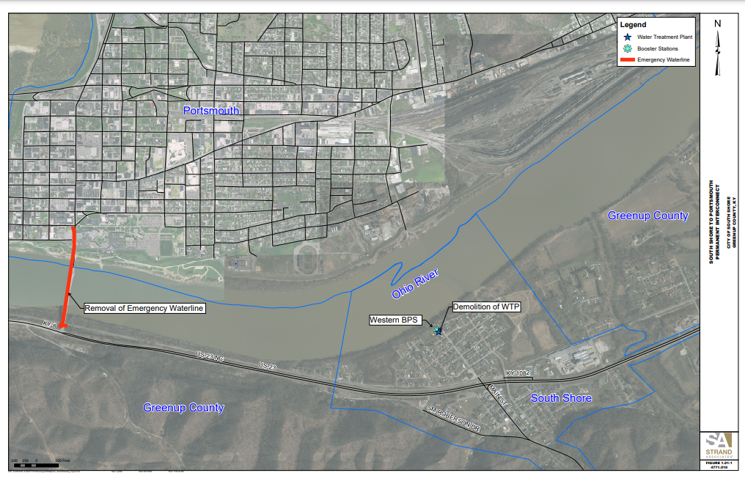

Slide 13
Overcoming Challenges
Historic Rivalries
Address directly by talking about it with other potential partners
Sense of Unfairness
Everyone brings different assets or different challenges to the table
Loss of Control
Focus on the ability to gain control over other aspects of the system
Hold meetings in communities other than the county seat
Some communities may just have a greater need
Not all partners will benefit equally
Bring decisions about a partnership to the broader community
Focus on what you have in common

Slide 14
Water Management Councils Responsible for Long Range Planning Efforts for Public Water and Wastewater Systems Represented on the Council
Water Management Councils meet quarterly
Project Information in the Water Resource Information System feeds the SRF Project Priority List
Project Profiles must be approved by the WMC prior to SRF submittal
Council members are made up of County Judge Executives, Mayors, utility managers, public members
Information can be used for asset management

