Slide 1
Texas Equivalency Project Selection
1

Slide 2
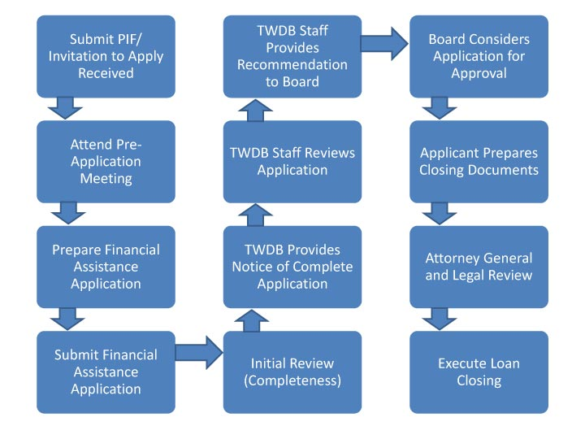
How & When TX picks EQ Projects
2

Slide 3
How & When TX picks EQ Projects
Initial Assignment of EQ
Second Assignment of EQ
Final Assignment of EQ
3

Slide 4
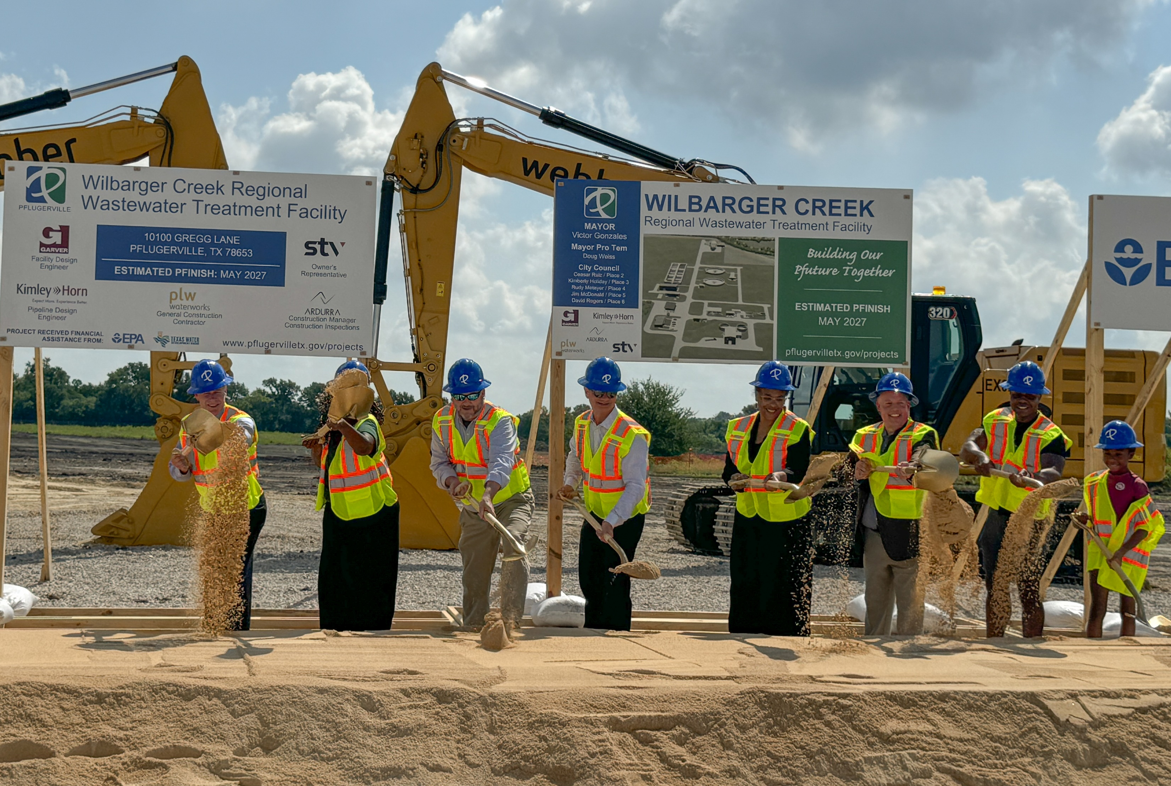
How & When TX picks EQ Projects
Equivalency project selections have been in place for over a decade
Texas traditionally awards Pre-Design Funding
4

Slide 5
Oversubscribed SRF Programs
For SFY 2025:
DWSRF is 10x Oversubscribed CWSRF is 9x Oversubscribed
5

Slide 6
Interest Rate Subsidies
Interest Rate Reductions from Market Rates
Funding Option | CWSRF | DWSRF
Equivalency | 40% | 35%
Non-Equivalency | 35% | 30%
6

Slide 7
Applying Equivalency Requirements
All EQ projects must meet federal requirements, e.g.:
Disadvantaged Business Enterprises
Build America Buy America
Signage
Staff assistance throughout project life-cycle to ensure compliance
Program | EQ Funding Commitments 2023 IUP | Symbol
CWSRF | $72,053,583
DWSRF | $165,951,752
7

Slide 8
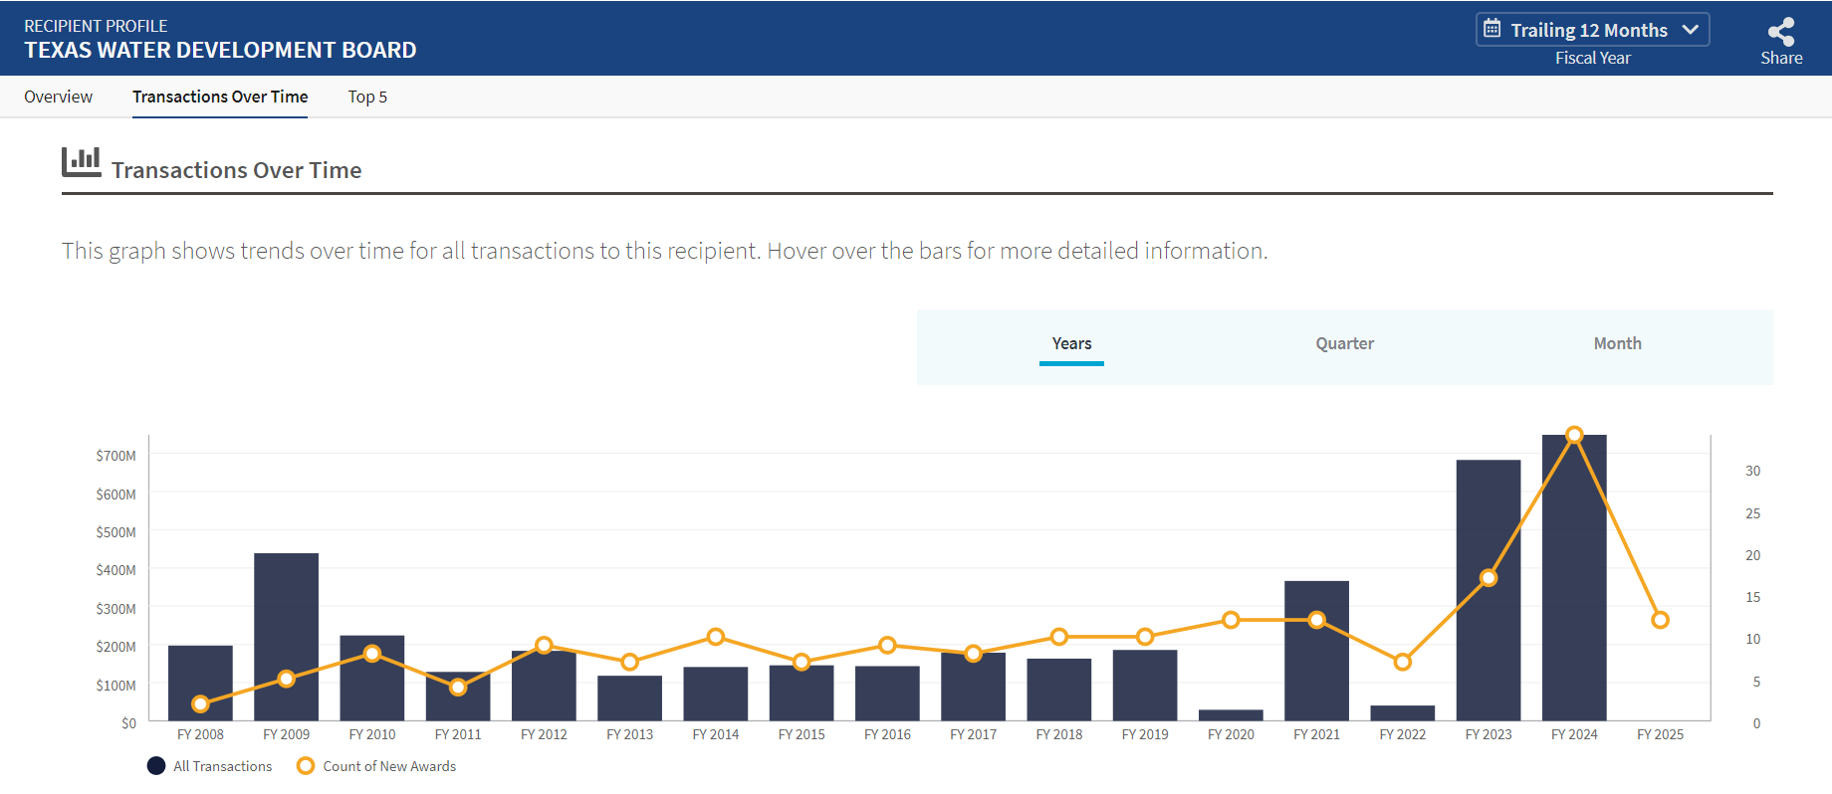
Meeting the Reporting Requirements
At closing, report to FSRS for FFATA
Tracking of FSRS reported projects is used for the SEFA and Single Audit requirements
8

Slide 9
Evaluate Your Strategies
Balance State and Community Needs
Listen to your applicants
Change Takes Time
9

Slide 10
Marvin Cole-Chaney Director, Program Administration & Reporting Texas Water Development Board marvin.cole-chaney@twdb.texas.gov 512.463.8750
Stay connected:
10

