Slide 1
WRF #4617 “New and Emerging Capital Providers for Infrastructure Funding”
Jonathan Cuppett
Water Research Foundation
&
John Mastracchio
Arcadis

Slide 2
Discussion Topics
WRF 4617 resources
Overview of Results and Conclusions
Examples

Slide 3

www.waterrf.org - 4617

Slide 4
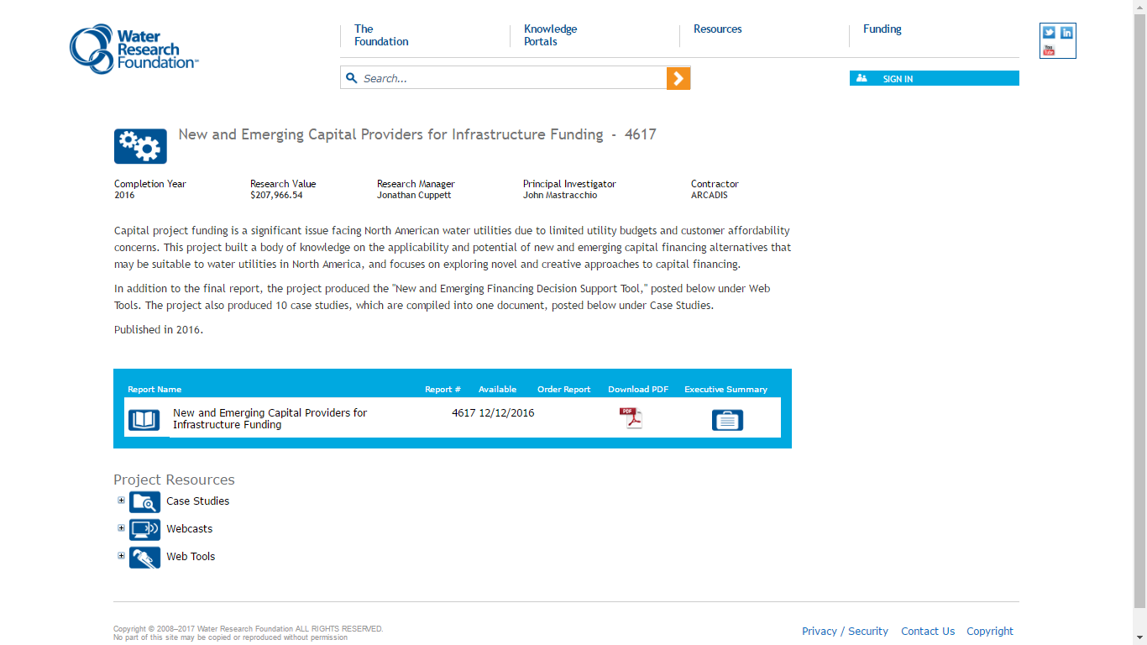
Project Resources

Slide 5

Case Studies
Allentown/Lehigh County Authority – P2
Bayonne – P3
Chicago Reclamation District – Green Bonds
DC Water – Century Bonds
LA Wastewater – Bank Funding
Norfolk, VA – Integrated Financing
Port of Miami - TIFIA
Puerto Rico – P3
San Antonio – P3
Carlsbad – P3

Slide 6

Decision Support Tool

Slide 7


Slide 8
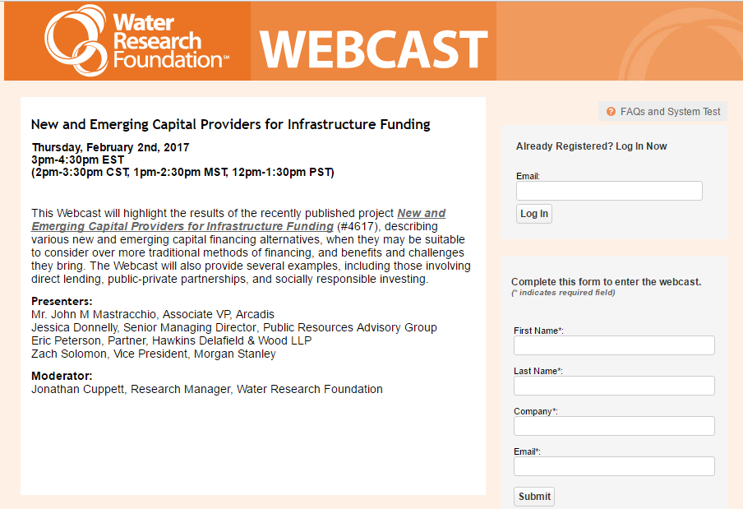

Slide 9
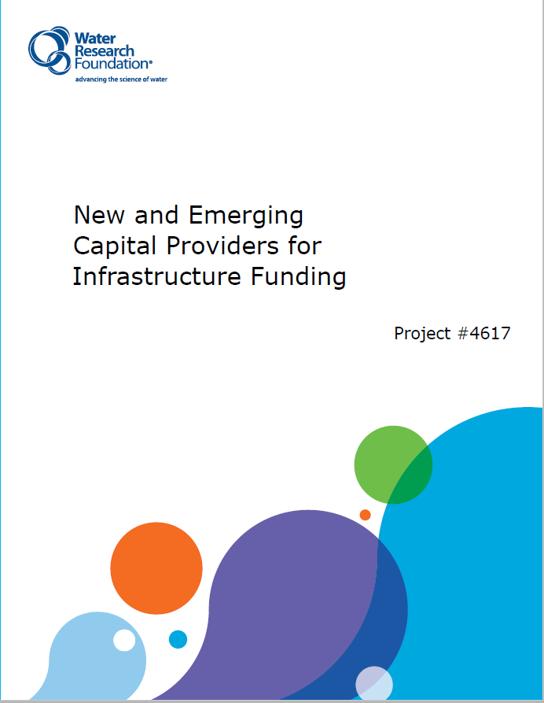
4617 Resources
Report
Executive Summary
Case Studies
Decision Support Tool
Webcast

Slide 10
Project Overview
Purpose: | Provide water industry with a resource that documents the body of knowledge of new and emerging financing alternatives.
Approach: | Literature review Interviews with issuers and investors Case study successes and lessons learned Workshops with municipal finance professionals
Team: | Arcadis; Hawkins Delafield & Wood; Public Resources Advisory Group, Ceres, Standard & Poor’s Rating Service, various utilities

Slide 11



Traditional Financing
Revenue Bonds, GO Bonds, SRF Loans
Reliable, low cost financing sources
Most water utilities can access
Relatively low issuance cost
Sufficient demand and capacity in the market
Notes:
Traditional financing is good in the US.
US municipal Bond market Very diverse, broad access to low cost tax exempt loan options
Robust State revolving loan fund program in every state that offers options to most utilities.
Not a lack of capital sources, but a lack of sufficient revenue to support the financing.
Comes down to ability and willingness to raise rates as customers are ultimately paying regardless of whatever financing approach is taken.
Why look at alternative methods? When you cant achieve the benefits you are looking for under a traditional approach.
There are some sweet spots where alternative financing can play a role.

Slide 12
Financing Alternatives
Partnerships
Government Sponsored
Crowdfunding
Public-Private
Public-Public
WIFIA
SRF
Loan
Guarantees
Mini/Micro
Bonds
Direct Lending & Asset-Backed Options
Integrated Financing
Other Alternatives
Private
Placements
Securitization
Long-
Duration
Bonds
Catastrophe/
Resilience
Bonds
Socially Responsible Investors
Self-Financing
Green
Bonds
Social
Impact
Bonds
Tax
Increment
Financing
Efficiency
Savings

Slide 13
Why consider alternative financing?
Risk
Cost
Sweet Spots
BENEFITS
Brand

Slide 14
Potential Benefits of Alternative Financing
Value Capture
Access to Capital
Certainty
Lower Borrowing Costs
Benefits
Positive Publicity / Image
Lower
Life-Cycle
Costs
Increased Investor Demand
Risk
Transfer
Notes:
Access to capital: Small portion of utilities have capital access problems due to poor financial condition, high interest rates with traditional financing
Lower borrowing costs – WIFIA
lower life cycle costs and risk transfer – private financing with a p3s…..san Antonio, Carlsbad, bayonne
Increased investor demand – green, social, sustainability (social and env investors) micro/mini (small local investors)
Brand image – env green benefits
Certainty – locking in annual reinvestment or rate increases to support a certain a project
Value capture – tax increment financing

Slide 15
New & Emerging Financing Alternatives - Benefits
Financing Alternative | Access to Capital | Lower Borrowing Cost | Lower Life-Cycle Costs | Risk Transfer | Increased Investor Demand | Positive Publicity / Brand | Certainty / Capacity | Value Capture
Direct Lending / Asset Backed
Private Placements | x | x
Securitization | x | x
Government Sponsored Programs
WIFIA | x | x
SRF Loan Guarantees
Partnerships
Public-Public |  |  |  | x |  |  | x
Public-Private |  |  | x | x |  |  | x | x
Socially Responsible Investing
Green Bonds |  | x |  |  |  | x
Impact Bonds |  |  |  | x
Locally Focused Financing
Mini Bonds |  |  |  |  | x | x
Crowdfunding |  |  |  |  | x | x
Self Financing
TIFs | x |  |  |  |  |  |  | x
Efficiency Savings | x
Notes:
E.S. – table highlights advantages, limitations

Slide 16
Who Are the New
Capital Providers?
Private investors
Environmental investors
Local individual investors
Local lending institutions
New Federal Government Program Administrators
Notes:
Part of the research approach …Talked to various capital providers about investing in water sector infrastructure
Private investors –interested in p3s, very interested in large scale water projects around $100M or more but there are not enough p3 projects to satisfy demand.
Investment advisors – demand in socially responsible projects that benefit the environment (demand is retail and institutional and philanthropic (foundations)) .
Local lending institutions that want to invest locally to be a part of the solutions
Government - WIFIA

Slide 17
General Research Conclusions
No lack of financing innovation
Use where they can achieve desired benefits over traditional approaches
Challenges limit more widespread use
Integrated approach is a significant opportunity
Notes:
1) No lack of financing innovation. Research showed that there are plenty of innovative ways to finance projects that can achieve various benefits and they do have a role to play to address the infrastructure gap. Challenge still remains of raising rates to generate revenues to support the projects. To address affordability issues.
2) Use new approaches when they provide tangible benefits over traditional approaches. No one size fits all. Decision support tool provides some insight into this issue.
3)
Many alternatives are new. More best practices and standards and demonstrated successes are needed.
Transaction cost of scale . High upfront costs can limit applicability.
Transparency – many new concepts that require additional disclosures. (off balance sheet)
4) Multiple financing and funding sources (traditional and new). Coordinating and planning collaboratively across government departments or agencies to stack benefits and funding into an integrated approach could allow different options to be more realistic. (Philanthropic groups driving this option)
Integrated approach -

Slide 18
GREEN BONDS

Slide 19
Growth in the Green Bond Market
47 Municipal Issues:
  11 Wastewater
  9 SRF
  4 Water

Slide 20
Benefits of Green Bonds to Municipal Utilities
POSITIVE OUTCOMES | Demonstrate Leadership
 | Generate Positive Publicity
 | Diversify Investor Base

Slide 21
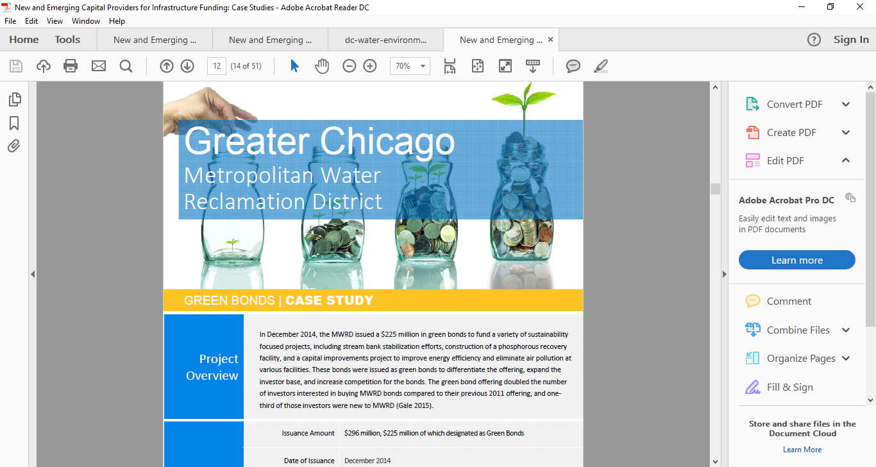

Slide 22
Chicago Water Reclamation District
December 2014
$225M, 30 Year @ 3.568%
Doubled number of investors compared to the 2011 non-green offering
Mostly sold to Bond Funds and Asset Managers (allotments in case study)
Green offering to differentiate and expand investor base and increase competition
Funds used for
  TARP – Tunnel and Reservoir Plan Project (captures stormwater runoff into 3 reservoirs)
  Streambank stabilization projects for flood control
  Phosphorus recovery projects
No independent green certification or 3rd party opinion - no unified standard at the time
Reviewed Green Bond Principles and Climate Bond Standards as reference
Evaluation Metrics
  Reduction is CSO events
  Tons of Phosphorus sold for reuse

Slide 23
ENVIRONMENTAL IMPACT BOND

Slide 24
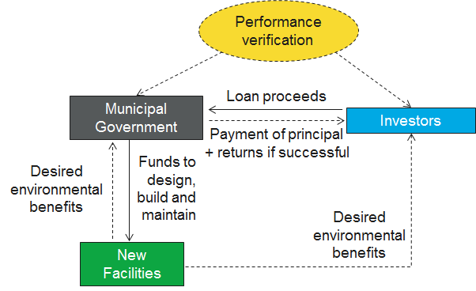
Environmental Impact Bonds
Financing Contract (Loan) –
Not a Bond
Privately offered
Performance Based
Environmental /
Social Benefits
Relatively Complex

Slide 25
Benefits of Environmental Impact Bonds to Utilities
BENEFITS | Performance Risk Transfer
 | Conventional Project Delivery Approach
 | Access to Environmental Investors

Slide 26
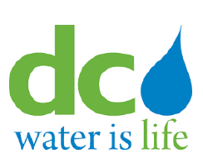


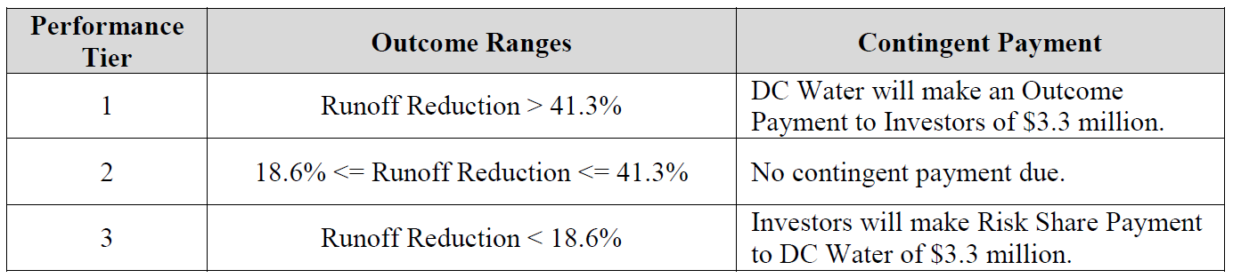
Environmental Impact Bond
PAY FOR SUCCESS CONTRACT
$25 million financing
Base interest rate = 3.43% (comparable to past rates)
DC Water pays implements and maintains GI projects
Performance risk is shared between DC Water and the investors
Reduction in stormwater runoff determines investor payments
2.5% chance of Tier 1 or Tier 3 based on pre-construction modeling outcomes
Notes:
construct green infrastructure to manage stormwater from 20 impervious acres (in this case, porous pavement and bio-retention will be built). DC Water will also undertake an evaluation program that includes: a) pre-construction monitoring of stormwater runoff in the locations where the green infrastructure will be built; b) modeling to identify a range of expected performance outcomes; and c) post-construction monitoring using the same methodology which was used pre-construction.
After the green infrastructure is built, in the year 2021 (the term of this particular contract is 4.5 years) it’s time for DC Water to repay its investors—the precise amount they must pay will depend on how well the installed green infrastructure assets perform against the range of outcomes modeled before construction. If, for example, the assets fall short of the target performance range, DC Water will repay its investors $21.7 million at the mandatory tender date. If, on the other hand, the project performs better than projected, DC Water will pay investors back their principal $25 million, the remaining accrued interest at the 3.43% interest rate agreed to by the parties plus an additional $3.3 million. If the project performs in the middle range of the modeled outcomes, DC Water simply pays the investors back the same amount they were provided upfront ($25 million) plus any remaining interest.
Let’s consider the conventional municipal financing alternatives to the EIB. If DC Water had chosen to use a more traditional route to fund its green infrastructure through directly using bond proceeds, city general funds, or ratepayer funds, they would most likely have had to pay for the entirety of the project regardless of project performance, because that is how most municipal procurement tends to work. The EIB is helpful and different because it ties a project’s spending to its success. In principle, a city could write a similar performance-based contract for any private-public-partnership, but the terms of those contracts can be complicated and the negotiations between the private entity and the municipality can be lengthy. Some places, such as Prince George’s County, have managed to strike P3 deals that do pay on a performance basis. However, for the vast majority of municipal stormwater procurements, cities usually pay up front and, in doing so, assume all project risks.

Slide 27
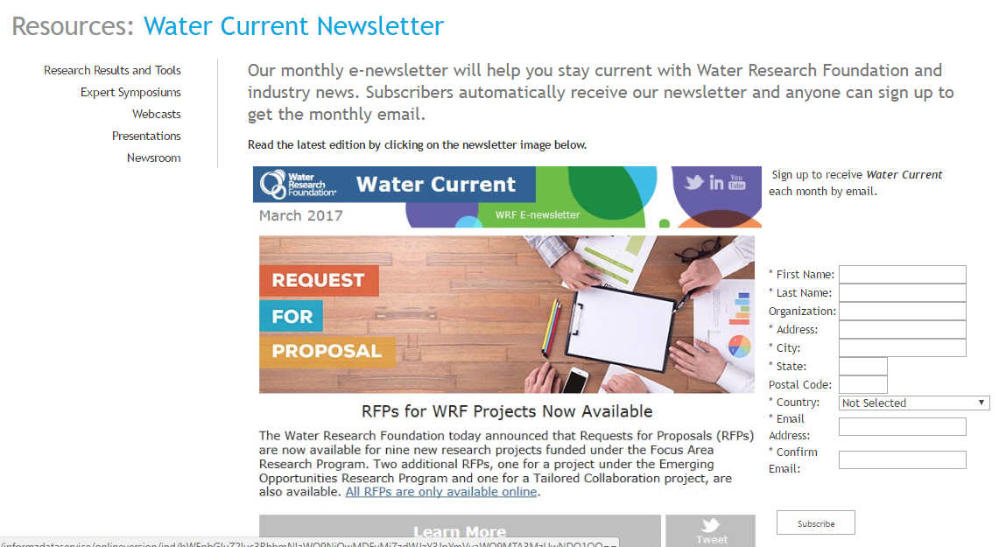
Sign Up!

Slide 28
Comments or questions, please contact:
jcuppett@waterrf.org
For more information visit:
www.waterrf.org

