Slide 1
Department of Environmental Quality Division of Water Infrastructure
April 20, 2017
North Carolina’s Statewide Water and Wastewater Infrastructure Master Plan

Slide 2
General Assembly Legislation in 2013
Created Division of Water Infrastructure
Consolidated major water-related infrastructure funding programs
State Revolving Funds
CDBG – Infrastructure
State programs
One department (NCDEQ) and one division
Created 9-member State Water Infrastructure Authority
Qualifications and knowledge
Wastewater professional engineer
Federal water/wastewater funding
Urban water/wastewater systems
Rural water/wastewater systems
Rural county commissioner/resident; public health services experience
Water, wastewater, stormwater issues and state funding sources
12 tasks
Department of Environmental Quality
Notes:
First some background information

Slide 3
Some of the Authority’s Tasks
Establish criteria and set priorities for project funding
Distribute loan and grant funds
Assess and make recommendations on the role of the State in the development and funding of water infrastructure
Maximize the use of current funding resources – federal, state, local – and ensure coordinated use
Review the application of emerging best practices in utility management
Develop a master plan to meet the State's water infrastructure needs
Department of Environmental Quality
Notes:
Of the 12 tasks provided in the legislation, focus on just a couple
Initially the DWI and SWIA focused on … next slide

Slide 4
State Water Infrastructure Authority
Synchronization of funding programs
Priority systems
Fixing existing infrastructure first
Benefits (environmental / public health)
Proactive system management
Funding long-term solutions
Utility best practices
Stretching grants funds
Recommended changes to funding statutes
Affordability
Asset Inventory and Assessment Grants
Merger / Regionalization Feasibility Grants
Department of Environmental Quality
Notes:
First worked on these things. As we worked on many of these initiatives, some key themes emerged about

Slide 5
Some of the Authority’s Tasks
Distribute loan and grant funds
Establish criteria and set priorities for project funding
Assess and make recommendations on the role of the State in the development and funding of water infrastructure
Maximize the use of current funding resources – federal, state, local – and ensure coordinated use
Review the application of emerging best practices in utility management
Develop a master plan to meet the State's water infrastructure needs
Department of Environmental Quality
Notes:
So when we started working on the master plan we already had common themes running through the priorities, role of the state, resources, and best practices. But what should the focus of the master plan be – even what was a master plan. It could just focus on the needs …

Slide 6
Water Infrastructure Needs
Drinking water systems needs are $10-$15 billion over next 20 years*
Wastewater systems needs are $7-$11 billion over next 20 years*
For most funding sources, users pay to meet capital needs (e.g., loans, bonds, reserves, etc.)
(*) Environmental Finance Center at the University of North Carolina’s School of Government (EFC) evaluation of needs surveys
Notes:
Needs are substantial and grants will not be able to fund most of those needs
Users must pay for most of these needs – low-interest loan programs can be a substantial, wide spread benefit though
[next slide] Federal support is good but not something at the local level a utility can count on for grants – and loans are still users paying

Slide 7
Percent
Source: CBO's March 2015 report Public Spending on Transportation and Water Infrastructure, 1956 to 2014.
Department of Environmental Quality
Notes:
Federal spending on water infrastructure has been declining since construction grants days – at that time is federal loans and grants were 20-30% of overall funding. Interestingly, highways seems to run inversely to water infrastructure …
[next slide] Long-term decline in federal spending is at the same time there’s an overall increase

Slide 8
Federal grants and loans now make up only 4% of water infrastructure spending in 2014
Source: CBO's March 2015 report Public Spending on Transportation and Water Infrastructure, 1956 to 2014.
Notes:
Now federal loans and grants are represent only 4% and a substantial amount is loans (again users pay). And even though CBO puts state and local into the green area, it’s really mostly local. So for the local users are really going to be responsible for paying for the tremendous infrastructure needs.

Slide 9
Operating as an Enterprise System?
Source: UNC-CH Environmental Finance Center
Department of Environmental Quality
Notes:
But many are not in a position to pay for those – they are not prepared to take on any debt.
In NC, we have many small and medium size utilities and many do not currently bring sufficient revenue.
How do these utilities meet their needs?
So as the MP work progressed, these needs became the dominant theme more so than the construction needs.

Slide 10
Master Plan Vision
The state will best be able to meet its water infrastructure needs by ensuring individual utilities are, or are on a path to be, viable systems
A viable system is one that functions as a long-term, self-sufficient business enterprise, establishes organizational excellence, and provides appropriate levels of infrastructure maintenance, operation, and reinvestment that allow the utility to provide reliable water services now and in the future
Notes:
With that, viability became the theme of the master plan

Slide 11
Characteristics of Viable Systems
All levels of organization embrace responsibility for utility’s primary mission
Public health and environmental protection
Ensure access to clean drinking water and to sanitary sewer systems
Comply with regulations
Ability to access a range of different forms of capital
Prioritize and continuously reinvest in the most critical infrastructure components
Proactively manage system assets and minimize reactive projects
Department of Environmental Quality
Notes:
Many of these aspects are reflective of asset management planning and effective utility management.

Slide 12
Characteristics of Viable Systems
Function as self-sufficient business enterprise
Appropriate levels of funding without long-term reliance on grants
Succession planning
High degree of partnership with other utilities
Transparent decision-making
Engage stakeholders and customers
Department of Environmental Quality
Notes:
Business enterprise is not a given and there’s some deferral not accounted for
The utilities work with other utilities – knowledge transfer, resource sharing (efficiency), and trust builds.
GASB and enterprise fund accounting are fundamental to transparency and accountability.
If you’re transparent then must engage with customers.

Slide 13
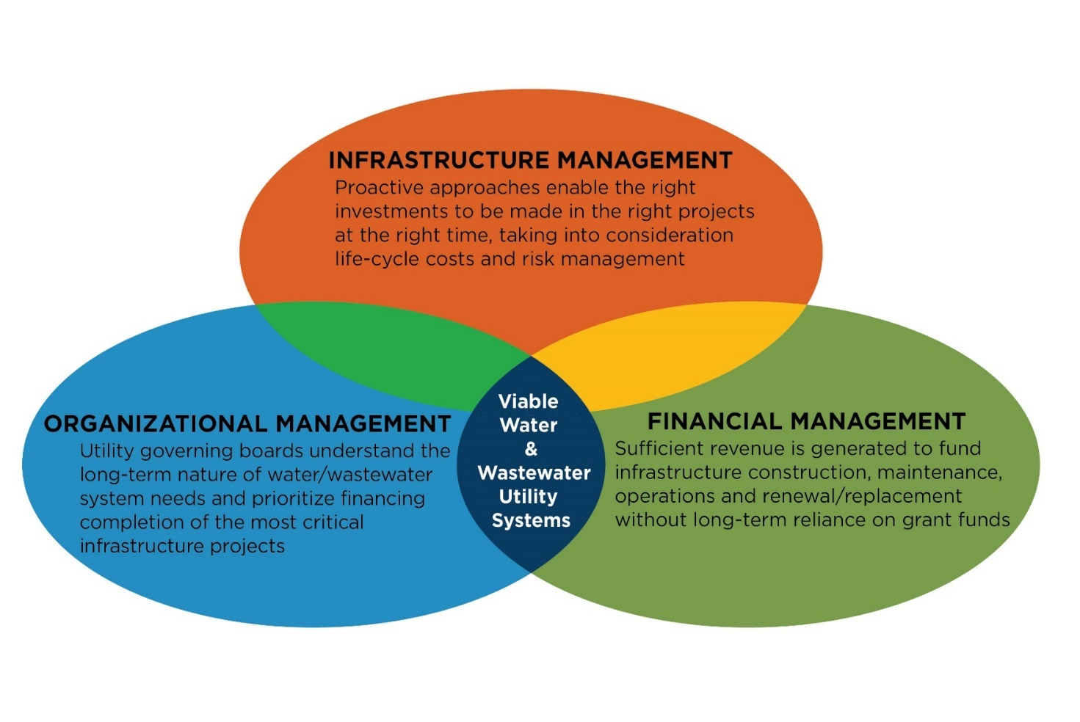
Best Practices in Utility Management
Infrastructure management
Proactive approaches
Life-cycle costs
Risk management
Organizational management
Long-term nature of system needs
Governing boards prioritize the most critical projects
Financial management
Sufficient revenue generation for O&M, renewal/replacement, reserves
Permanent local funding solutions
Department of Environmental Quality
Notes:
We boiled this down to three categories that are all needed to be a successful, viable utility.

Slide 14
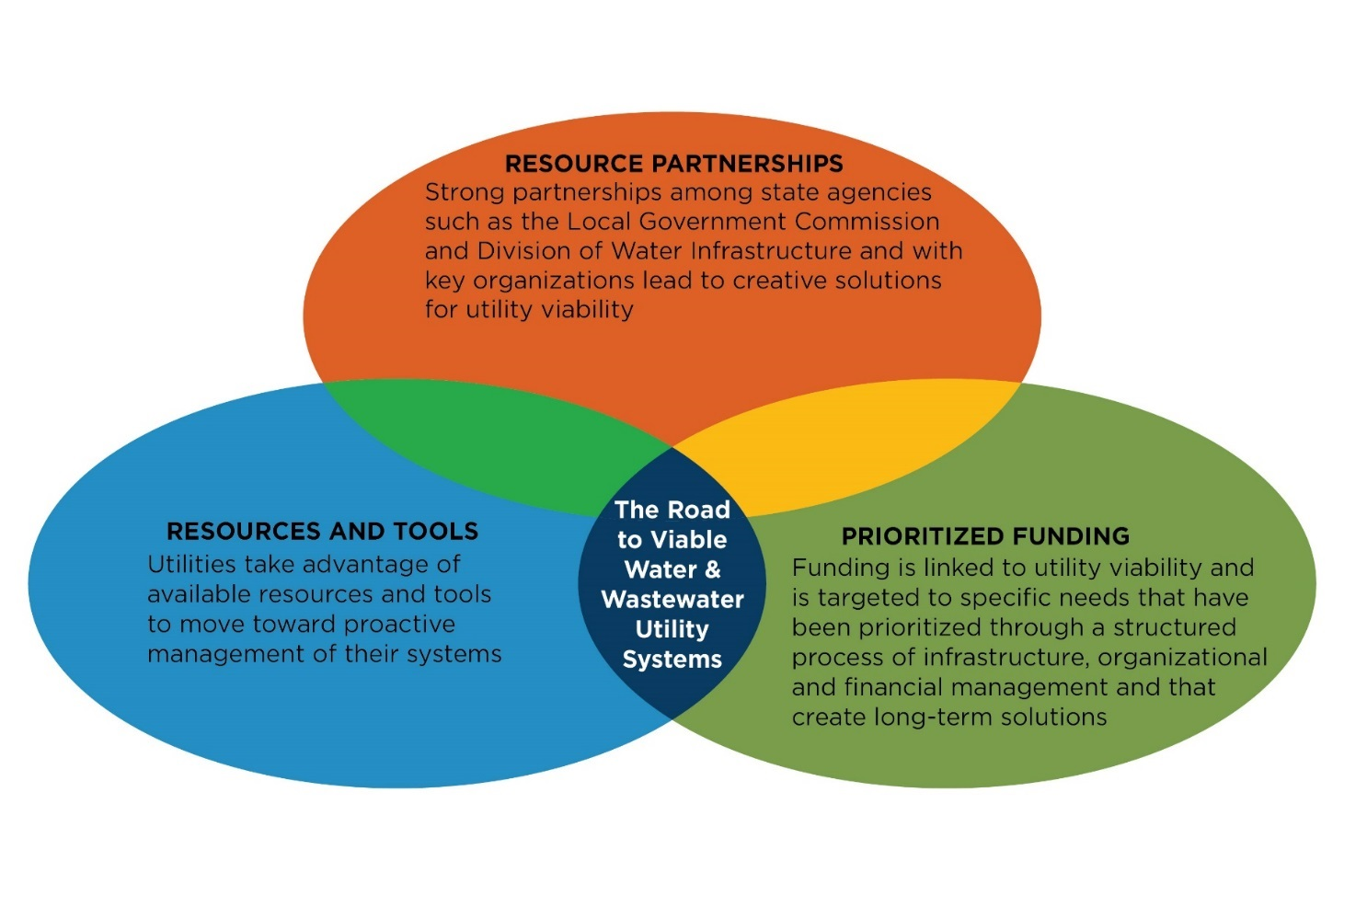
Steps Toward Achieving the Vision
Resource Partnerships
State agencies
Key organizations
Resources and
Tools
Available today,
many at no cost
Appendix B –
Resource Toolbox
Webinars, videos
Publications
Prioritized Funding
Targeted to specific needs that create permanent solutions
Linked to utility viability
Department of Environmental Quality
Notes:
Of course for some utilities this means change – so make aware of resources and the environment in which they operate.

Slide 15
Master Plan Outline
Section 1 – Introduction
Section 2 – Master Plan Vision and Purpose
Section 3 – Water Infrastructure Funding Programs
Section 4 – Statewide Needs
Section 5 – Achieving the Vision: Infrastructure
Section 6 – Achieving the Vision: Organizational
Section 7 – Achieving the Vision: Financial
Section 8 – Assessing Financial Capacity
Section 9 – Troubled System Protocol
Section 10 – Moving Forward
Appendices – including a resource toolbox
Department of Environmental Quality
Notes:
The result is a document that outlines the plan, the water infrastructure environment, and potential ways of achieving results.

Slide 16
Master Plan Take-Aways
Vision is for viable water and wastewater utilities across NC
Organizational and financial management needs are as critical as infrastructure/construction needs
Strengthen partnerships
Target limited grant funds for permanent solutions and proactive system management
Merger Regionalization Feasibility grants
Asset Inventory and Assessment grants
Project selection
Department of Environmental Quality

Slide 17
Master Plan Take-Aways
Local discussion of water infrastructure issues
Governing boards must make long-term decisions about water and wastewater infrastructure spending
Investing in their economic future
Beyond 2- to 4-year terms
“I’ve already used this information on several occasions and it has helped make the point of the current state of the industry and what we can expect going forward as far as the priorities of your Division. … If this ‘Master Plan’ and the strategic approach it promotes gains traction long term, it will give utilities like us the stability we need to map our own path forward with some certainty.” Dan Harbaugh, Executive Director, TWASA
Department of Environmental Quality
Notes:
This is the key take away – the local level result

Slide 18
Division of Water Infrastructure http://portal.ncdenr.org/web/wi/home State Water Infrastructure Authority http://portal.ncdenr.org/web/wi/authority

