Slide 1
Oregon Clean Water State Revolving Fund: Expanding Reach and Impact through Program Enhancements
Council of Infrastructure Finance Authorities SRF Workshop 2024
Chris Marko and Deb Mailander
Nov. 18, 2024
Long Beach, CA.

Slide 2
Oregon CWSRF Program Enhancements and Impacts Session Overview
Oregon CWSRF Bipartisan Infrastructure Law action plan
Oregon DEQ Rulemaking 2022
New Principal Forgiveness limits
Outreach and technical assistance
Increasing staff capacity
Impacts and results

Slide 3
Oregon Context
COVID
Wildfire
BIL
Program changes

Slide 4
Bipartisan Infrastructure Law Implementation Action Plan
Rulemaking
Principal forgiveness limits
Affordability criteria
Environmental Justice metrics
Outreach and technical assistance
Program guidance – BABA, Emerging Contaminants, IUP, cap grants, EPA coordination

Slide 5
Principal Forgiveness
Increased limits for PF up to $2,000,000 for design and construction loans documented in Intended Use Plan
Added 100% PF for eligible planning loans up to $100,000
Removed rule language limiting PF maximum of $500,000
Removed rule language limiting PF to only sustainable planning projects and 50% principal forgiveness

Slide 6
Affordability Criteria
Removed rule language referencing Oregon Distressed Areas Index, retained language of affordability criteria requirements in Clean Water Act
Revised affordability criteria regarding income, unemployment, and population trends
Developed environmental justice metrics including water pollution burdened and health burdened communities
Prioritized very small communities
Documented program enhancements in Intended Use Plan

Slide 7
Outreach and Technical Assistance for Pipeline Development
Loan Information Request Form
Online easy to fill out form about entity and project
Early consultation with potential applicants
Pipeline development
One Stops
Business Oregon organizes meetings with communities and funding agencies
Agencies highlight programs and funding scenarios
Finance scenarios include projected impacts on rates
Technical assistance
Internal to applicants on IUP to understand requirements for loans
Goal to move applications to loan commitments more timely
External coordination with EPA region 10 and TA providers in Oregon

Slide 8
Agency Changes: Staffing and Structures
New People
New Opportunities
Headquarters: 100% new staff or staff in new positions since October 2021.
In Fall 2023 most staff and managers statewide had between 3 months and 2.5 years of experience with the Program.
New energy and commitment to the mission
Organizational structure to enhance communication and responsiveness
New guidance and tools for staff and the public
Strengthen External partnerships
Notes:
HQ –
Chris 3 years, both Noosh and Alli within last
Regional staff:

Slide 9
Impacts from Outreach and Engagement
Loan Information Request Form
The program received 21 Loan Information Form Requests in SFY24, which led to 17 applications.
One Stops
CWSRF staff participated in 10 One Stop meetings during SFY2024, resulting in loan applications from six communities.
Technical Assistance
Focus on applicants on the IUP to support progress to loan commitments.
New Resources for staff and applicants

Slide 10
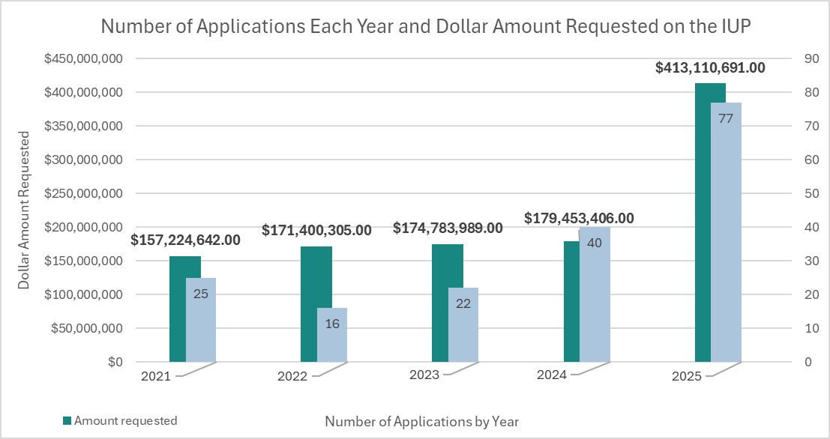
Intended Use Plan: Number of Applications and Dollar Amount Requested Increased
Notes:
Rows 3 &4 from spreadsheet

Slide 11
Principal Forgiveness Eligibility
SFY 2021 $6,812,000 (4%)​
SFY 2022 $5,922,500 (3%)​
SFY 2023 $7,765,000 (4%)​
SFY 2024 $43,105,154 (24%)​
SFY 2025 $58,789,510 (19%)
Rule Change Spring 2023 to implement BIL
Notes:
Row 7 from spreadsheet

Slide 12
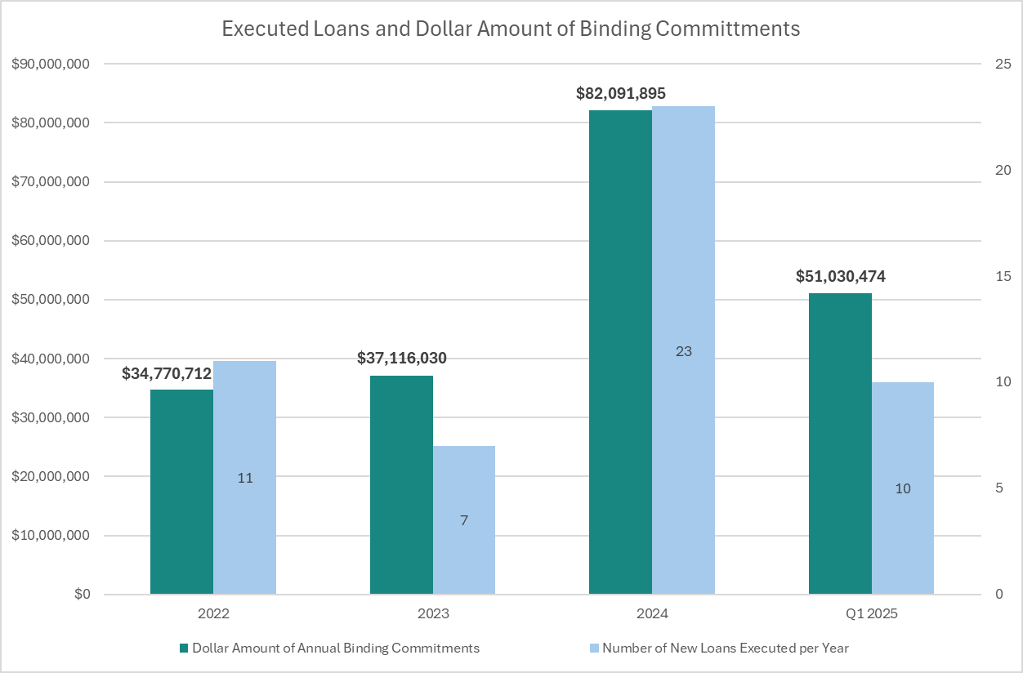
Results: Notable Increase in Commitments
Notes:
** SFY2021 after COVID-related shutdowns, loans that were in the queue were signed and a backlog was addressed.
***SFY 2025 still in progress
The low number of loans signed in SFY2022 and 2023 were due to the rule change process and staff transitions.

Slide 13
Project Planning and Expanded Opportunities to Improve Water Quality Benefits
Planning Loans
Emerging Contaminants and Green Projects
Drinking Water Source Protection
Co-Funding with Grant and Loan Programs

Slide 14
What’s Next?
Applicants: Loan requirements other technical assistance
Modernization: Clean Water Funding Hub
Loan Administration: Adding staffing

Slide 15
Title VI and alternate formats
DEQ does not discriminate on the basis of race, color, national origin, disability, age, sex, religion, sexual orientation, gender identity, or marital status in the administration of its programs and activities.
Visit DEQ’s Civil Rights and Environmental Justice page.
Español | 한국어 | 繁體中文 | Pусский | Tiếng Việt | العربية
Contact: 800-452-4011 | TTY: 711 | deqinfo@deq.oregon.gov

