Slide 1
Sharing Resources and Promotion Partnerships
Donna Marlin McNeil
Executive Director
Kentucky Infrastructure Authority
CIFA – Indianapolis, IN
October 30, 2017

Slide 2
KIA and SB 409
Created to provide the mechanism for funding construction of local public works projects.
KRS 224A.300 passed to encourage regionalization, consolidation, and partnerships
Goal of making potable water and wastewater treatment available to all Kentuckians

Slide 3
KIA
KIA to implement a program for the provision of water services as authorized in the budget and directed by the General Assembly.
KRS 151
Water Management Councils – local level prioritization
Water Resource Information System. http://kia.ky.gov/wris/
The authority shall maintain and, at least annually, update the information contained in this system to ensure its accuracy.

Slide 4
2005 LRC Update
The Legislative Research Commission looked at SB 409 progress.
133 projects funded 17% were regional
Received $17 million or 38% of state grants (2020 funds)
From 2000 to 2004 purchasing water systems rose form 30 to almost 40%.
Kentucky ranked 3rd highest according to US EPA with 90%.
LRS Research Report No. 329
http://www.lrc.ky.gov/

Slide 5
LRS Research Report No. 329
Planning process
15 Area Development Districts have a planning coordinator
Project Profiles developed
Water Management Councils formed
Local prioritization
2020 Fund ($850 million in funding)
Regional plan
KIA review create state plan
SRF priority points

Slide 6
Natural Consolidation
Kentucky
YEAR
1974
1979
1989
1999
2009
2017
TNCWS
1058
805
400
199
49
25
NTNCWS
252
252
215
85
26
15
CWS
868
755
639
497
409
358
PWS
2178
1812
1254
781
484
398
CHANGE
-17 %
-31 %
-38 %
-38 %
-18 %

Slide 7
Fund A, B and F Interest Rates
2.75% State MHI and above
1.75% Below State MHI or Consent Degrees or Agreed Orders or Regional Project
0.50% below 80% of State MHI ($34,673)

Slide 8
Types of Partnerships
Informal Cooperation
Contract Required
Joint Partnership Agency
Ownership Transferred

Slide 9
Informal Cooperation
Sharing equipment
Sharing bulk supply purchases
Mutual Aid Agreements

Slide 10
Contract Required
Operation & Maintenance
Engineering Services
Purchasing Water

Slide 11
Joint Partnership Agency
Creation of a new utility by existing utilities (regionalization).
System Management
Operators
Source Water

Slide 12
Logan-Todd Regional Commission
Customers Served: About 300-3,300 customers
•7 systems served <1,000
System Ownership:
•8 municipally-owned systems – with their own treatment plants
•3 water districts – purchased finished water; 1 treated water
•1 privately-owned water association – purchased finished water
System Sources:
•Several flashy springs, some lakes and rivers

Slide 13
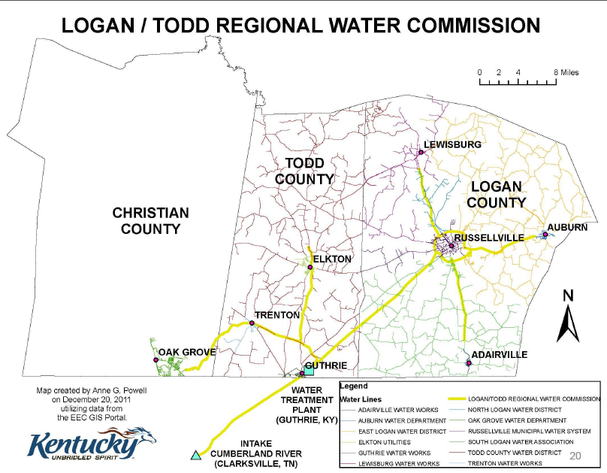

Slide 14
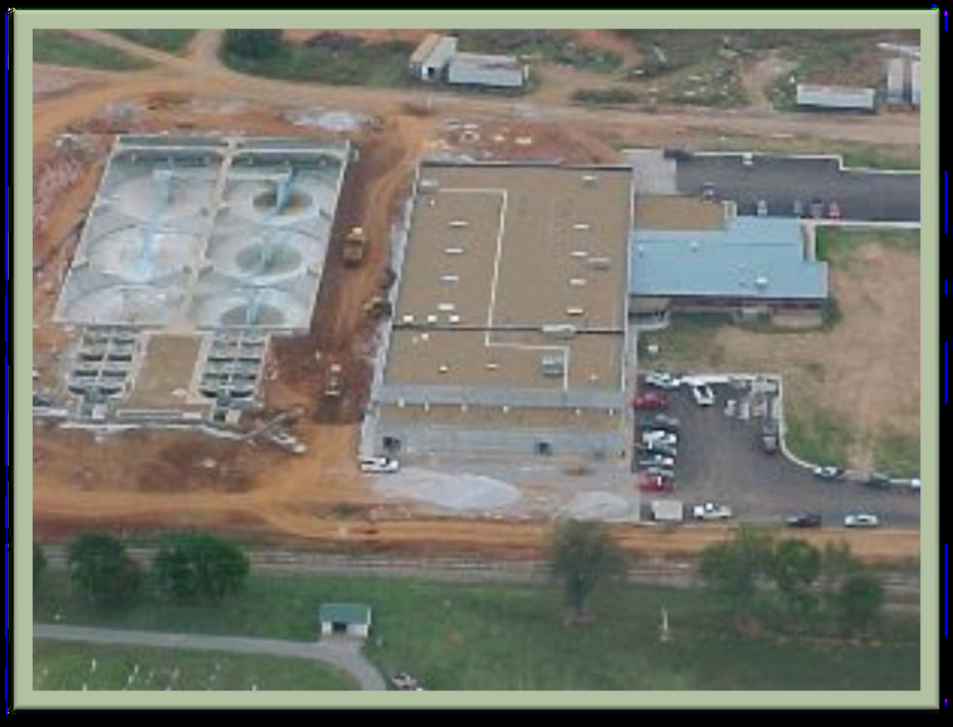
Why the systems came together?
•Russellville was a key plant
– it served 3 other systems
•Drought
•Not enough water for industry

Slide 15
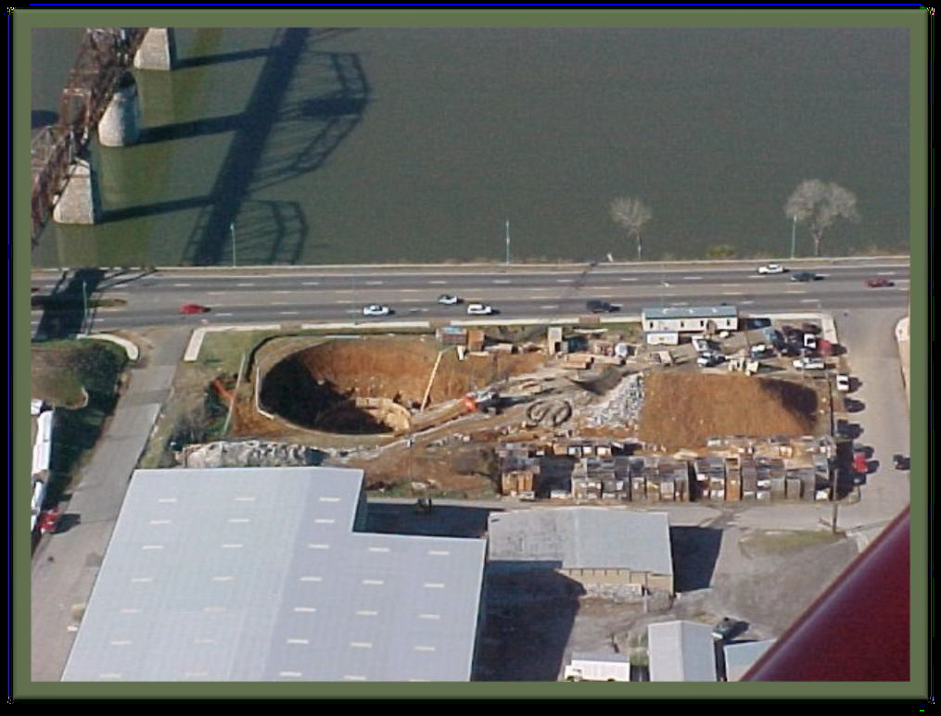

Slide 16
Logan-Todd Regional Water Commission
Management determined by Kentucky Statutes –Regional Water Commission by-laws, positions
Board has 12 members – one from each member system
Each member has one vote on the board

Slide 17
Funding
Total project cost of regional project was about $77M
Funded through various sources:
USDA loan amount $49.8M
DWSRF $10.4M
KIA 20/20 Grant $5M
Appropriation - Earmarks $3.3M
State funds $3.5M –CDBG $1M
Area Development Grant Fund $5K
Systems’ contributions $19K
Other funding $4M
*Water Plant currently serves a population of 62K

Slide 18
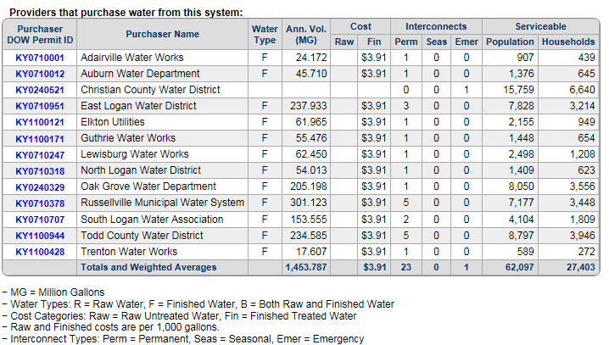
Systems (WRIS)

Slide 19
Ownership Transfer
Consolidation of existing utilities.
Acquisition with physical interconnection
Acquisition with satellite management

Slide 20
Questions?
Donna McNeil
Executive Director
Kentucky Infrastructure Authority
Donna.McNeil@ky.gov
502-892-3496

