Slide 1
Water Privatization: Approach with Caution
Elizabeth Douglass, InquireFirst.org
Council of Infrastructure Financing Authorities, SRF Workshop
October 31, 2017

Slide 2
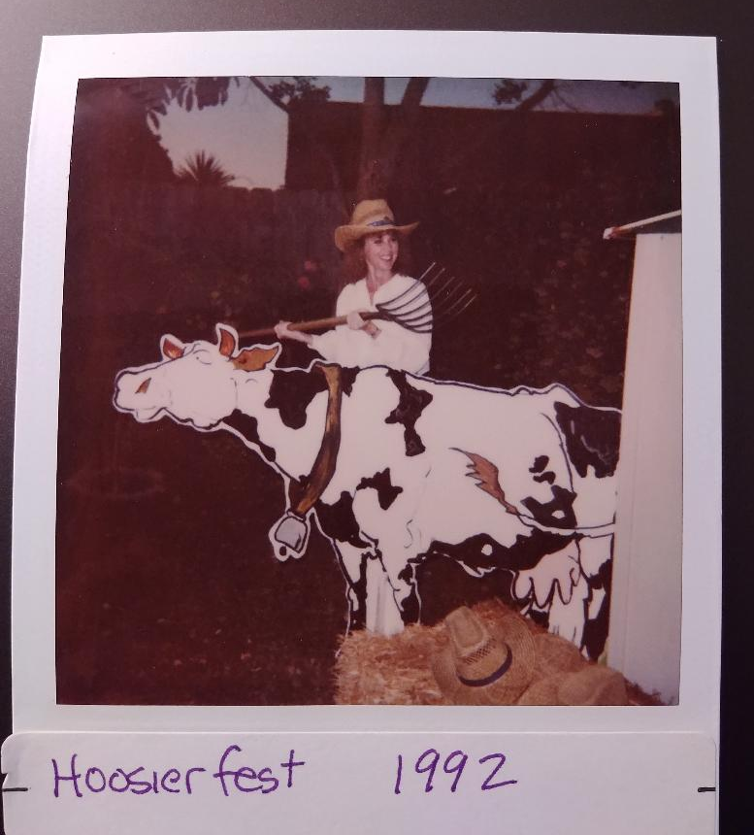

Slide 3
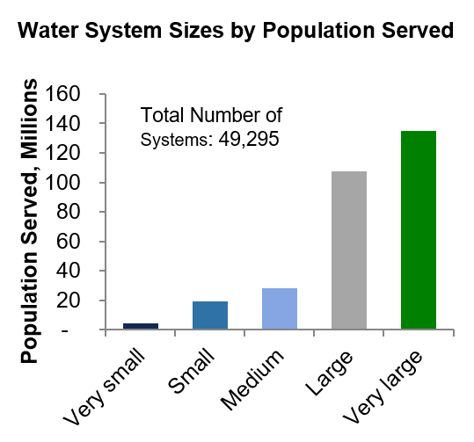
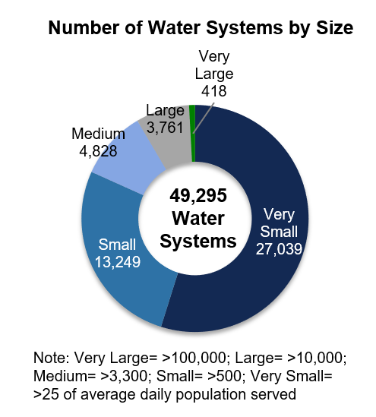
Drinking Water Systems in the U.S
Among the population served by community water systems --
Almost half get water service from an operator that has more than 100,000 customers.
If you add “large” systems serving more than 10,000 people, the share jumps to 83%.
But the little providers are problematic…there are more than 27,000 water systems serving fewer than 25 people.
83%
Source: Bluefield Research

Slide 4
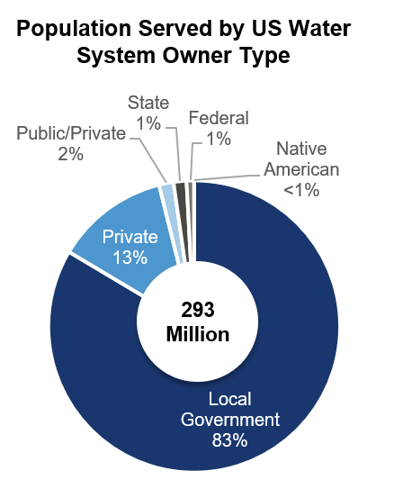
Drinking Water Systems in the U.S
Most Americans get their residential drinking water from public systems, such as those operated by municipalities and water districts.
Private water operators serve about 13% of people connected to water systems (excluding private wells).
If you narrow the definition of ‘private’ water systems to just those whose stock is publicly traded, then the percentage drops to around 3%.
Source: Bluefield Research

Slide 5
Water System Privatization
An unusual confluence of circumstances has created very favorable conditions for privatizing water systems, triggering a surge in acquisitions:
The need for long-delayed and expensive infrastructure improvements
Escalating costs for complying with federal drinking water standards and regulations
The fear among public officials of being “the next Flint”
The need for cash to shore up shrinking city budgets, especially where there are large pension obligations, a shrinking population base and/or broad economic woes (low household incomes, high unemployment)
Broad support for water utility consolidation as a way to reduce public health risks, improve service and lower customer costs for major investments

Slide 6
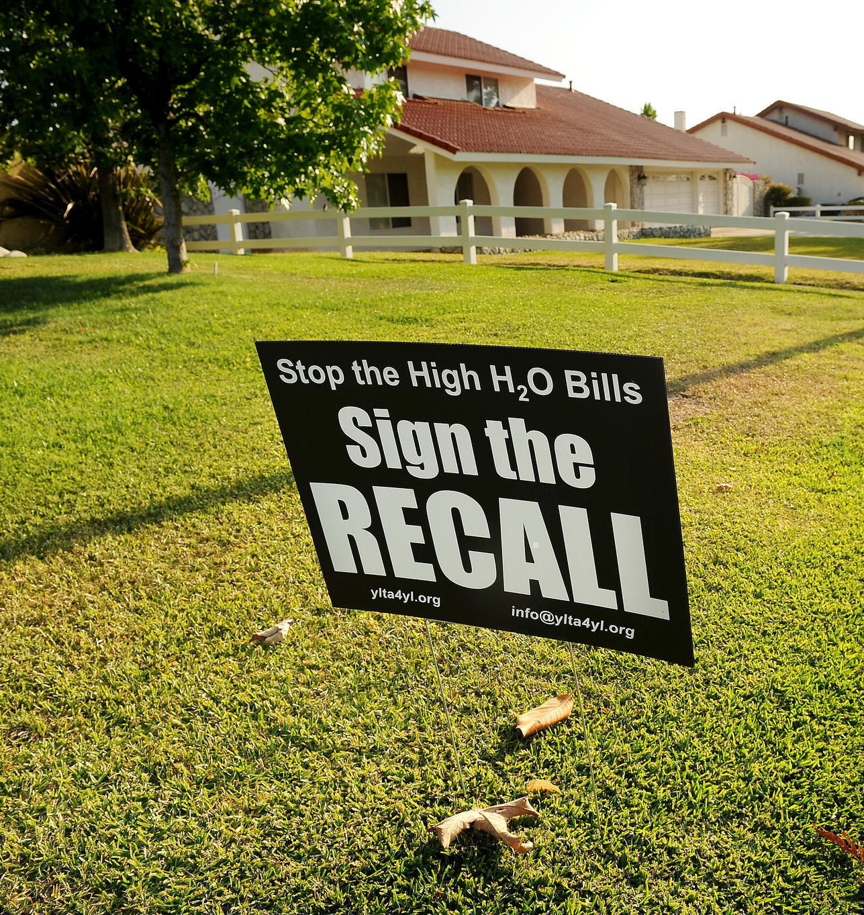
NIMTOO*
And of course …
A strong desire by public officials to avoid the backlash caused by raising water rates.
*aka Not in My Term of Office
Photo: Los Angeles Times

Slide 7
In a Nutshell

Slide 8
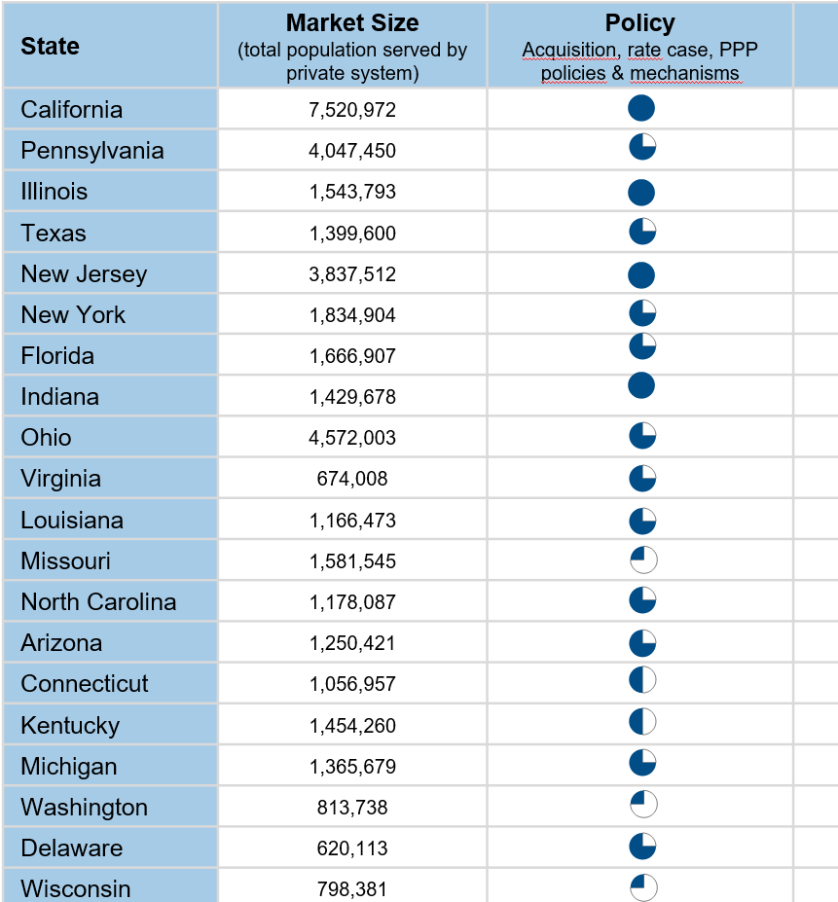
Certain States are More Privatization-Friendly
Top states based on their policies on acquisitions, rate cases, and public-private partnerships:
California
Illinois
New Jersey
Indiana
followed by
Pennsylvania North Carolina
Texas Arizona
New York Michigan
Florida Delaware
Ohio Louisiana
Virginia
Source: Bluefield Research

Slide 9
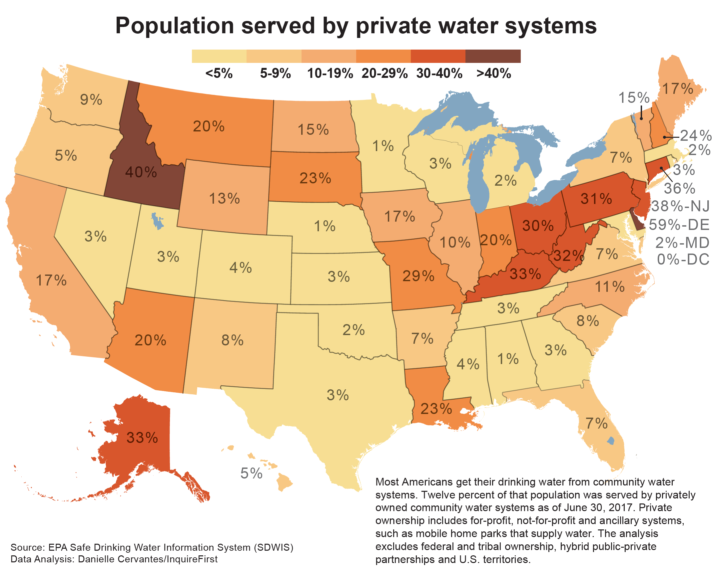
State Populations served by Private Water Utilities

Slide 10
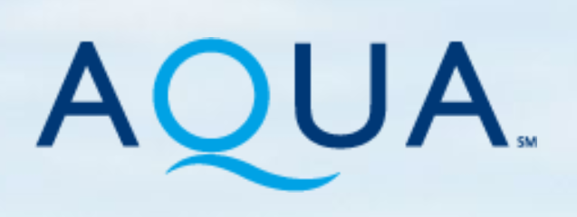
Investor-Owned Private Water Utilities
There are roughly 20 publicly traded water utilities in the United States, but the top three players dominate the space

Slide 11
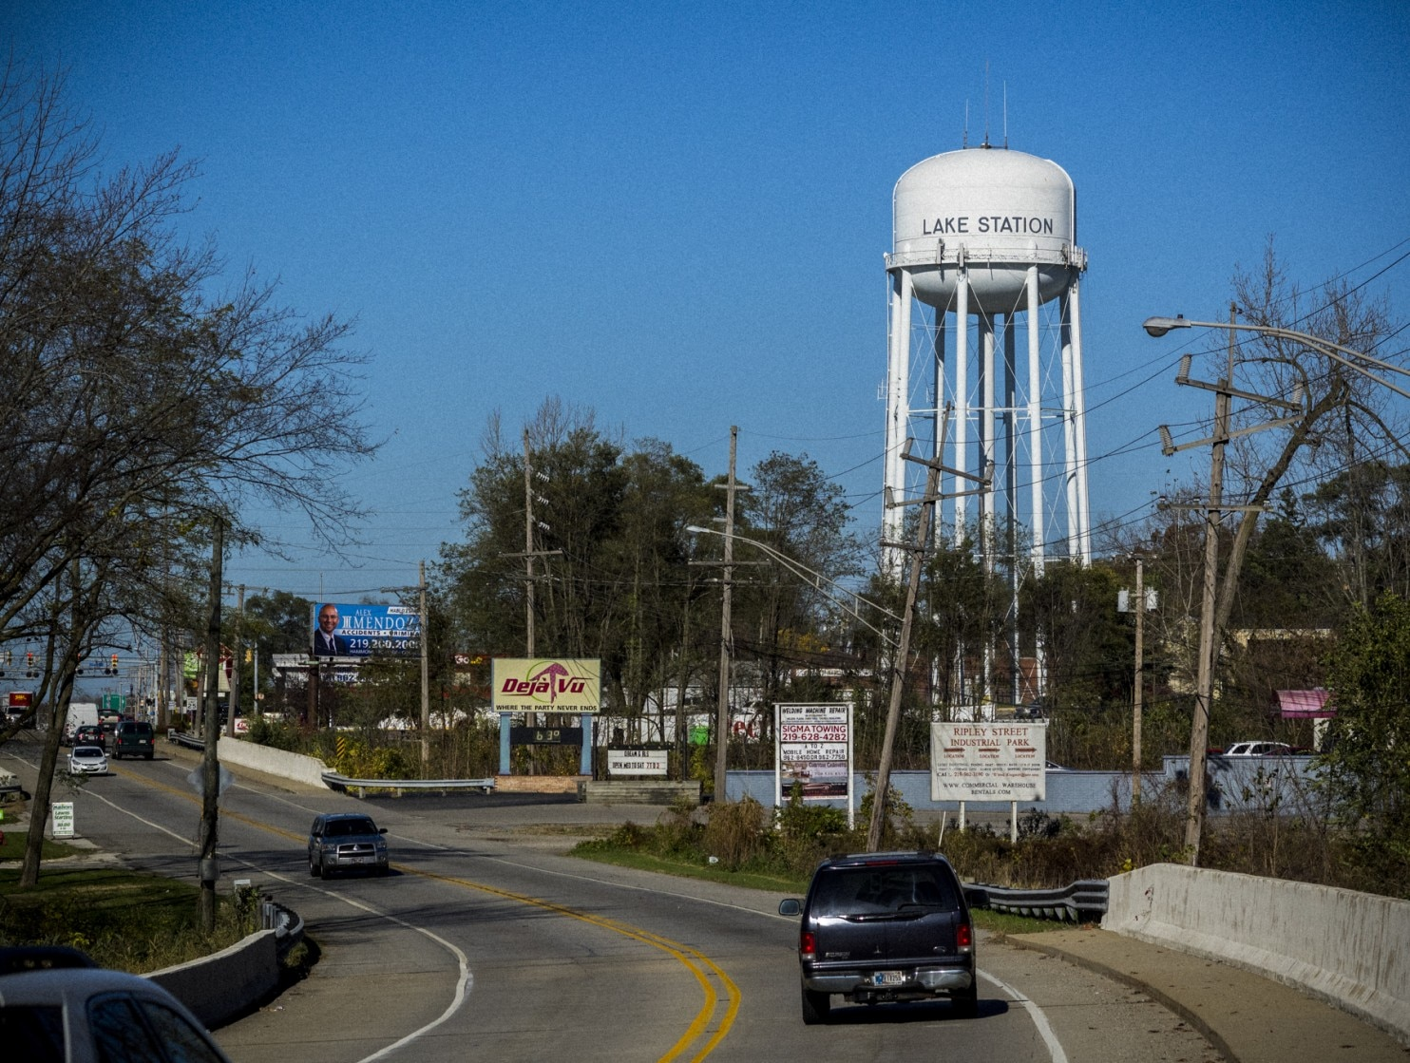
Lake Station, Indiana
Population: 12,000
Economically distressed
Municipal water system customers: 3,500 (2/3 of the city) Daily usage- ~1 million gals/day
SRF loan for $11 million project (approved Sept. 2012): New filtration plant, 1.5 million gallons cap., (April 2015) 5 new replacement wells Replaced/enlarged/upgraded certain water mains
Three rates increases phased in, last one in 2014
Photo by John Nelson

Slide 12
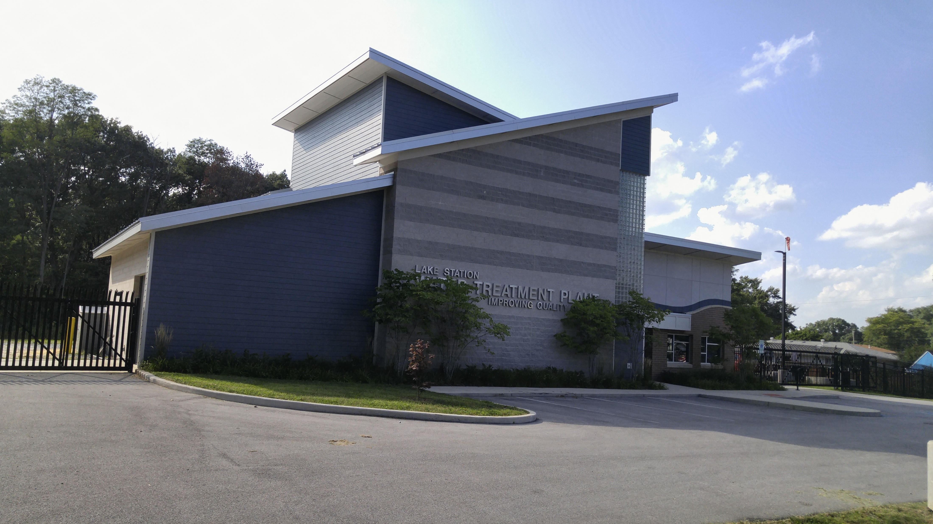
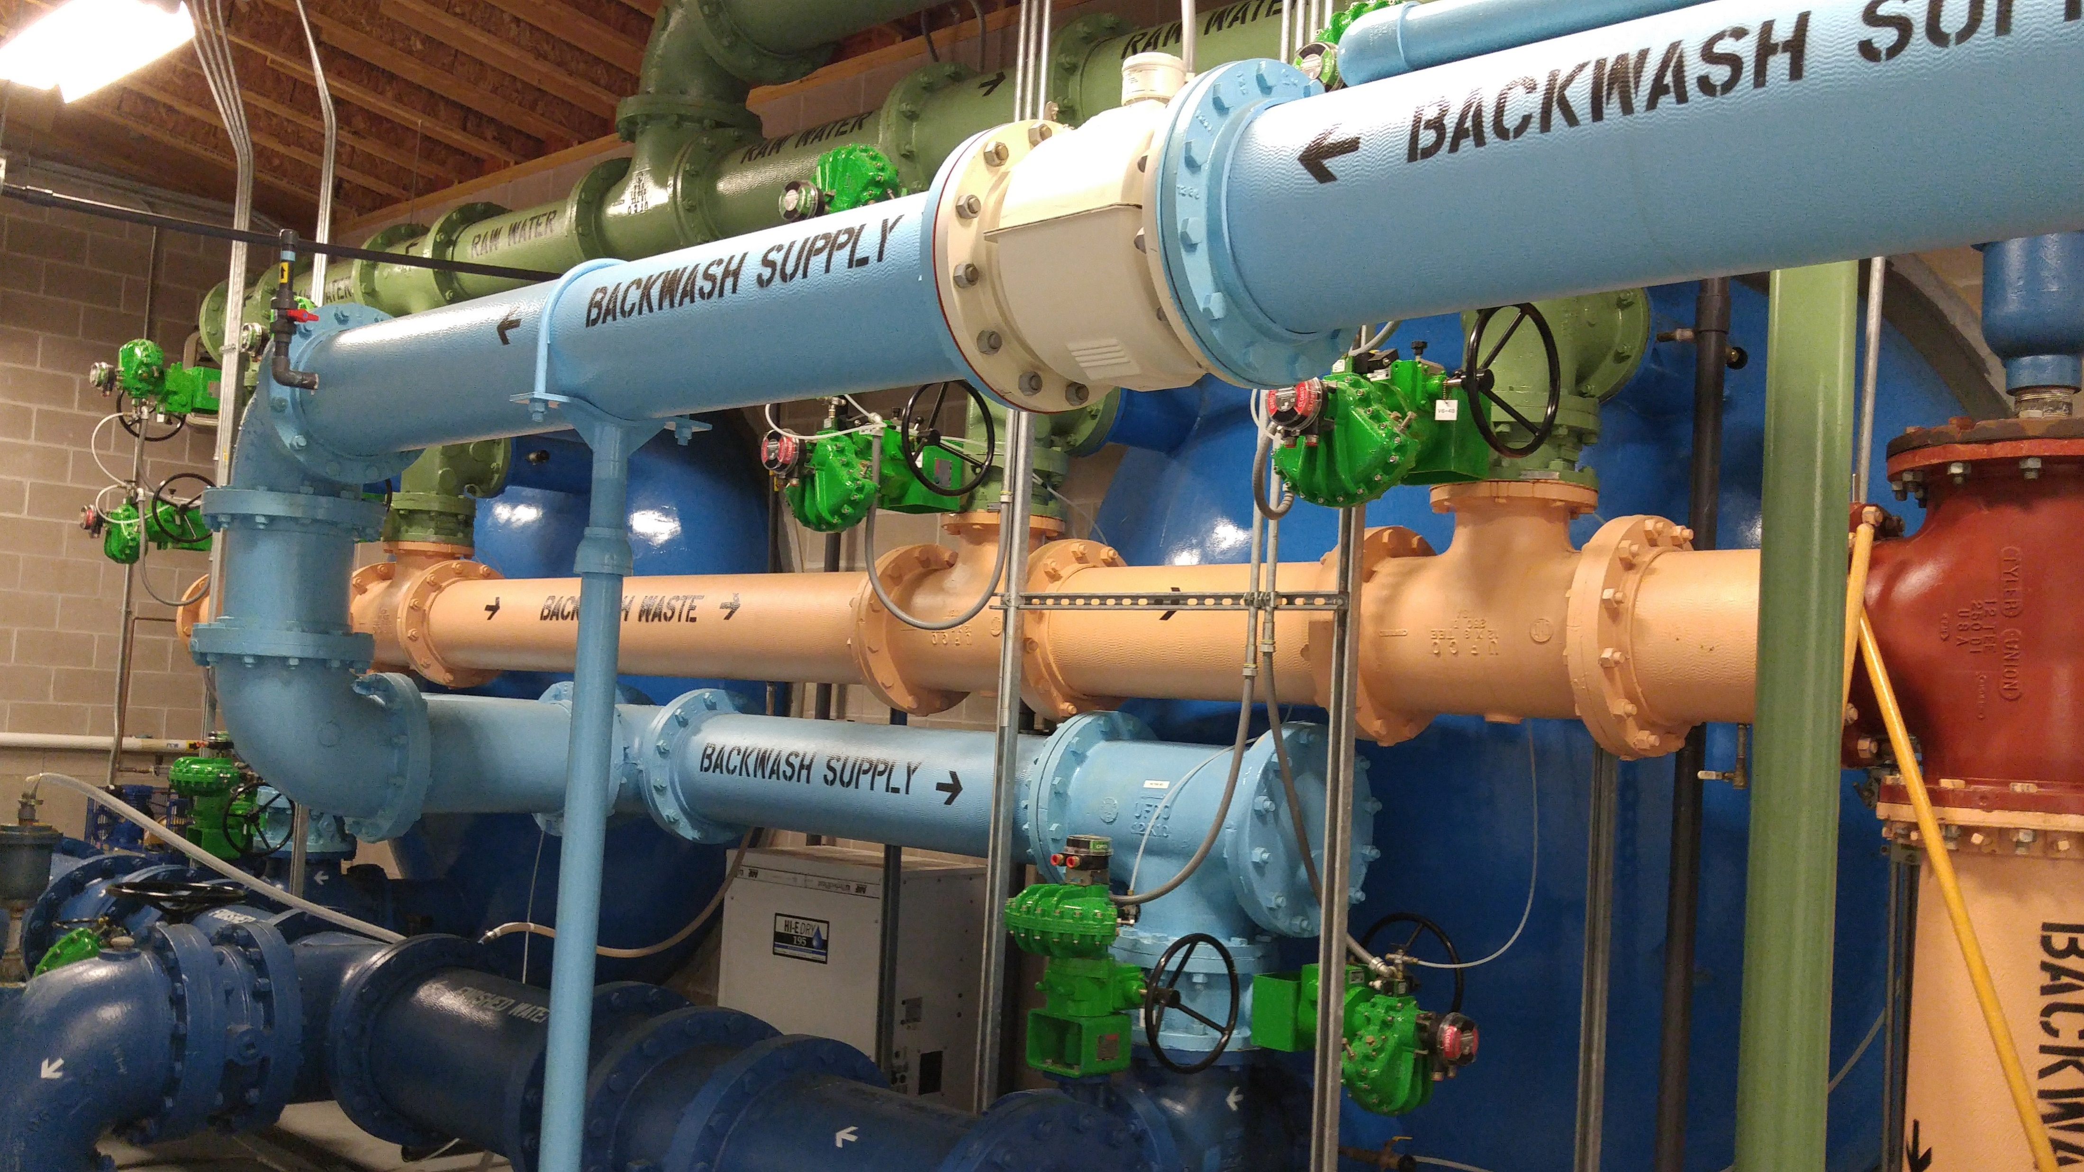
$11+ million SRF Loan: Major Water Projects
Photo by John Nelson
“I'm excited for the opportunity to improve the quality of our water and control our destiny for future generations”
-- Lake Station Mayor Keith Soderquist, April 2015

Slide 13
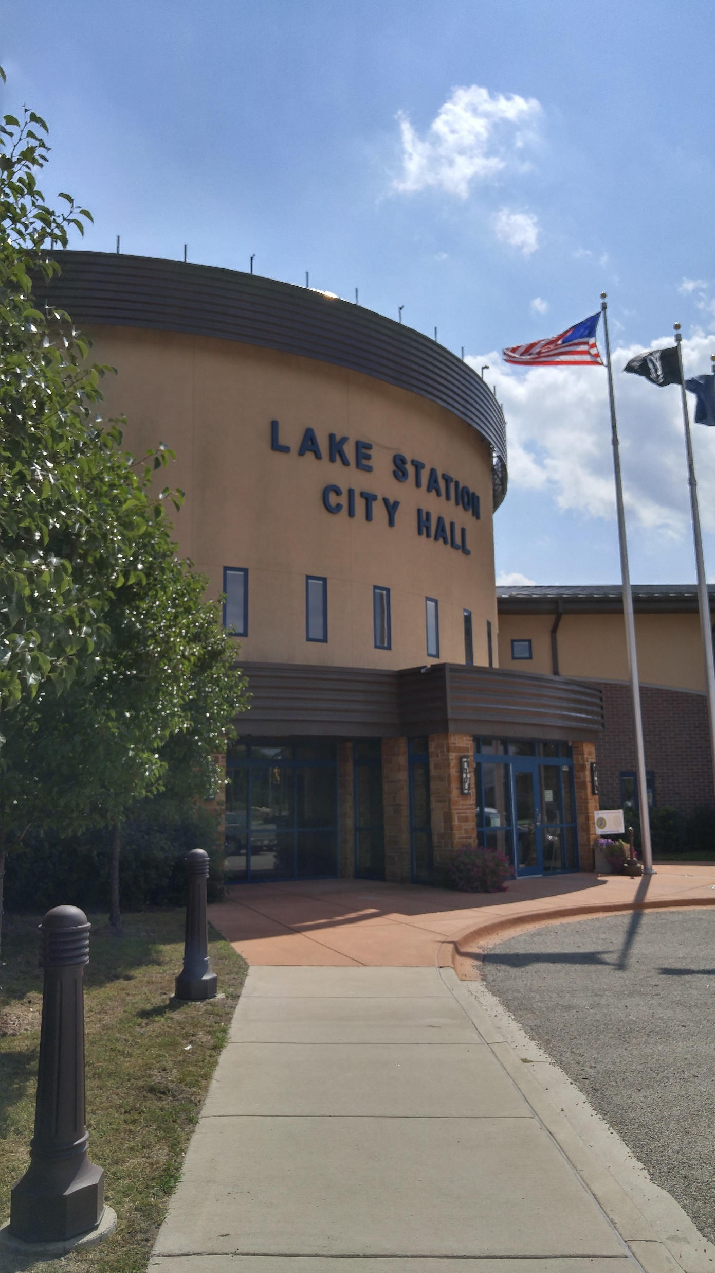
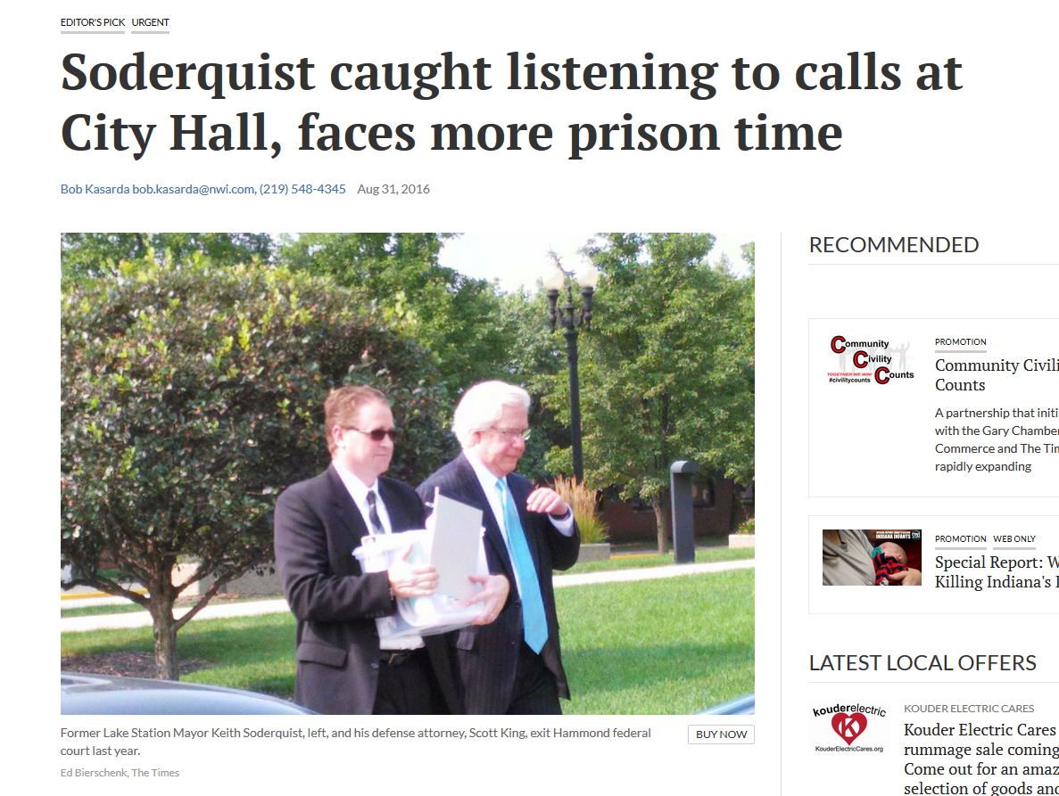
…But This Also Happened

Slide 14
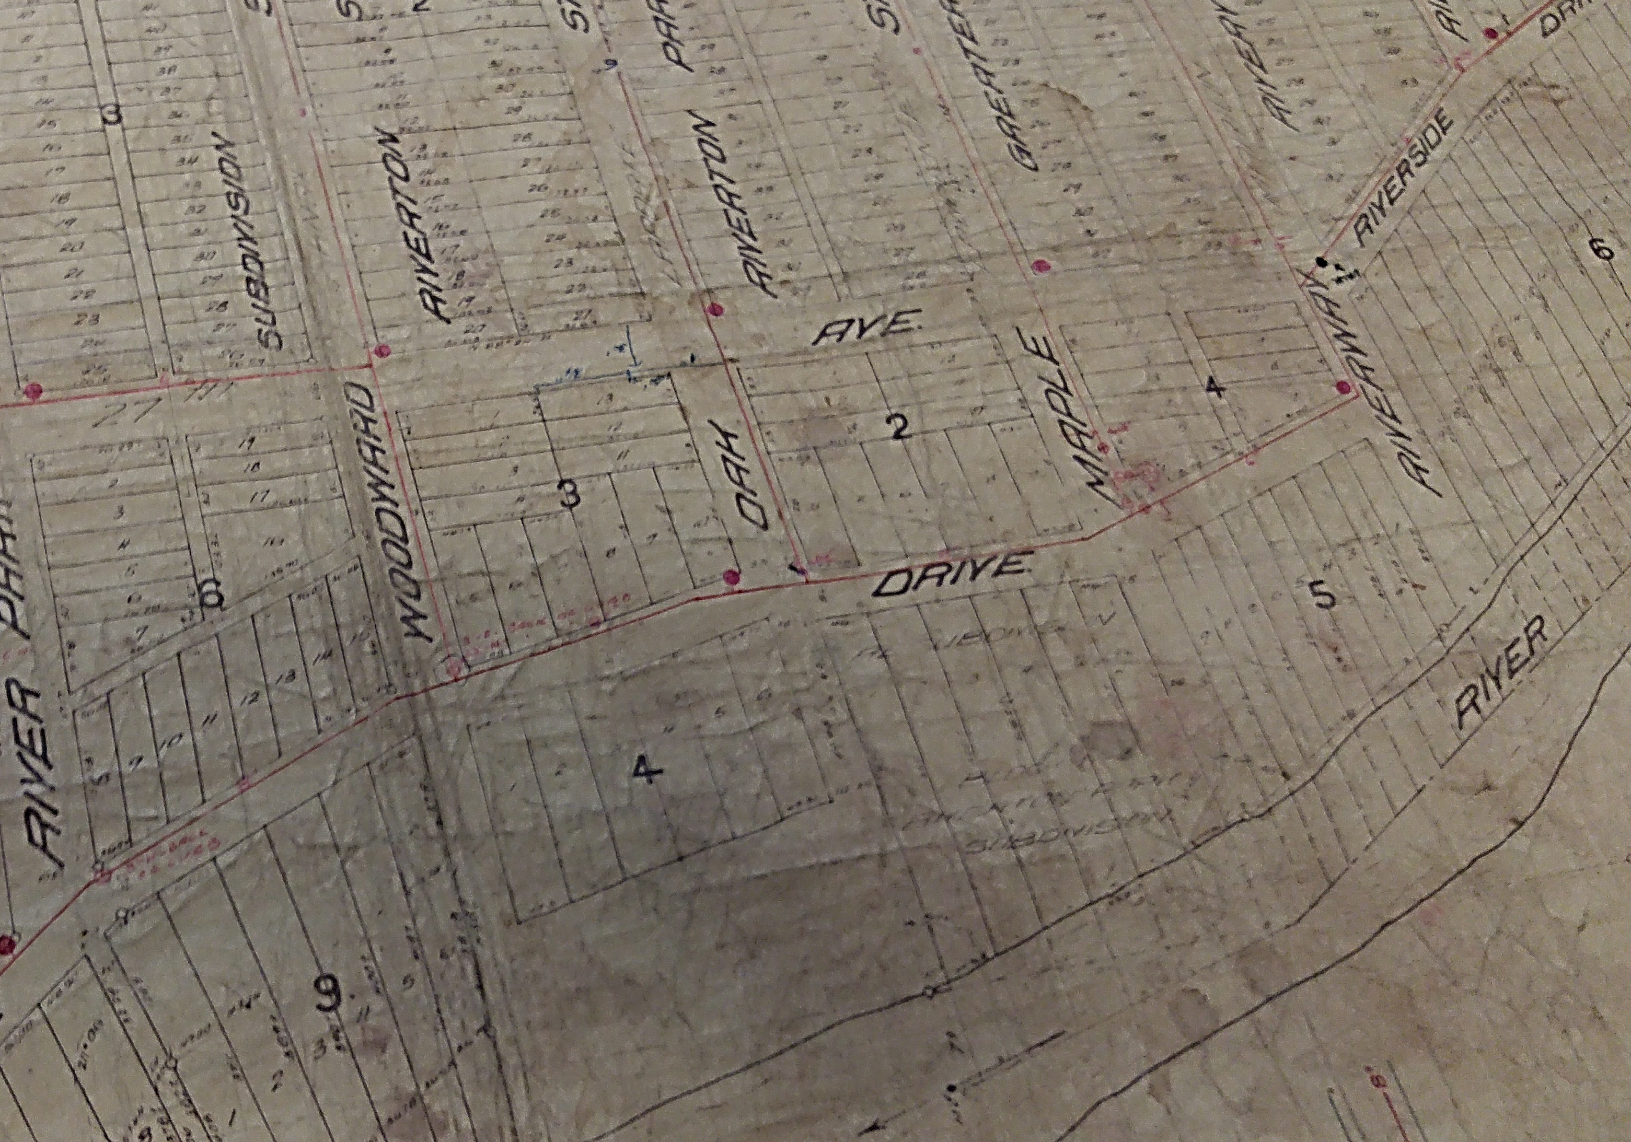
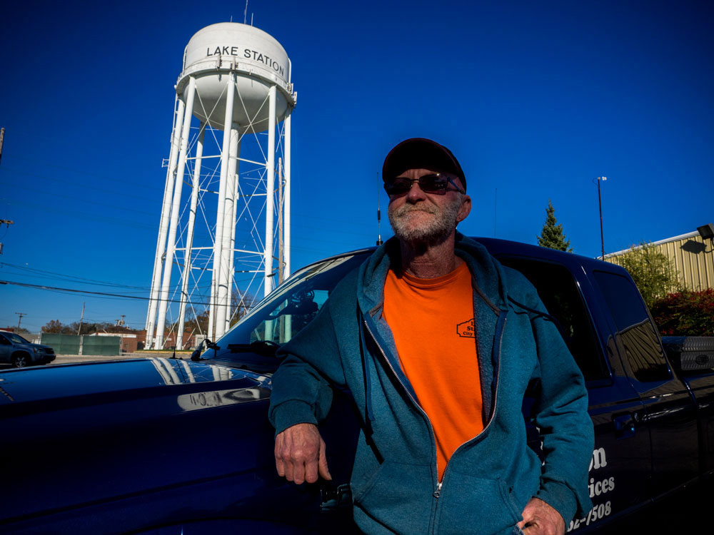
Old-School Maps & Institutional Knowledge
Harry Heath, water tech supervisor,
30 years of service
“I do know the system, every size main, valves…I don’t even have to look at maps”
Photos by John Nelson

Slide 15
Indiana American Water

Slide 16
Benefits of Selling to Indiana American Water
$20.68 million cash payment to City of Lake Station for the system;
Net to city of $9.5 million, erases budget deficit, allows road repairs and restoration of services
Lower rates initially: cost of 4,000 gals/month, drops to $33.25 from current rate of $39.33
Higher quality water, sourced from Lake Michigan
Economies of scale:
Purchasing power, R&D, greater expertise, more manpower and resources for emergency work,
sharing costs with larger customer base, more automated billing and customer service
Transfers potential liabilities, responsibility for upgrades and rate increases to Indiana American
City collects property taxes from Indiana American
Indiana American removes existing water tower on commercially valuable city-owned land

Slide 17
Opposition to Privatizing Water
Water rates often increase, sometimes dramatically
No free money – customers still pay
Investor-owned companies have different priorities;
Profit and shareholder dividends is Job #1
Focus on profit can lead to cutting corners on safety or
emergency preparedness
Less local accountability
Less transparency; private companies aren’t subject
to freedom of information laws

Slide 18
Missoula, Mont.
The City of Missoula has wanted to own the local water utility for decades.
The latest attempt began in December 2010, when the owners of Mountain Water sold the utility to the Carlyle Group, one of the world’s largest investment firms.
City of Missoula’s original offer to Carlyle: $65 million.
Final purchase price: $88.6 million, plus millions more in legal expenses.
Takes over the operation in June 2017.
During the eminent domain litigation, Carlyle sells Mountain Water to a subsidiary of a Canadian company.
“Frankly, the stakes were so high that throwing in the towel was not an option… This water will forever be, and the system will forever be, in the hands of the people who use it.”
--- Missoula Mayor John Engen, the sixth mayor to take up the fight

Slide 19
Downsides to Lake Station Sale
There are extra costs for ratepayers
The $20.7 million purchase price, plus the 6.6 percent profit state regulators currently allow the company to earn on those assets. In this case, that would add $1.4 million to ratepayers’ bills.
6.6 percent profit on every dollar the company spends to fix Lake Station’s aging pipes. American Water estimates it will spend $2.8 million on improvements over five years, earning an extra $184,800 in profit.
The business and property taxes the company pays on the Lake Station operation. (While this is a gain for the city, it’s an additional cost for customers since municipally owned systems are exempt from these taxes--though they sometimes pay a similar city fee.)
“Incidental” acquisition costs such as appraisals and legal fees, plus 6.6 percent profit on those costs. (Indiana American Water’s purchase of the Georgetown, Ind., water system—a deal about a third of the size of Lake Station’s—those costs exceeded $100,000.)

Slide 20
Downsides to Lake Station Sale
There’s almost no chance of re-establishing a municipal system
The deal with Indiana American includes the removal of Lake Station’s water tower; once that’s
gone, the city would have to build a new one to remunicipalize.
Customers will pay dearly for $12 million in assets that aren’t really needed.
Indiana American intends to provide Lake Station customers with Lake Michigan water, so it
doesn’t need the city’s new water treatment plant, new wells and connecting pipes. Since the
company plans to put all those assets in its rate base, tack on a 6.6% return on those assets too.
Future rates are uncertain. Water rates will drop for Lake Station customers once they become par of Indiana American, but it’s unclear how that will shake out in the long run.
It’s not clear that the city was incapable of financing needed improvements itself. Rates rose after the treatment plant investment, but Lake Station was also illegally and regularly using water utility revenue to pay unrelated city expenses. What would the water system’s budget look like if the revenues were not being siphoned off?

Slide 21
Who’s the owner?
The Carlyle Group – “Global Alternative Asset Manager” (~ $170 billion assets)
Carlyle Infrastructure Partners LP
Western Water Holdings LLC
Park Water Co. (Downey, CA)
Mountain Water (Missoula, MT)
Algonquin Power & Utilities Corp. (Canada)
Liberty Utilities Co.
Sold to

Slide 22
West Virginia
Public disclosure and disaster preparedness became issues in the aftermath of the 2014 Freedom Industries chemical spill in West Virginia, which contaminated drinking water in a West Virginia American Water system serving 300,000 people.
In a its preliminary review, the state public service commission said the water utility:
Failed to notify the public of the spill in a timely manner
Didn’t properly maintain the system, provide adequate water storage, or install pollution
monitoring equipment, and didn’t create a protection plan for its water source.
When the PSC began a formal investigation, the water company spent months fighting to keep documents secret and prevent any information about pre-spill conditions to be considered.
The commission noted that some company documents were so heavily redacted that "the 1-800 number for the Public Service Commission was inexplicably labeled as 'Highly Sensitive Confidential Information.”

Slide 23
New Garden, Penn.
Aqua Pennsylvania Wastewater’s pending purchase of the New Garden, Penn. Wastewater system will be the first deal completed under the state’s 2016 ‘fair value’ legislation [Act 12].
Purchase price: $29.5 million; 2,100 customers
For 10 years after close of the transaction, rate increases for New Garden customers may not exceed a compound annual growth rate of more than 4%.
Protests by the Bureau of Investigations and Enforcement and the Office of Consumer Advocate
New Garden’s net book value is $18,567,728, so purchase price is $10.9 million, or 59% above what would have been paid before Act 12 was enacted.
Aqua’s average net plant per customer was about $3,700; but New Garden’s is $14,000
The combined figure would be ~ $1,000 more per customer.

Slide 24
Summary
Know the trade-offs
Consider multiple scenarios (including worst-case)
Question your assumptions; circumstances change
Customers pay the bill regardless of ownership structure
What would the sale provide that can’t be obtained through some other option?
For the most part, the success of a water utility is determined by how well it’s managed, not strictly by its size or ownership type.
Once a city’s sells its water system, getting it back is difficult, time-consuming and expensive. But Missoula did it and doesn’t regret it.
Don’t rely on promises. Get it in writing and make sure it’s enforceable

Slide 25
Happy Halloween !
Elizabeth.Douglass@InquireFirst.org / 760.436.6459

