Slide 1
Dr. Peter Grevatt Director, Office of Ground Water and Drinking Water US Environmental Protection Agency

Slide 2
Drinking Water State Revolving Loan Fund
1997
$887,366
2001
$3.8 Billion
2006
$11.0 Billion
2011
$21.7 Billion
2016
$32.5 Billion
Infrastructure loan funding over 20 years
Covering nearly 13,000 loans

Slide 3
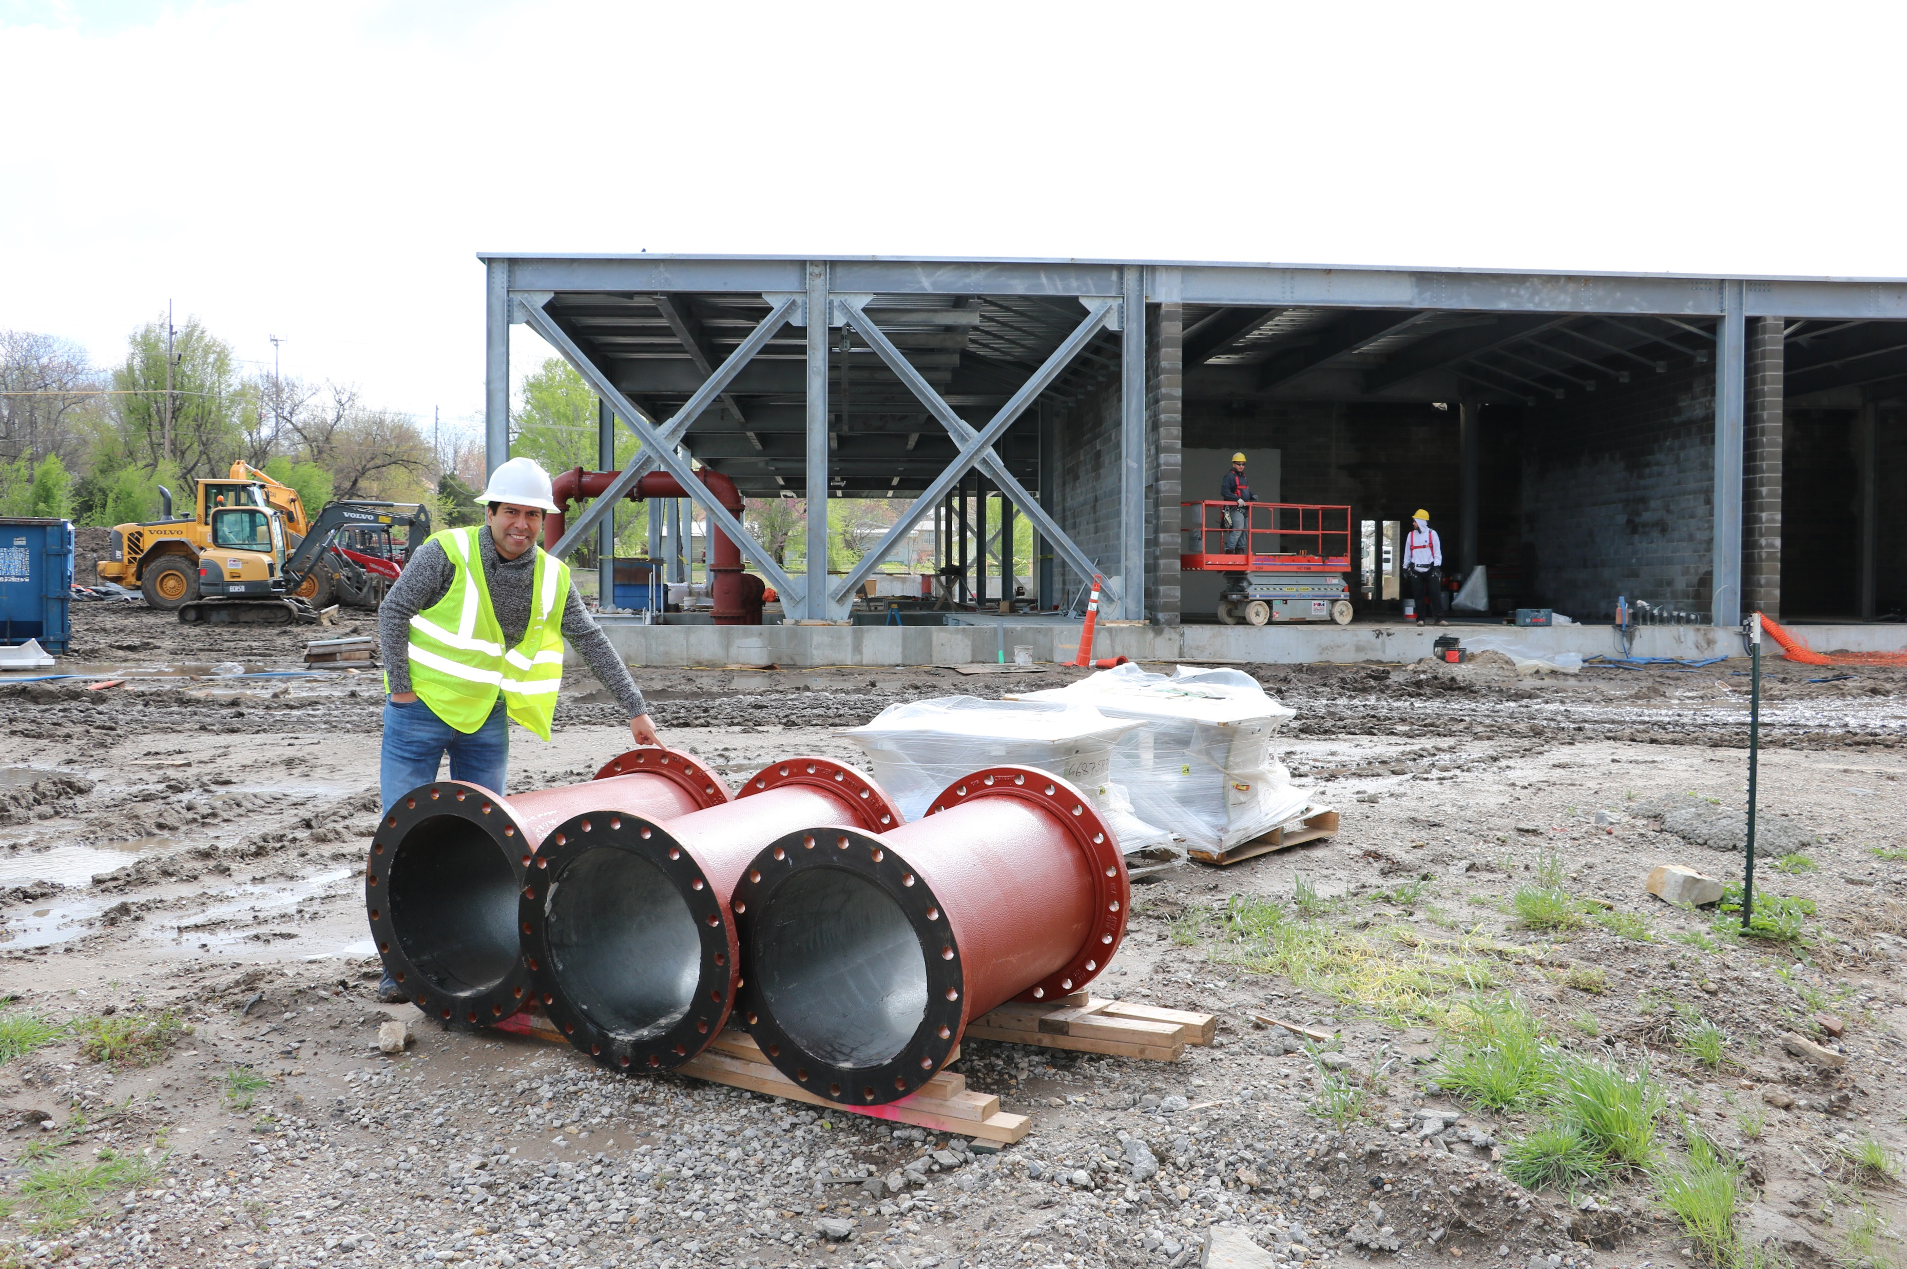
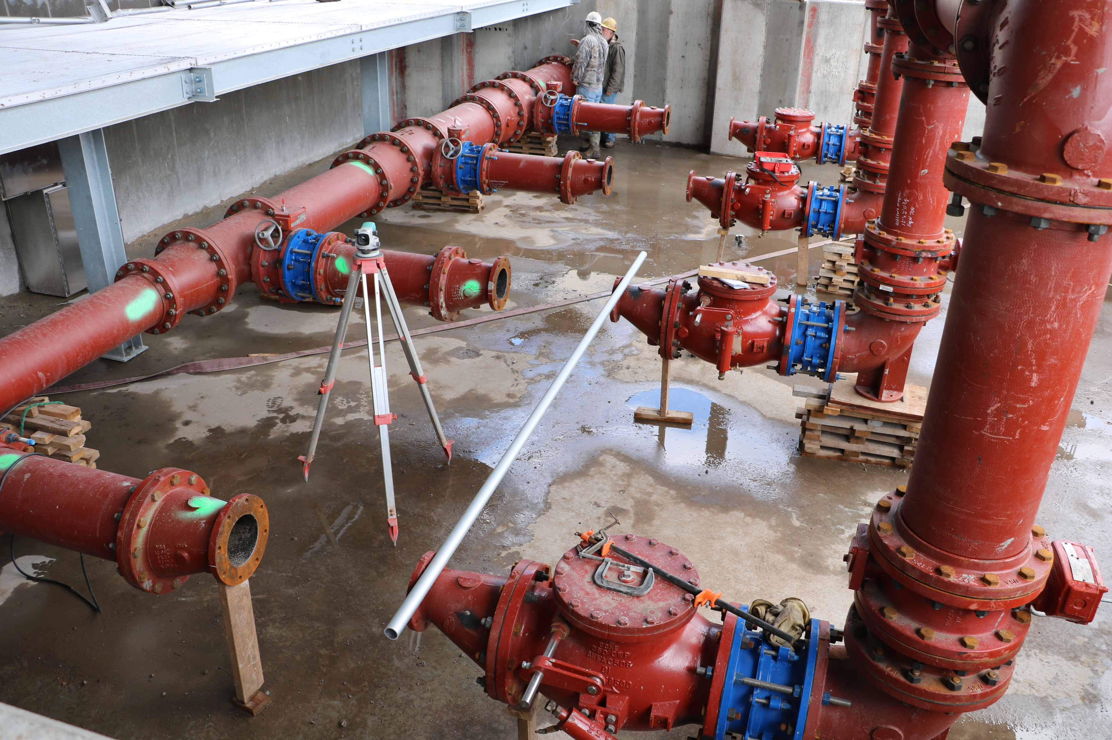
Arkansas City, KS
Notes:
Project: Reverse Osmosis Treatment Plant
Right: High service pumps (finished water).

Slide 4
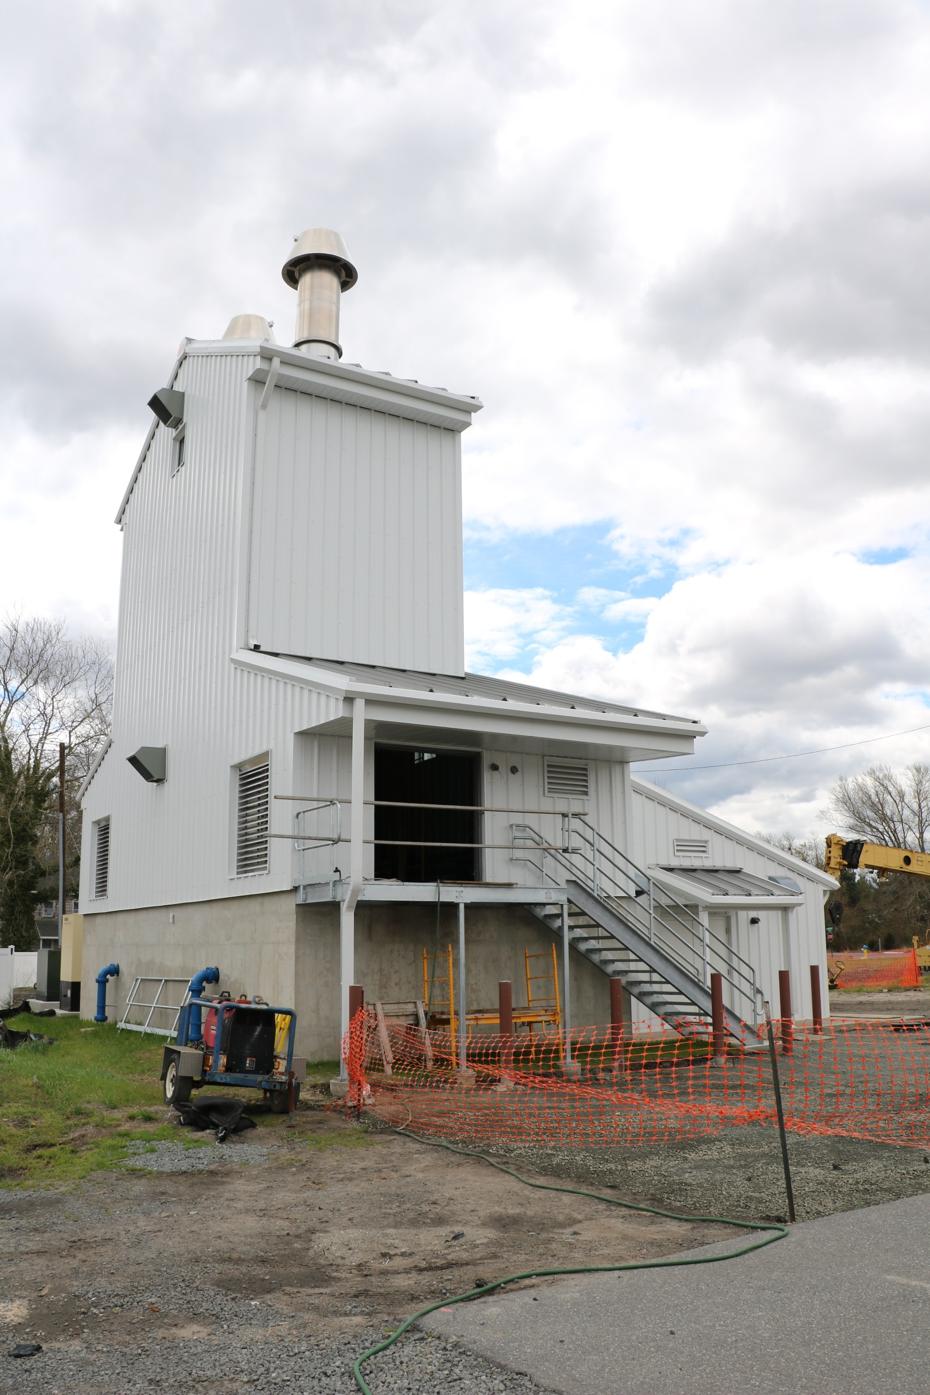
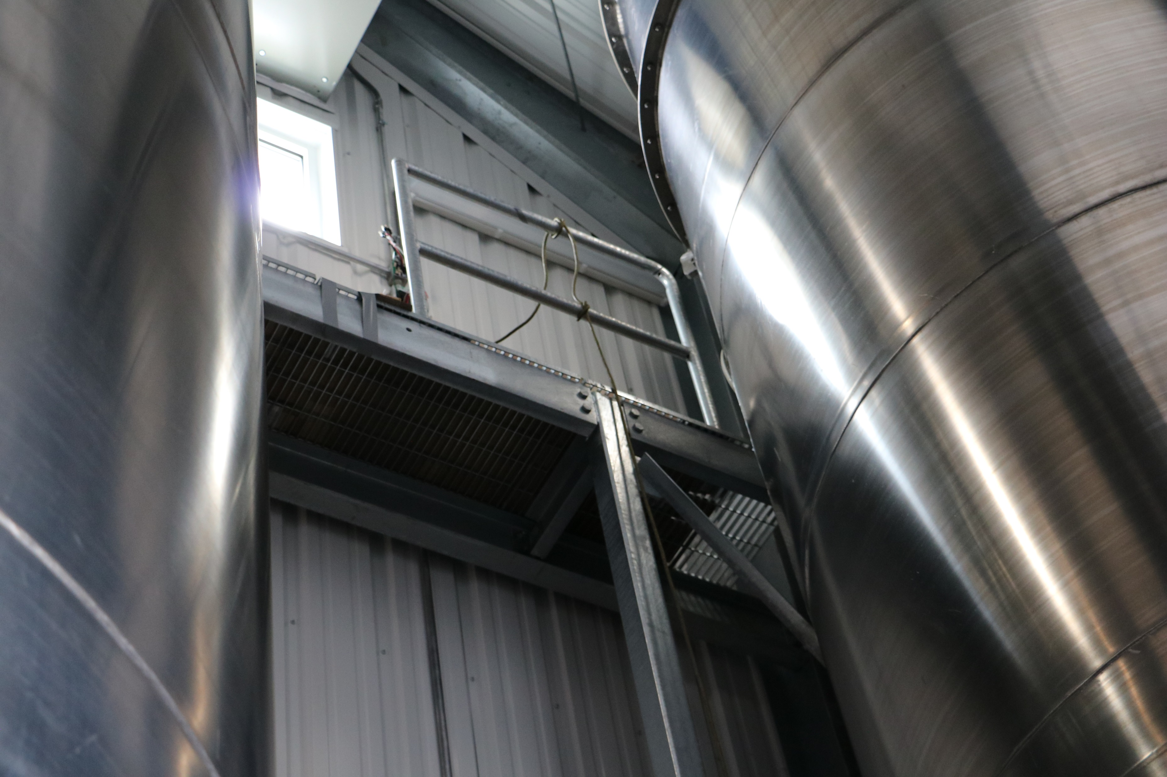
Selbyville, DE
Notes:
Air stripper treatment system Left: New Building for Air Stripper Equipment
Right: Air Stripping Tanks

Slide 5
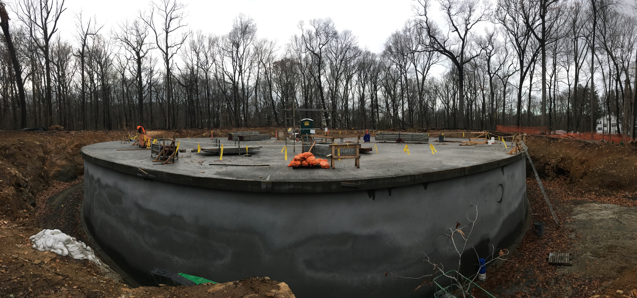
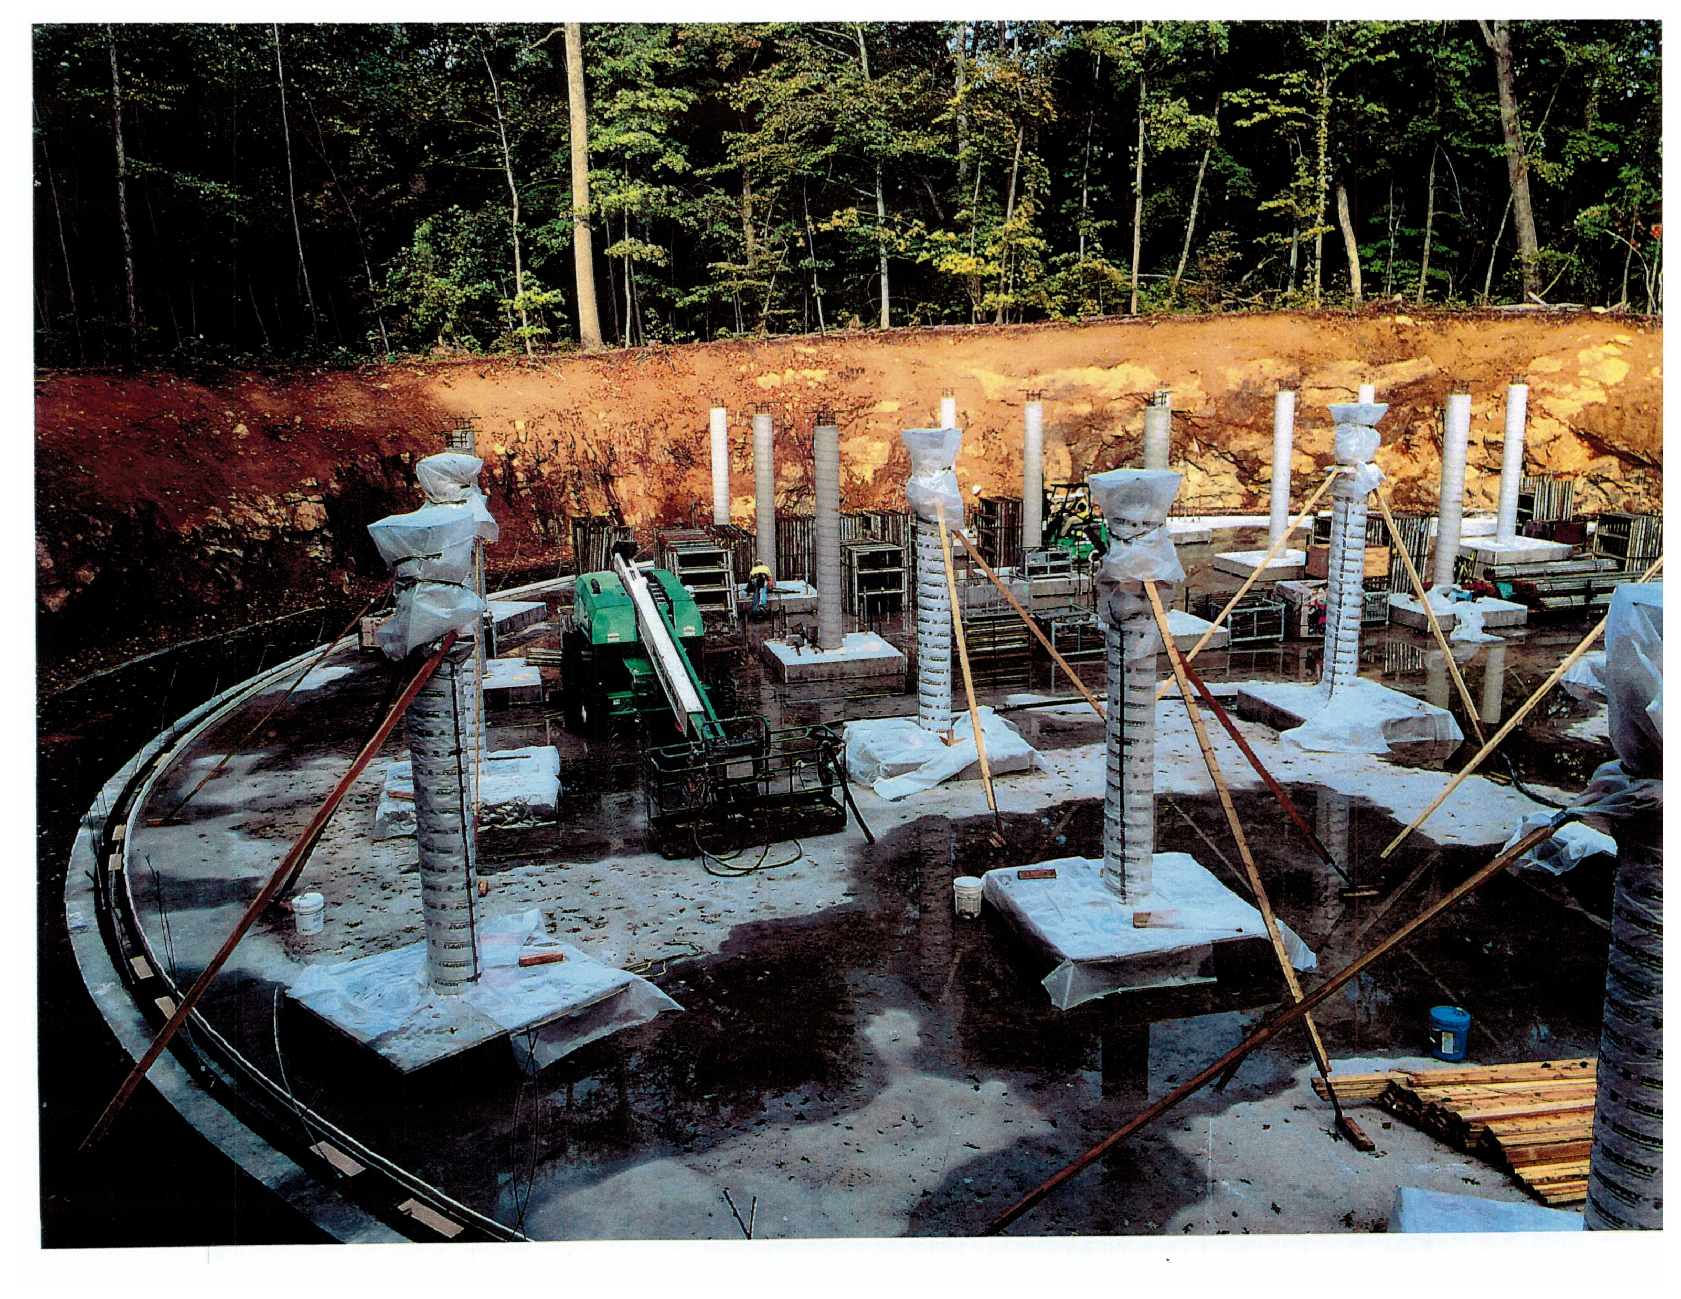
Sleepy Hollow, NY
Notes:
Left: Panoramic Shot of the storage tank
Right: Column Installation

Slide 6
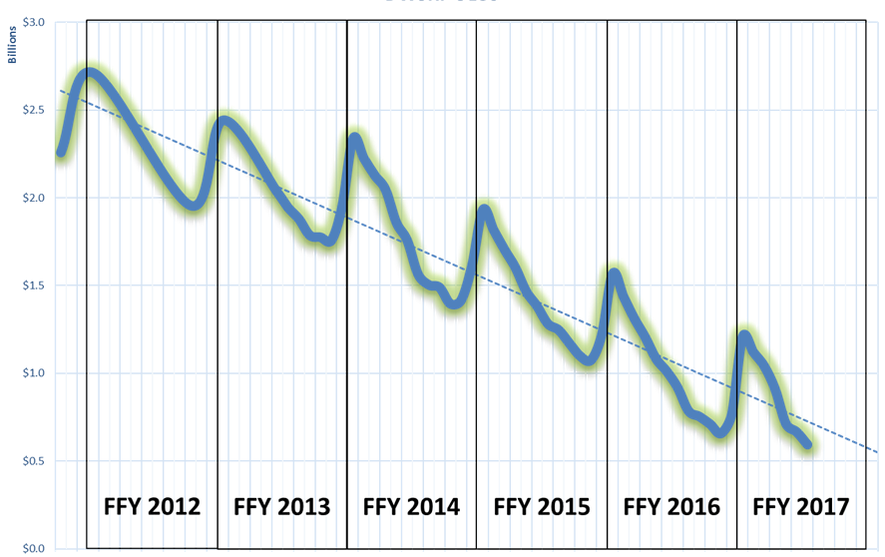
Unliquidated Obligations

Slide 7
Questions?

