Slide 1
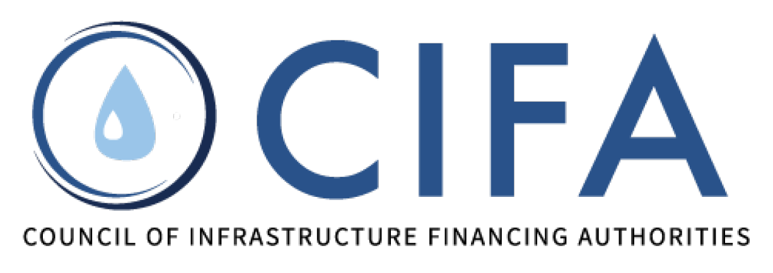
Scaling Up NPS Success: An Exploration of Watershed Financing Partnerships
Don Waye, US EPA Nonpoint Source Program
Jeff Lerner, US EPA Office of Wetlands, Oceans & Watersheds
Alison Souders, US EPA CWSRF Program (Moderator)
Nov. 18, 2024

Slide 2
CWSRF & NPS by the Numbers
$172 B | provided via the 51 CWSRF programs since 1988
$8.8 B | provided by the 51 CWSRF programs in FY23
83% | TMDLs with greater pollutant load allocation to NPS (vs PS)
3.3% | CWSRF funding that has gone toward NPS ($5.7 B since 1988)
2
Notes:
Most of us are likely familiar with the top 2 numbers but may be less familiar with the bottom 2 numbers. The state Clean Water SRFs have provided 172 billion dollars to water quality improvement projects since the beginning of the program in the late 1980s. In fact, last year alone the states provided $8.8 billion dollars for such projects. 83 percent of TMDLs out there identify nonpoint source pollution as the more significant piece to address if we want to clean up our waters, yet just 3.3% of the CWSRF goes toward addressing nonpoint source problems. And of that 3.3% figure, most of that was not effectively targeted to address priority NPS needs; rather, most of it went toward “random acts of BMPs.”

Slide 3
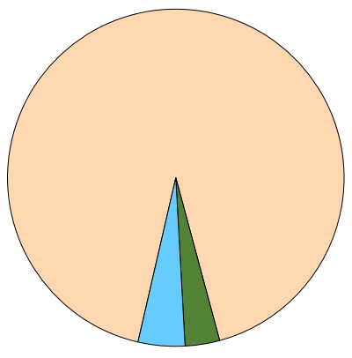
CWSRF Investments through 2023, $ Billions
% of TMDLs by Greater
Pollutant Load Allocation:
Point Sources vs Nonpoint Sources
Nonpoint Sources (83%)
Point Source,
$158.2 (92.2%)
Point Sources (17%)
Stormwater & Other,
$7.7 (4.5%)
Nonpoint Source,
$5.7 (3.3%)
(Source: Nationwide TMDL Analysis, EPA NSMB, 2024)
$171.6 billion provided via the 51 CWSRF programs since 1988
Notes:
If you want to solve water quality problems, the data that guides you is the TMDL data. Where are our water bodies (our rivers, lakes, streams & estuaries) polluted? The TMDL data not only alerts us to which water bodies are polluted, but also what sources we need to focus on. Do the problems come from needing to upgrade our wastewater treatment plants (…point sources…). Or are the sources from farms or timber harvesting or some other kind of polluted runoff (a.k.a., nonpoint sources)? Well, more than 4 out of 5 of TMDLs identify nonpoint sources as the main piece that needs to be addressed. In short, what this shows is that if we just focus on addressing point source needs, we won’t come close to fixing our water quality problems. [click]
By contrast, you can see on the right side that less than 4% of the Clean Water SRF dollars have gone toward addressing nonpoint source needs.

Slide 4
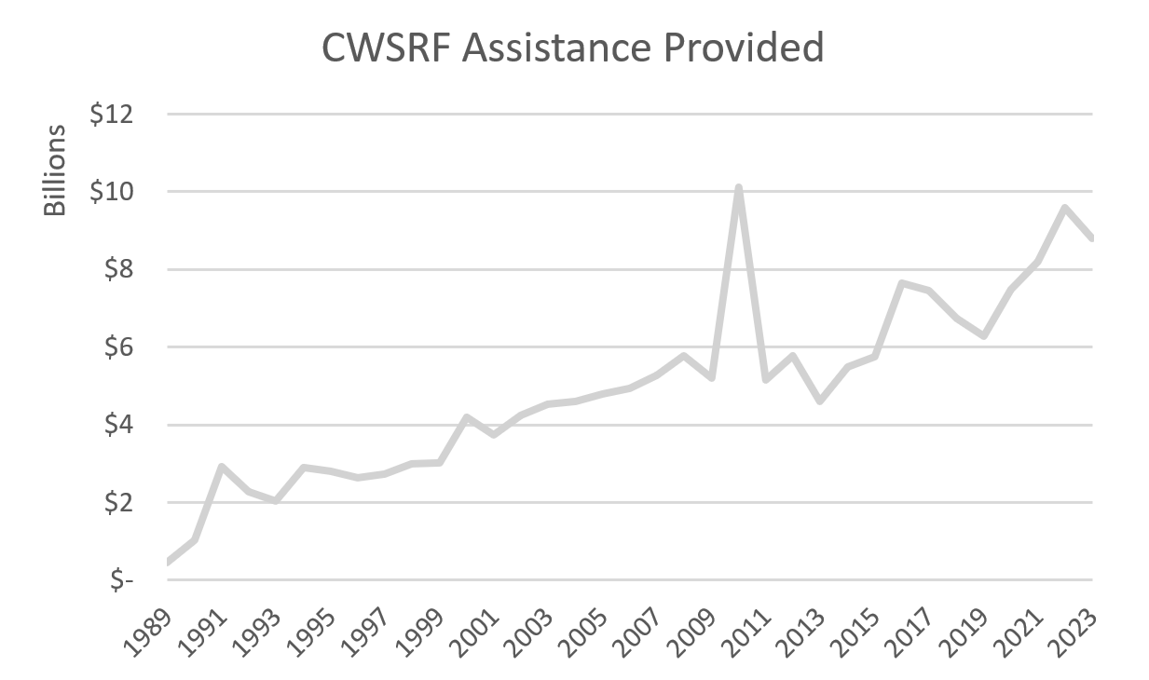
$171.6 billion provided as of FY2023
Notes:
This chart shows how much assistance the CWSRF has provided each year for on-the-ground water quality improvement projects for both point and nonpoint source projects. The cumulative assistance through FY23 is $171.6B. In recent years, CWSRF has provided in the 8-to-10-billion-dollar per year range. The spike in 2010 represents a one-time infusion of 4 billion dollars from the federal government to state CWSRF programs from ARRA, the American Recovery and Reinvestment Act, which was intended to jumpstart the U.S. economy after a bad recession to fund “shovel-ready projects.” If you added up the assistance provided in dollars each year, you would get 171.6 billion dollars.
We hear this excuse a lot: “Our state can’t fund more nonpoint source projects because we’re over-subscribed trying to fill the demand for point source projects.”
My first response is: CWSRF is not a point source entitlement program. It’s to address water quality needs across all the different eligibilities.
My second response is, the amount of money state CWSRFs have available to address water quality needs is on a growth trajectory, so states can address NPS needs without having to take a hit on the point source side. It’s not an either-or proposition.

Slide 5
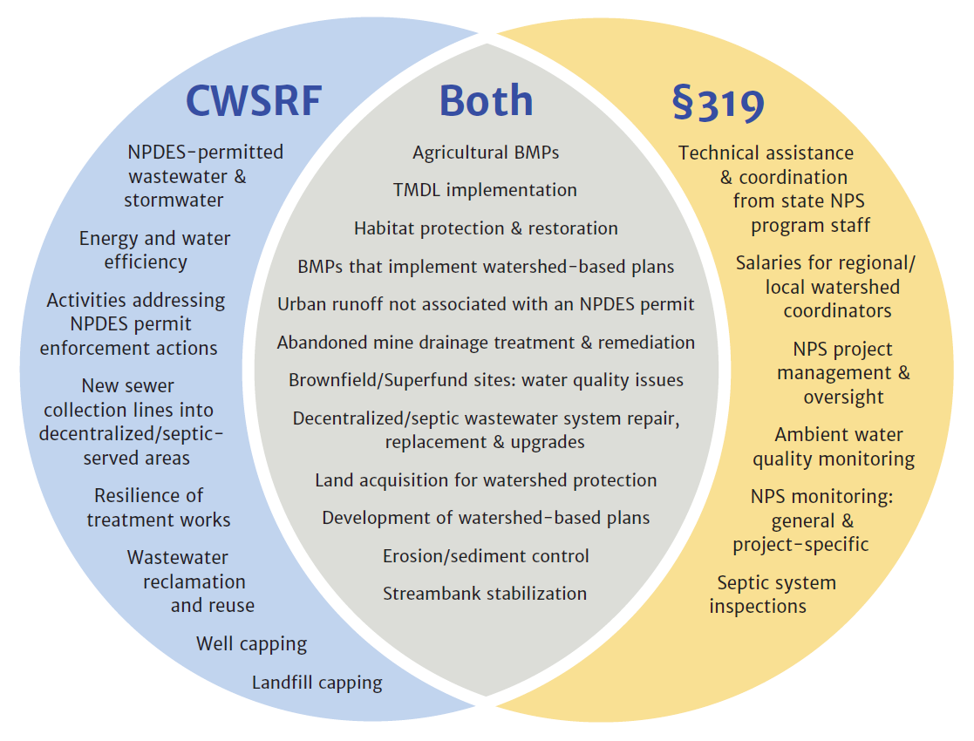
What kinds of things can be funded with the CWSRF and CWA §319?
The federal view…
Examples of eligible uses of CWSRF and §319 funds
Notes:
What kinds of things can be funded with the Clean Water SRF and Section 319? Well, the Venn diagram shows that there are things that 319 grants can pay for that the CWSRF program can’t. Things like nonpoint source program staff positions or monitoring or inspections of septic systems. That’s the gold crescent on the right. And the blue crescent on the left shows that Clean Water SRF can pay for things that 319 cannot, like wastewater treatment plant upgrades. And frankly, that’s where about 90% of what CWSRF has historically funded, but also these days more is going toward green stormwater infrastructure projects to fulfill MS4 permit requirements. But we created the diagram to highlight how 319 and Clean Water SRF can work together to fund NPS work. Like peanut butter and jelly, they go well together. And yes, Clean Water SRF can even be used to pay for developing watershed-based plans because they are essentially capital improvement plans to produce high functioning green infrastructure that restores water quality.

Slide 6
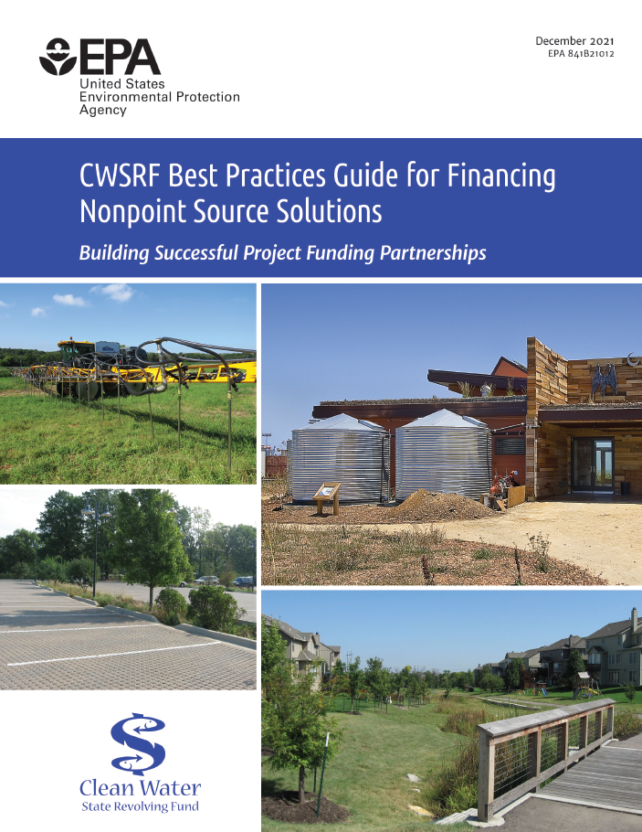
Hello.
I am your friend.
Find me here.
Notes:
And a few years ago, we produced this guide on all the best tricks that the most innovative state CWSRF programs have devised to solve NPS problems. We hope it’s a useful resource as your programs continue to evolve to better address our nation’s biggest water quality challenges.

Slide 7
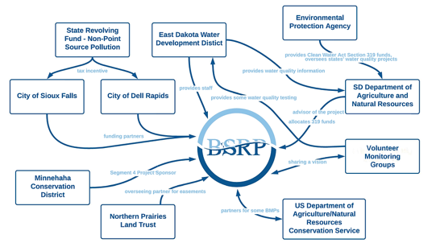
Scale Up NPS Success with Watershed Financing Partnerships
Maximize impacts for watershed restoration and protection
Provide upfront capital
Provide flexibility for practitioners
Today’s State CWSRF Examples
South Dakota - Ag BMPs in the Big Sioux River basin
Iowa - Aquatic Connectivity & Flood Protection
Maine - Watershed Protection
The Big Sioux River Project serves as a hub for watershed restoration
Notes:
EPA is now promoting this new term: Watershed Financing Partnerships. But it’s not a new idea. The idea is to take a watershed-based approach to investments in water quality. Such investments can include stream restoration, dam removals, protection of watershed lands or other green infrastructure investments. SRFs could provide upfront financing and offer flexibilities to bundle projects at a watershed scale. At the center is a coordinating entity that could play the role of a broker, intermediary or assistance provider. They might line up projects, move funds to projects or execute projects themselves. We are starting to see some early examples, but we want to see them develop in more watersheds to help with large transformational initiatives. The idea here is to expand innovation, funding and impact. Characteristics of WFPs include:
1) A water quality outcomes-based approach. Think optimizing dollars per pound of pollution removed …or prevented, in the case of watershed protection
2) Serving as a hub to aggregate and stack different funding sources to implement NPS projects across a watershed (or multiple watersheds). Andy Bruels is going to talk about how they are working with various partners to support the Big Sioux River Project. In the graphic in the lower right, the Big Sioux River Project is an organizing construct that serves as a hub for watershed restoration through written agreements with an array of partners all working together. As of 2023, BSRP has protected nearly 100 miles of river and streams by preventing nitrogen, phosphorus, and sediment from entering the river each year by implementing agricultural BMPs. As a direct result of BSRP and its partners’ efforts, Skunk Creek, a 60-mile major tributary of the Sioux River, was removed from the impaired streams list for sediment in 2016, and I understand there’s more on the way.

Slide 8
Emphasis on Leveraging with CWSRF in Updated CWA § 319 Guidelines
Section 2.6 - Leverage Innovative Financing for NPS Solutions
EPA continues to encourage states to explore collaboration between their… CWSRF programs and NPSMPs to expand the use of CWSRF financing to address priority NPS needs. These guidelines provide new incentives for investments in CWSRF watershed financing partnerships.
Section 6.3.3 Coordinating a Watershed Financing Partnership
To incentivize greater use of CWSRF to support the implementation of WBPs, funding to create or support watershed financing partnerships is an eligible use of watershed project funds, so long as there is a reasonable expectation that any such partnership will begin to implement a WBP or EPA-approved alternative within three years of the use of the Section 319 grant funds.
Notes:
Watershed Financing Partnerships are typically local implementers who are working to carry out multiple projects simultaneously on a watershed scale by leveraging Clean Water Act Section 319 funds with Clean Water State Revolving Funds and other financial resources, including potentially even public-private partnerships. EPA just updated its Section 319 grant guidelines to help incentivize such partnerships. These grant dollars can be used to build capacity in nascent watershed financing partnerships, which can then work to secure the additional capital needed to scale up success.

Slide 9
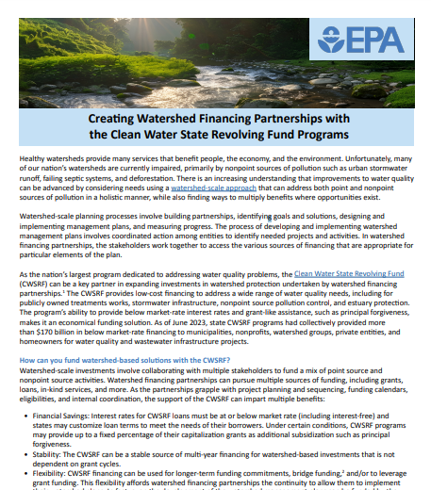
New
Fact Sheet
Download
me here
Notes:
EPA just released a new fact sheet on Watershed Financing Partnerships. Page 3 highlights a real-world example from South Dakota that I was just telling you about: the Big Sioux River Project. And Andy Bruels is going to explain the important role that his CWSRF program has been playing in that success.

Slide 10
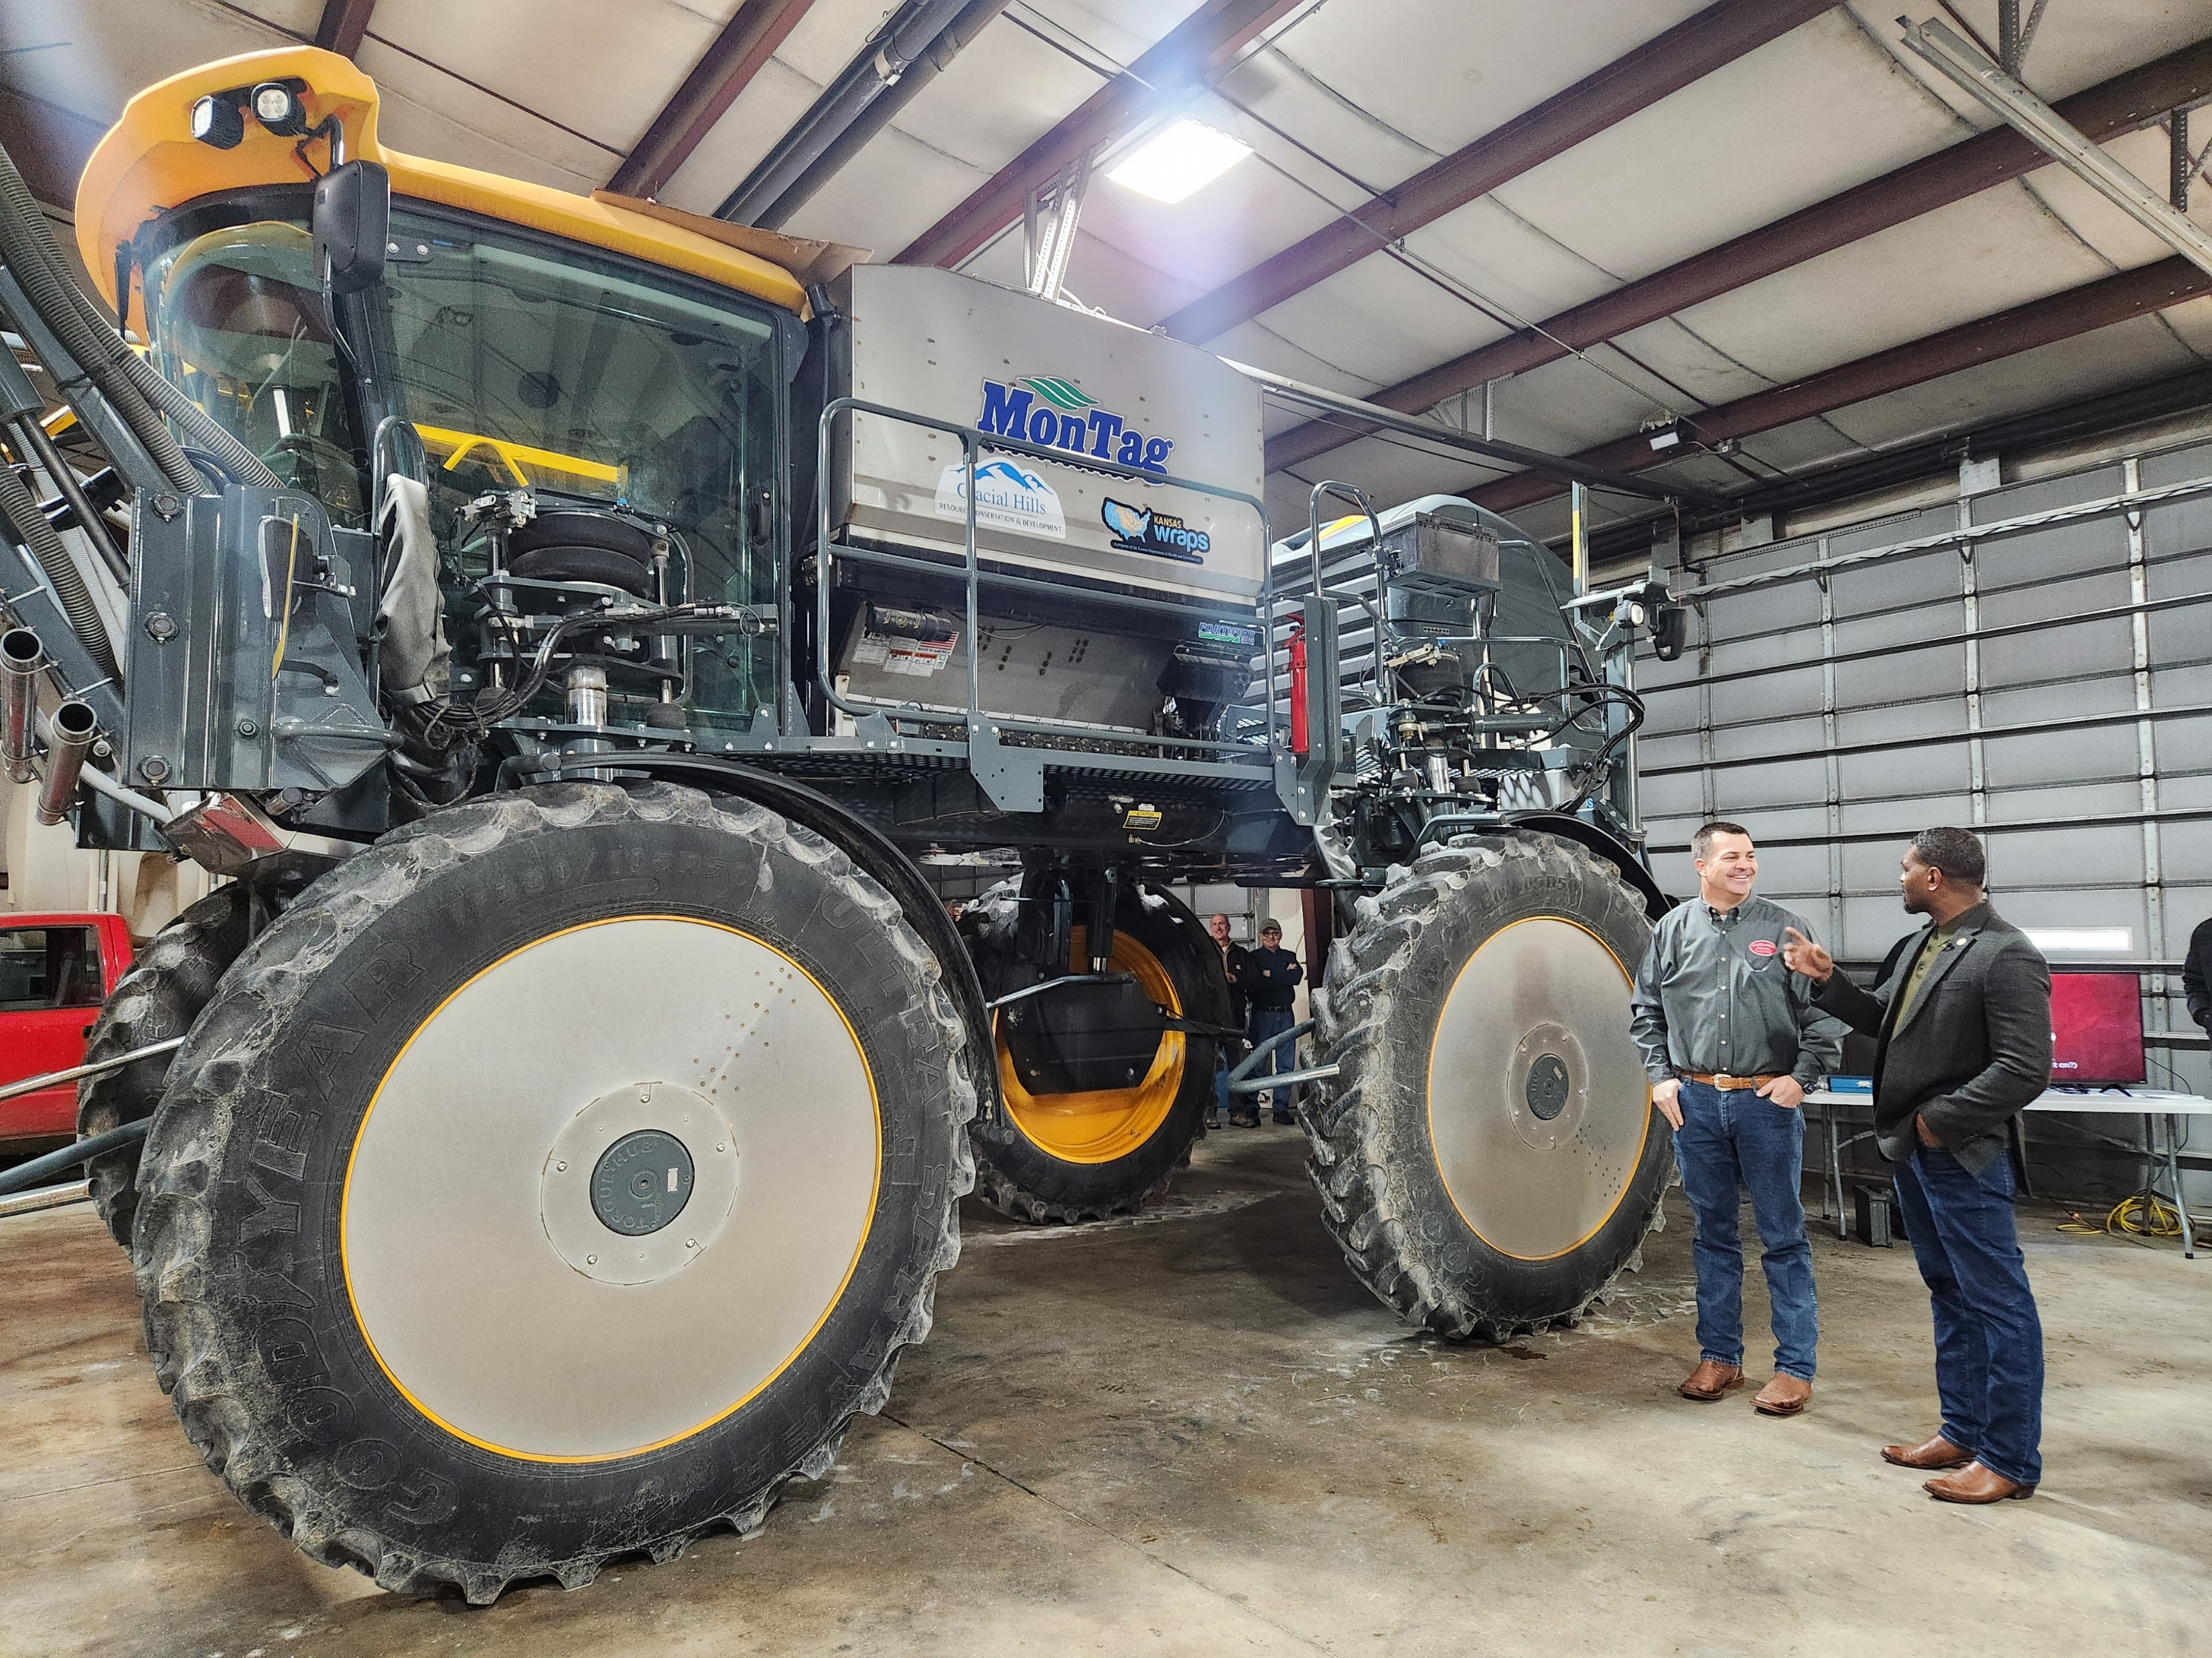
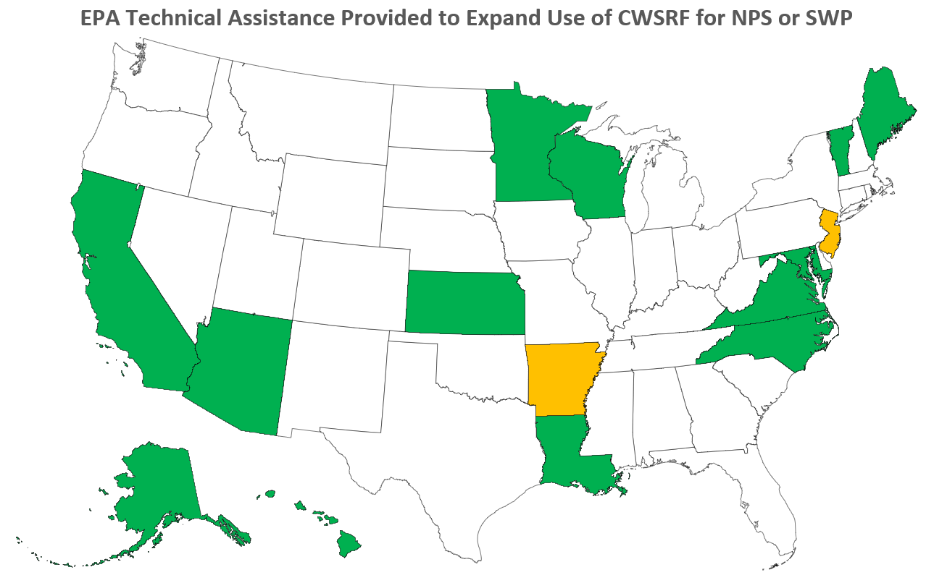
SRF for NPS Assistance Opportunities
2017 - first EPA-funded NPS-SRF assistance pilot
To date we have helped SRFs in 13 states and have just started 2 more (not BIL funded)
Notes:
Starting in 2017, EPA has been working directly with state SRF programs to figure out how individual state CWSRF programs can be better used to address priority nonpoint source needs. And we’ve been helping a couple of states each year. And now we’re up to 15 states now. A few have led to PISCES awards, like the Kansas cover crop agricultural assistance. Here in the photo the local implementer is showing off the new equipment purchased with state CWSRF money to the EPA administrator.

Slide 11
Discussion Questions
Do you know what your state’s biggest current NPS challenges are?
How does your CWSRF program work to help meet state’s biggest current NPS challenges ?
How regularly are your state’s CWSRF program staff meeting with your state’s NPS program counterparts? What are some ways that you coordinate project funding with your state’s NPS program?
How might your state create opportunities for these programs to meet more regularly to address those challenges?
What are some next steps to consider taking on NPS program priorities in priority watersheds?

