Slide 1
Co-Funding in Montana
Rural Development &
Revolving Fund Loan Program
Anna Miller
Fall 2017

Slide 2
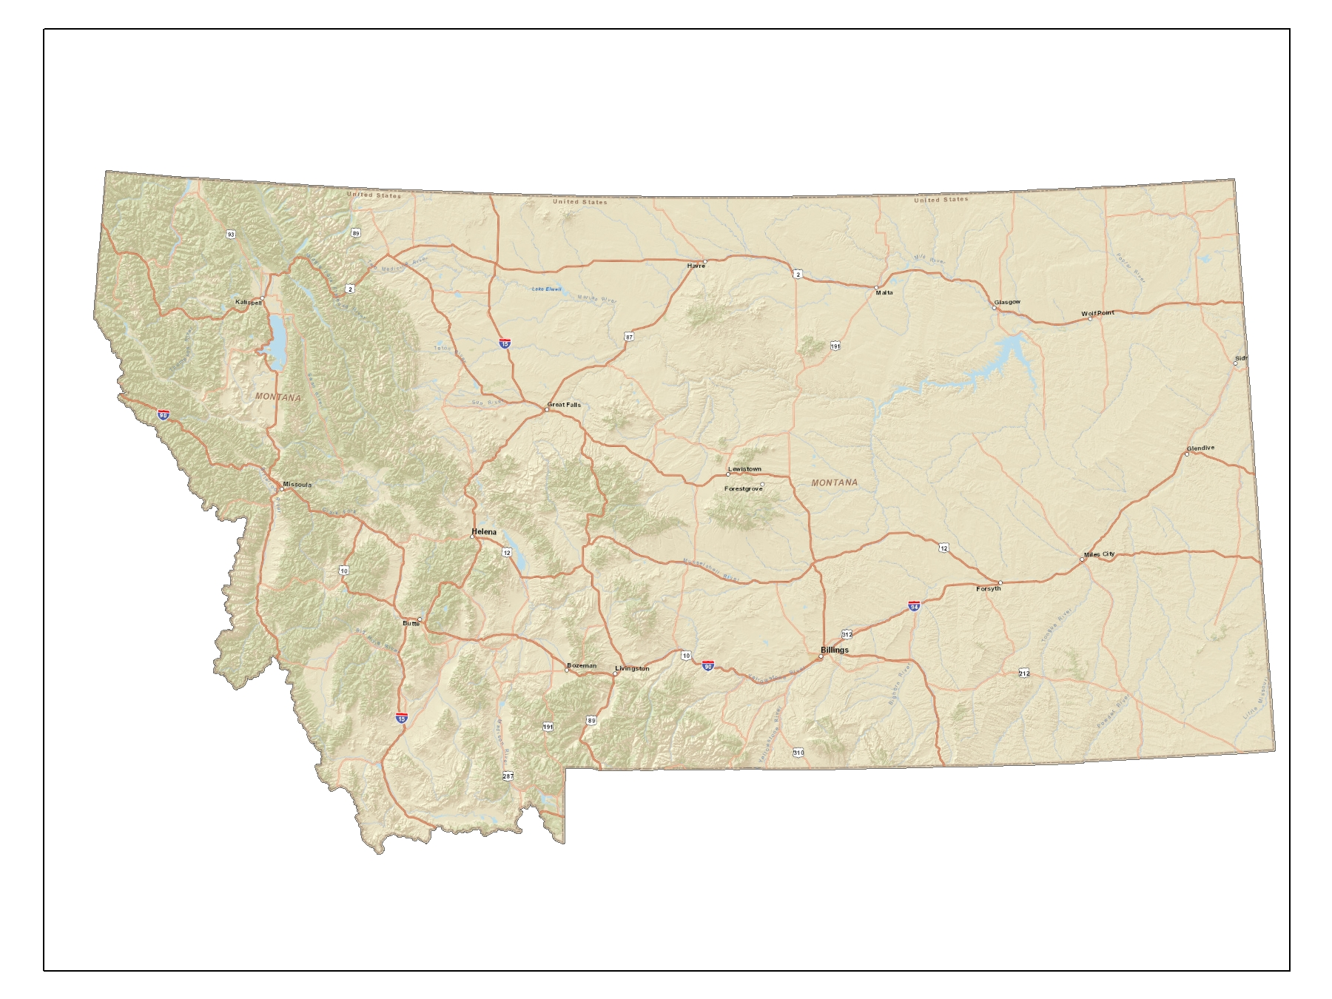
Montana

Slide 3
Montana’s Geography
650 Miles East to West
250 Miles North to South
Area is 150,000 square miles
Elevation is 2,000 to 13,000 MSL
Population is 1,025,000
7 people per square mile
1% is covered by surface water

Slide 4
Water Systems in Montana
Population Population
Per System # of Systems Overall
< 500 1,896 213,338
< 1500 165 128,255
< 3200 61 122,764
< 10000 31 168,842
< 25000 4 66,208
< 50000 3 96,005
< 100000 2 116,335
<=1000000 1 114,000
2,163 1,025,747

Slide 5
Coordination
The synchronization and integration of activities, responsibilities, and command and control structures to ensure that the resources of an organization are used most efficiently in pursuit of the specified objectives. The key functions of management include organization, monitoring, controlling and coordination.

Slide 6
W2ASACT
Water,
Wastewater and
Solid Waste
Action Coordinating Team

Slide 7
W2ASACT
In 1982, a group of professionals from state, federal and non-profit organizations that finance, regulate, or provide technical assistance for community water and wastewater systems, decided to start meeting to coordinate and enhance their efforts. W2ASACT meets several times a year to find ways to improve our state's environmental infrastructure.

Slide 8
W2ASACT
30+ years of coordinating infrastructure needs. Networking among stakeholders to benefit utility development.
NOT a funding source
Is a forum to work together and assist communities with project needs.

Slide 9
W2ASACT TOOLS
Uniform Application
Uniform Preliminary Engineering Report
Uniform funds tracking
Uniform invoice tracking
Workshops
Web site
http://dnrc.mt.gov/divisions/cardd/wasact

Slide 10
Choteau, Montana
Photo from onlyinourstate.com

Slide 11
Funded Projects
City of Choteau WWTP
Applicant $ 148,000
Treasure State Endowment Program $ 750,000
Renewable Resource Grant $ 100,000
SRF Loan $ 2,974,000
SRF Loan Forgiveness $ 646,000
RD Loan $ 3,860,000
RD Grant $ 1,625,000
TOTAL $10,057,000

Slide 12
Funded Projects
City of Choteau WWTP
If funded just by SRF Loan = $8,459,000
On 30 yrs/2.5% = $404,172/year (est.)
$56.30/edu/month
As funded RD/SRF = $288,589/year –
$44.00/edu/month
$115,582/yr savings in 30 yrs = $3,467,460
Savings of $8.30/edu/month in rate

Slide 13
Bozeman, Montana
Photo from Montana.edu

Slide 14
Funded Projects
Four Corners Water and Wastewater District
Applicant $ 81,000
SRF Loan $ 9,300,000
Coal Tax Fund Loan $ 3,060,000
RD Loan $ 3,940,000
RD Loan $ 6,700,000
TOTAL $23,081,000
RD funded awarded project in 28 calendar days because of the coordination and communication.
Obligated 9/25/2015 closed on 12/23/2015.

Slide 15
Uniform Status of Funds – Dawson County
UNIFORM STATUS OF FUNDS SPREADSHEET FOR: Dawson County DATE: |  |  |  |  |  |  |  |  |  |  |  |  |  |  |  |  | 10/26/2017
 | Funding Source: State Revolving Fund (SRF) |  |  |  | Funding Source: SRF Loan Forgiveness |  |  |  | Funding Source: TSEP |  |  |  | Funding Source: RRGL |  |  |  | Total Budget
ADMINISTRATIVE/ FINANCIAL COSTS: | Budgeted | Previously Expended | Amount of Draw | Balance Remaining | Budgeted | Previously Expended | Amount of Draw | Balance Remaining | Budgeted | Previously Expended | Amount of Draw | Balance Remaining | Budgeted | Previously Expended | Amount of Draw | Balance Remaining | Budgeted | Expended | Balance
Personnel Costs |  |  |  | $0.00 |  |  |  | $0.00 |  |  |  | $0.00 |  |  |  | $0.00 | $0.00 | $0.00 | $0.00
Office Costs |  |  |  | $0.00 |  |  |  | $0.00 |  |  |  | $0.00 |  |  |  | $0.00 | $0.00 | $0.00 | $0.00
Professional Services |  |  |  | $0.00 |  |  |  | $0.00 |  |  |  | $0.00 |  |  |  | $0.00 | $0.00 | $0.00 | $0.00
Legal Costs | $12,400.00 | $5,053.00 |  | $7,347.00 | $100.00 | $100.00 |  | $0.00 |  |  |  | $0.00 |  |  |  | $0.00 | $12,400.00 | $5,053.00 | $7,347.00
Audit Fees | $10,000.00 |  |  | $10,000.00 |  |  |  | $0.00 |  |  |  | $0.00 |  |  |  | $0.00 | $10,000.00 | $0.00 | $10,000.00
Travel & Training |  |  |  | $0.00 |  |  |  | $0.00 |  |  |  | $0.00 |  |  |  | $0.00 | $0.00 | $0.00 | $0.00
Loan Fees |  |  |  | $0.00 |  |  |  | $0.00 |  |  |  | $0.00 |  |  |  | $0.00 | $0.00 | $0.00 | $0.00
Loan Reserves | $171,888.00 |  |  | $171,888.00 |  |  |  | $0.00 |  |  |  | $0.00 |  |  |  | $0.00 | $171,888.00 | $0.00 | $171,888.00
Interim Interest |  |  |  | $0.00 |  |  |  | $0.00 |  |  |  | $0.00 |  |  |  | $0.00 | $0.00 | $0.00 | $0.00
Bond Cost | $12,000.00 |  |  | $12,000.00 |  |  |  | $0.00 |  |  |  | $0.00 |  |  |  | $0.00 | $12,000.00 | $0.00 | $12,000.00
 |  |  |  | $0.00 |  |  |  | $0.00 |  |  |  | $0.00 |  |  |  | $0.00 | $0.00 | $0.00 | $0.00
 |  |  |  | $0.00 |  |  |  | $0.00 |  |  |  | $0.00 |  |  |  | $0.00 | $0.00 | $0.00 | $0.00
 |  |  |  | $0.00 |  |  |  | $0.00 |  |  |  | $0.00 |  |  |  | $0.00 | $0.00 | $0.00 | $0.00
 |  |  |  | $0.00 |  |  |  | $0.00 |  |  |  | $0.00 |  |  |  | $0.00 | $0.00 | $0.00 | $0.00
 |  |  |  | $0.00 |  |  |  | $0.00 |  |  |  | $0.00 |  |  |  | $0.00 | $0.00 | $0.00 | $0.00
 |  |  |  | $0.00 |  |  |  | $0.00 |  |  |  | $0.00 |  |  |  | $0.00 | $0.00 | $0.00 | $0.00
 |  |  |  | $0.00 |  |  |  | $0.00 |  |  |  | $0.00 |  |  |  | $0.00 | $0.00 | $0.00 | $0.00
Total Administrative Costs | $206,288.00 | $5,053.00 | $0.00 | $201,235.00 | $100.00 | $100.00 | $0.00 | $0.00 | $0.00 | $0.00 | $0.00 | $0.00 | $0.00 | $0.00 | $0.00 | $0.00 | $206,288.00 | $5,053.00 | $201,235.00
ACTIVITY COSTS:
Land Acquisition/ROW/Addl Services | $67,000.00 | $43,920.89 |  | $23,079.11 |  |  |  | $0.00 |  |  |  | $0.00 |  |  |  | $0.00 | $67,000.00 | $43,920.89 | $23,079.11
Preliminary Design | $141,000.00 | $44,745.56 |  | $96,254.44 |  |  |  | $0.00 |  |  |  | $0.00 | $95,000.00 | $95,000.00 |  | $0.00 | $236,000.00 | $139,745.56 | $96,254.44
Final Design/Bidding | $72,000.00 | $45,989.37 |  | $26,010.63 |  |  |  | $0.00 |  |  |  | $0.00 |  |  |  | $0.00 | $72,000.00 | $45,989.37 | $26,010.63
Construction Engineering | $319,190.00 | $92,595.00 |  | $226,595.00 |  |  |  | $0.00 |  |  |  | $0.00 |  |  |  | $0.00 | $319,190.00 | $92,595.00 | $226,595.00
Construction | $849,440.00 |  |  | $849,440.00 | $399,900.00 |  | $399,900.00 | $0.00 | $707,740.00 |  | $131,175.65 | $576,564.35 | $5,000.00 |  |  | $5,000.00 | $1,962,080.00 | $131,175.65 | $1,962,180.00
 |  |  |  | $0.00 |  |  |  | $0.00 |  |  |  | $0.00 |  |  |  | $0.00 | $0.00 | $0.00 | $0.00
Construction Alternate | $563,250.00 |  |  | $563,250.00 |  |  |  | $0.00 |  |  |  | $0.00 |  |  |  | $0.00 | $563,250.00 | $0.00 | $563,250.00
Paving | $216,000.00 |  |  | $216,000.00 |  |  |  | $0.00 |  |  |  | $0.00 |  |  |  | $0.00 | $216,000.00 | $0.00 | $216,000.00
 |  |  |  | $0.00 |  |  |  | $0.00 |  |  |  | $0.00 |  |  |  | $0.00 | $0.00 | $0.00 | $0.00
Contingency | $246,732.00 |  |  | $246,732.00 |  |  |  | $0.00 | $42,260.00 |  |  | $42,260.00 |  |  |  | $0.00 | $288,992.00 | $0.00 | $288,992.00
Total Activity Costs | $2,474,612.00 | $227,250.82 | $0.00 | $2,247,361.18 | $399,900.00 | $0.00 | $399,900.00 | $0.00 | $750,000.00 | $0.00 | $131,175.65 | $618,824.35 | $100,000.00 | $95,000.00 | $0.00 | $5,000.00 | $3,724,512.00 | $853,326.47 | $2,871,185.53
TOTAL PROJECT COSTS | $2,680,900.00 | $232,303.82 | $0.00 | $2,448,596.18 | $400,000.00 | $100.00 | $399,900.00 | $0.00 | $750,000.00 | $0.00 | $131,175.65 | $618,824.35 | $100,000.00 | $95,000.00 | $0.00 | $5,000.00 | $3,930,800.00 | $858,379.47 | $3,072,420.53
*SRF Draw is pending loan approval-County is paying with anticipation of reimbursement
*Land Acquisition includes engineering plus possible cost to acquire easements

Slide 16
Uniform Invoice Tracking – Dawson County Sewer
UNIFORM INVOICE TRACKING SPREADSHEET FOR: DATE: |  |  | Dawson County Sewer |  |  |  |  |  |  | DATE: |  | 10/26/2017
Vendor's Name | Invoice or Pay Estimate Number | Invoice Date or Time Period Covered | Total Amount of Invoice | Warrant Number | Date Paid |  |  |  |  |  |  | Funding Source, Amount Expended, Drawdown Number |  |  |  | Total Amount Paid This Invoice
 |  |  |  |  |  | Funding Source: |  |  |  | Funding Source: |  | Funding Source:
 |  |  |  |  |  | SRF Loan B | # | SRF Loan A | # | TSEP | # | RRGL
Great West Engineering | 12851 | 10/28/14 | $1,175.00 | 85551 | 10/30/14 | $0.00 |  | $0.00 |  | $0.00 |  | $1,175.00 |  |  |  | $1,175.00
Great West Engineering | 12662 | 09/24/14 | $8,803.29 | 85551 | 10/30/14 | $0.00 |  | $0.00 |  | $0.00 |  | $8,803.29 |  |  |  | $8,803.29
Great West Engineering | 12966 | 11/24/14 | $7,485.50 | 85748 | 12/03/14 | $0.00 |  | $0.00 |  | $0.00 |  | $7,485.50 |  |  |  | $7,485.50
Great West Engineering | 13110 | 01/20/15 | $6,167.00 | 86160 | 01/29/15 | $0.00 |  | $0.00 |  | $0.00 |  | $6,167.00 |  |  |  | $6,167.00
Great West Engineering | 13067 | 01/05/15 | $12,181.25 | 86160 | 01/29/15 | $0.00 |  | $0.00 |  | $0.00 |  | $12,181.25 |  |  |  | $12,181.25
Great West Engineering | 13283 | 03/02/15 | $3,641.00 | 86586 | 03/31/15 | $0.00 |  | $0.00 |  | $0.00 |  | $3,641.00 |  |  |  | $3,641.00
Great West Engineering | 13308 | 03/24/15 | $4,459.00 | 86794 | 04/30/15 | $4,459.00 |  | $0.00 |  | $0.00 |  | $0.00 |  |  |  | $4,459.00
Great West Engineering | 13444 | 04/23/15 | $11,944.51 | 86794 | 04/30/15 | $4,087.00 |  | $0.00 |  | $0.00 |  | $7,857.51 |  |  |  | $11,944.51
Great West Engineering | 13562 | 05/21/15 | $25,623.99 | 87242 | 07/01/15 | $1,460.00 |  | $0.00 |  | $0.00 |  | $24,163.99 |  |  |  | $25,623.99
Great West Engineering | 13667 | 06/29/15 | $31,474.30 | 87390 | 07/07/15 | $7,948.84 |  | $0.00 |  | $0.00 |  | $23,525.46 |  |  |  | $31,474.30
Great West Engineering | 13946 | 08/21/15 | $27,765.35 | 87748 | 08/31/15 | $27,765.35 |  | $0.00 |  | $0.00 |  | $0.00 |  |  |  | $27,765.35
Great West Engineering | 14049 | 09/29/15 | $21,712.90 | 88165 | 09/30/15 | $21,712.90 |  | $0.00 |  | $0.00 |  | $0.00 |  |  |  | $21,712.90
Great West Engineering | 14154 | 10/22/15 | $21,433.50 | 88477 | 11/30/15 | $21,433.50 |  | $0.00 |  | $0.00 |  | $0.00 |  |  |  | $21,433.50
Great West Engineering | 14284 | 11/25/15 | $33,281.81 | 88607 | 11/30/15 | $33,281.81 |  | $0.00 |  | $0.00 |  | $0.00 |  |  |  | $33,281.81
Great West Engineering | 15675 | 12/31/16 | $3,136.80 |  |  | $3,136.80 |  | $0.00 |  | $0.00 |  | $0.00 |  |  |  | $3,136.80
Great West Engineering | 15585 | 11/10/16 | $3,592.75 |  |  | $3,592.75 |  | $0.00 |  | $0.00 |  | $0.00 |  |  |  | $3,592.75
Crowley Fleck Attorney | 801310 | 07/31/16 | $136.00 |  |  | $136.00 |  | $0.00 |  | $0.00 |  | $0.00 |  |  |  | $136.00
Crowley Fleck Attorney | 803570 | 08/31/16 | $68.00 |  |  | $68.00 |  | $0.00 |  | $0.00 |  | $0.00 |  |  |  | $68.00
Crowley Fleck Attorney | 805425 | 09/30/16 | $34.00 |  |  | $34.00 |  | $0.00 |  | $0.00 |  | $0.00 |  |  |  | $34.00
Great West Engineering | 15785 | 01/23/17 | $4,125.62 |  |  | $4,125.62 |  | $0.00 |  | $0.00 |  | $0.00 |  |  |  | $4,125.62
Great West Engineering | 15898 | 02/21/17 | $2,423.25 |  |  | $2,423.25 |  | $0.00 |  | $0.00 |  | $0.00 |  |  |  | $2,423.25
Great West Engineering | 16032 | 03/22/17 | $17,497.68 |  |  | $17,497.68 |  | $0.00 |  | $0.00 |  | $0.00 |  |  |  | $17,497.68
Great West Engineering | 16145 | 04/17/17 | $6,679.94 |  |  | $6,679.94 |  | $0.00 |  | $0.00 |  | $0.00 |  |  |  | $6,679.94
Great West Engineering | 16325 | 05/25/17 | $17,761.25 |  |  | $17,761.25 |  | $0.00 |  | $0.00 |  | $0.00 |  |  |  | $17,761.25
Great West Engineering | 16372 | 06/20/17 | $49,885.13 |  |  | $49,885.13 |  | $0.00 |  | $0.00 |  | $0.00 |  |  |  | $49,885.13
Crowley Fleck Attorney | 815745 | 02/23/17 | $4,915.00 |  |  | $4,815.00 |  | $100.00 |  | $0.00 |  | $0.00 |  |  |  | $4,915.00
COP Construction | 1 | 07/18/17 | $531,075.65 |  |  | $0.00 |  | $399,900.00 |  | $131,175.65 |  | $0.00 |  |  |  | $531,075.65
 |  |  | $0.00 |  |  | $0.00 |  | $0.00 |  | $0.00 |  | $0.00 |  |  |  | $0.00
 |  |  | $0.00 |  |  | $0.00 |  | $0.00 |  | $0.00 |  | $0.00 |  |  |  | $0.00
 |  |  | $0.00 |  |  | $0.00 |  | $0.00 |  | $0.00 |  | $0.00 |  |  |  | $0.00
 |  |  | $0.00 |  |  | $0.00 |  | $0.00 |  | $0.00 |  | $0.00 |  |  |  | $0.00
 |  |  | $0.00 |  |  | $0.00 |  | $0.00 |  | $0.00 |  | $0.00 |  |  |  | $0.00
Copy and submit to the applicable funding agency with each drawdown request. |  | TOTALS | $858,479.47 |  |  | $232,303.82 |  | $400,000.00 |  | $131,175.65 |  | $95,000.00 |  |  |  | $858,479.47

Slide 17
Summary of Co Funding Goals
By working together, we can get more done.
Combine resources to fund expensive projects.
Solve enforcement problems.
Work with technical providers to help provide support for the communities.

Slide 18
Community Benefit
Provide Health and Safety for communities
Working to better the environment
Economic Benefits – Jobs
Solve problems

Slide 19
Wastewater Systems State Revolving Loan Fund Projects Closed FY 2016
PROJECT NAME | COUNTY | TOTAL PROJECT COST | RRGL STATE GRANT | TSEP STATE GRANT | SRF FORGIVEN | LOAN REGULAR SRF | RURAL DEV GRANT | RURAL DEV LOAN | FEDERAL ARMY CORP WRDA | COMMUNITY FUNDS LOCAL | COAL TAX LOAN WDL | US FEDERAL FOREST LEGACY GRANT | HABITAT CONSERVATION GRANT
Wastewater Collection | Teton | $2,728,000 |  |  |  | $2,728,000
Wastewater lines | Stillwater | $1,965,644 |  |  |  | $1,904,000 |  |  |  | $61,644
Wastewater Phase 2-BAN | Roosevelt | $6,793,515 |  |  | $400,000 | $2,847,000 | $2,683,000 | $674,000 |  | $143,485
Extend Lines | Lincoln | $861,500 |  |  | $215,500 | $646,000
Storm Sewer - RSID | Lake | $1,316,860 | $100,000 |  |  | $1,203,860 |  |  |  | $13,000
Wastewater System Acquisition | Gallatin | $23,081,000 |  |  |  | $9,300,000 |  | $10,640,000 |  | $81,000 | $3,060,000
BANs and Loan WW Project | Yellowstone | $11,649,151 | $100,000 | $750,000 |  | $3,700,000 | $1,890,380 | $3,000,000 |  | $2,208,771
Dewatering Project | Missoula | $970,000 |  |  |  | $970,000
Wastewater | Richland | $2,438,019 |  |  | $200,000 | $832,000 |  |  |  | $1,406,019
Wastewater Treatment | L & C County | $4,441,000 | $125,000 | $500,000 | $400,000 | $3,416,000
Sewer Lines Phase 2 Hwy 93 | Flathead | $1,408,050 |  |  |  | $960,000 |  |  |  | $448,050
Haskill Basin Conservation | Flathead | $17,219,500 |  |  |  | $8,219,500 |  |  |  |  |  | $7,000,000 | $2,000,000
 | Totals | $74,872,239 | $325,000 | $1,250,000 | $1,215,500 | $36,726,360 | $4,573,380 | $14,314,000 | $0 | $4,361,969 | $3,060,000 | $7,000,000 | $2,000,000
 |  |  |  |  | SRF TOTAL | $37,941,860

Slide 20
Together we can solve problems

