Slide 1
Strategic directions in the water industry
ANN BUI
MANAGING DIRECTOR
Notes:
Hard to distinguish between B&V Blue and blacks unless it is large type or a background color. Recommend using other brand colors as accent and highlights if trying to place emphasis on something.
What appears light on the laptop appears dark in a conference room. What appears dark in a laptop appears lighter on screen in conference room.
Tested P6B, G, and IP3

Slide 2
About the report
More than 350 utilities surveyed in 5th annual report

Slide 3
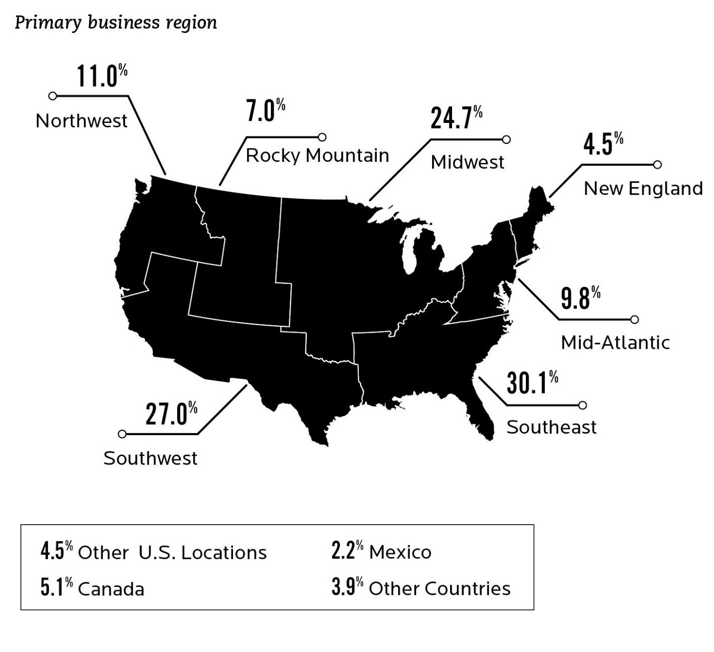
Organizations and regions surveyed

Slide 4
Importance of industry issues
Regardless of size, the most important issues today for water utilities are those that drive investment and costs.
Notes:
Aging infrastructure is viewed by the industry as its top challenge, but financial concerns impact every aspect of the U.S. water utility industry. From system upgrades aimed at improving efficiency to the deployment of new technologies to optimize assets, the industry must adapt to the new fiscal reality. Managing capital costs and finding the funding to make these needed investments will heavily influence operational decisions for the foreseeable future.

Slide 5
Asset investment and costs key to sustainability
Notes:
Aging infrastructure is viewed by the industry as its top challenge, but financial concerns impact every aspect of the U.S. water utility industry. From system upgrades aimed at improving efficiency to the deployment of new technologies to optimize assets, the industry must adapt to the new fiscal reality. Managing capital costs and finding the funding to make these needed investments will heavily influence operational decisions for the foreseeable future.

Slide 6
Report identifies that industry is at the intersection of costs and customer expectations
Cost of Water vs. Value of Water Resources
High visibility problems like those in Flint, Michigan are fueling new debates over America’s infrastructure
$
Pricing ALIGNMENT

Slide 7
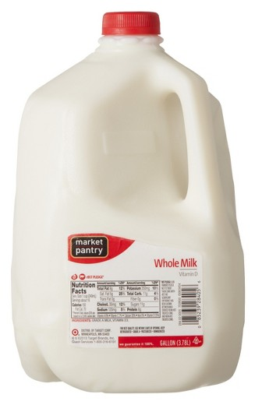
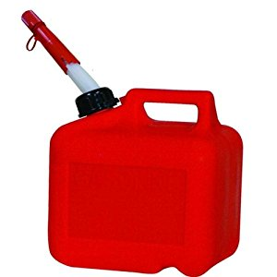
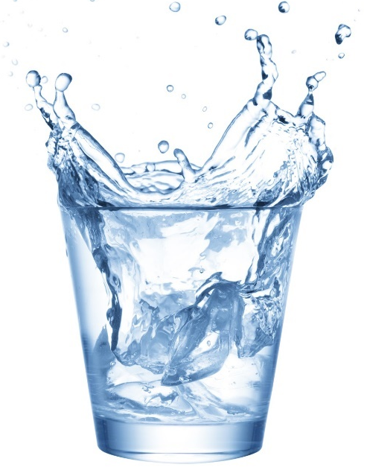
Even though water is essential to life, it remains undervalued
$3.93/gallon
$2.98/gallon
$11.14/gallon
$0.004/gallon
$1 buys you ¼ gallon
$1 gets you about 1/3 gallon
$1 buys you ½ bottle
$1 gets you 214 gallons

Slide 8
Past funding trends are not coming back
2/3 of Americans are younger than 50 and likely do not recall the last federal grant program of the 1970s – but still benefit from these facilities.

Slide 9
The Internet of Things is also driving customer expectations
Why can’t I pay my bill online?
How much water am I using?

Slide 10
Utilities and consumers are missing each other’s messages

Slide 11
The rate-payer conundrum
“I use less water, so why do my rates keep rising?”

Slide 12
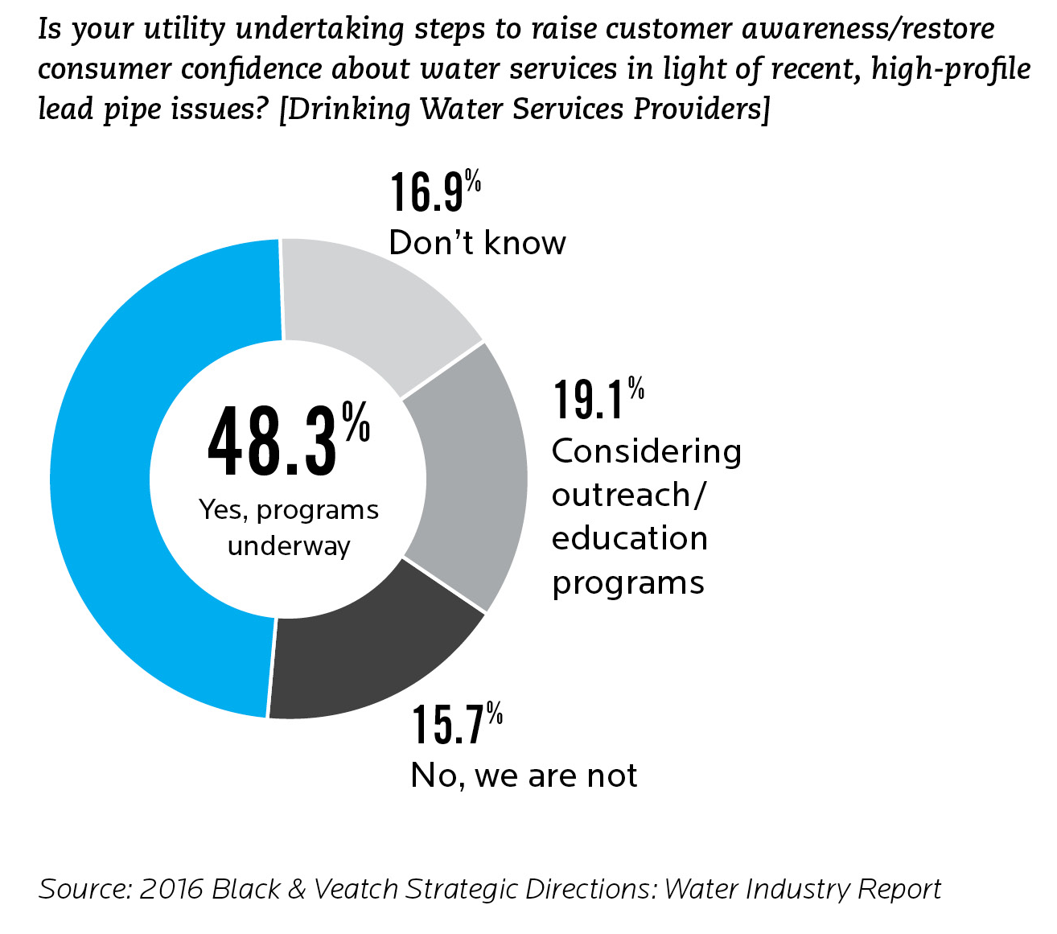
Utilities are working on improving outreach efforts
Notes:
Survey participants were asked, “How much impact does infrastructure replacement and rehabilitation demands have on the financial health of water utilities?” Nearly three-fourths stated it has a strong impact.
The potential for catastrophic failures in our water and wastewater infrastructure is a ticking time bomb waiting for a place to happen.
In 2009, the American Society of Civil Engineers assigned the nation’s infrastructure nearly failing grades in its Report Card on America’s Infrastructure.
Not much has changed since that time, except for the gap between system needs and funding has continued to expand since the economic downturn.
Leaks and inefficiencies caused by crumbling infrastructure lead to higher operating costs and a loss of precious resources. This compounds financial challenges for water utility providers by putting additional stresses on systems. ASCE estimates that 7 billion gallons of clean drinking water are lost each day through leaking pipes.

Slide 13
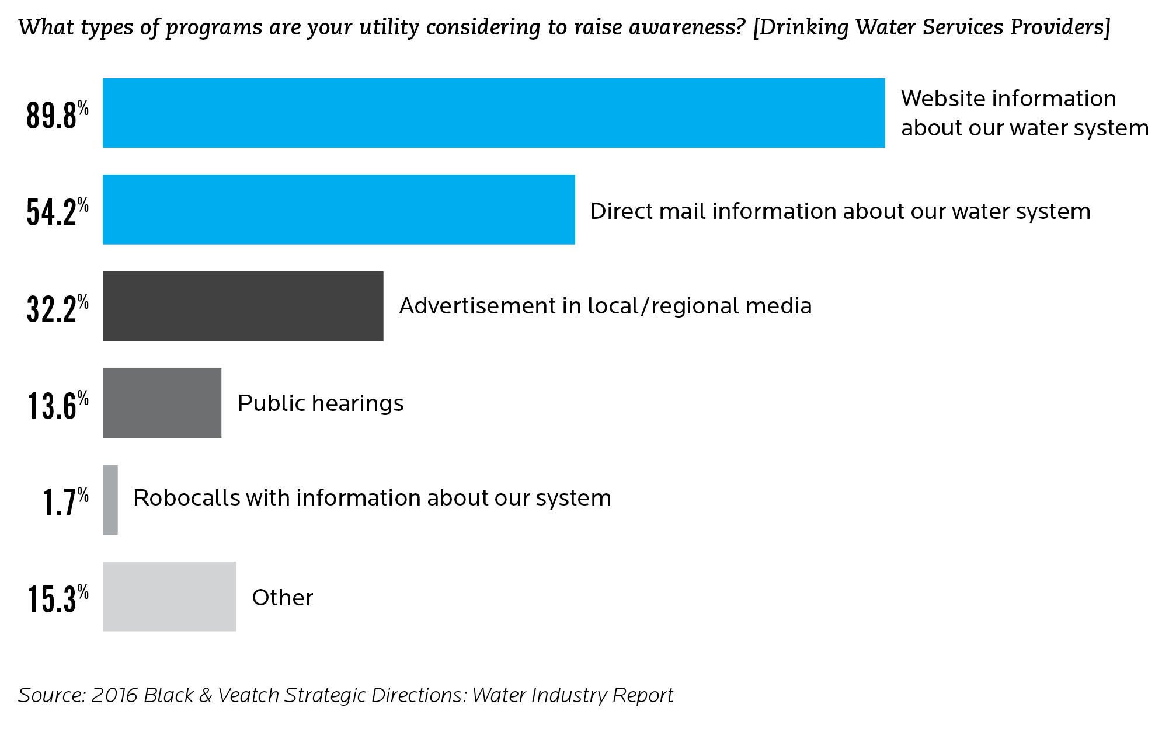
Though outreach efforts are still mostly passive
Notes:
Survey participants were asked, “How much impact does infrastructure replacement and rehabilitation demands have on the financial health of water utilities?” Nearly three-fourths stated it has a strong impact.
The potential for catastrophic failures in our water and wastewater infrastructure is a ticking time bomb waiting for a place to happen.
In 2009, the American Society of Civil Engineers assigned the nation’s infrastructure nearly failing grades in its Report Card on America’s Infrastructure.
Not much has changed since that time, except for the gap between system needs and funding has continued to expand since the economic downturn.
Leaks and inefficiencies caused by crumbling infrastructure lead to higher operating costs and a loss of precious resources. This compounds financial challenges for water utility providers by putting additional stresses on systems. ASCE estimates that 7 billion gallons of clean drinking water are lost each day through leaking pipes.

Slide 14
Closing the financial gap

Slide 15
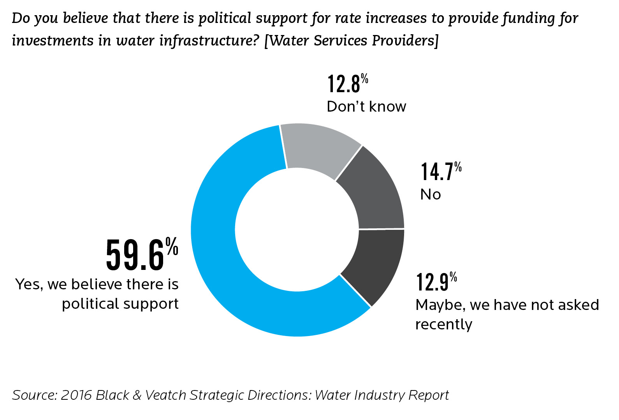
Political support for revenue increases is higher than expected
Notes:
Survey participants were asked, “How much impact does infrastructure replacement and rehabilitation demands have on the financial health of water utilities?” Nearly three-fourths stated it has a strong impact.
The potential for catastrophic failures in our water and wastewater infrastructure is a ticking time bomb waiting for a place to happen.
In 2009, the American Society of Civil Engineers assigned the nation’s infrastructure nearly failing grades in its Report Card on America’s Infrastructure.
Not much has changed since that time, except for the gap between system needs and funding has continued to expand since the economic downturn.
Leaks and inefficiencies caused by crumbling infrastructure lead to higher operating costs and a loss of precious resources. This compounds financial challenges for water utility providers by putting additional stresses on systems. ASCE estimates that 7 billion gallons of clean drinking water are lost each day through leaking pipes.

Slide 16
Addressing the deferred maintenance backlog is still an issue

Slide 17
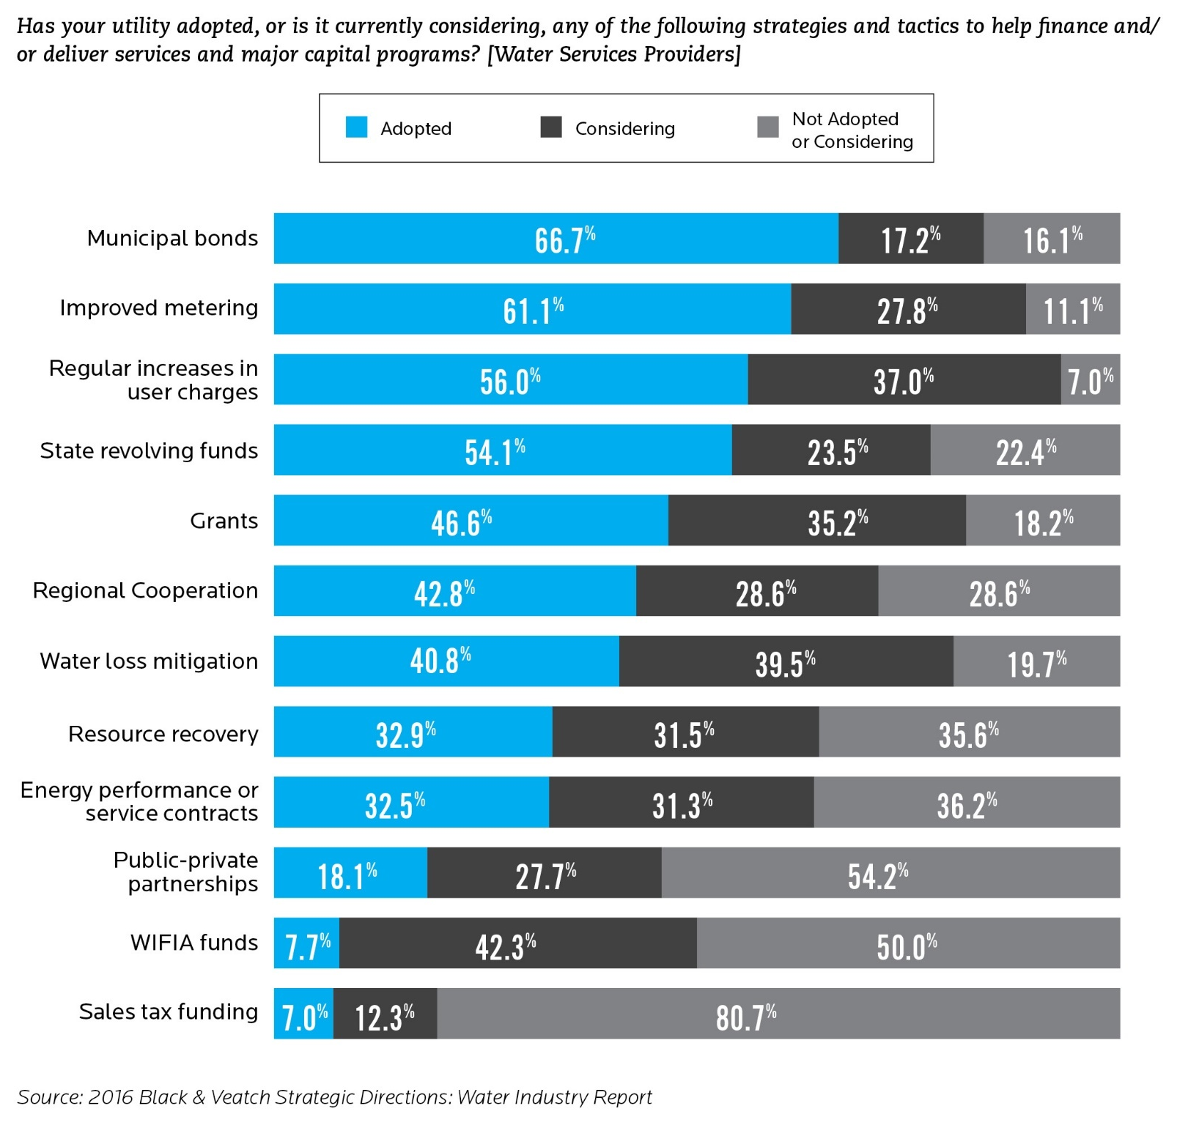
Traditional funding sources are still the top way to fund capital needs
Notes:
Survey participants were asked, “How much impact does infrastructure replacement and rehabilitation demands have on the financial health of water utilities?” Nearly three-fourths stated it has a strong impact.
The potential for catastrophic failures in our water and wastewater infrastructure is a ticking time bomb waiting for a place to happen.
In 2009, the American Society of Civil Engineers assigned the nation’s infrastructure nearly failing grades in its Report Card on America’s Infrastructure.
Not much has changed since that time, except for the gap between system needs and funding has continued to expand since the economic downturn.
Leaks and inefficiencies caused by crumbling infrastructure lead to higher operating costs and a loss of precious resources. This compounds financial challenges for water utility providers by putting additional stresses on systems. ASCE estimates that 7 billion gallons of clean drinking water are lost each day through leaking pipes.

Slide 18
Alternative financing options are gaining ground

Slide 19
“Local” control still limits regionalization opportunities and consolidation

Slide 20
Fundamental paradigm shift is needed to address infrastructure needs
New thinking needed to address strategic and capital plans
Understand the customer perspective
Prolong life of current infrastructure through sound asset management programs

