Slide 1
Never Forever: Cleaning Up PFAS in Drinking Water NH’s Workplan
Johnna McKenna
November 2024

Slide 2
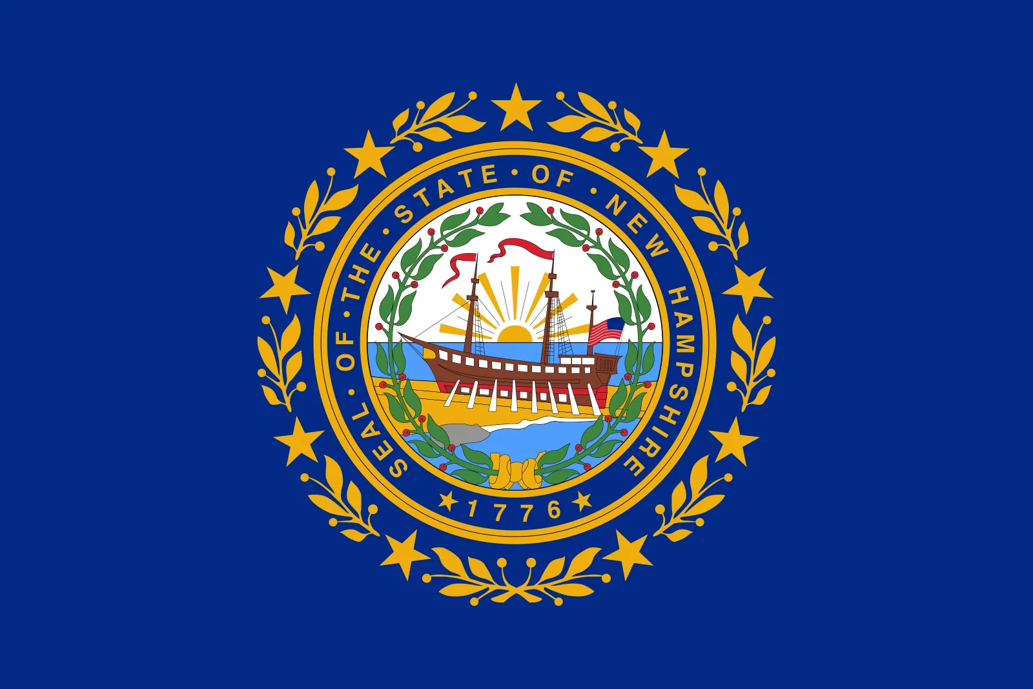
Emerging Contaminant Funding in NH
PFAS Revolving Loan Fund (PFAS RLF)
DWSRF Emerging Contaminants (DWSRF EC)
Emerging Contaminants Small Disadvantaged Communities (EC-SDC)

Slide 3
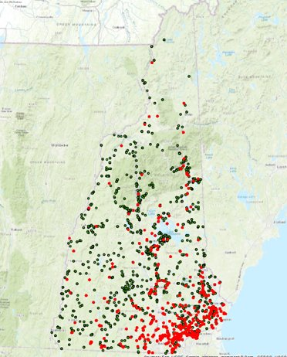
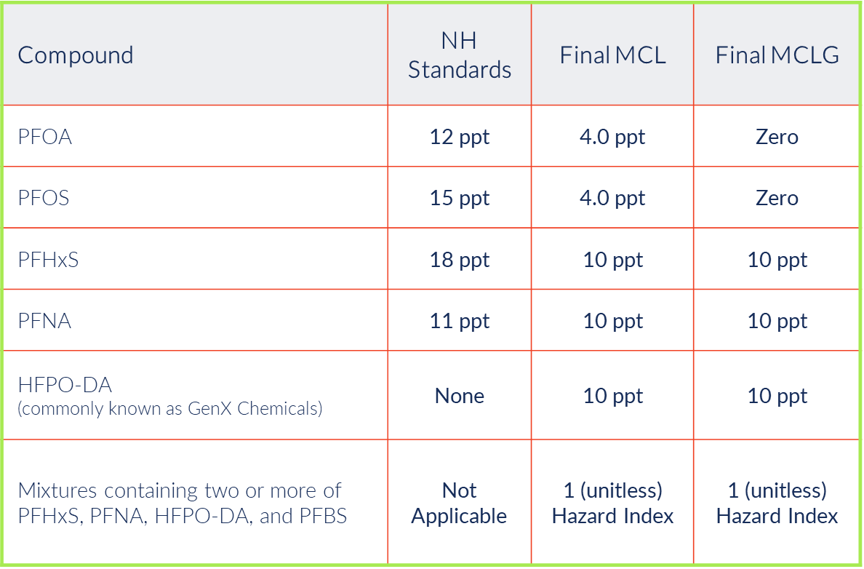
NH Standards
PWS Detecting PFAS/PFOA

Slide 4
Working Across Divisions
NHDES
Water
Waste
Air
Drinking Water Groundwater Bureau
MtBE Remediation Bureau

Slide 5
Emerging Contaminant/PFAS Funding
 | PFAS RLF | DWSRF EC | EC-SDC
Source | State | Federal | Federal
Funding Type | Grant/Loan | Loan (100% principal forgiveness) | Grant
Available Funding | Grant - $0 Loan - $15.6M | $7.6M (2022-2026) | $9.85M (2022-2026)
Eligibility | Exceedance of PFAS Standard | PFAS Detection | PFAS Detection
Application | Open Enrollment | Annually - Spring | Invitation

Slide 6
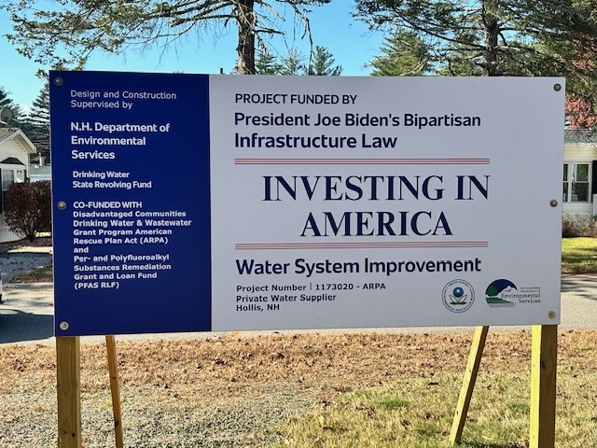
Total EC/PFAS Funding to Date
Over
$115,000,000
Grant $45M
Loan $70M

Slide 7
PFAS Revolving Loan Fund (PFAS RLF)
State Funding $85M
Over 40 projects
Exceedance of a NH PFAS AGQS/MCL, not a violation
Loan $50M (70% awarded)
- 10% Principal Forgiveness for Disadvantaged Communities
- Contingent Reimbursement – up to 50%
Grant $35M (100% awarded)
- $1.5M or 30% of total project costs
https://www.pfas.des.nh.gov/funding/pfas-remediation-grant-and-loan-fund

Slide 8
DWSRF Emerging Contaminants (DWSRF EC)
Loan
100% Principal Forgiveness
PFAS and Manganese
Allocated/offered $20.7M (2022-2024)
50% of total amount requested
Capped at $2.5M/project – disadvantaged
Capped at $1M/project – non-disadvantaged
Lots of co-funding
Year | # Projects | Type
2022 | 5 | 2 municipal 2 small
2023 | 6 | 4 municipal 2 small
2024 | 5 | 2 municipal 3 small

Slide 9
EC-SDC Workplans
2022/2023 Allocation
$18,914,000
2024 Allocation
$9,457,000

Slide 10
EC-SDC 2022/2023 Workplan Tasks
Infrastructure Grants
$10.8M
PFAS Laboratory
$3.3M
Environmental Health Program
$1.5M
Source Water Protection
$3.1M

Slide 11
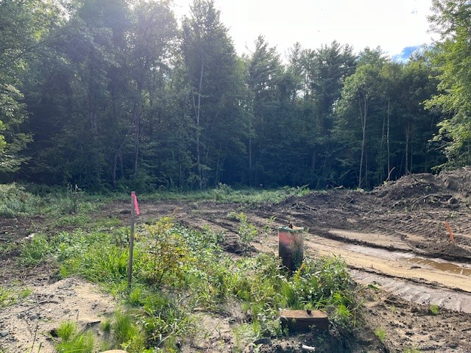
1. Infrastructure Projects
1st Round
11 total (9 approved by EPA)
Exceedance of one of the NH PFAS MCLs
2nd Round
Approximately 9 projects (not yet approved by EPA)
Identified from the 2024 DWSRF Project Priority List (PPL)
Projects that applied for DWSRF EC money, were not funded, and could be fully funded by the BIL EC-SDC funds were chosen

Slide 12
2. PFAS Lab
State Lab Capacity
Retrofitting of State Public Health Lab
Procurement of PFAS testing equipment
Computers, reagents, and supplies
2 Lab scientists

Slide 13
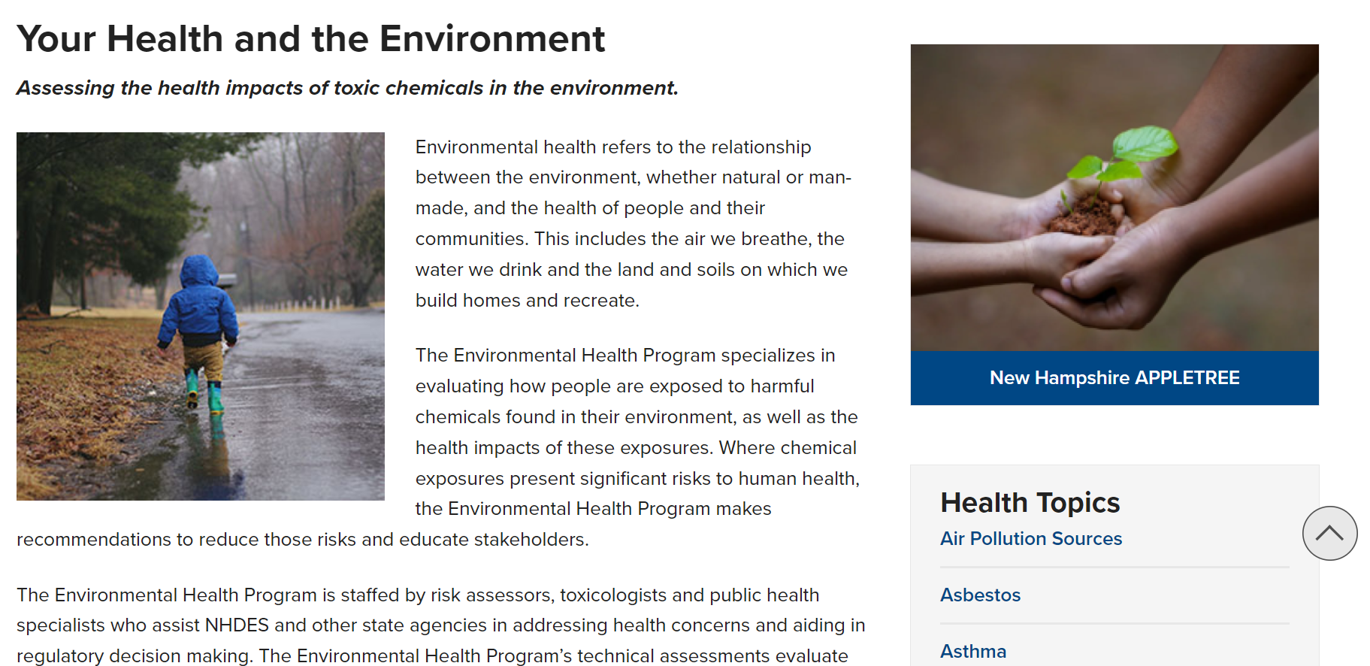
3. Environmental Health Program
Evaluating how people are exposed to harmful chemicals found in their environment, as well as the health impacts of these exposures
Establish Literature Review Coordinator position
Support risk assessor, toxicologist and health educator team
Research support for emerging contaminants
Summarizing relevant information to promote education

Slide 14
4. Source Water Protection Initiatives
Identify sources of Emerging contaminants (PFAS), personal care products (PPCP) and 1,4-dioxane in wastewater
Coordinate with NHDES Groundwater Discharge /Underground Injection Control Program
Develop strategies to protect drinking water for small/disadvantaged PWSs
Emerging Contaminants in Domestic Waste Streams
Domestic Sources of PFAS
Lab contracts to support analyses

Slide 15
EC-SDC 2024 Workplan Tasks
Private Well Sampling
$8.1M
PFAS Lab Analysis
$900,000
PFAS Removal Rebate Program
$423,000

Slide 16
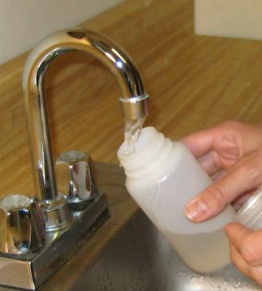
1. PFAS Private Well Testing
To identify the occurrence of EC in eligible private wells
Four sampling positions
Sampling at approx. 2,500-3,500 wells per year
Standard Analysis included (arsenic, bacteria, manganese, sodium, etc.)
Information needed to determine if removal of metals and hardness is required before treating for PFAS

Slide 17
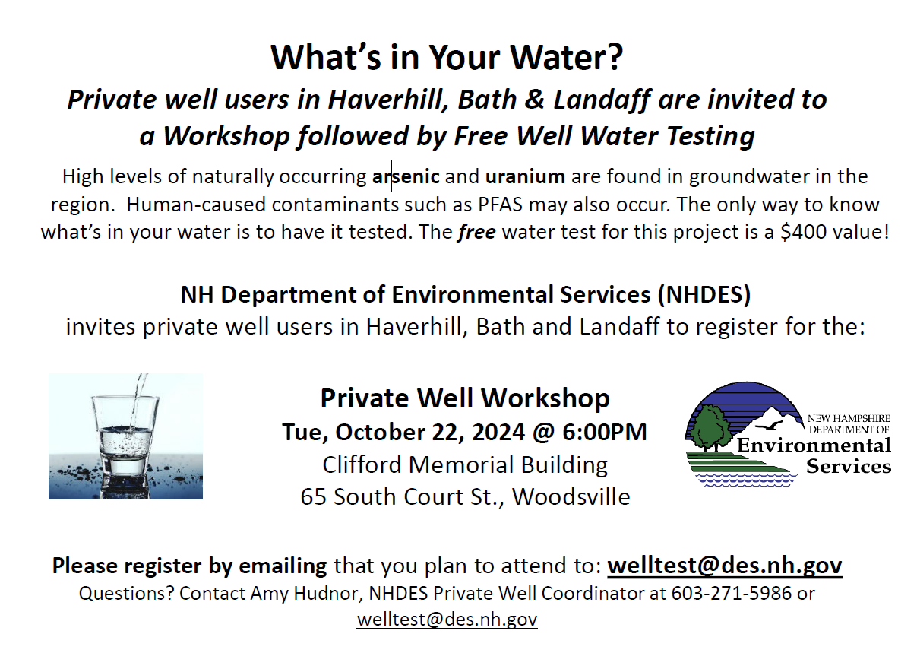
2. Community Based Private Well Testing
Conduct community wide free testing in private wells in rural/disadvantaged communities
Approx. 500 wells/year
Workshops - contaminants, health effects, water testing and treatment options
Be Well Informed Report
Water pitchers for low-income participants with contaminants

Slide 18
3. PFAS Removal Rebate Program
Rebates to private residential well owners
Up to $5,000 to assist in the installation of a treatment system designed to remove PFAS
Or up to $10,000 for a service connection to a public water system
Owners of residential properties that use a drinking water well impacted by PFAS and have not been offered or are not being provided alternate water, temporary or permanent, from a potentially liable third party
Approx. 60 properties

Slide 19
Thank you
Johnna McKenna
NHDES
Drinking Water and Groundwater Bureau
PWS Sustainability Section
johnna.m.mckenna@des.nh.gov
603-271-7017
des.nh.gov
https://www.pfas.des.nh.gov/

Slide 20
Contacts
Brandon Kernen
Brandon.M.Kernen@des.nh.gov
Amy Rousseau
Amy.E.Rousseau@des.nh.gov

