Slide 1
BETTER SOFT DATA WITH TRUMP, BUT HARDER DATA is lagging
ECONOMIC OUTLOOK
Augustine Faucher
Chief Economist
April 19, 2017

Slide 2
HIGHER INTEREST RATES WITH THE ELECTION…
Interest rate, %
10-year Treasury bond (R)
3-month Treasury bill (L)
Source: Federal Reserve
Notes:
2

Slide 3
…AND BETTER CONFIDENCE
Small business optimism index,
1986=100 (R)
Consumer confidence index,
1985=100 (L)
Sources: The Conference Board, NFIB
Notes:
3

Slide 4
THIS EXPANSION ALREADY MUCH LONGER THAN RECENT AVERAGE
Length of expansion, months, by starting date of recovery
Source: NBER
Notes:
4

Slide 5
GROWTH BOUNCES BACK IN SECOND HALF OF 2016…
Real, annualized % change
Source: BEA
Notes:
5

Slide 6
…AND JOB GROWTH REMAINS NEAR 200,000 PER MONTH
Payroll employment, change, 3 mo. moving average, ths
Source: BLS
Notes:
6

Slide 7
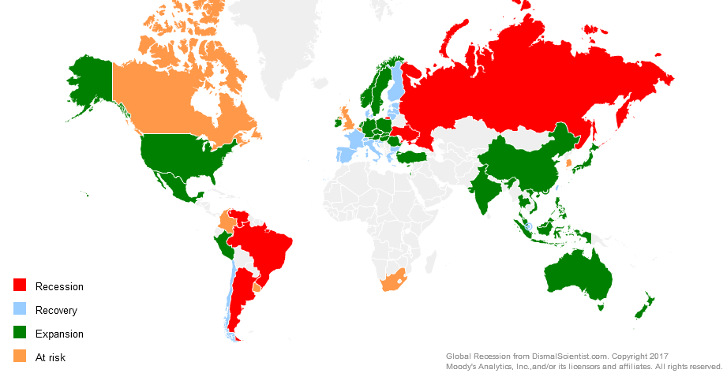
U.S. IS LEADING THE GLOBAL ECONOMY

Slide 8
LIMITED FALLOUT FROM BREXIT…
Exports, 2015, % of U.S. GDP
Source: BEA, Census
Notes:
8

Slide 9
…BUT RECENT DOLLAR STRENGTHENING COULD PULL EXPORTS DOWN FURTHER
Sources: BEA, Federal Reserve
Notes:
9

Slide 10
HISTORIC ENERGY BOOM MATTERS FOR LONG RUN, BUT WAS A DRAG IN 2016
Sources: Federal Reserve, NYMEX
Notes:
10

Slide 11
PRIVATE SERVICE INDUSTRIES, CONSTRUCTION DRIVING JOB GROWTH…
Payroll employment, change year ago, mil
Source: BLS
Notes:
11

Slide 12
CONSUMERS BENEFITTING FROM JOB GAINS, LACK OF TAX HIKES…
Real, % change year ago
Personal disposable income
Consumer
spending
Source: BEA
Notes:
12

Slide 13
…AND WAGE GROWTH WILL CONTINUE TO PICK UP
Quit rate, % of employment,
3-quarter lead (L)
Average hourly earnings,
all private-sector workers,
% change year ago (R)
Private-sector wages,
ECI, % change year ago (R)
Source: BLS
Notes:
13

Slide 14
LOWER GASOLINE PRICES SAVING HOUSEHOLDS $150 BILLION A YEAR
Consumer spending on
gasoline, annualized, $ bil (R)
Price of unleaded gasoline,
$ per gallon (L)
Sources: Oil Price Information Service, BEA
Notes:
14

Slide 15
PUT IT ALL TOGETHER, 2015 WAS A GREAT YEAR FOR REAL INCOMES
Real median household income, % change
Source: Census Bureau
Notes:
15

Slide 16
CONSUMER BALANCE SHEETS IN GREAT SHAPE
% of disposable income
Financial obligations ratio (R)
Mortgage debt
service ratio (L)
Source: Federal Reserve
Notes:
16

Slide 17
ANOTHER RECORD YEAR FOR THE AUTO INDUSTRY, ALTHOUGH JOB GROWTH HAS SLOWED
Cash for clunkers
Sources: AutoData, BLS
Notes:
17

Slide 18
STILL ROOM FOR IMPROVEMENT IN HOMEBUILDING…
Residential construction
employment, ths (R)
Housing starts,
SAAR, 3-month
moving average, ths (L)
Sources: Census, BLS
Notes:
18

Slide 19
…AND HOUSE PRICE GROWTH RUNNING AT A SUSTAINABLE PACE…
Sources: S&P/Case-Shiller, CoreLogic, PNC
Notes:
19

Slide 20
…BUT BIG JUMP IN MORTGAGE RATES AFTER ELECTION A DOWNSIDE RISK FOR HOUSING
30-year fixed mortgage rate, %
Source: Freddie Mac
Notes:
20

Slide 21
Small Businesses Hiring Intentions REMAIN SOLID INTO 2017
Expectations of own hiring, % of respondents
Source: PNC
Notes:
21

Slide 22
Small Businesses Hiring Intentions REMAIN SOLID INTO 2017
Real business fixed investment, 2009$ bil
Source: PNC
Notes:
22

Slide 23
Government is now neutral for growth
Real GDP, contribution to annualized growth, ppt
Source: BEA
Notes:
23

Slide 24
INTEREST RATE OUTLOOK DEPENDS ON INFLATION…
Personal consumption expenditures price index, % change year ago
Excluding food
and energy
Overall
Sources: BEA, PNC
Notes:
24

Slide 25
…AND INFLATION EXPECTATIONS HAVE SOARED
5-year, 5-year forward inflation expectations, %
Sources: Federal Reserve, Moody’s Analytics, PNC
Notes:
25

Slide 26
SOLID ECONOMIC GROWTH THROUGH 2017, WITH FULL EMPLOYMENT SOON
Real GDP, % change year ago (L)
Unemployment rate, % (R)
Sources: BEA, BLS, PNC
Notes:
26

Slide 27
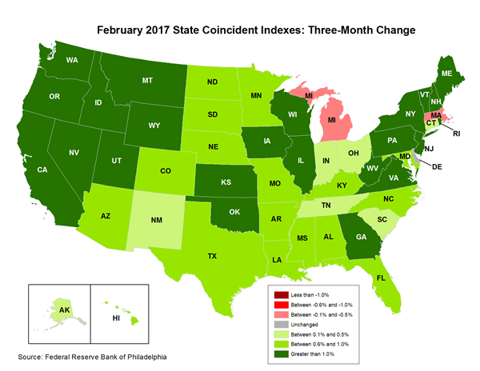
SOFTER GROWTH IN COMMODITY, AUTO STATES…

Slide 28
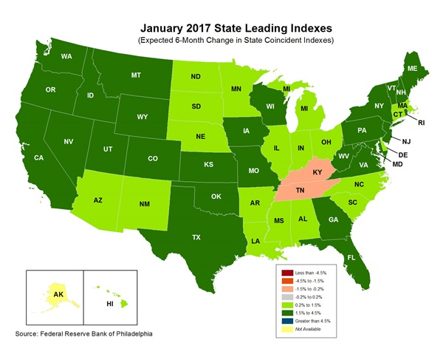
…BUT THAT DRAG SHOULD LIFT LATER THIS YEAR

Slide 29
STRUCTURAL SLOWDOWN IN PRODUCTIVITY GROWTH COULD BE BAD NEWS
Productivity, nonfarm business sector, 4-quarter MA, % change year ago
Source: BLS
Notes:
29

Slide 30
A NEW, BIG RISK
President Trump
↓ Trade
↑ Fiscal policy
↑ Jobs/income/confidence
↓ Strong $
↓ Monetary policy/interest rates
↑ Regulatory reform
↑ Stock market
↓ Immigration
↓ Brexit/Europe
↕ China/emerging economies
↕ Energy
↕ Housing market
↑ Commercial construction
↑ State budgets
↕ Healthcare
↓ Terrorism

Slide 31
PNC Economic Outlook
Q&A
For more information from PNC Economics: www.pnc.com/economicreports
Twitter:
@GusFaucherPNC

Slide 32
Disclaimer: The material presented is of a general nature and does not constitute the provision of investment or economic advice to any person, or a recommendation to buy or sell any security or adopt any investment strategy. Opinions and forecasts expressed herein are subject to change without notice. Relevant information was obtained from sources deemed reliable. Such information is not guaranteed as to its accuracy. You should seek the advice of an investment professional to tailor a financial plan to your particular needs.
©2017 The PNC Financial Services Group, Inc. All rights reserved.

