Slide 1
Utilization of SRF to Address Nonpoint Source Impacts from Hydromodification
Lee Wagner | SRF Program Specialist
Iowa Finance Authority

Slide 2
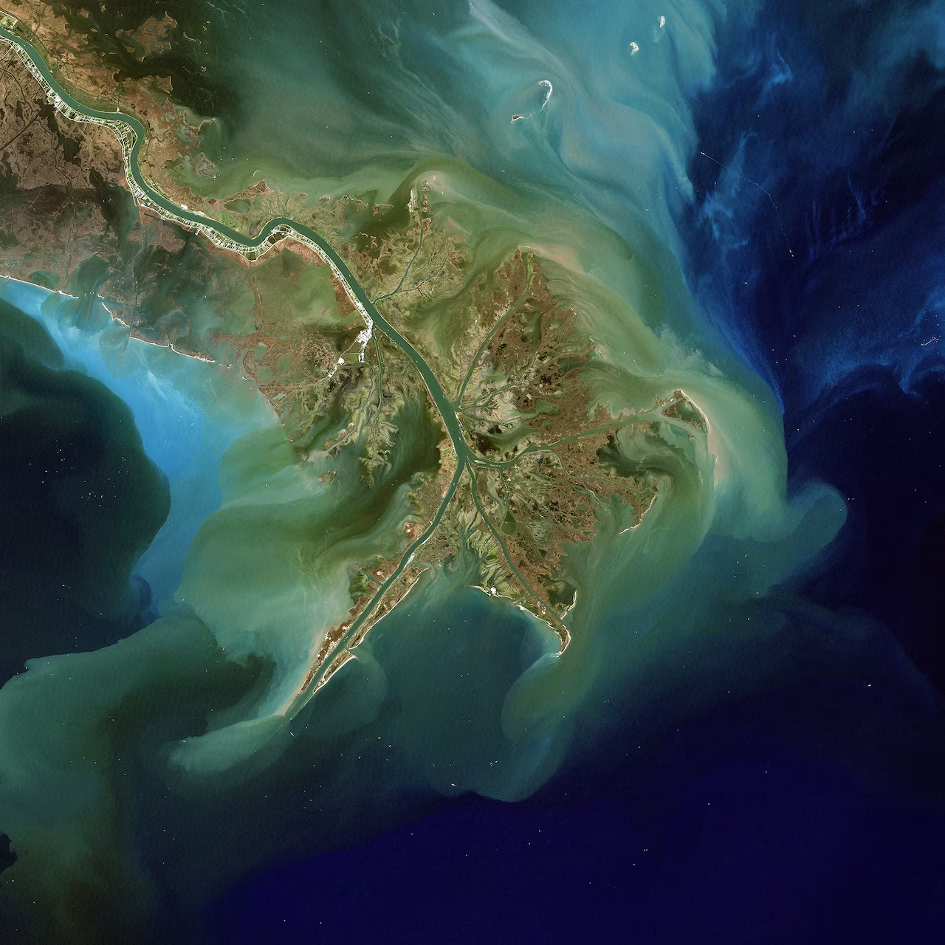
What is Hydromodification & Why is it Important?
Three categories:
channelization and channel modification,
Dams
streambank and shoreline erosion.
Hydromodification is one of the leading sources of impairment in our nation’s waters.
Sediment and phosphorous loads from streambank erosion are a significant contributor to Gulf hypoxia.
Photograph by Phil Degginger, NASA LANDSAT/ALAMY STOCK PHOTO
Notes:
USEPA (1993) defines hydromodification as the “alteration of the hydrologic characteristics of coastal and non-coastal waters, which in turn could cause degradation of water resources.”

Slide 3
Driver for Stream Restoration
The Iowa Legislative Council authorized the creation of The Iowa Rivers and Waterways Study Committee in 2013.
DNR held a Value Stream Mapping event with numerous programs, agencies and interested parties to develop new efforts for river restoration.
Notes:
The charge of the committee was to consult with interested parties in considering options for restoring the quality of Iowa's rivers and waterways and to develop recommendations for an initial plan to prioritize river and waterway projects and provide defined goals and measurable improvements.
In response to the legislative committee recommendations, DNR held a value stream mapping (VSM) event in early 2015 designed to explore the roles and priorities of DNR’s river-related programs, and to identify opportunities to improve collaboration, create efficiencies and develop new efforts for river restoration. This resulted in the development of a report with the goal to improve the function and value of our waterways for water quality, recreation, wildlife and fisheries habitat, flood mitigation, quality of life, and associated economic benefits. One of the new efforts to come out of the VSM was to develop consistent guidance for river restoration in Iowa.
Education and outreach partnerships with NGO’s
Development of comprehensive list of potential funding opportunities

Slide 4
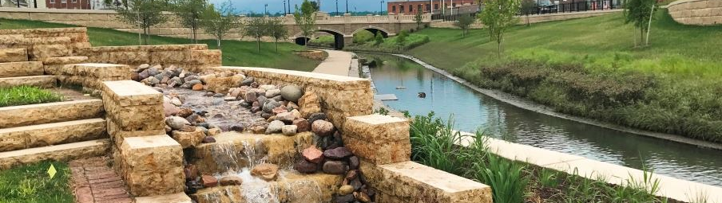
How & Why Did SRF Get Involved?
Photograph: cityofdubuque.org
Bee Branch Stream Daylighting design (Sponsored Project Program pilot project)- excellent example of using restoration techniques
More interest to use Sponsored Project funds for stream projects
Lack of stream restoration standards
Notes:
At the same time the SRF Sponsored Project program is in full swing and had several projects wanting to address streambank erosion concerns (mainly for infrastructure protection purposes), and we wanted those projects to use restoration practices rather than armoring methods.
Engineers had little to no experience with stream restoration practices, and we didn’t have good guidance to provide them.
The Bee Branch daylighting design was the poster child of what could be done using good stream restoration methods.

Slide 5
Iowa’s River Restoration Toolbox
Delivers a consistent, relevant assessment method and reviewable design checklists to aid decision making
Provides interactive assessment tool
Provides detailed drawings and specification requirements
Notes:
As a result, the Iowa SRF provided funding to contract Stantec to develop Iowa’s River Restoration Toolbox.
Like the VSM development of the toolbox was a collaboration with input from multiple programs, agencies, experts, and interested parties.
Iowa’s River Restoration Toolbox was developed to assist designers in stream stabilization and restoration projects in Iowa with proven techniques with emphasis on incorporating natural materials.
The Toolbox contains two main components: An assessment tool, and a series of practice guidelines.
The assessment tool allows users to see the predicted effect of design changes on stream parameters and functions as a review checklist for funders, land managers, or technical reviewers.
The Toolbox also provides detailed drawings and specification requirements to make natural stabilization projects more biddable.
SRF also provided funding for the first round of training workshops for designers and stream professionals.
Beginning in 2017 SRF required stream projects using Sponsored Project funding to use the River Restoration Toolbox for design.

Slide 6
Why Fund Hydromodification with CWSRF?
Issues resulting from Hydromodification are vast, solutions are expensive, and outcomes are not immediate.
Minimal funding provided for stream restoration projects.
Improve quality of projects through requirements for funding or funding incentives (LF, reduced interest rate, etc.).
Restoration projects have multiple benefits.
Notes:
The scale of the problems resulting from past hydromodification is enormous (e.g. over 40% of Iowa’s 70,000 stream miles are actively eroding). The majority of hydromodification occurred long ago and is extremely expensive to fix, resulting in a I didn’t do it, so why should I have to pay to fix it.
While there are numerous programs that can fund stream restoration and other hydromodification solutions these types of projects don’t often receive funding (at least in Iowa).
Restoration projects improve the function and value of our waterways for water quality, wildlife and fisheries habitat, climate change resiliency, recreation and boater safety, mitigation, quality of life, and associated economic benefits.

Slide 7
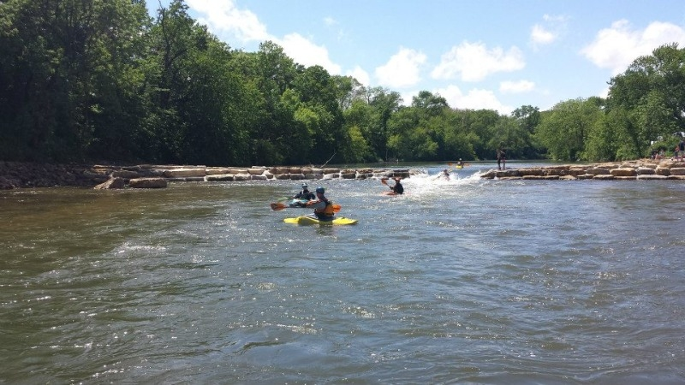
How Can My SRF Start Funding Restoration Projects?
You have to want to
Collaboration
Education and outreach
Make it easier- develop/ provide resources and guidance
Be creative
Photograph: Manchester-ia.org
Notes:
You can’t create a successful funding program for Hydromodification unless it is truly a priority for your SRF.
Collaborate with other programs, agencies, NGO’s that do stream related work to see if there are opportunities to work together to create better projects with multiple benefits instead of just a single outcome.
Think outside the confines of the primary purpose of a project.
How can you make a flood mitigation or dam safety project into a whitewater park with water quality and aquatic habitat benefits

Slide 8
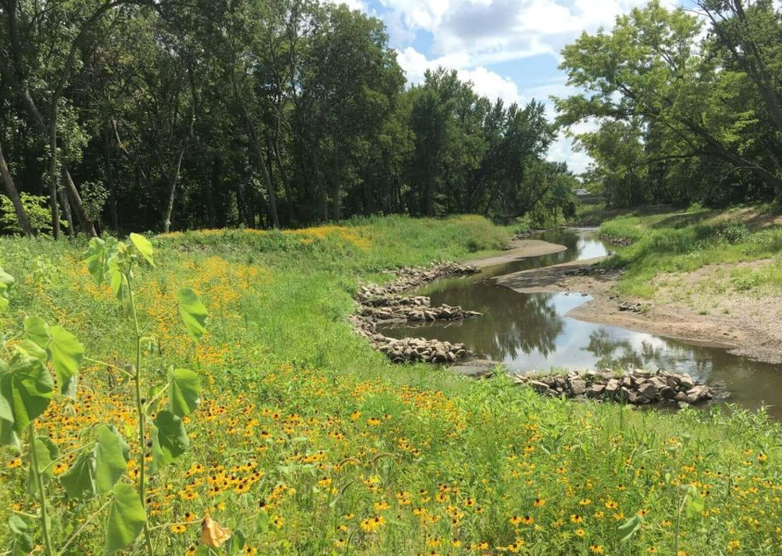
Resources
National Management Measures to Control Nonpoint Source Pollution from Hydromodification, EPA 841-B-07-002, July 2007, https://www.epa.gov/nps/nonpoint-source-hydromodification-and-habitat-alteration
Iowa’s River Restoration Toolbox- https://www.iowadnr.gov/Environmental-Protection/Water-Quality/River-Restoration/River-Restoration-Toolbox
City of Dubuque, Bee Branch Creek Restoration- https://www.cityofdubuque.org/804/Bee-Branch-Creek-Restoration
Photograph, Fourmile Creek, Ivo Lopez, snyder-associates.com.

Slide 9
THANK YOU
Name | Title
Iowa Finance Authority

