Slide 1
CIFA SRF Workshop
Lead Service Line Inventory RFP
November 7, 2022

Slide 2
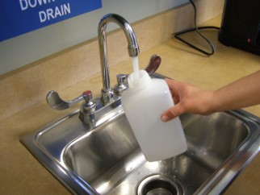
Lead Service Line Inventory RFP
1 RFP – 4 Modules
Module A: PWS System Records Review and Customer Surveys
Module B: Predictive Modeling, Statistical Analysis
Module C: On-site Investigations to Validate Information From A & B
Module D: Develop Lead Service Line Replacement Plans
To protect and improve the health and environment of all Kansans
Notes:
Module A:
Previous Materials Evaluations – 40 CFR 141.42(d)
Construction and Plumbing Codes and Records
Water System Records – DS maps and drawings, meter installation records, tap cards, historical records on service connections
Distribution system Inspections and Records
Other State specific requirements
Customer surveys
Module B:
Machine learning, predictive modeling, statistical analysis
Use attributes from known locations to make inferences about areas of unknown condition.
Use similar information as Module A such as building age and location or other community data that may be available
Help prioritize areas for Module C
Can use machine learning algorithms to improve model as new data are added
Module C: Onsite Verification for Modules A & B
Visual Inspection
Water Quality Sampling
Excavation
Camera inspection
Module D: Development Lead service Line Replacement plans
Must contain the 7 elements listed in 40 CFR 141.84(b)
Requirements may be subject to change based upon the LCRI requirements

Slide 3
Lead Service Line Inventory RFP
Goals of RFP Contracts
Create a “Pool” of qualified vendors
Competitive Costs for services
All under KDHE oversight
Consistent services for each PWS
Avoid administration of multiple individual grants to PWS systems
To protect and improve the health and environment of all Kansans

Slide 4
Lead Service Line Inventory RFP
Let’s Talk About Subawards
States and subrecipients must:
Have transparent and fair competition
Ensure subawards oversight terms are met
Maintain records for 3rd party compliance
Obtain proposals from minority and women owned businesses
To protect and improve the health and environment of all Kansans
Notes:
July 2022 memo: Understanding SRF additional Subsidy as a Grant
Subrecipients must follow appropriate procurement procedures, seek competitive bids and maintain records to demonstrate that all requirements of 2 CFR 200.317 through 200.327 are followed
Subrecipients must also follow the monitoring requirements set forth in 2 CFR 200.331 through 200.333

Slide 5
Lead Service Line Inventory RFP
Phased Awards
Phase 1 (RFQ - like Approach)
Vendors submit proposals & costs
KDHE will select best proposals
Creates a “pool” of vendors
Vendors can submit for one or more Modules
Vendors can select to serve a specific region of State
Phase 2 – Work Requests Single Projects
Work Requests sent to selected Vendors from Phase 1
Work awarded based on cost & time to complete submitted from vendors responding to Work Requests
To protect and improve the health and environment of all Kansans
Notes:
Mention how this has worked for the DWPP.

Slide 6
Lead Service Line Inventory RFP
How Will KDHE Fund LSLI Technical Assistance?
2022 BIL Technical Assistance Funding
Funding Source | Funding Amount
General Supplemental 4% | 835,000
General Supplemental 2% | 417,500
Lead Service Line 4% | 1,315,640
Lead Service Line 2% | 657,820
Total | $3,225,960
Funding will cover the cost of work completed under the RFP
Priority is PWS systems serving < 10,000 population
PWS > 10,000 can apply for loan to complete inventory
To protect and improve the health and environment of all Kansans

Slide 7
Lead Service Line Inventory RFP
Local Contract Option
Contract open to local units of government
Use SRF loan
Use local funds
If SRF loan…
Contract requirements added as conditions
To protect and improve the health and environment of all Kansans

Slide 8
Lead Service Line Inventory RFP
Getting The Word Out
Public Meetings
Email blasts to PWS systems
Outreach to PWS systems needing TA
KDHE inventory email address:
KDHE.LSLInventory@ks.gov
To protect and improve the health and environment of all Kansans

Slide 9
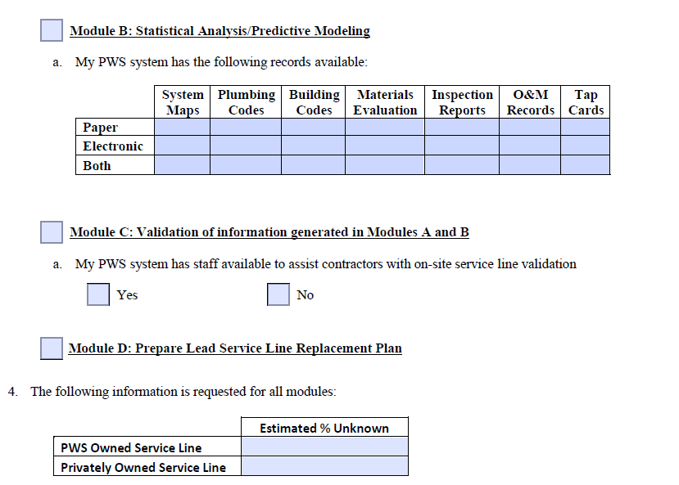
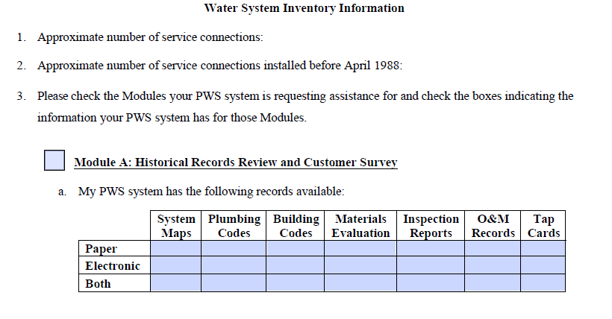
Lead Service Line Inventory RFP
TA Application Form: https://www.kdhe.ks.gov//Lead & Copper Rule
To protect and improve the health and environment of all Kansans

Slide 10
Lead Service Line Inventory RFP
Thank you/Questions
Cathy Tucker-Vogel
Public Water Supply Section Chief
(785) 368-7130
Cathy.Tucker-Vogel@ks.gov
https://kdheks.gov/water
To protect and improve the health and environment of all Kansans

