Slide 1
Application Streamlining
California CWSRF
CIFA SRF Workshop
Indianapolis, IN
Fall 2017

Slide 2
CALIFORNIA CWSRF
STATE WATER RESOURCES CONTROL BOARD
5 Member Board
Appointed by Gov. & Approved by Senate
Part of CA Environmental Protection Agency
5 Divisions + 9 Regional Water Boards + 24 DW Districts (About 2,100 Positions)
Financial Assistance
CWSRF
DWSRF (effective 7/1/2014)
State Programs
Underground Storage Tank Clean Up
Water Quality
Water Rights
Drinking Water (effective 7/1/2014)
Administrative Services
CWSRF HISTORY THRU JUNE 30, 2017
>$10.5 Billion Financed
Approximately 800 Projects Since Inception
Net Position: $4 Billion
Approximately $875 Million in Bonds Outstanding
Notes:
Hilda: FY 16-17 annual repayments after debt service approx. $220 M
FY 17-18 annual repayments after debt service approx. $200 M

Slide 3
STREAMLINING, NOT STREAMLINED
A Work in Progress
Board Policy – Not Regulations
Amended on Average Every 2 Years
Policy vs. Practice
2012 Streamlining Effort
Ground Up Review of Process and Policy
High Cash Balances
2005 to 2015 = $200 to $380 Million
Strategic Management Review - 2008
ARRA: 2009 - 2011
Furloughs

Slide 4
REDUCE # OF APPROVALS
OLD WAY
NEW WAY
Hybrid Facilities Plan Approval Letter with Preliminary Funding Commitment
Remnants of Previous Processes
FPA/PFC Prepared by Technical Staff; Routed for Approval
Authorized Representative Must Agree with FPA; Then PFC Made by Deputy Director
“We’re going to send you an agreement.”
FPA/PFC, Essential Documents, & Draft Agreement Assembled into “Master File”
Routed Through Many of the Same People
Send the Agreement to Auth. Rep.
Execute Initial Agreement (Est’d Budget)
Final P & S Approval (Eligibility) Letter
Auth. Rep. Must Agree with Letter before Proceeding
Approval of Award
Applicant Submits Bids and Procurement + DBE Documents
Amend Agreement
Execute Final Agreement (Final Budget)
Checklists
Prepared by Staff – Verified by Applicant’s Staff
Checklists, Essential Documents, and Draft Agreement Assembled into “Master File”
Routed Once for Management Review and Approval
Send the Agreement
Execute Initial Agreement (Est’d Budget)
Final Budget (Eligibility) Approval
Applicant Submits Final P & S + Bids and Procurement + DBE Documents
Establish Eligibility & Amend Agreement
Final Agreement (Final Budget)
Notes:
Hilda: FY 16-17 annual repayments after debt service approx. $220 M
FY 17-18 annual repayments after debt service approx. $200 M

Slide 5
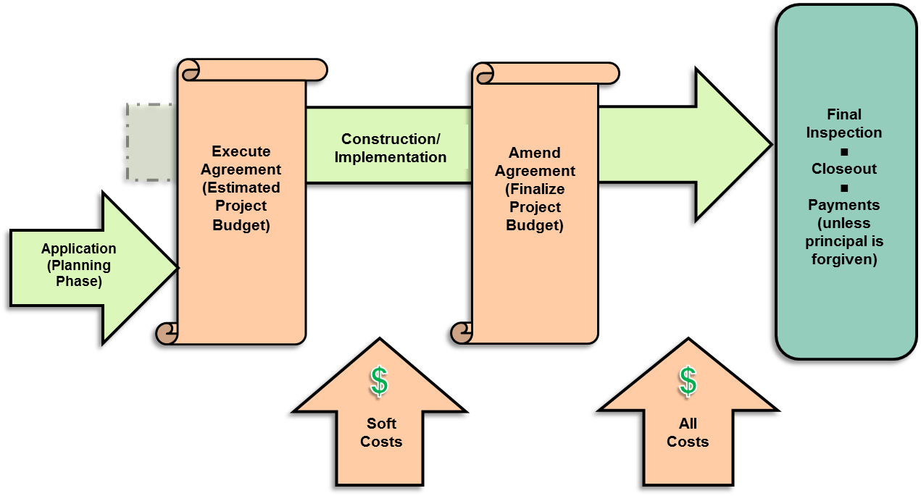
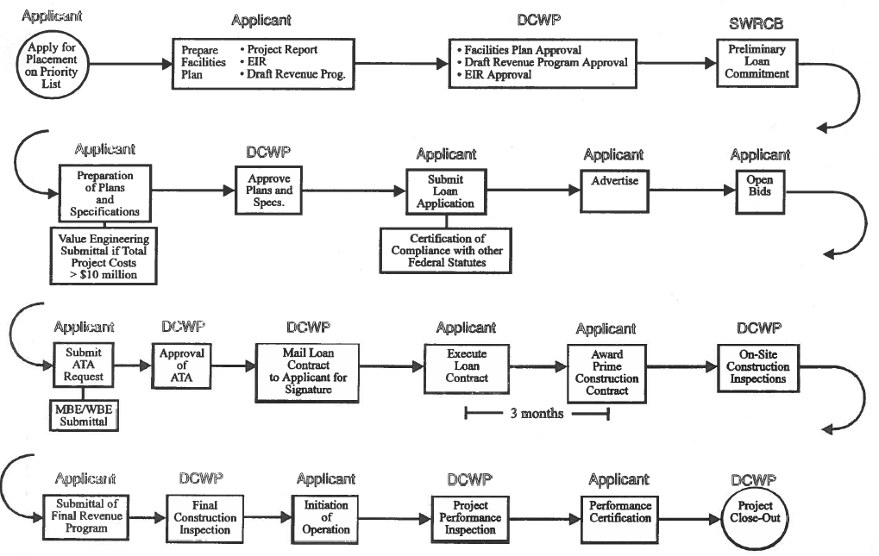
OLD VS NEW process

Slide 6
Revamped Application
Sub-Divide Application into 4 “Packages”
General
Technical
Financial
Environmental
Federal Cross-Cutter Form
Complete Packages & Complete Applications
Only Review Complete Packages
Only Approve Complete Applications
1 CW Application & 1 DW Application
Sometimes Templates Aren’t Your Friends
Stale Legal Opinions
Web-Based Electronic Submittal
Adapted Financial Assistance Application Submittal Tool (FAAST)
All FAAST Documents Viewable in LGTS

Slide 7
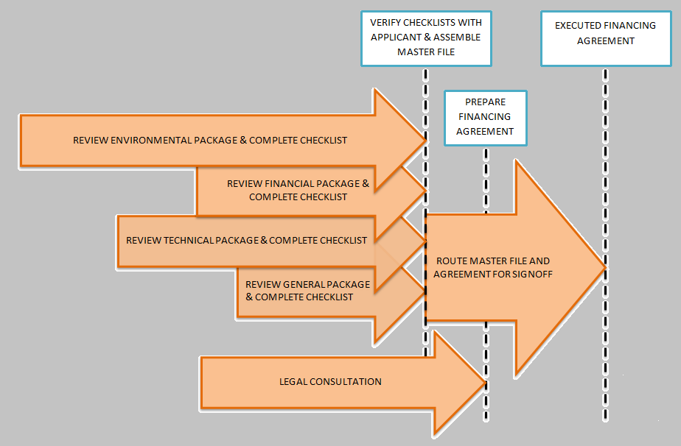
4 application packages

Slide 8
parallel review AND coordination
KEYS
Timing of Packages
Env. 1st
Fin. Last
Environmental Review
During Clearinghouse Review
Coordinate Fed Reviews
Review Drafts
Tracking Reports Match Workflow
Monthly “Staging” Meetings
Day-to-Day Coordination
SIMULTANEOUSLY
2 SRFs +
State Funds
30 to 40 CW +
30 to 40 DW Applications
2016/2017
179 Agreements $2.0 Billion

Slide 9
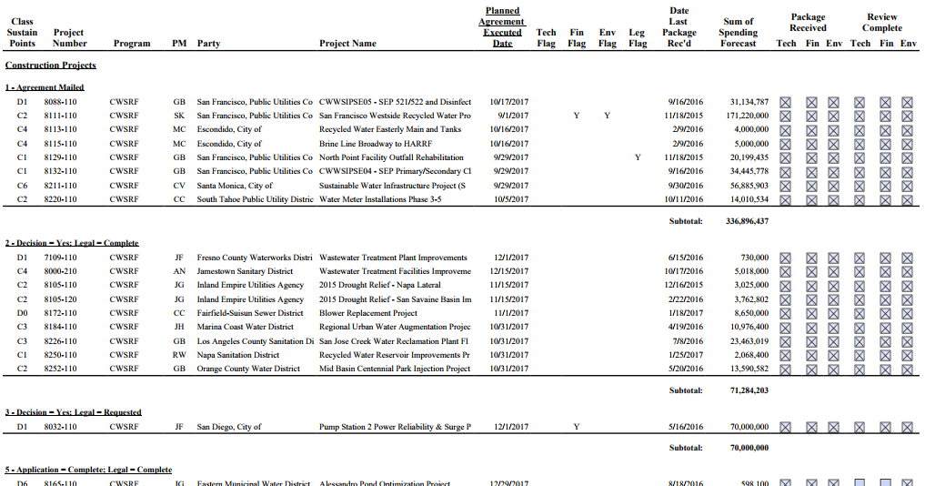
TRACKING by STATUS AND group
STATUS SETTINGS
Active
Potential
Inactive
Withdrawn
GROUP LEGEND
Group | Application Complete | Legal Consult Done | All Checklists Done | Agreement Mailed
1 | ✓ | ✓ | ✓ | ✓
2 | ✓ | ✓ | ✓
3 | ✓ | In Process | ✓
4 | ✓ | Not Started | ✓
5 | ✓ | ✓
6 | ✓ | In Process
7 | ✓ | Not Started
8

Slide 10
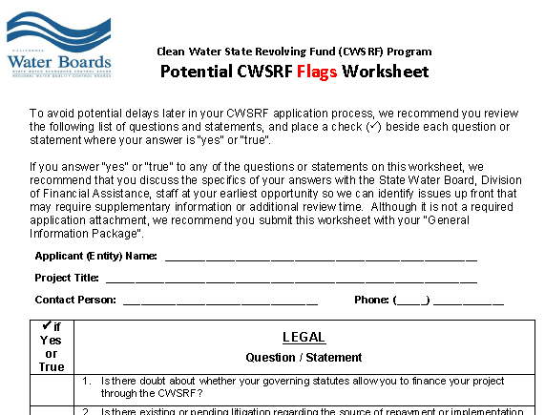
flags
Flags Worksheet
http://www.waterboards.ca.gov/water_issues/programs/grants_loans/srf/docs/forms/cwsrf_potential_flags_worksheet.pdf
Collective Experience of Staff
Identify Pitfalls & Barriers Early
Notes:
Hilda: FY 16-17 annual repayments after debt service approx. $220 M
FY 17-18 annual repayments after debt service approx. $200 M

Slide 11
SIMPLIFY PRIORITY LIST
Eliminated Regional Board Involvement
Most Projects Have a Clear Objective – Permit Compliance or Basin Plan Requirements
Consult with Regional Board As Needed (Rarely)
Renamed List
“Priority” List ➔ “Project” List
Avoid Implied Commitment and Order of Funding
Consolidated CWSRF + State Programs Into One Project List
Automatically Add Project to List When Application Started
Delegated List Updates to Executive Director
Routine Process Done Quarterly
Previously Done Yearly
Notes:
Hilda: FY 16-17 annual repayments after debt service approx. $220 M
FY 17-18 annual repayments after debt service approx. $200 M

Slide 12
95% of complete Applications Financed in ≤ 9 months
Annual Target | 12/13* | 13/14 | 14/15 | 15/16 | 16/17
95% | 34% | 85%
* Board approved Policy amendment in May 2013

Slide 13
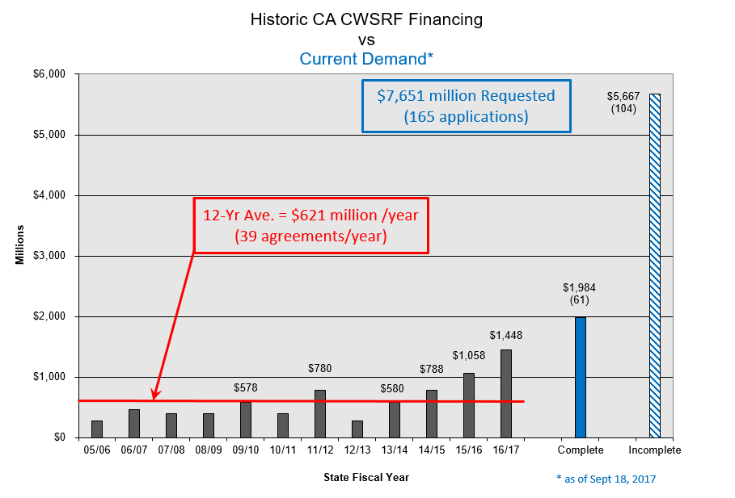
Past FINANCING AND CURRENT demand

Slide 14
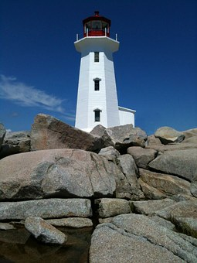
What’s neXT?
No More 50 yd Gainers, but Little Things Add Up
A “Short” List
Effective Scoring (Priority) System + Yearly $ Target
Less Horse Race; More Focus
Eliminate Project List
Use IUP List for “Priority List” Requirement
Reevaluate Process Steps
“Perfect” Coordination
Avoid Multiple Rinse Cycles
“Distribution List”
Send All Checklists & Draft Documents to Everyone
Special Conditions At Top of Checklist
Manage Applicant Expectations
Up-Front Assessment & Regular Status Updates

Slide 15
contact information
E-mail: Christopher.Stevens@waterboards.ca.gov
Telephone: (916) 341-5698
Mailing Address:
State Water Resources Control Board
Division of Financial Assistance
P.O. Box 944212
Sacramento, CA 94244-2120
Street Address:
1001 I Street
Sacramento, CA 95814

Slide 16
Thank you

