Slide 1


Guidance for Developing Service Line Inventories
CIFA SRF Workshop
November 7, 2022
Office of Water
www.uswateralliance.org

Slide 2
Today’s Presentation
Presentation Outline
  Summarize contents of inventory guidance document
  Overview of EPA’s inventory template
  Brief overview of DWSRF set-asides
Office of Water
2

Slide 3

What’s in the Inventory Guidance?
Purpose and audience
  Drinking water systems of all sizes
  States
Guidance scope
  LCRR inventory-related requirements
  Recommendations/best practices
  Case studies and example materials
  Inventory template
Disclaimer
This document is not a regulation itself, nor does it change or substitute for those provisions and regulations nor impose legally binding requirements on EPA, states, or the regulated community
Office of Water
3

Slide 4
Guidance Document Topics
Benefits of a service line materials inventory
Summary of LCRR inventory requirements
Inventory elements
Inventory planning
Historical records review
Service line investigation methods
Developing and updating the inventory
Public accessibility
Appendix featuring case studies and more
Office of Water
4

Slide 5
The Benefits of a Comprehensive and Accurate Inventory
Facilitate LSLR programs
Can be used in applications for external LSLR funding
Increase LSLR programs efficiency, stretching the value of internal or external funding
Enables prioritization of underserved communities for LSLR
Improve public health
Allows for notification to customers about lead sources in drinking water infrastructure so they can take action to reduce their risk of exposure
Allows for mitigation of exposure risk after disturbance of a known or potential lead service line (LSL) or galvanized requiring replacement (GRR) service line
Engage the community
Builds customer transparency
Showcase progress of LSLR program
Opportunity to educate and involve customers, which can create opportunities for LSLR
Improved asset management
Office of Water
5

Slide 6
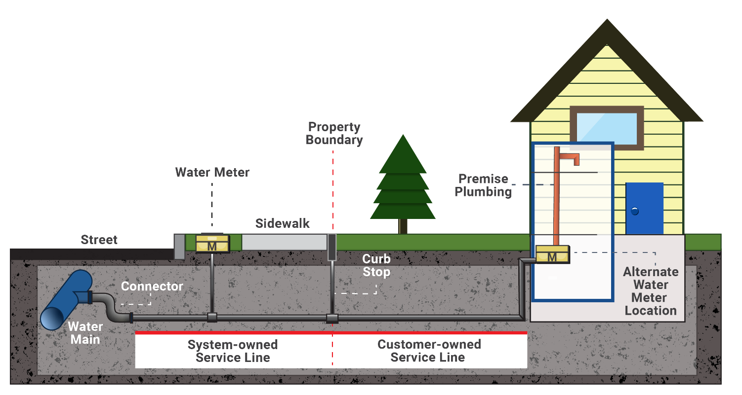
Inventory Elements- Required
Required service line material classifications
Include all service lines, regardless of the actual or intended use
Classify LSL, Galvanized Requiring Replacement (GRR), Unknown, Non-Lead
Include both the system- and customer-side where ownership is split
Office of Water
6

Slide 7
Inventory Elements- Recommended
Recommended subclassifications
Likelihood that an unknown is lead
Actual material of non-lead lines
Recommendation to include other drinking water infrastructure potentially containing lead
Lead goosenecks, pigtails, connectors
Lead solder
Other leaded infrastructure
Recommended service line characteristics to include
Pipe diameter
Installation date
Source of material information
Office of Water
7

Slide 8
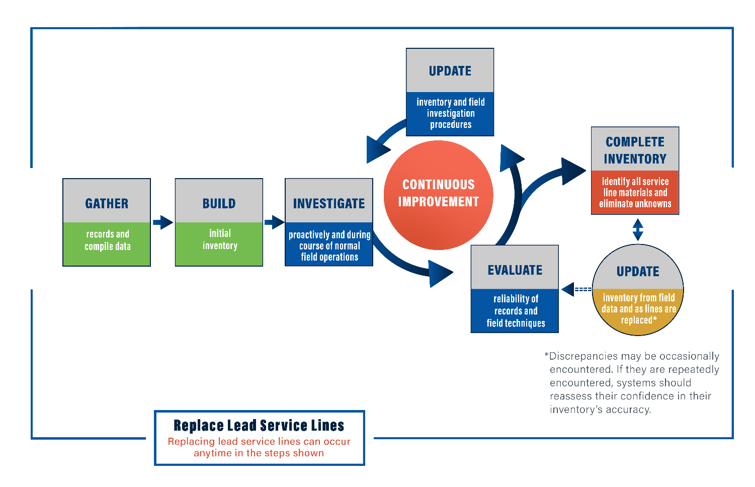
Inventory Planning
Office of Water
8

Slide 9
Historical Records Review
LCRR Initial Inventory Requirements
Review and/or use the records specifically referenced in 40 CFR §141.42(d), 40 CFR §141.84(a)(3), including any required by the state
Recommended Practices
Document the records source used to identify a service line’s material
Continue to gather information on service line materials after they have been classified to assess the accuracy of historical records
If a certain record source is found to be unreliable, consider reclassifying service lines based on that source as “unknown” until additional information can be gathered
Records already reviewed for service line material information (i.e., for proactive inventory efforts done previously) do not need to be reviewed again
Source: Hensley et al., 2021
Office of Water
9

Slide 10
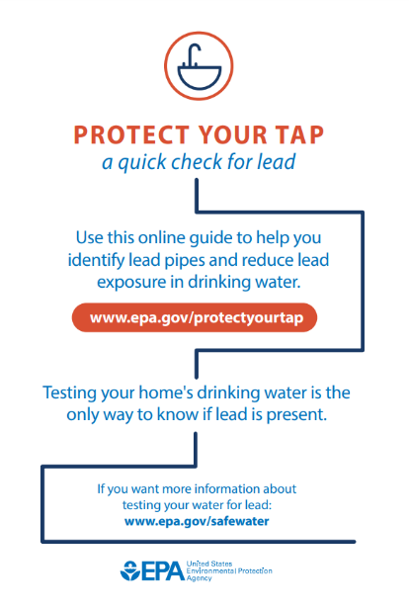
Service Line Material Investigation Methods
Investigation Methods
Description of service line investigation methods that water systems have used to identify the material of unknown service lines and to verify records
Note the LCRR requires that states approve which investigation methods are acceptable
Pros and Cons of Each Method
Including but not limited to cost/labor, disturbance, and accuracy
Real-World Examples
System level examples as well as their lessons learned
https://www.epa.gov/ground-water-and-drinking-water/protect-your-tap-quick-check-lead.
Office of Water
10

Slide 11
Developing and Updating the Inventory
Developing the Initial Inventory
LCRR initial inventory requirements
Recommended initial records screening process
Recommended weight-of-evidence approach when records are conflicting
Prioritizing Field Investigations
Vulnerable or environmental justice populations
Areas with the most unknowns
Service lines that are most likely lead, especially in tandem with LSLR
Areas where LSLR is occurring
To verify historical records
Source: Liggett, 2021
Office of Water
11

Slide 12
Developing and Updating the Inventory (continued)
Requirement for customer notification of known or potential service line containing lead
Water systems with LSL, GRR, or lead status unknown services lines must provide notification to persons served by these lines within 30 days after completing the initial inventory.
Requirements and recommendations for systems with only non-lead lines
May publish a statement indicating they have only non-lead service lines in lieu of making their inventory publicly accessible
Requirements and recommendations for non-lead systems that later discover an LSL in their system
Submitting the initial inventory and inventory updates
Initial inventory must be submitted to the state by October 16th, 2024
State review and reporting
EPA has developed a checklist for the initial inventory submittal with recommended considerations for states to use in their review
Office of Water
12

Slide 13
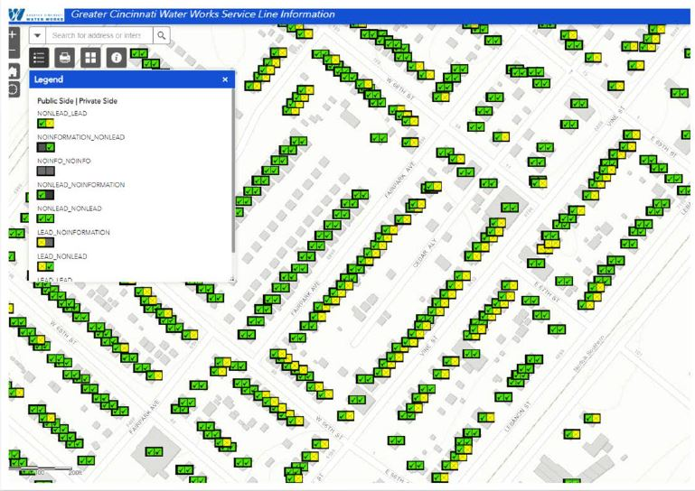
Public Accessibility
Elements of the Publicly Accessible Portion of the Inventory
Must include each LSL and GRR with a location identifier, such as a street address, block, intersection, or landmark.
Recommended to include (see document for full list)
  All service line materials (include unknowns and non-lead lines)
  Consider using street addresses as your location identifier
  Information on steps that consumers served by LSLs can take to reduce exposure risk
  Instructions on how to use and interpret the inventory along with a disclaimer
Format Considerations (i.e., pros and cons of various formats)
Consumer Confidence Report Requirements
Source: Greater Cincinnati Water Works Service Line Information map. https://gcww.maps.arcgis.com/apps/webappviewer/index.html?id=0a170c268c694e46a8a4e394630df0bd. Accessed December 16, 2021.
Office of Water
13

Slide 14
Appendix
Appendix A: Selected Forms from Service Line Inventory Template
Appendix B: Case Studies
Appendix C: Instructions for Self-Identifying LSLs and Information When Water System Conducts Verification
Appendix D: Summary of State Lead Ban Provisions
Appendix E: Michigan Field Investigation Protocol
Appendix F: Data Quality Disclaimer Language
Office of Water
14

Slide 15
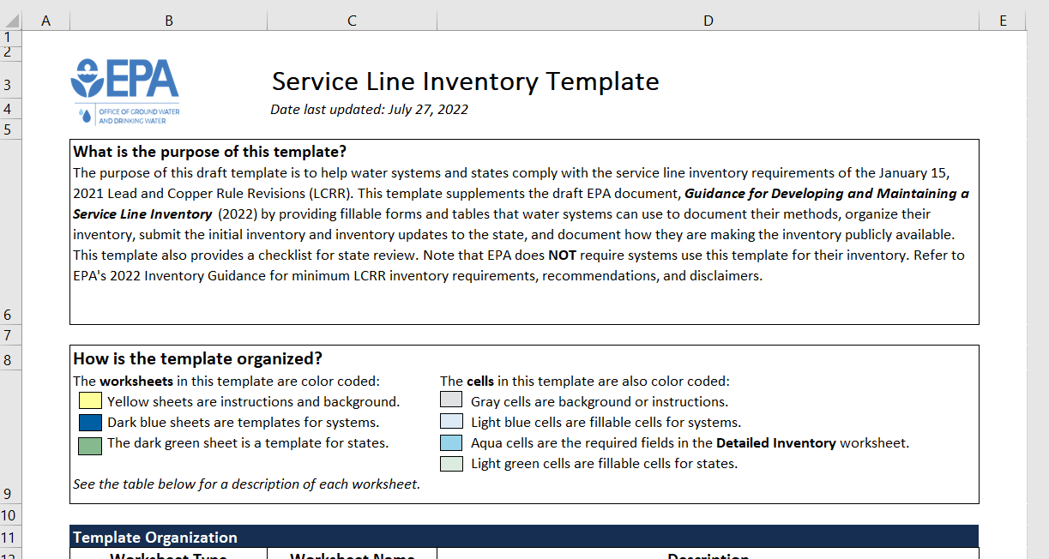
Template Overview
Instructions and Background
Introduction
Template Instructions for Systems
Template Instructions for States
Information on Classifying Service Lines
Templates for Systems
PWS Information
Inventory Methods
Inventory Summary
Detailed Information
Public Accessibility Documentation
Template for States
State Checklist for Initial Inventory Submittal

Slide 16
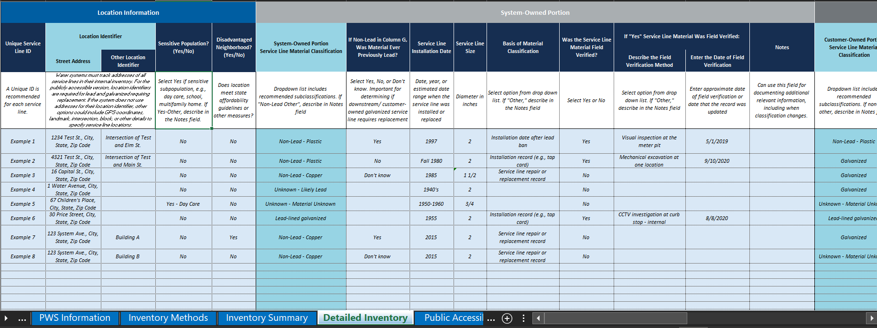
Template Overview
Office of Water
16

Slide 17

Next Steps
EPA is developing a small system compliance guide and fact sheets drawing from information in the guidance
Propose LCRI in 2023 and finalize no later than October 16, 2024
  EPA does not expect to change the requirements for the initial inventory
Office of Water
17

Slide 18
Set-Asides Under the BIL
States can take set-aside from BIL capitalization grants.
  Lead Service Line Replacement: must be used to either administer this capitalization grant or meet the statutory purpose of these funds: “for lead service line replacement projects and associated activities directly connected to the identification, planning, design, and replacement of lead service lines.”

Slide 19
LSL Inventory-Related Eligibilities
DWSRF Account | DWSRF LSL Inventory-Related Eligibilities
Infrastructure Fund | Assistance agreements (potentially including additional subsidization such as loan principal forgiveness or grants) with public water systems (PWSs) to conduct LSL inventories; states may optionally roll these loans into actual LSLR construction projects at a later date.
2% Small System Technical Assistance Set-Aside | Issue grants to small PWSs to conduct inventories; hire contractors to conduct inventories on behalf of PWSs; provide technical assistance to small water systems considering or currently undertaking inventory development; develop and conduct LSL-related outreach and training.
4% Administration & Technical Assistance Set-Aside | Same as the “2% set-aside” info above, but for any size public water system. State staff to administer the BIL LSL capitalization grant.
10% State Program Management Set-Aside | Have state employees or contractors conduct inventories on behalf of PWSs of any size; have state employees or contractors conduct state-wide inventory-related work, such as inventory database management, developing LSL outreach plans and materials, etc.
15% Local Assistance Set-Aside | From the 10% Capacity Development portion of the 15% set-aside: same as the 2% small system technical assistance set-aside above, but for any size public water system. Note that work funded under this portion of the set-aside must be a part of the state’s Capacity Development Strategy document.

