Slide 1
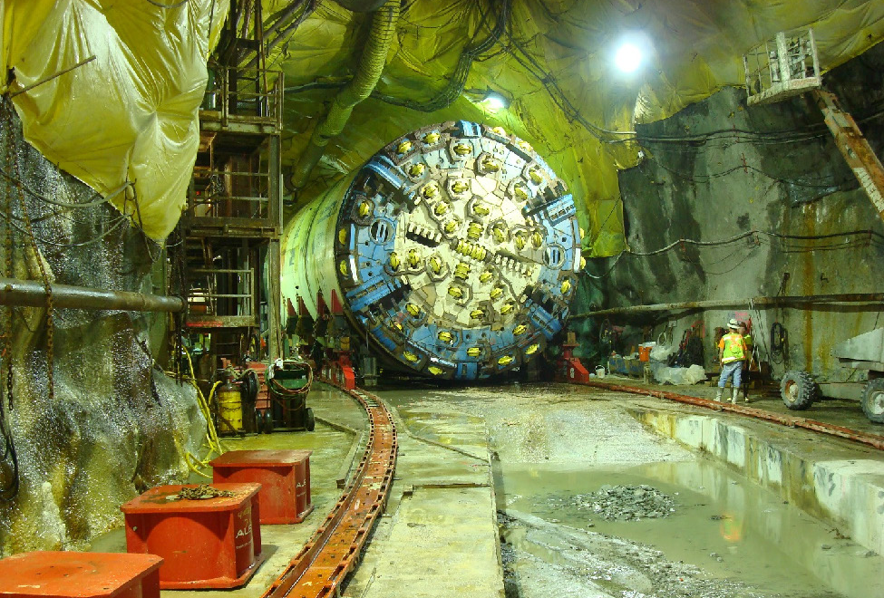
Andrew Sawyers, Ph.D., Director
Office of Wastewater Management
U.S. Environmental Protection Agency
Indianapolis, IN • October 30, 2017

Slide 2
Celebrating 30 Years of CWSRF Success
The Construction Grants program was created in 1956.
Over the years, approximately $60 billion went to fund municipal wastewater treatment plants.
Clean Water Act amendments of 1987 replaced the Construction Grants program with the CWSRF.
The CWSRF fundamentally changed the landscape of wastewater infrastructure financing.
From federal program to state managed program
From grants to loans and other assistance
The CWSRF was amended in 2014 by the Water Resources Reform and Development Act.
Greatly expanded project eligibilities and financing options.

Slide 3
Celebrating 30 Years of CWSRF Success
Total Loans and Annual Assistance Provided
$10.1
Weighted Average Interest Rate in 2017: 1.4%
$7.6
$7.4

Slide 4
CWSRF Leveraging Power
Assistance Provided and Federal Capitalization Grants
For each $1 of Federal Capitalization, $3 of assistance has been provided to communities through the CWSRF
$84
$126
$42

Slide 5
Celebrating 30 Years of CWSRF Success
Percentage of Funding by Community Size
2017
1998 – 2017: 43.1%
50.9%
$3,775 million
1998 – 2017: 34.5%
30.5%
$2,267 million
1998 – 2017: 10.9%
7.4%
$551 million
1998 – 2017: 11.5%
11.2%
$830 million

Slide 6
Celebrating 30 Years of CWSRF Success
Number of Loans by Community Size
1,821
From 1988 – 2017, the CWSRF has issued 38,441 loans
883
795
474
330
127
189
170

Slide 7
Celebrating 30 Years of CWSRF Success
Assistance by Project Type (Needs Categories)
4%
3%
1%
4%
5%
2%
12%
22%
6%
19%
10%
14%
20%
44%
33%

Slide 8
Celebrating 30 Years of CWSRF Success
Environmental Benefits
FUNDING FOR CLEAN WATER ACT GOALS
$53.9 billion to improve water quality
$33.1 billion to achieve compliance
$54.7 billion to protect and restore aquatic life and wildlife
$11.4 billion to protect and restore drinking water sources
$56.9 billion to protect and restore recreational uses

Slide 9
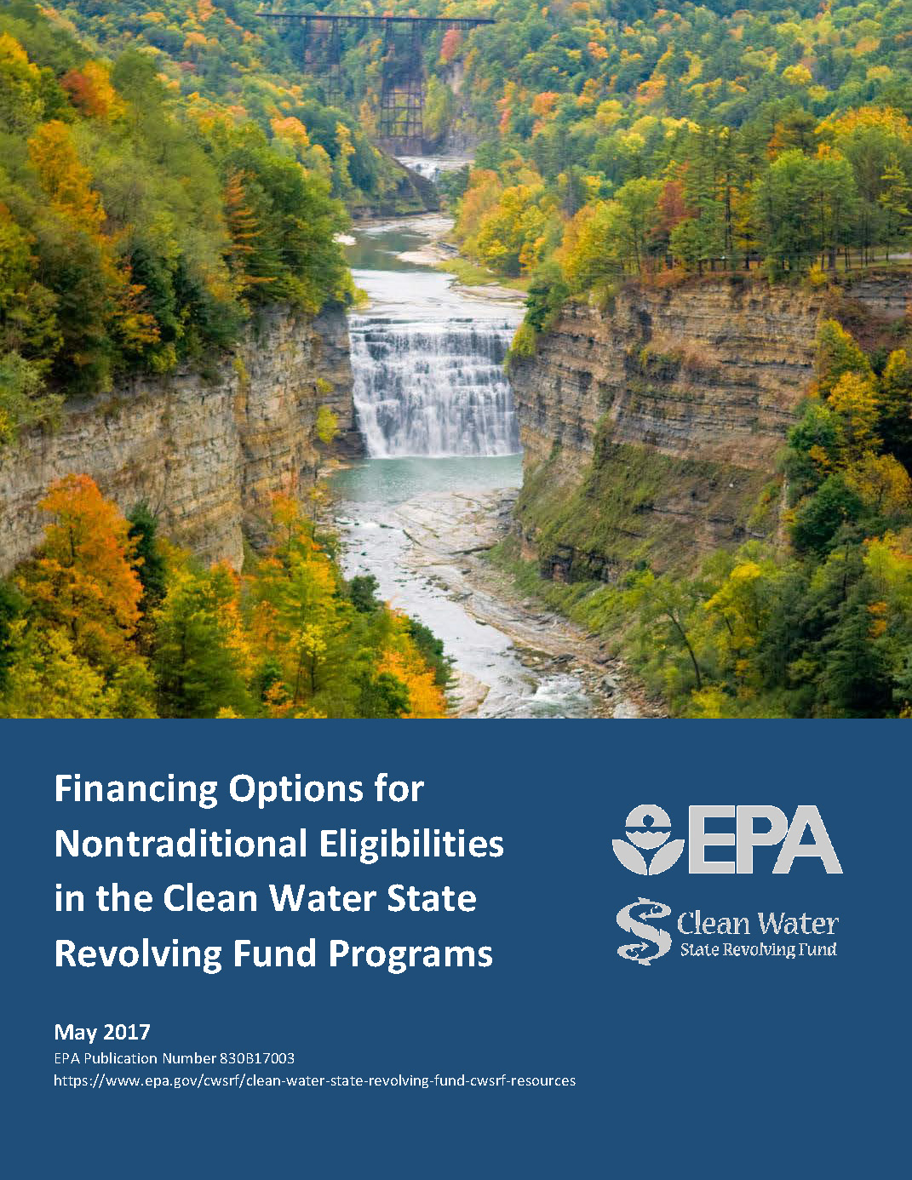
CWSRF Innovation
Financing Options for Nontraditional Eligibilities
The CWSRF has a variety of innovative financing options.
Many of these options are covered in “Financing Options for Nontraditional Eligibilities in the CWSRF”.
Types of CWSRF Assistance
Sources of Revenue
Strategic Planning
Multiple state examples are included.

Slide 10
CWSRF Innovation
Sponsorship Lending

Slide 11
CWSRF Innovation
Extended Term Financing (ETF)
In addition to loans, the Clean Water Act allows CWSRF programs to buy or refinance debt obligations.
This form of assistance can extend beyond 30 years.
EPA recently approved ETF proposals for:
Ohio: Approved to provide financing up to 45 years or the useful life of the project.
Indiana: Approved to provide financing up to 35 years or the useful life of the project.

Slide 12
CWSRF Innovation
The CWSRF has 11 wide-ranging project eligibilities.
The “Overview of Clean Water State Revolving Fund Eligibilities” provides detailed information on each eligibility.
This flexibility has allowed the CWSRF to fund many creative solutions to our nation’s most pressing water quality problems.

Slide 13
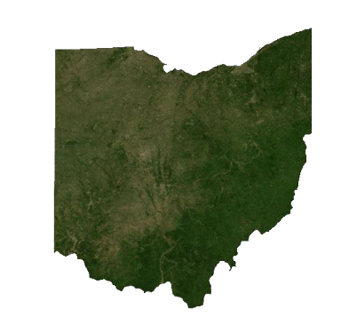
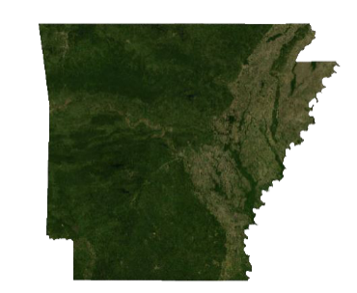
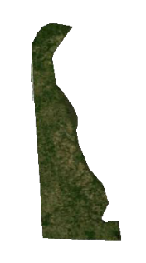
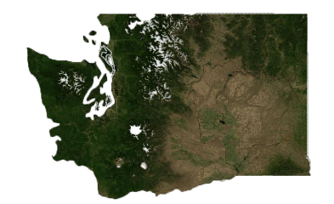
CWSRF Innovation
PISCES Exceptional Projects
Arkansas: Little Rock Sewer Service Line Replacement Program
Delaware: NVF Yorklyn Site Wetland Project
Ohio: Howard Storage Basin-North Hill Separation Project
Rhode Island: RIAC Glycol Recovery System
Washington: Tacoma - Pierce On-Site Sewage System Loan Program

Slide 14
Streamlining the CWSRF
Federal Requirements and Emergency Response Activities
Regional Oversight Best Management Practices
State Best Management Practices
Application of LEAN Principles and Methods
Utilizing Financing Options
Utilizing Program Assistance (e.g., Technical Assistance and Marketing)
Data Collection

Slide 15
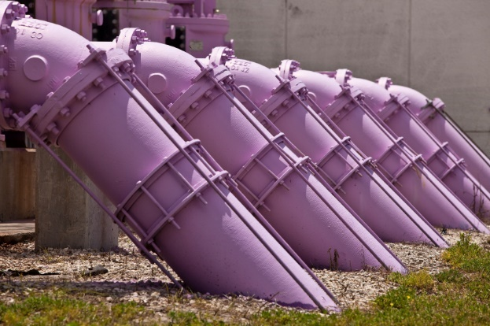
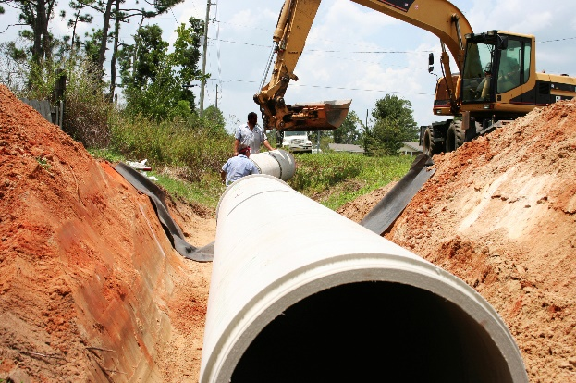
Looking Forward to the Next 30 Years
Measuring and Communicating Progress
The Role of Critical Stakeholders in Funding and Financing
The Need for Improved Asset Management
Spurring Innovation by Promoting Technology in Infrastructure Investment

Slide 16
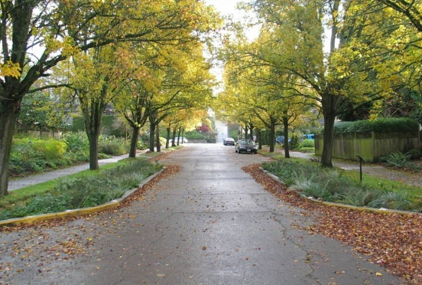
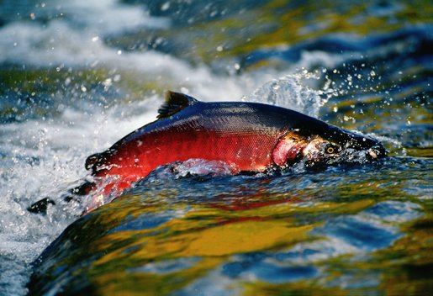
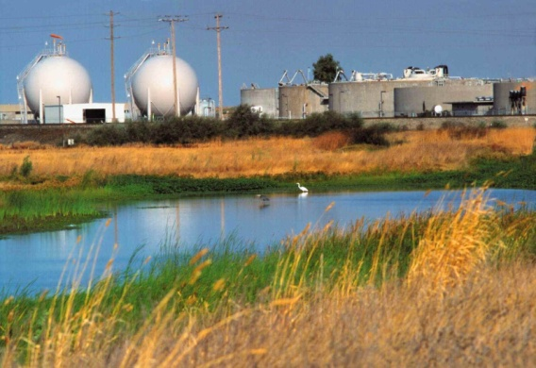
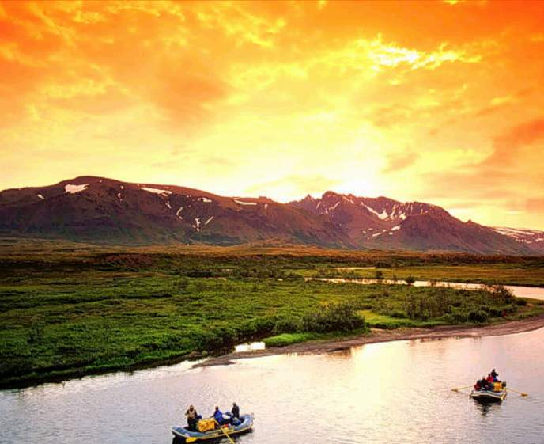
Looking Forward to the Next 30 Years
The Need to Create Sustainable Revenue Models
The Need to Address Affordability Issues
Policy Adjustments and Streamlining
Labor & Workforce Considerations
Support the Creation of Efficient Markets

Slide 17
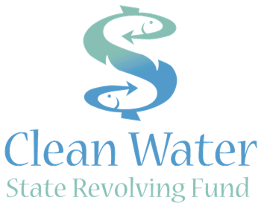
Celebrating 30 Years of CWSRF Success
www.epa.gov/cwsrf

