Slide 1
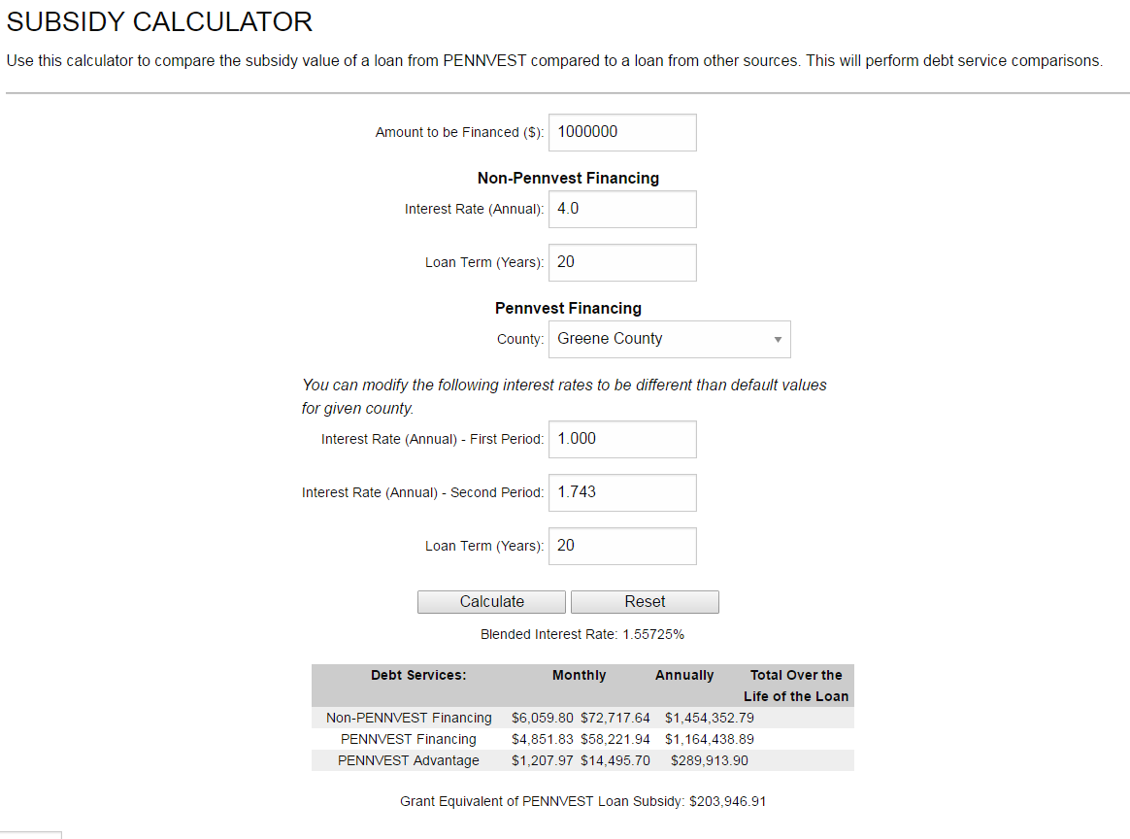
http://www.pennvest.pa.gov/Tools/Pages/Subsidy-Calculator.aspx

Slide 2
Why and When do you need multiple funding sources?
Private Funding Sources do not result in an affordable project
Available Public Sources are insufficient to provide for an affordable funding package to allow project to Proceed
Projects are too large for any one funding entity to cover
Pockets of residential users may have difficulty in paying for improvements and could help project qualify for additional subsidy.
Economic Development Opportunities may qualify the project for participation by related funding entities
Existing funding may require matching funds

Slide 3
How to Succeed when using Multiple Funding Sources for your Capital Improvement Project
Meet Early on in the process –
Earlier is better, no matter what…you can always have a subsequent meeting to follow-up if necessary. Strive to set the pace for a successful project at the start.
Have Regular Progress Reports and Involve Public
Keep Funders in the loop – build a good report, co-opt them into the project
Public involvement is necessary for successful implementation of any project
Develop a sense of ownership top to bottom / the locals own the system at the end
Involve the Regulators in the Process
Nothing to loose but valuable time and $ with non compliance – make them your advocates
Coordinate Funding Requirements
Minimize duplication – target funding where it best fits the project for implementation and eligibility – You may have to step out of our comfort zone a bit but it keeps everyone’s idea of the project on the same page. Reach out, don’t wait.
Manage Implementation Schedules With Funding Cycles
This can be targeted at the planning meetings – no need to Hurry Up….and wait but….
Be Prepared to Move as soon as the Planets Align!
I have seen more projects move to construction because they were ready to move when the $ was there, than projects that just begin the process when the money becomes available.

Slide 4
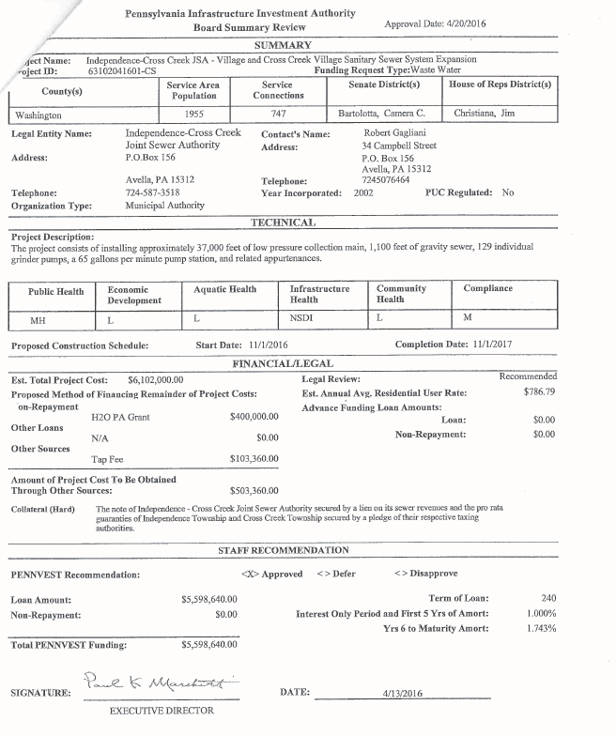
Total Project Cost = $6,102,640
Funding Sources:
State H2O PA Grant $ 400,000
Tap Fees $ 103,360
PENNVEST (SRF Loan) $5,598,640
Service Connections = 747
Monthly Fee = $65.50
Project Description: installing service extension of 37,000 ft of low pressure sewers, 1,100 ft of gravity sewer, 129 grinder pumps and a 65 GPM pump station and related appurtenances.
Problem Statement: documented on lot malfunctions greater than 50%, including a number of wildcat sewer systems.
Leverage other state programs with local contribution with a low interest loan to move this project forward.

Slide 5
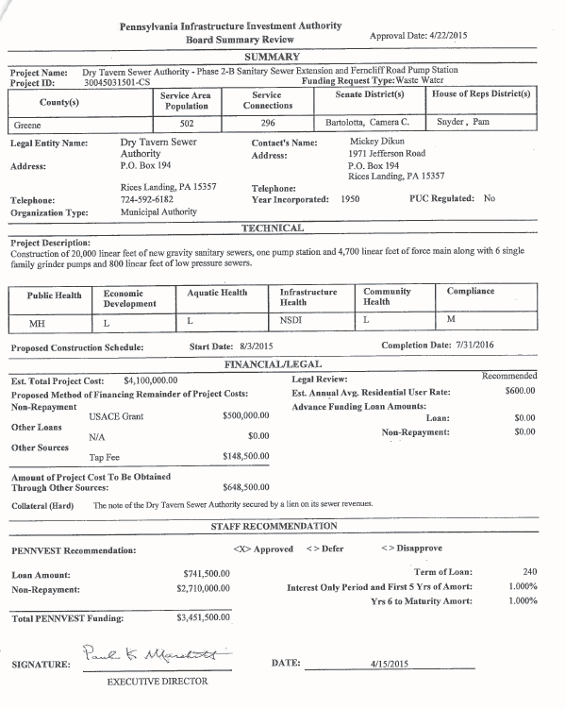
Total Project Cost = $4,100,000
Funding Sources:
US Army Corps Grant $ 500,000
Tap Fees $ 148,500
PENNVEST (SRF Loan) $ 741,500
PENNVEST (SRF P/F) $2,710,000
Service Connections = 296
Monthly Fee = $50.00
Project Description: extension of 20,000 ft of gravity sewers, 4,700 ft of force main, 6 grinder pumps and 800 ft of low pressure sewers, and related appurtenances.
Problem Statement: documented on lot malfunctions greater than 55%, including a number of wildcat sewer systems.
This project was able to utilize US Army Corps Grant, local tap fees, and PV Loan and Grant. Army Corps can play a significant role for some projects, but will tend to slow down the implementation.

Slide 6
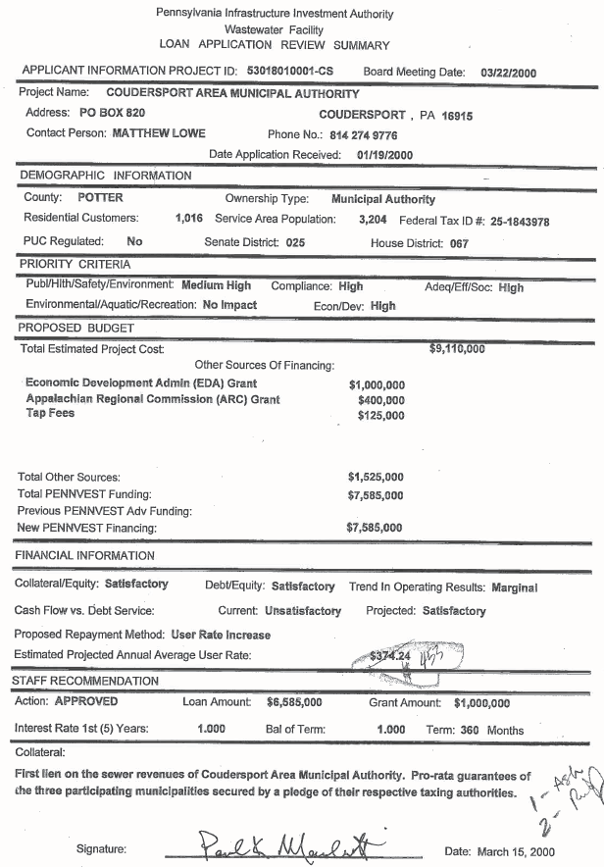
Total Project Cost = $9,110,000
Funding Sources:
Economic Development Administration (EDA) Grant: $ 1,000,000
Appalachian Regional Commission (ARC) Grant $ 400,000
Tap Fees $ 125,000
PENNVEST (SRF Loan) $ 6,585,000
PENNVEST (State Grant) $ 1,000,000
Service Connections = 1,016
Monthly Fee = $37.75
Project Description: Construction to expand the treatment facilities to .95 MGD to provide adequate treatment for existing as well as capacity for neighboring communities.
Problem Statement: Hydraulic and Organic overloading of the existing treatment facilities and documented on lot malfunctions greater than 26%.
Benefits – environmental and economic development / consent order compliance and support creation of tech related 500 jobs

Slide 7
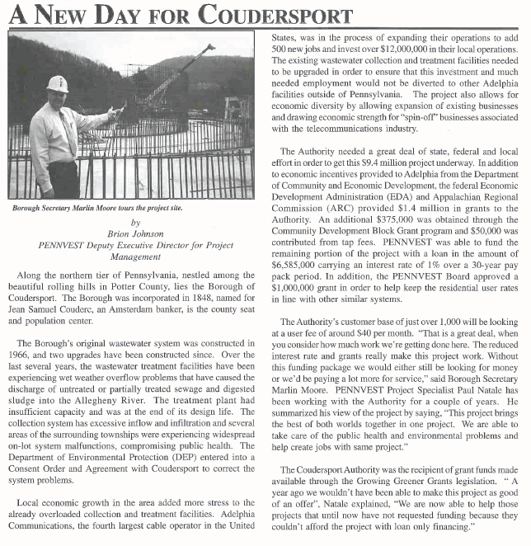

Slide 8
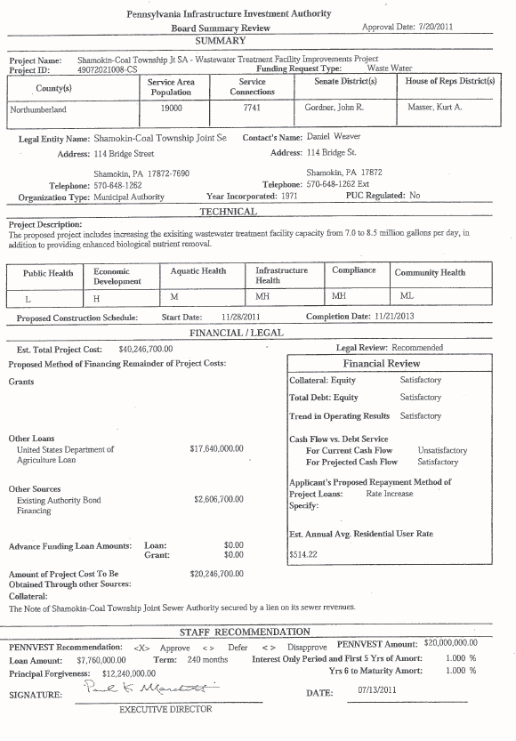
Total Project Cost = $40,246,700
Funding Sources:
US Dept of Agriculture (Loan) $ 17,640,000
Local Financing $ 2,606,700
PENNVEST (SRF Loan) $ 7,760,000
PENNVEST (SRF PF) $ 12,240,000
Service Connections = 7,741
Monthly Fee = $42.85
Project Description: increasing the existing treatment facilities from 7 to 8.5 MGD and provide enhanced nutrient
Problem Statement: hydraulically overloaded treatment facilities, need to treat to a lower discharge limits in order to comply with the Chesapeake Bay Tributary Strategy.
Extra Benefits – this project will support the investment of over $11 Million in private investment in local industries securing existing and creating over 250 new jobs
Good example of using USDA and SRF to help with a project that may have been too large for either one individually

Slide 9
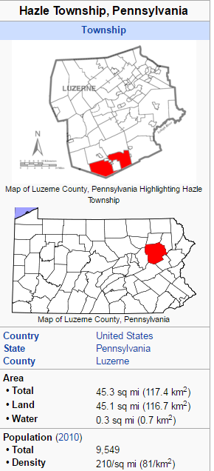
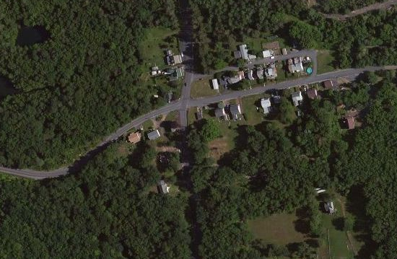
Stockton -

Slide 10
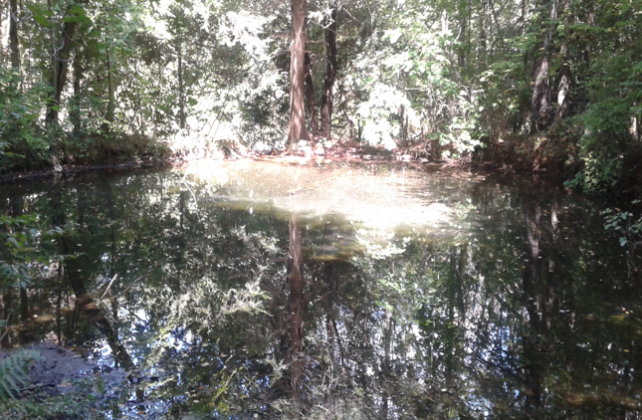
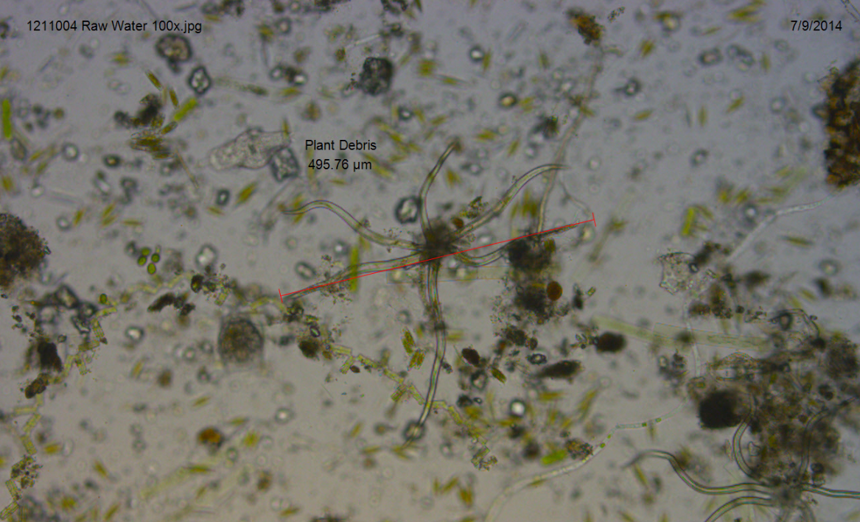
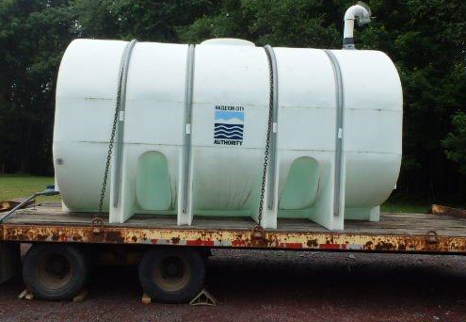
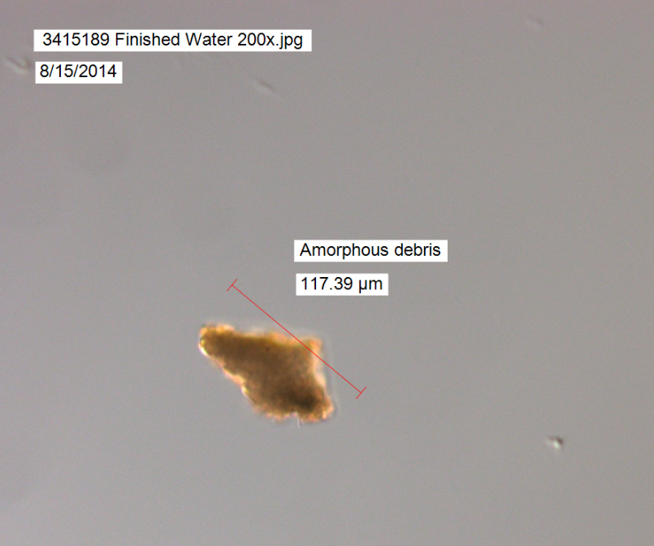
Hazelton City Authority – Stockton / White Knight
Total Project Cost = $2,210,181
Funding Sources:
PENNVEST (SRF PF) $2,210,181
Service Connections = 43
Monthly Fee = $35.50
Project Description: extend water service, and replace existing distribution to residents in the Village of Stockton.
Problem Statement: unfiltered and contaminated surface water source.

Slide 11
