Slide 1
Why Marketing & Outreach for New Hampshire?
Clean Water State
Revolving FUND
Tracy L. Wood, P.E.
November 1, 2016

Slide 2
Financial Situation of the NH CWSRF

Slide 3
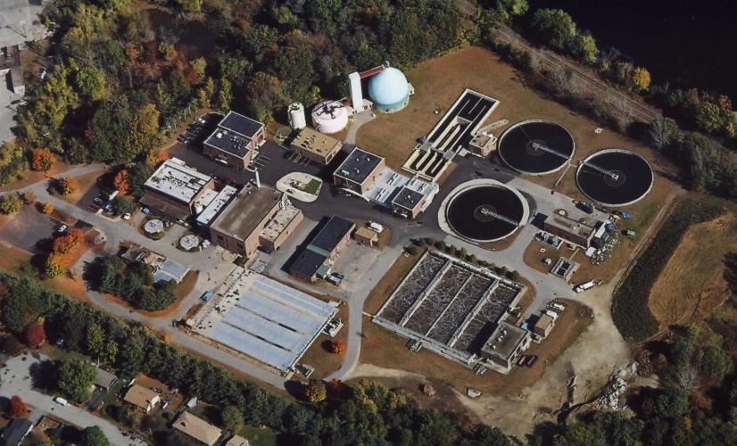
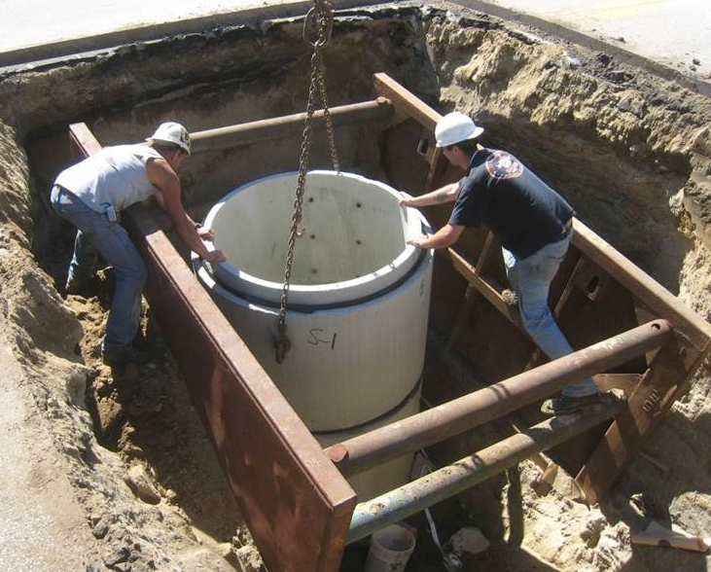
WASTEWATER INFRASTRUCTURE NEEDS
Based on the 2012
Clean Watersheds Needs Survey (CWNS)
Notes:
The CWNS identifies and documents the cost of the capital needs required to meet the water quality and water-related public health goals of the Clean Water Act.
The USEPA works in partnership with the States to conduct the CWNS every 4 years.

Slide 4
What is New Hampshire’s Funding Need for Clean Water? $1.98 Billion demonstrated in the 2012 Clean Watersheds Needs Survey
Nonpoint Source?
On-Site Septic Systems?
Asset Management?
Energy Efficiency?

Slide 5
What has the New Hampshire CWSRF Funded to Date? $670 Million of Loans Issued Since 1989
As of June 30, 2013

Slide 6
Side by Side Comparison
CWNS - $1.98 Billion
Loans Issued Since 1989 - $670M

Slide 7
CWSRF Funding Totals by Town and City
Where is the Clean Water Need?
Where Has NH CWSRF Funded?
$1.98 Billion Total
$670 Million Total
CWSRF CWNS Needs by Town and City
Less than $1 M
$1 M – $2.9 M
$3 M – $9.9 M
$10 M – $29.9 M
Greater than $30 M

Slide 8
Communities Utilizing CWSRF Program

Slide 9
No. of CWSRF Projects Completed in Last 10 Years
Notes:
What does this slide tell us?
NH averages funding 5 to 10+ CWSRF projects per year.
Years where there were larger $ value projects.
ARRA – 60 CWSRF projects funded. Shovel ready projects. What does this tell us? NH communities have projects that they are ready to do if the subsidy is right.
Although there was talk that # of annual projects dropped off after ARRA this chart does not show a significant decline.

Slide 10
The Old Normal – Pre ARRA
Increasing or at least stable funding levels
Conditions known to all and did not vary year to year
Relatively minimal reporting
Program sold itself

Slide 11
The New Normal – Post ARRA
Annual federal funding…level, reduced or elimination
Federal funding conditions
e.g. forgiveness, Davis Bacon, AIS, green project reserve, cost and effectiveness, etc.
Increased reporting and oversight
e.g. Davis Bacon, AIS
Asset and financial management expected (fiscal sustainability plan)
Marketing & outreach needed

Slide 12
Administrator Tracy July 2015 to Present
Two Largest Projects in NH CWSRF History
Portsmouth $75M
Exeter $53M

Slide 13
Portsmouth Pierce Island WWTF

Slide 14
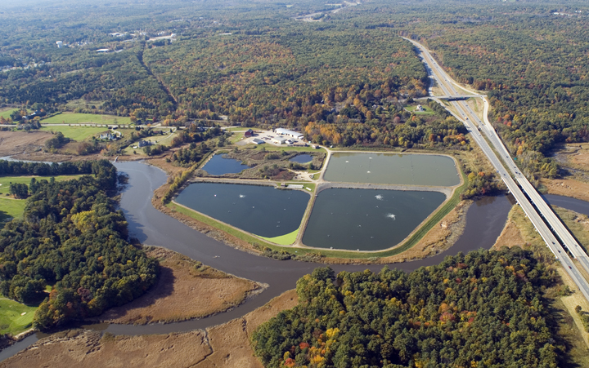
Exeter WWTF

Slide 15
Administrator Tracy July 2015 to Present
Two Largest Projects in NH CWSRF History
Portsmouth $75M
Exeter $53M
One-on-One Site Visits
Marketing Cards

Slide 16
CWSRF Loan Program Promotional Card

Slide 17
CWSRF Promotional Card
CWSRF offers below-market interest rates with no closing costs and no prepayment fees for planning, design, construction and equipment
Principal forgiveness is available to make infrastructure projects more affordable and sustainable for NH communities.
Extra incentives are available for initiating energy audits, planning and implementing asset management programs, and other “green” projects.

Slide 18
CWSRF Promotional Card
Interest on disbursements is 1% until substantial completion and reimbursement can be requested as costs are incurred.
Loan repayments begin up to one year after project completion at the lowest available interest rate – if rates are lower at the end of the project, the loan will be closed at the lower rate.
CWSRF staff are here to help you through every step of your project. This includes project planning and administration, design review, environmental review, construction oversight, and achieving optimal performance.

Slide 19
NH Clean Water State Revolving Fund 2016
Funds Available :

Slide 20
Administrator Tracy July 2015 to Present
Two Largest Projects in NH CWSRF History
Portsmouth $75M
Exeter $53M
One-on-One Site Visits
Marketing Cards
Marketing Survey

Slide 21
Marketing Survey
March 2016 SRF Newsletter –Marketing & Outreach Work Assignment–Katie Marese
June-August 2016 Developing Surveys – Consultant & Community
Sept. 6th thru 23rd - On-Line Survey
October 2016 Results & Next Steps
Review last 10 years of CWSRF data

Slide 22
Results
# 1 Factor in Funding Source Selection
Low Interest Rates
Principal Forgiveness

Slide 23
Results
Customer Satisfaction Levels are High
94% Community Respondents & 86% Consultants – Good or Excellent
75% Both Respondents Interactions w/DES staff Easy to Relatively Easy

Slide 24
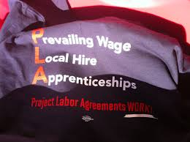
Results
Primary Challenge Area – Davis-Bacon & AIS
Need to Streamline Reporting
Davis-Bacon Wages & AIS Make SRF More Expensive

Slide 25
Results
Majority of Respondents Willing to Use CWSRF for Future Funding Needs
78% Respondents will consider CWSRF for Future Projects, 20% Maybe
What do Communities and Consultants Want?
Lower Interest Rates
Increase Flexibility in Types of Funded Projects
Grants for Project Planning and Design
Increase Flexibility in Timing

Slide 26
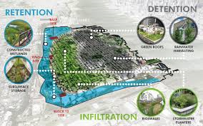
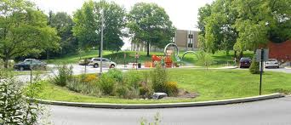
Results
Traditional Projects are Most Important
Wastewater
Stormwater
Some Need for Nonpoint Source Projects
Green Infrastructure
Restoration of Natural Hydrology
Contaminated Site Projects

Slide 27
Results
Preferred Communication Methods
NHDES Website
SRF Email Subscription Service
Workshops/Conferences

Slide 28
Next Steps
Quantify Added Cost of Davis-Bacon
Primary Disincentive
Minimize Impact-Administrative Burden
Contributing Factors for Determining Added Cost
Location of Project
Size of Contractor
Scope of Project
Balanced Bid

Slide 29
Next Steps
Focus Group & One-On-One Follow-Up
Further Delve into Specific Issues Raised in Survey
Further Identify Areas for Improvement
Communities
Consultants
Build Relationships

Slide 30
Communities Utilizing CWSRF Program

Slide 31
Consultants doing CWSRF Projects in NH
65 Prequalified Engineering Firms (PEFs) in NH
24 (or 37%) PEFs have done 136 CWSRF Projects 2006 to 2015
52 (or 37%) of 139 CWSRF Projects were completed by 2 (or 3%) PEFs
89 (or 64%) of 139 CWSRF Projects were completed by 8 (or 12%) PEFs

Slide 32
Next Steps
Develop a Marketing Plan
Survey
Develop Formal Plan
Streamline Efforts
Process Optimization Drill
Lean Events
Management Study
Opportunities for Program Growth

Slide 33
NH Clean Water State Revolving Fund
2016 EPA Capitalization Grant
Federal Grant $13.3M
20% State Match $2.7 M
Total $16 M
Green Project Reserve: 10% of Grant ($1.3M)
Principal forgiveness:
Minimum: 10% of Grant ($1.3M)
Additional WRDDA: 30% of Grant ($4M)
Total: 40% of Grant ($5.3M)

Slide 34
Thank you!
Tracy L. Wood, P.E.
N.H. Department of Environmental Services
Administrator - Wastewater Engineering Bureau 29 Hazen Drive, P.O. Box 95
Concord, NH 03302-0095
Telephone: (603) 271-2001
Fax: (603) 271-4128
Email: tracy.wood@des.nh.gov

